Slide 1

Electrical Safety at Work Place

Slide 2

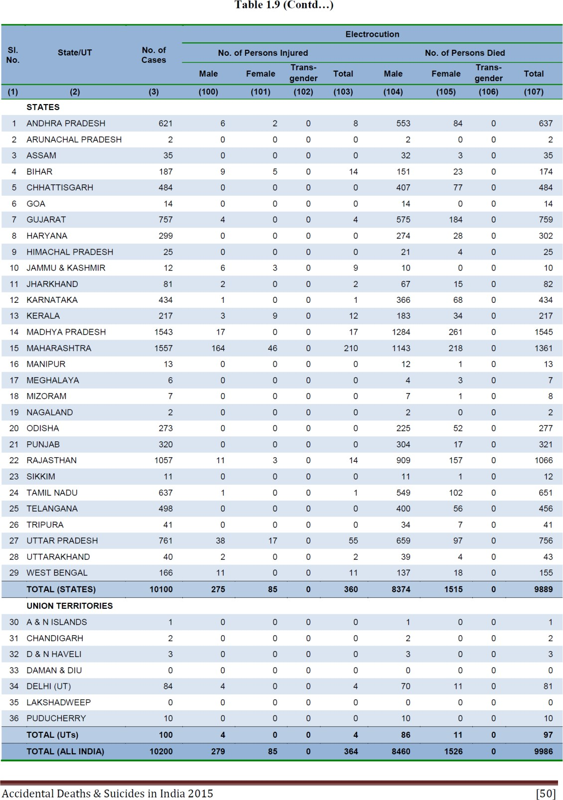
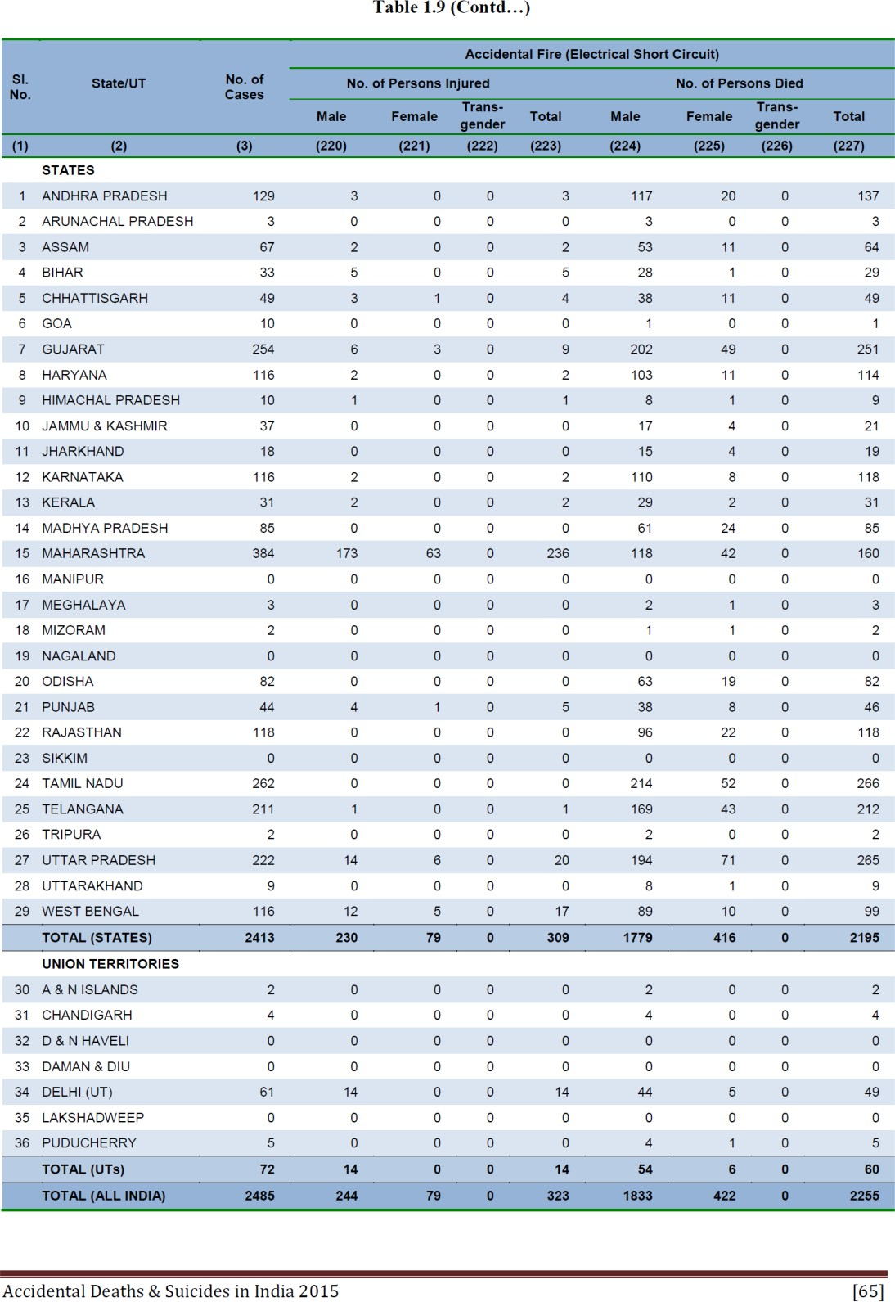
ELECTRIC
Electrical Fire Safety – Indian context
National Crime Records Bureau
Fire due to electricity - 2487 cases, 323 injured, 2255 died Electrocution – 10200 cases, 364 injured, 9986 died
+
1000’s of unreported cases
100’s of millions of Rupees Loss

Slide 3
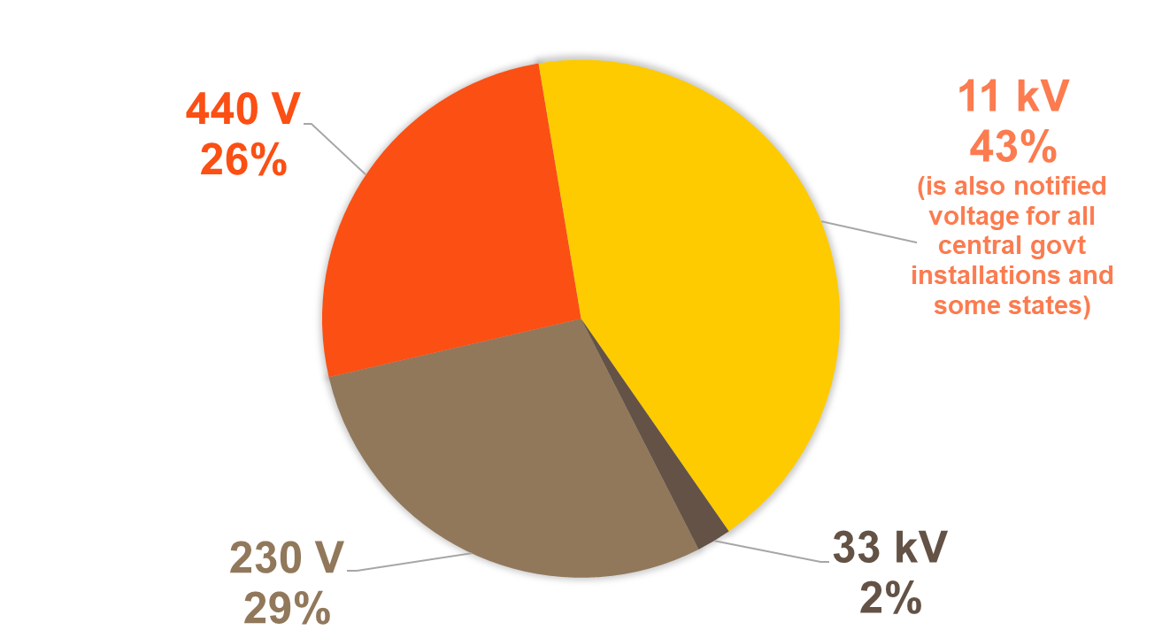
More than 55% electrical incidents occur in 230V – 440V
Data Source CEA, 2017-18 data

Slide 4

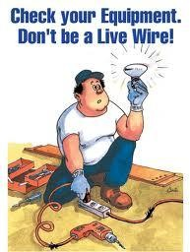

How Electrical Current Affects the Human
Other factors that may affect the severity of the shock are:
  The voltage of the current.
  The presence of moisture in the environment.
  The phase of the heart cycle when the shock occurs.
  The general health of the person prior to the shock.

Slide 5
In the field of electrical engineering, engineers and other professionals get exposed to electricity indirectly during generation, transportation, installation and usage. Such conditions might cause hazards if accurate safety measures are not taken.
To promote the safety and the right usage of equipment, there are certain rules and regulations formulated by the Bureau of Indian Standards (BIS). BIS follows the following five principles −
Safety
Ease of use and adaptability
Simple technology
Value for money products
Energy efficiency and environment

Slide 6
Code of Practice for Electrical Wiring Installation
IS − 732 (1989)
Section − Electrical Installation
Application − Design of installation, selection and erection of equipment, inspection and testing of wiring system

Slide 7
Code of practice for Earthing
IS − 3043 (1987)
Section − Electrical Installation
Application − Design, installation and calculation of Earthing system

Slide 8
Lightning arrester for Alternating Current System
IS − 3070 (1993)
Section − Electro technical: Surge Arresters
Application − Identification, ratings, classification and testing procedure of Arrester

Slide 9
Electrical hazards
Basically , electrical hazards can be categorized into three types.
  Electrical shock.
  Electrical burns.
  Effects of blasts

Slide 10
Electrical Safety - Short Circuit Protection
A short-circuit condition means a circuit allows the current to flow through an unintended path with very low electrical impedance. It is a direct contact between two points of different electric potential.
The short circuit protection system is broken down into the following systems −
Alternating Current System
Phase to Ground contact
Phase to Neutral contact
Phase to Phase contact
Contact between windings of an electrical machine in a phase

Slide 11
Direct Current System
Pole to Ground contact
Contact between two poles

Slide 12
Major Causes of Short Circuit
A sudden surge of current equals to hundred times of working current flows through the circuit. This leads to the damage of electrical equipment. The following two phenomena are responsible for the devastating effects of short circuits −
Thermal Phenomenon: This phenomenon refers to the energy released into the electrical circuit when short-circuiting current flows through the circuit. This thermal effect results in the causes of a short circuit −
Melting of the conductor contacts
Damage to insulation
Generation of electrical arcs
Destruction of the thermal elements in the bimetallic relay

Slide 13
Electro-dynamic Phenomenon
This phenomenon refers to the production of intensive mechanical stress when the current crosses and results in the following conditions −
Breakage of the conductors
Repulsion of contacts inside the contactors
Distortion of conductors in windings

Slide 14
Short Circuit Protection Devices
To protect the devices and people from short circuit hazards, protecting devices are used in electrical circuits. These devices can detect the faults and trip the circuit immediately before the surge current reaches to the maximum.
There are two popular protecting devices used frequently in every electrical circuit.
Fuse - Fuse is operated once in the circuit and then must be replaced after the trip occurs. It is helpful for phase by phase (single pole) protection. It offers a high breaking capacity at low volume, which limits electro-dynamic stress.

Slide 15
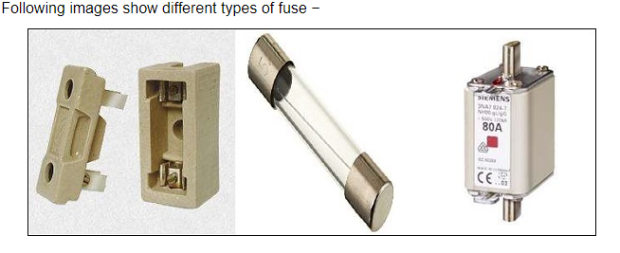

Slide 16
Circuit Breaker
Circuit breakers can be reset either manually or automatically. It automatically breaks the circuit within a short cutoff time and separates the load from the power supply that protects the circuit from any damage. The magnetic triggers of CB open the poles. CBs limit both the thermal and thermodynamic effects. It works faster than a fuse. For example, Molded Case Circuit Breaker (MCCB), Molded Case Switch (MCS), Air/Oil/SF6/Vacuum Circuit Breaker (ACB/OCB/SCB/VCB).

Slide 17
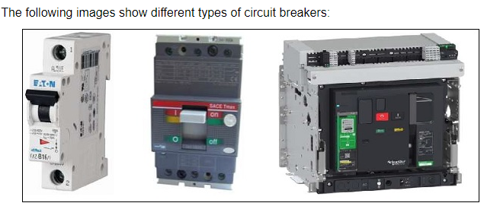

Slide 18
Electrical Safety - Earth Fault Protection
Earth Fault
Earth Fault is an inadvertent fault between the live conductor and the earth. When earth fault occurs, the electrical system gets short-circuited and the short-circuited current flows through the system. The fault current returns through the earth or any electrical equipment, which damages the equipment. It also interrupts the continuity of the supply and may shock the user. To protect the equipment and for the safety of people, fault protection devices are used in the installation.

Slide 19
Earth Fault Protection Devices
The devices give the tripping command to break the circuit when earth fault occurs. The fault current is restricted and the fault is dispersed by the Restricted Earth Fault Protection (REFP) scheme. Normally earth fault relay, earth leakage circuit breaker and ground fault circuit interrupter, etc. are used to restrict the fault current.
Earth Fault Relay (EFR) - It is a safety device used in electrical installations with high earth impedance. It detects small stray voltages on the metal enclosures of electrical equipment. The result is to interrupt the circuit if a dangerous voltage is detected. The EFR is protected against tripping from transients and prevents shock.

Slide 20
Earth Leakage Circuit Breaker
The Earth Leakage Circuit Breaker detects the leakage current directly and prevents injury to humans and animals due to electrical shock. It is a voltage-sensing device and has recently been replaced by Residual Current Circuit Breaker (RCCB), which is a current sensing device. It is a special type of latching relay that is connected to the main power supply. When the fault current flows from live wire to the earth wire within the installation, the coil of ELCB senses the voltage and switches off the power. This requires a manual reset process to work again. The RCCB senses the leakage current and sends a signal to trip the system.

Slide 21
Ground Fault Circuit Interrupter
The Ground Fault Circuit Interrupter is a safety device to prevent an electrical accident when any faulty tool is plugged in. It is a fast acting circuit breaker to shut down the supply when the earth fault occurs within 1/40th of a second. It compares the incoming and outgoing current from the equipment along the circuit conductor. If there is any difference as little as 5 mA, GFCI restricts the current and trip quickly. GFCI does not help much with line contact hazards but protects from fire, overheating and destruction of wire insulation.

Slide 22
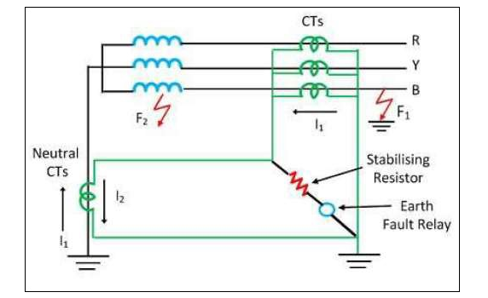
Restricted Earth Fault Protection Scheme
Let us consider a star winding transformer, which is protected by a Restricted Earth Fault Protection with EFR protecting device as shown in the figure below.
The following image shows the Earth Fault Protection with EFR −

Slide 23
When an external fault F1 occurs in the network, I1 and I2 flow through the secondary side of the CTs. The resultant of I1 and I2 will be zero. However, if an internal fault F2 occurs inside the protective zone, only I2 flows and I1 is neglected. The resultant current I2 passes through the earth fault relay, which senses the fault current and protects the restricted portion of winding. The fault current is approximately 15% more than the rated winding current. To avoid the magnetizing inrush current, the stabilizing current must be in series with the relay.

Slide 24
Electrical Safety - Earthing
The process of transferring an unintended electrical energy directly to the earth through a low resistance wire is called electrical earthing. It refers to the connection of a noncurrent-carrying part of the equipment or neutral of supply system to the ground, which represents the zero potential. The leakage current chooses the simple low resistance path to flow. Thus, the electrical system and equipment are protected from damage.

Slide 25
Types of Electrical Earthing
Types of Electrical Earthing : The electrical equipment has two non-current carrying parts such as neutral of the system and frame of the equipment. Earthing system is also classified into two types.
Neutral Earthing: The process of connecting neutral of the system to the earth through a GI wire is known as Neutral earthing or System earthing. It is used in star winding systems including generator, transformer, etc.
Equipment Earthing: When the metallic frame of the equipment is connected to the earth by the help of a conducting wire then it is called Equipment earthing. In fault condition in the apparatus, the fault current flows to the earth and the system is protected.

Slide 26
Need of Earthing
Earthing is needed for the following reasons −
To protect the user from electrical shock.
Earthing system shows the easiest path to the fault current even after the insulation failure.
It protects the electrical apparatus used in the circuit from short circuit current, high voltage surges and lightning discharges.

Slide 27
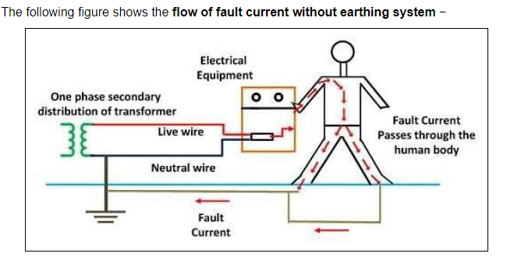

Slide 28
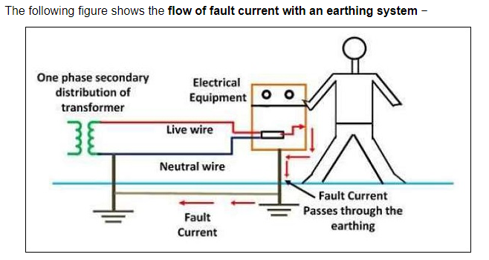

Slide 29
The earthing system must follow the rules and regulations for the risk reduction according to the following standards.
Indian Standards: IS 3043- Code of practice for Earthing (latest)
National Electricity Code (NEC)
IEEE guide for safety in AC substation grounding No. ANSI/IEEE standard, 80-1986.
Proper inspection and field survey is necessary before the installation. A flowchart needs to be followed for the different steps: Inspection & Survey – Design – Testing – Installation - Maintenance - Preparing Report.
Electrode resistance, soil resistivity is measured periodically and megger test should be exercised.
Do not use copper or aluminium wire as substitute, paint, enamel and grease on the electrode. Protect the electrode lead from mechanical stress and corrosion.
Proper training and management can reduce the risk factor.

Slide 30

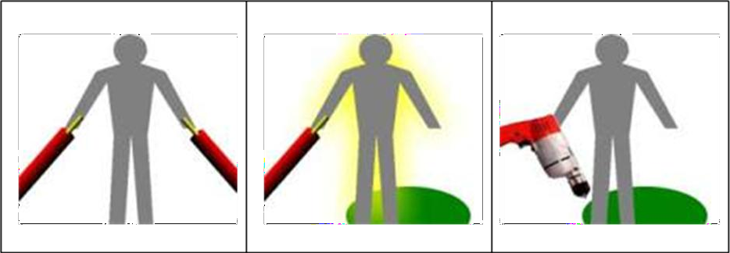
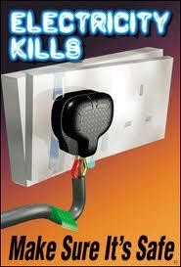
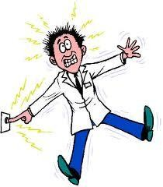
How Shocks Occur
Electric shock occurs in one of three ways. Individuals, while in contact with the ground, must come in contact with:
Both wires of an energized circuit. | One wire of an energized circuit and the ground. | A metallic part in contact with an energized wire while the person is also in contact with the ground.

Slide 31
Effects of AC current across human body
500 mA
80 mA
50 mA
30 mA
10 mA
0.5 mA
Heart stopping
Severe injuries
heart fibrillation
Tissue burnings
breath paralysis
Muscle and lung contraction
no physiological damage
Discomfort
no actual danger
Perception threshold
no physical reaction
Notes:
31
31

Slide 32
Electric Burns
Human skin provides great protection from normal elements; however human skin provides poor protection from extreme heat which is a byproduct of exposure to electricity. Typically there exist three types of burns:
Electrical burns happen when electric current flows through tissues and organs.
Arc burns result from high temperatures (up to 35,000 F) when an arc flash event occurs.
Thermal burns typically happen when skin touches a hot surface

Slide 33
Arc Flash
An arc flash is a phenomenon where a flashover of electric current
leaves its intended path and travels through the air from one conductor to
another, or to ground. The results are often violent and when a human is in close proximity to the arc flash, serious injury and even death can occur.
Arc flash can be caused by many things including: Dust, Dropping Tools, Accidental Touching, Condensation, Material Failure, Corrosion, Faulty Installation.

Slide 34
Approach boundaries designed to protect employees while working on or near energized equipment
Flash Protection Boundary (outer boundary)
Limited Approach
Restricted Approach
Prohibited Approach (inner boundary)

Slide 35
Flash Protection Boundary (outer boundary): The flash boundary is the farthest established boundary from the energy source. If an arc flash occurred, this boundary is where an employee would be exposed to a curable second degree burn (1.2 calories/cm2).
Limited Approach: An approach limit at a distance from an exposed live part where a shock hazard exists.
Restricted Approach: An approach limit at a distance from an exposed live part which there is an increased risk of shock.
Prohibited Approach (inner boundary): A distance from an exposed part which is considered the same as making contact with the live part.

Slide 36
Ways to protect the workers
De-energize the circuit
Work Practices
Insulation
Guarding
Barricades
Ground Fault Circuit Interrupters (GFCI)
Grounding (secondary protection)

Slide 37
Employees working in areas where there are potential electrical hazards, they must be provided with
PPE for the Body (FR Clothing): During an arc flash event the temperatures can reach an excess of 35,000 degrees. Even at temperatures much lower, typical daily wear clothing would do little to protect the worker from being seriously injured. In fact, at such high temperatures, the clothing will ignite and continue to burn on the body well after the arc flash has dissipated. This is where serious injury and death often occur. To counteract the extreme heat from an arc flash, FR clothing is required.

Slide 38
PPE for the Hands (Gloves)
Since employees working on energized electrical parts are using their hands, obviously that part of the body (hands and arms) are most susceptible to electric shock and must be protected.
Insulating gloves provide an excellent means of protecting the workers from accidental electrical contact. To be effective the insulating gloves must have high insulative qualities, while also being comfortable, durable and flexible.
For insulating gloves there are two “Type’s”:
Type I glove is not ozone-resistant
Type II is ozone-resistant.

Slide 39
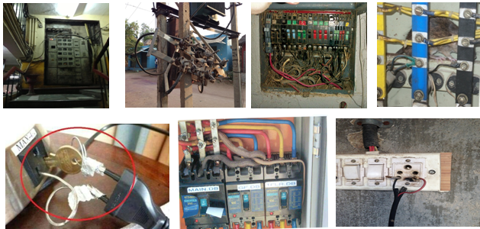
REASONS for Electrical failures-Quality of installations & maintenance is poor…

Slide 40


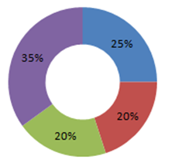


Electrical Safety Core issues
Old Installations
Addition of loads – Modification
Degradation of insulation & Components Ageing
Poor Maintenance practices
Technology up gradation
Design Issues
Code violations
Competent designer
Adequate wire sizing
Selection of reputed make cost reduction
Active & Passive fire systems
Protective device coordination
Workmanship
Training & Skill level
Non competence person
Outsourcing
Maintenance Man Power Vs Cost reduction
Maintenance Issues
Work force Availability
Outage based maintenance practices
Predictive maintenance (thermographic Survey)
Obsolescence of components

Slide 41
GENERAL SAFETY POINTS TO BE REMBERBERED FOR ELECTRICAL SAFETY

Slide 42
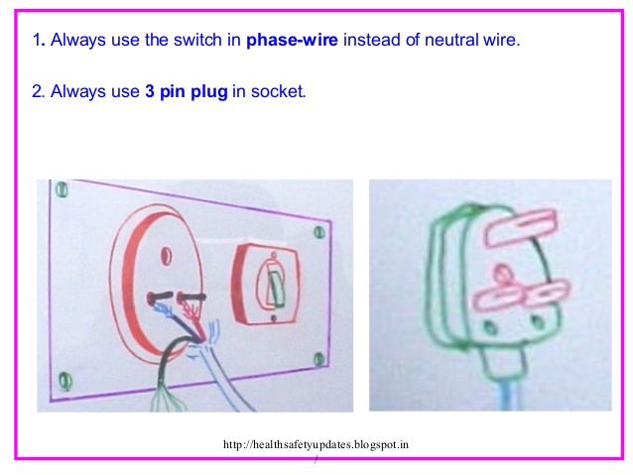

Slide 43
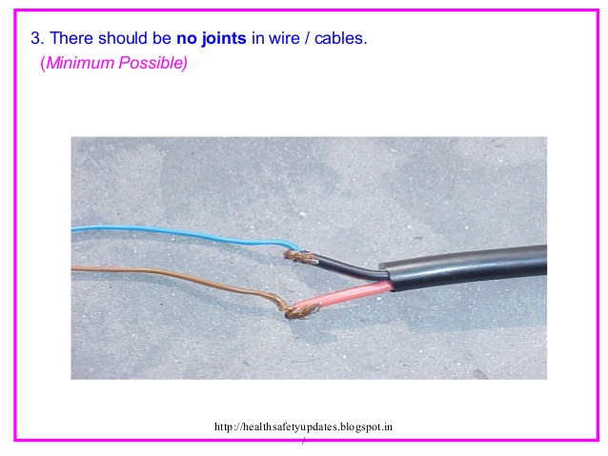

Slide 44
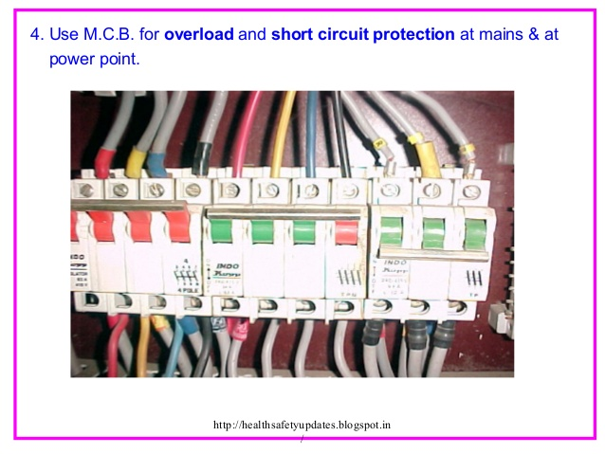

Slide 45
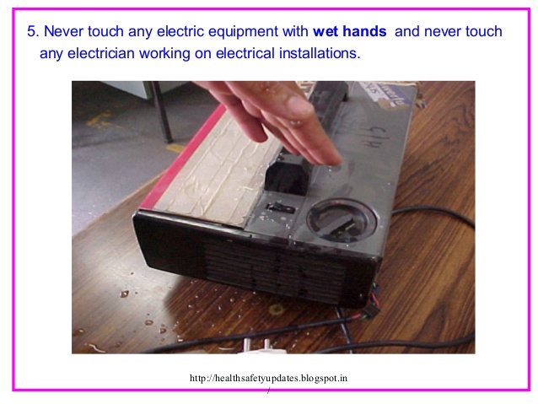

Slide 46
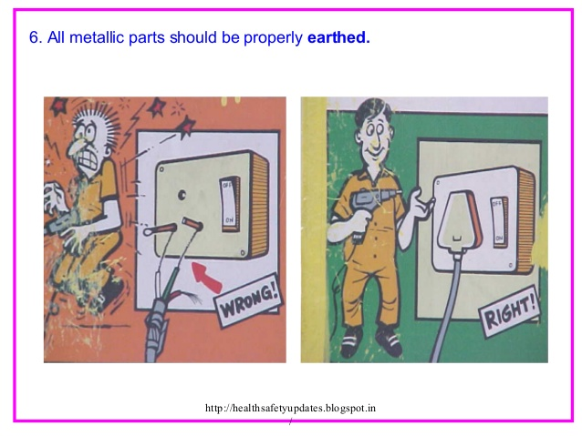

Slide 47
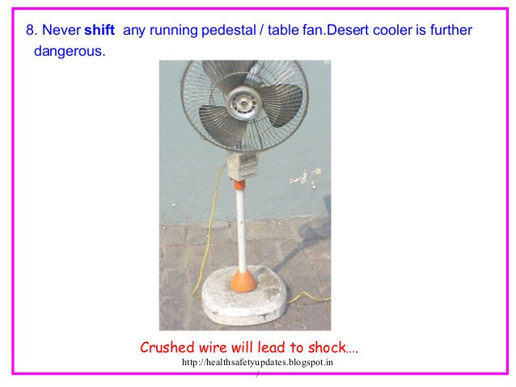

Slide 48
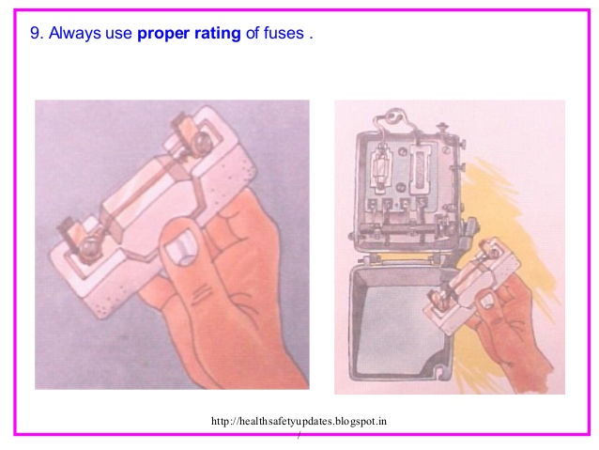

Slide 49
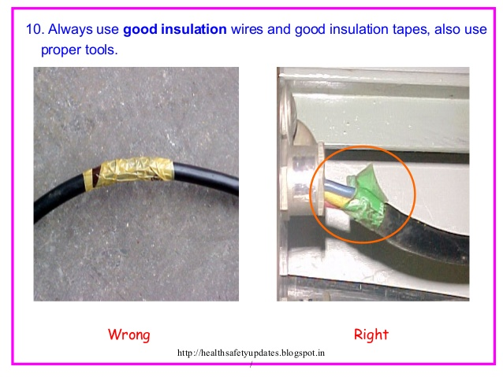

Slide 50
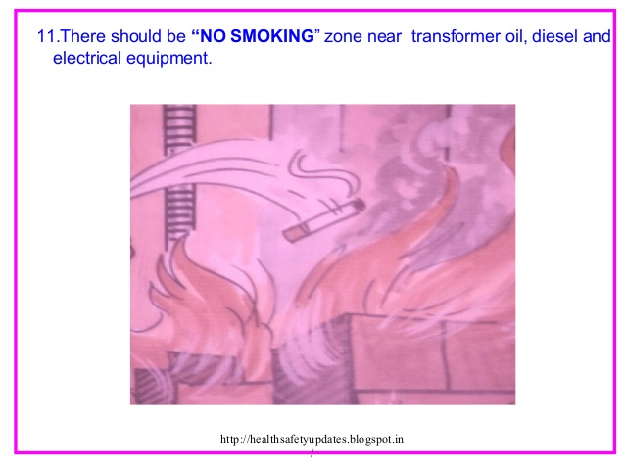

Slide 51
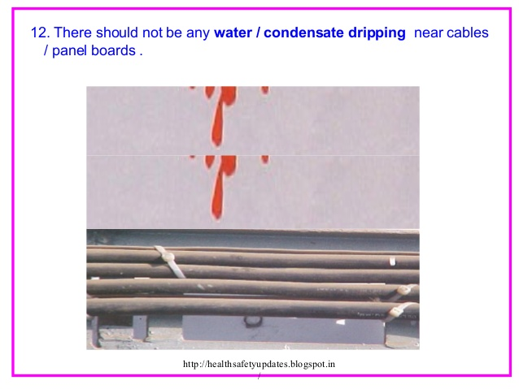

Slide 52
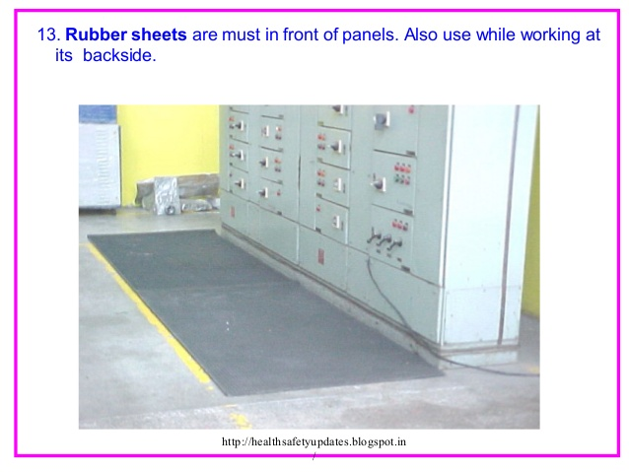

Slide 53
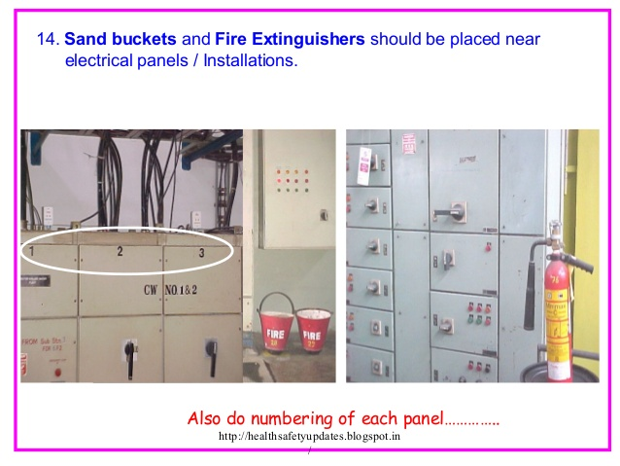

Slide 54
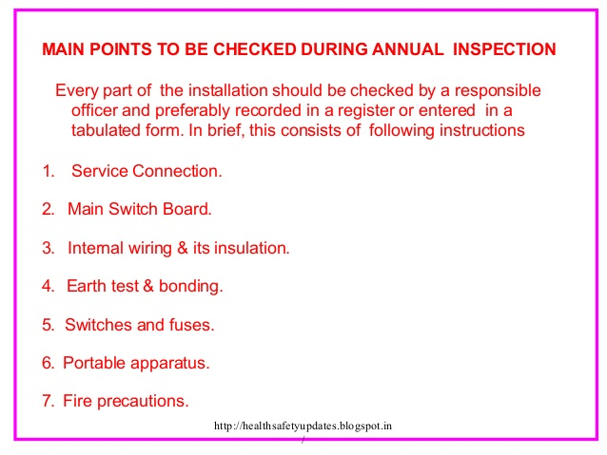

Slide 55
The do's for a worker
Before carrying out any task, make sure that the equipment is 100% dead and is in no condition to get energized at any stage of work.
For proper caution, it is ideal to write down all the measures that you are going to take, on a control sheet.
Reanalysis your written instructions, and if possible, you can discuss this with your supervisor or fellow workers.
Always stick with the work instruction provided to you.

Slide 56
The do's for a worker
Using a well-rated instrument is necessary. It is recommended that only good quality, insulated tools, probes, and prods are used.
Working in the sequence is the key to a safe operation especially the switching sequences. Make sure you close the isolator first and then close the associated circuit breaker.
While testing equipment, it is vital that you create a spacious exclusion area.
If you found anyone is interfering with your way of work, then stop them politely. If a co-worker is working on your test area and following a wrong procedure, then insist him/her to follow the right method.

Slide 57
The do's for a worker
Before starting your work, make sure that you draft a proper layout of all your equipment in proper order. Following a correct order will not only help you to provide a comfortable working position but also offer you other advantages such as −
  Provide ample of space to work
  Provide ease of accessibility to your equipment
  Allows you appropriate time and visibility to read your instructions
  Provide adequate light
  Provide you quick gateway during an emergency

Slide 58
The don'ts for a worker
Never try to reclose a circuit during a fault, when it is still under process. A fault should always be located and then it should either be removed or rectified. Until proper steps have been followed, do not do anything with the circuit.
Unless the motor load has been disconnected, do not try to open the supply of the alternator set.
If the primary winding is capable of allowing current flow through it, then never try to open-circuit the secondary winding. Also never, use the secondary winding open-circuit as an energizer for primary winding.

Slide 59
The don'ts for a worker
Before working on a circuit make sure, it is entirely dead or has been discarded by an authorized worker. Until then, it is better to maintain your distance from it.
While using test equipment, never try to interact with any safety devices as it is quite unsafe.
While running a dc machine, it is crucial to make sure you arrange an armature and open the field circuit at the same time. Without proper provisions, do not ever attempt to run a DC machine. However, you can try it with caution only if you secure the circuit breaker in the field circuit.

Slide 60
The don'ts for a worker
While using test equipment never alter, any permanent connects and even if you do, make sure you consult correctly with your supervisor. If you modify test equipment, make sure you label it with block letter. After using the equipment, replace the connection to its original position unless your supervisor has asked you not to do it.
Never use damage equipment or leave faulty equipment at a place that is accessible by others.
Even if your injuries seem light, always get yourself adequately checked by a trained expert.

Slide 61

Thank you!

