Slide 1
Building Regulatory System: Administration and Permits as per SP 73: 2023 ‘Standardized Development and Building Regulations 2023’

Slide 2
Chapter 2 Administration
About
This chapter outlines the administrative set up required for regulating land development or redevelopment, building construction or reconstruction, alteration and demolition activities by an Urban Local Body (ULB)/ Authority which is conferred with relevant powers through legal statute. The chapter is divided into three key sections as depicted below. Each section provides powers and duties of BO, Applicant and the RBP.
Key Highlights – clear documentation of roles, exhaustive listing and identification of RBPs (10 in total) involved in development and/ or construction work along with their qualification and competence criteria, guidelines for manual process of permits
2.1 Building Official (BO)
2.2 Applicant
2.3 Registered Building Professional (RBP)
Any land development or redevelopment, building construction or reconstruction, alteration and demolition activity shall be carried out only after obtaining permission from the Authority where a Competent Official (CO) or a delegated official of the Authority may act as the BO.
Applicant is fully responsible for compliance with these regulations, master plan/development plan/zonal plan and other relevant acts/regulations applicable on the development/ construction/ demolition/ alteration activity being undertaken by them.
All plans for development or redevelopment, building construction or reconstruction and alteration and demolition shall be prepared and signed by a qualified RBP.
10 types of RBP, to be engaged by Applicant - Architect, Civil engineer, Structural engineer, Geotechnical engineer, Town Planner, Supervisor, Landscape architect, Urban designer, Engineer for utility services and Building constructor
Engagement of RBP basis type of development/ construction activity, minimum qualification competence criteria of each RBP is in Annex A
Table of contents

Slide 3
Chapter 2 Administration
2.1 Building Official (BO)
Key responsibilities of a BO include –
Receive applications
Undertake scrutiny, inspections, etc
Issue notices
Sanction any compoundable development in accordance with these or any prevalent regulations,
Ensure compliance for allotment of land and relevant acts such as RERA
Issue permits for land development or redevelopment, building construction or reconstruction, alteration and demolition activity,
Issue occupancy permit and maintain records of all applications
Stall work on site for non-permissible development and/or construction
2.12 Applicant
Key responsibilities of an Applicant include –
Obtain necessary permit(s), NOCs and approvals,
Undertake development/ construction in accordance with sanctioned plans,
Engage RBPs, comply with BO in inspection and scrutiny,
Notify BO at various stages of development and construction,
Ensure no development/ construction is undertaken during lapsed or revoked permit,
Ensure safety on site, safeguards for environment protection and maintain the building in accordance with Part 12, ‘Asset and Facility Management’ of NBC 2016,
Maintain permit records for at least 1 year after completion of construction.
2.3 Registered Building Professional (RBP)
Key responsibilities of an RBP include –
Study and be conversant with state and local rules, regulations, orders and other instructions,
Prepare all plans in accordance with regulations,
Upload the documents on Authority’s portal, ensure submission of correct details intimate applicant the corrections/ changes suggested by BO,
Carry out work on site, ensure accessibility requirements as per these regulations and Rights of Persons with Disabilities Act, 2016, as amended from time to time
Inform BO of their employment/ assignment/ resignation for any work

Slide 4
Chapter 2 Administration
Note: Guidelines for manual process for Permit
The regulations do not encourage manual process of permit. However, in case the authority is still adapting to the online permit process, additional responsibilities and duties for obtaining permits (through a manual process) shall be as follows:
BO - Ensure availability of all the required forms, inform the applicant and RBP about any modifications/objections/grant or refusal, accept scanned copies of updated plans, documents and application
Applicant - Ensure signature of documents/ plans before submission, provide correct details of communication to BO, inform BO about revisions in plan submission
RBP – Prepare plans in required legible formats, sign the plans as per their competence along with their full name, registration no, contact no and address

Slide 5
Chapter 3 Permits
About
This chapter details out the process for obtaining Development Permit, Building Permit, Occupancy Permit and Demolition Permit across nine sections as depicted below
Key highlights –process documentation aligned to sequential flow of development, flowchart representation for processes, tabular representation for list of documents, standard templates for all forms/ approvals/ permits/ orders, functions for single window approval system - all of which can be readily embedded into an online plan approval system
3.1 Applicability
3.2 Development Permit and/or Building Permit Issued Prior to These Regulations
3.3 Permit Process
3.4 Violations and Penalties
3.5 Unsafe buildings
3.6 Third Party Audit
3.7 Demolition for building
3.8 Permit for signage
3.9 Online single window clearance system
Annex B - certificate for engagement of RBP
Annex C - application for development / building permit
Annex D - indicative list of NOCs/ approvals
Annex E - certificate for structural design sufficiency
Annex F - indemnity bond 1
Annex G - indemnity bond 2
Annex H - fees and charges
Annex I - description of list of documents
Annex J - application for demolition permit
Annex K - certificate for subsurface investigation
Annex L- grant of sanction/refusal of development permit/building permit
Annex M - notice for commencement of development/construction/demolition
Annex N - notice of completion/partial completion
Annex O - certificate for supervision of work
Annex P - certificate for completed work by building constructor
Annex Q - occupancy permit
Annex R - part occupancy permit
Annex S, S1 - quality assurance inspection form, detailed
Annex T- demolition permit
Annex U - application for permit to erect, re-erect or alter advertising sign
Annex V - colouring of plans
Table of contents

Slide 6
Chapter 3 Permits
3.1 Applicability
Any development or redevelopment of land, construction or reconstruction, alteration and demolition activity and occupation of any building or its part shall be carried out only after obtaining permission from the BO of the Authority.
Exemptions for certain activities such as alterations (plastering, flooring, internal partitioning, gardening, public art, etc.), operational construction/ installations of government services from taking permit, provided they conform to all clauses of these regulations
3.2 Development Permit and/or Building Permit Issued Prior to These Regulations
Development and/or building permit has been issued before the notification of these regulations. Following cases are included –
where the sanctioned activity is not completed within the validity period of permit
where the validity of permit has expired, and the work has not commenced
a plot or a building is allotted/leased by any government department or Authority with specific provisions
where the validity of permit has not expired and the sanctioned activity is in progress

Slide 7
Chapter 3 Permits
3.3 Permit process
Permit process to be followed for any land development or redevelopment, building construction or reconstruction, alteration and demolition activity (including occupancy and part occupancy permit) through following steps.
Submission of application
Scrutiny of application
Sanction or Refusal of Development Permit and/or Building
Deemed Approval in Case of Development and/or Building Permit
Addition and/or Change in Sanctioned Development and/or Building or Sanctioned Demolition Plan
Withdrawal of Application
Procedure During Development and/or Construction
Validity and Extension of Time
Notice of Completion
Inspection for Occupancy Permit
Grant or Refusal of Occupancy Permit
Each process step details timelines, documents, responsibilities, flow of information, output, etc. represented through an individual flowchart.

Slide 8
Chapter 3 Permits
List of Documents to be Provided along with the Application of Permit (except for Demolition Permit)
List of Documents to be Provided along with Application for Demolition Permit
Documents | Development permit | Building permit
Engagement of RBP (ANNEX B) | Y | Y
Application for obtaining development permit/building permit (ANNEX C) | Y | Y
Subdivision/layout plan | Y | NA
Key plan | Y | Y
Site plan | Y | Y
Building plan | NA | Y
Services plans | Y | Y
Specifications | Y | Y
Applicant/ownership documents | Y | Y
Certificate of structural design sufficiency (ANNEX D) | NA | Y
NOCs (as per requirement); (ANNEX E) | Y | Y
Indemnity Bonds (ANNEX F and ANNEX G) | Y | Y
Valid time extension (wherever applicable) | Y | Y
Photographs of the site with date-time stamp | Y | Y
Receipts of all applicable fees and charges including labour cess (ANNEX H) | Y | Y
Energy Efficiency Compliance Report from BEE certified professional, wherever applicable as per ECBC Rules | NA | Y
Documents
Engagement of RBP (ANNEX B)
Application for obtaining demolition permit (ANNEX J)
An engineering survey of the structures/buildings prepared by RBP.
Demolition plan as described in 3.7.5 of these regulations
NOC from all essential utility services (supply of gas, water, sewerage, telecommunications, electricity). (ANNEX E)
Receipts of all applicable fees and charges (ANNEX H)

Slide 9
Chapter 3 Permits
Key
Applicant
CO / Authority
Process flow for obtaining Development Permit and/or Building Permit (illustrative)
A
START
Application stands cancelled
No
No
Submission of application
Documents/drawings
NOCs related to site
Fees (as applicable)
Modifications submitted as per timelines
All modifications made?
Yes
Yes
Technical scrutiny of submitted plans /documents
No
Submission of additional documents
Resubmission made as per timelines
Submitted plans confirm to Regulations
Yes
Validate completion of application
Submit required modifications
Notice to Applicant
No
Repeat process for Stage 2
Repeat the entire process for Stage 1 & 2 (in case of high rise & special buildings)
No
All required documents exist
Yes
Notice to Applicant indicating deficiencies
Yes
Is the application for a high rise/special building?
Is stage 2 application submission complete?
No
Yes
Application stands cancelled
No
No
Modifications submitted as per timelines
All modifications made?
Have all NOCs been granted?
No
Yes
Yes
Site Inspection
Yes
No
Obtain NOCs on technically scrutinized plans
Grant of Permit
Refusal of Permit
Yes
Have all NOCs been received?
No
Is the status of the site verified
Submit required modifications
Notice to Applicant
No
B
C
Procedure during development and/or construction
Validity and Extension of time for Permit
Intimate Applicant

Slide 10
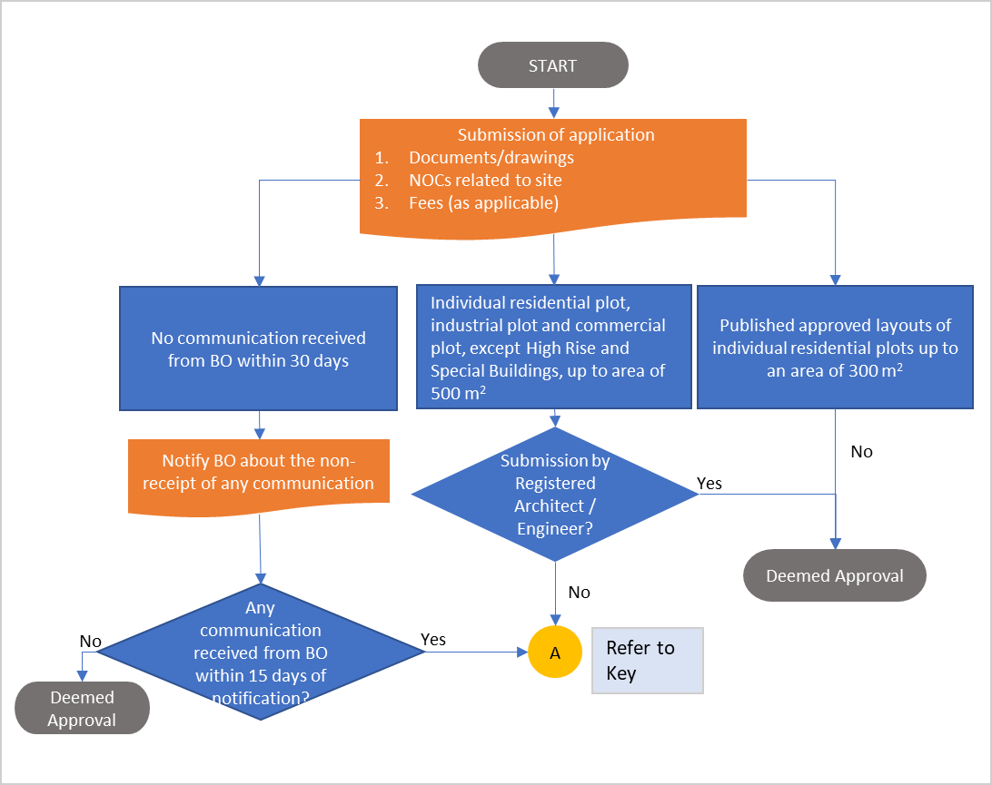
Chapter 3 Permits
Key
Applicant
CO / Authority
Flow chart for deemed approval (illustrative)
Indicative list of NOCs/ approvals required
Agencies from whom NOCs/Clearances may be required (wherever applicable)
Airport Authority of India (AAI)
National Monuments Authority of India
Ministry of Environment, Forest and Climate Change (MoEFCC)
Fire Service Department
Designated authorities under factories act
Designated authorities under cinema regulation act
Urban Art Commission
Heritage Committee
Pollution Control Board
Designated Coastal Regulation Zone Authority
Clearance from Metro Rail Corporation (MRC)
Lessor in case of leased sites
Chief Controller of Explosives
Service departments
Town planning department
Clearance from defence, border roads
Public Works Department (PWD)
National Highway Authority of India (NHAI)
Departments/Agencies responsible for the maintenance of the public utilities (If the allotted site falls in the proximity of their establishment or has any departmental utilities or conveniences or infrastructure, etc. within, below or above the ground or on the periphery of the site which has the possibility of being affected while undertaking the construction.)
Railways
Police (For construction of religious structures)
District Magistrate
Inspectorate of boilers and smoke nuisance
Atomic Energy Regulatory Board
Yes

Slide 11
Chapter 3 Permits
Key
Applicant
CO / Authority
Procedure During Development/Construction (illustrative)
B
Any deviations observed in the development / construction?
End
Procedure during development and/or construction
Notify the BO for Commencement of work
Site Inspection
No
Yes
Immediately inform the in-charge on site
Send notice to the Applicant and the RBP within 3 days of Site inspection
Joint inspection by BO, Applicant & RBP
Notify the BO
Applicant agrees to the defects / deviations ?
No
Send notice for demolition if the deviations are dangerous to public health
Are the deviations rectifiable?
Yes
No
Yes
Notify the BO regarding all rectifications
Rectification of deviations / defects
Resume work if the rectifications are satisfactory

Slide 12
Chapter 3 Permits
Key
Applicant
CO / Authority
Validity and Extension of Time (illustrative)
C
Validity and Extension of time for Permit
Is Permit still valid?
Yes
No
Resume work
Apply for Extension of time
Submission of application
Original Sanctioned Plan
50% of original plan processing fees
Is the development / construction on lease site?
No
Yes
Is the lease valid ?
Grant Extension of Time
No
Yes
Refusal
Grant Extension of Time

Slide 13
Chapter 3 Permits
Key
Applicant
CO / Authority
Process for Occupancy Permit (illustrative)
Submission of Notice of Completion:
Documents/drawings
NOCs related to site
Fees (as applicable)
Minimum works completed
START
Refusal
No
Yes
No
Modifications submitted as per timelines
No
Yes
All modifications made
Yes
Site Inspection
Is the site compliant with submitted Completed Plans?
Make required modifications
Notice to Applicant
No
Refusal
No
No
Modifications submitted as per timelines
Yes
All modifications made
Yes
Scrutiny of Completion Plans
No
Completion plans confirm to Regulations
Make required modifications
Notice to Applicant
Yes
Grant of Occupancy Permit

Slide 14
Chapter 3 Permits
Timelines for the Permit Process for Development and/or Building Permit(other than 2-stage process)
T₀ + 30 days
T₃
T₃ + 15 days
No Communication from BO
Notify BO about no communication
T₀
No Communication after notification
Deemed Approval
Submission of application
Notify CO with modifications
Resubmission of application
T₀
T₀ + 7 days
T₂
T₀ + 15 days
T₀ + 21 days; T₁
T₀ + 30 days
Validate completion of application
Communication to Applicant for deficiencies
Technical scrutiny of application
Grant / Refusal of Permit
T₁ + 15 days
T₂ + 30 days
Communication to Applicant for modifications

Slide 15
Chapter 3 Permits
3.4 Penalties and Violations
BO is empowered to undertake following actions against person who contravenes any of the provisions of these regulations -
Levy penalty
Seal and demolish or bring within limits
Cancel registration of the concerned RBP or make such recommendation to the statutory body governing such profession
Any other appropriate actions as provided in law
All expenses shall be borne by the applicant and if not paid on demand, the BO shall recover the same as revenue arrears
3.5 Unsafe buildings
Unsafe buildings shall be dealt in the following manner, after their examination –
Serving a legal notice to the applicant or occupier of any unsafe building stating time period to vacate the building or complete specified repairs/improvements or demolish and remove the building or portion thereof.
BO vacating the building to remove the danger by repair or demolition of the building or portion thereof. All expenses shall be borne by the owner/occupier and if not paid on demand, BO shall recover as revenue arrears.

Slide 16
Chapter 3 Permits
3.6 Third Party Audit
Appointment of third-party technical audit agency (TPTAA) and/or third-party quality assurance (TPQA) by BO for highrise and special buildings. Following in context of these agencies is detailed-
Selection criteria of TPTAA to be based on experience of similar works, conflict of interest, etc.
Objectives of TPTAA include review of project implementation and procurement process, statutory clearances, quality monitoring plan; examination of documentation with respect to sanctioned covenants; preparation of detailed reports and their follow up, etc.
Process flow for appointment of TPTAA by the applicant and their audit at various stages of development and/ or construction works
3.7 Demolition of a building
Provisions for demolition of a building include -
Applicability and procedure for seeking demolition permit
Safety provisions during demolition as per Chapter 7 of these regulations, Part 4 and Part 7 of NBC 2016 and waste disposal provisions during demolition as per Chapter 12 of these regulations
Notification to concerned departments/agencies related to utilities having service connections within the building, such as water, electricity, gas, sewer and other connections and obtain an NOC related to their disconnection;
Plan of procedure for the demolition work to be prepared by RBP ensuring structural integrity of the adjacent / adjoining building, safe methods, lifting, handling, storing arrangements, safe access and working area, disposal of waste, risk assessment plan, etc.

Slide 17
Chapter 3 Permits
3.8 Permit for signage
Applicant shall erect, alter or maintain a sign after obtaining a permit. Provisions in terms of the following are detailed -
Process for application including steps, documents, validity, approval, deemed approval and cancellation/ revoke of permit
Placement of signages (including accessible signages for public buildings)
Content and display of signages (conforming to Part 10 , Section 2 of NBC 2016)
Structural safety (conforming to Part 6 of NBC 2016
Existing advertising signages
Exemptions
Unsafe and Unlawful signages

Slide 18
Chapter 3 Permits
3.9 Online building permits
Functions for permits that may be performed through an online approval system with the use of electronic forms such as -
Receipt or acknowledgement of applications (see Note 1) and payments;
issue of notices, permits, orders or directions;
scrutiny, enquiry or correspondence for grant of sanction/refusal of permits,
filing of documents;
calculation and payment of fees and any charges;
maintenance of registers and records;
any other function that the Authority may deem fit in public interest; and
communication with the applicant .
Additional requirements for an online single window approval system are in terms of–
unique identification number for each application
status of the approval, stage of development, observations, etc to be posted on the website and made available through SMS
In cases where an online system is still in the process of being adopted, application status to be constantly updated to the Applicant, forms to be signed and accepted in triplicate, multiple payment options for online transaction/ Demand Draft/ Cheque and cash.

