Slide 1
Dam Safety, Repair, and Rehabilitation

Slide 2

Table of contents
Dams Scenario
1
4
OUR VISION
A business plan is a written document that describes in detail how a business.
2
5
BIS Code use In Flood Mitigation
BUSINESS MODEL
Types of Lining of canal
Use of BIS codes In Canals
A business plan is a written document that describes in detail how a business.
3
6
OUR MISSION
OUR HISTORY
A business plan is a written document that describes in detail how a business.

Slide 3
Dams around the World
Post-Independence in 1947, India embarked on a massive dam-building program to support agriculture, hydroelectric power generation, flood control, and water supply for growing urban populations.
India stands 3rd in terms of Large Dams worldwide having 6138 operational large dams and 143 under-construction large dams
24089
10158
6138
3135
1440 1428 1359
Canada South
Africa
1280
1107 1066
China
USA India
Japan
Rep. of Korea
Brazil
Mexico
Spain

Slide 5
WHY DAM SAFETY?
Dams are very costly infrastructure built at great expense and effort and are a public asset.
Dams enable the management of an ever-lasting water resource and are required to last forever.
With the change in environment, age and usage pattern, the continued operation of a dam requires systematic review and upgradation at regular intervals
Dam safety is an asset management discipline relying on science and technology and has components of public administration
Dams do pose a hazard if not maintained or managed properly. Management of risk is also covered by the dam safety discipline
Being linked to public safety and benefit assurance, Governance structures are needed to implement and supervise the activities under the dam safety

Slide 6
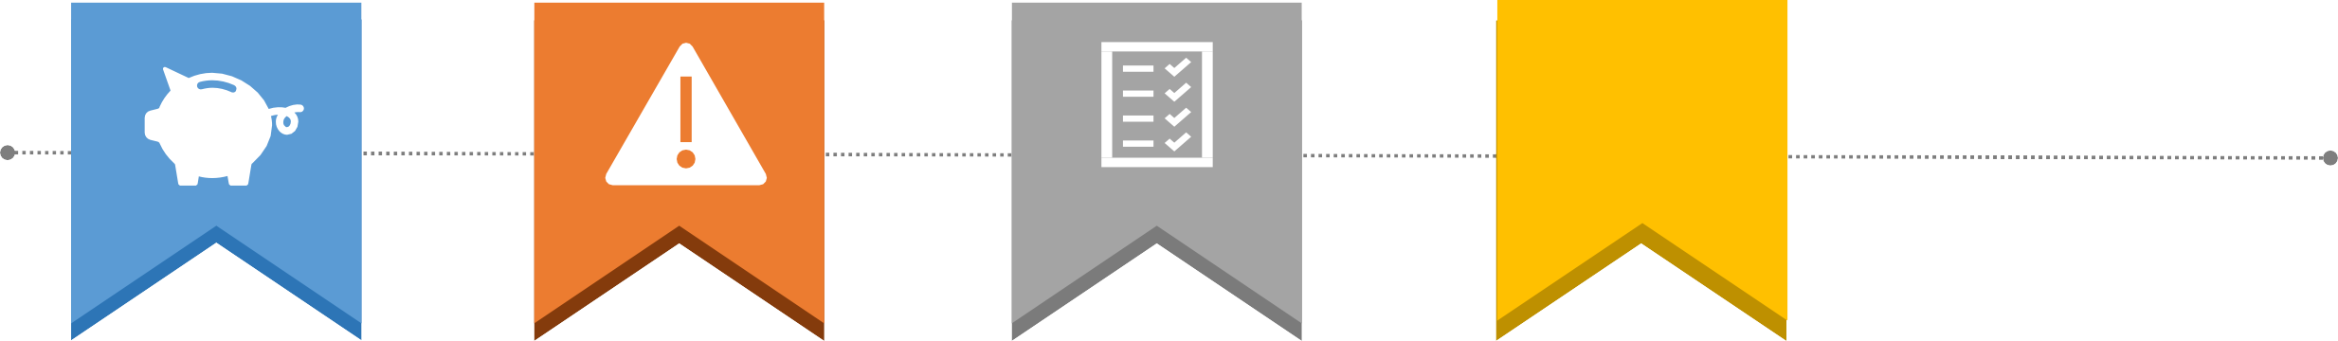
Dam Safety: Why a priority concern for India?
₹
Critical infrastructure constructed with large public investment, vital for water security
Unsafe dam constitutes a hazard to human life, ecology and public & private assets
Planning inadequacy, existing design parameters not upto mark as per present standards, structural deficiencies arising on a/c of ageing
States/dam owners have not been able to provide sufficient budgets for O&M of dams
Climate change causing extreme hydrometeorological
events

Slide 7
AGEING IMPACT
Every dam has its own unique ageing process contributed by
Type of dam
Construction methodology
Material and workmanship of construction
Location of construction and environment
Symptoms of ageing of dams
Loss of strength of the mass
Loss of Water tightness
Leads to increase in uplift pressure
Leads to slope instability
Leads to internal erosion
Leakage observed on the downstream side, toe of the dam, piping, soil erosion etc.
Crack formation in concrete dams
Swelling of dam due to chemical reactions

Slide 8















Dam Failures in India
Earthen Dams (83%)
Concrete/Masonry Dams (17%)
12
Piping / Workmanship issues
10
No. of Dam Failure
Incidents →
8
14%
6
10
10
4
6
5
44%
2
1
2
1
1
Others
17%
Breaching failure due to flooding
2
1
1
2
1
0
25%
Decades →
Overtopping due to inadequate spillway capacity
The first dam failure was recorded in Madhya Pradesh in 1917 when the Tigra dam failed due to overtopping.
The worst dam disaster was the Machu dam (Gujarat) failure in 1979, in which about 2,000 people were reported dead.
43 No. of reported dam failures including failure of Teesta III Dam in Oct 23
26 dams were of height less than 25 m

Slide 9













The existing dams have been constructed with substantial investments including substantial ones in terms of social and environmental costs.
Deferred maintenance some of these dams have associated risks, with huge consequences
Specified dams- 70% are more than 25 years old and about 212 are more than 100 years. 976 nos. between 51 to 100 years old.
In addition to various stresses, new threats posed by a changing climate are also playing a role in augmented associated safety risks
6138 large dams completed and another 143 under construction
Safety of existing dams is paramount to ensure water security and other linked services
Dam Safety in India

Slide 10
Dam Safety Act, 2021 : Institutional Setup
Dam Safety Act, 2021 has the provisions for the constitution of national as well as state level bodies for the implementation of the Act
National Committee on Dam safety (NCDS)
to evolve policies and recommend necessary regulations regarding dam safety standards
Constituted and notified in the Gazette of India dated 17.2.2022
National Dam safety Organization (NDSA)
a regulatory body to implement the policy, guidelines and standards for proper surveillance, inspection and maintenance
Constituted and notified in the Gazette of India dated 17.2.2022
Composition notified vide OM dated 25.04.2022
State Committee on Dam Safety (SCDS)
supervise state dam rehabilitation programs, review the work of the SDSO, and review the progress on measures recommended in relation to dam safety
Constituted by all States and 3 UTs
State Dam Safety Organisation (SDSO)
to keep perpetual surveillance, carry out inspections, monitor the operation and maintenance
Established by all States and 3 UTs

Slide 11
Guidelines Published
Guidelines for Developing Emergency Action Plans for Dams (February 2016)
Manual for Rehabilitation of Large Dams (January 2018)
Guidelines for Instrumentation of Large Dams (January 2018)
Guidelines for Preparing Operations and Maintenance Manuals for Dams (January 2018)
Guidelines for Mapping Flood Risks Associated with Dams (January 2018)
Guidelines for Safety Inspections of Dams (January 2018)
Guidelines for Assessing and Managing Reservoir Sedimentation (February 2019)
Guidelines for Assessing and Managing Risks Associated with Dams (February 2019)
Guidelines for Operation Procedures for Assessing and Managing Environmental Impacts in Existing Dam Projects (November 2020)
Guidelines for Classifying the Hazard Potential of Dams (November 2020)
Manual for Assessing Structural Safety of Existing Dams (November 2020)
Manual for Assessing the Hydraulic Safety of Dams (June 2021)
Guidelines for Selecting and Accommodating Inflow Design Floods for Dams (June 2021)

Slide 12
Dam Safety issues being addressed through DRIP
Inspections, Maintenance, Repair & Retrofitting works to improve the safety performance of dams
Hydrological Safety particularly in the context of climate change
Managing Sedimentation of reservoirs
Instrumentation in existing dams
Glacial Lake Outburst Flood (GLOF)
Seismic Safety
Uniform protocols and documentation:
Rapid Risk Assessment
Comprehensive Dam Safety Evaluation,
Preparation of Rule Curves, Operation and Maintenance (O&M) Manuals
Dam Break Analysis, Emergency Action Plan (EAP)

Slide 13
Rehabilitation
Rehabilitation of a dam is the act of restoring the distressed dam not only to its original state but improvement to meet added requirements caused by changes in the safety criteria from time to time.
Rehabilitation needs vary for each dam and the approach is different for diverse types of dams. Field investigations, engineering analysis and material selection are vital for planning and finalizing rehabilitation and improvement programme.

Slide 14
REHABILITATION OF CONCRETE AND MASONRY DAMS
REHABILITATION OF THE FOUNDATION
Loss of strength under permanent or repeated actions
Erosion
Grout curtains and foundation drains
REHABILITATION OF THE DAM BODY
Chemical reactions resulting in swelling
Deficiencies on account of increased seepage
Shrinkage and Creep leading to contraction
Degradation at dam faces
Loss of strength due to repeated actions
Structural joints

Slide 15
REHABILITATION OF EMBANKMENT DAMS
Deformation
Seepage Flows
Internal Erosion
  Filters And Drains
  Grouting
  Diaphragm Walls And Cutoffs
  Sheet Piling
  Clay Blanket
  Reconstruction And Replacement Of The Core Section
External Erosion
  Upstream Protection
  Crest, Parapet Walls & Downstream Slope
Loss Of Bond Between Concrete Structure And Embankment
Slope Stability Improvement
Enhance Resistance To Seismic Effects
Rehabilitation Of Upstream Face

Slide 16
Dam Repair Measures
Hydraulic:
spillways
crest height increase
parapet walls
gates and hoists
reservoir de-silting
Stability:
embankment dam re-sectioning
upstream and downstream slope protection
porous and foundation drain reaming
masonry/concrete dam backing concrete, abutment repair
Seepage:
Raking and pointing with UV-resistant high-strength mortar
dam body and foundation grouting
geomembranes on upstream faces
cutoff walls
Basic Facilities:
access roads
O&M equipment
low-voltage electrical supplies in inspection and drainage galleries
security lighting
emergency generators
inspection launches and monitoring instrumentation

Slide 17











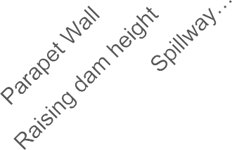

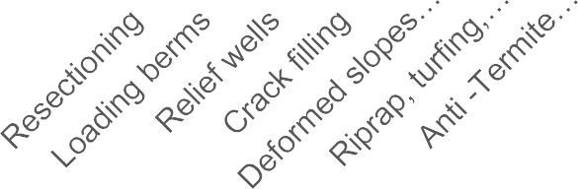














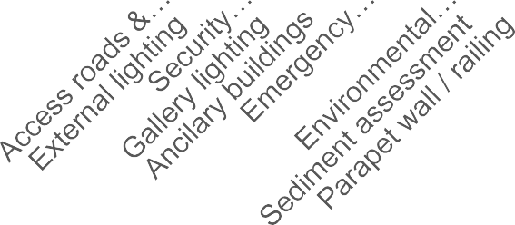



Hydraulic Measures
Stability Measures
59
37
41
Dam Count
Dam Count
Embankment Dams
71 DRIP embankment dams were rehabilitated for various issues.
In the DRIP dam portfolio, embankment dams are the second most common type after composite dams.
Embankment dam rehabilitation measures include dam body grouting, riprap revetment, turfing and drainage, spillway repair, reaming of porous and foundation drains, and improvement to dam access.
25
7
5
3
3
2
2
2
7
3
Seepage Measures
Basic Facilities
55
Dam Count
40
5
Dam Count
29
22
19
4
11
4
10 10
1
Dam body Cutoff wall grouting

Slide 18
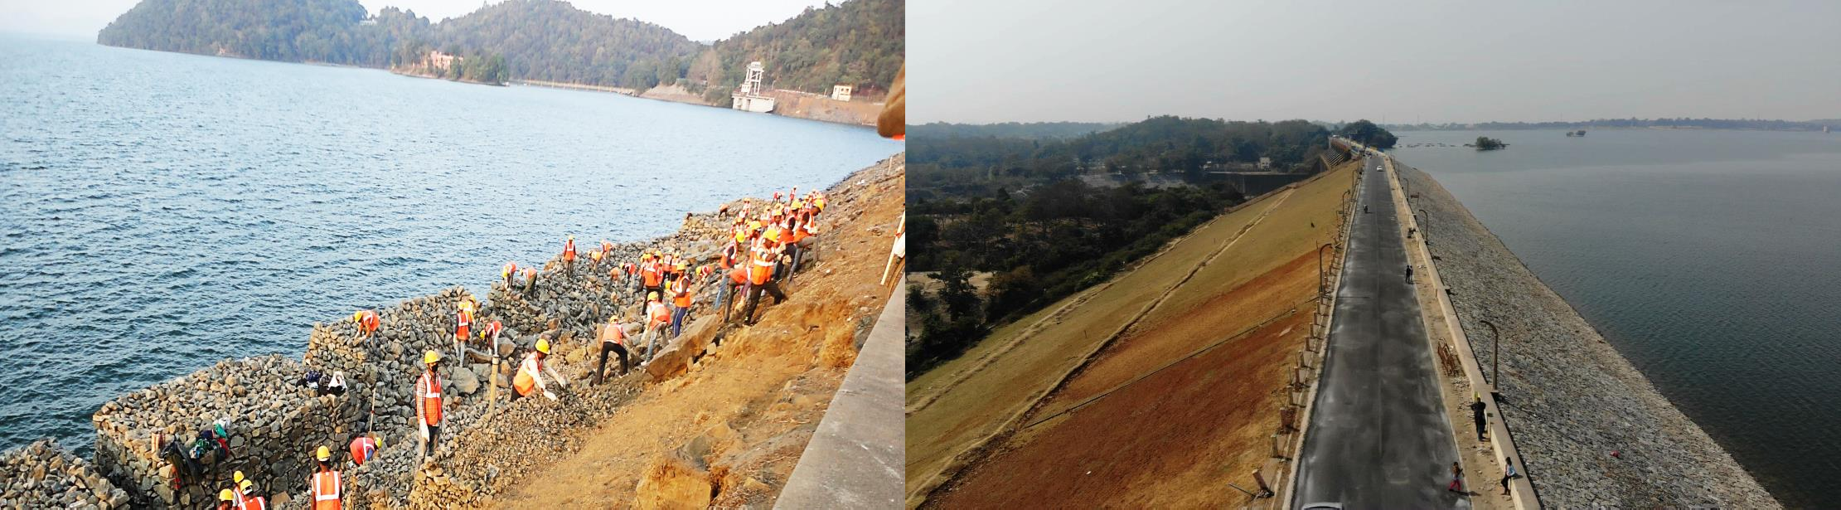
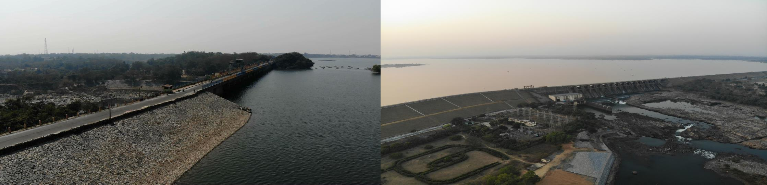
Maithon Dam, DVC

Slide 19
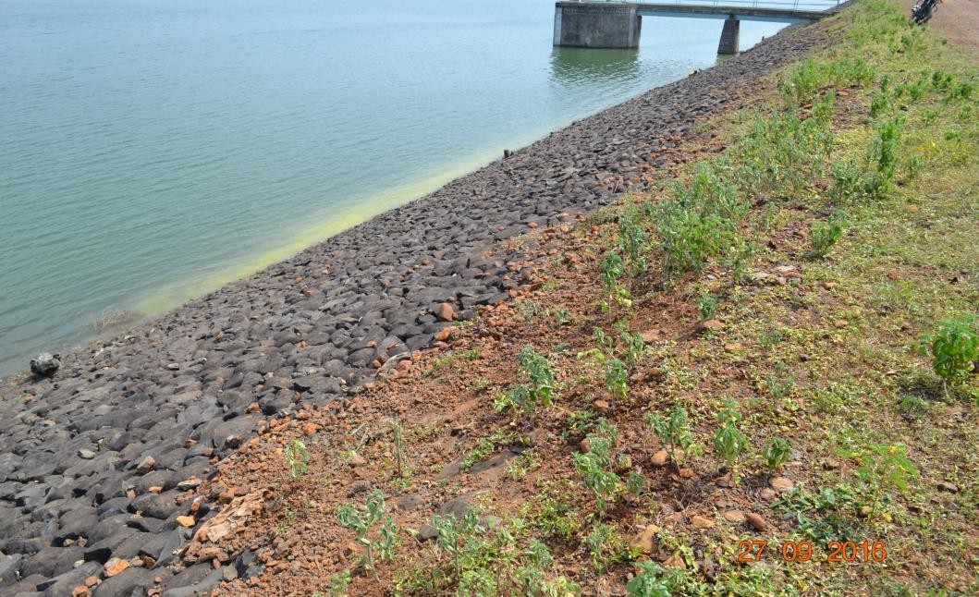
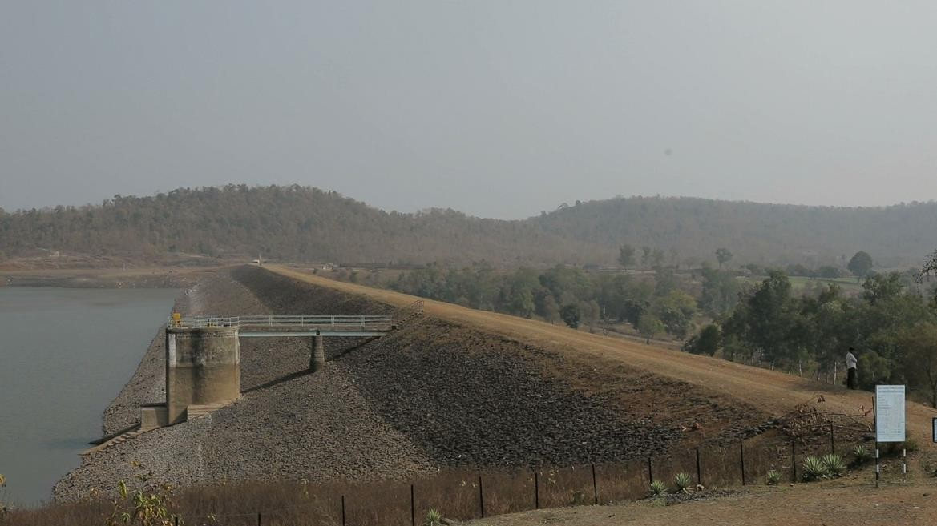
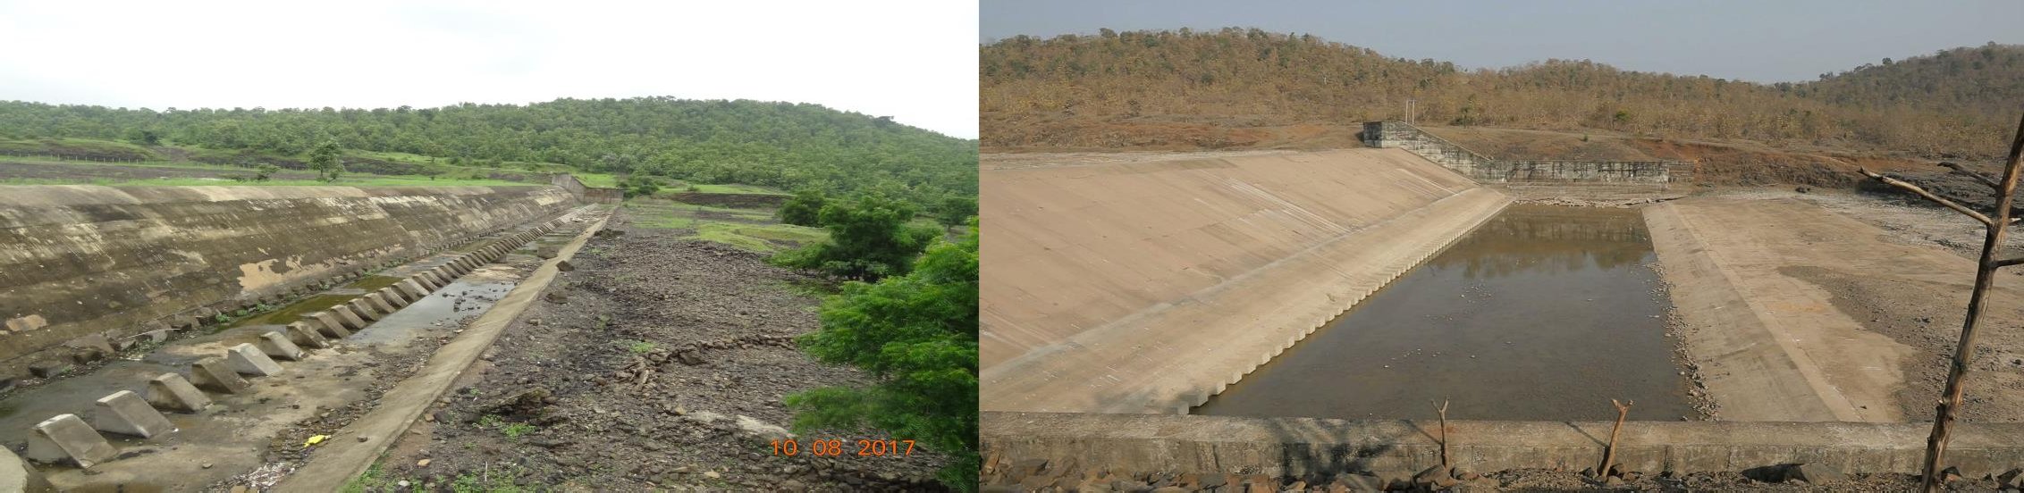
Sanjay Sagar Dam, MPWRD

Slide 20
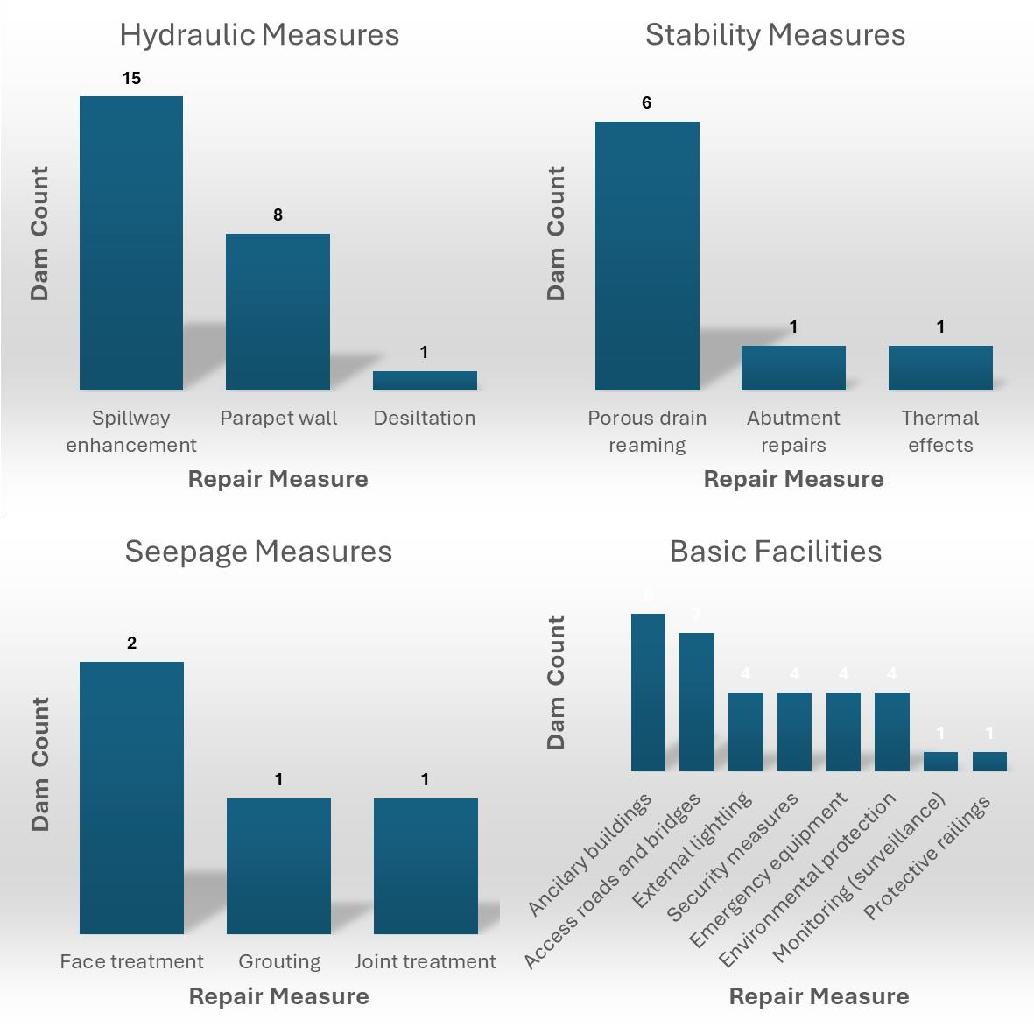
Concrete Dams
Concrete dams are built as either gravity, buttress, or arch dams, depending on how they maintain structural stability.
Concrete dams can be built using conventional or roller-compacted concrete (RCC).
Repair measures were implemented for 12 concrete DRIP dams.

Slide 21
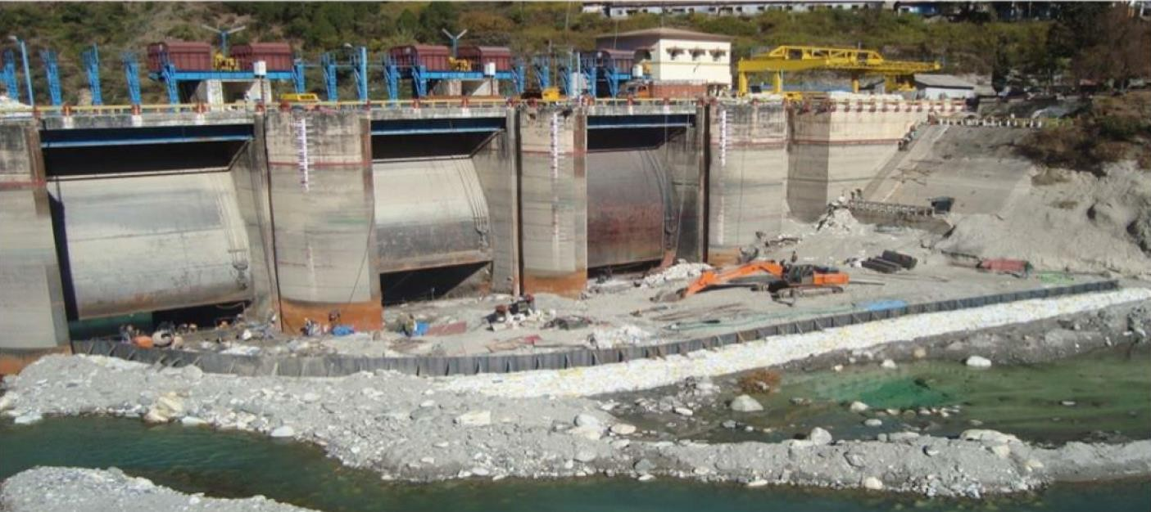
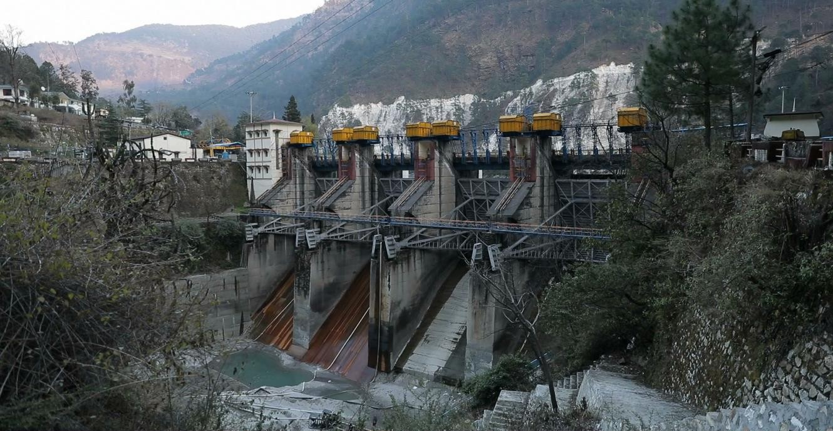
Maneri Dam, UJVN Ltd, Uttarakhand
The impoundment was silted up to the spillway crest
Extensive damage from cobbles and boulders rolling down the spillway
Spillway crest/glacis repaired with SS plate, high-strength concrete (M90) with & without fibers
Slotted roller bucket replaced with stilling basin

Slide 22
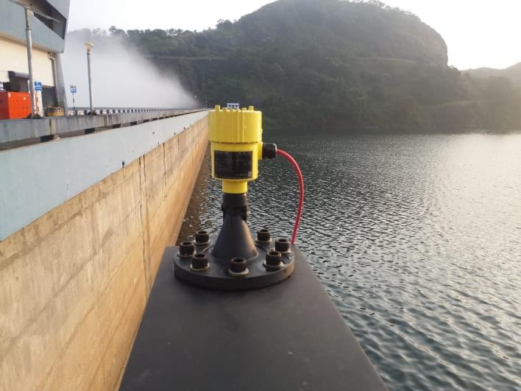
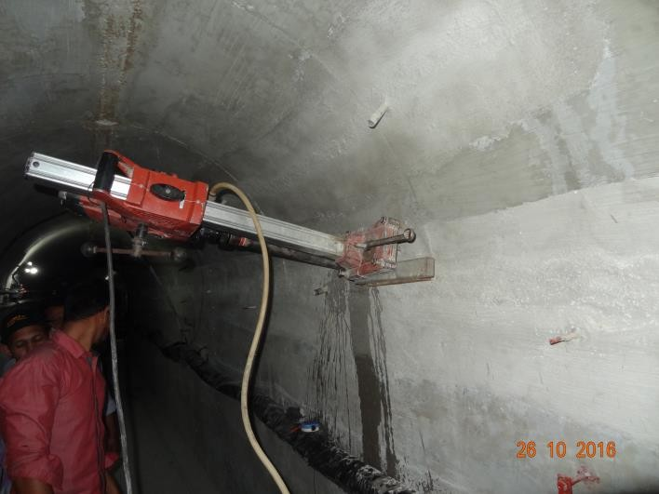
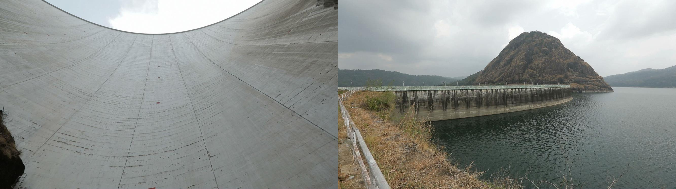
Idduki Dam, KSEB, Kerala
Repairs of Cracks
Reaming of foundation drain holes
Advanced Numerical Modelling for Sensitivity stress analysis
Instrumentation & Monitoring System
Reflective Paint application

Slide 23









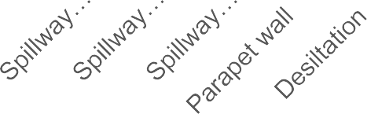












Masonry Dams
Masonry dams are built using stone and brick joined using mortar.
Understanding the ageing process of India’s large masonry dams and how to repair them is crucial.
Despite their age, masonry dams still perform adequately, although most are subject to substantial deterioration.
Repair measures were made for 62 masonry DRIP dams.
Hydraulic Measures
15
Stability Measures
23
Dam Count
Dam Count
3
3
4
1
3
1
reaming
Porous Abutment
Backing drain renovation supports
Seepage Measures
19
Basic Facilities
17
12
Dam Count
Dam Count
10
4
2
4
2 2 2

Slide 24
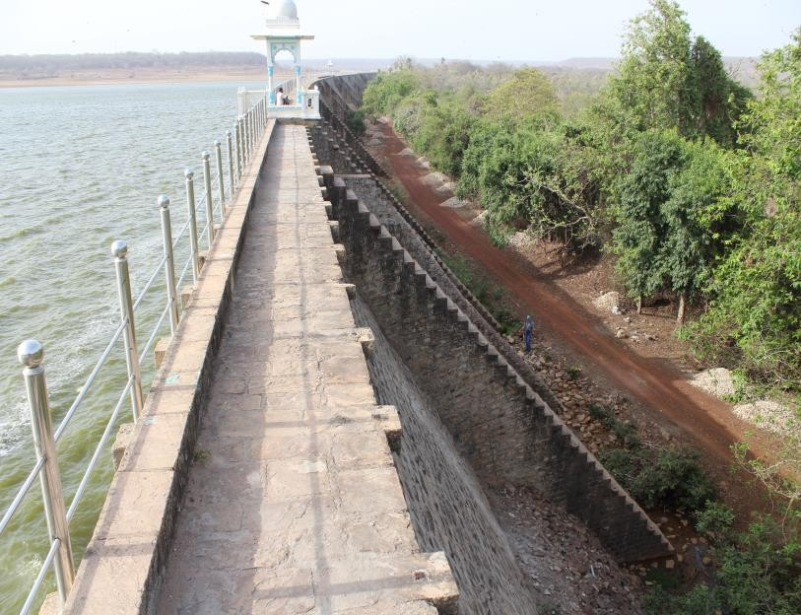
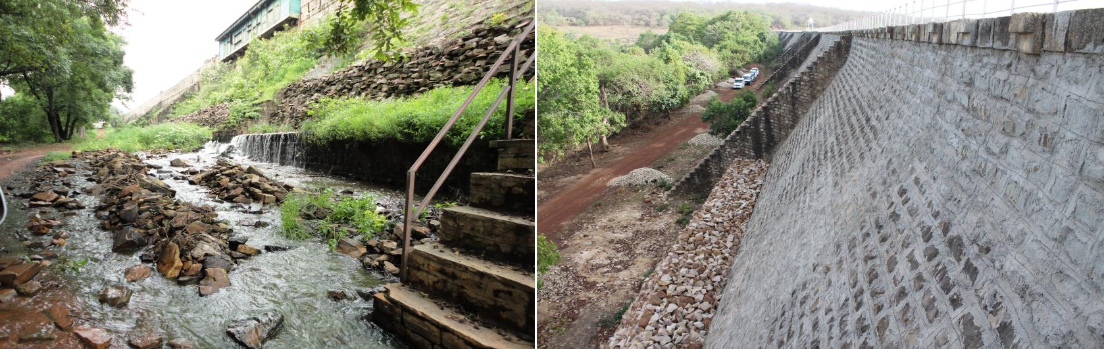
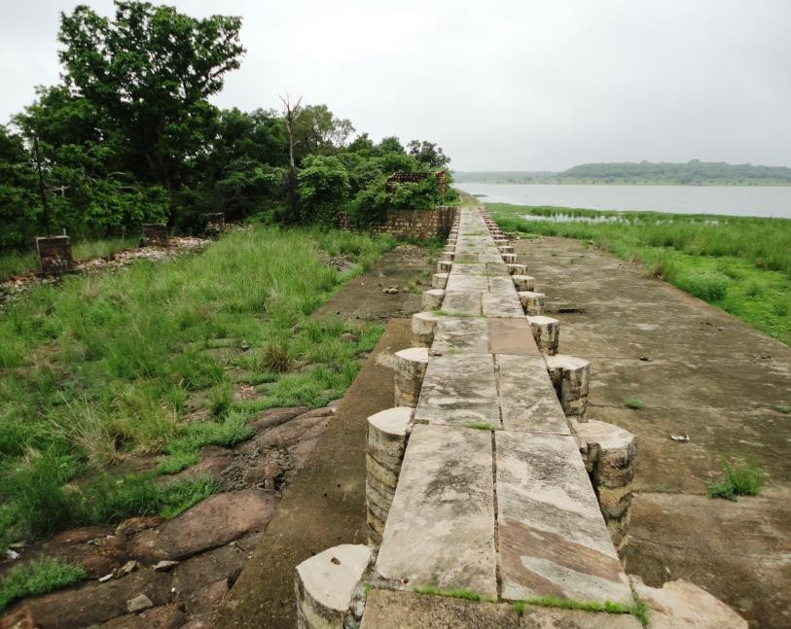
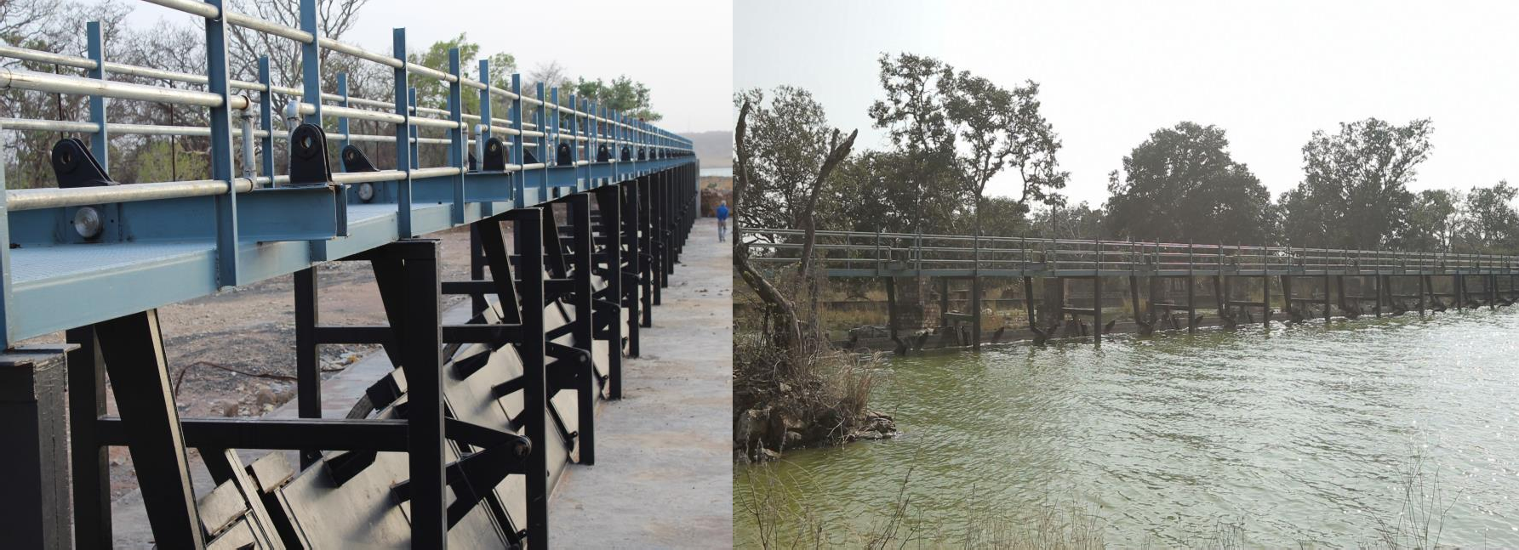
Chandpatha Dam, MPWRD

Slide 25
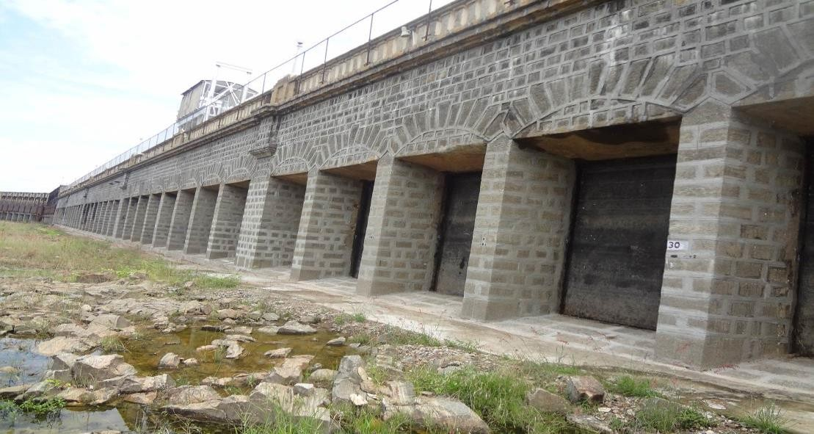
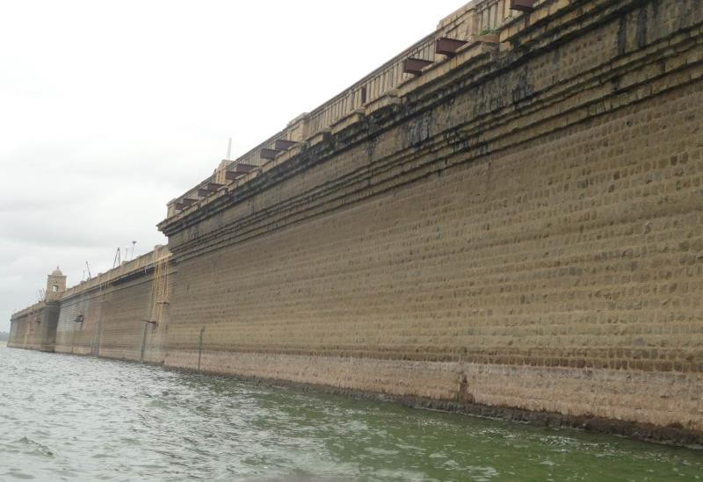
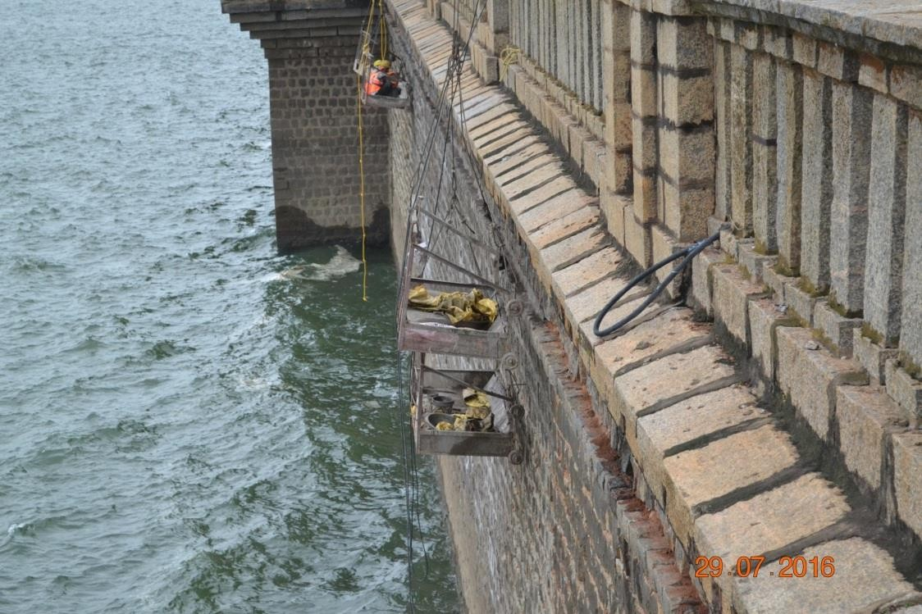
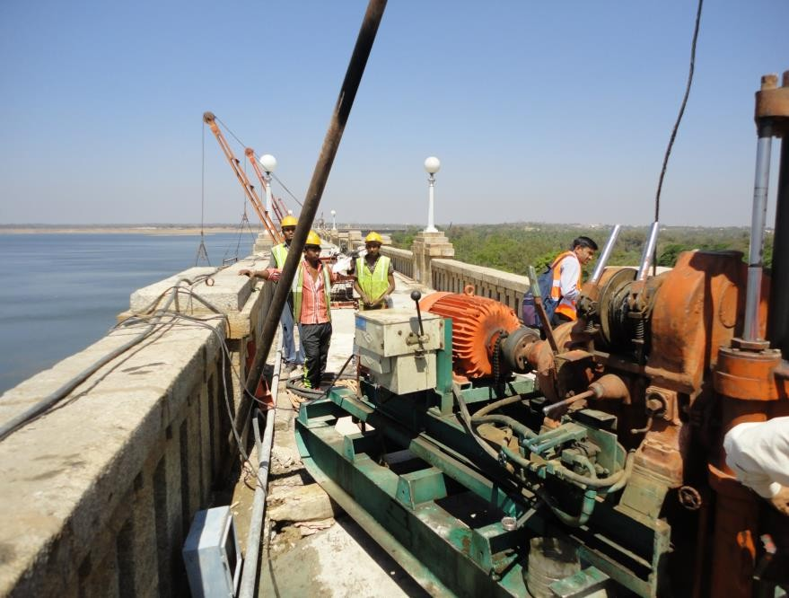
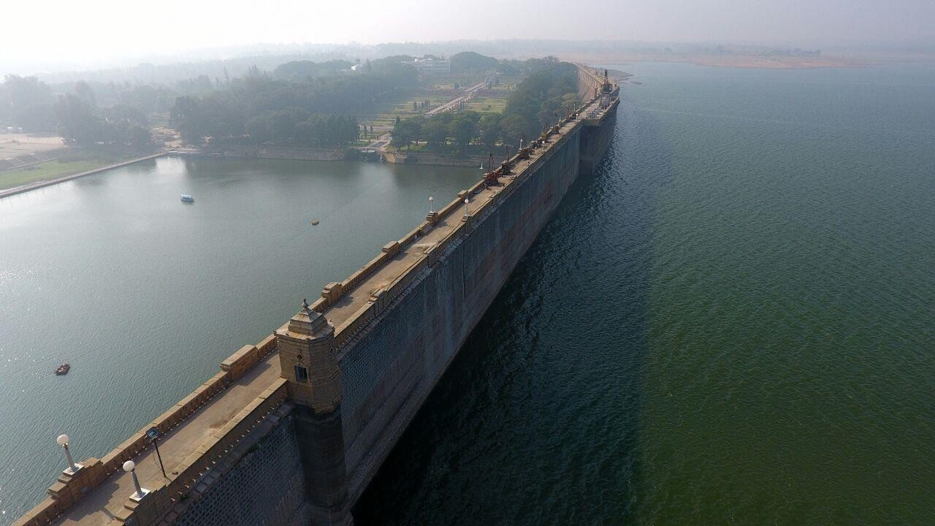
Krishna Raja Sagar Dam, KaWRD

Slide 26
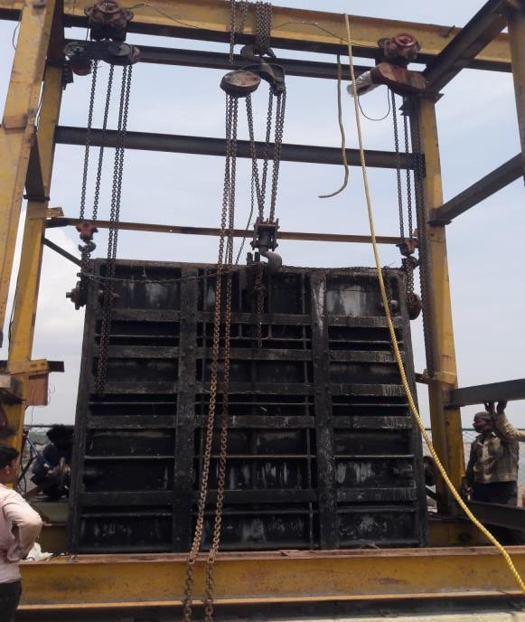
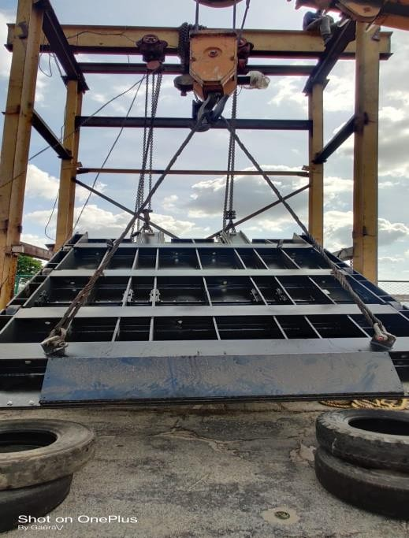
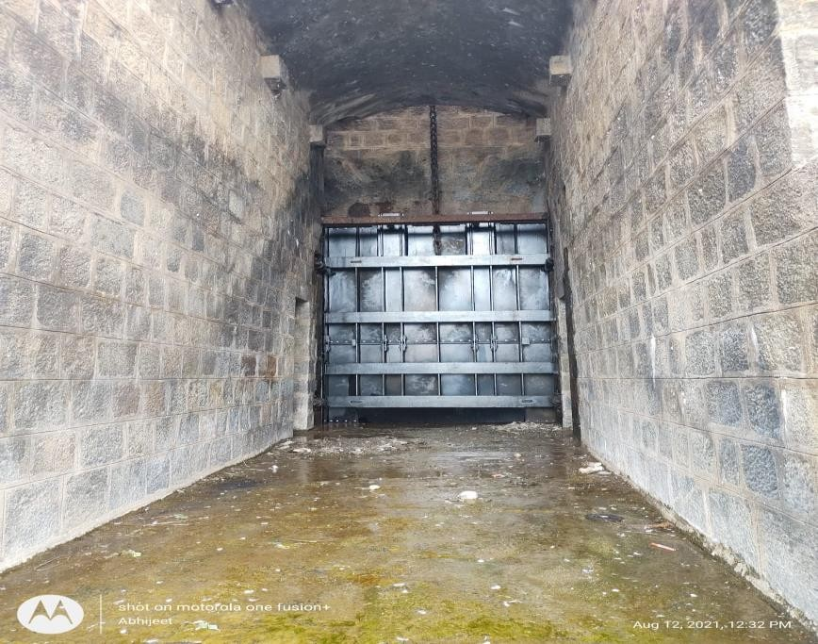
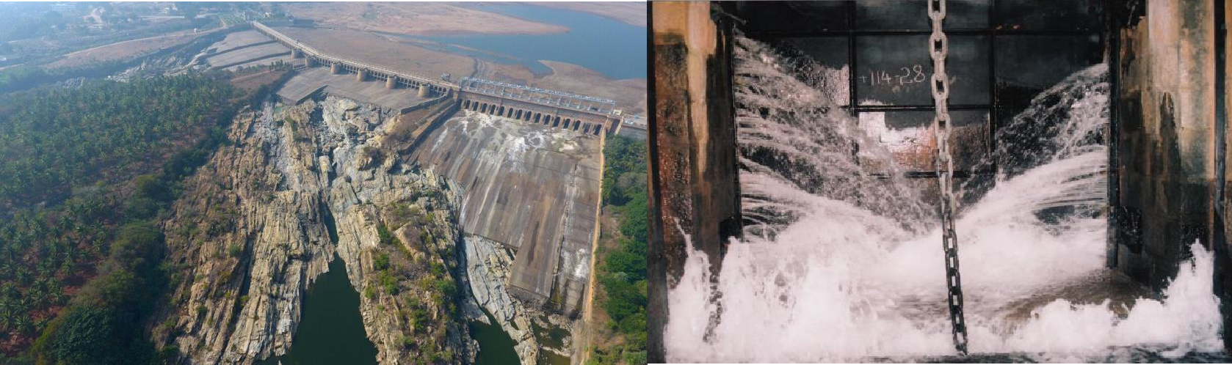
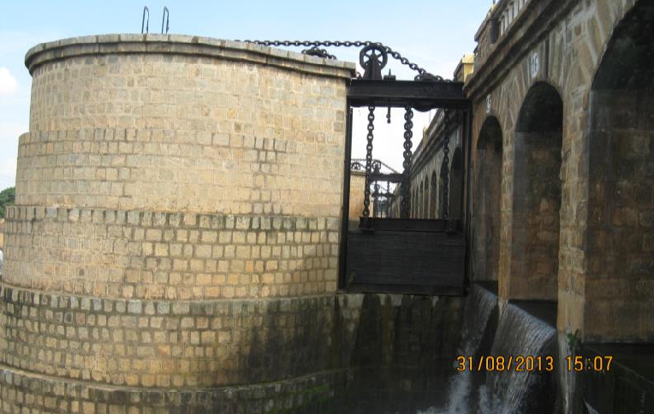
Krishna Raja Sagar Dam, KaWRD

Slide 27
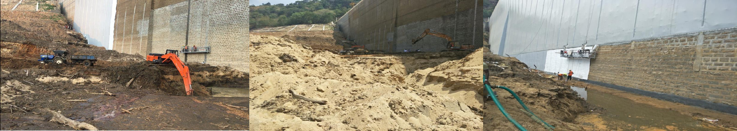
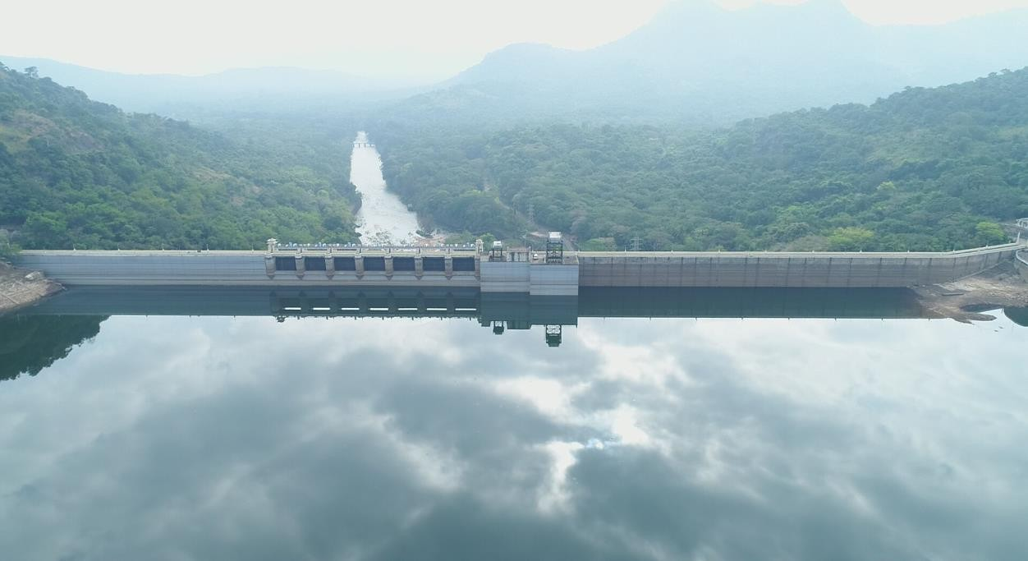
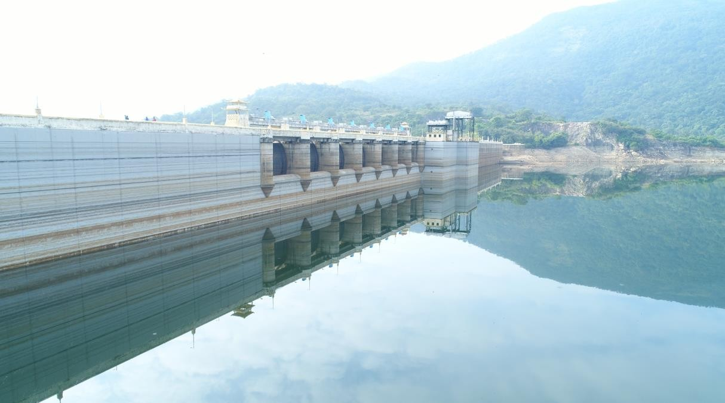
Servelar Dam, TANGEDCO

Slide 28











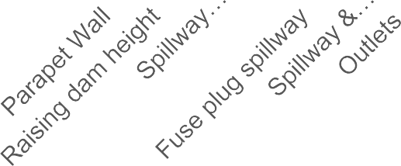
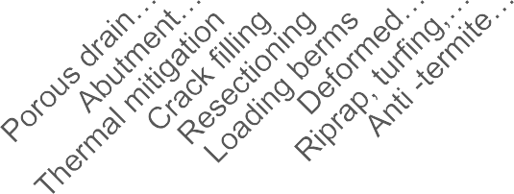














Hydraulic Measures
41
Composite Dams
Composite dams use both earth embankment and concrete sections.
Outlet works, hydropower structures, spillways and stilling basins are either part of or connected to the concrete portion of the dam.
75 composite dams were rehabilitated under DRIP, the highest number in the DRIP portfolio.
Stability Measures
75
Dam Count
28
Dam Count
18
27
1
3
1
2
5
5
1
5
3 4
2
Seepage Measures
Basic Facilities
56
Dam Count
21 21
Dam Count
40
39
31
6
22
1
10
11
5
12

Slide 29
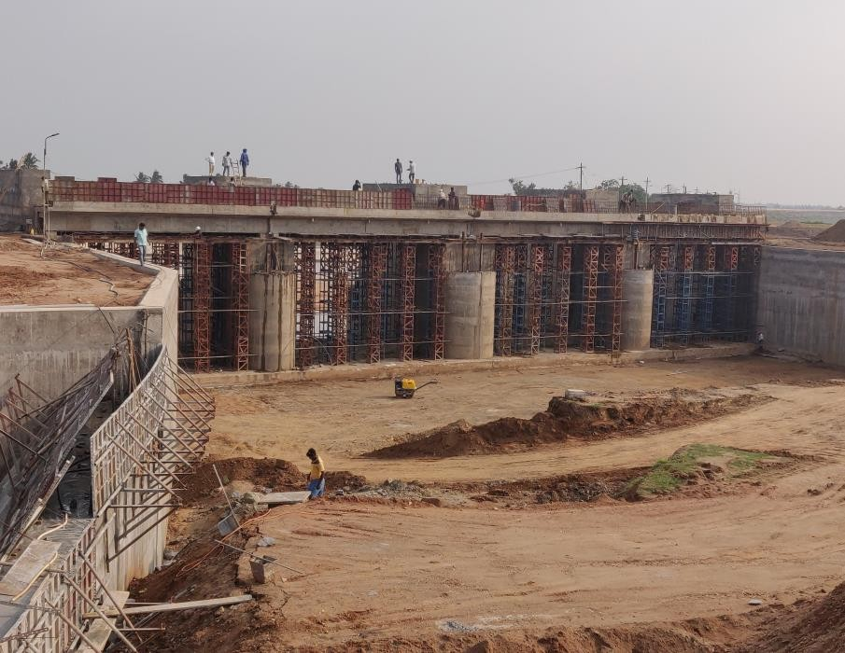
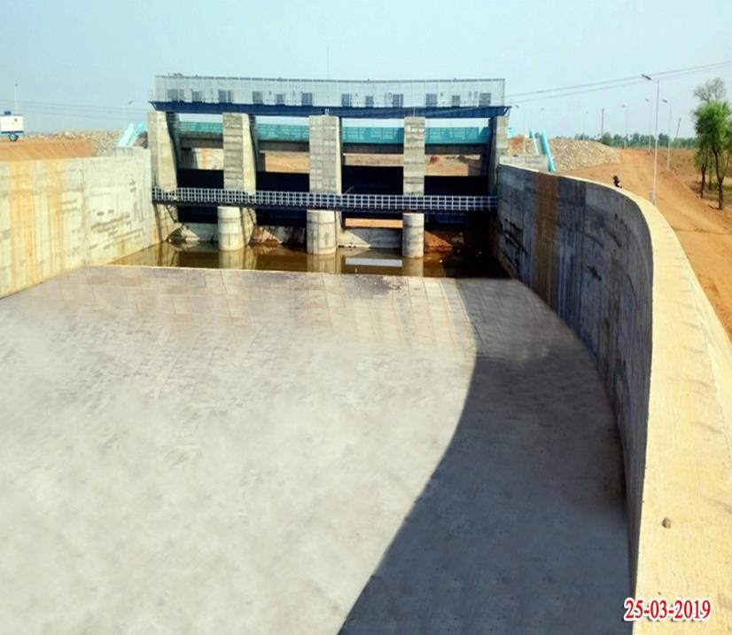
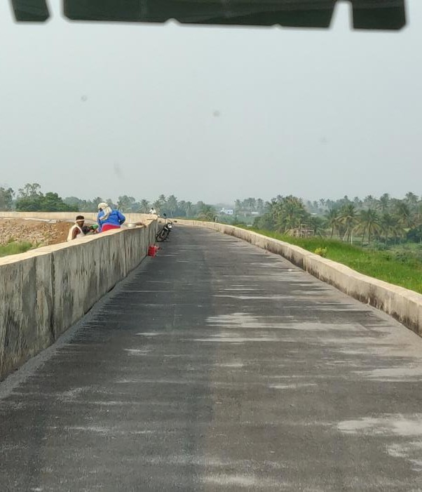
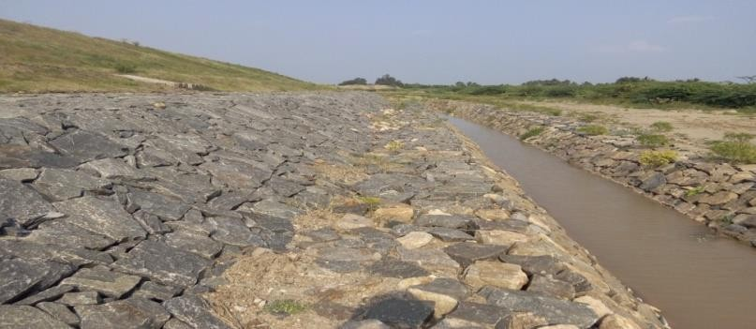
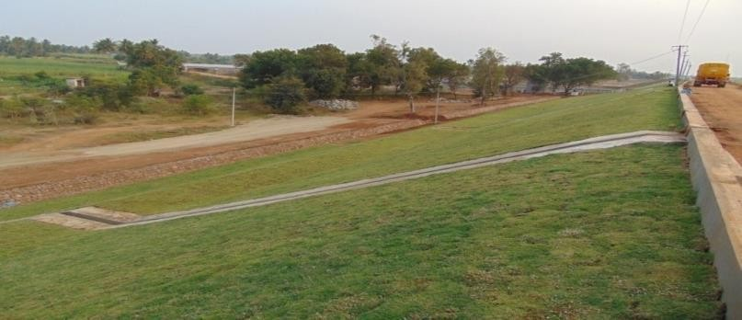
Manimuktha Nadhi Dam, TNWRD

Slide 30
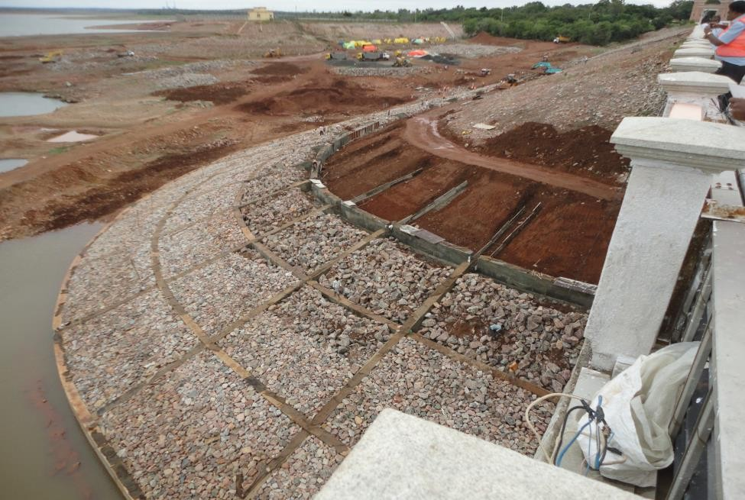
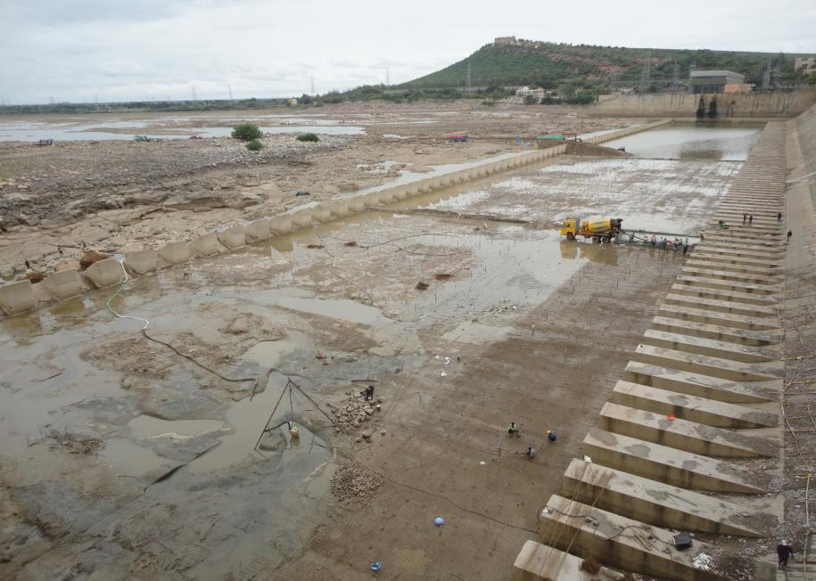
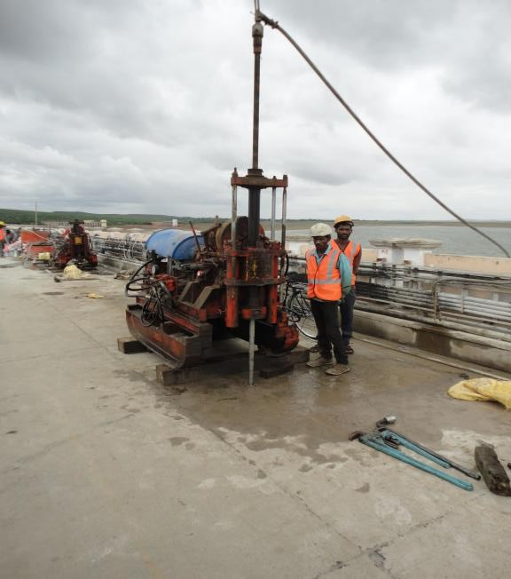
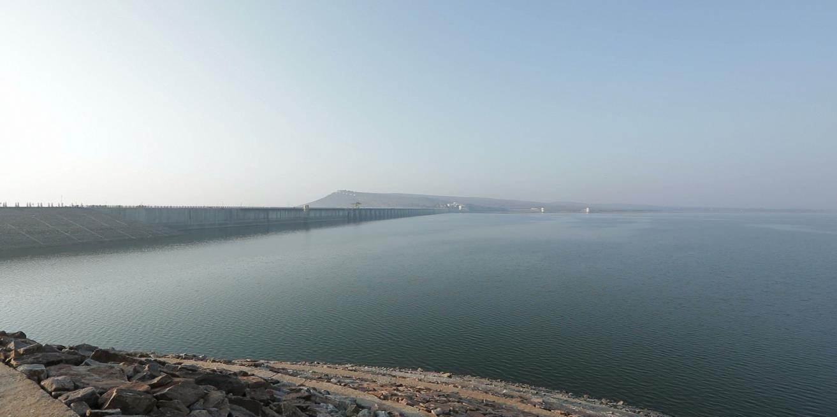
Almatti Dam, Karnataka
Upstream left flank revetment works with new toe wall.
Repair of spillway Glacis
Downstream stilling basin repairs using anchored M60 silica fume reinforced concrete
Grouting of dam body

Slide 31

Write to Us
wrd@bis.gov.in

