Slide 1

SELECTION OF DISTRIBUTION TRANSFORMERS
Electrotechnical Department
Bureau of Indian Standards, New Delhi

Slide 2
Importance of proper selection of distribution transformers
Load Requirements
Voltage Regulation
Parallel Operation
System Configuration
Cooling and Thermal Considerations
Safety and Durability
Efficiency and Cost Effectiveness

Slide 3

Impacts/consequences due to improper selection of distribution transformers
Overloading and Failure
Inefficiency and Increased Losses
Voltage Instability
Operational issues in Parallel Systems
Safety Hazards
Increased Maintenance Costs
System Reliability Issues
Economic Losses

Slide 4
Challenges encountered in selection of DISTRIBUTION transformer

Slide 5

Challenges encountered in selection of transformer
Load Requirements and Ratings
Voltage Levels and Regulation
Tap Changer Configuration
Cooling Systems Selection
Efficiency & Losses
Impedance and Fault Levels
Compatibility and Parallel Operation
Regulatory Compliance

Slide 6
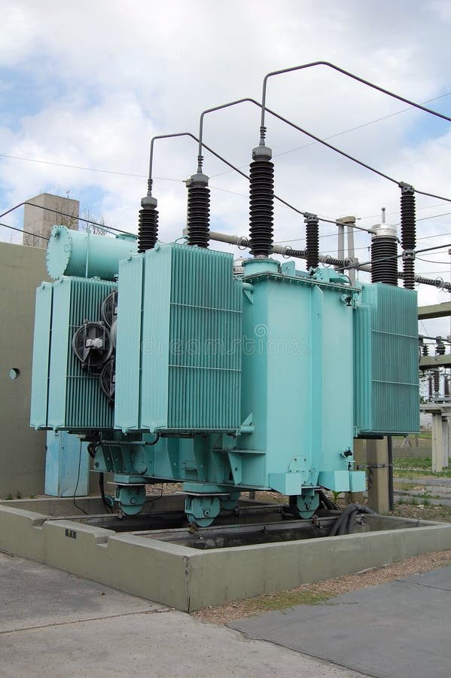
Code of practice for selection of transformers
IS 10028 (Part 1) covers guidelines for selection of distribution and power transformers covered by IS 1180 (Parts) and IS 2026 ( Parts 1 to 4 ) respectively for voltage ratings up to and including 400 kV ( highest system voltage Um = 420 kV).
IS 10028 (Part 1) covers the following types of Transformers
Distribution Transformers (up to and including 1600 kVA)
Power Transformers (Above 1600 kVA)
Generator Transformers
Unit Auxiliary and Station Transformers

Slide 7
OVERVIEW of IS 10028 (Part 1)

Slide 8
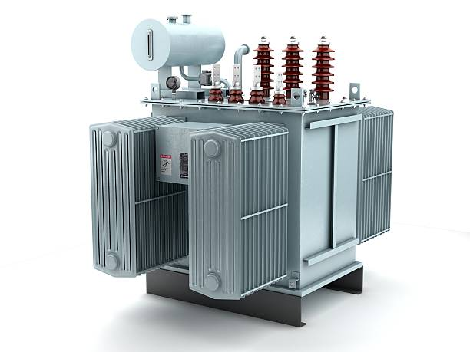
Overview of IS 10028 (Part 1)
IS 10028 (Part 1) specifies the criteria for selection of distribution transformers on the basis of the following.
Ratings
Taps-Off Circuit and On Load Tap Changers
Connection Symbols- Depends upon requirements of parallel operation and guidelines specified in IS 10028 (Part 2)
Impedance- Conforming to IS 2026 (part 1) and selection as per IS 10028 (part 2) for parallel operation.
Termination Arrangement- Bare Outdoor Bushings, Cable Boxes or Bus Trunking depending upon method of installation
Cooling System-ONAN, ANAN etc.
Fittings & Accessories-As specified in IS 10028 (Part 1)

Slide 9

Installation OF DISTRIBUTION TRANSFORMERS
Electrotechnical Department
Bureau of Indian Standards, New Delhi

Slide 10
Importance of proper INSTALLATION of distribution transformers
Safety Assurance
Prevention of Electrical and Fire Hazards
Maintenance Accessibility
Prevention of Environmental Damage

Slide 11

Impacts/consequences due to improper installation of distribution transformers
Safety Hazards
Fire Hazards
Equipment Damage
Reduced Operational Efficiency
Electrical Faults
Environmental Pollution
Increased Maintenance Cost
Premature Failure
Disruptions in Power Supply

Slide 12
Challenges encountered in Installation of transformer

Slide 13

Challenges encountered DURING INSTALLATION of transformer
Site Preparation and Space Constraints
Transportation and Handling
Compliance with Electrical and Safety Standards
Earthing and Grounding Systems
Connection and Cabling
Oil Handling and Insulation Testing
Cooling System Setup
Testing and Commissioning
Environmental Conditions
Fire Safety and Oil Containment
Parallel Operation and Synchronization

Slide 14
Code of practice for installation of distribution transformers-IS 10028 (Part 2)
Covers guidelines for Installation of distribution and power transformers covered by IS 1180 (Parts) and IS 2026 (Parts).
IS 10028 (Part 2) also refers to the following statutory provisions.
Indian Electricity Rules 1956
The Factories Act, 1948
Fire Insurance Act, 1938

Slide 15
OVERVIEW of IS 10028 (Part 2)

Slide 16
installation requirements
IS 10028 (Part 2) specifies the following key installation Requirements.
Site Preparation
Indoor Installations
Ensure proper ventilation for cooling (inlets near floor, outlets near ceiling).
Maintain clearances from walls for inspection and maintenance.
Outdoor Installations
Use of transformers designed for outdoor use;
consider shelters in polluted areas.
Foundations
Level, stable plinths above flood levels.
Lock rollers to prevent accidental movement.

Slide 17
Safety and risk mitigation
Safety Measures
Fire Safety
Installation of fireproof walls and oil soak pits for transformers >2000L oil capacity.
Use of fire extinguishers and fire-resistant barriers.
Electrical Safety:
Earthing as per IS 3043.
Isolate transformers using circuit breakers or linked switches.
Surge Protection
Use of lightning arresters as per relevant Indian Standards to protect against voltage surges.

Slide 18
Transportation, installation and handling
Transportation
Packing and Dispatch Condition of Distribution Transformers (Dried and completely filled with oil, With oil covering core and coil, balance space filled with dry air or inert gas, Completely filled with dry air or inert gas at a small positive pressure, Removal and packing of External fittings which are liable to be damaged during transport.
Means of Transportation
Rail Transport
Road Transport
Water Transport
Installation Guidelines
Handling
Use of lifting lugs and jacks provided by the manufacturer, Avoid contamination or damage during assembly.
Cabling
Laying of cables in non-inflammable trenches or use clamps and trays, Segregation of control, power, and instrument transformer cables.
Oil Management
Use of IS 335 compliant oil, air pockets to be prevented during filling and ensure proper filtration.
IS 1866 to be referred for supervision and maintenance guidance of Mineral Insulating Oil

Slide 19
Accessibility and Management
Inspection and Maintenance
Providing clear access to components like breathers, thermometers, and valves.
Installation of lifting beams or rails for heavy component removal.
Storage Considerations:
Storage of unused transformers indoors, filled with oil or nitrogen to prevent moisture ingress.
Protection of outdoor-stored transformers with covers or inert gas.

Slide 20
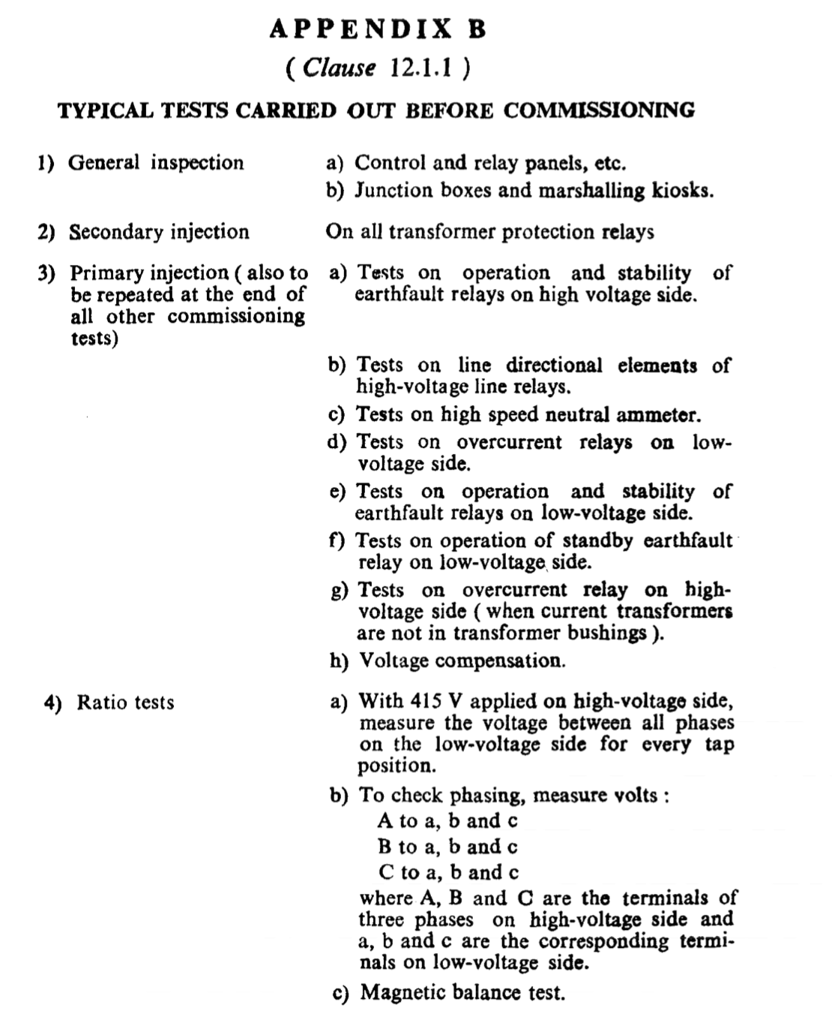
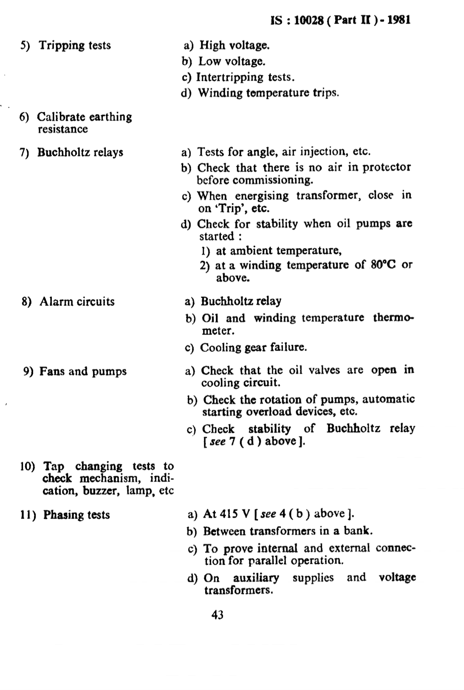
Testing and commissioning
Pre-commissioning Inspection
Dielectric tests
Oil Testing
Ratio, Polarity, and Vector Group Testing
Magnetic Balance and Excitation Current Tests
Functional Testing of Accessories
Earthing System Verification
Load Test
Safety Checks

Slide 21
Maintenance of distribution transformers
Electrotechnical Department
Bureau of Indian standards, new delhi

Slide 22
Importance of maintenance of distribution transformers
Prevention of Breakdowns
Ensuring Long Service Life
Optimization of Performance
Cost Effectiveness
Avoidance of Downtime
Environmental Protection

Slide 23

Impacts/consequences due to improper maintenance of distribution transformers
Transformer Failures
Reduced Efficiency
Safety hazards
Environmental Damage
Increased Operational Costs
Decreased Reliability
Shortened Transformer Life span
Compromised Performance of Power Systems

Slide 24
Challenges encountered in Maintenance of Distribution transformer

Slide 25

Challenges encountered DURING Maintenance of Distribution transformer
Oil Contamination and Degradation
Moisture Ingress
Monitoring and Testing Equipment Accuracy
Ageing Components
Safety Risks
Accessibility Issues
Handling and Inspection Complexity
High Maintenance Cost
Non-Availability of Spare Parts
Insufficient Maintenance Planning

Slide 26
Code of practice for Maintenance of distribution transformers (IS 10028 (Part 3))
Covers guidelines for Maintenance of distribution and power transformers covered by IS 1180 (Parts) and IS 2026 (Parts)
IS 10028 (Part 3) refers to the following statutory provisions.
Indian Electricity Rules 1956
IS 10028 (Part 3) provides General Causes of Breakdown of Transformers, Factors Affecting the Life of the Transformers, Maintenance Guidelines, Maintenance Schedules & Trouble Shooting of Distribution Transformers.

Slide 27
OVERVIEW of IS 10028 (Part 3)

Slide 28
General Maintenance Guidelines as specified in IS 10028 (Part 3)
Essential Maintenance Practices
Inspection & Testing
Regular checks for insulation resistance, oil quality, bushings, and core condition.
Preventive maintenance as per specified schedules
Oil Management
Periodic testing for dielectric strength, acidity, and sludge formation.
Recommends Use of oil compliant with IS 335 and avoid mixing oils from different source.
Safety Precautions
Isolation of transformers and ensure proper earthing before maintenance.
Use of non-flammable tools and avoid open flames near oil-filled transformers.

Slide 29
Maintenance of Components
Key Components for Maintenance
Bushings
Inspection for cracks, chips, and dirt; replace damaged bushings.
Cooling Systems
Cleaning of radiators, checking of fans for ensure adequate airflow.
Tap Changers
Inspection and servicing of on-load and off-load tap changers.
Breathers & Conservators:
Replacement or reactivate silica gel when colour changes to pink.
Cleaning of conservators and ensure maintenance of oil level.
Relays & Protective Devices:
Testing of Buchholz relay and alarm circuits and analysis of collected gases for faults.

Slide 30
Maintenance Schedules & Troubleshooting
Schedules & Troubleshooting
Maintenance Schedules:
Hourly: Check load and temperature.
Daily: Inspect oil levels and breather condition.
Quarterly/Yearly: Test oil, inspect windings, and check connections.
Troubleshooting:
Address high temperatures, oil leaks, and electrical faults promptly.
Regularly clean, tighten, and replace faulty parts.
Documentation:
Maintain detailed records of inspections, repairs, and testing.

Slide 31
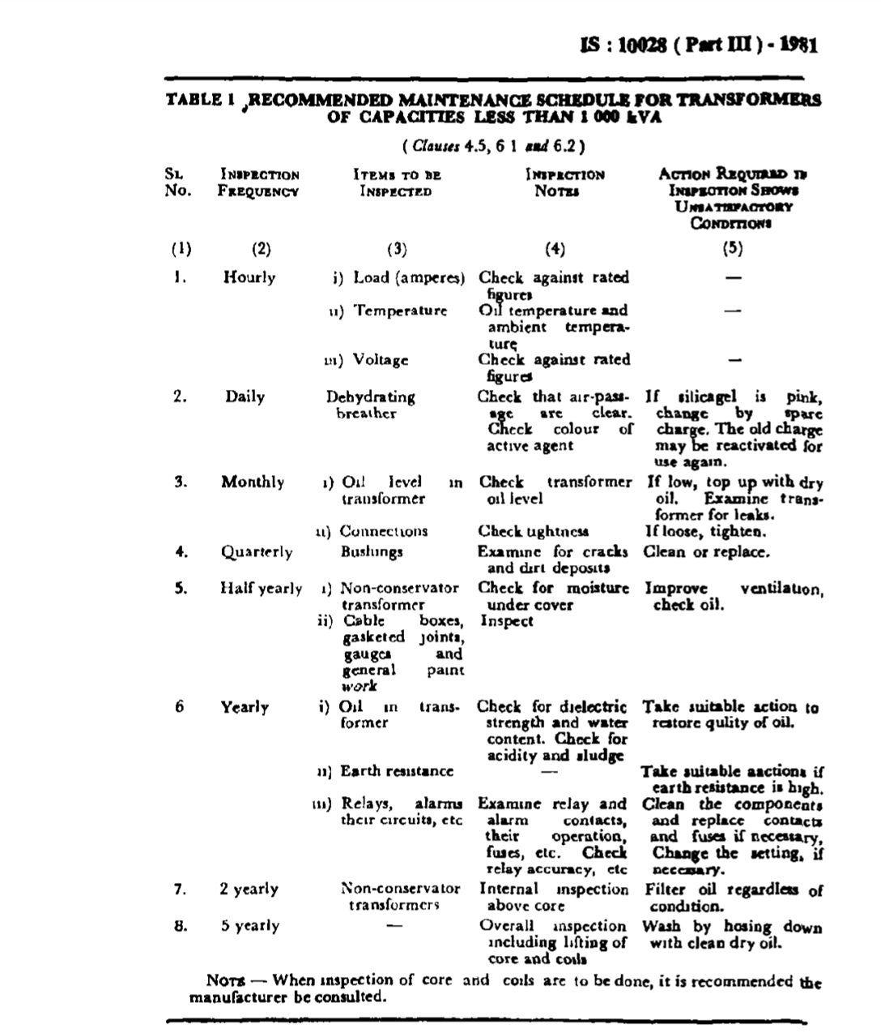
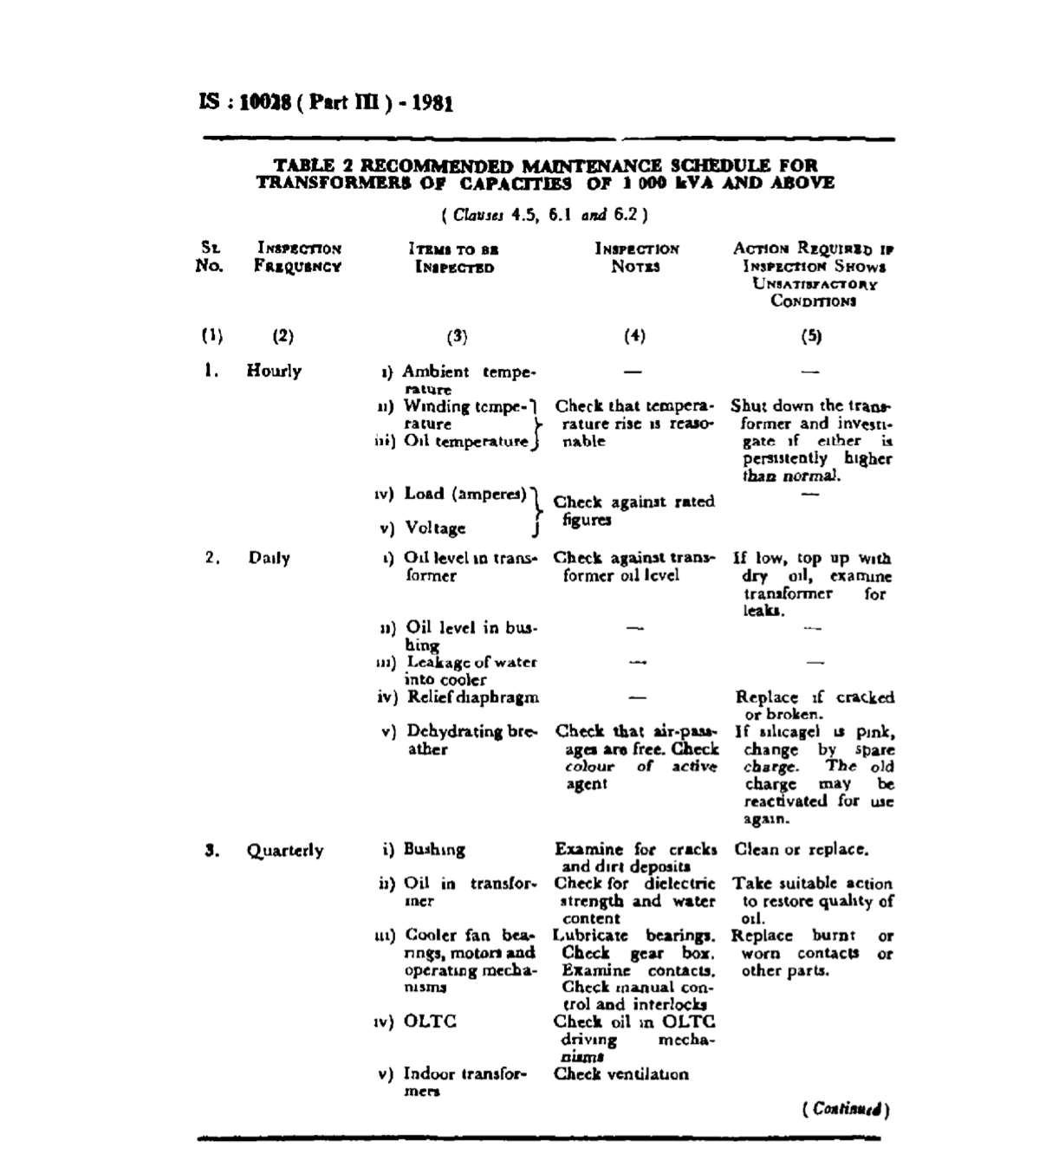
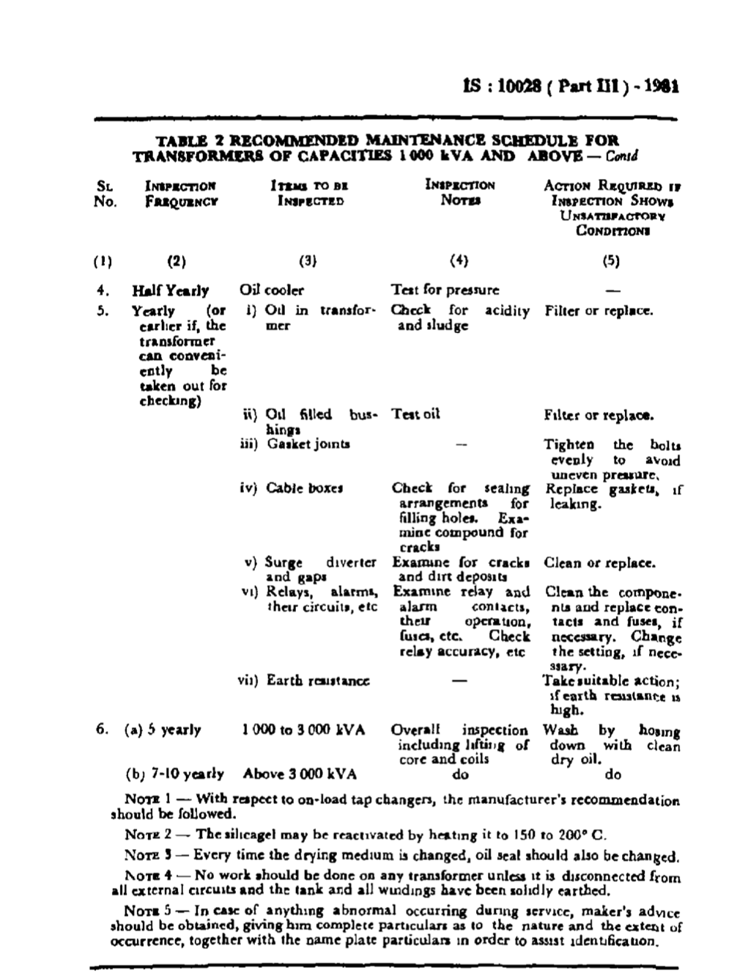
Recommended Maintenance Schedule

Slide 32
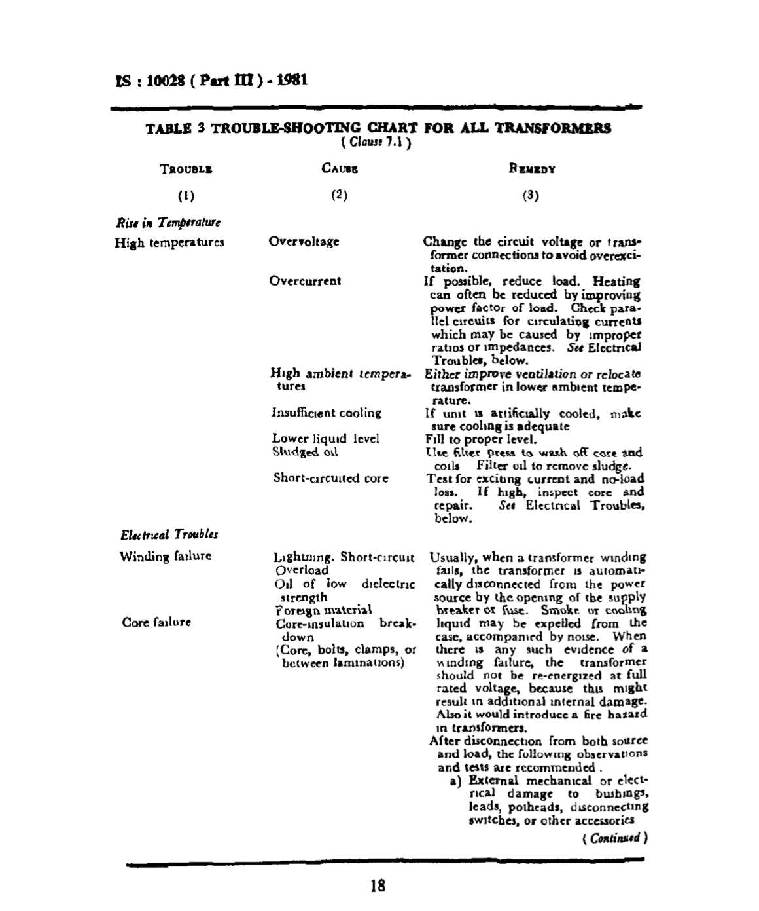
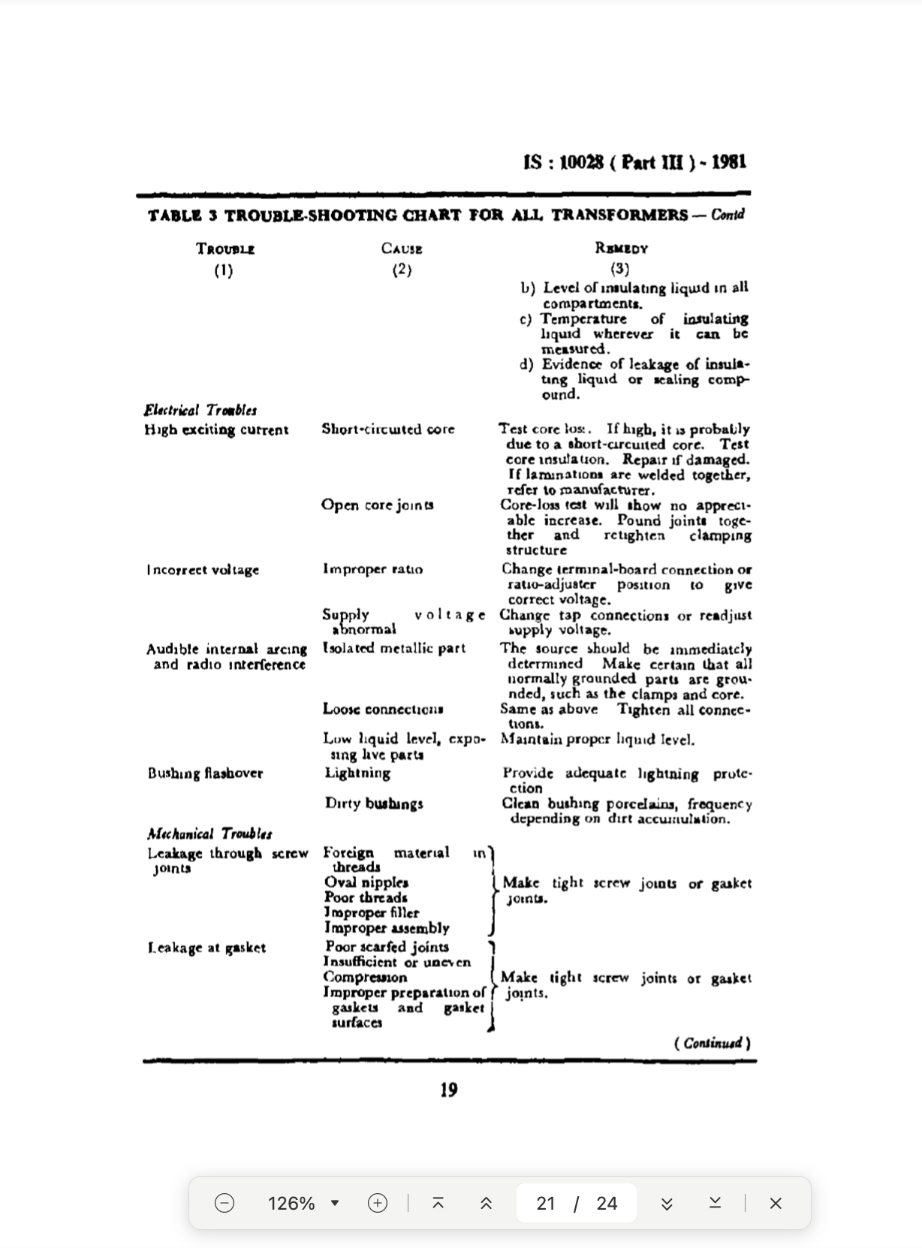
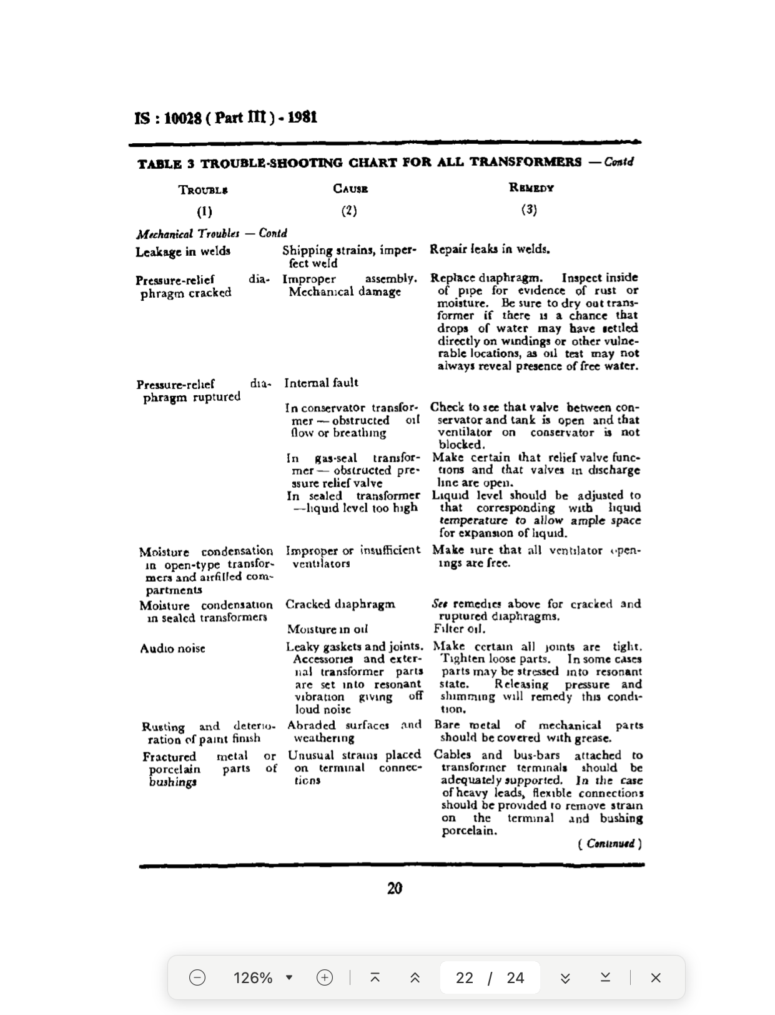
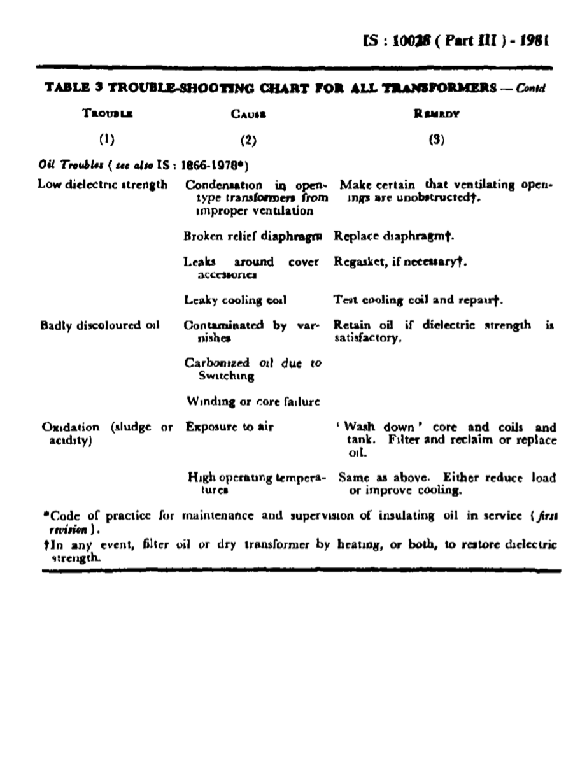
Trouble-shooting in transformers

Slide 33
PROJECTS UNDER PROGRESS
REVISION OF IS 10028 (PART 1): 1985
REVISION OF IS 10028 (PART 2):1981
REVISION OF IS 10028 (PART 3):1981

Slide 34


