Slide 1

Distribution Transformers-Types and Tests
Electrotechnical Department
Bureau of Indian Standards, New Delhi

Slide 2
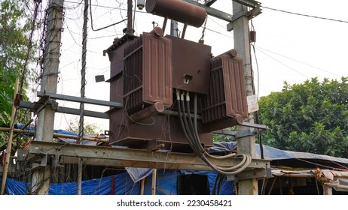
Present Scenario of Distribution Transformers in India
High Demand due to expanding Power Infrastructure
Frequent Failures
Economic Impact
Energy Efficiency Concerns
Push for Sustainability
Renewable Energy Integration
Policy and Regulation

Slide 3
Importance of Distribution Transformers in current Scenario
Backbone of Power Distribution
Economic Development
Energy Loss Reduction
Integration with Renewable Energy
Supporting Government Initiatives/schemes like Deendayal Upadhyaya Gram Jyoti Yojana (DDUGJY), Integrated Power Development Scheme (IPDS) and High Voltage Distribution Scheme (HVDS)

Slide 4
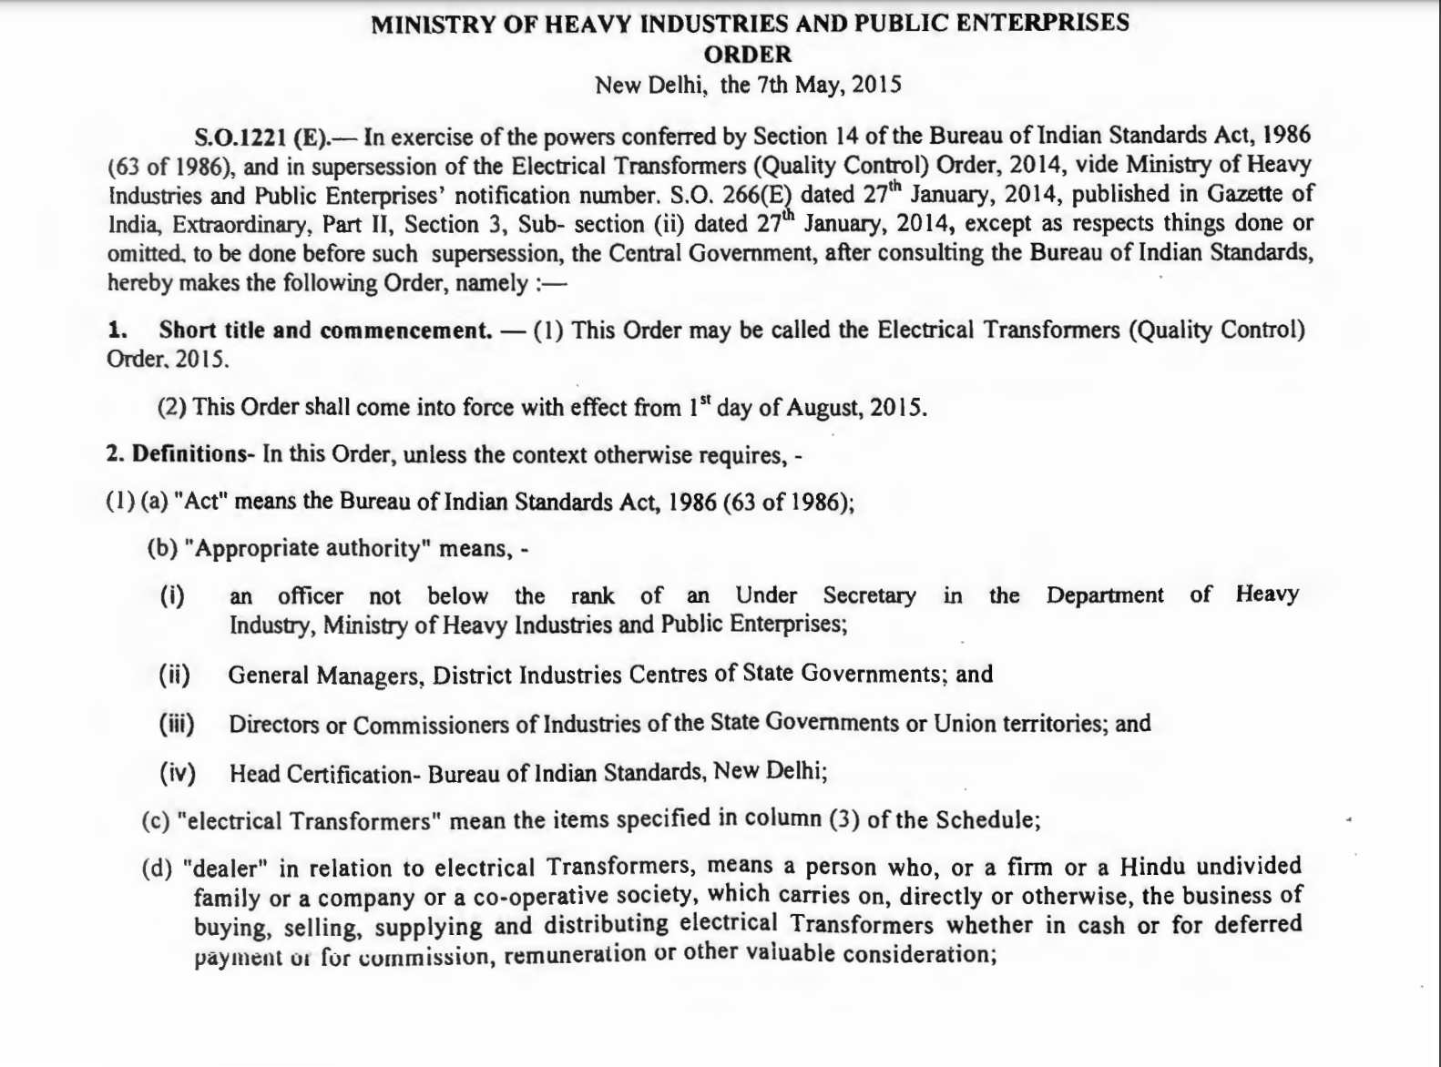
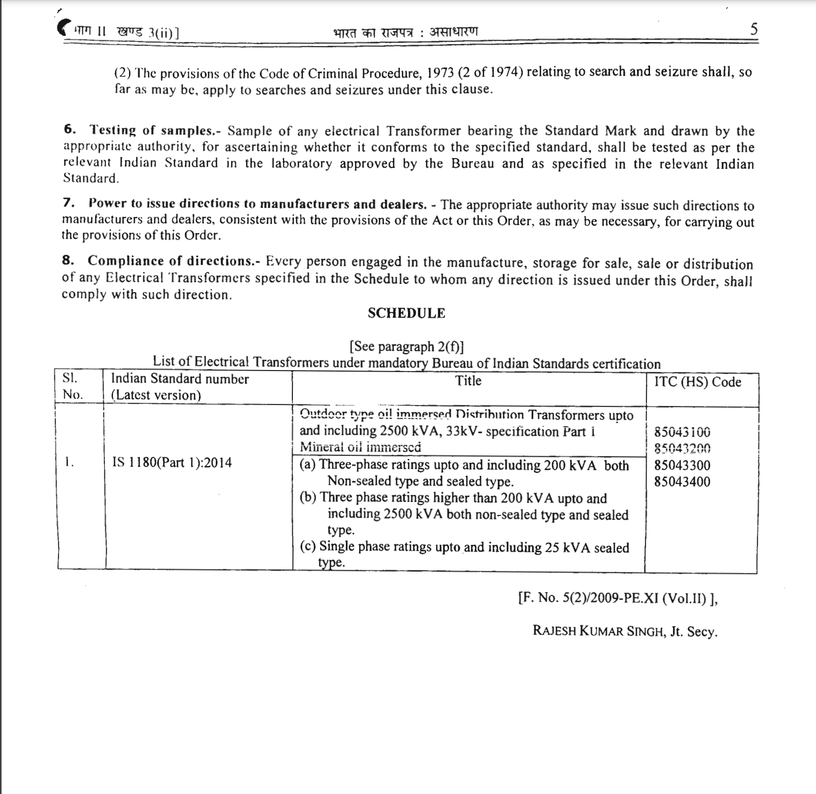
Statutory/Legal Provisions
Electrical Transformers (Quality Control) Order, 2015.
Mandatory BIS Certification ensuring compliance with IS 1180 (Part 1) specifications.
Central Electricity Authority (CEA) Regulations
Applicable for Indoor Transformers and Installations

Slide 5
Challenges encountered in the current Scenario & Key Features of IS 1180 (Part 1 & 3) for addressing the challenges

Slide 6

Challenges
High Failure Rates
High Technical and Commercial Losses (AT&C)
Environmental Challenges
Regulatory and Compliance Issues
Weather and Environmental Factors

Slide 7
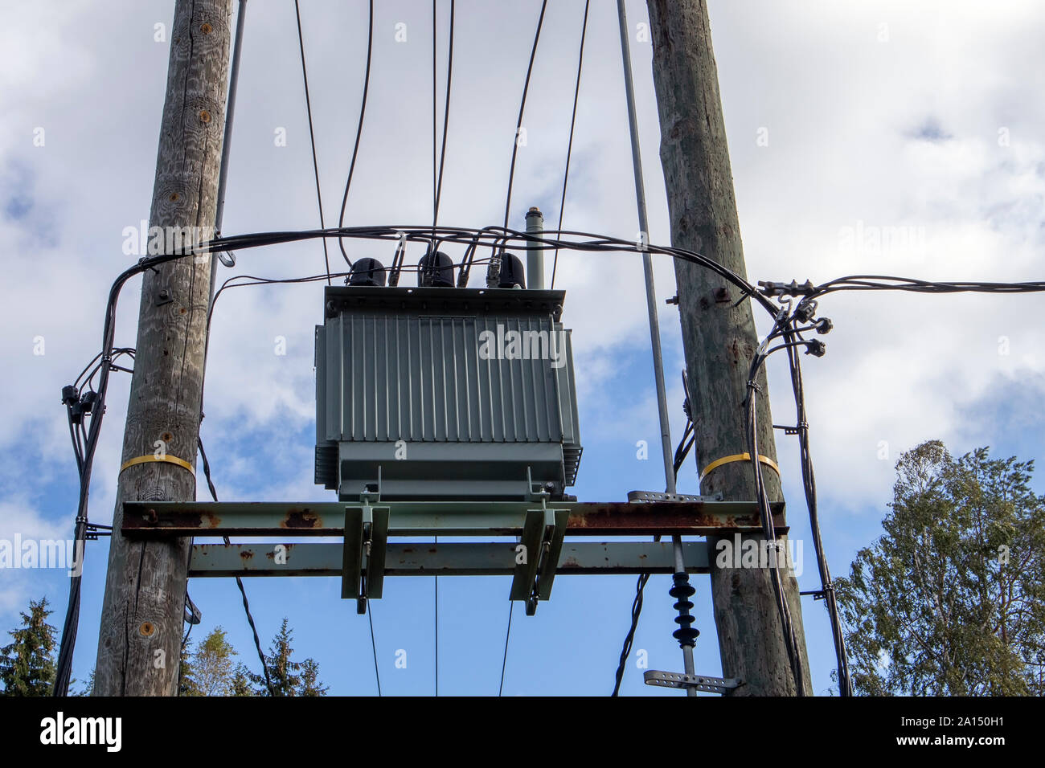
Indian Standards for Distribution Transformer (IS 1180 Part 1 & Part 3)
IS 1180 (Part 1 & 3) specifies the requirements and tests including standard loss levels of Mineral Oil /Natural/Synthetic organic ester liquid immersed, natural air-cooled, outdoor/indoor type, double-wound distribution transformers for use in power distribution systems with nominal system voltages up to and including 33 kV and of following types and ratings:
Three phase ratings up to and including 200 kVA both non-sealed and sealed type;
Three phase ratings higher than 200 kVA, up to and including 2500 kVA both non-sealed type and sealed type; and
Single phase ratings up to and including 100 kVA sealed type.

Slide 8


Key Features of IS 1180 (Part 1 & 3)
Energy Efficiency
Introduces Higher Efficiency Transformers for reduced Energy Losses. Specifies five Energy Efficiency Levels from Level 1 to Level 5.
Synchronization of Loss Levels with the specification of Bureau of Energy Efficiency.
Fire Safety
IS 1180 (Part 3) specifies Ester Liquids with fire points more than 300 deg C.
Environmental Benefits
Biodegradable Esters minimize Environmental Impact and contributes to Sustainability.
Specifies Permissible Temperature rise limits and insulation levels.
Specifies Standard Raw Materials for use in Distribution Transformers
Specifies Technical Parameters for a robust design and tests for the Quality Assessment.

Slide 9
Overview of IS 1180 (Part 1 & 3)

Slide 10
Overview of IS 1180 (Part 1 & 3)
Terminology & Definitions
Distribution Transformer
Non-Sealed and Sealed Type
Types of Esters (Natural and Synthetic) and Insulation Class (‘K’ )
Pad Mounted Transformer
Types of Dielectric System (Type A & Type B)
Ratings and Basic Insulation Levels
Sl. No | Nominal System Voltage | No. of Phases | Type | Standard Ratings (kVA)
1 | Up to 11 kV, Above 11 kV up to and including 22 kV, Above 22 kV up to and including 33 kV | Three Phase | Non-Sealed/Sealed | *6.3, *10, 16, *20, 25, *40, 63,100, 160, 200, 250, 315, 400, 500, 630,800, 1000, 1250,1600, 2000 and 2500. * Non-Preferred ratings
2 | Up to 11 kV, Above 11 kV up to and including 22 kV, Above 22 kV up to and including 33 kV | Single Phase | Sealed | 5, 10, 16, 25, *50, *75 and *100 * Non-Preferred ratings
Sl. No | Nominal System Voltage in KV | No. of Phases | Minimum BIL (KV_{p})
1 | 3.3 | Three Phase/ Single Phase | 40
2 | 6.6 |  | 60
3 | 11 |  | 75
4 | 22 |  | 125
5 | 33 |  | 170

Slide 11
Overview of IS 1180 (Part 1 & 3)
Technical Parameters
Nominal System Voltage, Frequency, No Load Voltage Ratios and Winding Connections.
Sl. No | Nominal System Voltage | Frequency | No. of Phases/ Polarity | No Load Voltage Ratios |  | Winding Connections Phase Displacement/ Polarity
1 | HV-3.3, 6.6, 11, 22 and 33 kV LV-415 V | 50 Hz | Three Phase | 3 300/433-250, 6600/433-250, 11000/433-250, 22 000/433-250 and 33 000/433-250 V Note — Secondary voltage may be selected as 415-240 V, subject to agreement between the user and the supplier. |  | DYN 11/DYN 1
2 | HV-3.3, 6.6, 11, 22 and 33 kV LV- 415 V/240 V | 50 Hz | Single Phase (Additive/ Subtractive) | 3 300/√3/250 V, 6600/√3/250 V, 11000/√3/250 V, 22 000/√3/250 V, 33 000/√3/250 V, | 3 300/250 V, 6600/250 V, 11000/250 V, 22000/250 V, 33 000/250 V | Additive/Subtractive
 |  |  |  | NOTE — Secondary voltage may be selected as 415-240 V, subject to agreement between the user and the supplier. | NOTE — Secondary voltage may be selected as 415-240 V, subject to agreement between the user and the supplier.

Slide 12
Overview of IS 1180 (Part 1 & 3)
Technical Parameters
Tapping Range, Permissible Flux Density and No-Load Current
Sl. No | No. of Phases | Tapping Range | Permissible Flux Density | No Load Current
1 | Three Phase | 100 kVA- No Taps normally required. Above 200 kVA up to and including 2500 kVA-Taps may be provided as per the tapping range specified in IS 1180 (Part 1 & 3) Tapping Range may be subjected to agreement between the user and supplier. | 1.9 Tesla (Max) with +12.5 percent combined voltage and frequency variation from rated voltage and frequency. | Up to 200 kVA- Max. 3 percent of full load current and Max. 6 percent of full load current with an Increase of 12.5 percent of rated voltage. Above 200 kVA- Max. 2 percent of full load current and Max. 5 percent of full load current with an Increase of 12.5 percent of rated voltage
2 | Single Phase | No Taps required |  | Max. 3 percent of full load current and Max. 6 percent of full load current with an Increase of 12.5 percent of rated voltage.

Slide 13
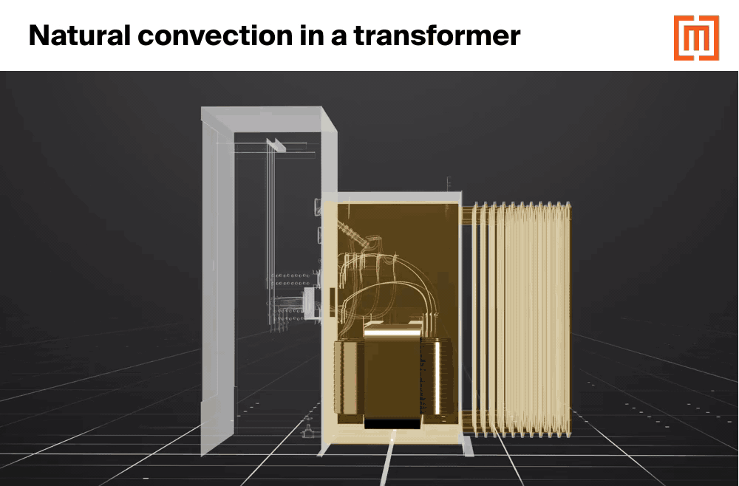
Overview of IS 1180 (Part 1 & 3)
Technical Parameters
Limits of Temperature Rise
Sl. No | No. of Phases | Type of Cooling | Rating | Permissible Temperature Rise
1 | Three Phase and Single Phase | ONAN-Mineral Oil Immersed KNAN-Ester Liquid Immersed | Up to 200 kVA for Three Phase and up to 100 kVA for Single Phase | Dielectric System | Top Liquid temperature rise | Average Winding temperature rise
 |  |  |  | Type A | 40 deg C | 45 deg C
 |  |  |  | Type B | 50 deg C | 55 deg C
2 | Three Phase |  | Above 200 kVA up to and including 2500 kVA | Dielectric System | Top Liquid temperature rise | Average Winding temperature rise
 |  |  |  | Type A | 45 deg C | 50 deg C
 |  |  |  | Type B | 55 deg C | 60 deg C

Slide 14
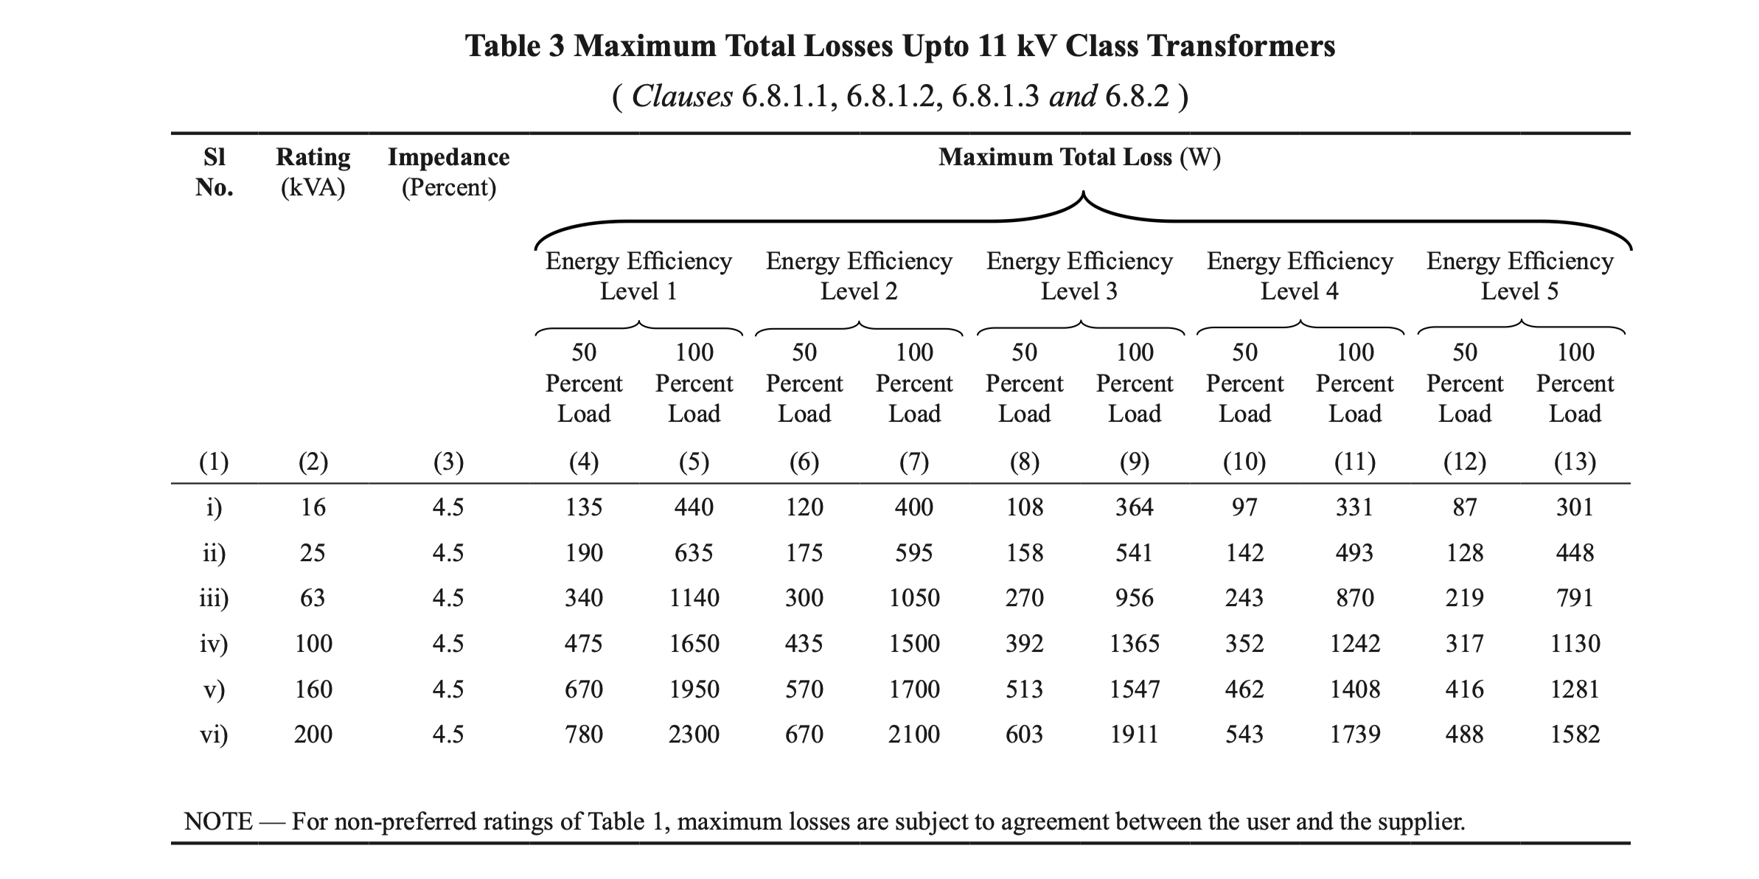
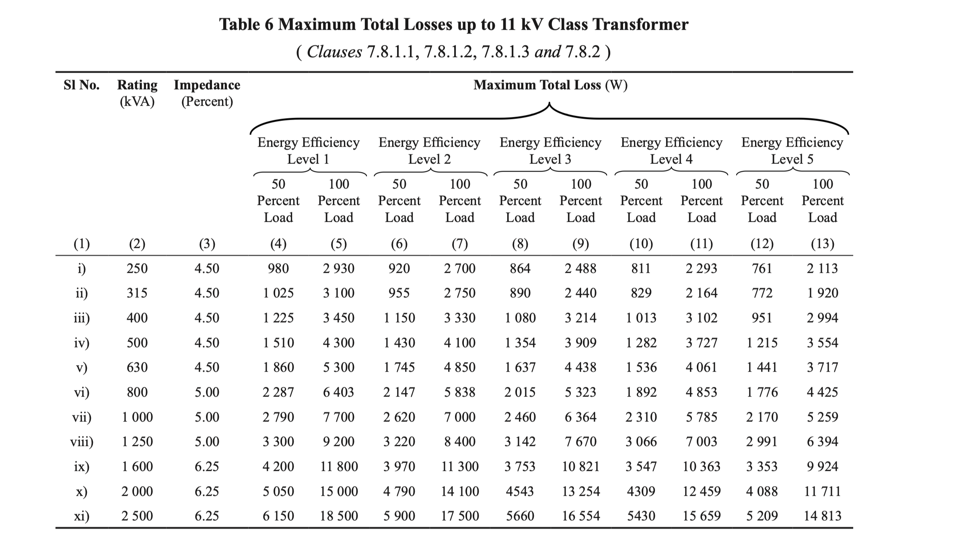
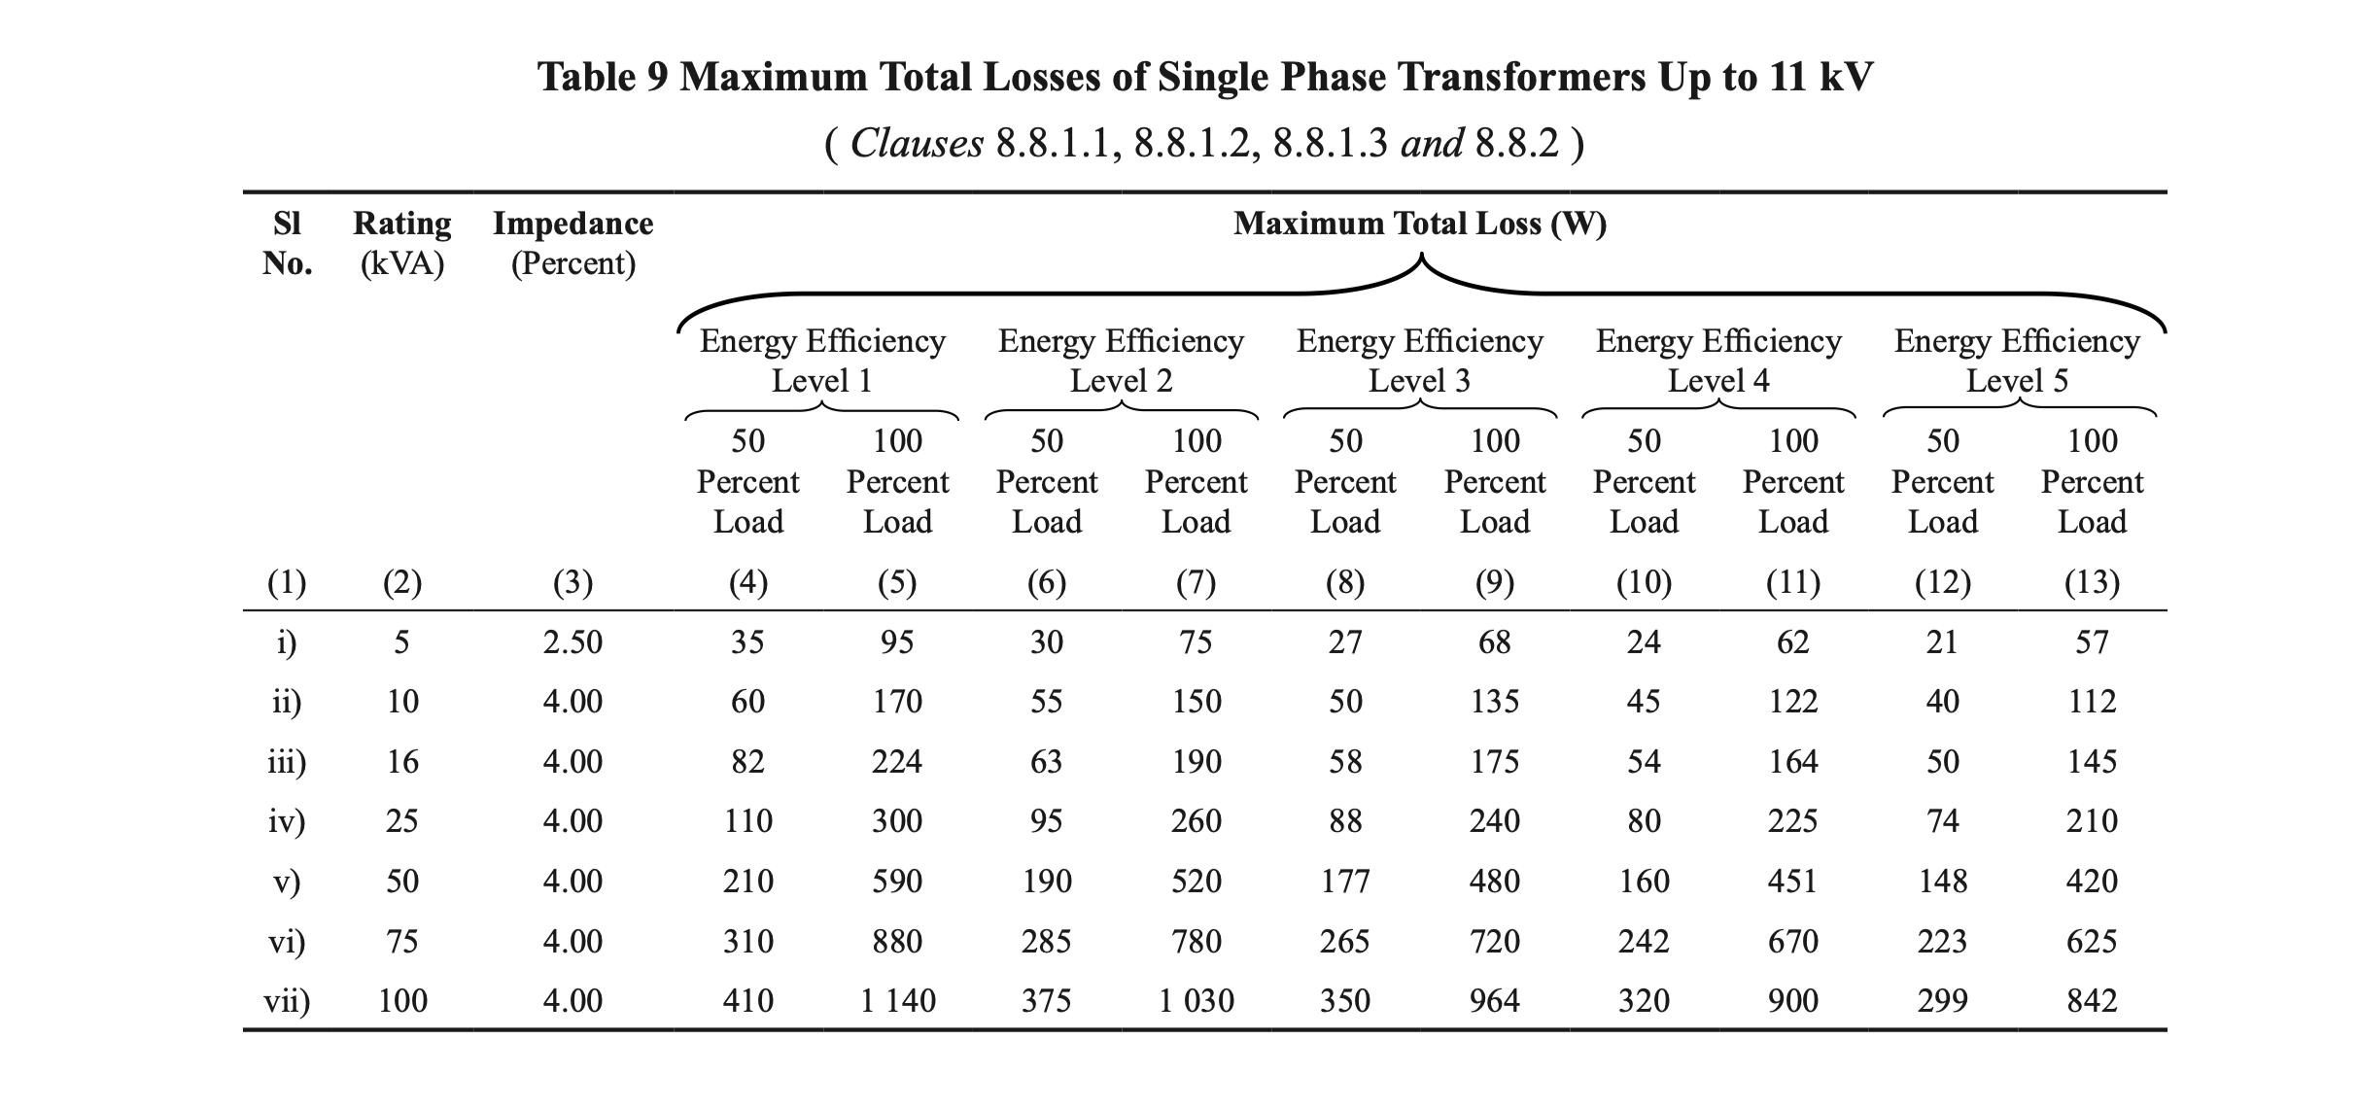
Losses and Impedance Values for Three/Single Phase 11kV Distribution Transformers

Slide 15
Losses and Impedance Values for Distribution Transformers with voltage class above 11 kV
Clearance in Air
External (Air) Clearances Between bushings
Sl. No. | Voltage Class | No. of Phase | Ratings | Max. Loss Value
1 | Above 11 kV and up to and including 22 kV | Three | Up to 2500 kVA | Max. 5 percent of the maximum total loss values for 11 kV voltage class.
2 | Above 22kV and up to and including 33 kV | Three | Up to 2500 kVA | Max. 7.5 percent of the maximum total loss values for 11 kV voltage class.
3 | Above 11 kV and up to and including 22 kV | Single | Up to 100 kVA | Max. 7.5 percent of the maximum total loss values for 11 kV voltage class.
4 | Above 22kV and up to and including 33 kV | Single | Up to 100 kVA | Max. 10 percent of the maximum total loss values for 11 kV voltage class.
Sl. No | Nominal System Voltage | Min. Phase to phase Clearance (mm) | Min. Phase to Earth Clearance (mm)
1 | Up to 1.1 kV | 75 | 40
2 | 11 kV | 255 | 140
3 | 22 kV | 330 | 230
4 | 33 kV | 350 | 320
Air Clearances in Cable Box
Sl. No | Nominal System Voltage | Min. Phase to phase Clearance (mm) | Min. Phase to Earth Clearance (mm)
1 | Up to 1.1 kV | 25 | 20
2 | 11 kV | 130 | 80
3 | 22 kV | 240 | 140
4 | 33 kV | 350 | 220

Slide 16
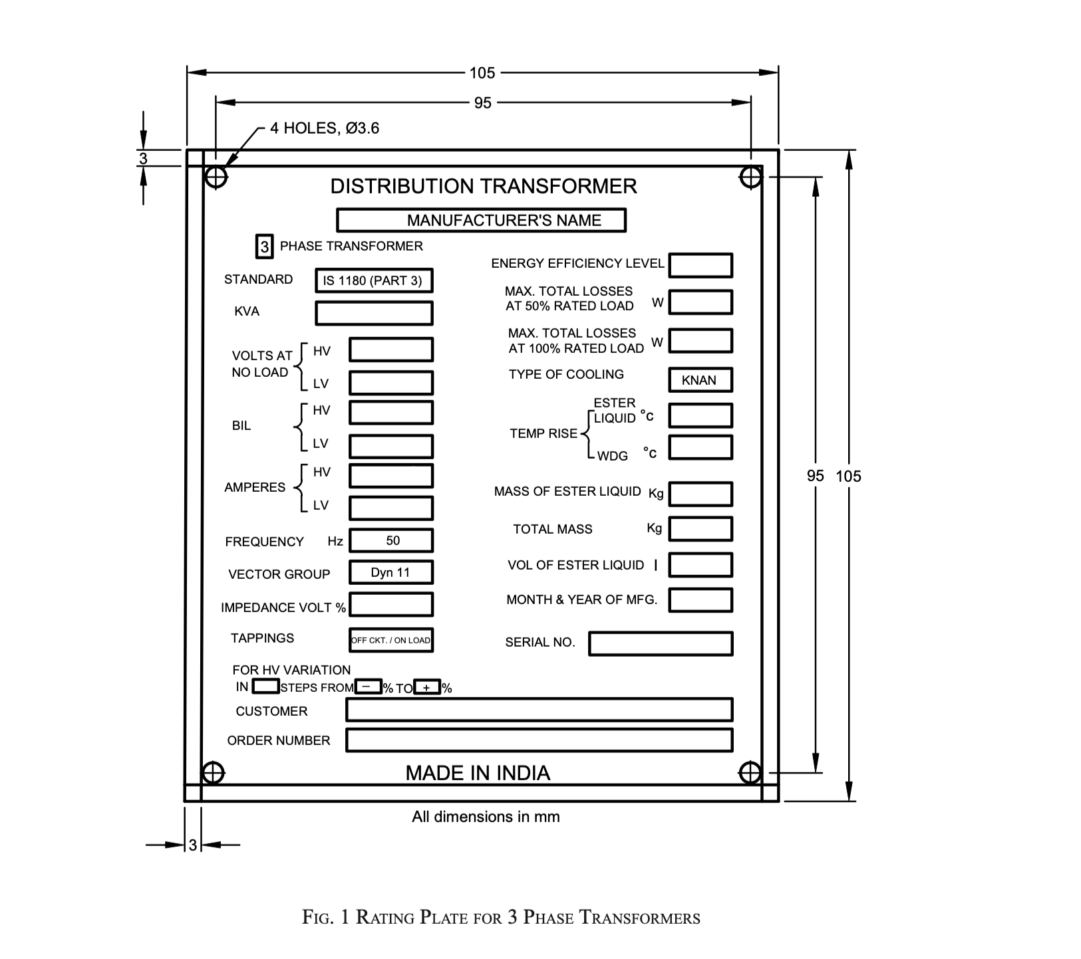
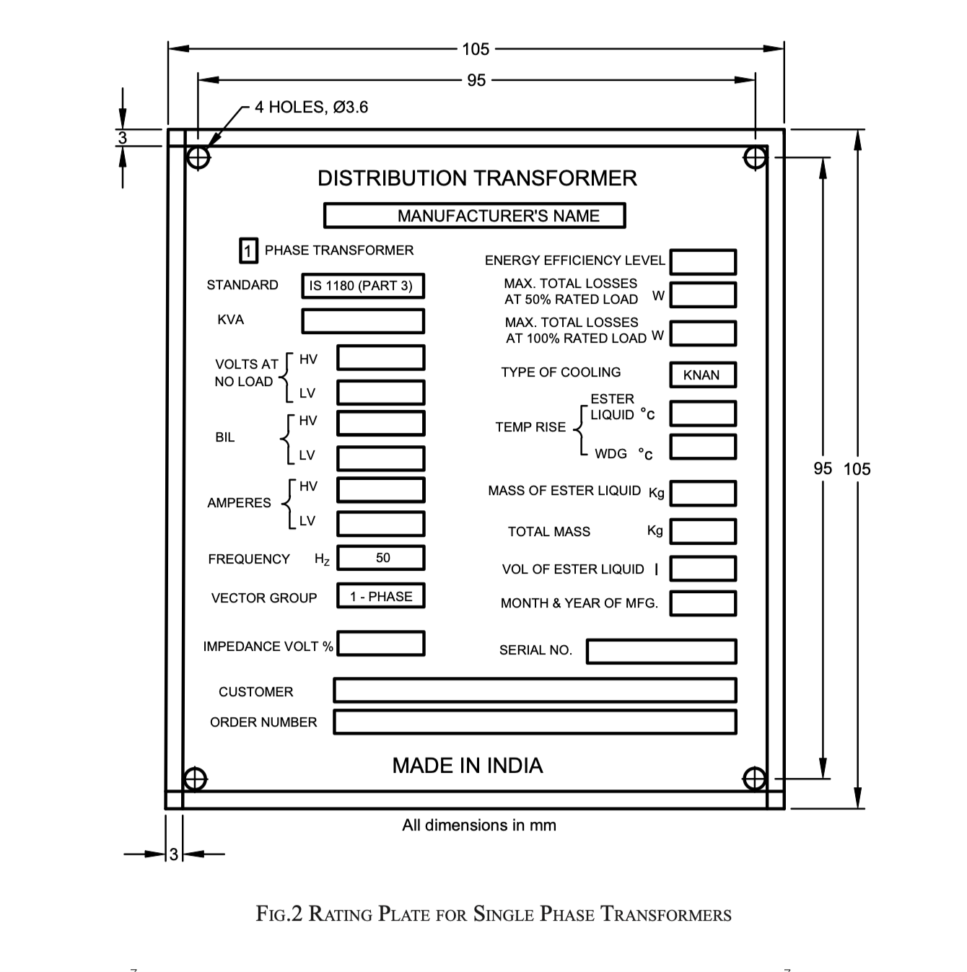
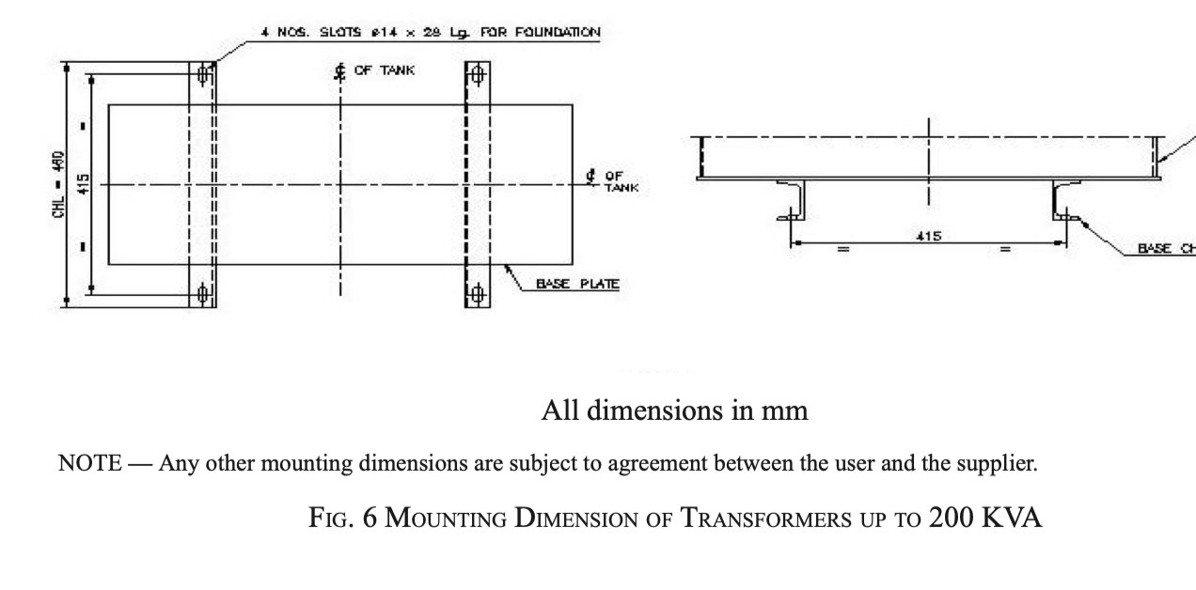
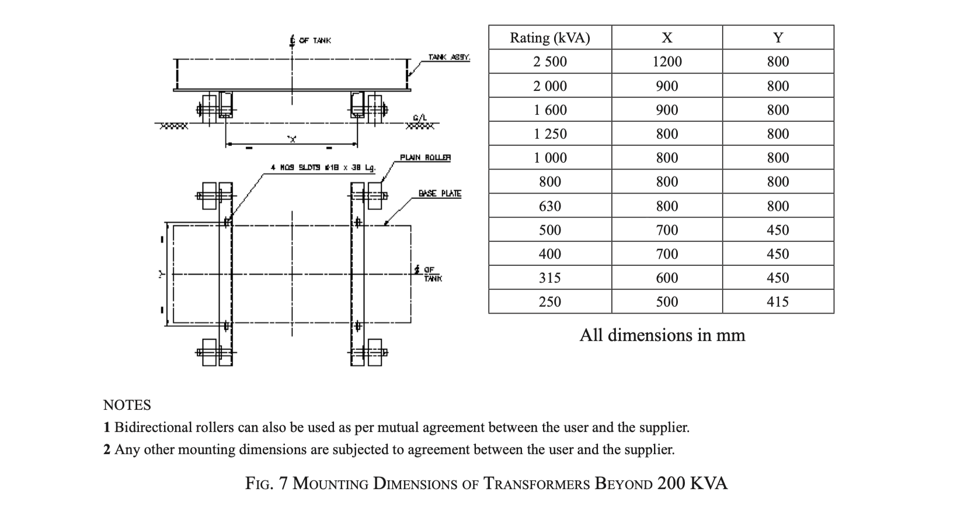
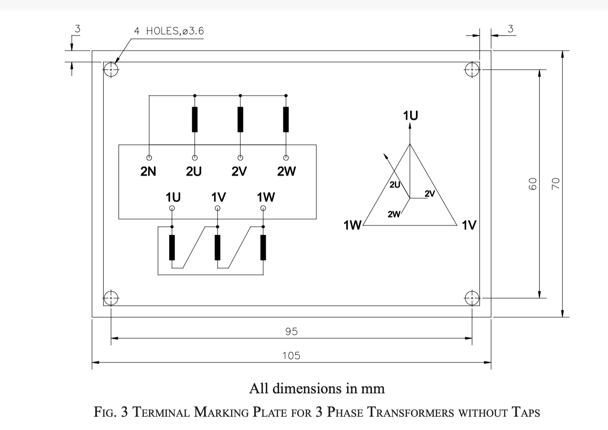
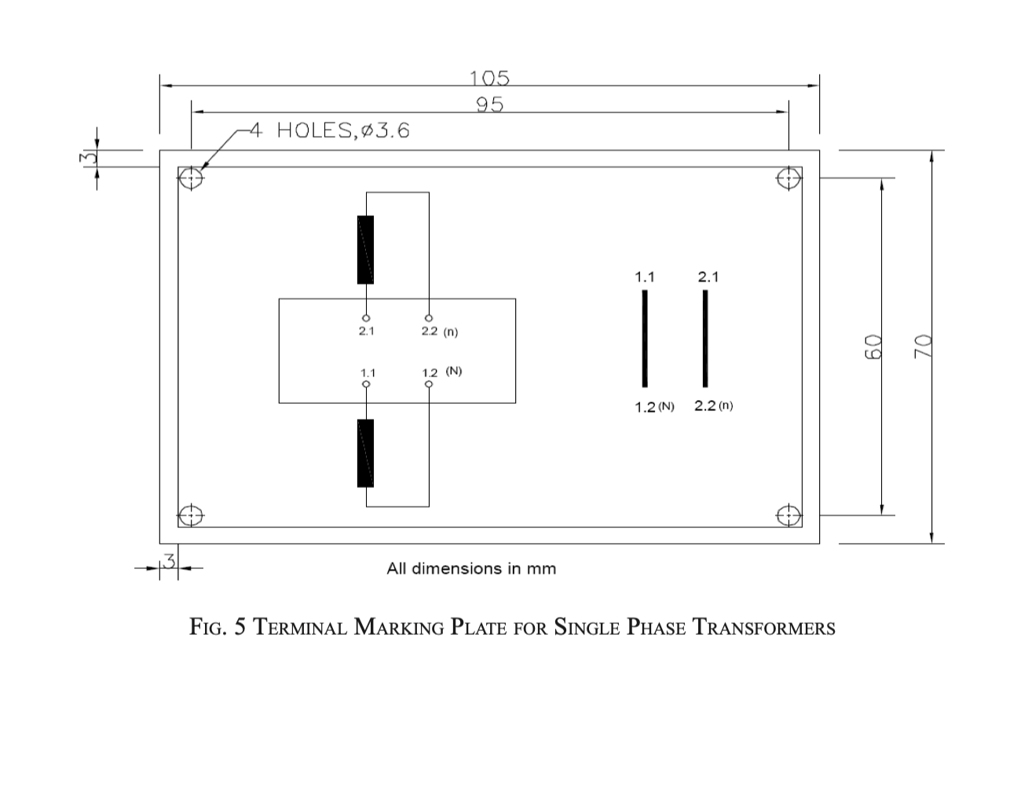
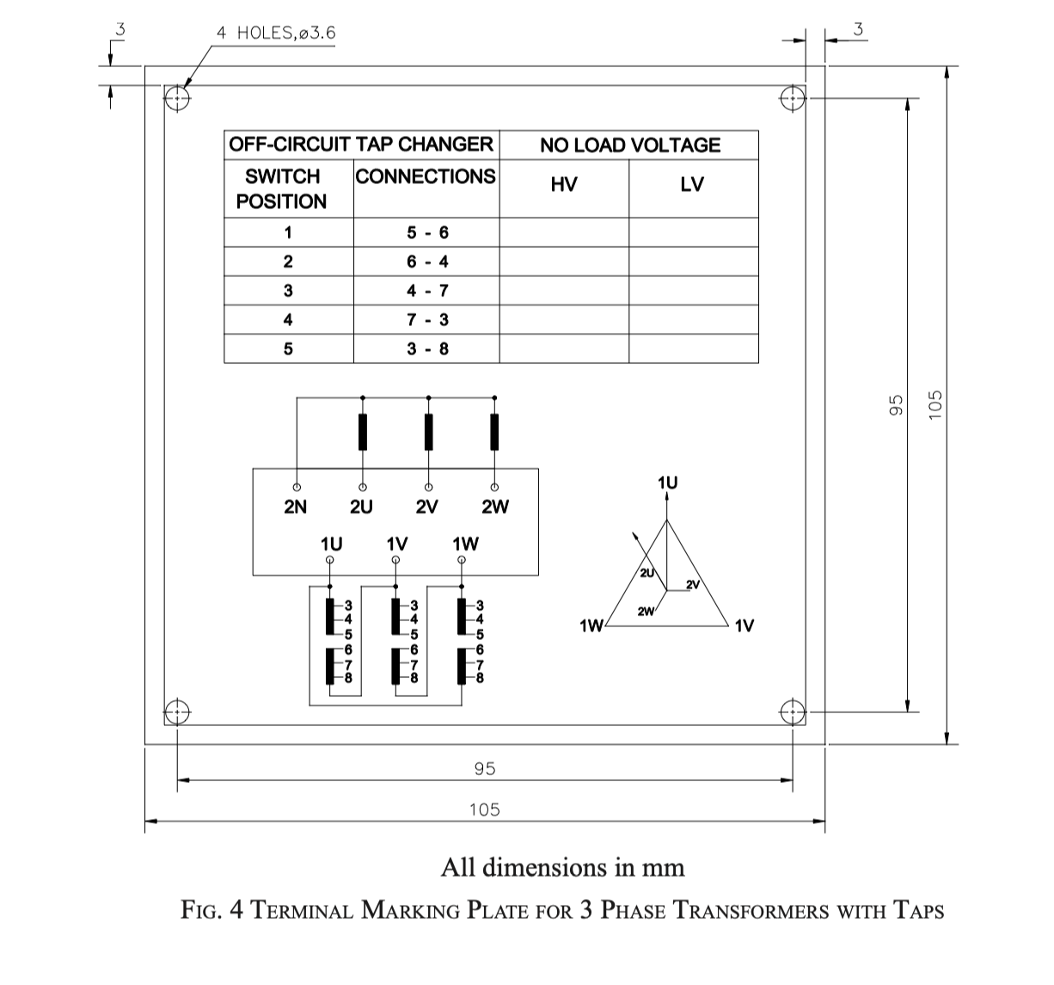
Mounting Arrangement, Rating and Terminal Marking Plate
Material-Anodized aluminum/Stainless Steel
Sl. No | Type of Mounting Arrangement | Dimensions of Mounting Arrangement | Ratings of Transformer
1 | Channels | 75 mm X 40 mm (Min) | Up to 200 kVA-Three Phase
2 | Rollers |  | Above 200 kVA-Three Phase
3 | Pole Mounting | a. Subject to Agreement between user and supplier. b. Steel Lugs of min. 5 mm thickness and fixed to the pole by means of two bolts of 20 mm dia. | Single Phase
Note- Dimensions of Rating Plate, Terminal
Marking Plate can be changed subject to
Agreement between user and supplier.

Slide 17
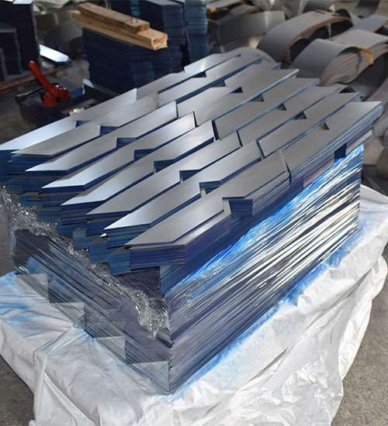
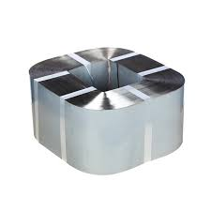
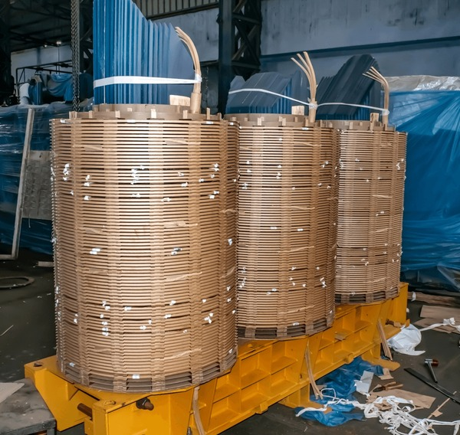


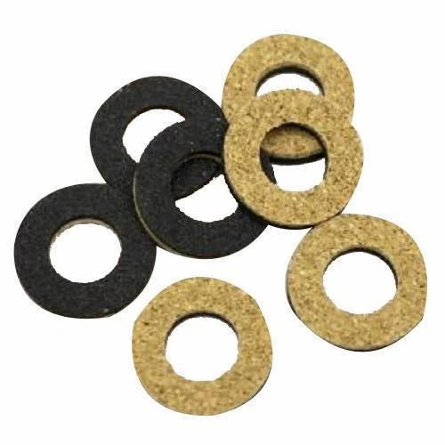
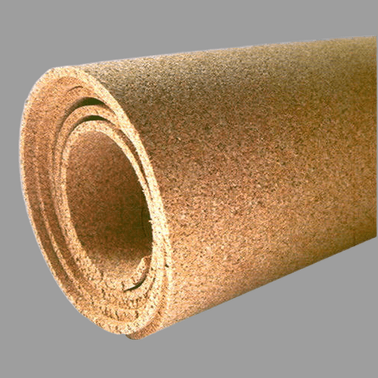
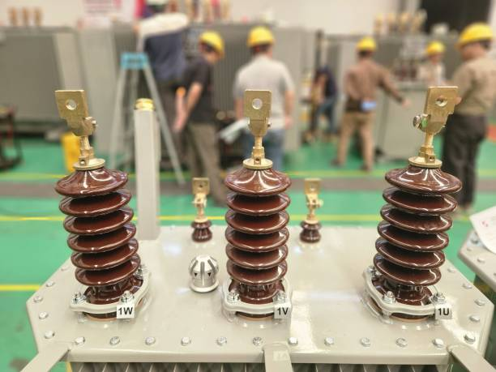
Materials used in the Distribution Transformer
Sl. No | Components | Material | Indian Standard No.
1 | Core | Cold Rolled Grain Oriented Electrical Steel (CRGO) | IS 3024
 |  | Amorphous Core Material | IS 16585
2 | Winding | Aluminium | IS 6162 (Series), IS 13730 (Part 0/Sec 3)
 |  | Copper | IS 191, IS 1897, IS 7404, IS 12444, IS 13730 (Series)
3 | Insulation | Press Board | IS 1576
 |  | Kraft Paper | IS 9335 (Series)
 |  | Natural Ester | IS 16659
 |  | Synthetic Ester | IS 16081
 |  | Mineral Oil | IS 335
4 | Gasket | Synthetic Rubber or Synthetic Rubberized Cork | IS 11149, IS 4253
5 | Bushings | Porcelain, Cast Resin, Polymer, Epoxy | IS/IEC 60137, IS 7421, IS 3347 (Series), IS 8603

Slide 18
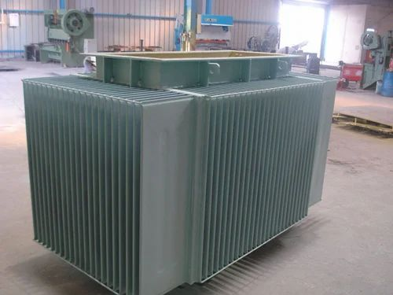
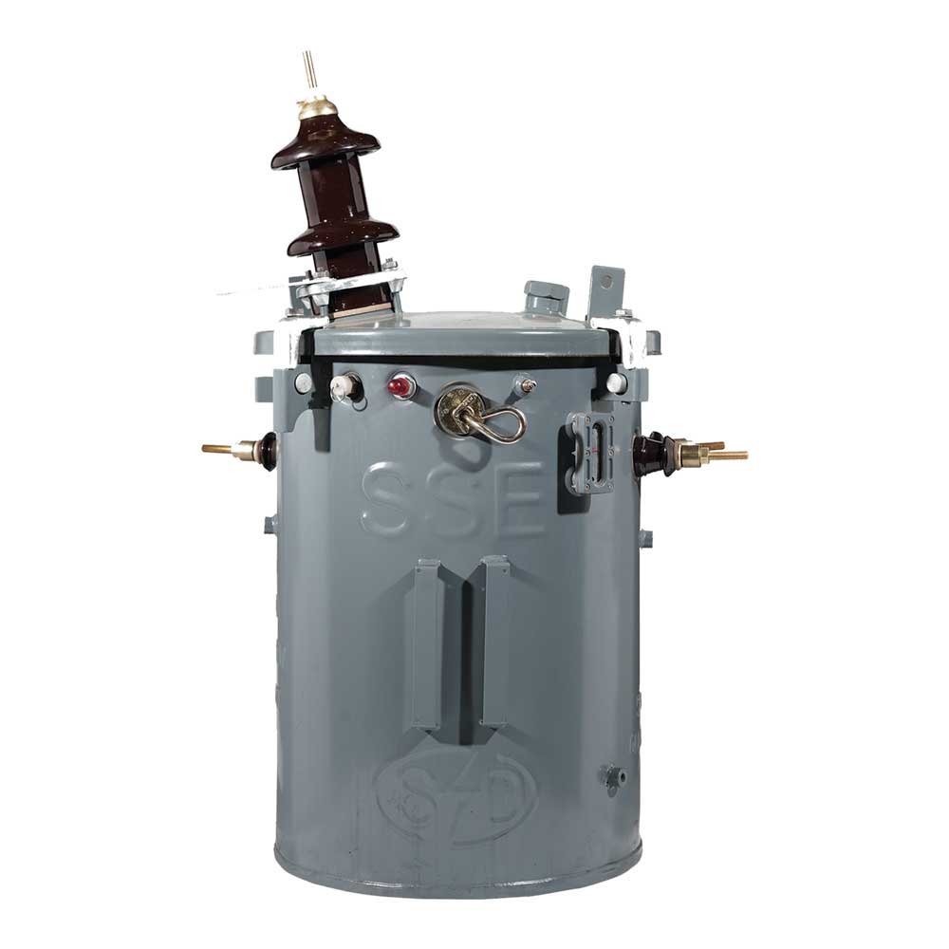
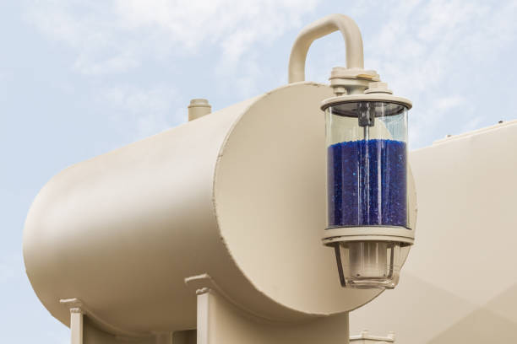
Components of Distribution Transformer
Sl. No | Component | Provisions in IS 1180 (Part 1 & 3)
1 | Transformer Tank ans Painting | Plain tank configuration with/without radiator fins or cooling tubes, Round shape tank bolted/clamped/welded with tank rim to make leak proof joint. Adequate mechanical strength to withstand positive and negative pressures built up inside the tank while the transformer is in operation. Painting Requirements of Tank including the thickness are specified in IS 1180 (Part 1 & 3)
2 | Conservator | Transformers of ratings 63 kVA and above with plain tank construction, the provision of conservator is mandatory. For sealed type transformers with or without inert gas cushion, conservator is not required. Provided with Liquid gauge, drain plug and a filling hole (1¼” normal size thread) with cover. In case of transformers immersed in natural ester liquid, care shall be taken to prevent the liquid getting exposed to atmosphere by the use of an airbag (which is connected to a breather with silica gel) or suitable liquid preservation system.
Mandatory and Optional Fittings provided with distribution transformers are specified in IS 1180 (Part 1 & 3)

Slide 19
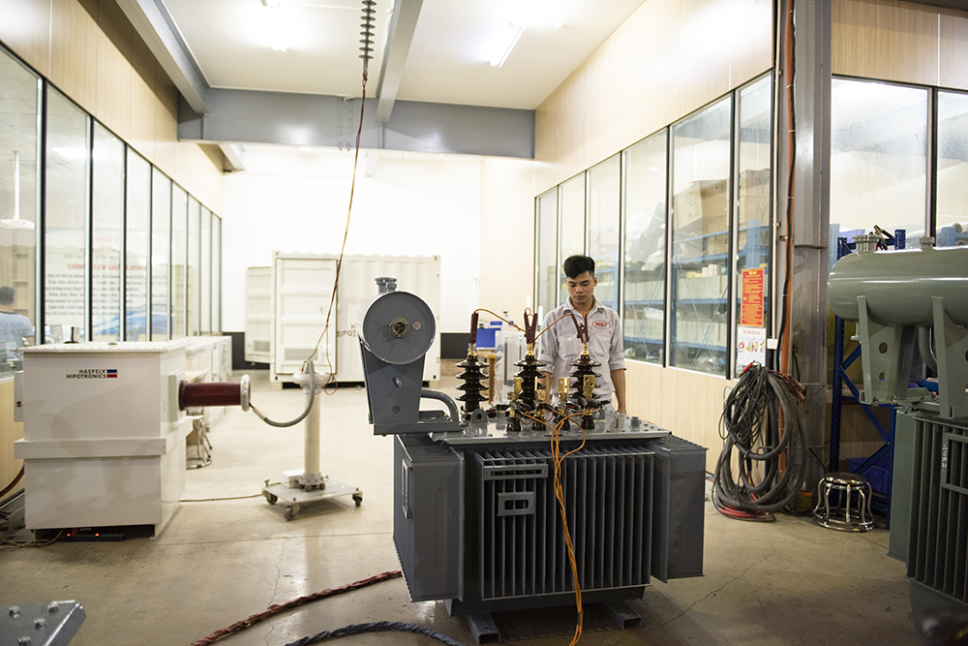
Quality Assessment of Distribution Transformers

Slide 20
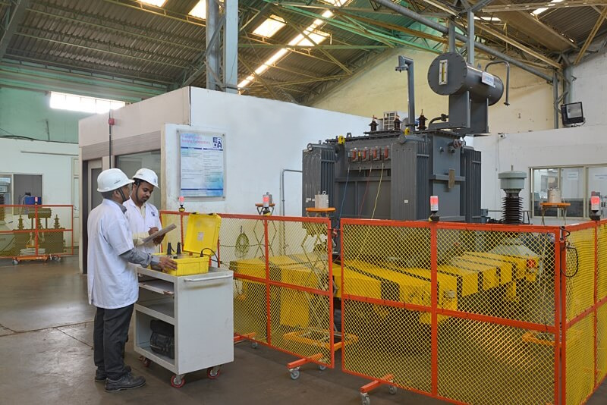
Tests
Routine Tests
Measurement of winding resistance
Measurement of voltage ratio and check of phase displacement
Measurement of short-circuit impedance (principal tapping, when applicable) and load loss at 50 percent and 100 percent load.
Measurement of no-load loss and current
Measurement of insulation resistance
Induced over-voltage withstand test
Separate-source voltage withstand test
Pressure test
Ester liquid leakage test
Type Tests
Special Tests
Lightning impulse test
Temperature-rise test
Short-circuit withstand test (up to 200 kVA)
Pressure test
Determination of sound levels
Short-circuit withstand test
No load current at 112.5 percent voltage
Paint adhesion test
BDV and Moisture content of liquid in the transformer

Slide 21
Impacts of Non-Compliance and Compliance with IS 1180 (Series)

Slide 22
Impacts of Non-Compliance and Compliance with IS 1180 (Series)
Risks & Consequences
Short Term Risks
Immediate Inefficiencies, Safety Hazards and Operational Failures.
Long Term Consequences
Environmental degradation, Higher Operational Costs and Penalties.
Legal Repercussions
Violation of Statutory Provisions would lead to actions as per the provisions of existing rules and regulations.
Failures due to Non-Compliance
Examples of accidents and inefficiencies from lack of adherence.
Results of Compliance
Increased Efficiency
Increased Reliability
Reduced Safety Incidents
Quality Product

Slide 23
Important Indian Standards and New Standards under Development

Slide 24
Important Indian Standards Referred in IS 1180 (Part 1 & 3)
Sl. No. | IS No. | Title of Indian Standard
1 | IS 2026 (Part 1) | Power transformers: Part 1-general
2 | IS 2026 (Part 2) | Power transformers: Part 2 temperature – Rise
3 | IS 2026 (Part 3) | Power transformers: Part 3 insulation levels, dielectric tests and external clearances in air
4 | IS 2026 (Part 5) | Power transformers: Part 5 ability to with stand short circuit
5 | IS 2026 (Part 7) | Power transformers: Part 7 loading guide for oil - Immersed power transformers
6 | IS 2026 (Part 8) | Power transformers: Part 8 application guide
7 | IS 2026 (Part 10) | Power transformers: Part 10 determination of sound levels
8 | IS 2026 (Part 14) | Power transformers: Part 14 liquid - Immersed power transformers using high - Temperature insulation materials

Slide 25

Indian Standards under Development
Solar Inverter Duty Transformer
Dry Type Distribution Transformers
Submersible Duty Transformers and Accessories
Onsite Diagnostic testing of Power Transformers for Condition-Health Assessment

Slide 26


