Slide 1
Flood Control and Diversion Head Works

Slide 2



Table of contents
1
4
Basics of Floods
Diversion Head Works Recommendations
Flood, Types of flood, causes of flood
Area affected from flood
Design of Diversion Head Works
Construction of Diversion Head Works
2
5
Flood Management
Guidelines for Diversion Head Works
Methods for Prevention of Flood
Use of Indian Standards in Flood Management and Anti-Erosion Works
Operation of Diversion Head Works
Maintenance of Diversion Head Works
3
6
Diversion Head Works
Safety Parameters
Objectives of Diversion Head Works
Site Selection of Diversion Head Works
Safety in Diversion Head Works

Slide 3
Flood
Flood occurs when there is an overflow of water onto normally dry land. This can happen due to heavy rainfall, melting snow or ice, storms, or other factors that cause water levels to rise beyond their usual limits. Floods can lead to widespread damage, affecting homes, infrastructure, and the environment.
According to the National Disaster Management Authority (NDMA), over 40 M ha (12.16% of Total Geographical Area) ha of land in India is prone to flooding.
According to the Ministry of Jal Shakti (MoJS) reported that the recent estimate on flood prone area in the country is 49.15 Mha, out of which Assam, Bihar, Odisha, Uttar Pradesh and West Bengal are largely affected.

Slide 4
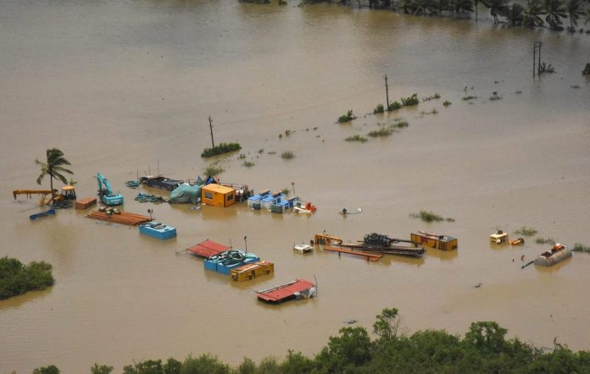
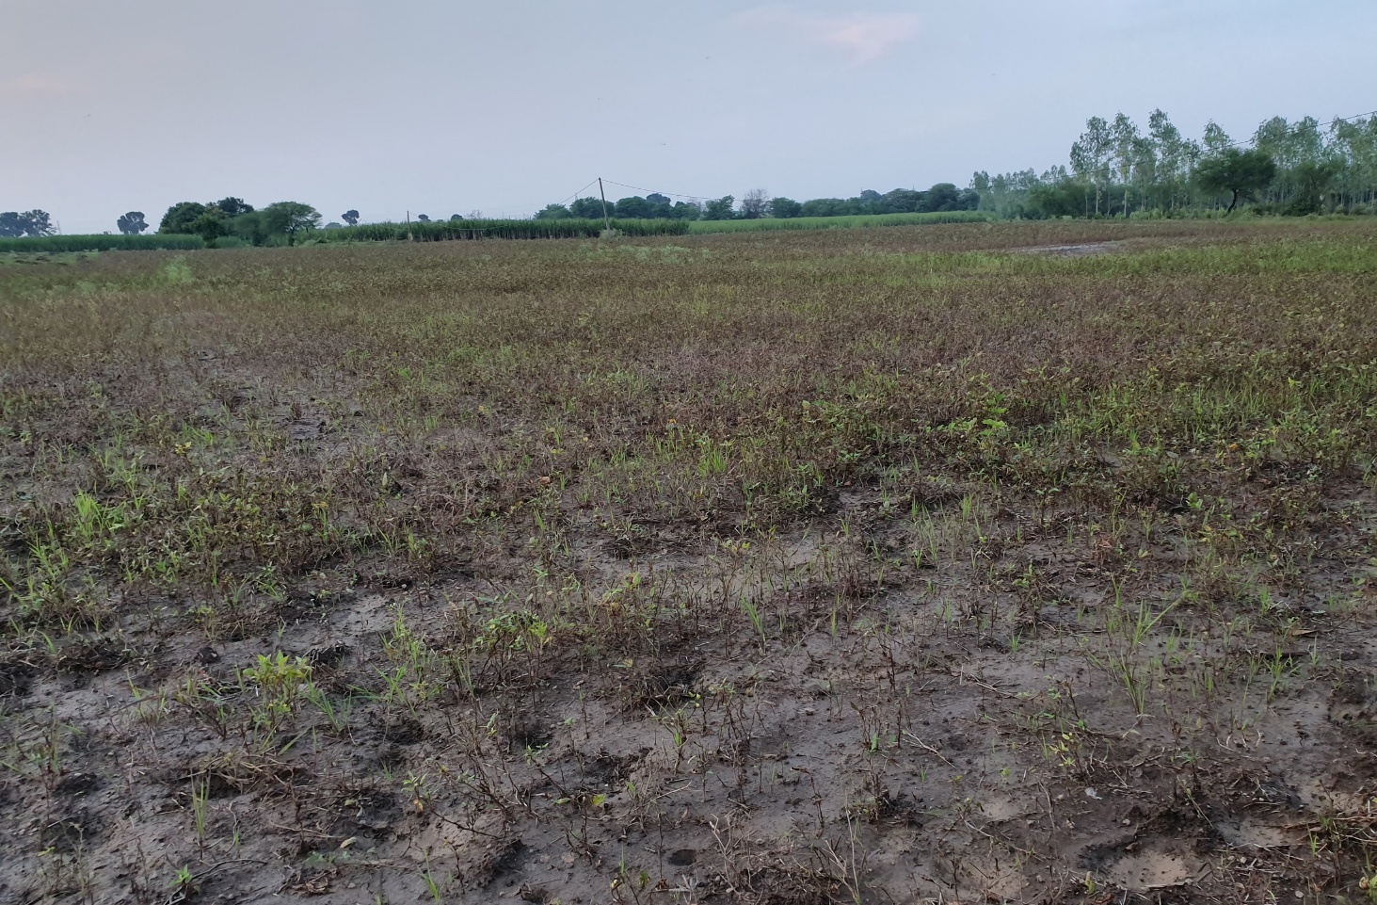

Slide 5
Types of Floods
Types of Floods
Riverine floods
Coastal floods
Flash floods
Pluvial floods
Dam or levee failures
Urban floods

Slide 6
Types of Floods
Riverine floods - These floods occur when heavy rainfall or snowmelt causes rivers or streams to overflow their banks.
Coastal floods- These occur when high tides, storm surges, or large waves cause seawater to flood onto coastal areas.
Flash floods-These floods occur when heavy rainfall occurs in a short period of time, overwhelming the capacity of drainage systems and causing water to rapidly accumulate in low-lying areas.
Urban floods-These occur in urban areas when the built environment and pavement prevent rainwater from being absorbed into the ground.
Pluvial floods- These occur when heavy rainfall exceeds the capacity of drainage systems, causing water to accumulate on the surface of the land.
Dam or levee failures- These occur when dams or levees are unable to withstand the pressure of floodwaters, causing them to breach and release large volumes of water downstream.

Slide 7
Causes of Floods
India is prone to floods due to its geography, heavy rainfall during the monsoon, changing weather patterns with rising temperatures leading to more frequent and intense rainfall events, snowmelt, river overflows-flooding, rapid snowmelt, dam or levee failure, coastal storms or storm surges, and tsunamis, as well as flash flooding and landslides. Coastal regions are also at risk of flooding due to tropical cyclones and storm surges.
Land-use / land cover changes such as deforestation, rapid urbanization and poor drainage conditions, and poor agricultural practices might have led to flood severity.
During the last four decades, it has been observed that the frequency and severity of floods in India have been increasing.

Slide 8
Flood Affected Areas in India
Sl. No. | State | No. of Districts Affected | Flood Affected Area (Ha)
1 | Andhra Pradesh | 24 | 738200
2 | Arunachal Pradesh | 5 | 3373
3 | Assam | 35 | 2464958
4 | Bihar | 38 | 3976861
5 | Chhattisgarh | 12 | 12029
6 | Delhi | 7 | 5848
7 | Gujarat | 16 | 517770
8 | Haryana | 9 | 67852
9 | Jammu & Kashmir | 10 | 43022
10 | Jharkhand | 2 | 2966
11 | Karnataka | 26 | 280156
12 | Kerala | 10 | 79377
13 | Madhya Pradesh | 30 | 210809
14 | Maharashtra | 20 | 233590
15 | Manipur | 9 | 88352
16 | Meghalaya | 2 | 8787
17 | Odisha | 23 | 1424313
18 | Punjab | 15 | 142692
19 | Rajasthan | 10 | 155144
20 | Tamil Nadu | 24 | 552010
21 | Telangana | 14 | 102318
22 | Uttar Pradesh | 72 | 2662942
23 | Uttarakhand | 2 | 7604
24 | West Bengal | 20 | 1969750
Total |  | 435 | 15750723
Source: (NRSC Flood Affected Area Atlas of India)

Slide 9
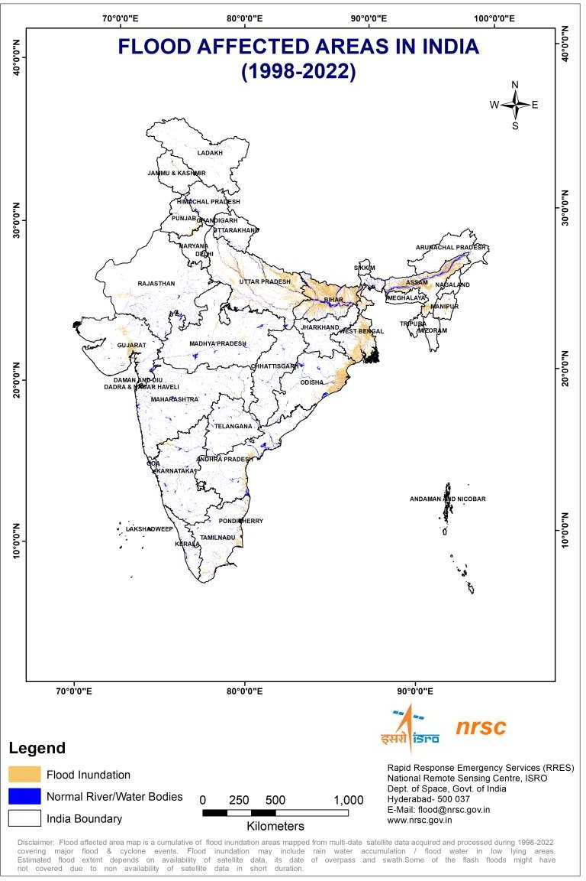
Flood Affected Areas in India

Slide 10
Methods for Prevention of Flood
Prevention of Flood
Non -Structural Measures
Structural Measures

Slide 11
Methods for Prevention of Flood
Flood mitigation approaches fall into two categories :
Structural Measures - form of mitigation to mitigate harm by reconstructing landscapes. They include floodwalls/seawalls, floodgates, levees, and evacuation routes.
Non-Structural Measures - reduce damage by removing people and property out of risk areas. They include elevated structures, property buyouts, permanent relocation, zoning, subdivision, and building codes.

Slide 12
Use of Indian Standards in Flood Management and Anti-Erosion Works
Some of the Indian Standards on Flood Management (River Training Works):
IS 13739:1993 – Guidelines For Estimation Of Flood Damages
IS 4410:Part 12: 1993 – Glossary of terms relating to river valley projects: Part 12 Diversion works
IS 4410:Part 21: 1987 – Glossary of terms relating to river valley projects: Part 21 Flood control
IS 4410:Part 22: 1994 – Glossary of terms relating to river valley projects: Part 22 Barrages & weirs
IS 7349: 2012 – Barrages and weirs - Operation and maintenance – Guidelines
IS 8408: 1994 – Planning and design of groynes in alluvial river – Guidelines
IS 14262: 1995 – Planning and design of revetments – Guidelines
IS 12094 : 2018 – Planning and design of river embankments (Levees) - Guidelines (Second Revision)
IS 11532 : 1995 – Construction and maintenance of river embankments (Levees) - Guidelines (First Revision)
IS 10751 : 2022 – Planning and design of guide banks for alluvial rivers guidelines
IS 12926 : 1995 – Construction and maintenance of guide banks in alluvial rivers - Guidelines (First Revision)
IS 12892 : 1989 – Safety of barrage and weir structures – Guidelines
IS 14955 : 2001 – Guidelines for hydraulic model studies of barrages and weirs

Slide 13
Use of Indian Standards in Flood Management and Anti-Erosion Works
Planning & Design of River Embankment (IS 12094 : 2018)
An embankment (levee) is an artificial bank built along banks of a river for the purpose of protecting adjacent land from inundation by flood. Such type of structure is also called ‘embankment’, ‘stop-bank’, ‘bund’ or ‘dyke’. Construction of embankment to control flood is an age-old practice and is still being followed due to its proven suitability.
This standard covers planning and design of river embankments (levees) on dry land. The salient features/main design aspects covered in this standard are as follows:
Planning including classification, collection of data, degree of protection, alignment, spacing and length of embankments, etc.;
Design of embankment such as types, design HFL, freeboard, top width, hydraulic gradient, side slope, safety measures in design, sluices, etc.;
Treatment of embankments;
Protection of embankments, etc.

Slide 14
Use of Indian Standards in Flood Management and Anti-Erosion Works
Planning and Design of Groynes/Spur (IS 8408-1994)
Planning & Design of Groynes in Alluvial River – Guidelines (IS 8408 : 1994)
Groynes ( spurs ) are structures constructed transverse to the river flow and extend from the bank into the river. These are widely used for river training and bank protection.
This standard covers the planning and design of Groynes (Spurs) in alluvial rivers. The salient features/main design aspects covered in the code are described in the following paragraphs:-
Design discharge: should be equal to that for which any structure in close proximity is designed or 50 year flood whichever is higher.
Length of spur:- Length of groyne should be decided on the basis of availability of land on the bank. Length should not be less than that required to keep the scour hole formed at the nose away from the bank. Normally, effective length should not exceed 1/5th of width of flow in case of single channel. The spacing of spur is normally 2 to 2.5 times its effective length.
Top level:- Depends on the type namely submerged, partially submerged or non-submerged and will be best decided by model experiment.
Top width: 3 to 6 meters as per requirements.
Free board :- 1 to 1.5 meter above design flood level.
Side slope: Between 2:1 and 3:1

Slide 15
Diversion Head Works
A structure constructed across a river for the purpose of raising water level in the river so that it can be diverted into the off-taking canals.
These are generally constructed on the perennial rivers which have adequate flow throughout the year and, therefore, there is no necessity of creating a storage reservoir.

Slide 16
Diversion Head Works
It serves to divert the required supply into the canal from the river. The objectives of this type of headwork's are as following.
It raises the water level in the river so that the commanded area can be increased.
It regulates the intake of water into the canal.
It controls the silt entry into the canal.
It reduces fluctuations in the level of supply in the river.

Slide 17
Objectives of Diversion Head Works
The purpose of diversion head works is to divert river water into canals for irrigation and other uses:
Raise Water Level - Diversion head works are built across rivers to raise the water level, which helps the water flow by gravity.
Control Water Flow - Diversion head works help control the flow of water into canals and keep silt and other sediments out.
Provide A Continuous Water Supply - Diversion head works ensure a regulated, continuous supply of silt-free water into the canal.

Slide 18
Components of Diversion Head Works
The components of diversion head works are:
Weir or barrage
Canal head regulator
Divide Wall
Fish Ladder
Scouring Sluices Under sluices
Silt excluder
Silt ejector
River Training Works
Marginal embankment or dikes(IS 9461 : 1980)
Guide bank (IS 10751 : 2022)
Spurs or groynes(IS 8408 : 1994)

Slide 19
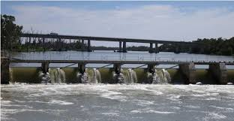
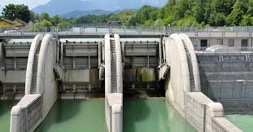
Components of Diversion Head Works
Weir is a solid obstruction placed across the river. Its main function is to raise the water level so that water can be diverted from canal to crop field due to head difference.
Barrage is practically a low weir with an adjustable gate over this low weir. Heading up of water is affected by gate.
IS11130 : 1984 - Criteria for structural design of barrages and weirs
IS 14955 : 2001 - Guidelines for hydraulic model studies of barrages and weirs
IS 14248 : 1995 - Guidelines for instrumentation of barrages and weirs
IS 6966 (Part 1) : 1989 - Hydraulic design of barrages and weirs - Guidelines: Part 1 alluvial reaches (First Revision)
IS 7349 : 2012 - Barrages and weirs - Operation and maintenance - Guidelines (Second Revision)
IS 7720 : 1991 - Criteria for investigation, planning and layout for barrages and weirs (First Revision)

Slide 20
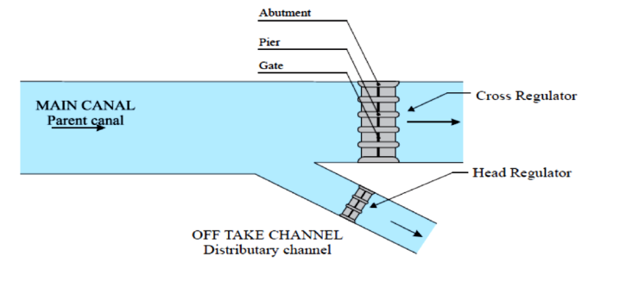
Components of Diversion Head Works : Canal Head Regulator
Canal Head Regulator is a structure at the beginning of a canal that controls the flow of water and prevents silt from entering the canal.
Purpose: Regulates the amount of water entering the canal and controls the amount of silt that enters.
Location: Typically located upstream of a barrage or near a reservoir.
Alignment: Usually aligned at a 90° to 110° angle to the axis of the barrage.
Construction: Made up of piers that divide the canal into spans called bays.
Gates: Steel gates are used to control the discharge, and can be operated manually or by electric winches.
Breast wall: An RCC wall that runs the length of the regulator to prevent water from spilling over the gates.
IS 6531 : 2021 - Canal head regulators - criteria for design (Second Revision)

Slide 21
Components of Diversion Head Works : Divide wall
The 'divide wall' is a masonry or a concrete wall constructed at right angle to the axis of the weir, and separates the 'weir proper' from the 'under-sluices.
The divide wall extends on the upstream side beyond the beginning of the canal head regulator; and on the downstream side, it extends up to the end of loose protection of the under sluices.
The top width of divide wall is about 1.5 to 2.5 meters. These walls are founded on wells closely spaced beyond, the pucca floor up to the end. The wells are taken well below the deepest possible scour.
IS11130 : 1984 - Criteria for structural design of barrages and weirs
IS 7720 : 1991 - Criteria for investigation, planning and layout for barrages and weirs (First Revision)

Slide 22
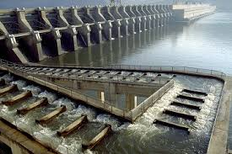
Components of Diversion Head Work : Fish Ladder
Fishes move from one part of the river to another part, according to the season. In India, only one such migratory fish is found, and this. specie is known as Hilsa.
Fish have been found to be moving from upstream (hills) to downstream (plains) in the beginning of the winter season in search (of Warmer waters, and return to their spawning grounds upstream, slightly before· monsoons, in the month of May and June.
A structure which enables the fish to pass upstream is called a 'fish ladder'. It is a device by which the flow energy can be dissipated in such a manner as to provide smooth flow at sufficiently low velocity, not exceeding 3 to 3.5 m/sec
IS 13877 : 1993 - Planning and design of fish pass - Guidelines

Slide 23
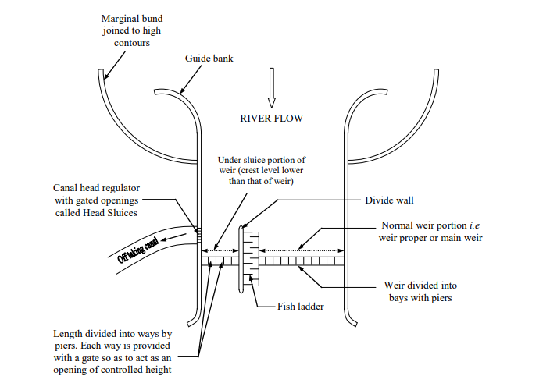
Components of Diversion Head Works : Scouring Sluices/Under sluices
Scouring Sluices/Under sluices- A comparatively less turbulent pocket of water is created near the canal head regulator by constructing under-sluice portion of the weir. A divide wall separates the main weir portion from the under-sluice portion of the weir. The crest of the under-sluice portion of the weir is kept at a lower level than the deepest bed level of the river during non-monsoon season; whereas, the crest level of the 'weir' is kept higher by about 1 to 1.5 m.

Slide 24
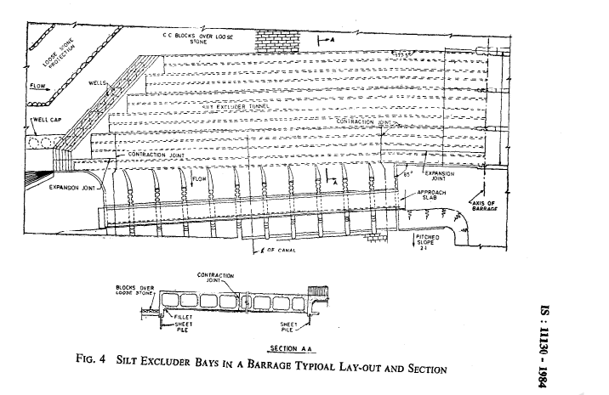
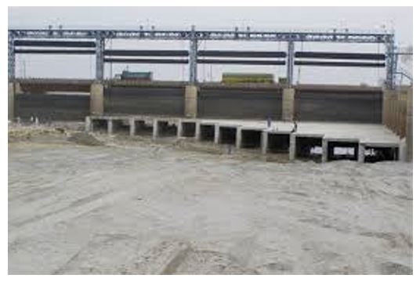
Components of Diversion Head Work : Silt Excluder
Silt Excluder - Silt excluder are those works which are constructed on the bed of the river, upstream of the head regulator. The clearer water enters the head regulator and the silted water enters the silt excluder. In this type of works, the silt is therefore removed from the water before it enters the canal.
IS11130 : 1984 - Criteria for structural design of barrages and weirs

Slide 25
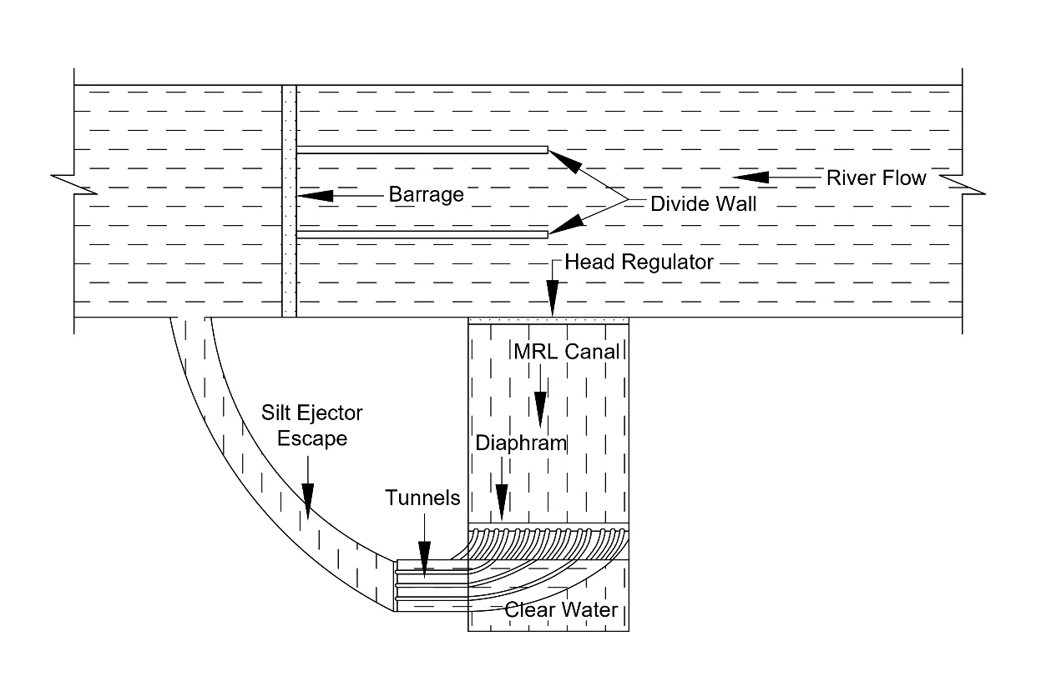
Components of Diversion Head Work : Silt Ejector
Silt Ejector -Silt ejectors also called silt extractors, are those devices which extract the silt from the canal-water after the silted water has travelled a certain distance in the off-take canal.
These works are constructed on the bed of the canal, and a little distance downstream from the head regulator.

Slide 26
River Training Works
Guide Banks The guide banks force the river into a restricted channel, and thus, ensuring a smooth and an almost axial flow near the weir site.
Marginal bunds are provided on the upstream side of the Works in order to protect the area from submergence due to rise in HFL, caused by the afflux. These bunds are, therefore, continued till they join contours higher than the new HFL. Construction of these bunds would be justified only, when the value of land saved is more than the cost of the marginal bunds.
Spurs and groynes are both small structures built in rivers or along coasts to control water flow, protect riverbanks, and improve navigation.
Spurs - Spurs are used to train the flow of water along a desired course. They are often built perpendicular to the river bank.
Groynes -Built along coasts, groynes are used to protect beaches and maintain their stability. They are effective on sand and shingle beaches

Slide 27
Selection of Site for Diversion Head Works
The selection may be made The selection may be made in accordance with the for in accordance with the following considerations. following considerations.
As far as possible a narrow, straight, well defined channel confined banks not submerged by the highest flood.
It should be possible to align the off taking canal in such a way that the command of its area is obtained without excessive digging.
The material of construction such as stone, sand, etc. should be available in the vicinity of the site.
The site should be accessible by road. And there should be (enough) workers available in the vicinity of project site.

Slide 28
Design of Diversion Head Works IS 10084 (Part 1) : 1982
The Following are the recommendation of IS 10084 (Part 1) : 1982.
The coffer dam being a temporary structure is normally designed for a flood with frequency less than that for the design of the main structure.
While fixing up the top level of the coffer dam, adequate free board shall be kept, so that over-topping of the coffer dam due to waves created by wind action is avoided.
Length of the coffer dam will depend upon the length and width of the area to be enclosed.
For compressive stresses, the permissible stress shall be increased by 20 percent of the provisions.
The upstream of the steel coffer dam shall not be kept flatter than 1 :1 and it may vary up to 1 : 1.5.

Slide 29
Design of Diversion Head Works IS 10084 (Part 1) : 1982
The Following are the recommendation of IS 10084 (Part 1) : 1982.
Design requirements - The design of double wall coffer dam shall satisfy the following conditions of equilibrium:
∑ horizontal forces =0
∑ moments =0
Stability-The stability of the cellular steel sheet pile coffer dam shall be checked for:
Cell shear;
Sliding;
Tilting;
Bursting of cell;
Soil support.

Slide 30
Design of Diversion Head Works IS 10084 (Part 2) : 2014
Earth or rockfill dams should not be allowed to be overtopped by floods during construction. Therefore, it is imperative to ensure that the highest water level, either during diversion of non-monsoon flows or passage of monsoon floods is lower than top level of the dam during construction.
The radius of the circle should be 3 to 5 times the bed width of the channel to obtain equitable flow across the channel.
Channels are designed on the basis of Manning’s formula, after adopting suitable value of rugosity coefficient depending on site conditions. The velocity in the unlined and lined channels should not exceed 5 m/s and 10 m/s respectively.

Slide 31
Design of Diversion Head Works IS 10084 (Part 2) : 2014
Structural design of conduit should be done according to IS 1296.
While provision of a spur could help ensuring concentration of discharge in the central portion of the channel with minimum velocities along the banks, it nevertheless requires protection to avoid erosion of the banks.
While designing care should be taken for the following:
Protection by rip rap, if required in case of unlined channel.
Protection of the lined channel so that the lining doesn’t get damaged for the design velocity.
Analysis should be made to ensure stability of channel and to ensure there is no formation of hydraulic jump.

Slide 32
Construction of Diversion Head Works IS 10788(Part-1) : 1984
Diaphragm Type - These are made up of a series of circular arcs connected by cross walls ( diaphragms ). The arcs are connected to diaphragms by Y-pile of 120⁰.
Clover Leaf Type - Clover-leaf type cells consist of four circular arcs fixed on two transverse walls perpendicular to each other, and connected by means of small arcs.
Steel Sheet Piles - Straight web steel sheet piles conforming to IS 2314 shall be suitable for cellular coffer dams.
Fill Material - used in cellular coffer dam should be freely draining, non-cohesive with high shear strength and high unit weight.

Slide 33
Construction of Diversion Head Works IS 10788 (Part-1) : 1984
It should be ensured that a thorough inspection of hydro-mechanical installations/equipment is done at least once in a year to check corrosion.
All machinery at the works should be kept clean, tidy and in proper working order and care should be taken to ensure that it is properly handled in conformity with the manufacturer’s instructions.
The main hydro-mechanical items are generally the gates, hoist equipment, control system, etc. IS 7718 may also be referred for inspection, testing and maintenance of gates.

Slide 34
Operation of Diversion Head Works IS 7349 : 2012
All lift gates should be operated at suitable intervals, preferably once in fortnight to clear the gate grooves/slots, flood passage and ensure free movement of moving parts of gate.
In low supplies when openings are not desirable, raising of gates by 150 mm for a few minutes should suffice.
If the gates have not been moved for a sufficiently long time, they should not be forcibly raised all at once but should be lifted by about 30 mm or so and left at that position for about 10 to 15 min till the silt deposited against the gates gets softened.

Slide 35
Maintenance of Diversion Head Works IS 7349 : 2012
All cavities and angles in the gates/shutters should be kept clear of debris, driftwood, moss and silt accumulations.
All drainage holes in the webs of horizontal structural members should be kept clear to drain off any accumulated water.
Green stains should not be allowed to form on the steel members at the back of the gates/shutters. The gates and counter balanced boxes should hang perfectly in level and plumb.

Slide 36
Maintenance of Diversion Head Works IS 7349 : 2012
This should be checked occasionally and adjustment made as needed. In case of shutters, the chains/anchors holding them should be kept free from rust. IS 10096 (Part 1/Sec 1) and IS 7718 may also be referred for the inspection/ maintenance of the gates considering the type of gates provided on the barrages/weirs.
No painting is required for machined surfaces and surfaces of stainless steel, brass or bronze.
These surfaces should be protected by a coating of gasoline-soluble rust preventive non-corrosive compound.

Slide 37
Safety of Diversion Head Works
Proper site selection with a strong foundation, aligning the weir perpendicular to the river flow, ensuring sufficient space for the head regulator and other components, controlling silt entry through design features like divide walls and silt excluders, and taking measures against scour and uplift pressure during high water events.
Foundation stability: The site should have a strong, stable foundation to withstand the forces exerted by the water flow

Slide 38
Safety of Diversion Head Works
Alignment: The weir or barrage should be positioned at a right angle to the river flow for optimal water diversion.
Silt control: Design features like divide walls and silt excluders should be implemented to prevent excessive silt from entering the canal.
Flood protection: Consider the potential for high flood events and design the structure to withstand the increased water levels and forces.
Hydraulic design: Proper calculations to manage water flow, velocities, and potential scour at the downstream face of the structure.

Slide 39
Use of Indian Standards for Diversion Head Works
Sl. No. | IS Number | IS Title
1 | IS 10084 (Part 1) : 1982Reviewed In : 2021 | Criteria for design of diversion works: Part 1 coffer dams
2 | IS 10788 (Part 1) : 1984Reviewed In : 2021 | Code of practice for construction of diversion works: Part 1 cellular coffer dams
3 | IS 11130 : 1984Reviewed In : 2021 | Criteria for structural design of barrages and whrs
4 | IS 11150 : 1993Reviewed In : 2021 | Construction of concrete barrages - Code of practice (First Revision)
5 | IS 11532 : 1995Reviewed In : 2021 | Construction and maintenance of river embankments (Levees) - Guidelines (First Revision)
6 | IS 12094 : 2018Reviewed In : 2023 | Planning and design of river embankments (Levees) - Guidelines (Second Revision)
7 | IS 12892 : 1989Reviewed In : 2021 | Safety of barrage and weir structures - Guidelines
8 | IS 12926 : 1995Reviewed In : 2021 | Construction and maintenance of guide banks in alluvial rivers - Guidelines (First Revision)
9 | IS 13877 : 1993Reviewed In : 2021 | Planning and design of fish pass - Guidelines
10 | IS 14262 : 1995Reviewed In : 2021 | Planning and design of revetment - Guidelines
11 | IS 14815 : 2000Reviewed In : 2021 | Design flood for river diversion works - Guidelines
12 | IS 14955 : 2001Reviewed In : 2021 | Guidelines for hydraulic model studies of barrages and weirs
13 | IS 4410 (Part 12) : 1993Reviewed In : 2021 | Glossary of terms relating to river valley projects: Part 12 diversion works (First Revision)
14 | IS 4410 (Part 22) : 1994Reviewed In : 2021 | Gloss4ry of terms relating to river valley projects: Part 22 barrages and weirs
15 | IS 4410 (Part 3) : 1988Reviewed In : 2021 | Glossary of terms relating to river valley projects: Part 3 river and river training (First Revision)
16 | IS 6966 (Part 1) : 1989Reviewed In : 2021 | Hydraulic design of barrages and weirs - Guidelines: Part 1 alluvial reaches (First Revision)
17 | IS 7349 : 2012Reviewed In : 2021 | Barrages and weirs - Operation and maintenance - Guidelines (Second Revision)
18 | IS 7720 : 1991Reviewed In : 2021 | Criteria for investigation, planning and layout for barrages and weirs (First Revision)
19 | IS 8408 : 1994Reviewed In : 2021 | Planning and design of groynes in alluvial river - Guidelines (First Revision)
20 | IS 9461 : 1980Reviewed In : 2021 | Guidelines for data required for design of temporary river diversion worrs
21 | IS 9795 (Part 1) : 1981Reviewed In : 2021 | Guidelines for the choice of the type of diversion works: Part 1 coffer dams
22 | IS 10751 : 2022 | Planning and design of guide banks for alluvial rivers guidelines

Slide 40

Write to us
wrd@bis.gov.in

