Slide 1

Insulating Oils - Supervision and Maintenance for Healthy Electrical Equipment

Slide 2
Emerging Trends and Challenges in POWER Sector
POWER Industry witnessing major changes due to SDG initiatives: integration of Renewable Power sources resulting in
Frequency and voltage anomalies
Overloading of existing transmission lines
Demand and supply mismatch: Increased Power demands. Higher Loads & Extra High Voltage requirements
Use of energy storage technologies. ...
Implementation of Smart grid : technology upgradation leading to more severe Operating conditions.
Material compatibility/compact design/higher and severe operating conditions/ new and alternate materials

Slide 3
Transformers with improved Operational efficiency
Transformers play indispensable role in connecting renewable energy sources to the grid
Higher efficiency to maximize the utilization of generated power.
Must withstand harsh environmental conditions: high temperatures and humidity in power generation.
Need to be adaptable to fluctuations in energy output: grid stability.
Environmentally Friendly Materials: New generation insulating materials biodegradable and eco-friendly, minimizing environmental impact meeting variable loads

Slide 4


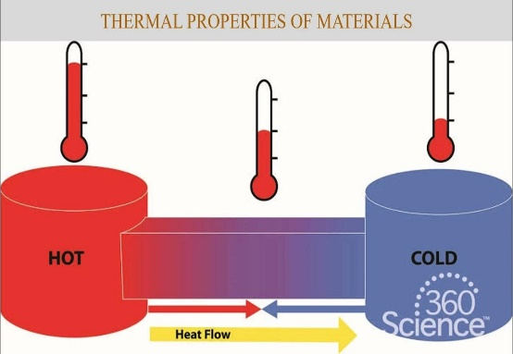

Key Parameters for Selection of Insulating Oil
Chemical Stability
Oxidation & Thermal Stability : Resistance to degrade over time and at high temp.
Material Compatibility : Compatible as long as instrument life
Thermal & Electrical Properties
Specific Heat Capacity : Higher capacity
Better heat Dissipation
Electrical Conductivity: Very Low – To prevent short circuits
Environmental & Health Safety
Biodegradable : Meet OECD 301 test specification
Non- toxic : Safe to use and disposal
Low Global Warming Potential (GWP)
PFAS free: (Per- and polyfluoroalkyl substances)
Flammability and Safety : High Flash point – reduce fire hazards.

Slide 5
Oil Properties – Significance
PROPERTY | SIGNIFICANCE
Density at 20 º C / Specific Gravity | Mass Volume conversion/heat transfer
Kinematic Viscosity | Heat transfer / Cooling
Flash Point | Safety & Fire Hazard
Pour Point | Minimum Operating Temp
Interfacial Tension | Refining Quality
Acidity / Neutralization No | Corrosion / Sludge build up / affects electrical properties
Water Content | electrical properties Sludge / Paper deterioration
Sulphur Content | Corrosion
Corrosive Sulphur | Copper conductor corrosion copper sulphide formation
Oxidation Stabilitry | Service life / Deterioration of electrical properties / Sludge

Slide 6
Oil Properties – Significance
PROPERTY | SIGNIFICANCE
Breakdown Voltage | Electrical Strength – Lower values indicate impurities like moisture / dirt / particles
Dielectric Dissipation Factor ( Tan δ ) | Higher values - presence of polar compounds. Decides refining quality & dissolved contamination
Power Factor , % | Percentage power loss - DDF x 100
Gassing Tendency | extent of Hydrogen Gas evolution / absorption, Important for better diagnosis by DGA & Safe operation
PCA - Poly Cyclic Aromatics | Gassing Tendency / Impulse BDV / Health hazards while handling
PCB / PCT | Highly Hazardous
2 FAL / Furans | Quality of refining / Higher values due to Used / Re refined oils
Carbon Type Composition | Not specified in any standard. Can decide Type of oil from Cp Cn value and performance

Slide 7

Transformer Oils for improved fire safety
01
Mineral Oil
High Molecular Weight Hydrocarbons:
(POWEROIL TO-HFLL)
02
Natural Ester Oil
From Natural Renewable sources:
Chemically modified
03
Synthetic Ester Oil
Esters Synthesized from
Basic Chemical Molecules
Notes:
Move NE to no. 2

Slide 8

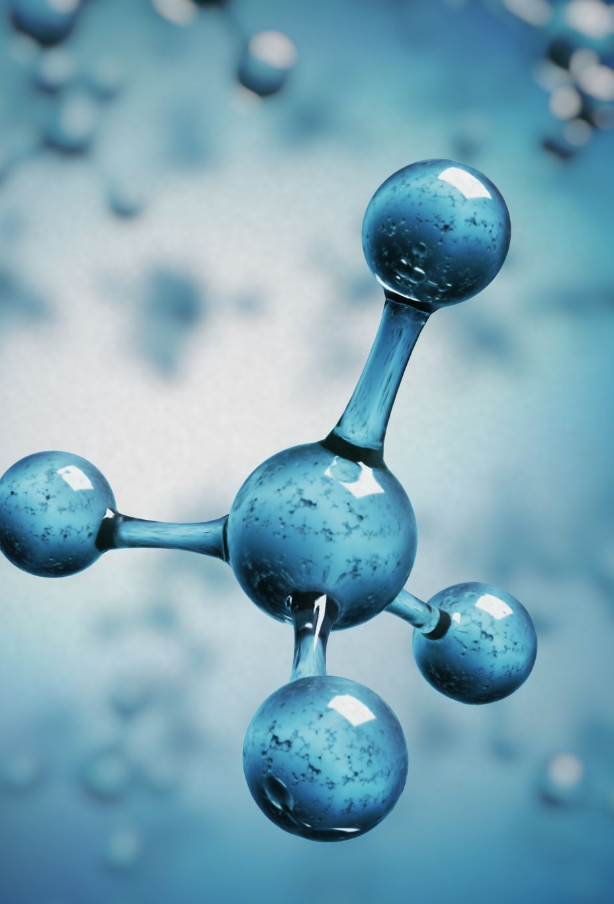
IS 335: 2018 ‘NEW INSULATING OILS - SPECIFICATION’
The standard covers specifications and test methods for unused mineral insulating oils for use in transformers, switchgear and similar electrical equipment in which oil is required as an insulant and for heat transfer.
Oils obtained by distillation and refining of crude petroleum.
Oils with and without additives (Inhibited and uninhibited) are both within the scope of this standard.
The standard is applicable only to unused mineral insulating oils.
Two types

Slide 9

IS 335:2018 Key difference in Type I & II Specifications
Characteristics | IS 335-2018
 | Type I | Type II
Viscosity at 0 °C, mm ² / s , max. | - | 1800 (LCSET)
Viscosity at at 40 °C , mm ² / s , max. | 12 | 15
Viscosity at at -30 °C , mm ² / s , max. | 1800 (LCSET) | -
Pour Point, º C , max. | -40 | -10
In Convective cooling systems, coolant (dielectric fluid) properties such as density, viscosity, thermal conductivity, Operating viscosity (VI) etc will define the heat transfer properties

Slide 10
Significance of Viscosity
Viscosity of oil plays significant role on ONAN type cooling units (Distribution transformer and solar transformers) on top oil temperature and shopfloor testing.
Type I, (<12 cSt viscosity) oil temp. rise is less compared to type II oil(<14.5cSt)
As DTs have very tight margins on materials and clearances, with ONAN type of cooling, Oil Viscosity plays significant role and Type I oils are most suitable.

Slide 11
IS 1180 (Part 1) Mineral Oil: Outdoor; Oil Immersed Distribution Transformers Up to 2500 kVA, 33kV - Specification
Requirement | 3 phase distribution transformers up to and 200 kva | 3 phase distribution transformers higher than 200 kva up to and 2500 kva
Top Oil temperature rise | 35°C | 40°C
H.V. Winding Temp. rise | 40°C | 45°C
L.V. Winding Temp. rise | 40°C | 45°C

Slide 12

Effect of Viscosity of Transformer oil on top oil temperature in DTs
Distribution transformers and Solar transformers are of ONAN type and Heat transfer coefficient is dependent on Viscosity resulting high the top oil temperature crossing the specified BIS limits
Shop floor heat run test on full load test condition is the acceptance criteria
CFD simulations on ONAN type of Distribution Transformers under laminar flow and natural convection clearly show the effect of viscosity.
Distribution Transformers have less tolerances on materials consumption and low clearances in general
Type I oils offer better protection in terms of acceptance on shopfloor testing and life protection
Notes:
ONAN - Oil Forced Air Forced Cooling
The heat produced in the winding and core is transferred to the transformer oil by conduction. The heated oil, being lighter, moves up on the transformer tank, and the cool oil takes the place of the hot oil. Thus, by convection process, the oil circulates from the bottom to the top of the tank. The ambient temperature then takes the heat away. The efficiency of the cooling system depends on the temperature of the ambient temperature and the surface area of the transformer. To increase the surface area of the transformer, a radiator is fitted on the transformer tank. ONAN cooling method is best suited for small-rating oil-filled transformers up to 5 MVA.
OFAF- Oil Forced Air Forced Cooling
For transformers above 60 MVA rating, the ONAF (Oil Natural Air Forced) cooling system is inadequate, and the OFAF cooling system is used. In a large rating transformer, more heat is generated, and the convection circulation of transformer oil is replaced with forced circulation. The oil pump is fitted in an OFAF cooling system; the pump forces the oil to circulate, and the heat transferred to the radiator is radiated in the ambient by force cooling of the transformer radiator.
CFD – Computational Fluid Dynamics

Slide 13
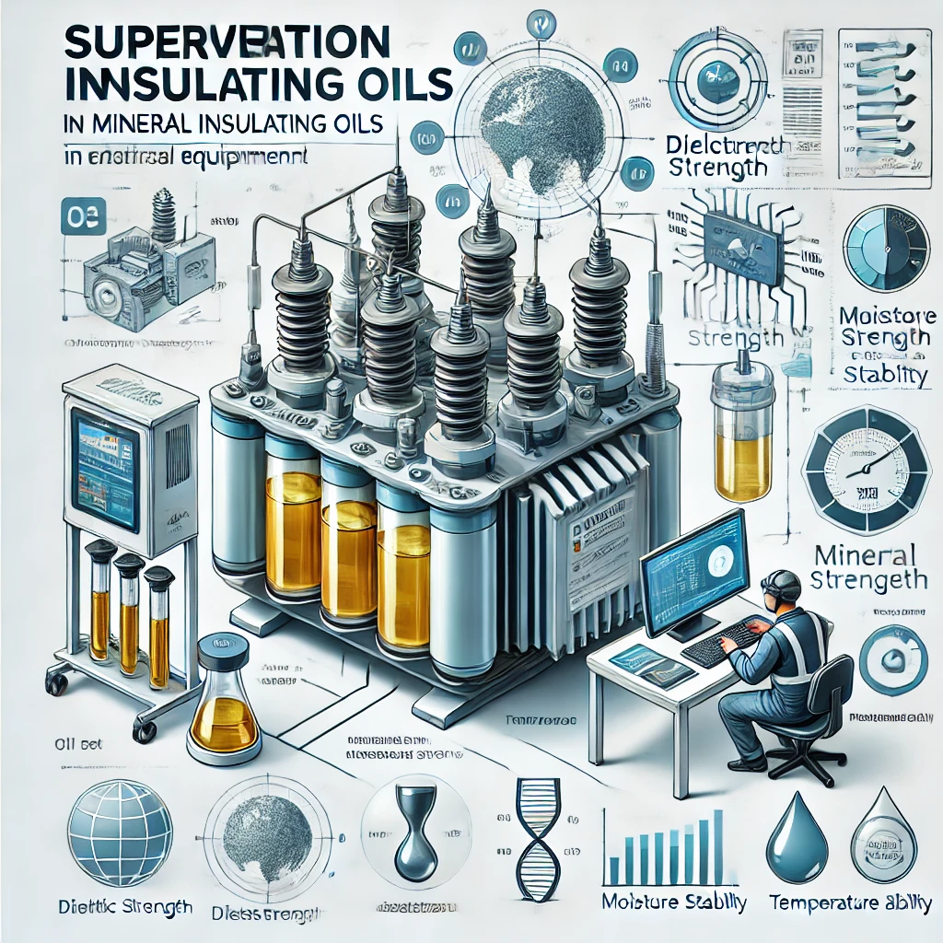
IS 1866: 2017 MINERAL INSULATING OILS IN ELECTRICAL EQUIPMENT - SUPERVISION AND MAINTENANCE GUIDANCE
intended to assist the power equipment operator to evaluate the condition of the oil and maintain it in a serviceable condition
- includes recommendations on tests and evaluation procedures and outlines methods for reconditioning and reclaiming oil and the decontamination of oil contaminated with PCBs.

Slide 14
Oil tests and their significance
Property | Significance
Colour and appearance | A rapidly increasing or a high colour number may be an indication of oil degradation or contamination. Besides colour, the appearance of oil may show cloudiness or sediment, which may indicate the presence of free water, insoluble sludge, carbon particles, fibres, dust, or other contaminants.
Breakdown voltage | Breakdown voltage is a measure of the ability of oil to withstand electric stress and has primary importance for the safe operation of electrical equipment. It indicates the presence of contaminants such as water or particles. A low value of breakdown voltage can indicate that one or more of these are present.
Water content | The water content of insulating oils influences • the breakdown voltage of the oil, • the solid insulation, • the ageing tendency of the liquid and solid insulation.

Slide 15
Oil tests and their significance
Property | Significance
Acidity (neutralization value) | - Acids and other oxidation products, in conjunction with water and solid contaminants, affect the dielectric and other properties of the oil. - Acids have an impact on the degradation of cellulosic materials and may also be responsible for the corrosion of metal parts in a transformer. The rate of increase of acidity of oil in service is a good indicator of the ageing rate. The acidity level is used as a general guide for determining when the oil should be replaced or reclaimed.
Dielectric dissipation factor (DDF) and resistivity | High values of DDF, or low values of resistivity, may deleteriously affect the dielectric losses and/or the insulation resistance of the electrical equipment. The measurement of resistivity is also considered to be of value for monitoring oils in service, as it has been shown to be reasonably proportional to oxidation acids and to be affected by undesirable contaminants such as metal salts and water

Slide 16
Oil tests and their significance
Property | Significance
Inhibitor content and oxidation stability | The oxidation stability gives the resistance to formation of acidic compounds, sludge and compounds influencing the dielectric dissipation factor (DDF). A decrease of IFT in inhibited oils may also be an early indication of initial formation of oxidation products.
Sediment and Sludge | The presence of sediment and/or sludge may change the electrical properties of the oil, and in addition, deposits may hinder heat-exchange, thus encouraging thermal degradation of the insulating materials.
Interfacial tension (IFT) | The interfacial tension between oil and water provides a means of detecting soluble polar contaminants and products of degradation.
Particles (counting and sizing) | Suspended particles have an effect on the dielectric strength of insulating oil. Historically, some failures on HV transformers have been associated with particle contamination.

Slide 17
Oil tests and their significance
Property | Significance
Flash point | A low flash point is an indication of the presence of volatile combustible products in the oil. This may result from contamination by a solvent but, in some cases, the cause has been observed to be extensive sparking discharges
Compatibility | A compatibility test may be needed to determine the feasibility of mixing unused oils of different origins with oil in service for topping up and/or refilling electrical equipment.
Pour point | Changes in pour point can normally be interpreted as the result of topping-up with a different oil.
Density | In cold climates, the density of oil may be important in determining its suitability for use. For example, ice crystals formed from separated water may float on oil of high density and lead to flashover on subsequent melting.
Viscosity | Viscosity is an important controlling factor in the dissipation of heat. Ageing and oxidation of the oil tend to increase viscosity. Viscosity is also affected by temperature. Normal ageing and oxidation of the oil will not significantly affect its viscosity

Slide 18
Oil tests and their significance
Property | Significance
Polychlorinated biphenyls (PCBs) | PCBs’ chemical stability and resistance to biodegradation is a cause for concern in terms of environmental pollution
Corrosive sulphur | At relatively high temperatures, sulphur-containing oil molecules may decompose and react with metal surfaces to form metal sulphides. Such reactions may take place in switching equipment and will impact the conductivity of contacts.
Dibenzyl disulfide (DBDS) content | DBDS is potentially corrosive to copper surfaces at normal transformer operating temperatures and may form copper sulphide under certain conditions. Among corrosive sulphur compounds DBDS appears to play a predominant role in the problem of corrosion.
Passivator content | Passivators in insulating oils, while beneficial for inhibiting corrosion and improving stability, can degrade over time, producing harmful byproducts and reducing effectiveness. They may interfere with diagnostic tests, cause compatibility issues with transformer materials, and sometimes decrease oxidation stability. Overuse can lead to deposits that hinder heat dissipation, and their degradation poses environmental disposal concerns. Regular monitoring and proper dosing are essential to minimize these risks.

Slide 19
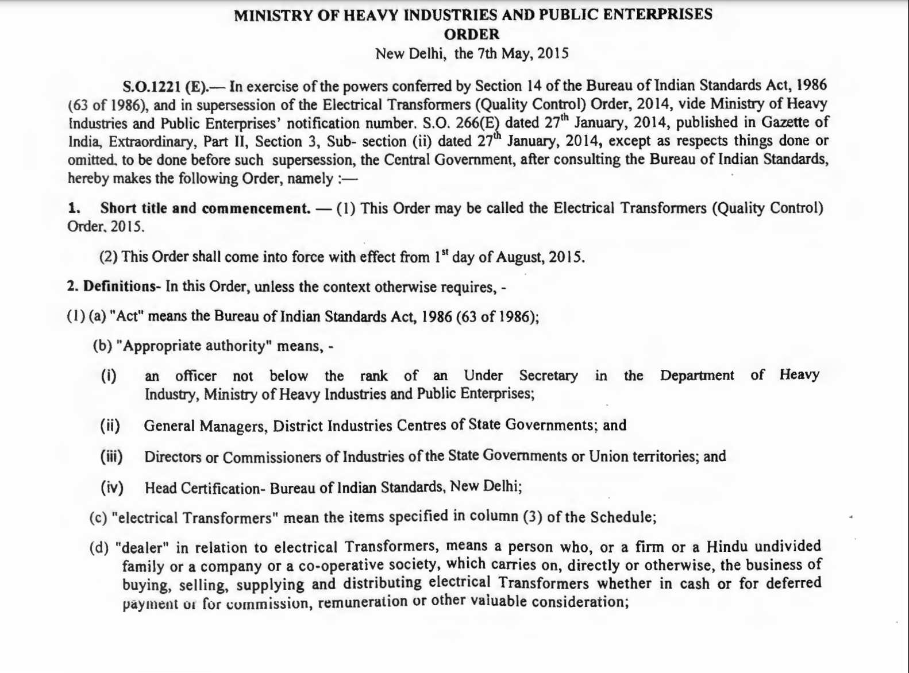

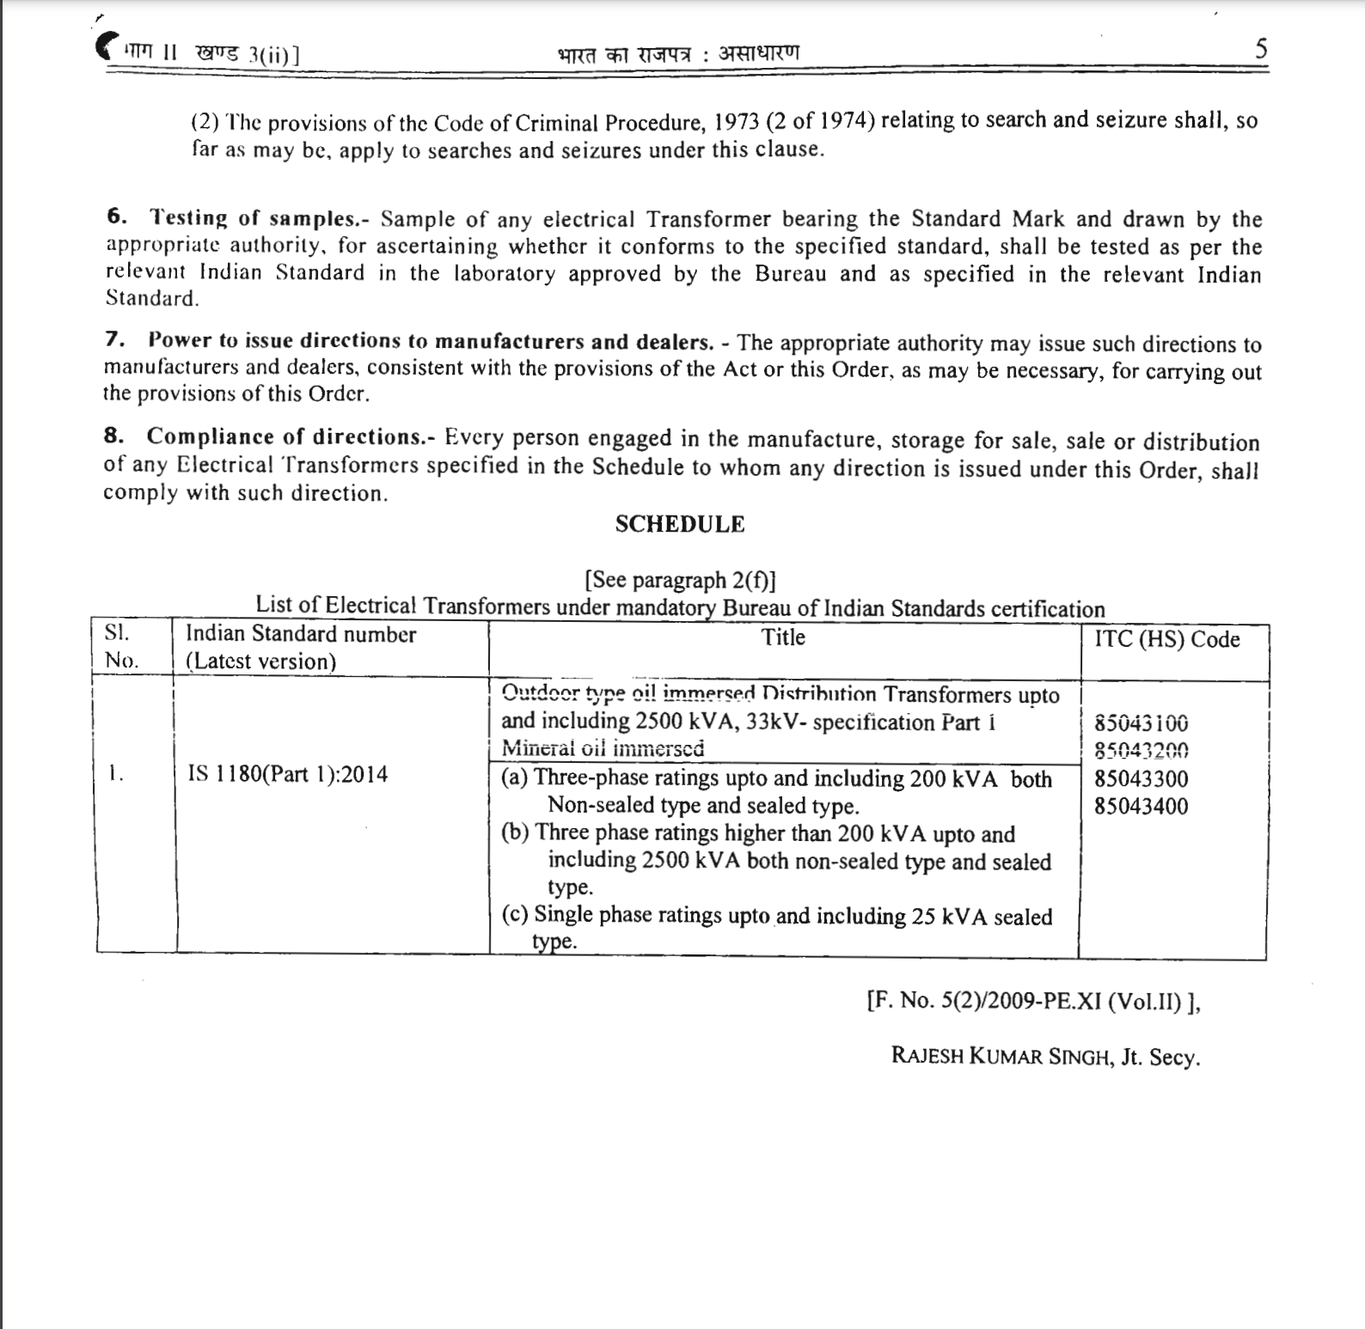
Statutory/Legal Provisions
Electrical Transformers (Quality Control) Order, 2015.
Mandatory BIS Certification ensuring compliance with IS 1180 (Part 1) specifications which make reference to IS 335
Central Electricity Authority (CEA) Regulations
Applicable for Indoor Transformers and Installations

Slide 20

Thank You!

