Slide 1



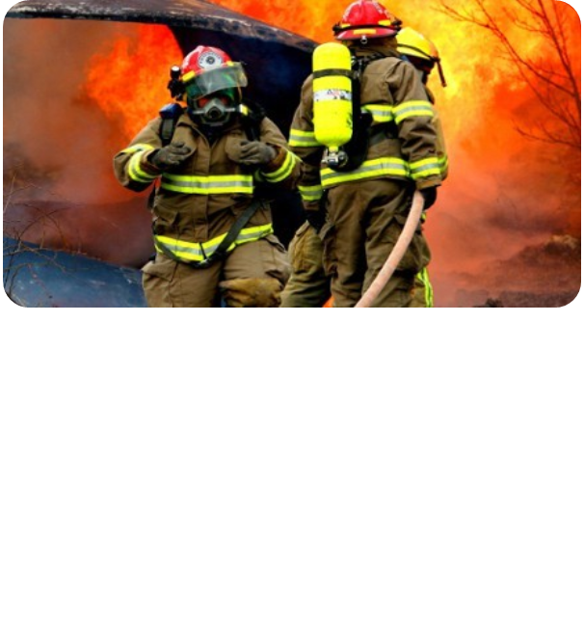

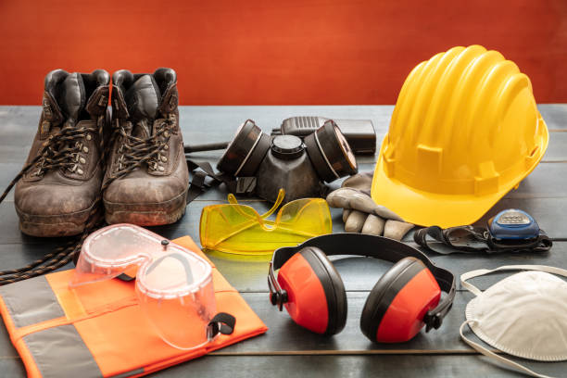
Labour Safety at the Workplace

Slide 2


Agenda
Personal Protective Equipment
5
Guide for Selection for PPE
14
Construction Safety
38
Safety Colours and Safety Signs & Accident Prevention Tags
64
OHSMS - IS/ISO 45001:2018
70

Slide 3
Introduction
3
Labour safety at the workplace is a crucial aspect of organizational management, aiming to ensure the health and well-being of employees.
Importance of workplace safety:
Ensures the well-being of employees and reduces operational disruptions.
Fosters a positive workplace culture.
Key statistics:
Over 2.3 million workplace accidents occur globally each year (source: ILO).
Proper safety measures can reduce accidents by up to 60%.
Benefits:
Reduced medical costs and downtime.
Increased employee morale and productivity.

Slide 4
Key components for maintaining safety in the workplace
Regulatory Compliance
Risk Assessment
Training and Education
Emergency Preparedness
Equipment and Machinery Safety
Ergonomics
Incident Reporting and Investigation
Health and Wellness Programs
Personal Protective Equipment (PPE)
Safety Culture
Monitoring and Continuous Improvement

Slide 5
Personal Protective Equipment’s
Definition: Equipment designed to protect workers from physical, chemical, biological, and ergonomic hazards.
Importance:
Reduces workplace injuries and fatalities.
Ensures compliance with safety regulations.
Common hazards:
Physical (e.g., falling objects, sharp tools).
Chemical (e.g., toxic fumes, spills).
Biological (e.g., pathogens).
Ergonomic (e.g., repetitive motion injuries).
Employer responsibilities:
Provide appropriate PPE.
Train employees on correct usage.
Regularly inspect and replace damaged equipment.

Slide 6
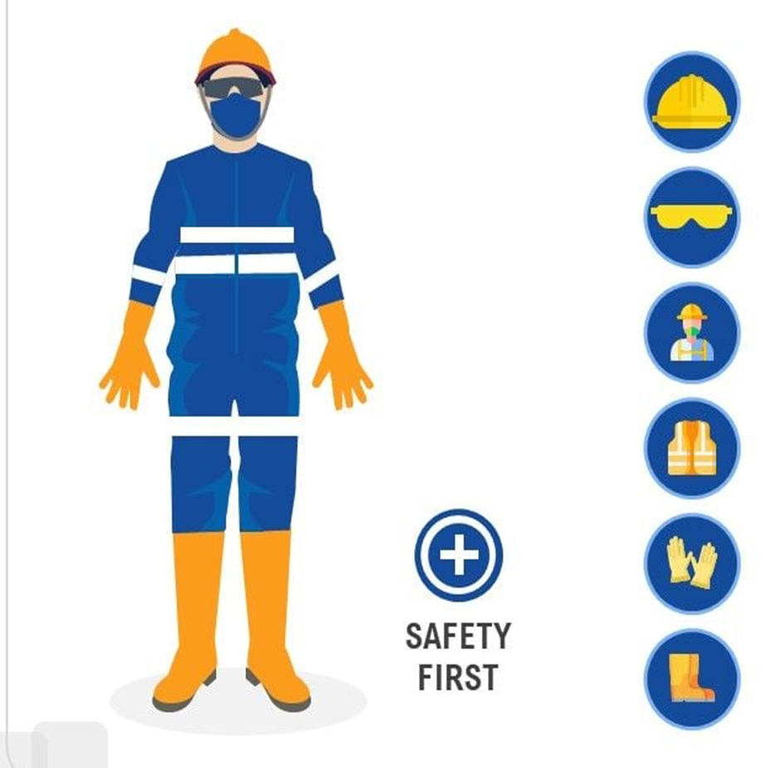
Personal Protective Equipment’ s
Wear Head Protection
Wear Eyes and Ear Protection
Wear Face Mask
Wear Vest
Wear Hand Gloves
Wear Safety Shoes

Slide 7
Head Protective Equipment’ s
IS 11207 : 1983 - helmets for mountaineers
These helmets are critical for protecting climbers from falling debris, sharp rocks, and accidental falls during their ascent or descent.
IS 2745 : 1983 - Metal helmet for firemen and civil defence personnel
Firefighting and civil defence operations expose individuals to intense heat, flames, and falling debris. The IS 2745: 1983 standard provides guidelines for metal helmets specifically designed for these high-risk professions.
IS 9562 : 1980 - Specification for non - Metal helmet for police force
The IS 9562: 1980 standard defines the specifications for non-metallic helmets designed for the police force, particularly for riot control and other operational duties.
IS 2925 : 1984 -industrial safety helmets
Industrial environments often expose workers to risks such as falling objects, accidental bumps, and electric hazards. The IS 2925: 1984 standard specifies the requirements for industrial safety helmets to protect workers in such hazardous conditions.
IS 4151 : 2015 - Helmets for motorcycle riders
Motorcycle riders are at significant risk of head injuries in accidents. The IS 4151: 2015 standard lays down the specifications for helmets designed for motorcyclists, emphasizing safety and performance.

Slide 8
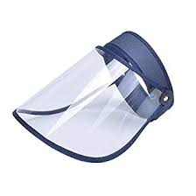
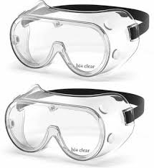
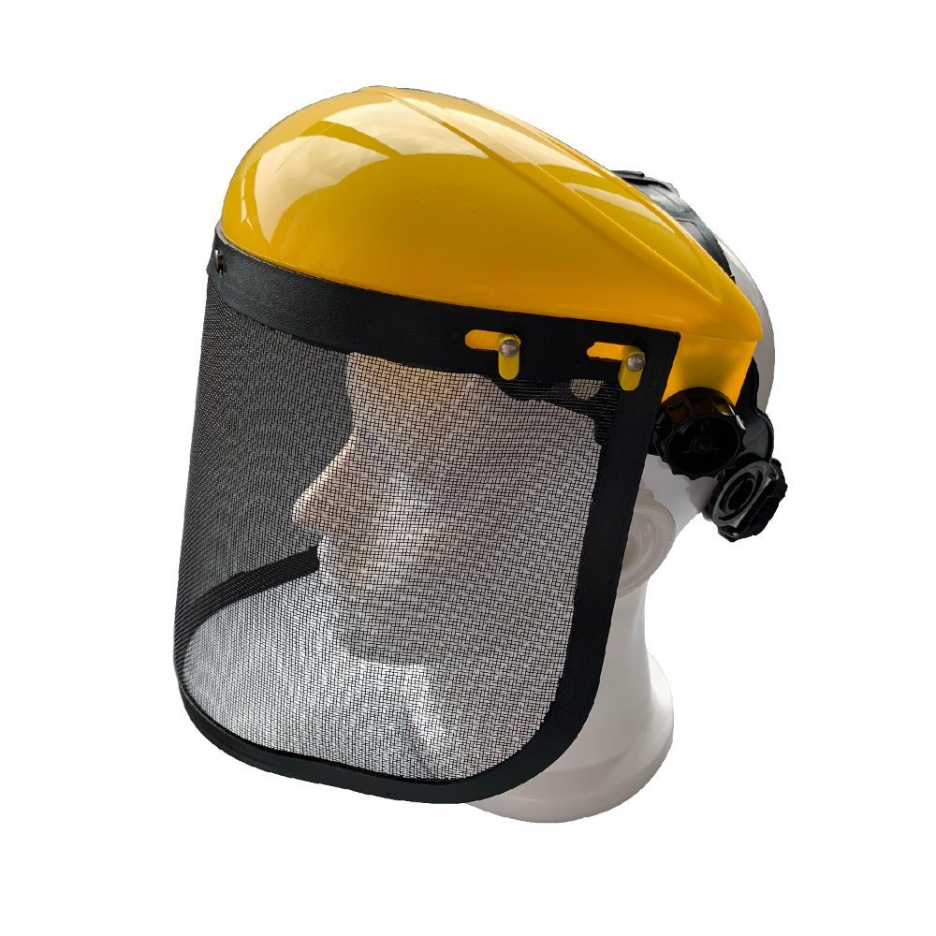
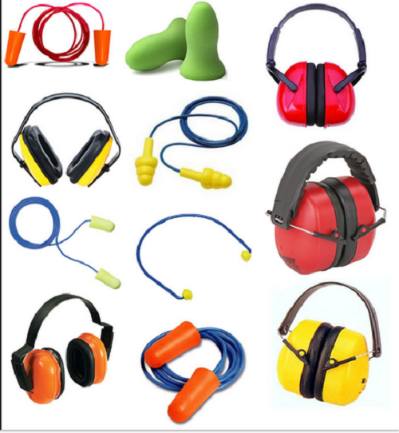
EYE, EAR AND FACE PROTECTIVE EQUIPENTS
IS 8521 (Part 1) : 2022 Eye and Face Protection for Occupational Use
These protectors are intended to provide protection for the eyes and faces of persons against one or more common occupational hazards such as impacts from flying particles and fragments, optical radiation, dusts, splashing liquids, molten metals, heat, flame, hot solids, harmful gases, vapours and aerosols
IS 9167 : 1979 Specification for ear protectors
Noise, unwanted sound, is present in all environments, predominantly in industrial environments. Exposure to high-intensity noise may cause hearing impairment. The degree of such impairment depends on the noise level and duration as well as the sensitivity of the individual.

Slide 9
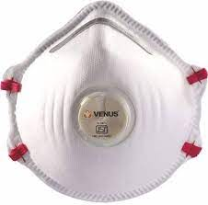
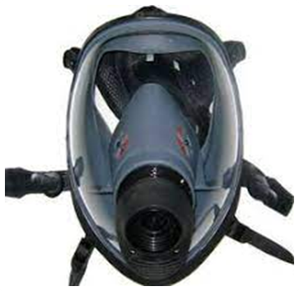
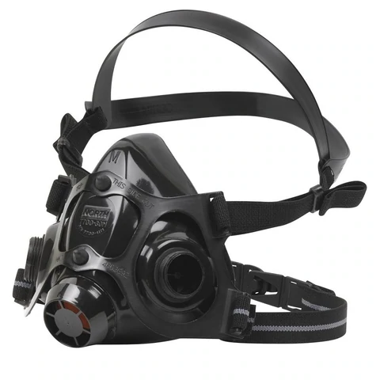
Respiratory Protective Devices
1. IS 9473 : 2002 Respiratory protective devices - Filtering half masks to protect against particles
These devices are designed to protect against solid and water-based aerosols only or against both solid and liquid aerosols.
2. IS 14166 : 1994 Respiratory protective devices full - Face masks – Specification
This standard covers full face masks for respiratory protective devices, except escape apparatus and diving apparatus. It specifies requirements for full face masks for use as part of respiratory protective devices.
3. IS 14746 : 1999 Respiratory protective devices - Half masks and quarter masks – Specification
Half masks and quarter masks are widely used in the environment where there is contamination of toxic or hazardous gases in the air. Depending on concentration and nature of the contamination, the half masks or quarter masks are used.

Slide 10
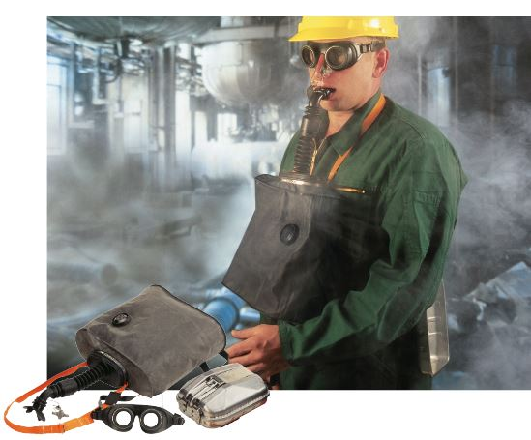
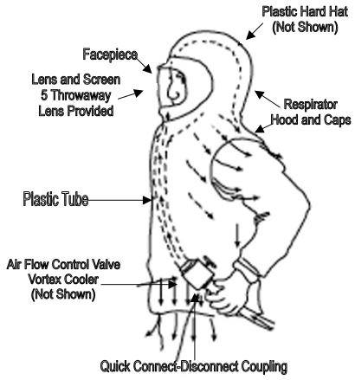
Continue…
4. IS 15803 : 2008 Respiratory protective devices – Self contained closed circuit breathing apparatus chemical oxygen (KO2) type, self generating, self rescuers – Specification
Chemical oxygen (K02) type self generating, self rescuers are used for escape by miners/persons from irrespirable atmosphere after an explosion/similar situation, to a safe place within a reasonable time . These are self contained closed circuit breathing apparatus for escape.
5. Breathing apparatus (Series of IS 10245) – Breathing apparatus enable a person to remain in irrespirable and poisonous atmosphere for a long and short period and to still retain his full physical and mental capacity.
The apparatus is required in mines, gas works, chemical factories, iron works, steel plants, smelting and metallurgical works, oil refineries and oil tankers. It may also be used by fire brigade, municipality, defense personnel and mountaineers
IS 10245 (Part 1) : 1996 Closed circuit breathing apparatus
IS 10245 (Part 2) : 2023 Open Circuit Breathing Apparatus
IS 10245 (Part 3) : 1999 Fresh air hose and compressed air line breathing apparatus
IS 10245 (Part 4) : 1982 Escape breathing apparatus (Short Duration Self - Contained Type)

Slide 11
BODY PROTECTIVE EQUIPMENT
IS 15748 for Clothing to Protect Against Heat and Flame
Heat and flame-resistant clothing is essential for workers exposed to high temperatures, flames, or radiant heat. IS 15748 outlines the requirements for protective clothing designed to shield the wearer from such hazards.
IS 16890 for Firefighter Suits:
Firefighters face extreme conditions, including high heat, flames, and hazardous environments. IS 16890 specifies the performance requirements for firefighter suits to provide maximum protection.
IS 16874 Firefighter Gloves:
Firefighter gloves are an integral part of a firefighter’s protective gear. IS 16874 outlines the requirements for gloves designed to protect hands from heat, flames, and mechanical hazards.
IS 15809: High-Visibility Warning Clothes
High-visibility clothing is essential for workers operating in low-light or high-risk environments, such as road construction or traffic management. IS 15809 specifies the requirements for such clothing.
IS 16655: Protective Clothing for Welding and allied processes
Welders face hazards such as sparks, molten metal splashes, and ultraviolet radiation. IS 16655 specifies the requirements for protective clothing designed for welding and related tasks.
IS 18849: 2024 Workwear for Cement Workers
Cement workers are exposed to dust, abrasive materials, and chemicals that can cause skin irritation and respiratory issues. IS 18849: 2024 provides guidelines for protective clothing tailored to the needs of this workforce.

Slide 12
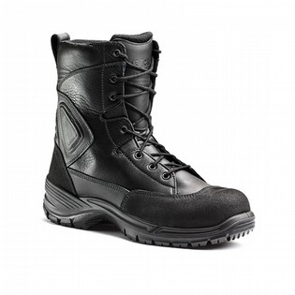
Foot and Legs Protective Equipment’s
Foot and leg protection is critical for workers in industries where they face risks such as heavy objects, sharp materials, chemicals, or extreme temperatures
IS 15298 (Part 2) : 2024 – safety footwear
IS 15298 (Part 3) : 2024– protective footwear
IS 15298 (Part 4) : 2024 – protective footwear
IS 1989 (Part 1) : 1986 – leather safety boots for miners
IS 1989 (Part 2) : 1986 – leather safety boots for heavy metal industries
IS 11226 : 1993 – leather safety boot with moulded rubber sole
IS 14544 : 2022 – leather safety boot with moulded PVC sole

Slide 13
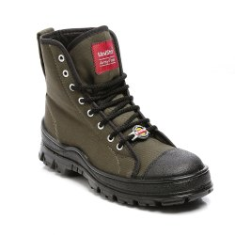
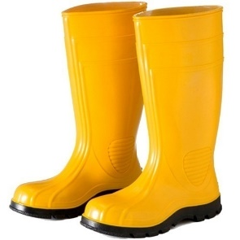
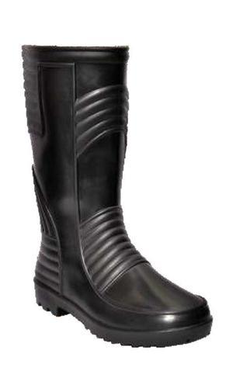
Continue…
Canvas safety boots for miners
IS 3976 : 2018
Gumboots
IS 5557 : 2004 – safety and protective gum boots
IS 5557 (Part 2) : 2019 – occupational gum boots
PVC industrial boots
IS 12254 : 2021

Slide 14
Guide for Selecting Personal Protective Equipment (PPE)
Personal Protective Equipment (PPE) is critical for ensuring safety in environments where hazards exist. The selection of appropriate PPE depends on several factors, including the type of hazard, the level of exposure, and the specific tasks being performed. Below is a guide to help select the right PPE
Identify Workplace Hazards
Match PPE to the Hazard
Consider Fit and Comfort

Slide 15
GUIDE FOR SELECTION OF PPE FOR WASTE HANDLING
Eye Protector to protect eyes from splashes of waste material
Sl No. | Different Types of Waste | Eye Protection | Relevant Indian Standard
(1) | (2) | (3) | (4)
i) | Municipal solid waste | Safety goggles | IS 8521 (Part 1)
ii) | Municipal liquid waste | Face shield/Full face piece | IS 8521 (Part 1) and IS 14166
iii) | Municipal sewage waste | Safety goggles | IS 8521 (Part 1)
iv) | Fumigation | Safety goggles | IS 8521 (Part 1)
v) | Biodegradable waste | Safety goggles | IS 8521 (Part 1)
vi) | Chemical waste | Safety goggles | IS 8521 (Part 1)
vii) | Biomedical waste | Safety goggles | IS 8521 (Part 1)
viii) | Construction waste | Safety goggles | IS 8521 (Part 1)
ix) | Domestic waste | Safety goggles | IS 8521 (Part 1)
x) | e-Waste | Safety goggles | IS 8521 (Part 1)
xi) | Food waste | Safety goggles | IS 8521 (Part 1)
xii) | Gaseous waste | Safety goggles | IS 8521 (Part 1)
xiii) | Hazardous/Toxic waste | Full face piece/hood | IS 8521 (Part 1) and IS 14166

Slide 16
Respiratory protective devices to protect nose and mouth from splashes waste
Sl No. | Different Types of Waste | Respiratory Protection | Relevant Indian Standard
(1) | (2) | (3) | (4)
i) | Municipal solid waste | Filtering face piece FFP1/FFP2/FFP3 | IS 9473
ii) | Municipal liquid waste | Half face/Full face masks with appropriate cartridge | IS 14746, IS 14166, IS 15323 and IS 15322
iii) | Municipal sewage waste | PAPR (Powered Air-Purifying Respirators) & SAR (Supplied-Air Respirators) /SCBA(Self-Contained Breathing Apparatus) | IS 10245 (Part 2) and IS 10245 (Part 3)
iv) | Fumigation | Filtering face piece FFP1/P2/P3 Respirator with OV relief | IS 9473, IS 14746, IS 14166, IS 15323 and IS 15322
v) | Biodegradable waste | Filtering face piece FFP1/FFP2/FFP3 | IS 9473
vi) | Chemical waste | Half face/Full face masks with appropriate cartridge/SAR | IS 14746, IS 14166, IS 15323 & IS 15322, IS 10245 (Part 2) and IS 10245 (Part 3)
vii) | Biomedical waste | Half face/Full face masks with appropriate cartridge | IS 14746, IS 14166, IS 15323 & IS 15322, IS 10245 (Part 2) and IS 10245 (Part 3)
viii) | Construction waste | Filtering face piece FFP1/FFP2/FFP3 | IS 9473
ix) | Domestic waste | Filtering face piece FFP1/FFP2/FFP3 | IS 9473
x) | e-Waste | Filtering face piece FFP1/FFP2/FFP3 | IS 9473
xi) | Food waste | Filtering face piece FFP1/FFP2/FFP3with OV relief | IS 9473
xii) | Gaseous waste | Half face/Full face masks with appropriate cartridge/ SAR (Supplied-Air Respirators) /SCBA(Self-Contained Breathing Apparatus) | IS 14746 ,IS 14166, IS 15323, IS 15322, IS 10245 (Part 2) and IS 10245 (Part 3)
xiii) | Hazardous/Toxic waste | Half face/Full face masks with appropriate cartridge/ SAR (Supplied-Air Respirators) /SCBA(Self-Contained Breathing Apparatus) | IS 14746 ,IS 14166, IS 15323, IS 15322, IS 10245 (Part 2) and IS 10245 (Part 3)

Slide 17
Gloves to prevent exposure of hands to waste
Sl No. | Different Types of Waste | Hand Protection | Relevant Indian Standard
(1) | (2) | (3) | (4)
i) | Municipal solid waste | Cut resistant gloves/leather hand gloves | IS 6994 (Part 1)
ii) | Municipal liquid waste | Chemical protective gloves | IS 6994 (Part 1)
iii) | Municipal sewage waste | Chemical protective gloves | IS 6994 (Part 1)
iv) | Fumigation | Chemical protective gloves | IS 6994 (Part 1)
v) | Biodegradable waste | Chemical protective gloves | IS 6994 (Part 1)
vi) | Chemical waste | Chemical protective gloves | IS 6994 (Part 1)
vii) | Biomedical waste | Surgical gloves | IS 6994 (Part 1)
viii) | Construction waste | Cut resistant gloves/leather hand gloves | IS 6994 (Part 1)
ix) | Domestic waste | Chemical protective gloves | IS 6994 (Part 1)
x) | e-Waste | Cut resistant gloves/leather hand gloves | IS 6994 (Part 1)
xi) | Food waste | Chemical protective gloves | IS 6994 (Part 1)
xii) | Gaseous waste | Cryogenic/heat resistant gloves | IS 6994 (Part 1)
xiii) | Hazardous/Toxic waste | Cryogenic/heat resistant gloves | IS 6994 (Part 1)

Slide 18
Body protection to keep human waste or sewage off clothing.
Sl No. | Different Types of Waste | Body Protection | Relevant Indian Standard
(1) | (2) | (3) | (4)
i) | Municipal solid waste | Protective leather clothing | IS 6153
ii) | Municipal liquid waste | Aprons and suits , rubberized, acid and alkali resistant | IS 4501
iii) | Municipal sewage waste | Protective suits , rubberized, acid and alkali resistant | IS 4501
iv) | Fumigation | CBRN (Chemical, Biological, Radiological and Nuclear) Suit | As per India Military standard
v) | Biodegradable waste | CBRN (Chemical, Biological, Radiological and Nuclear) Suit | As per India Military standard
vi) | Chemical waste | CBRN (Chemical, Biological, Radiological and Nuclear) Suit | As per India Military standard
vii) | Biomedical waste | CBRN (Chemical, Biological, Radiological and Nuclear) Suit | As per India Military standard
viii) | Construction waste | Protective leather clothing | IS 6153
ix) | Domestic waste | Aprons and suits , rubberized, acid and alkali resistant | IS 4501
x) | e-Waste | Aprons and suits , rubberized, acid and alkali resistant | IS 4501
xi) | Food waste | Aprons and suits , rubberized, acid and alkali resistant | IS 4501
xii) | Gaseous waste | CBRN (Chemical, Biological, Radiological and Nuclear) Suit | As per India Military standard
xiii) | Hazardous/Toxic waste | CBRN (Chemical, Biological, Radiological and Nuclear) Suit /X-ray lead rubber protective aprons and Suits | As per India Military standard

Slide 19
Foot protection to prevent exposure to human waste or sewage.
Sl No. | Different Types of Waste | Foot Protection | Relevant Indian Standard
(1) | (2) | (3) | (4)
i) | Municipal solid waste | Safety shoes | IS 10667
ii) | Municipal liquid waste | Safety shoes liquid resistant | IS 10667
iii) | Municipal sewage waste | Safety shoes liquid resistant | IS 10667
iv) | Fumigation | Safety shoes liquid resistant | IS 10667
v) | Biodegradable waste | Safety shoes | IS 10667
vi) | Chemical waste | Chemical protection shoe | IS 10667
vii) | Biomedical waste | Chemical protection shoe | IS 10667
viii) | Construction waste | Safety shoes | IS 10667
ix) | Domestic waste | Safety shoes | IS 10667
x) | e-Waste | Safety shoes | IS 10667
xi) | Food waste | Safety shoes | IS 10667
xii) | Gaseous waste | Safety shoes impermeable to gas | IS 10667
xiii) | Hazardous/Toxic waste | CBRN (Chemical, Biological, Radiological and Nuclear) shoe | IS 10667

Slide 20
Guide for Selection of Industrial Safety Equipment for Protection of Foot and Leg: IS 10667
This standard is intended to guide workers and those in charge of their safety in industrial operations in selecting such protective equipment for foot and leg that will give the required protection against hazards likely to be encountered.
Foot injuries are caused due to:
Striking against stationary object;
Striking by moving object;
Stepping on hot objects;
Stepping on sharp objects;
Heat radiation and welding sparks;
Chemicals and microbiological contamination; and
Ergonomic risk
For foot protection it is also necessary for the employer to provide washrooms, showers, and locker facilities so that employees can conveniently bathe their feet and change into clean, dry footwear after the day’s work.

Slide 21
LIST OF INDIAN STANDARDS ON PROTECTION OF FOOT AND LEG FOR VARIOUS HAZARDS
Indian Standard | Typical Operations | Hazard Description
IS 11226 | Used by workers of mines, refiners, fertilizer plants, or places where working surface is oily. | Impact, cut, vibration, abrasion, slip
IS 14544 | Used in the industry and with general purpose resistance to oils and chemical | Solvents, oil and grease
IS 15298 (Part 2) and IS 15298 (Part 3) | Used for general purpose, for example, mechanical risks, slip resistance, thermal risks, and ergonomic behavior. | Striking against stationary object, striking by moving object; stepping on hot objects, stepping on sharp objects,
IS 16645 | Ankle boots to full thigh height inclusive used for general industrial purpose | Ergonomic risk
IS 17012 | Used for grueling marches and operations during heat or rain, or facing obstacles in day to day work to keep the feet protected and comfortable | Ergonomic risk
IS 17043 (Part 1) | Generally used by armed forces/police forces for daily wear and for marching purposes | Ergonomic risk
IS 16994 | Used by Municipal workers exposed to unhygienic conditions during their scavenging work | Chemical and biological hazard

Slide 22
Continue…
Indian Standard | Typical Operations | Hazard Description
IS 17037 | Safety shoes meant for use by police forces/paramilitary forces when handling hostile situations | Injuries from stones, fire, sharp objects, water, oil, electric shock and slip.
IS 17861 : 2022 | Used by police forces, paramilitary forces, similar security agencies and trekkers in carrying out their work. These boots are designed such that they can withstand long strenuous working and walking conditions. | Ergonomic risk, slip
IS 1989 (Part 1) | Used in coal mines, especially by categories of workers like trammers and shot firers suitable for most of the surface mines of coal, limestone, iron ore, etc. | Impact, cut, vibration, abrasion, slip
IS 1989 (Part 2) | Safety boots and shoes for workers engaged in heavy metal industries | Impact, cut, vibration, abrasion, slip
IS 3976 | Used by workers engaged in underground mining of coal, mica, silica, clay, stone and other minerals where wet surface condition is prevalent | Impact, cut, vibration, abrasion, slip
IS 5557 | Used in mines as well as for workmen in heavy metal industries and where the floor is covered with water, chemicals, oil, grease, waxes, lubricants etc. | Impact, cut, vibration, abrasion, slip
IS 5557 (Part 2) | Recommended for use in tanneries, food and beverage industries, sewage treatment plant, Petrochemical industries, pharmaceutical industries, garbage disposal and related municipal operations, cement and construction work, road building, etc. | Chemical and biological hazard

Slide 23
Guide for Selection of Occupational Protective Clothing — Body Protection (Selection, Care and Maintenance) – IS 8519
This standard is intended to guide workers and those in charge of their safety in industrial operations in selecting such protective equipment for the body as will give the required protection against hazards likely to be encountered.
The types of protective clothing for body protection used in various occupations are given below:
Apron
Clothing worn to protect against physical, chemical, biological hazards that covers the partial, or greater part of the body.
Bib Type
Covering chest, waist and legs down to the knees or sometimes to ankles.
Waist Type
Covering waist and legs down to the knees or below.
Split Type
Divided at the crotch and fastened around each leg.

Slide 24
Continue…
Cape Sleeve
Back, shoulder and arm covering which extends over the upper chest. They can also be worn over aprons.
Coat
Extending either to knee or ankle to give body and leg protection.
Coverall
Coverall is a type of personal protective equipment (PPE) intended to be worn for the purpose of isolating all parts of the body from a potential hazard.
Jacket
Garment which covers upper body from shoulders to hips.
Suit
Garment which covers the whole body to wrists and ankles and to which breathing air is to be supplied.

Slide 25
List of Body Protection Equipment Related to Hazards
Protection Against Hazard | Typical Operations | Typical Material of Constructions | Typical Body Protection | Relevant Indian Standard
Sustained radiant heat | Glass furnaces, forgings, hearths, pit and salt bath furnace, etc, fire fighters, oil and natural gas drilling, chemical industry, electrical installations | Glass fiber insulated fabric, fire resistant textiles, cooling vest | Coverall, suit, coats, jackets, trousers, bib-trousers, googles, spectacles | IS 15748, IS 16655, IS 8521 (Part 1), and IS 8521 (Part 2)
Flame (heat transmission due to exposure to flame) | Flame proximity and flame entry 3; Oil and natural gas drilling, metallurgical, welding, chemical industry | Aluminized fabric, glass fiber insulated fabric, fire-resistant duck, fire resistant textiles, multi-layer barrier film laminated flame proof textile | Coverall, suit, coats, jackets, trousers, shirts, bib-trousers, googles, spectacles | IS 15742, IS 15748, IS 16655, IS 8520, IS 8521 (Part 1), and IS 8521 (Part 2)
Hot metal splash and sparks | Foundry, forging and welding, heat treatment and die casting | Leather, aluminized fabric, fire resistant duck | Coverall, suit , coats Jackets, trousers, shirts, bib-trousers, googles, spectacles | IS 15748, IS 16655, IS 8520, IS 8521 (Part 1), and IS 8521 (Part 2)

Slide 26
Continue…
Protection Against Hazard | Typical Operations | Typical Material of Constructions | Typical Body Protection | Relevant Indian Standard
Electric current | Work on live conductors | Rubber, multi-layer barrier film laminated electric resistant textile fabric | Suit, electric arc resistant suits
Water splashes | Dairies and laundries, fisheries, catering industries, automotive industries, agriculture | Rubber, coated fabric, HDPE plastic, plastic coated fabric, water resistant non-woven breathable fabric resistant to abrasion and bacterial penetration. | Aprons, coverall, suit, coats, jackets, googles, spectacles | IS 17423, IS 8520, IS 8521 (Part 1), and IS 8521 (Part 2)
Mild acids and alkalis | Pickling and degreasing | Rubber, plastic, plastic coated fabric, synthetic rubber, water resistant non-woven breathable fabric resistant to abrasion and bacterial penetration Fabric suited for chemical and biological hazards | Aprons, coverall, suit, coats, jackets, googles, spectacles | IS 15071, IS 8520, IS 8521 (Part 1), and IS 8521 (Part 2)

Slide 27
Continue…
Protection Against Hazard | Typical Operations | Typical Material of Constructions | Typical Body Protection | Relevant Indian Standard
Strong acids and alkalis | Handling and manufacturing chemicals | Rubber, plastic, plastic coated fabric, synthetic rubber; chemical resistant textiles, multi-layer barrier film laminated textile fabric, spun bonded polypropylene fabric | Aprons, coverall, suit, coats, jackets Trousers, shirts, bib-trousers, googles, spectacles | IS 15071, IS 8520, IS 8521 (Part 1), and IS 8521 (Part 2)
Organic solvents, oils | Handling petroleum products | Synthetic rubber, | Aprons, coverall, suit, coats, | IS 1001
Flying chips, rough objects, mild impacts | Grinding, woodworking and shot-blasting, machining of metals | Leather, linen, para aramid fabric | Aprons, coverall, suit, coats, googles, spectacles | IS 6153, IS 8520, IS 8521 (Part 1), IS 8521 (Part 2)
Severe blows and sharp tools | Saw operations, grinders and butchers | Wire mesh, reinforced leather, para aramid fabric | Coverall, suit, coats, googles, spectacles | IS 8520, IS 8521 (Part 1), and IS 8521 (Part 2)
X-rays and gamma rays, Ionizing radiations | X-ray technicians and laboratory workers | Lead plastics or lead rubber or lead leather | Aprons, coverall, suit, coats, googles, spectacles | IS 8520, IS 8521 (Part 1), and IS 8521 (Part 2)

Slide 28
Continue…
Protection Against Hazard | Typical Operations | Typical Material of Constructions | Typical Body Protection | Relevant Indian Standard
Low temperature | Industrial operations, cold storage, laboratories | Leather, wool | Aprons, coverall, suit, coats, googles, spectacles
Cryogenic | Industrial operations, space application | Leather, wool | suits
Fire | Fire fighting | Fire resistant textiles | Suits, googles, spectacles | IS 16874, IS 16890, IS 8520, IS 8521 (Part 1), and IS 8521 (Part 2)
High visibility | Traffic operations, construction, aviation, oil and natural gas drilling, areas of low visibility in different industries prone to accidents | Luminescence material High visibility textiles and retro-reflective material | Aprons, coverall, suit, coats, jackets, cape sleeve Jackets, trousers, shirts, bib-trousers, googles, spectacles | IS 15809, IS 8520, IS 8521 (Part 1), and IS 8521 (Part 2)
Microbial penetrations Biological exposure | Hotels, slaughter house, leather industries, pathology labs, healthcare, pharmaceuticals, medical diagnostic lab, clean rooms etc | Melt blown fabric, non-woven fabric, spun bonded polypropylene fabric | Aprons, coverall, suit, coats, jackets, sleeves, shoe covers, googles, spectacles | IS 17423, IS 8520, IS 8521 (Part 1), and IS 8521 (Part 2)

Slide 29
Continue…
Protection Against Hazard | Typical Operations | Typical Material of Constructions | Typical Body Protection | Relevant Indian Standard
Static charge | Areas in the industry where electrostatic charges can develop due to environment or work practice; electronic industry, computer manufacturing and assembling | Textile Fabric coated/treated for antistatic protection ESD Shoes | Coverall, suits, shirt, jackets, trousers, googles, spectacles | IS 8520, IS 8521 (Part 1), and IS 8521 (Part 2)
Electric arc | Electrical depots, power generation companies, metallurgical industry, any industry equipped with heavy electrical equipment | Textiles, polymer coated or multi-layer barrier film laminated for electric arc or arc flash protection | Coverall, suits, coats, jackets, jackets, trousers, shirts, bib-trousers, googles, spectacles | IS 8520, IS 8521 (Part 1), and IS 8521 (Part 2)

Slide 30
Guide for Selection of Industrial Safety Equipment for Protection of Arms and Hands- IS 8807
Hazard Description | Typical Application | Potential Damage | Typical material of Constructions | Selection Criteria (Conditions to Consider) | Relevant Indian Standard
Heat, but where no irritant substance present and the risk of wear is not serious | Furnace work drop stamping, casting and forging, handling hot tyres and similar operations | Temperature Burns, | Para aramid Heat resistant fibers Aluminized Fabric | Dexterity, Size, Temperature to be handled, Fire-resistant capacity, Grip, and Duration of exposure | IS 16874
Heat, when irritant substance is present and risk of wear is Serious | Stoking gas retorts, riveting, holding up, hot chipping | Temperature Burns, molten splash, | Para aramid Heat resistant fibers Aluminized Fabric | Dexterity, Size, Temperature to be handled, Fire-resistant capacity, Grip, and Duration of exposure | IS 16874
Heat, when fair degree of sensitivity is required and splashes or spatter of molten metal may occur | Welding, case hardening in cyanide bath | Temperature Burns, molten splash, Material that isn’t flame resistant melts into the skin which often can never be completely removed | Para aramid Heat resistant fibers Aluminized Fabric | Dexterity, Size, Temperature to be handled, Fire-resistant capacity, Grip, and Duration of exposure | IS 16874 IS 2573

Slide 31
Continue…
Hazard Description | Typical Application | Potential Damage | Typical material of Constructions | Selection Criteria (Conditions to Consider) | Relevant Indian Standard
Heat, when caused by steam | Generated in Boilers, furnace etc. | Steam burns | Para aramid Heat resistant fibers | Dexterity, Size, Temperature to be handled, Fire-resistant capacity, Grip, and Duration of exposure | IS 16874
Cryogenic | Handling Cryogenic liquids and cryogenic containers | Cold burns |  | Dexterity, Size, Grip, and Cryogenic temperature expected | IS 5866
Sharp Materials or Objects | Sharp metal after guillotining, blanking or machining | Cuts Lacerations | Polyester, High performance Polyethylene (HPPE) Para aramid Nitrile Leather | Dexterity, Size, Penetration, Permeability, Degradation, and Grip | IS 2573, IS 6994 (Part 9), and IS 6994 (Part 10)
Glass or timber with splintered Edges | Handling wooden chips, glass moulding, glass handling, pottery | Cuts Lacerations | Polyester, High performance polyethylene (HPPE) Para aramid Nitrile Leather | Dexterity, Size, Penetration, Permeability, Degradation, and grip | IS 2573, IS 6994 (Part 9), and IS 6994 (Part 10)

Slide 32
Continue…
Hazard Description | Typical Application | Potential Damage | Typical material of Constructions | Selection Criteria (Conditions to Consider) | Relevant Indian Standard
Abrasions | Handling cold castings or forgings, precast concrete, bags of cement or bricks | Cuts Lacerations | Polyester, High performance polyethylene (HPPE), Para aramid, Nitrile, and Leather | Dexterity required to perform the operation , Level of abrasion expected during operation, Level of cut expected, Puncture Level of Damping, Shock absorption capacity, Size, and Grip | IS 2573 IS 6994 (Part 9) IS 6994 (Part 10)
Gross Abrasion | Shot blasting | Cuts Lacerations | Polyester, High performance polyethylene (HPPE), Para aramid, Nitrile, and Leather | Dexterity required to perform the operation, Level of abrasion expected during operation, Level of cut expected, Puncture, Level of Damping, Shock absorption capacity, Size, and Grip | IS 2573 IS 6994 (Part 9) IS 6994 (Part 10)
Light Abrasion | Light handling operations | Cuts Lacerations | Polyester, High performance polyethylene (HPPE), Para aramid, Nitrile, and Leather | Dexterity required to perform the operation, Level of abrasion expected during operation, Level of cut expected, Puncture, Level of Damping, Shock absorption capacity, Size, and Grip | IS 2573 IS 6994 (Part 9) IS 6994 (Part 10) IS 5450

Slide 33
Continue…
Hazard Description | Typical Application | Potential Damage | Typical material of Constructions | Selection Criteria (Conditions to Consider) | Relevant Indian Standard
Sharp materials or objects in alkaline degreasing bath | Electro plating, Chemical handling | Skin Irritation, Chemical Burns, Skin Diseases ansd skin allergies Etching | Polyester, High performance polyethylene (HPPE), Para aramid, Nitrile, Leather, Latex rubber, and Poly urethane | Dexterity, Size, Penetration, Permeability, Degradation, Grip, Level of abrasion expected during operation, and Level of cut expected | IS 2573 IS 6994 (Part 9) IS 6994 (Part 10) IS 6994 (Part 1) : 2021
Impact | Mechanical operations like hammering, power press, using heavy duty hand tools etc. | Cuts Broken bones Finger or hand amputations |  | Dexterity, Size, Grip, Level of abrasion expected during operation, Level of cut expected, and Amount of Impact expected | IS 6994 (Part 6)
Vibration | Mechanical operations like hammer drilling, Concrete vibrators, power press. | Cuts swelling of Tendon Carpel tunnel syndrome (Numbness) Back disorders |  | Dexterity, Size, Grip, Level of abrasion expected during operation, Level of cut expected, and Amount of Impact expected | IS 6994 (Part 6)

Slide 34
Continue…
Hazard Description | Typical Application | Potential Damage | Typical material of Constructions | Selection Criteria (Conditions to Consider) | Relevant Indian Standard
Chemicals | Handling or contact with acids, alkalis, dyes, and general chemicals, but not involving contact with solvents or oils | Skin Irritation, skin allergies, Skin absorption of life-threatening toxins, Severe chemical burns skin diseases that last for a long time | Nitrile, Latex rubber, Poly urethane, and Cotton/polyester lining | Dexterity, Size, Penetration, Permeability, Degradation, and grip | IS 6994 (Part 1), IS 6994 (Part 8) IS 16390
Solvents, Oil and Grease | Handling or contact with solvents) oils or grease | Skin Irritation, Chemical Burns, Skin Diseases and skin allergies Etching | Nitrile, Latex rubber, Polyurethane, and Cotton/polyester lining | Dexterity, Size, Penetration, Permeability, Degradation, and grip | IS 6994 (Part 1) IS 6994 (Part 8)
Electrolytic deposition | Plating and subsequent operations | Skin Irritation, Chemical Burns, Skin Diseases and skin allergies Etching | Nitrile, Latex rubber, Polyurethane, and Cotton/polyester lining | Dexterity, Size, Penetration, Permeability, Degradation, and grip | IS 6994 (Part 1)

Slide 35
Continue…
Hazard Description | Typical Application | Potential Damage | Typical material of Constructions | Selection Criteria (Conditions to Consider) | Relevant Indian Standard
X-Ray and other Radioactive Radiations and Radioactive waste | Work on X-ray, radio isotopes, etc. |  | Lead | Type of Radiation Intensity of Radiation Duration of exposure grip
Electric Shock | Electric current carrying equipment | Electric Burns | Rubber/Latex Cotton /polyester Lining | Dexterity Size Voltage ATPV (Arc Thermal Performance Value) grip | IS 13774
Electric Arc | Working on high voltage equipment | Electric Burns | Rubber/Latex Cotton/polyester Lining | Dexterity Size Voltage ATPV (Arc Thermal Performance Value) grip | IS 13774

Slide 36
Continue…
Hazard Description | Typical Application | Potential Damage | Typical material of Constructions | Selection Criteria (Conditions to Consider) | Relevant Indian Standard
Anti-Static | Working on low voltage electronic components | Cuts Lacerations | Polyurethane | Dexterity, Size, Grip, Level of abrasion expected during operation, Level of cut expected, and Level of Antistatic Charge developed | IS 13774
Food Handling | Restaurants , canteens | Skin Irritation, Skin Diseases and skin allergies Etching | Rubber/Latex Poly urethane | Type of Virus/ Bacteria, Intensity of Virus/ Bacteria, Penetration, Permeation, Degradation, and grip | IS 6994 (Part 5)
Micro-organisms | Working in hospitals , Chemical laboratories | Skin Irritation, Skin Diseases and skin allergies/ Etching | Nitrile Latex rubber Poly urethane PVC | Type of Virus/ Bacteria, Intensity of Virus/ Bacteria, Penetration, Permeation, Degradation, and grip | IS 6994 (Part 5) IS 4148 IS 15354 (Part 1)

Slide 37
Continue…
Hazard Description | Typical Application | Potential Damage | Typical material of Constructions | Selection Criteria (Conditions to Consider) | Relevant Indian Standard
Solid waste handling | Handling garbage and waste | Skin Irritation, Skin Diseases and skin allergies Etching | Nitrile Latex rubber Poly urethane Cotton/polyester lining PVC | Type of Virus/ Bacteria Intensity of Virus/ Bacteria Penetration Permeation Degradation grip | IS 4148 IS 15354 (Part 1)
Medical waste handling | Handling hospital waste | Skin Irritation, Skin Diseases and skin allergies Etching | Nitrile Latex rubber Poly urethane | Type of Virus/ Bacteria Intensity of Virus/ Bacteria Penetration Permeation Degradation grip | IS 4148 IS 15354 (Part 1)

Slide 38
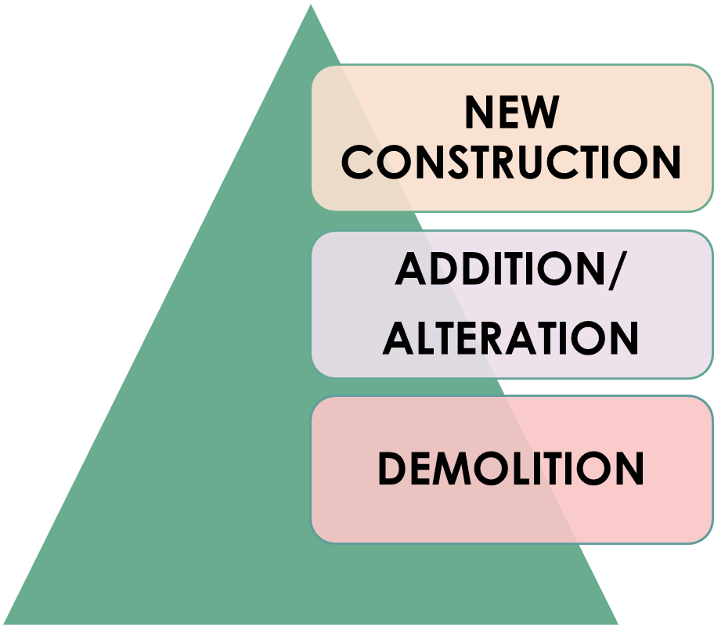
Construction safety
SAFETY CODES RELATED TO ALL KINDS OF CONSTRUCTION ACTIVITY

Slide 39
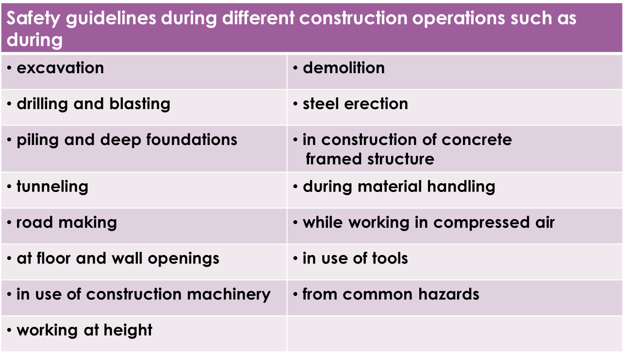
SAFETY GUIDELINES
Concept of safety committees/management
Habitat and welfare requirements for construction workers
Safety in electrical installations for construction sites and demolition sites

Slide 40
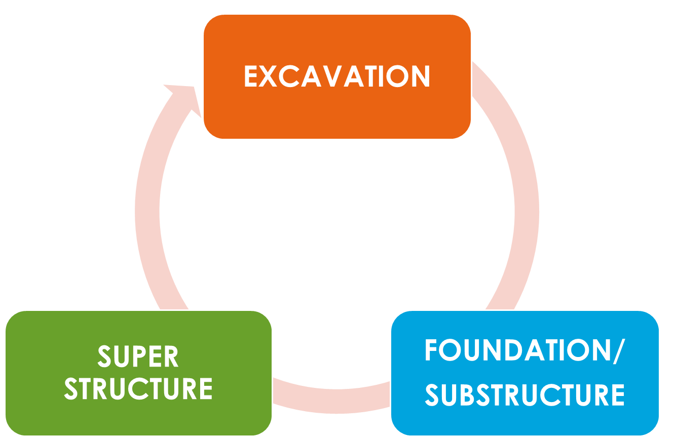
SAFETY CODES RELATED TO ALL PHASES OF CONSTRUCTION

Slide 41
SAFETY CODES RELATED TO EXCAVATION
IS Code No | IS Code Name | Scope
IS 3764:1992 | Code of safety for excavation work | This standard lays down the requirements for carrying out safely the excavation work, such as trenches, test pits, cellars, borrow pits, cuttings forrail, canal and road formations and all excavations on which the sides of excavations are not trimmed simultaneously to a stable slope.
IS 4081:2013 | Code of safety for blasting and related drilling operations | This standard lays down the safety requirements for blasting and related drilling operations in locations other than mines.

Slide 42
SAFETY CODES RELATED TO SUBSTRUCTURE
IS Code No | IS Code Name | Scope
IS 5121:2013 | Code of safety for piling and other deep foundations | This standard lays down the safety requirements for piling and other deep foundations as stated below: a) Safety measures while working with a piling rig; and b) Safety measures while preparing other deep foundations.

Slide 43
SAFETY CODES RELATED TO SUPERSTRUCTURE
IS Code No | IS Code Name | Scope
IS 8989:1978 | Safety code for erection of concrete framed structures | This standard lays down the safety requirements for erection of concrete framed structures. 1.2 Safety requirements for erection of structural steel work are covered separately in IS : 72051973t.
IS 7205:1974 | Safety code for erection of structural steelwork | This ‘standard lays down the safety requirements for erection of structural steelwork.

Slide 44
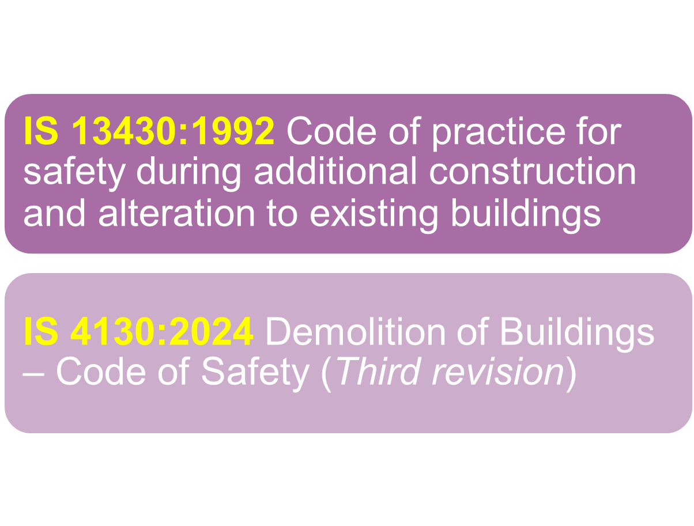
SAFETY CODES RELATED TO ADDITION/ALTERATION OR DEMOLITION OF BUILDINGS

Slide 45
IS 4130: 2024 Demolition of Buildings - Code of Safety (Third Revision)
Factors to be Considered Prior to Demolition
The needs of the building owner, the client and the workmen.
Identifying the hazardous materials that could be generated during or after demolition and preparing methods for their safe disposal.
Information related to the structure, material used, electrical system, plumbing system, HVAC system, presence of hazardous chemicals if any, information on utilities, etc shall be collected.
Health, safety, and environmental regulatory requirements.
The type, age, condition, use and business activity (if appropriate) of the facility and local conditions and constraints (for example, access, existing services, party walls).
Potential for disruption to business continuity, the community and nearby structures.
Legislative requirements.

Slide 46
IS 4130: 2024 Demolition of Buildings - Code of Safety (Third Revision)
Precautions before starting demolition work
On every demolition job, safety signages shall be conspicuously posted all around the site demolition area. Structure, all doors and openings giving access to the structure shall be kept barricaded or manned except during the actual passage of workmen or equipment. Provision shall be made for at least two independent exits for escape of workmen during emergency.
During nights, solar blinkers (at least 125 V; 55 W), LED rope light (at least 230 V; 36 W) or any other suitable means of red colour emitting lights shall be placed on all the barricades provided around the demolition sites. No demolition activity is permitted during night.
Where in any work of demolition it is imperative, because of inherent danger, to ensure that no unauthorized person shall enter the site of demolition outside working hours; a security person/unit shall be employed. In addition to watching the site, the person/unit shall also be responsible for maintaining all notices, lights and barricades.

Slide 47
IS 4130: 2024 Demolition of Buildings - Code of Safety (Third Revision)
Protection to the public
Before any demolition work is started, every footpath or road adjacent to the work likely to be affected shall be closed or protected, and alternatives provided for the diverted traffic.
Children and members of the public shall be kept out of the building and the adjoining yard.
If the structure to be demolished is more than two storeyed or 7.5 m high, measured from the footpath or street which cannot be closed or safely diverted, and the horizontal distance from the inside of the footpath to the structure is 4.5 m or with less a substantial footpath canopy (see Fig. 1) shall be constructed over the entire length of the footpath adjacent to the structure of sufficient width to protect pedestrian traffic on the footpath from falling debris or other materials. The footpath canopy shall be lighted sufficiently to ensure at all times.

Slide 48
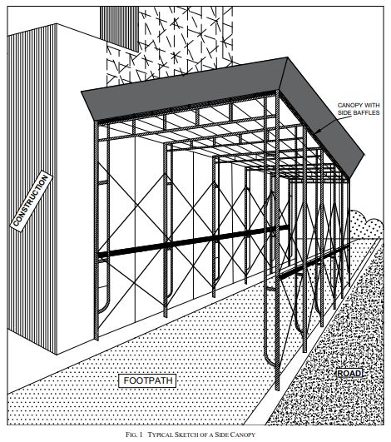
IS 4130: 2024 Demolition of Buildings - Code of Safety (Third Revision)
Protection to the public

Slide 49
IS 4130: 2024 Demolition of Buildings - Code of Safety (Third Revision)
Protection to the public
Before any demolition work is started, every footpath or road adjacent to the work likely to be affected shall be closed or protected, and alternatives provided for the diverted traffic.
Children and members of the public shall be kept out of the building and the adjoining yard.
If the structure to be demolished is more than two storeyed or 7.5 m high, measured from the footpath or street which cannot be closed or safely diverted, and the horizontal distance from the inside of the footpath to the structure is 4.5 m or with less a substantial footpath canopy (see Fig. 1) shall be constructed over the entire length of the footpath adjacent to the structure of sufficient width to protect pedestrian traffic on the footpath from falling debris or other materials. The footpath canopy shall be lighted sufficiently to ensure at all times.

Slide 50
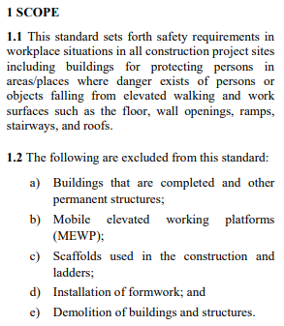
IS 4912: 2024 Temporary Protection of Floor and Wall Openings, Open-side Floors, Staircases and Guardrail Systems

Slide 51
IS 4912: 2024
Protection of floor openings
Every floor opening, regardless of resulting elevation change, or through which persons can pass, or which may cause a person to trip or fall, shall be protected in such a manner to prevent a person from passing through that opening and falling. Where there is a risk of personal injury or property damage due to the fall of materials through the floor openings, these openings shall be protected in such a manner as to prevent objects from passing through the opening and falling.
Signages indicating the presence of such risk and adequate lighting shall be provided near the opening protection. Typical signages for floor opening is given below (see Fig. 1).

Slide 52
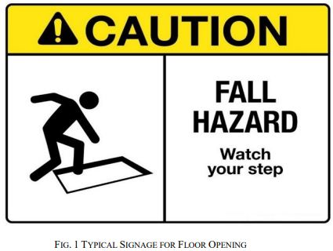
IS 4912: 2024
Protection of floor openings

Slide 53
IS 4912: 2024
Guarding of wall openings including vertical shaft opening
Prevention of Fall of Person
Prevention of Falling Objects
Signages indicating the presence of such risk and adequate lighting shall be provided near the wall and shaft opening protection. Typical signages for wall and shaft opening protection is given below (see Fig. 6).
Protection of Wall Openings (Shaft)
Requirements of Wall Opening Protection

Slide 54
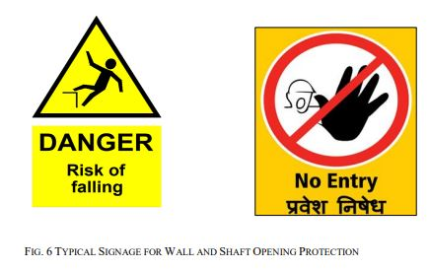
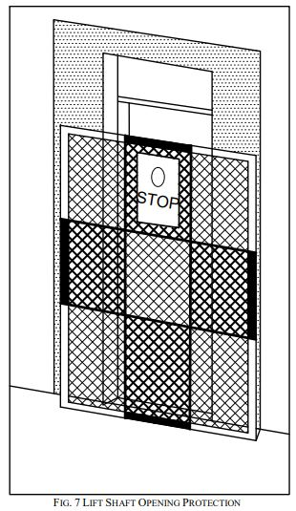
IS 4912: 2024
Guarding of wall openings including vertical shaft opening

Slide 55
IS 4912: 2024
Stairway railings and guards
Every flight of stairs having four or more risers shall be equipped with stair railings or handrails as specified below, the width of the stair being measured clear of all constructions except handrails:
On stairways less than 150 cm wide having both sides enclosed, at least one handrail, preferably on the right side descending;
On stairways, less than 150 cm wide, having one side open, at least one stair railing on the open side;
On stairways less than 150 cm wide having both sides open, one stair railing on each side;
On stairways more than 150 cm wide one handrail on each enclosed side and one stair railing on each open side; and
The height of handrails shall be not more than 85 cm measured vertically above the pitch line; a handrail is required for all stairs, or a ramp having a rise of more than 60 cm.

Slide 56
SAFETY CODES RELATED TO ENABLING WORKS
Staging (Scaffolds & ladders) | IS 3696 (Part 1):1987 Safety code of scaffolds and ladders: Part 1 Scaffolds IS 3696 (Part 2):1991 Safety code of scaffolds and ladders: Part 2 Ladders IS 4014 (Part 2):2013 Code of practice for steel tubular scaffolding: Part 2 Safety regulations for scaffolding
Material | IS 7969:1975 Safety code for handling and storage of building materials
Machinery | IS 7293:1974 Safety code for working with construction machinery

Slide 57
OTHER SAFETY CODES
IS 4138:1977 Safety code for working in compressed air
IS 4756:1978 Safety code for tunneling work
IS 5916:2013 Safety code for construction involving use of hot bituminous materials
IS 10291:1982 Safety code for dress divers in civil engineering works
IS 15883(Part 5):2013 Guidelines for construction project management: Part 5 Health and safety management
IS 15883(Part 8):2015 Guidelines for construction project management: Part 8 Risk management
IS 16601:2016 Guidelines for habitat requirements for construction workers
SP 70:2001 Handbook on construction safety practices

Slide 58
OTHER SAFETY CODES
IS 4138:1977 Safety code for working in compressed air
IS 4756:1978 Safety code for tunneling work
IS 5916:2013 Safety code for construction involving use of hot bituminous materials
IS 10291:1982 Safety code for dress divers in civil engineering works
IS 15883(Part 5):2013 Guidelines for construction project management: Part 5 Health and safety management
IS 15883(Part 8):2015 Guidelines for construction project management: Part 8 Risk management
IS 16601:2016 Guidelines for habitat requirements for construction workers
SP 70:2001 Handbook on construction safety practices

Slide 59
Conclusion
Safety in construction is essential for protecting workers and the public. Following safety standards and guidelines helps prevent accidents and creates a safer work environment.
The codes outlines how to handle different construction activities safely, from digging foundations to building superstructures, and also highlights the importance of worker welfare and proper facilities.
Using Indian Standards ensures that safety is built into every step of construction. These standards make the work environment safer and encourage everyone involved to stay aware and responsible.
By following these guidelines, we can make construction safer and more reliable for everyone

Slide 60
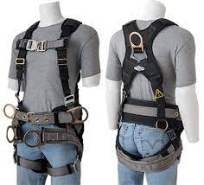
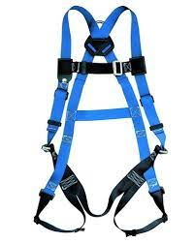
Fall Arrest Systems
IS 3521 (Part 1 to 9 ) : 2021 Personal Fall Arrest Systems
Part 1 Full Body Harness (Fourth Revision)- Full body harnesses are required to protect persons from injury by arresting the fall in the event of the user losing his/her balance or support and falling from the place of working either at an elevation or in closed locations or containers.

Slide 61
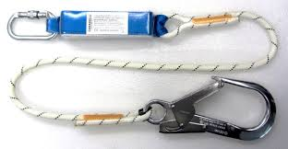
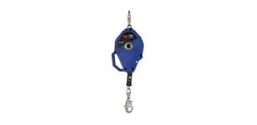
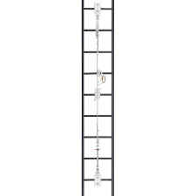
Continue…
Part 2 Lanyards and Energy Absorbers- Lanyards and energy absorbers are used together as a connecting subsystem in personal fall-arrest systems (PFAS).
Part 3 Self-retracting Lifelines - Self-retracting lifelines are used as a connecting sub-system in personal fall-arrest systems (PFAS).
Part 4 Vertical Rails and Vertical Lifelines Incorporating a Sliding-type Fall Arrester- Vertical rails and vertical lifelines incorporate a sliding-type fall arrester and constitute a personal fall-arrest system (PFAS) when connected to a full-body harness.

Slide 62
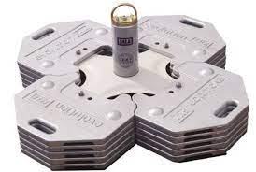
Continue…
Part 5 Connectors with Self-closing and Self-locking Gates- Connectors are used in personal fall-arrest systems (PFAS), such that, if an arrest takes place, the arresting force will not exceed 6kN .
Part 7 Single Point Anchor Devices - This standard specifies requirements, test methods, and marking, labelling and packaging, as appropriate, of both permanent and temporary single-point anchor devices exclusively for the attachment of personal protective equipment (PPE) for protection against falls from a height for fall arrest, work positioning and travel restriction (work restraint).

Slide 63
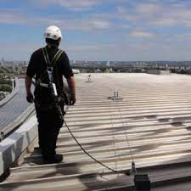
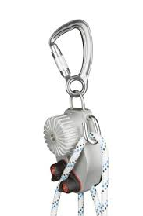
Continue…
Part 8 Flexible Horizontal Lifeline Systems- This Standard specifies design and performance requirements, test methods, user instructions, marking and labelling as appropriate, of flexible horizontal lifeline systems for use at any one time by up to three persons, exclusively for the attachment of personal protective equipment for protection against falls from a height. It does not stipulate designs for flexible horizontal lifelines, except for design limitations that are necessary for safe and durable service.
Part 9 Descending Devices- Descending devices are intended to be used in conjunction with an appropriate descent line and other equipment, for example, an appropriate harness or rescue loop and a reliable anchor, to enable a person to descend from one position to another, either on their own or assisted by another person.

Slide 64
Safety Colours and Safety Signs & Accident Prevention Tags IS 9457
This standard prescribes the safety identification colours, design principles for safety signs and accident prevention tags to be used in workplaces and in public areas for the purpose of accident prevention, fire protection, health hazard information and emergency evacuation.
This standard is applicable to workplaces, all locations and all sectors where safety-related questions may be posed. However, it is not applicable to the signaling used for guiding rail, road, river, maritime and air traffic and generally speaking, to those sectors subject to regulations which may differ.

Slide 65
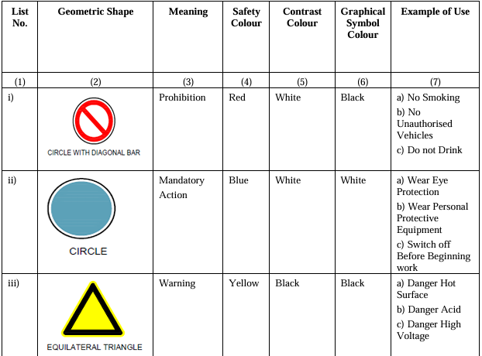
General Meaning of Geometric Shapes, Safety Colours and Contrast Colours

Slide 66
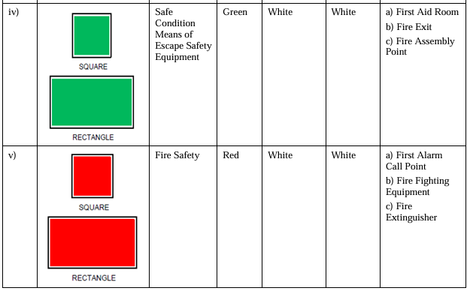
Continue…

Slide 67
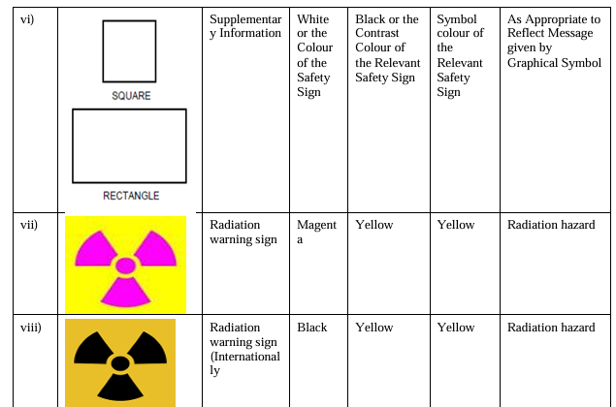
Continue…

Slide 68
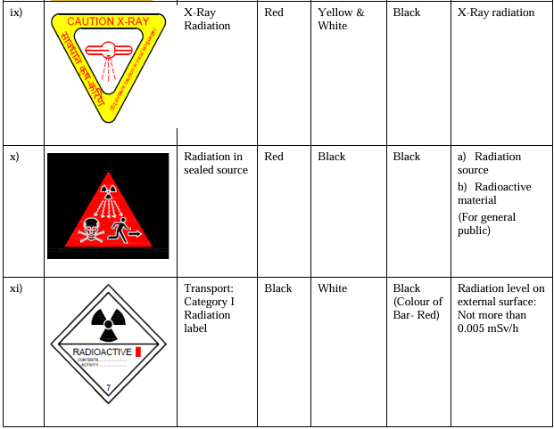
Continue…

Slide 69
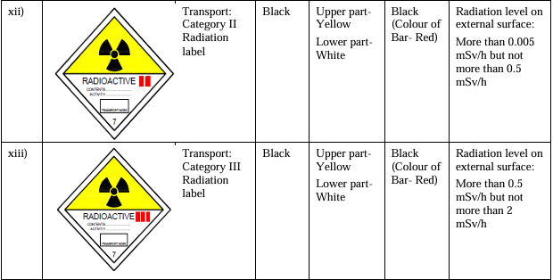
Continue…

Slide 70
Occupational Health and Safety Management Systems (OHSMS) - IS/ISO 45001:2018
•What is an OHSMS?
A framework for managing OH&S risks and opportunities to provide safe and healthy workplaces, prevent work-related injuries and ill health, and continually improve OH&S performance.
•Importance of OHSMS:
Ensures an accident-free environment and is crucial for an organisation's smooth functioning.

Slide 71
Key Principles of OHSMS
Plan-Do-Check-Act (PDCA): An iterative process for achieving continual improvement.
• Leadership and Worker Participation: Top management commitment and active worker involvement are essential.
• Risk-Based Approach: Identifying hazards, assessing risks and opportunities, and implementing appropriate controls

Slide 72



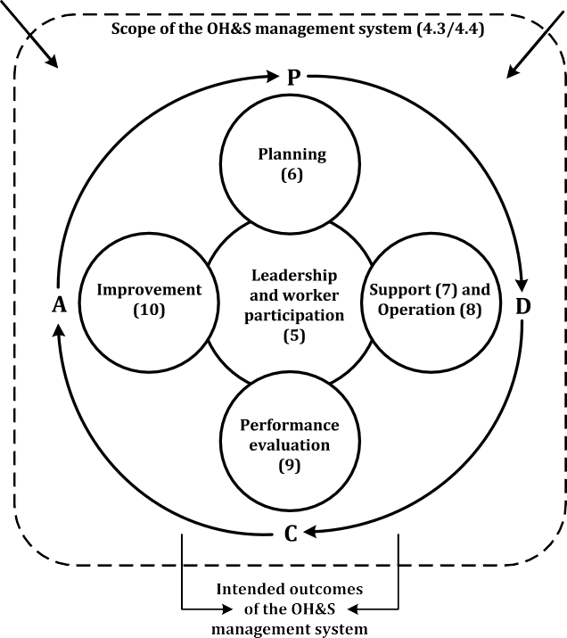
Relationship between PDCA and the framework in this document

Slide 73
Context of the Organisation
Understanding the Organisation: Internal and external factors influencing OH&S performance.
Needs and Expectations: Identifying stakeholders and their requirements related to OH&S.
Scope: Defining the boundaries and applicability of the OHSMS.

Slide 74
Leadership and Commitment
Top Management's Role: Demonstrating leadership by setting policy, allocating resources, and promoting a positive safety culture.
Worker Participation: Encouraging worker input, consultation, and participation in decision-making processes.
Protection from Reprisals: Ensuring workers can report hazards and concerns without fear of negative consequences.

Slide 75
Risk Management
Hazard Identification: Proactive and ongoing process to identify potential sources of harm.
Risk Assessment: Evaluating the likelihood and severity of harm arising from hazards.
Hierarchy of Controls: Implementing controls in order of effectiveness (elimination, substitution, engineering controls, administrative controls, PPE).

Slide 76
Support for the OHSMS
Resources: Providing adequate human, financial, and technological resources.
Competence: Ensuring workers have the necessary skills and knowledge.
Awareness: Raising awareness of OH&S policies, risks, and responsibilities.
Communication: Establishing effective internal and external communication channels.

Slide 77
Performance Evaluation
Monitoring and Measurement: Tracking key metrics to assess OH&S performance.
Internal Audits: Periodically evaluating the effectiveness of the OHSMS.
Management Review: Top management review to ensure suitability, adequacy, and effectiveness of the system.

Slide 78
Improvement
Incident Investigation: Investigating incidents to identify root causes and prevent recurrence.
Corrective Action: Implementing actions to address nonconformities and incidents.
Continual Improvement: Ongoing efforts to enhance OH&S performance and the OHSMS.

Slide 79
Benefits of OHSMS
Reduced workplace injuries and ill health.
Improved worker morale and productivity.
Enhanced organisational reputation.
Compliance with legal and regulatory requirements.
Proactive risk management and reduced costs associated with incidents.

Slide 80
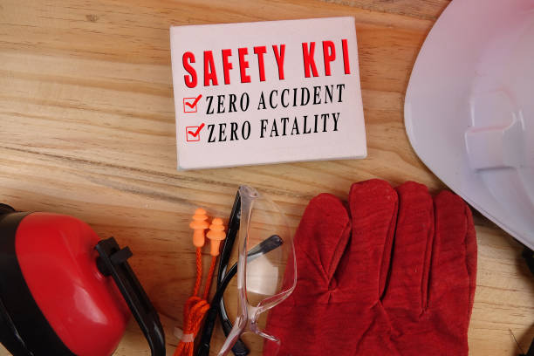
THANKS FOR YOUR KIND ATTENTION

