Slide 1
Land Development and Development and Building Controls

Slide 2

Chapter 4:
Land Development

Slide 3
Standardized Building Regulations
About
This chapter addresses various aspects related to land development or redevelopment in an area. It has been divided into three key sections- Land Use; Layout Plans; and Density.
Key highlights
Aspects related to Compensatory FAR (CFAR), Transferrable Development Rights (TDR) and Purchasable FAR ; buffer zones applicable for all Master Plans for different development types along with reference to relevant Guideline/Manual/ Notification.
4.1 Land Use
It includes detailed list of land use zones and sub – zones, considerations for development/ redevelopment activities and buffer zones as per the Guidelines /Manual/ Notification applicable in Master Plan areas
4.2 Layout Plans
Includes typical layout patterns for single plot and others
4.3 Density
Recommends population densities for different settlement types
Annex W – Resource mobilization for land development
Includes provisions on resource mobilization tools such as CFAR, TDR and purchasable FAR
Table of contents

Slide 4
Ch 4 Land Development
4.1 Land Use
This clausae empowers the Authority to regulate land development through a set of land use zones, sub zones and associated core and support activities defined in the master plan and subsequently detailed in the zonal and layout plans.
A list of land use classification is provided as illustrated below:
Sl No. | Land Use Zones | Alpha Numeric Code | Land Use Sub Zones
1 | Village abadi/Village extension | A-1 | Existing village abadi
 |  | A-2 | Proposed extension of village abadi
2 | Built up area | B-1 | Existing urban built-up area
3 | Residential | R-1 | Low density
 |  | R-2 | Medium to high density
 |  | R-3 | High density
 |  | R-4 | Special residential areas such as Foreign mission, government housing colonies, etc.
4 | Commercial | C-1 | Convenient or neighbourhood shopping centres
 |  | C-2 | Sector/local shopping centre
 |  | C-3 | Sub city centre/district centre
 |  | C-4 | Commercial Business District (CBD)/city centre
 |  | C-5 | Bazaar street and informal or weekly market
 |  | C-6 | Wholesale market/mandi/regulated market/terminal market/warehouse/logistic park/hubs

Slide 5
Ch 4 Land Development
Sl No. | Land Use Zones | Alpha Numeric Code | Land Use Sub Zones
5 | Industrial | I-1 | Household and non-polluting industry
 |  | I-2 | Service and light industry
 |  | I-3 | Medium and heavy industry
 |  | I-4 | Hazardous/noxious industry
 |  | I-5 | Special industrial zone/Special Economic Zones (SEZ’s)/industrial park
7 | Utilities and services | U-1 | Distributive services such as Fire, Telecom etc.
 |  | U-2 | Security services
 |  | U-3 | Public services such as under-ground reservoir, Water Treatment Plant (WTP), STP and SWM
 |  | U-4 | Energy generation and distribution services and power corridors
8 | Public and semi-public | PS-1 | Government/semi-government/public offices
 |  | PS-2 | Corporate or other private offices
 |  | PS-3 | Education/research and health/medical institutions
 |  | PS-4 | Social, cultural and religious institutions
 |  | PS-5 | Information Technology (IT) city and IT park
 |  | PS-6 | Community facilities and other public buildings
 |  | PS-7 | Cremation and burial grounds
9 | Mixed use | M-1 | Mixed residential use
 |  | M-2 | Mixed commercial use
 |  | M-3 | Mixed public/semi-public use
 |  | M-4 | Mixed industrial use

Slide 6
Ch 4 Land Development
Sl No. | Land Use Zones | Alpha Numeric Code | Land Use Sub Zones
10 | Transportation and communication | T-1 | Roads (elevated/flyovers/underpasses/cloverleafs/ interchanges/traffic islands)
 |  | T-2 | Railways (All railway lines, stations, junctions, terminals and depots)
 |  | T-3 | Multi Modal Transport (MMT) hubs/Transit-Oriented Development (TOD) areas/parking areas
 |  | T-4 | Bus terminal, truck terminal and bus depot
 |  | T-5 | Airport/heliport
 |  | T-6 | Seaports/dockyards
 |  | T-7 | Waterways
 |  | T-8 | Container depots/Integrated Freight Complexes (IFC)
 |  | T-9 | Ropeways
11 | Sports | S-1 | Stadium and sports complex
 |  | S-2 | Sports college, sports academy
 |  | S-3 | Sports city
 |  | S-4 | Adventure sports complexes
12 | Recreational and green | RG-1 | Parks and playgrounds
 |  | RG-2 | Multipurpose open spaces (Maidan)
 |  | RG-3 | City forest and green belts
 |  | RG-4 | River front/Lakefront development

Slide 7
Ch 4 Land Development
Sl No. | Land Use Zones | Alpha Numeric Code | Land Use Sub Zones
13 | Environmentally sensitive | SA-1 | Forest/sanctuaries/national parks
 |  | SA-2 | Biodiversity park
 |  | SA-3 | Natural conservation zone
 |  | SA-4 | Eco-sensitive zone
 |  | SA-5 | Water bodies (river/streams/lakes/canals/wetlands)
 |  | SA-6 | River flood plains/mangroves
14 | Agriculture | PA-1 | Agriculture/horticulture/urban agriculture
 |  | PA-2 | Other primary activities
15 | Heritage and conservation | HC-1 | Heritage zone/heritage village
 |  | HC-2 | Heritage buildings/structures
16 | Special development | SD-1 | Aero-city, integrated industrial townships, hi-tech township, free trade zone, theme- based development areas, Coastal Regulation Zone (CRZ), government restricted or protected areas, etc.

Slide 8
Ch 4 Land Development
4.1 Land Use (Continued)
Any redevelopment activity to be in consonance with the Master Plan which should also demarcate distinct fire zones as per 7.3 of these regulations
Any kind of development following areas shall only be proposed after due considerations as suggested in these regulations.
Areas with sharp and deep slopes, cliffs, major drainage, water channels, river flood plains, mangroves, wetlands, high tides, mining activities, and adjacent to active fault lines, which are prone to erosion, landslides, avalanches, floods, waterlogging, and other environment hazards
Other considerations included for –
Environmentally sensitive areas, heritage and conservation areas
Ensuring compact development
utilizing land resource mobilization tools
integrating urban and rural realms to achieve efficient management of growth and land development
use of urban agriculture like green roofs, neighbourhood and community farms, vertical/stack farming or large farm operations, within the greenbelts of planned urban areas.

Slide 9
Ch 4 Land Development
4.1 Land Use (Continued)
Buffer zones applicable for all master plans have been provided for different development types as illustrated below:
Sl No. | Development Type | Guideline/Manual/ Notification | Buffer Zones as per the Guidelines/Manual/Notification (Subject to Amendment from Time to Time)
i) | Eco-Sensitive Zones | Guidelines for declaration of Eco‐Sensitive Zones around national parks and wildlife sanctuaries, MoEF, 2011 | Delineation of eco-sensitive zones are site-specific, however, as a general principle, the width of this zone could go up to 10 km around the protected areas. In case where sensitive corridors, connectivity and ecologically important patches, crucial for landscape linkage, are even beyond 10 km width, these should be included in the Eco-sensitive Zone.
ii) | Railway Land | Para 827 of the Indian Railways Works Manual, Government of India, 2000 | A 30 m buffer between the railway boundary and the nearest edge of a building constructed on adjacent land shall be left, the exact space to be left being governed by local conditions.
iii) | Aerodrome | Ministry of Civil Aviation (Height Restrictions for Safeguarding of Aircraft Operations) Rules, 2015 | The buffer zone is applicable within 20 km radius of Airport on the height of the buildings, for which NOC is required from AAI for any construction activity. Aviation imposes height restrictions only. The airport should be 20 km away from green area such as wildlife sanctuaries/zoos/bird sanctuaries and should not have restricted activities such as butcheries, sewage and no garbage storage around airports.

Slide 10
Ch 4 Land Development
4.1 Land Use (Continued)
Buffer zones applicable for all master plans have been provided for different development types as illustrated below:
Sl No. | Development Type | Guideline/Manual/ Notification | Buffer Zones as per the Guidelines/Manual/Notification (Subject to Amendment from Time to Time)
iv) | Industrial Area/Sez | Urban and Regional Development Plans Formulation and Implementation (URDPFI) Guidelines, 2014. Ministry of Urban Development | In sensitive areas such as forests, mangroves, coral reefs, archeologically important systems, sensitive ecosystems, etc, SEZs shall not be planned. A buffer zone of 1000 m shall be maintained from such sensitive areas and a greenbelt with tree density of 1000 trees/acre shall be developed in the said buffer zone.
v) | Mining And Quarrying | Proforma for Environmental Appraisal of Mining Projects, MoEF | Buffer zone in case of Mining Lease (ML) area, is to be considered as: 5 km all around the periphery of the core zone for ML area up to 25 ha. 10 km all around the periphery of the core zone for ML area above 25 ha.

Slide 11
Ch 4 Land Development
4.1 Land Use (Continued)
Buffer zones applicable for all master plans have been provided for different development types as illustrated below:
Sl No. | Development Type | Guideline/Manual/ Notification | Buffer Zones as per the Guidelines/Manual/Notification (Subject to Amendment from Time to Time)
vi) | Petrochemical And Gas Industries | The Petroleum and Natural Gas Rules, 1959 | Gas pipeline shall not be located within 15 m of any private dwelling or any industrial building or place of public assembly, unless it is provided with at least 300 mm of cover over as specified in Petroleum And Natural Gas Regulatory Board Notification, 2009, as amended from time to time. Gas or oil well shall not be drilled at any point, within a minimum distance, as prescribed by the Central Government, of any railway, pipeline or other right of way, surveyed road, dwellings, industrial plant, air‐craft runway, buildings used for military or public purposes, or within 3 km of any mine, whether active or abandoned, unless the special permission of the Central Government is obtained in advance. About 90 m x 90 m buffer shall be shall be maintained along the active oil wells, petroleum storage tanks, encompassing all the safety norms for precautions against fire.

Slide 12
Ch 4 Land Development
4.1 Land Use (Continued)
Buffer zones applicable for all master plans have been provided for different development types as illustrated below:
Sl No. | Development Type | Guideline/Manual/ Notification | Buffer Zones as per the Guidelines/Manual/Notification (Subject to Amendment from Time to Time)
vii) | Heritage Related | Ancient Monuments and Archaeological Sites and Remains Act, 2010 (AMASR) | Every area, beginning at the limit of the protected area/monument, extending to 100 m in all directions shall be the prohibited area and extending up to 200 m in all directions shall be regulated area.
viii) | Natural Hazard Zones Such As River Flood Plains And Water Bodies Including Wetlands | National Disaster Management Guidelines- Management of floods, NDMA | The area likely to be affected by floods up to a 10‐year frequency may be kept reserved only for gardens, parks, playgrounds, etc. Residential or public buildings, or any commercial buildings, industries, and public utilities shall be prohibited in this zone. In an area liable to flooding in a 25-year frequency flood, residential buildings may be permitted with certain stipulation of construction on stilts (columns), minimum plinth levels, prohibition for construction of basements and minimum levels of approach roads, etc.
ix) | Coastal Regulation Zone(CRZ) | Guidelines for updation of Coastal Zone Management Plan (CZMP) prepared as per CRZ notification, 2011 to be aligned with CRZ notification, 2019. | Buffer zones in/around CRZ shall be based on the classification of CRZ as specified in the guidelines.

Slide 13
Ch 4 Land Development
4.1 Land Use (Continued)
Buffer zones applicable for all master plans have been provided for different development types as illustrated below:
Sl No. | Development Type | Guideline/Manual/ Notification | Buffer Zones as per the Guidelines/Manual/Notification (Subject to Amendment from Time to Time)
x) | Nuclear Plants | URDPFI Guidelines, 2014. Ministry of Urban Development; National Disaster Management Guidelines- Chemical Disasters (Industrial) NDMA | 500 ha of buffer shall be an exclusion zone all around the power station and shall be maintained as a vacant space and developed as a green belt area. The area within 5 km radius of the plant shall be designated as sterilized zone. No restriction shall be imposed by the plant on organic development activities of population in the annulus between 1.50 and 5 km. Administrative actions shall ensure that there is no influx of large population in this area. Population Restriction: Population density within 10 km radius of the plant shall be less than two‐third of state average; Population within sterilised zone shall be less than 20,000; Population centres above 10,000 persons shall be more than 10 km away from the plant; and Population centres above 1,00,000 persons shall be more than 30 km away from the plant.

Slide 14
Ch 4 Land Development
4.1 Land Use (Continued)
Buffer zones applicable for all master plans have been provided for different development types as illustrated below:
Sl No. | Development Type | Guideline/Manual/ Notification | Buffer Zones as per the Guidelines/Manual/Notification (Subject to Amendment from Time to Time)
xi) | Electric Line | Central Electricity Authority (Measures Relating to Safety and Electric Supply) Regulations, 2010 | A green corridor shall be proposed along the existing and proposed High Tension (HT) lines with the provision of a service road. Master plan may also propose power line corridors for urban areas and no other development and building construction activities/uses shall be proposed in these power corridors.
xii) | Burial/Cremation Grounds |  | Habitation shall not be proposed within 90 m distance from burial or cremation grounds. This 90 m wide area may be proposed for parks, playgrounds and service utilities.
xiii) | Defence/Firing Range Establishments | ‘The Work of Defence Act, 1903’, ‘The Civil Defence Act, 1968’ and ‘The Cantonments Act, 2006’ | The land use for urban activities and restrictions for building construction near the defence establishment/area and fire range shall be in accordance with the provisions mentioned in these guidelines.
xiv) | Government Buildings With High Importance | - | The plan shall clearly demarcate the security zone for high importance government establishments and buildings, as and where required. A low-rise development (not exceeding 10 m in height) shall be proposed within 200 m radius from the security zone or high importance government establishments/ buildings.

Slide 15
Ch 4 Land Development
4.1 Land Use (Continued)
Buffer zones applicable for all master plans have been provided for different development types as illustrated below:
Sl No. | Development Type | Guideline/Manual/ Notification | Buffer Zones as per the Guidelines/Manual/Notification (Subject to Amendment from Time to Time)
xv) | International Border/Line of Control (LoC)/Line of Actual Control (LAC) | - | Security buffer zones of minimum 500 m width shall be prescribed all along the international border/LoC/LAC and no land use for urban/rural development activities shall be proposed near of this zone. The local authority may take an appropriate decision in this regard in consultation with the security forces in the area.
xvi) | Industrial Zones | - | Industrial zones shall have a minimum 30 m wide green belt separating industrial zones from residential areas
xvii) | Prisons | Model Prison Manual, 2016 | There shall be no building construction within the 100 m of the boundary wall of the prison.
xviii) | Landfill Site | MoEFCC rules and notifications, as applicable for various types of landfill sites. | As per the norms for different types of landfill sites

Slide 16
Ch 4 Land Development
4.1 Land Use (Continued)
Buffer zones applicable for all master plans have been provided for different development types as illustrated below:
Sl No. | Development Type | Guideline/Manual/ Notification | Buffer Zones as per the Guidelines/Manual/Notification (Subject to Amendment from Time to Time)
xix) | Fault Lines |  | 20 m on both sides of the fault line. However, the local authority may decide wider buffer area along the active fault lines in Seismic Zones IV and V. Lifeline and emergency buildings such as hospitals, telecommunication buildings, bus stations, railway stations/buildings, airports, ports, food storage, power stations, fuel stations, fire stations, etc. should be avoided within 1 to 3 km area of the fault line.
xx) | Highways |  | Buffer as given below shall be provided on both sides of the highways in non-urbanizable areas: a) Expressways – 100 m b) National Highways – 50 m c) State Highways – 30 m

Slide 17
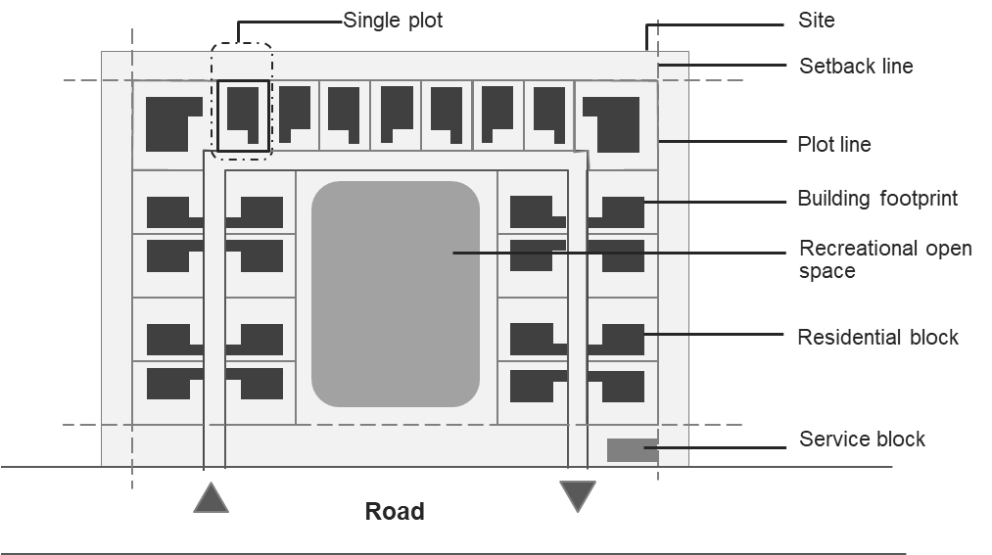
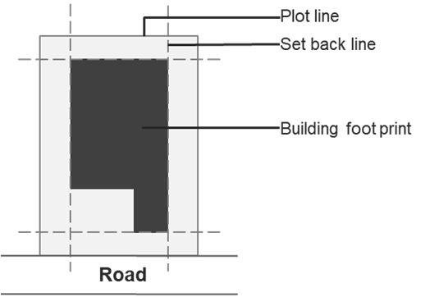
Ch 4 Land Development
4.2 Layout Plans
This clause addresses the requirements for layout plans.
4.3 Density
Population densities for different settlement types in tabular format
Typical Layout for Plots with Area More than 3000 m²
Typical Layout for a Single Plot

Slide 18
Ch 4 Land Development
ANNEX W
This annexure covers resource mobilization for land development. It states the requirements for the following:
Compensatory Floor Area Ratio (CFAR)
Transferrable Development Rights (TDR)
Purchasable Floor Area Ratio
Compensatory Floor Area Ratio
This section of the Annexure specifies the public purposes for which CFAR may be provided by the Authority to the landowner in lieu of land parcel, which is to be acquired partly or fully.
It also specifies the conditions that shall apply if CFAR is provided on the remaining part of the same plot.
Additionally, it specifies the conditions that shall apply if CFAR is provided on other receiving plot(s).
Transferrable Development Rights (TDR)
Conditions under which TDR can be issued.
Circumstances under which TDR shall not be permissible
Mechanisms for TDR
Stages of TDR
TDR utilization
Purchasable FAR
Cases in which Purchasable FAR shall be permitted
Conditions with which Purchasable FAR shall be permitted
Cases in which Purchasable FAR shall not be permitted
Calculation Method for the Rate of Charges of Purchasable FAR

Slide 19
Chapter 5:
Development and Building Controls

Slide 20
Standardized Building Regulations
About
The chapter details out the development and building controls and is structured in eight key sections– means of access, approach to a building, setbacks, open spaces, FAR and ground coverage, subdivision and amalgamation of plots, off-street parking, and urban design features.
Key highlights –inclusion of universal accessibility features as part of the regulations; recommendatory provisions, which can be modified by the states/UTs, regarding setbacks, ground coverage and FAR; Urban Design features including Public Art, Street Furniture, and Greenbelts and Landscaping.
5.1 Means of Access
5.2 Approach to a Building
5.3 Setbacks
5.4 Open Spaces
5.5 FAR and Ground Coverage
5.6 Subdivision and Amalgamation of Plots
5.7 Off-street Parking
5.8 Urban Design Features
Table of contents

Slide 21
Ch 5 Development and Building Controls
5.1 Means of Access
Minimum Right of Way (RoW) requirements for means of access of plots, as illustrated below:
Further, plots which do not abut on a street/road shall abut/front on a means of access, the width and other requirements of which shall be as given below:
Facilities and amenities for which direct access from highways or roads greater than 52 m in width shall be permitted
Provisions on means of access for high rise buildings and special buildings
Road intersections and junctions shall provide clear sight distance and shall be universally accessible.
Requirements for cul-de-sacs to ensure easy turning of vehicles.
Requirements for footpaths
Sl No. | Type of Development | Minimum RoW (m)
i) | Residential plotted
ii) | Low rise group housing
Sl No. | Minimum Width (m) | Length of Means of Access for Residential Plots (m) | Length of Means of Access for Other Plots (m)
illustrative

Slide 22
Ch 5 Development and Building Controls
5.2 Approach to a Building/Amenity
Approach to the buildings from road/street/internal means of access shall be through paved pathways.
Approach to the public buildings/ amenities and group housing.
5.3 Setbacks
Minimum front, rear and sides setback requirements for different building types with height up to 15 m as illustrated below:
Minimum front, rear and sides setback requirements for different building types with height 15 m and above
Exemptions to erections prohibited from the setback area.
Sl No. | Size of Plot (m²) | Front (m) | Rear (m) | Side (m)
i) | Up to 50
ii) | 51- 100
iii) | 101-200
iv) | 201-300
v) | 301-500
vi) | 501 and above
illustrative

Slide 23
Ch 5 Development and Building Controls
5.4 Floor Area Ratio (FAR), Ground Coverage and Building Height
Regulations for different land uses/activities as illustrated in the table below:
Exemptions from covered area calculations in accordance with NBC 2016.
Features and structures that shall be excluded from the FAR calculations and shall not exceed 20 percent of the permissible FAR of the building. Additionally, basement and podium used exclusively for parking, ramps used for multi-level car parking, and staircases which are fire exits shall be completely exempted from FAR calculation.
The FAR applicable in an area may be increased by the Authority based on the growth of the city subject to the conditions specified.
The exemptions to roof structures that shall not be included in the height of the building.
Sl No. | Use/activity | Minimum Plot size (m²) | Maximum FAR | Max ground coverage (percent) | Maximum height (m)
i) | Residential
a) | Plotted
b) | Group housing
c) | Studio apartments
ii) | Commercial
a) | Convenient/Neighbourhood shopping centre
b) | Sector shopping
illustrative

Slide 24
Ch 5 Development and Building Controls
5.5 Subdivision and Amalgamation of Plots
Conditions binding the subdivision and amalgamation of Plots.
The minimum size of the subdivided plot, setbacks of the subdivided plots, land use of subdivided plot, subdivision charges, amalgamation of two or more plots etc.
5.6 Open Spaces
Open spaces at four levels: master plan; zonal; layout Plan; and plot/building level.
Open space requirements in a plot for the following:
i) a single high rise/special building proposed on a plot;
ii) multiple high rise/special buildings proposed on a single plot including
a) When two or more independent buildings (not part of a block of buildings) are planned and
b) If multiple high rise buildings in the form of block of buildings are proposed on a plot; and
iii) when a low-rise building is proposed
(a) between two high rise buildings (independent or blocks) or
(b) next to a high rise building or (c) next to a low rise special building.
Exemptions to Open Spaces.

Slide 25
Ch 5 Development and Building Controls
5.7 Off-street Parking Facilities
Parking requirements for off-street parking facilities.
Minimum area required for parking different types of vehicles as shown below:
Minimum parking area to be provided based on building use/activity in terms of Equivalent Car Space (ECS), part of which has been illustrated below:
Requirements for accessible parking.
Other parking requirements such as access to the parking, planning of basement parking and surface parking, etc.
Sl No. | Vehicle Type | Minimum parking area
i) | Car/Taxi parked in individual parking
ii) | Car/Taxi parked in shared parking
iii) | Two-wheeler
iv) | Bicycle
v) | Trucks/ Buses
illustrative
Sl No. | Use/activity | Minimum parking area
i) | Residential
a) | Plotted | 1.0 ECS/150 m² area of permissible FAR
b) | Group housing
ii) | Commercial
a) | Convenient/neighbourhood shopping centre
b) | Sector shopping
illustrative

Slide 26
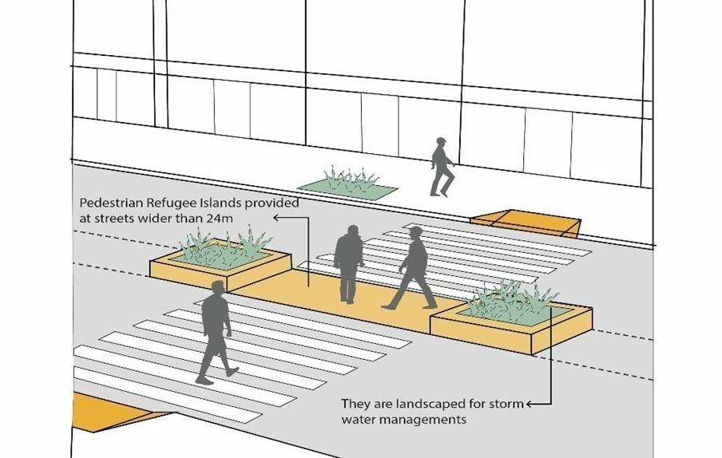
Ch 5 Development and Building Controls
5.8 Urban Design Features
Provisions on public art, public spaces, greenbelts and landscaping, uses permissible under flyovers, signages and outdoor display structures and architectural control in terms of -
provisions related to public art and empowers the Authority to issue guidelines on public art from time to time.
design and utility of public spaces.
unhindered access and pedestrian movement.
provisions related to greenbelts and landscaping.
uses permissible below flyovers.
provisions on architectural control that may be imposed/adopted by the Authority.

