Slide 1

BUREAU OF INDIAN STANDARDS
IS 18267 : 2024
Food Serving Utensils Made from Agri By-products – Specification (first revision)
Pradeep Sharma
Scientist-B/Assistant Director
Food and Agriculture Department,
BIS Head Quarter, New Delhi

Slide 2

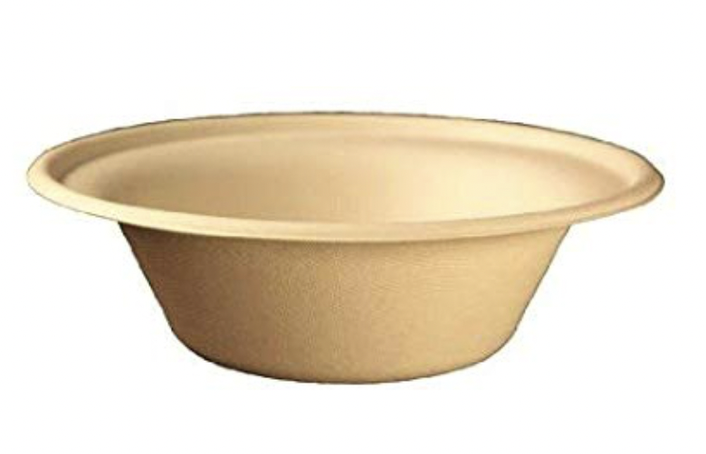
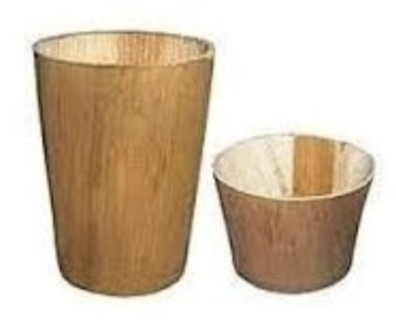
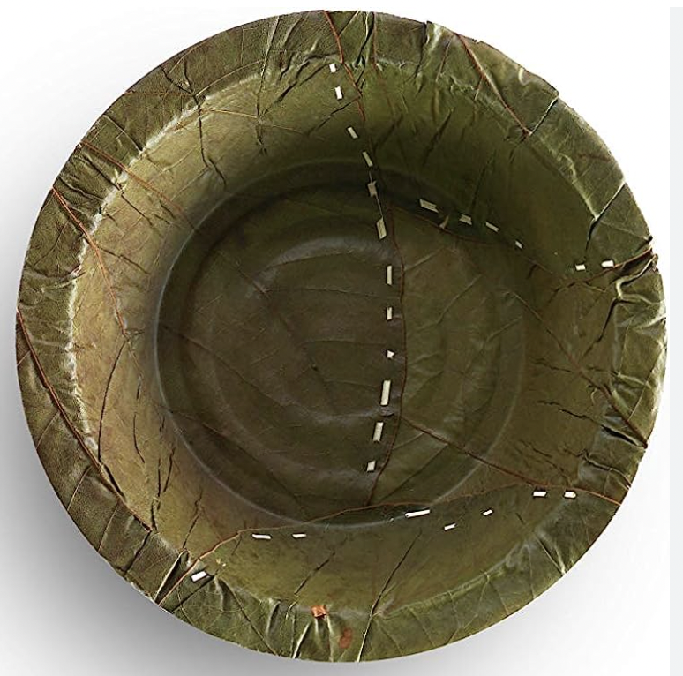
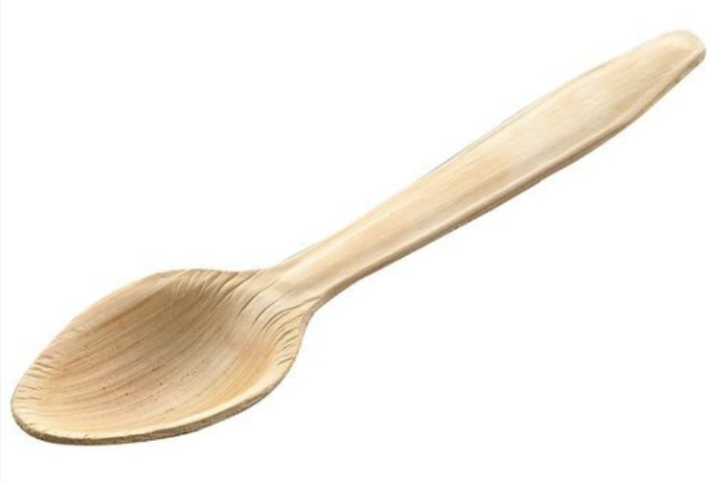
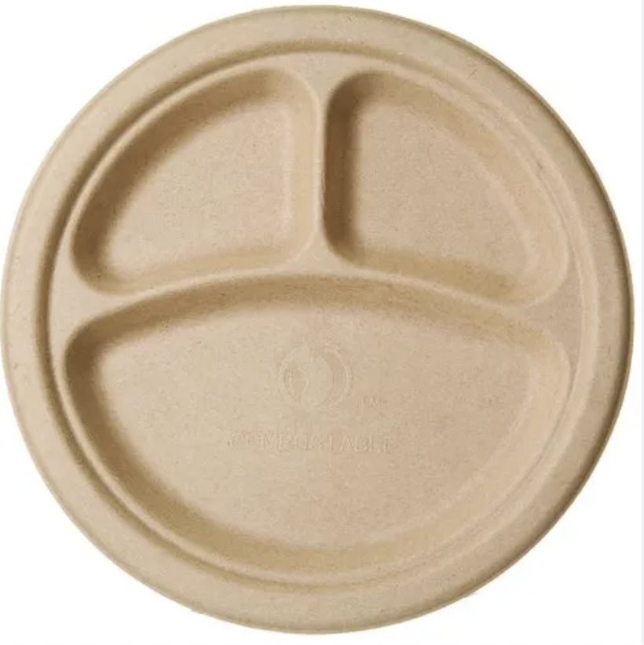
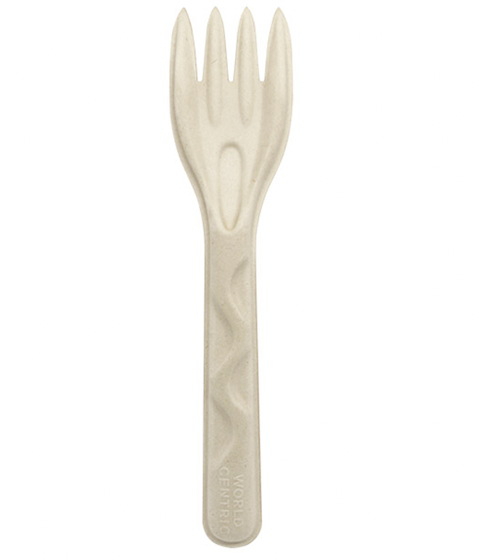
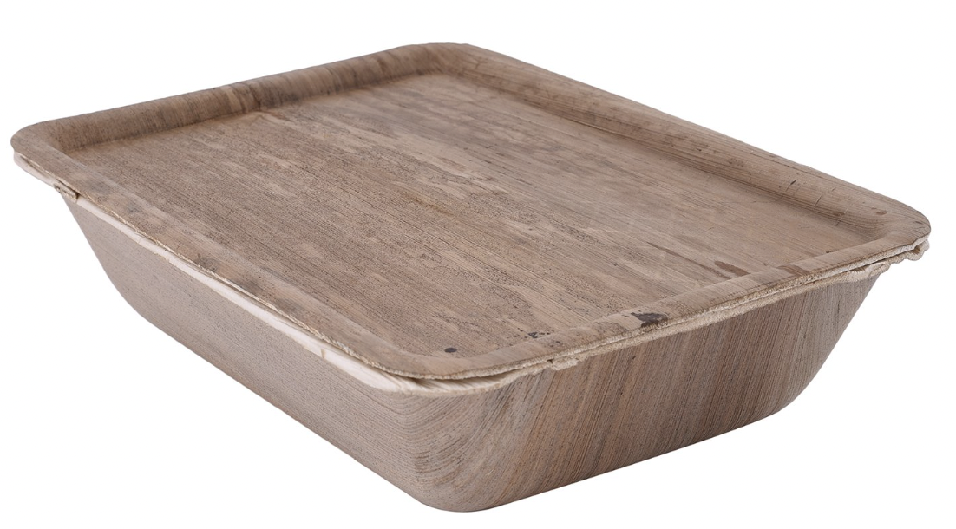
What is food serving utensil?
Food Serving Utensils (FSU)
(Set of vessels used for the purpose of serving the cooked food to others)

Slide 3

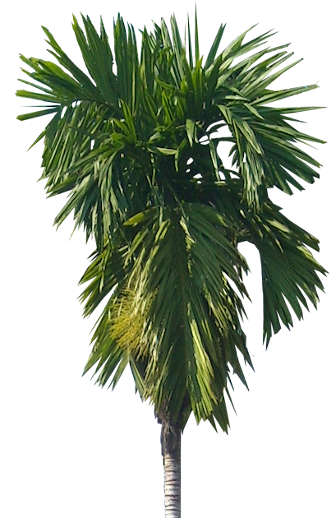
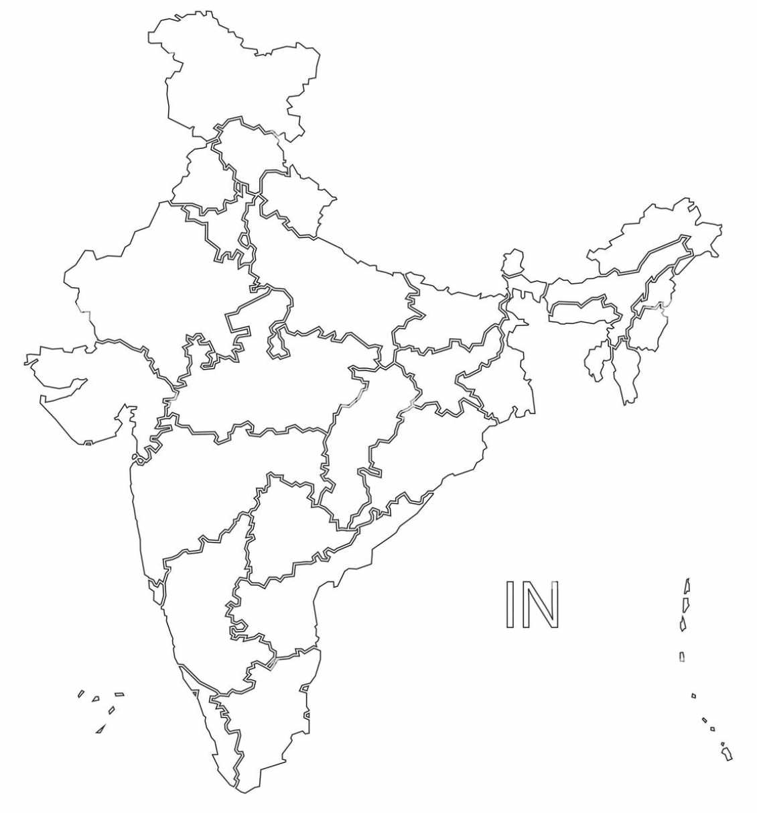


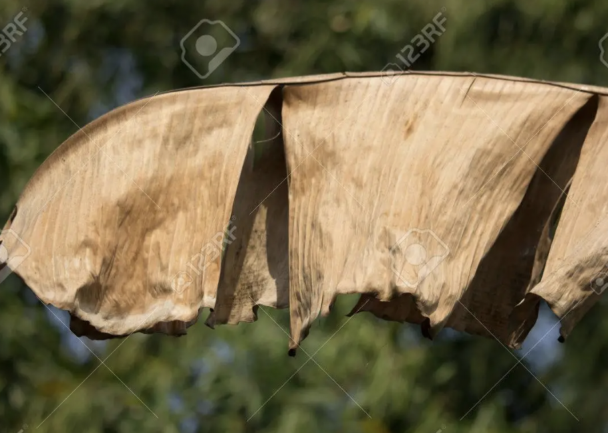
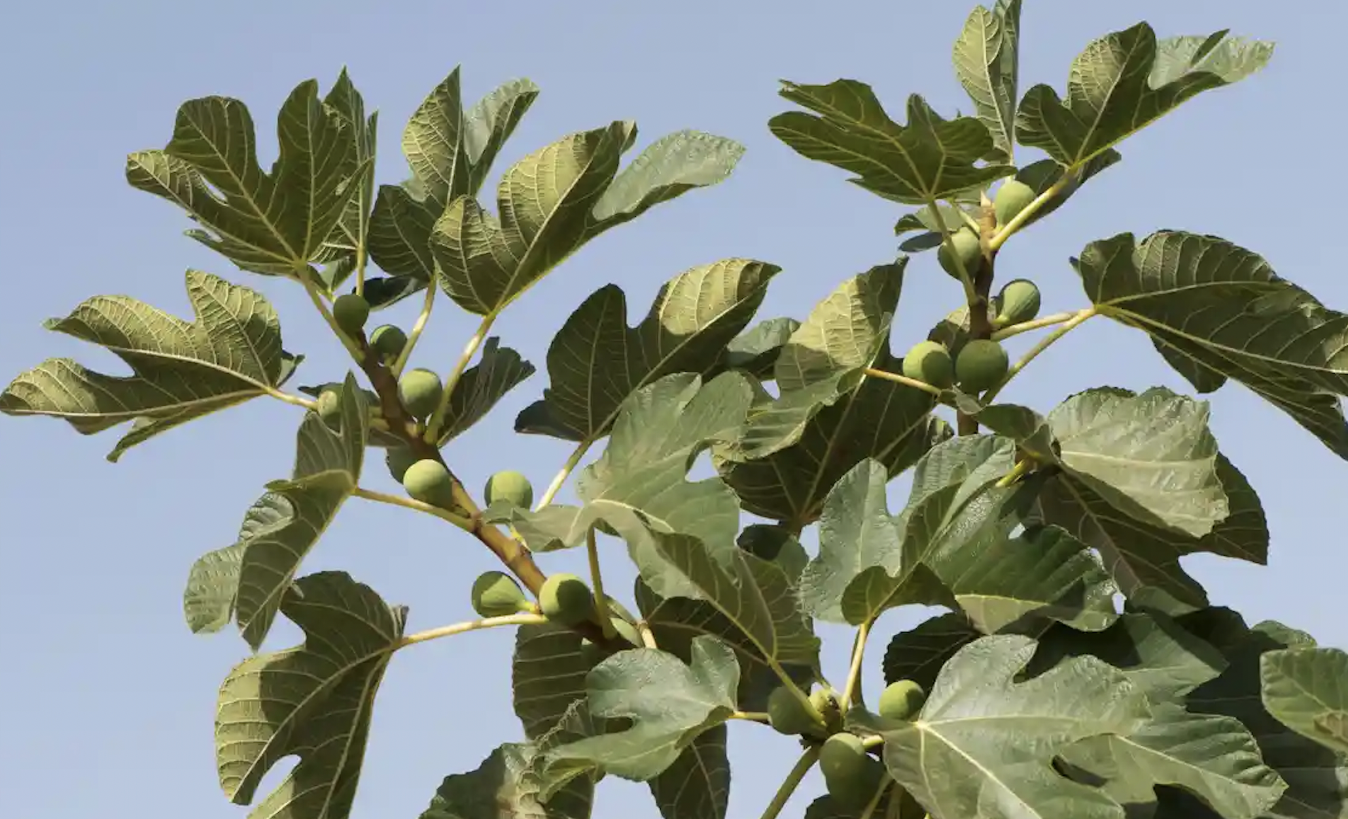

SOME OF THE RAW MATERIALS & TOP AREKA FARMING STATES IN INDIA
Teak ( Tectona grands ) – Leaves
20 % (Assam)
Almond (Terminalia Catappa ) – Leaves
Green Banana ( Mussa spp. ) - Leaves
Dry Banana ( Musa spp. ) - Leaves
Fig ( Ficus benghalensis ) - Leaves
40 % (Karnataka)
Jack ( Artocarpus heteropgyllus ) - Leaves
25 % (Kerala)

Slide 4
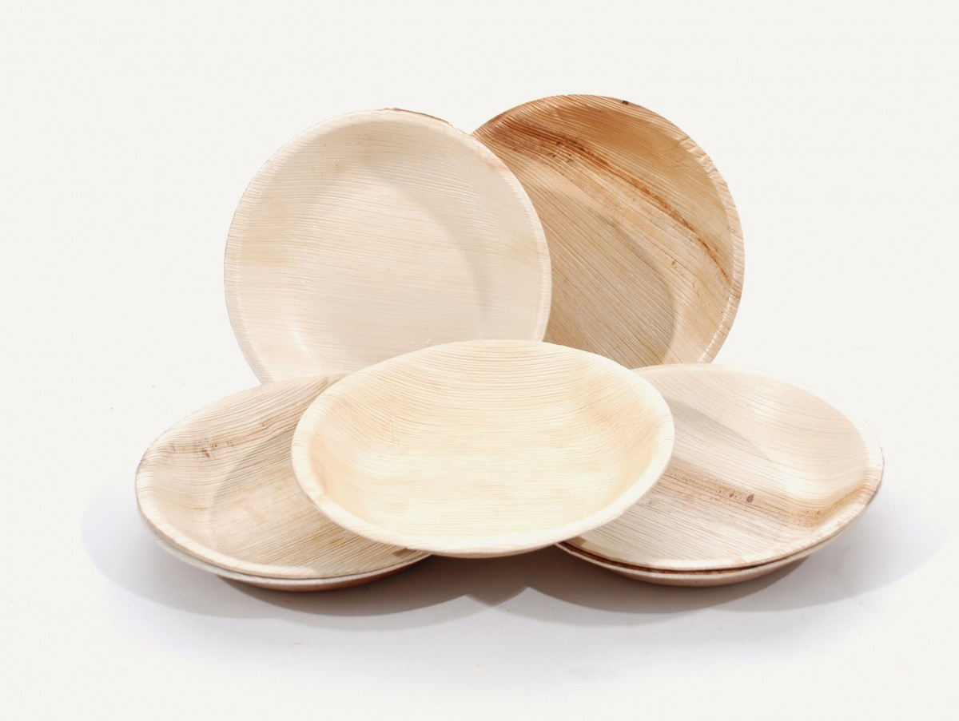
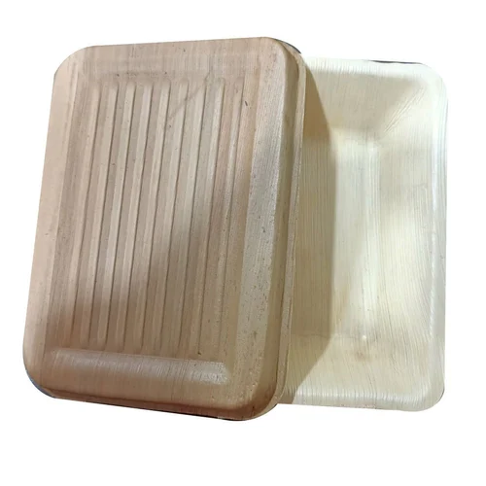
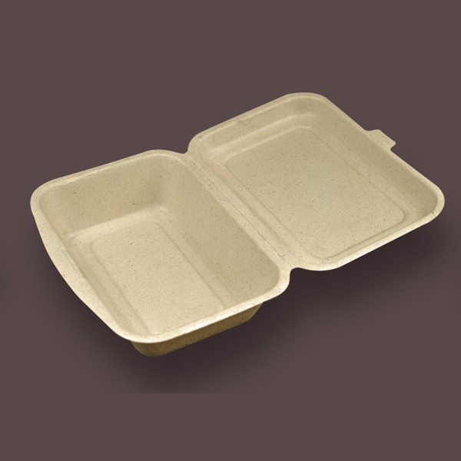
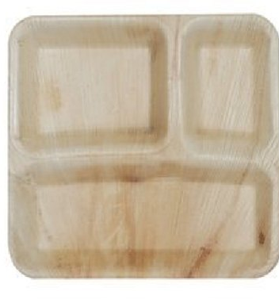
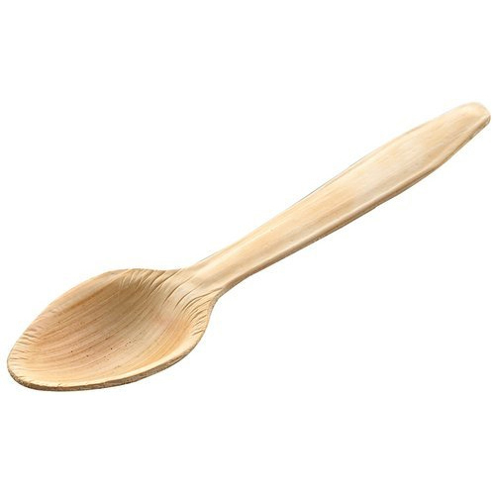
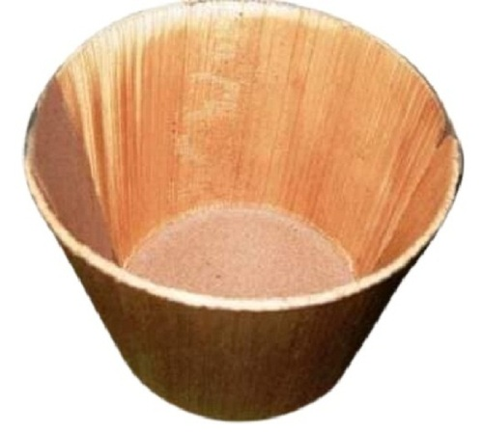
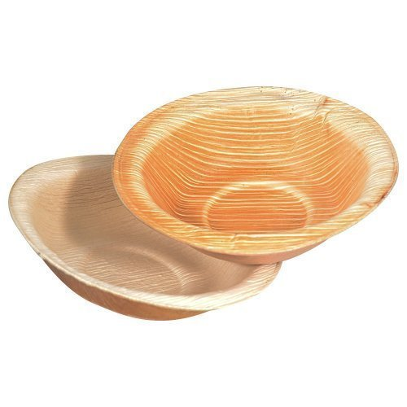
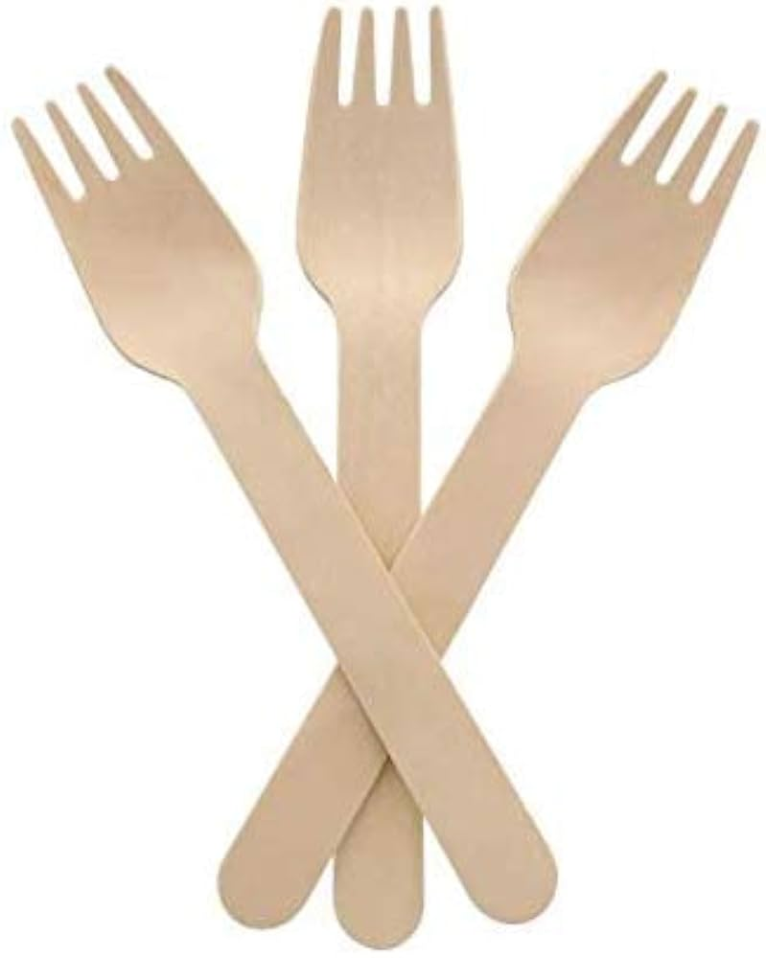
Various Shapes of Utensils Given in the Standard
Plates (Plane or Compartmental) : Round, Square
Tray with lid : Square
Containers with lid : Square
Compartmental plates
Spoon
Forks
Cups
BOWLS

Slide 5
REQUIREMENTS & TESTS
General Requirements | Performance Requirements | Tests
utensils shall be made only from the agricultural by-products. It shall be clean, well dried and free from any dust, dirt, foreign materials, etc. No chemicals, colours (synthetic or natural), resins, adhesives, etc. shall be used in the manufacture of utensils. The surface shall be smooth and free from and dent/damage The edges shall not be sharp, which will cause inconvenience during handling. It shall be ensured that mid ribs/twigs/any part of the plants/thread used for joining is firmly placed. | The deviations in the dimensions of utensils shall be within the specified tolerance when tested as per the prescribed method The moisture content of the utensils will not be more than 10 percent dry basis when removed from the package. The percent moisture absorption (increase in moisture content) will not be more than 5 percent dry basis, when completely immersed in water for 10 minutes as per the prescribed method. The total plate count of the microorganisms on the surface showed shall be below 5 cfu/cm2 when tested as per ISO 18593. During load bearing test the change in height shall not be more than 5 percent. | Measurement of Dimension Moisture Content And Water Absorption Estimation Bending Test of The Utensils Load Bearing Performance Drop Performance Folding Lid Fitting Performance Hot Water Resistance & Hot Oil Resistance Water Leakage Resistance

