Slide 1

COOKING UTENSILS
Capacity building programme for women and child welfare

Slide 2
INDIAN STANDARDS ON COOKING UTENSILS, COOKERS AND MITTI-COOL REFRIGERATOR
Standards Covered :
    IS 14756 – Stainless Steel Utensils
    IS 1660 – Wrought and Cast Aluminium Utensils
    IS 2347 – Domestic Pressure Cooker
    IS 17870 – Commercial Pressure Cooker
    IS 17693 – Non-electric Cooling Cabinet Made of Clay (Mitti-cool Refrigerator)

Slide 3
EXISTING REGULATIONS
Domestic pressure cookers are already under mandatory certification. ( 390 BIS licensee)
DPIIT, Ministry of Commerce and Industry vide their order dated 11 Oct 2024, has brought cooking utensils under mandatory certification. As per the order, no utensils can be sold without ISI market after the last date of implementation.
Sl No | IS No | Title of the Indian Standard | Last date of implementation for large scale enterprises | Last date of implementation for micro scale enterprises | Last date of implementation for small scale enterprises
1 | IS 14756: 2024 | Stainless Steel Utensils | 1st April, 2025 | 1st October, 2025 | 1st July, 2025
2 | IS 1660: 2024 | Wrought and Cast Aluminium Utensils

Slide 4
HEALTH HAZARDS
Sometimes, there is possibility of migration of material from cooking utensils to the food being cooked.
To take care of this issue, standardization plays an important role.
Standards prescribe the performance and safety requirements to ensure that product is of robust and durable nature.
Most importantly, these standards prescribe the permissible limits of heavy metals or toxic materials in the raw materials used in manufacturing of Utensils.

Slide 5
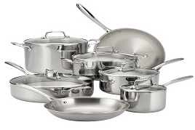
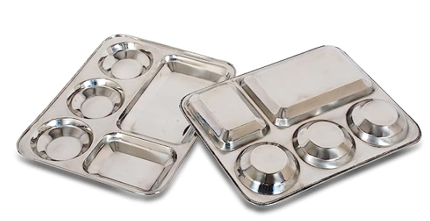
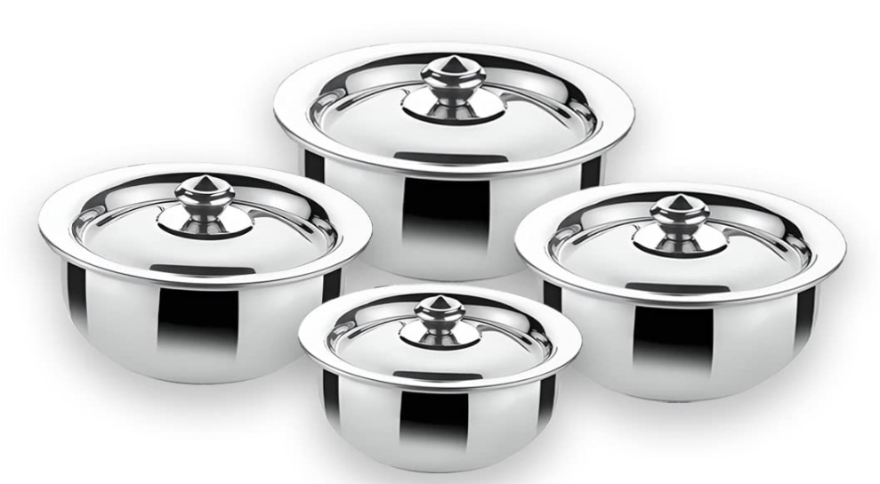
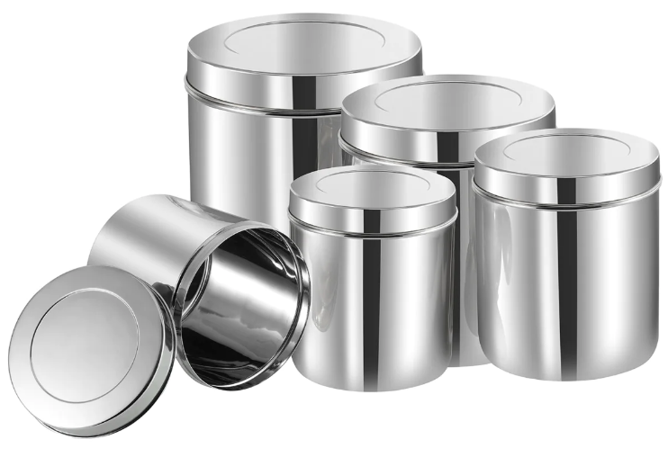
IS 14756 : STAINLESS STEEL UTENSILS
This standard lays down the minimum requirements for following types of stainless steel utensils:
  Cooking utensil;
  Serving utensils;
  Table utensils; and
  Storage utensils.

Slide 6
MATERIAL REQUIREMENTS
The stainless steel used for manufacture of utensils shall conform to IS 5522 (Stainless steel sheets and strips for utensils) or IS 15997 (Low nickel austenitic stainless steel plate, sheet, and strip for utensils and kitchen appliances).
The material used for composite bottom shall be as per IS 15960 (Composite bottom stainless steel cooking utensils).
If the body of the utensil is made of a 3 ply construction, 3 ply material shall be made with inner layer – designation X04Cr19Ni9 (grade 304) of IS 5522, middle layer – aluminium as per IS 21 and outer layer – designation X07Cr17 (grade 430)/X02Cr18Ti (grade 439) of IS 6911 (Stainless steel plate, sheet and strip)
If the utensil is provided with stainless steel lid, the material of lid shall be as per IS 5522 or IS 15997. The minimum thickness of the lid shall be 0.4 mm.
If the utensil is provided with tempered glass lid; the minimum thickness of glass shall be 3.5 mm.

Slide 7
MAJOR PERFROMANCE TESTS
Staining Tests: the utensil shall not show any sign of staining after removal from the test solutions/conditions.
Mechanical and Thermal Shock Test (for cladded utensils only): the cladded or deposited layer shall show no sign of peeling off or coming off.
Dry Heat Test (for cladded utensils only): There shall be no separation of cowl or disc from the utensil after cooling.
Nominal Capacity Test: The nominal capacity of cookware shall be expressed only in complete or 100 ml units. No negative tolerances shall be allowed on the nominal capacity.
Tempered Glass Lid (Thermal Shock Test): glass lid in air circulating oven (120 deg Celsius for 30 mins); after removal the glass lid shall not shatter when pouring one litre of water at ambient temperature.
Tempered Glass Lid (Free Fall Test): Drop the lid with/without rim facing down, from a height of 900 mm on a vitrified tile surface or a level smooth concrete surface. The glass shall not break/crack.

Slide 8
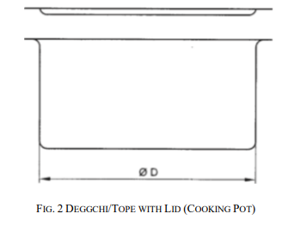
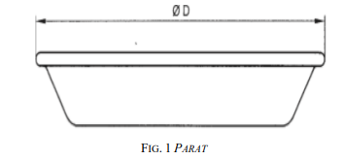
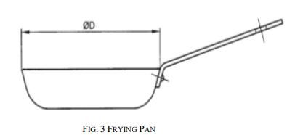
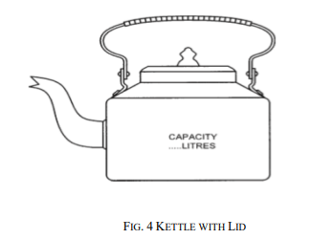
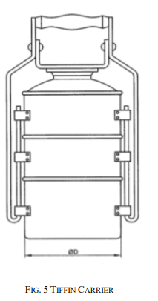
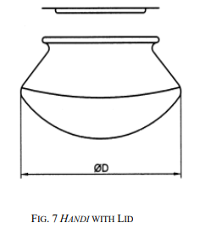
IS 1660 : WROUGHT AND CAST ALUMINIUM
UTENSILS
This standard prescribes general requirements, material and thickness for commonly used wrought and cast aluminium utensils (or thick bottom utensils, compartmental trays, lunch boxes) up to 30 litres capacity.
Aluminium utensils shall mean any utensils manufactured from aluminium or its alloys which can be used for cooking, boiling, baking, serving or storing of solid/semi-solid/liquid food, water and household provisions.
Utensils are classified into heavy, medium and light.

Slide 9
MATERIAL REQUIREMENTS
The steel used in manufacture of utensils shall conform to following chemical composition analysis:
Utensils and its various body parts | Relevant Complying Indian Standard | Additional Requirements
Main body of utensil, strips | IS 21 / IS 737 : Wrought aluminium and aluminium alloy sheet and strip for general engg. purposes | Toxic metals (Pb, Cd, Hg, Cr(VI)) – 0.05% (max)
Cast Cookware | IS 617 : Aluminium and aluminium alloy ingots for remelting & castings(general engg. Purposes) | _
Other aluminium components and parts | IS 737 / IS 617 / IS 734 (Specification for wrought aluminium and aluminium alloy forging stock and forgings) | _
Lids (if provided), SS handles, rivets and fittings | IS 21 / 737 (Aluminium), IS 6911 / IS 5522 (SS) | Minimum thickness of SS lid is 0.4 mm; if tempered glass lid 3.5mm (min thickness)
Gasket (if used) |  | Made from food grade silicon/nitrile
Lunch box clips | Aluminium alloy wire – IS 739 (19000 Designation) | _

Slide 10
MAJOR PERFORMANCE TESTS
Handles: sufficiently strong to support (in suspended position) a mass in the utensils equivalent to three times the mass of the water capacity of the utensils in the position of normal use for one minute without visible permanent deformation of the handle or utensil.
Coating: Requirement of PTFE, ceramic coating, powder coating and high temperature resistant liquid coating is that the material shall not contain more than 0.05 percent as metal of any toxic metals such as lead, cadmium, mercury or chromium(VI).
Lunch Box Performance Test: snapping the clip on and off for 2000 times; no weakening or damage to the securing arrangement shall be observed.
Ground Nut Oil Test for Leakage: filling inner pot of box by two third ground nut oil and then inverted; no appreciable leakage of the oil from the inner pot shall occur after one minute.
Tempered Glass Lid (Thermal Shock Test): glass lid in air circulating oven (120 deg Celsius for 30 mins); after removal the glass lid shall not shatter when pouring one litre of water at ambient temperature.

Slide 11
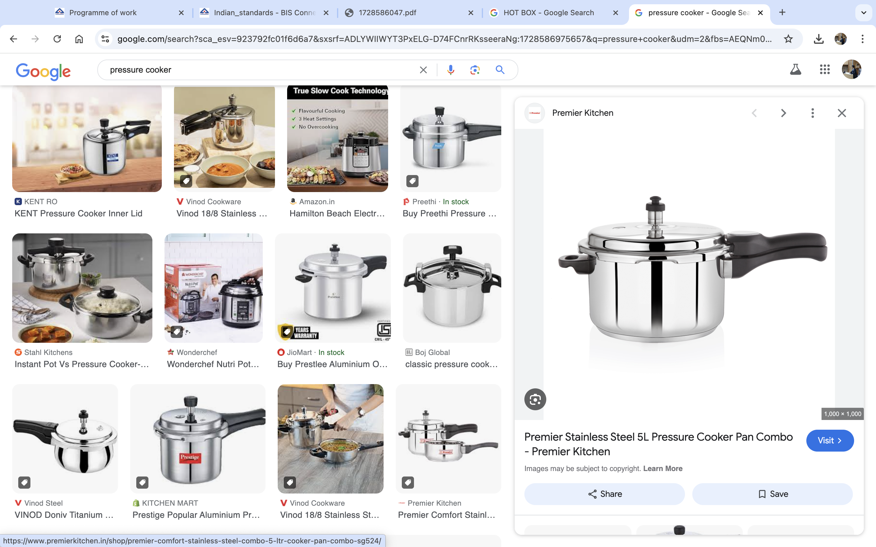
IS 2347: 2023 - DOMESTIC PRESSURE COOKER
This Standard cover the requirements for domestic pressure cookers of capacity upto 24 litres.
This Standard does not cover microwaveable pressure cookers.
Cookers above 24 litres are covered in a separate standard IS 17870 : 2022 ‘Commercial Pressure Cooker – Specification’.

Slide 12
MATERIAL REQUIREMENTS
Body, Lid, Containers and Grid — The body and lid of the pressure cooker shall conform to designation 19000, 19500, 31000, 40800 of IS 21 or stainless steel conforming to designation X04Cr19Ni9/X07Cr18Ni9 of IS 5522/IS 6911 or stainless steel conforming to designation X8Cr16Mn8Cu2Ni2N of IS 15997/IS 6911. The containers and the grid shall conform to any of the designations as per IS 21 or IS 5522 or IS 15997.
If stainless steel pressure cooker is provided with composite bottom, the composite bottom shall conform to IS 15960.
If the aluminium cooker is provided with an induction friendly base, the material of the induction plate shall be as per 430 or 439 series as given in IS 6911.
If the body of the pressure cooker is made of a 3 ply construction, 3 ply material shall be made with inner layer grade 304 of IS 5522, middle layer – aluminium as per IS 21 and induction friendly outer layer – grade 430 /439 of IS 6911.

Slide 13
MATERIAL REQUIREMENTS
Fusible Safety Device — The chemical composition of the fusible plug shall be such that it melts/ejects before a gauge pressure not greater than 3 times the nominal steam cooking pressure is reached. Maximum lead content shall not exceed 0.05 percent by mass in fusible plug pellet, when determined by any standard instrumental method or chemical method.
Gasket — The gasket shall conform to IS 7466.
Handles and Knobs — Construction and material of the handle/knob shall conform to IS 13395. In case of electric pressure cookers, the handles shall meet the requirements of IS 302 (Part 1).

Slide 14
MAJOR PERFORMANCE TESTS (Cont..)
Air Pressure Test
The cooker shall be subjected to air pressure of 40 percent of the nominal cooking steam pressure, slowly raised to nominal cooking steam pressure as specified by the manufacturer. It shall not show any sign of leakage or deformation.
Proof Pressure Test
The cooker shall be coupled to a hydraulic test pump provided with a calibrated pressure gauge. All the remaining openings in the body and lid of the cooker shall be suitably sealed. A pressure not less than twice the greatest nominal cooking pressure shall be applied. The cooker shall not show any sign of leakage or other forms of failure either during or after the test.

Slide 15
MAJOR PERFORMANCE TESTS (Cont..)
Operating Test for Pressure Regulating Device
The cooker shall be fitted with a calibrated pressure gauge in place of safety pressure relief device. It shall be half filled with water and placed in still air on a burner such as a pressure stove. The heat input shall be continued until the pressure regulating device first operates and the pressure noted. Operating pressure shall be within ± 20 percent of the nominal cooking pressure declared by the manufacturer.
Bursting Pressure Test
The cooker shall be coupled to a hydraulic test pump provided with a calibrated pressure gauge, suitably graduated. All the remaining openings in the body and lid of the cooker shall be suitably sealed or deactivated or removed.
  A gradually increasing hydraulic pressure shall be applied to the vessel of the cooker until a rupture takes place.
  The bursting pressure of the cooker shall not be less than 6 kgf/cm²

Slide 16
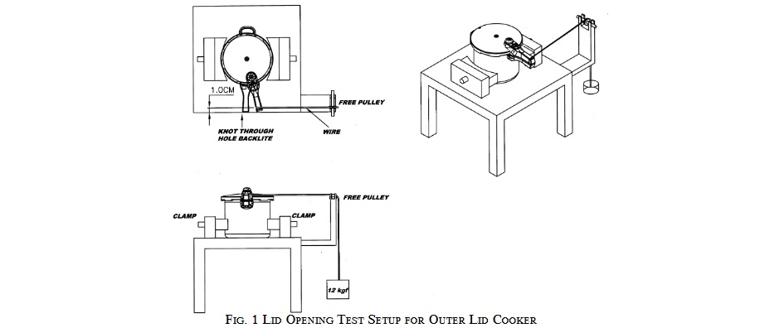
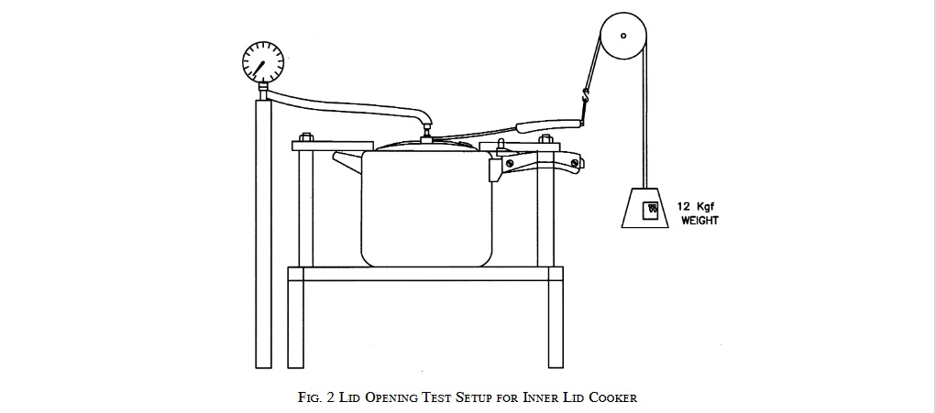
MAJOR PERFORMANCE TESTS
For Outer Lid Cooker: A force of 12 kgf (120 N approximately), when applied to the lid or cover or its fastening or locking device, shall not be able to release the lid or cover of the cooker unless the steam pressure inside has fallen below 0.18 kgf/cm² (18 kN/m² approximately) gauge.
For Inner Lid Cooker: A force of 12 kgf (120 N approximately), when applied to the lid or cover or its fastening or locking device, shall not be able to release the lid or cover of the cooker unless the steam pressure inside has fallen below 0.18 kgf/cm² (18 kN/m² approximately) gauge.

Slide 17
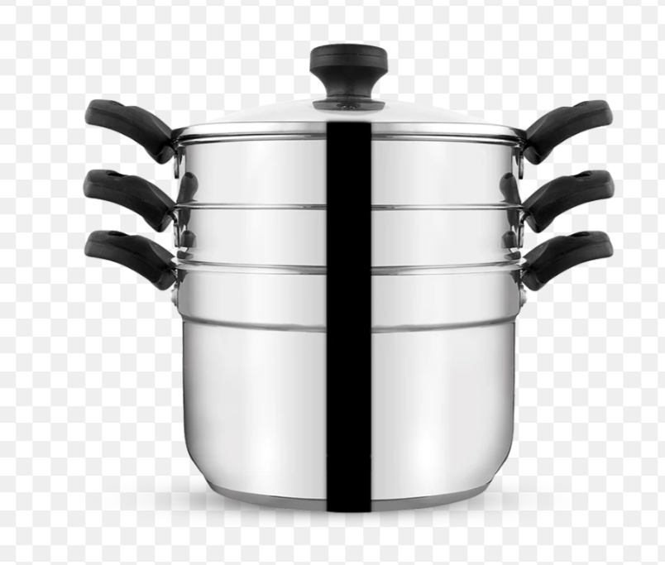
IS 17870: 2022 – COMMERCIAL PRESSURE COOKER
This standard cover the requirements for commercial pressure cookers of capacity above 24 litres and upto 100 litres.
Commercial pressure cooker is a closed commercial pressure cooking vessel for use with external heat source and capable of maintaining nominal cooking steam pressure of 0.8 kgf/cm2 gauge nominal (80 kN/m2 approximately).
Other requirements are similar to IS 2347.

Slide 18
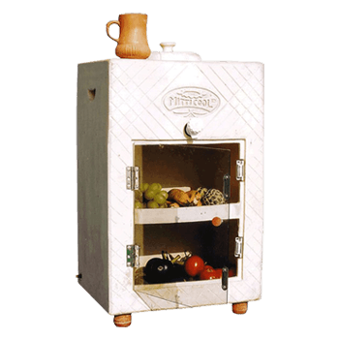
IS 17693 – Non-electric Cooling Cabinet Made of Clay (Mitti-cool Refrigerator)
Scope: Covers the requirements of a cooling cabinet made out of clay which is also called mitti-cool refrigerator.
Special Application:
This product works on the same principle as that of earthen pots which are used to cool water in summer which means the inside cabinet temperature, not below the ambient wet-bulb temperature can be maintained.
Useful for areas where electrical power is not available.
Not suitable to preserve the foodstuff which are required to be stored in frozen state.

Slide 19
IS 17693 – Non-electric Cooling Cabinet Made of Clay (Mitticool Refrigerator) (contd.)
Requirements:
Construction: Main body is constructed with clay. Door may be metallic or non-metallic which is fixed on the cabinet with stainless steel hinges conforming to IS 12817 or similar non-corrosive material. Chrome plated tap shall be used to draw water from the cabinet.
Cooling Performance: At defined steady-state condition, cooling performance is measured by comparing ambient DBT (dry-bulb temperature) and the cabinet internal DBT.
Volume: The method to determine cabinet volume is also defined.
User manual is provided with the product indicating the type of food stuff which can be stored in it along with time period.

Slide 20
CONSUMER GOODS FOR HOUSEHOLDS - NEW STANDARDS ON THE ITEMS OF HOUSEHOLD USE.
Electrical Appliances : ( IS : 374 , 366 , 1293 , 3854 , 1391 (Part 1 ) , 1391 (Part 2) , 17550 (Part 1) )
Bathroom Products : ( IS : 12701 , 8931 , 4120 )
Furniture And Home Fittings : ( IS : 1341 , 12817 , 205 , 18297 , 3564 , 208 , 17632 )
Medical Purpose Products : (IS : 3055 , 16289 )
Products For Women And Children : (IS : 17509 ,17514 )
General Utility Products : ( IS : 15558 , 1610 , 13129 , 15844 , 4151 )

Slide 21

Q&A SESSION

Slide 22
THANK YOU!

