Slide 1
Medical Devices for Women and Child care

Slide 2
Gynaecology Surgery Instruments
Vaginal speculum
Forceps
Ovum forceps
Uterine dilators
Obstetrical forceps
Scissors
Tenaculum forceps

Slide 3
Requirements for gynaecology surgery instruments
Material
Shape and Dimensions
Finishing requirements
Test for corrosion

Slide 4
MTP Suction Apparatus
Important device used in connection with implementation of various family welfare programmes
Used to remove pregnancy tissue from the uterus during an early abortion or miscarriage.
Requirements as per IS 7080 series
Protection against access to live parts
Leakage current and Electrical strength at operating temperature
Stability and mechanical hazards
Mechanical strength
Supply connection and external flexible cords
Terminals
Earthing
Screws and connections
Resistance to rusting

Slide 5
Medical equipment for infant care
Infant incubators
Infant warmers
Infant phototherapy equipment
Pulse oximeter
Foetal heart monitor
Construction
Protection against electrical and mechanical hazards
Protection against unwanted and excessive radiation hazards
Protection against excessive temperatures and other hazards
Accuracy of controls and instruments and protection against hazardous outputs

Slide 6
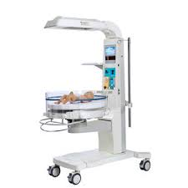
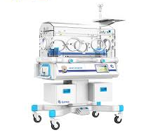
Infant incubator and Warmer
Temperature control
ALARM SYSTEMS
Indication of SKIN TEMPERATURE

Slide 7
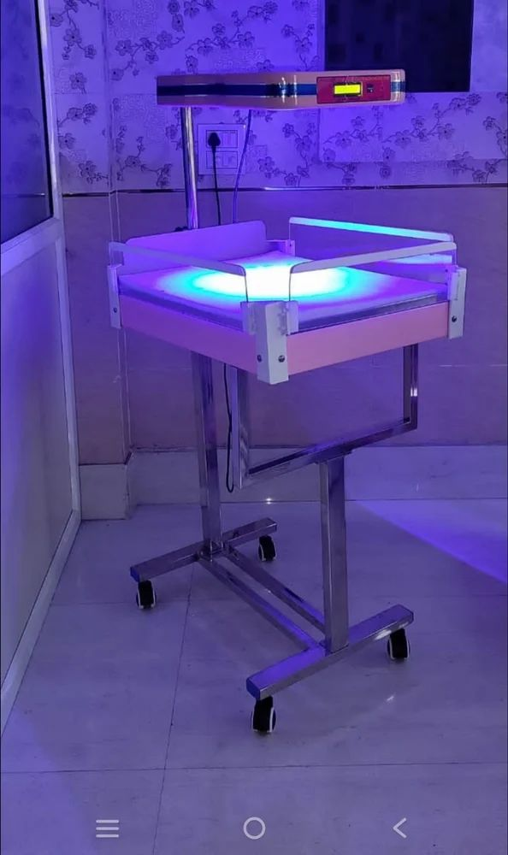
Infant phototherapy equipment
Safety sign for PATIENT eye shield
Heating elements or lamp holders
Warning and safety notices
Operating instructions
Irradiance distribution

