Slide 1



MICRO IRRIGATION SYSTEMS :
DRIP IRRIGATION AND SPRINKLER IRRIGATION SYSTEM COMPONENTS
By
VIKRANT CHAUHAN
Scientist-B/ Assistant Director
Member Secretary (FAD 11 & 17),
Food and Agriculture Department,
Bureau of Indian Standards, New Delhi

Slide 2
CONTENT
Irrigation
Indian Standards in the Area
What standard covers?
Drip Irrigation Standards
IS 12786
IS 13488
IS 13487
Sprinkler Irrigation Standards
IS 17425
IS 12232 Part 1 and Part 2
IS 14605
Valves Standard – IS 18286

Slide 3
IRRIGATION
Artificial application of water to the crops
Border
Irrigation
Check Basin Irrigation
Furrow Irrigation
Sprinkler
Irrigation
Drip Irrigation
Quality of Irrigation Water
Soil Type
Crop Type
Source of Water
Environmental Factors
FACTORS
TYPES

Slide 4
Indian Standards
Micro Irrigation
Drip
Sprinkler
Fertigation
Farm Drainage
Code of Practices
Quality of IW

Slide 5
WHAT STANDARD COVERS ?
SCOPE
TERMS
DEFINI^{T}
MAT^{r}
REQ^{M}
CONSTR^{N} REQ^{M}
TESTS
MARKING

Slide 6
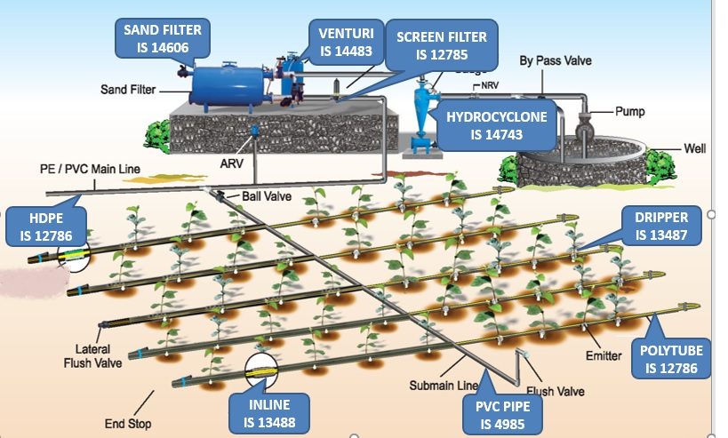

DRIP IRRIGATION SYSTEM
Pipes : IS 12786, IS 13488, IS 14482
Emitter : IS 13487
Prevention and Treatment : IS 14791
Filters : IS 12785, IS 14743, IS 14606

Slide 7
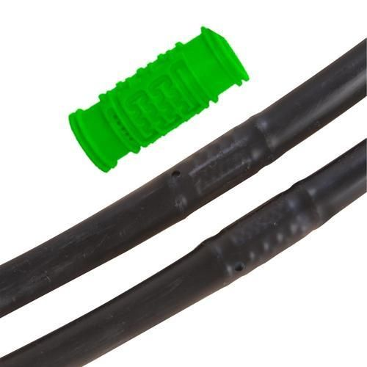
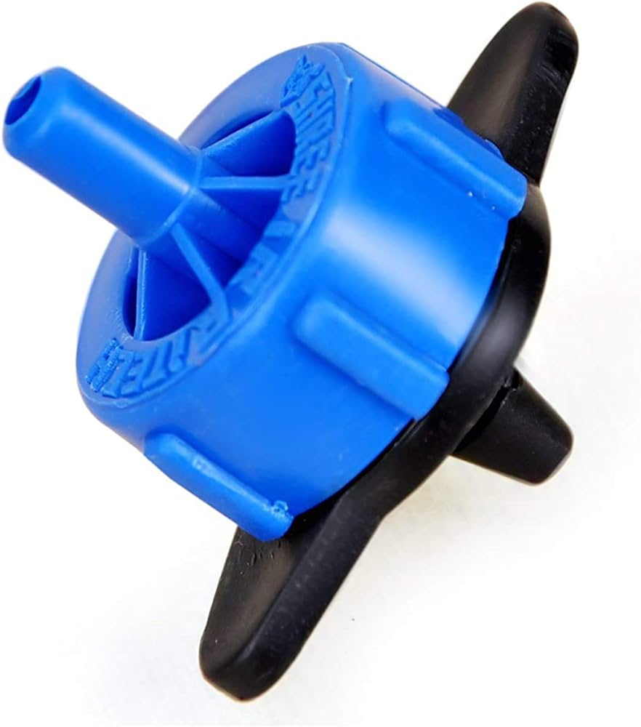
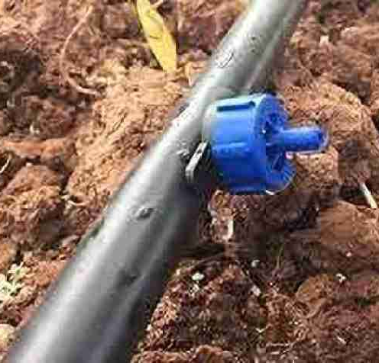
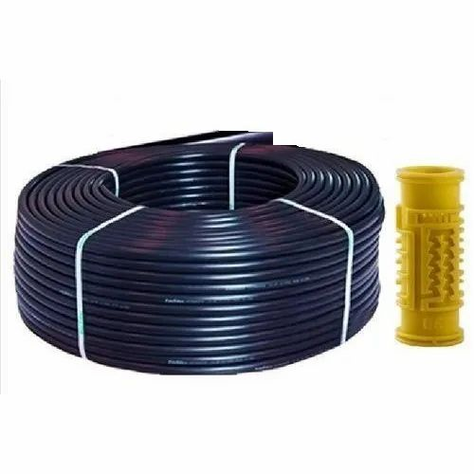
Pipes
IS 12786 for Irrigation Laterals
IS 13488 for Emitting Pipe Systems
Polyethylene pipes of outside diameter from 12 mm up to 32 mm
Class 1 (0.2 MPa), Class 2 (0.25 MPa), Class 3 (0.4MPa)Pipes
Material Requirement
Material Requirement
Categories of Pipes
(Regulating or Non-Regulating)
Various Tests

Slide 8
IS 12786 : 2024 IRRIGATION EQUIPMENT — POLYETHYLENE PIPES FOR IRRIGATION LATERALS — SPECIFICATION (first revision)
This standard lays down requirements for polyethylene pipes of outside diameter from 12 mm up to 32 mm to be used for irrigation laterals that is branch supply lines on which sprayers or drippers or emitters are mounted directly or by means of a fitting or formed in the pipe during production.
Class of Pipe | Working Pressure | Colour
Class 1 | 0.20 MPa | Red
Class 2 | 0.25 MPa | Yellow
Class 3 | 0.40 MPa | Green
Normal working conditions of pipes shall be operation of maximum 800 working hours per year at the pressure rating of the pipe and at a water temperature up to 35 °C. If these working conditions are exceeded the next higher class of pipe, that is, pipe with greater wall thickness shall be chosen. With these working conditions the life expectancy of the pipe is 10 years.

Slide 9
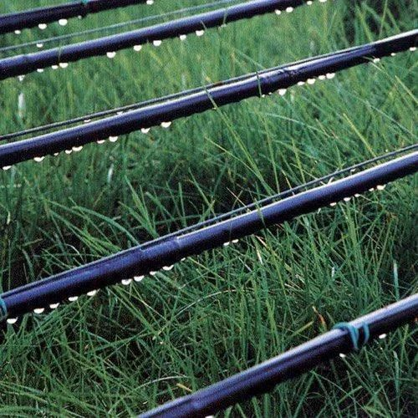
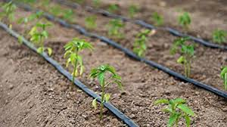
IS 12786 : 2024 IRRIGATION EQUIPMENT — POLYETHYLENE PIPES FOR IRRIGATION LATERALS — SPECIFICATION (first revision)
SPECIFICATION | SIGNIFICANCE
Material | To ensure right quality material with right amount of ingredients to achieve resistance against UV and to withstand environmental conditions.
Dimensions | All the manufacturer follows common dimensions. Makes it easy for the user to select proper tubing according to his requirements.
Hydraulic Characteristic | Pressure withstanding capacity of the tubing for ambient and elevated temperature.
Reversion Test | Checks effect of air temperature on laying length of the lateral.
Tensile Test | Tube shall withstand pulling force while laying and retrieval
Environmental Stress Crack Resistance | Ensure that tube shall not crack due to environmental stresses

Slide 10
IS 13488 : 2008 IRRIGATION EQUIPMENT — EMITTING PIPE SYSTEMS — SPECIFICATION (first revision)
This standard specifies the mechanical and functional requirements of the emitting pipes and their fittings, test methods and the data to be supplied by the manufacturer to facilitate correct installation and operation in the field.
Class of Pipe | Working Pressure
Class 1 | 0.100 MPa
Class 2 | 0.125 MPa
Class 3 | 0.250 MPa
Class 3 | 0.400 MPa
Unregulated Emitting Pipes
Regulated Emitting Pipes
Other Classif^{n}
Uniformity Category A
Uniformity Category B
NOTE - This standard applies to emitting and trickling pipes, hoses and tubings intended for irrigation. in which the emitting units form an integral part. This standard also applies to the fittings used for connecting these pipes, hoses and tubings. This standard does not apply to continuously porous pipe (porous along its entire length and circumference).

Slide 11
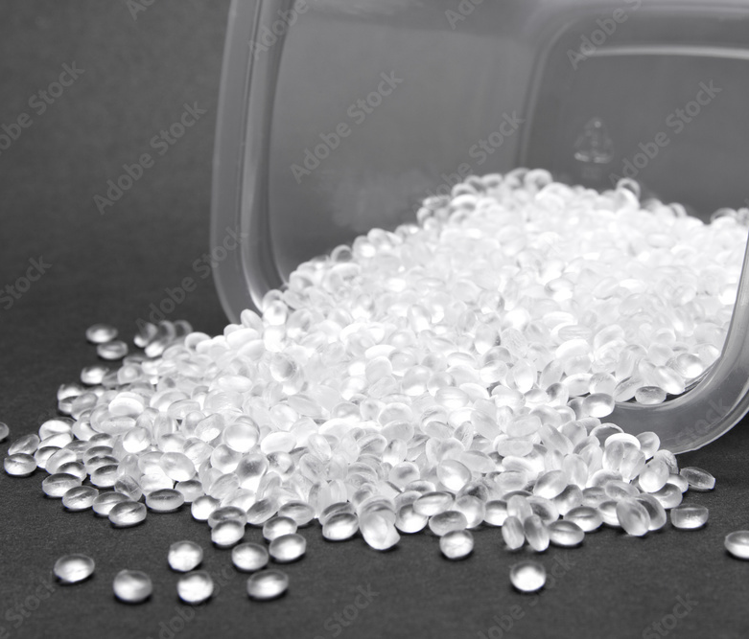
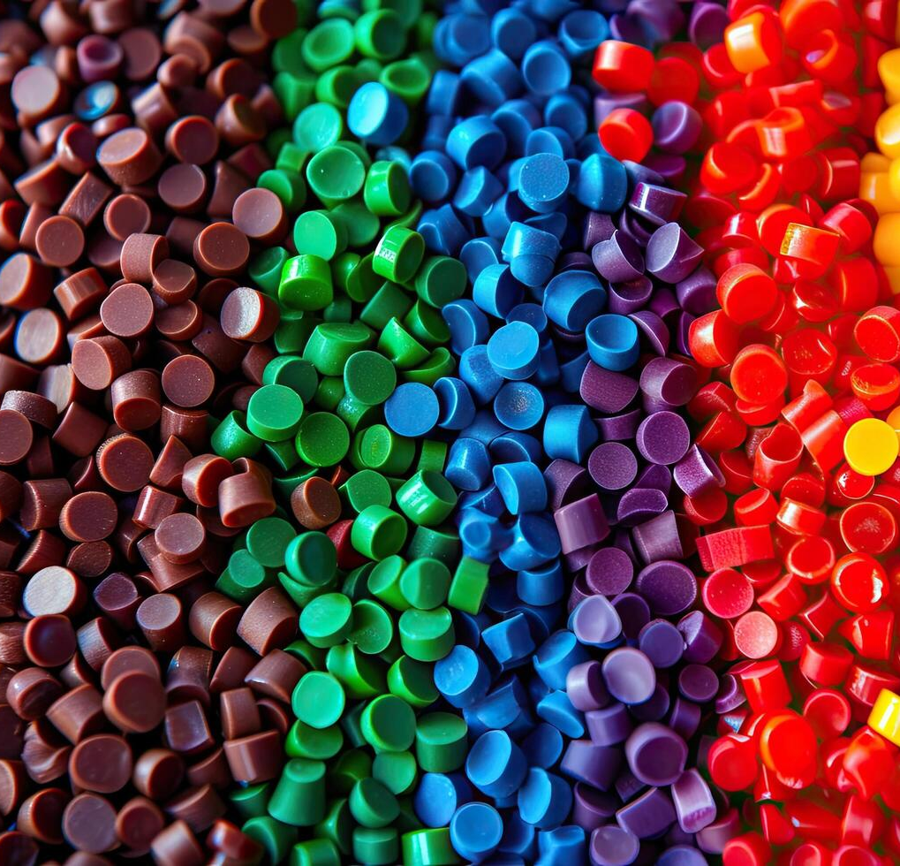
IS 13488 : 2008 IRRIGATION EQUIPMENT — EMITTING PIPE SYSTEMS — SPECIFICATION (first revision)
Material Req^{n}
suitable for use with water ≤ 60°C 1
protected against UV degradation
high pressures
shall be opaque
Resistant to growth of algae and bacteria
Resistant to fertilizers and chemicals

Slide 12
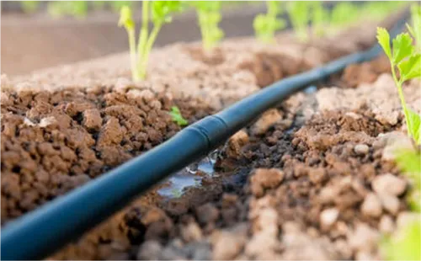
IS 13488 : 2008 IRRIGATION EQUIPMENT — EMITTING PIPE SYSTEMS — SPECIFICATION (first revision)
Specification | Significance
Uniformity of Flow Rate | Ensures that nearly uniform water shall be delivered to crops.
Emission Rate as a function of inlet pressure | Tells us how flow rate will vary for pressure fluctuations
Hydrostatic Pressure | Sudden change in pressure or operation of the dripline at higher pressure.
Resistance to tension at elevated temperature | Even if temperature increases, there shall not be deviation in flow rate by more than 5%
Resistance to Pull Out | Tube shall not be pulled out of fittings for nominal pulling force.
Environmental Stress Crack Resistance | Ensure that tube shall not crack due to environmental stresses
Emitter Unit Exponent | This is an indicator for performance of the emitter.

Slide 13
IS 13487 : 2025 IRRIGATION EQUIPMENT — EMITIERS — SPECIFICATION (first revision)
This standard specifies mechanical and functional requirements of irrigation emitters, test methods and the data to be supplied by the manufacturer to permit correct installation and operation in the field.
TYPES
On-Line
In-Line
Uniformity Cat A
Uniformity Cat B
Regulated
Unregulated
Single Outlet
Multi Outlet
NOTE - It applies to emitters, with or without pressure regulation, intended for irrigation; it does not apply to emitters which form an integral part of the pipe during manufacture as well as microtubes.

Slide 14
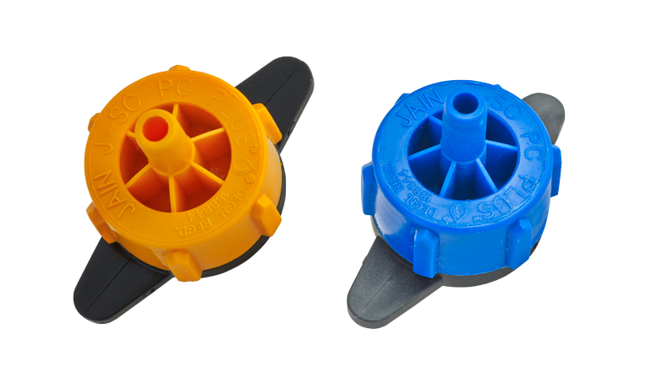
IS 13487 : 2025 IRRIGATION EQUIPMENT — EMITIERS — SPECIFICATION (first revision)
Material Req^{n}
protected against UV degradation
high pressures
shall be opaque
Resistant to growth of algae and bacteria
Resistant to fertilizers and chemicals
suitable for use with water ≤ 60°C 1

Slide 15

IS 13487 : 2025 IRRIGATION EQUIPMENT — EMITIERS — SPECIFICATION (first revision)
MECHANICAL TESTS AND REQUIREMENTS
Construction and Workmanship – visual inspection for manufacturing defects
Flow Paths In Emitter – dimension measurement
Resistance to Hydrostatic Pressure – performance of emitter against high pressure
Emitter Pull-out Test
FUNCTIONAL TESTS AND REQUIREMENTS
Uniformly of Emission Rate
Emission Rate as a Function of Inlet Pressure
Determination of Emitter Exponent

Slide 16
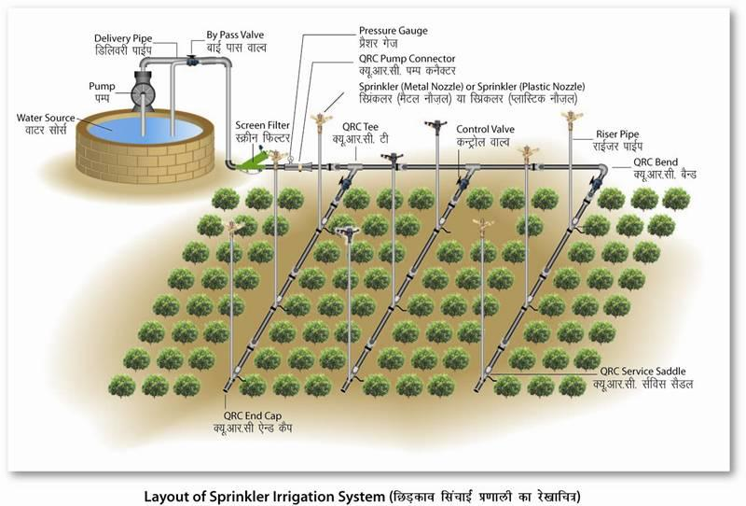

SPRINKLER IRRIGATION SYSTEM
Pipes : IS 17425
Sprinklers : IS 12232 (Part 1 & 2), IS 14605
Design and Installation of SIS :
IS 14792
Chemical Injection System : IS 14483 (Part 1,2 & 3)

Slide 17
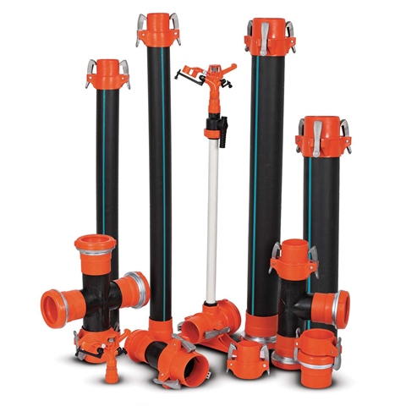
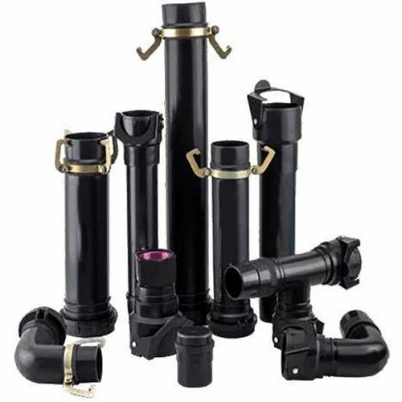

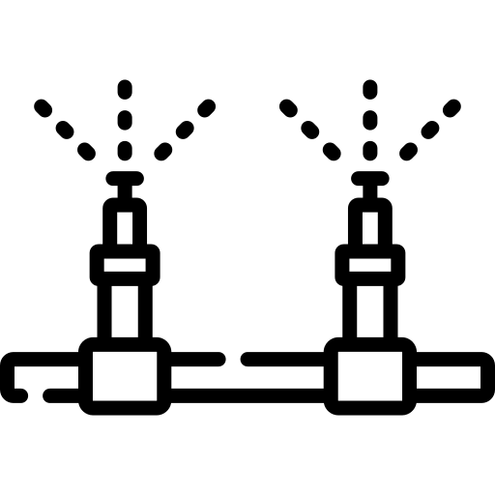
IS 17425 : 2020 IRRIGATION EQUIPMENT - QUICK COUPLED POLYETHYLENE PIPES AND FITTINGS FOR SPRINKLER IRRIGATION SYSTEMS - SPECIFICATION
Classification of Pipes
IS 17425 lays down the general requirements for raw materials, manufacturing, method of tests and testing of quick coupled and plain polyethylene pipes and fittings of outside diameters 40 mm to 200 mm used for portable sprinkler and drip irrigation systems as mains, sub mains or laterals.
Class of Pipe | Maximum Permissible Working Pressure at 30 °C
Class 1 | 0.25 MPa
Class 2 | 0.32 MPa
Class 3 | 0.40 MPa
Class 4 | 0.60 MPa
Coupler
Coupled Tee
Coupled Bend
Pump Connector
End Cap
Coupled Pipe
Coupled Fittings
Foot Batten Assembly
Riser

Slide 18
IS 17425 : 2020 IRRIGATION EQUIPMENT - QUICK COUPLED POLYETHYLENE PIPES AND FITTINGS FOR SPRINKLER IRRIGATION SYSTEMS - SPECIFICATION
Quick Coupled Pipes and Fittings
Plain PE Pipes
SPECIFICATION | SIGNIFICANCE
Leakage Test | Fittings coupled to the pipe are tested for leakage with water as medium with pressure from 0.0 MPa to maximum working pressure.
Hydraulic Proof Test | Same assembly as above tested at higher pressures checking the Pressure withstanding capacity.
Weldability Test | Hydraulic performance test (7.1.2) performed, to establish the joint between the couplers and pipe.
SPECIFICATION | SIGNIFICANCE
Visual Appearance and Workmanship (7.1.1) | pipes shall be smooth, clean and free from grooving, pit marks and melt fractures.
Hydraulic Performance Characteristics (7.1.2) | Pressure withstanding capacity of the pipe for ambient and elevated temperature.
Reversion Test (7.1.3) | Checks effect of air temperature on laying length of the lateral.
Tensile Test | Tube shall withstand pulling force while laying and retrieval
Fusion Compatibility Test | Testing the pipes joined with butt fusion, friction welding, socket fusion or using electro fusion fitting.
Environmental Stress Crack Resistance | Ensure that tube shall not crack due to environmental stresses

Slide 19
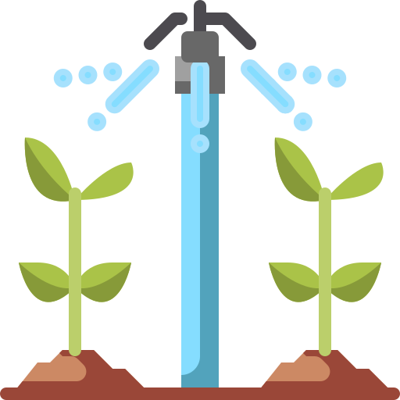
IS 12232 Part 1 and Part 2 : ROTATING SPRINKLER
IS 12232 (Part 1) specifies the design and operational requirements of rotating sprinklers, sprinkler nozzles and their test methods.
On the other hand IS 12232 (Part 2) specifies the conditions and methods used for testing of uniformity of distribution of rotating sprinklers which is important parameter for sprinkler irrigation system to achieve uniform/even application over the covered land area.

Slide 20
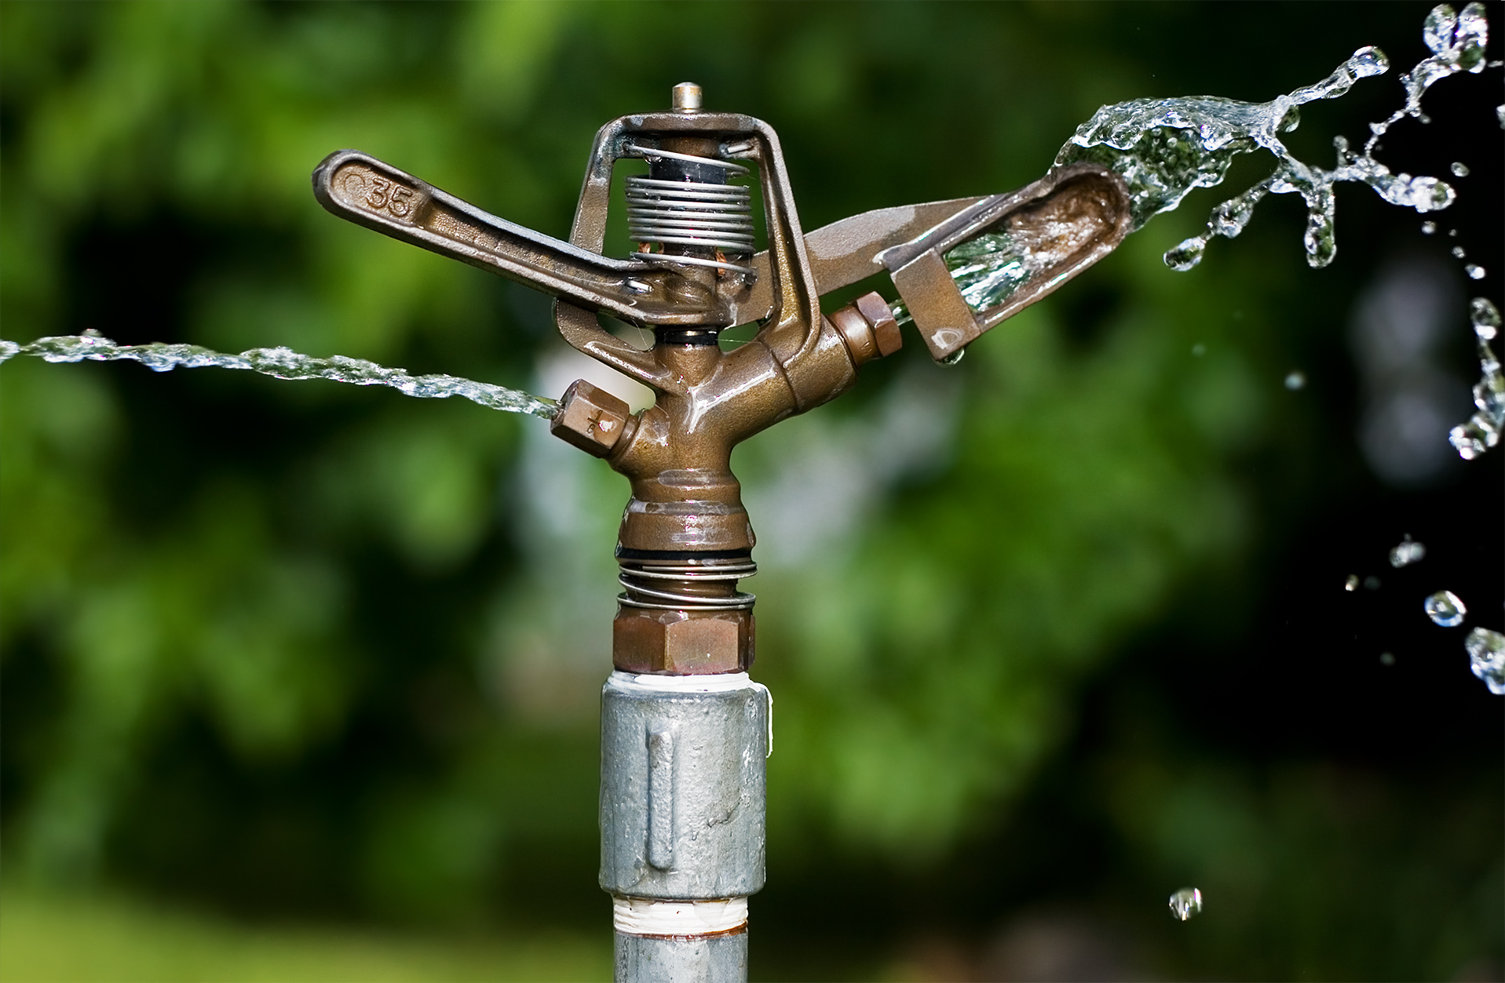
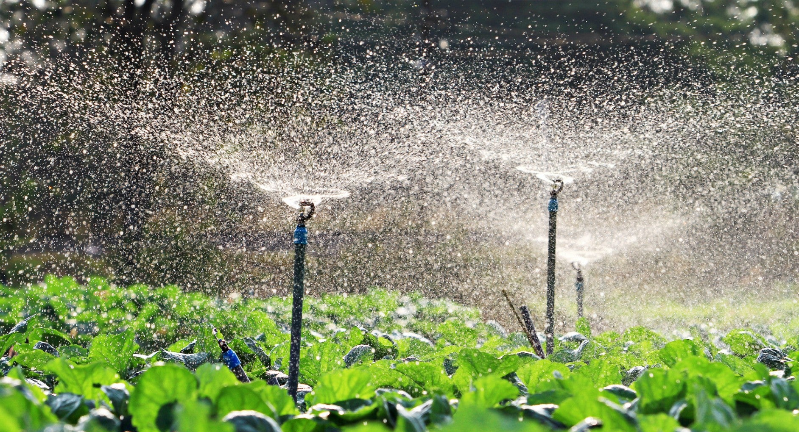
IS 12232 Part 1 and Part 2 : ROTATING SPRINKLER
Specification | Significance
Resistance to threaded connection | Sprinkler shall withstand tightening torque
Hydrostatic Pressure | Performance against increase in pressure.
Uniformity of Flow Rate | Ensures that nearly uniform water shall be delivered to crops.
Water Distribution Curve | Ensures uniformity of water distribution
Durability Test | This test ensures performance against life of the sprinkler.

Slide 21
IS 14605 : 1998 IRRIGATION EQUIPMENT — MICRO SPRAYERS — SPECIFICATION
Classification
Flow Rate in Relation to Pressure)
Based on Spray Characteristics
Non-Regulated Sprayer
Fan shaped coverage
Regulated Sprayers
fine jet sprayers
Micro sprayers are type of sprinklers used to deliver water to the crops as a fine spray or mist, ensuring efficient coverage with minimal water wastage.
IS 14605 specifies the general requirements and test methods for micro sprayers. It applies to sprayers intended for assembly in pipeline networks for irrigation and for operation with irrigation water.

Slide 22
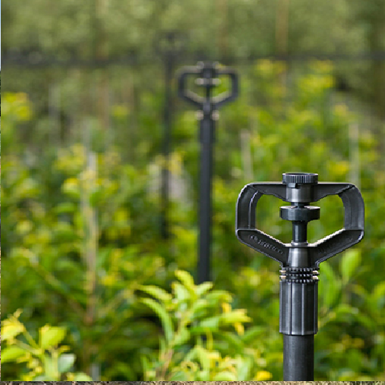
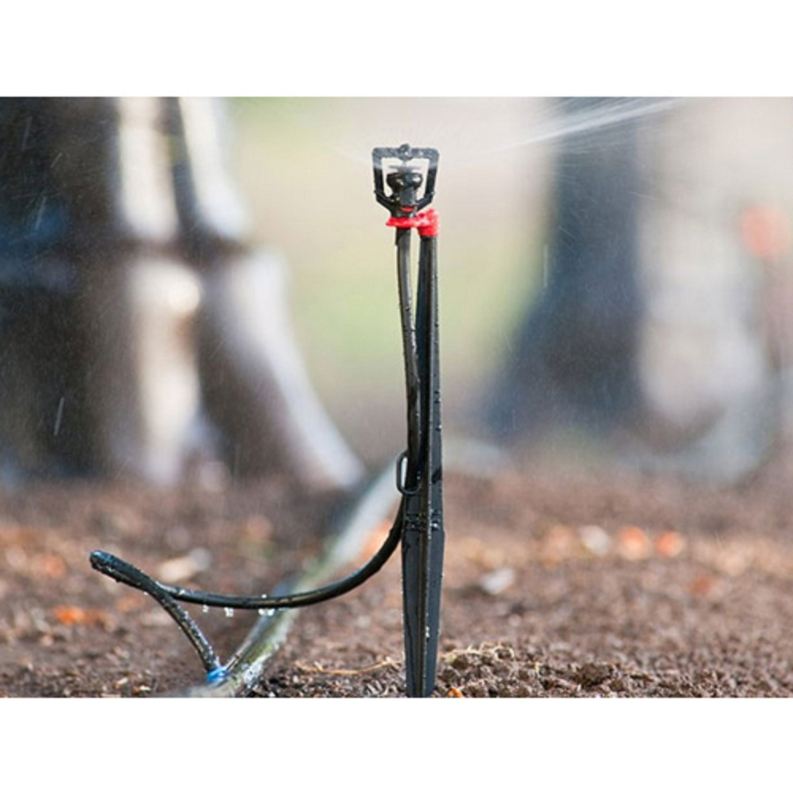
IS 14605 : 1998 IRRIGATION EQUIPMENT — MICRO SPRAYERS — SPECIFICATION
Specification | Significance
Hydrostatic Pressure | Performance against increase in pressure.
Uniformity of Flow Rate | Ensures that nearly uniform water shall be delivered to crops.
Water Distribution Curve | Ensures uniformity of water distribution

Slide 23
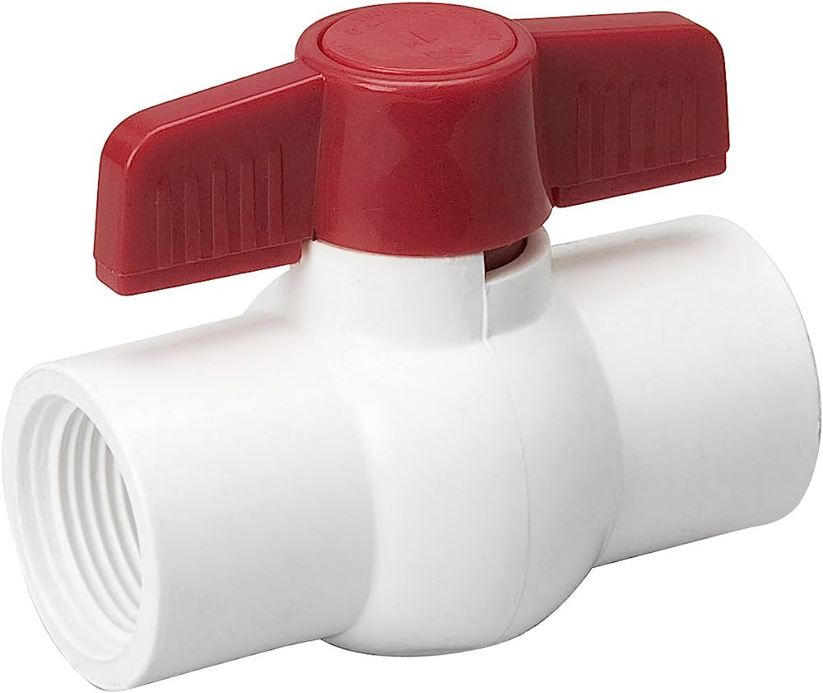
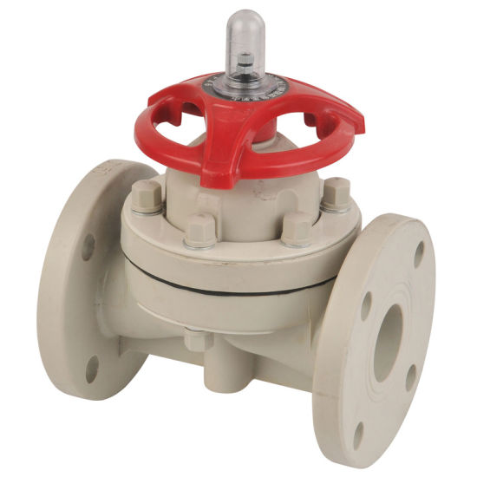
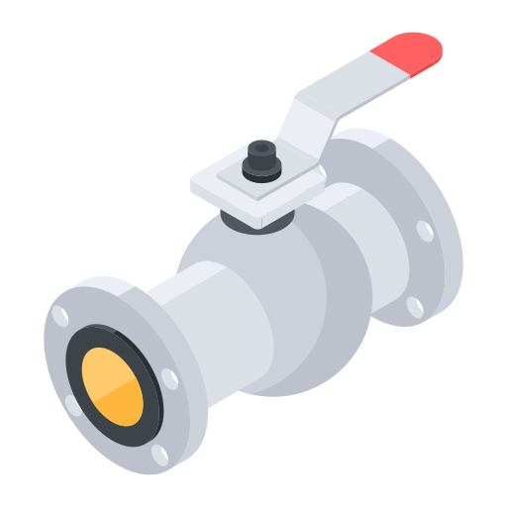
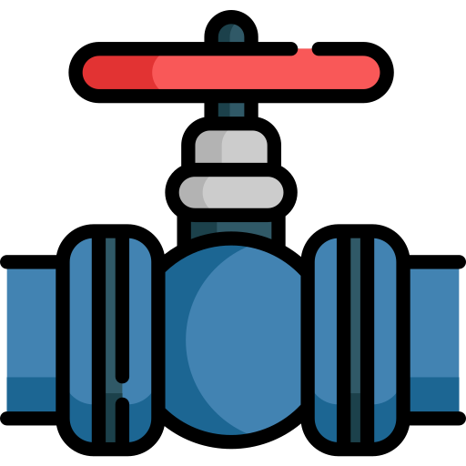
IS 18286 : 2023 Agricultural Irrigation Equipment — Manually Operated Serviceable Plastics Valves — Specification
Ball
Valve
Globe
Valve
Diaphragm
Valve
Angle
Valve
IS 18286 specifies the general requirements and test methods for manually operated serviceable plastics valves intended for operation in agricultural irrigation systems. It is applicable to manually operated plastics valves of diameter nominal (DN) 8 (1/4") to diameter nominal 110 (4") including angle, globe, diaphragm and ball valves.
The valves are intended for installation in irrigation piping networks, using water at temperatures from 5 °C to 60 °C. Nominal pressures of the valves are as designated by the manufacturer.

Slide 24
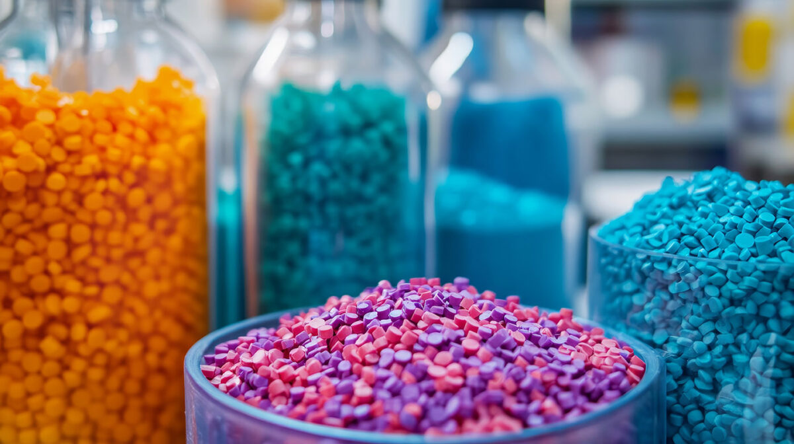
IS 18286 : 2023 Agricultural Irrigation Equipment — Manually Operated Serviceable Plastics Valves — Specification
PVC (Polyvinyl chloride)
PE (Polyethylene)
POM (Poly Oxy Methylene)
Poly Amide
PP (Polypropylene)
NBR (Nitrile rubber)
ABS (Acrylonitrile Butadiene Styrene)
EPDM (Ethylene propylene diene monomer)
All valve components those comes in contact with water shall not support the growth of algae and bacteria, nor be of metal which will corrode. Plastic parts of the valve that are exposed to sunlight shall be opaque and protected against UV degradation.

Slide 25
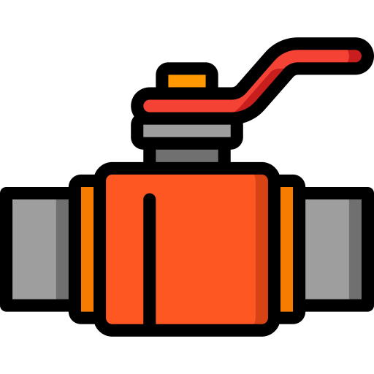

IS 18286 : 2023 Agricultural Irrigation Equipment — Manually Operated Serviceable Plastics Valves — Specification
Colour
Colour of Polyvinyl chloride (PVC), Polyethylene (PE), Polypropylene (PP) the compound should be either Grey or Black or as agreed between manufacturer and customer.
CONNECTIONS TO PIPELINE SHALL BE IN ACCORDANCE WITH FOLLOWING TABLE:
Material | Reference IS Standard
Polypropylene (PP) | IS 15801
Polyethylene (PE) | IS 4984/IS 17425
Unplasticized polyvinyl chloride (PVC-U) | IS 4985/IS 7834 (Part 1)
MECHANICAL AND FUNCTIONAL TESTS
Resistance to Increased Torque
Resistance of Valve and Valve Material to Internal Hydrostatic Pressure
Seat and Stem Sealing Test
Valve Performance at Increased Hydraulic Pressure
Endurance Testing

Slide 26
List of India Standards on MIS

Slide 27
Thank You…

