Slide 1



MICRO IRRIGATION SYSTEMS :
FILTERS, CHEMICAL INJECTION SYSTEM, INSTALLATION, OPERATION AND MAINTENANCE
By
VIKRANT CHAUHAN
Scientist-B/ Assistant Director
Member Secretary (FAD 11 & 17),
Food and Agriculture Department,
Bureau of Indian Standards, New Delhi

Slide 2

CONTENT
Filters
IS 12785
IS 14743
IS 14606
Chemical Injection System
IS 14483 (Part 1)
IS 14483 (Part 2)
IS 14483 (Part 3)
Installation, Operation and Preventive Maintenance
IS 14791
IS 14972

Slide 3

FILTERS
FILTERS
IS 14743
Hydrocyclone Filters
IS 14606
Media Filter
IS 12785 Strainer Filters
Filters are an essential component of micro-irrigation systems, designed to ensure clean and clog-free operation by removing debris, sediments, and other impurities from water before it enters the irrigation network.

Slide 4

IS 12785 : 1994 STRAINER-TYPE FILTERS – SPECIFICATION
Strainer type Filters use a fine mesh, screen, disc or combination of these to trap debris/impurities contained in the irrigation water to prevent clogging in micro-irrigation systems.
IS 12785 specifies the general construction requirements and test methods for strainer type filters (hereinafter called filters) intended for operation in agricultural irrigation systems.
TYPES
Screen Filter
Disc Filter

Slide 5
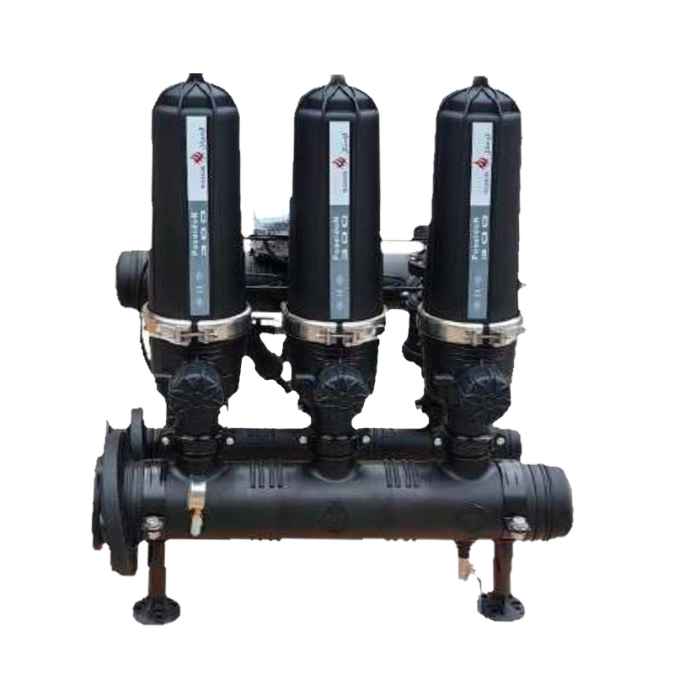
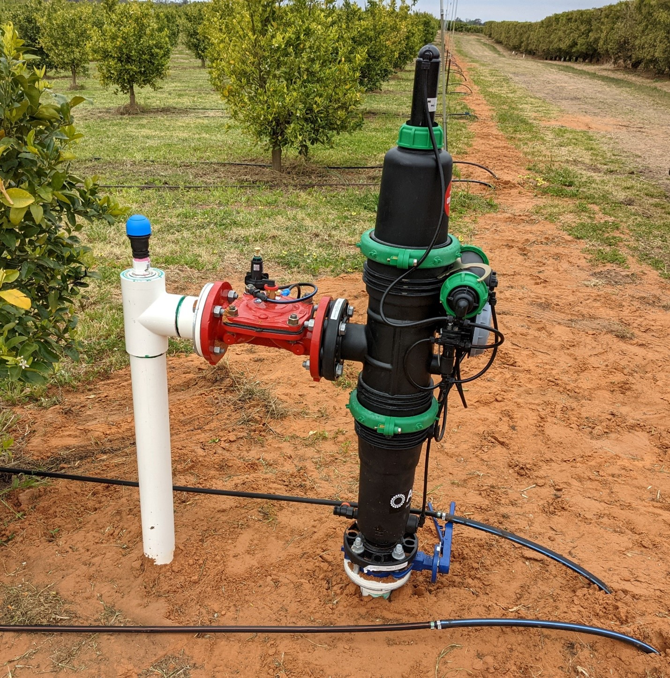
IS 12785 : 1994 STRAINER-TYPE FILTERS — SPECIFICATION
Specification | Significance
Resistance of Strainer to Internal Hydrostatic Pressure | Filter screen shall withstand pressure
Resistance to Internal Hydrostatic Pressure at High Temperature | Shall withstand even if water temperature is high
Resistance of Filter Element to Buckling or Tearing | Filter element shall not rupture even if filter is completely clogged
Tightness of Filter Element | Water shall not bypass the filter element
Clean Pressure Drop | Filters own pressure drop shall be considered for design of drip system

Slide 6
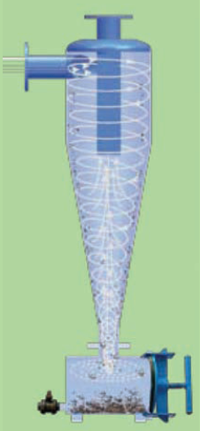
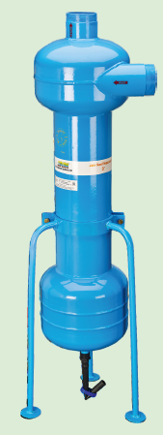
IS 14743 : 2024 HYDROCYCLONE FILTERS – SPECIFICATION (first revision)
Hydrocyclone filter is an essential component of micro irrigation system used to separate sand from the river or tube-well water. It works on the principle of centrifugal force. it is also called centrifugal filter/sand separator.
It is filtration device consisting of a cyclonic vessel having an arrangement to create spiral vortex flow, an inlet, a centrally rising up outlet and an underflow chamber for sand collection tank connected at the lower end, essentially having an opening for removal of accumulated entrapped particles.

Slide 7
IS 14743 : 2024 HYDROCYCLONE FILTERS – SPECIFICATION (first revision)
IS 14743 specifies the general constructional requirements and test methods of the hydrocyclone filters, intended for operation in agricultural irrigation systems.
The standard does not deal with filtration ability, efficiency and capacity nor it deals with the hydrocyclone filters that integrate automatic or continued flushing of accumulated sand.
TECHNICAL REQUIREMENTS
Material
Metallic body or parts shall be coated with durable abrasion resistant coating having a coating thickness more than 70μm or hot dip galvanized to resist corrosion and under scouring
Plastic body or parts of the filter that are exposed to ultraviolet (UV) radiation shall include additives to improve their resistance to UV radiation
Construction
Cyclonic Vessel
Connections

Slide 8
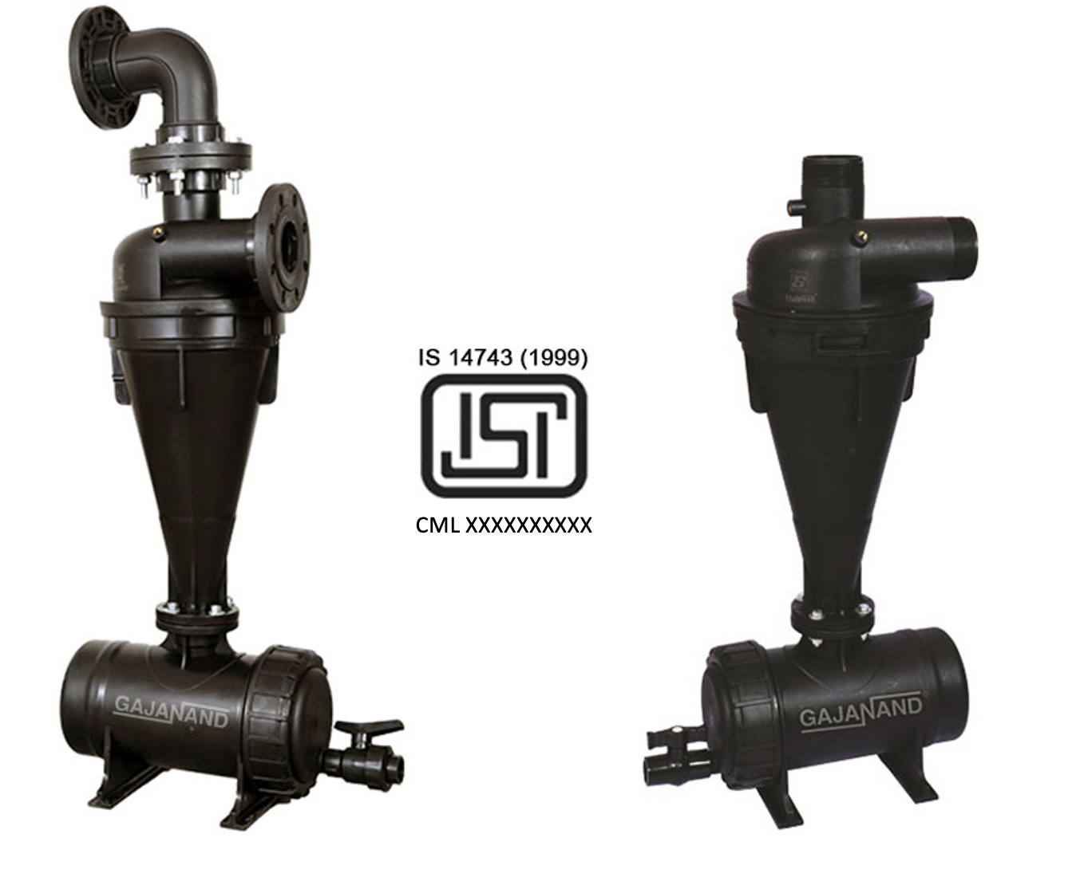
IS 14743 : 2024 HYDROCYCLONE FILTERS – SPECIFICATION (first revision)
TESTS
Resistance to Internal Hydrostatic Pressure
Resistance to Internal Hydrostatic Pressure at Elevated Temperatures
Pressure Drop vs Flow
Test Period
Loading Rate
Flows
Testing Sequence
Results
Observations
Cyclic Pressure Test

Slide 9
IS 14606 : 2022 IRRIGATION EQUIPMENT — GRANULATED MEDIA FILTERS — SPECIFICATION
This standard deals with manual and automatic backflow media filters and applies to:
a) manually cleaning filters.
b) complete automatic filters at a single unit level.
c) a filtration battery which is a complete filter system that includes:
Inlet — Unfiltered supply water;
Outlet — Filtered water carried to the irrigation network; and
Back flush outlet — This is for the water and filtrate, flushed out during the backflow procedure.
d) Command power source — Usually hydraulic-filtered water for automatic operation (can also be pneumatic or electric).
Media Filters also called as sand filters uses a bed of sand or granular media to trap particles/impurities, making them ideal for water sources with high organic loads, such as ponds or reservoirs.
IS 14606 specifies This standard specifies the construction requirements and test methods for “granulated media filters”,, intended for operation in agricultural irrigation systems. It includes manual cleaning media filters and automatic self-cleaning media filter “batteries” (2 units or more working in parallel).
This standard deals with the operation and performance of a media filter including related valves, backwash mechanism, under-drains, manifolds and all related accessories necessary for the operation of the filter.
This standard deals only with pressurized filters operating in a range of filtration velocities declared by the manufacturer. The standard does not deal with filtration ability, efficiency and capacity (quality of filtered water, time of operation before media filter becomes entirely clogged, etc).

Slide 10
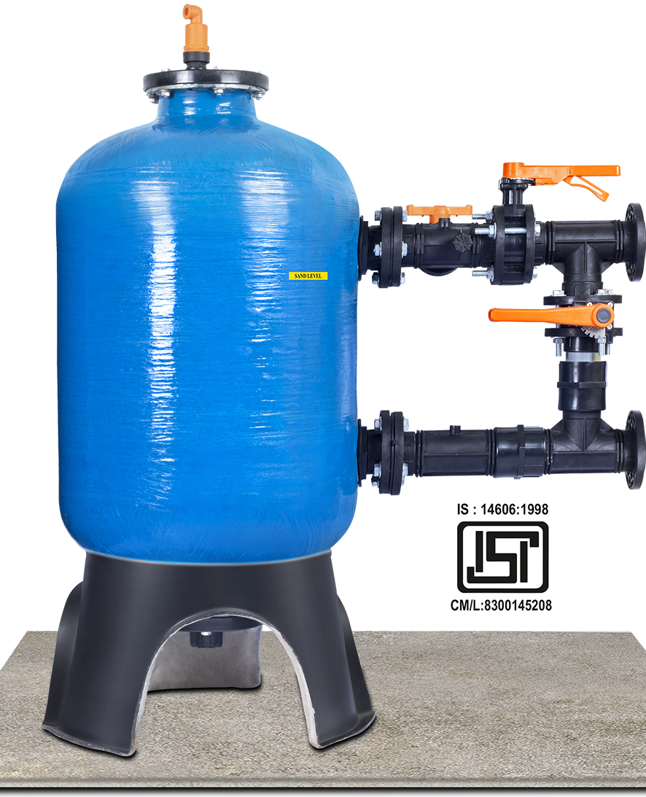
IS 14606 : 2022 IRRIGATION EQUIPMENT — GRANULATED MEDIA FILTERS — SPECIFICATION
CLASSIFICATION
Flow Direction
Top to bottom
Type and Number of Different Media Layers
Velocity of Filtration
Mechanical Structure and Shape
Bottom to Top
Single Layer
Multi layer
Cylinder
Oval/Ball/Spherical
Other Pressure Sustaining Shapes
Relatively High velocity, above 85 m³/h-m²
Medium flow, 50-85 m³/h-m²
low flow, 36-49 m³/h-m²

Slide 11
IS 14606 : 2022 IRRIGATION EQUIPMENT — GRANULATED MEDIA FILTERS — SPECIFICATION
MECHANICAL TEST
Resistance of Filter to Internal Hydrostatic Pressure
Requirements of Filter Housing (Metal and Plastic)
Resistance of Filter to Internal Hydrostatic Pressure at High Temperature
RESISTANCE TO CYCLIC PRESSURE
BACK FLUSHING HYDRAULIC PARAMETERS AND TESTS
AUTOMATIC BACK FLUSHING AND CONTROLLER
Backwash Initiation
Flushing Control Mechanism Testing
Mechanism Activated by Pressure Differential Sensor
Mechanism Activated by Duration of Operation
Mechanism Activated by Volume of Filtered Water
Mechanism Activated by Some Other Physical Quantity
Test of Protective Device
Test for Flushing Mechanism
Detecting Media Escape

Slide 12
FERTIGATION
Chemical Injection System
IS 14483 (Part 1)
Venturi Injector
IS 14483 (Part 2)
Water-driven Injector Pump
IS 14483 (Part 3)
Fertilizer Tank
Fertigation is the process of delivering fertilizers/chemicals or nutrients directly to crops through an irrigation system. It ensures precise nutrient application, enhancing plant growth and minimizing waste.
The application of fertilizer or/and other chemicals via irrigation water to crops/plants is based on the principle that a swiftly moving stream of water is able to carry with it the dissolved substances and fine dispersed suspended particles of fertilizer material.
Venturi injector, injector pump, fertilizer tank are such equipment used for this purpose

Slide 13
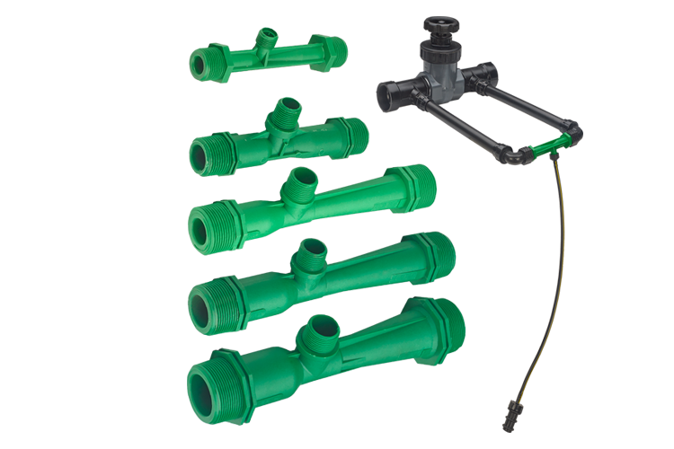
IS 14483 (Part 1) : 2024 FERTILIZER AND CHEMICAL INJECTION SYSTEM : PART 1 VENTURI INJECTOR (first revision)
Venturi Injector is an appliance used for fertigation or chemigation, chlorinating or injecting chemicals in the sprinkler and drip irrigation systems.
Venturi injector operates on the principle that, when a pressurized operating (motive) fluid enters the injector, it is constricted towards the injection chamber and changes into a high velocity jet stream. The increase in velocity inside the injection chamber results in decrease in pressure, thereby enabling an additive liquid material to be drawn through the suction port and entrained into the motive stream
IS 14483 (Part 1) prescribes the requirements of venturi injectors used for injecting fertilizer and chemicals in the sprinkler and drip irrigation systems.

Slide 14
IS 14483 (Part 1) : 2024 FERTILIZER AND CHEMICAL INJECTION SYSTEM : PART 1 VENTURI INJECTOR (first revision)
Material Req^{n}
Non-Toxic
protected against UV degradation
high pressures
tolerant
Resistant to growth of algae and bacteria
Resistant to fertilizers and chemicals
CONSTRUCTIONAL REQUIREMENTS
Should be ddetachable for removal when not in use
Suction port shall have suitable connection
inbuilt check valve may be provided
A metering device shall be provided
pressure reducing device or flow control device to be provide
TESTS
Resistance of Venturi Injector to Internal Hydrostatic Pressure
Performance Test as per manufacturer’s declaration

Slide 15
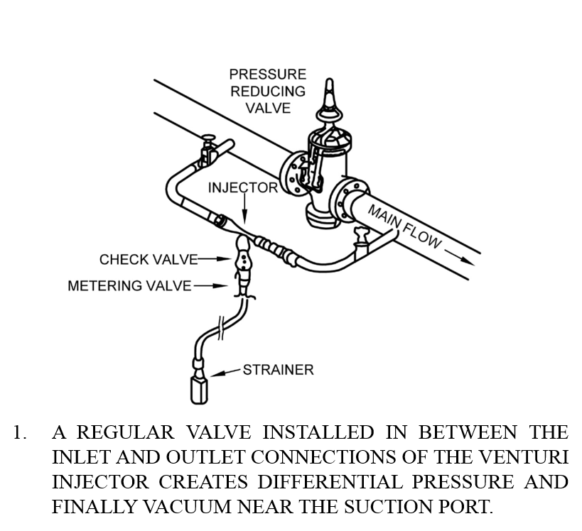
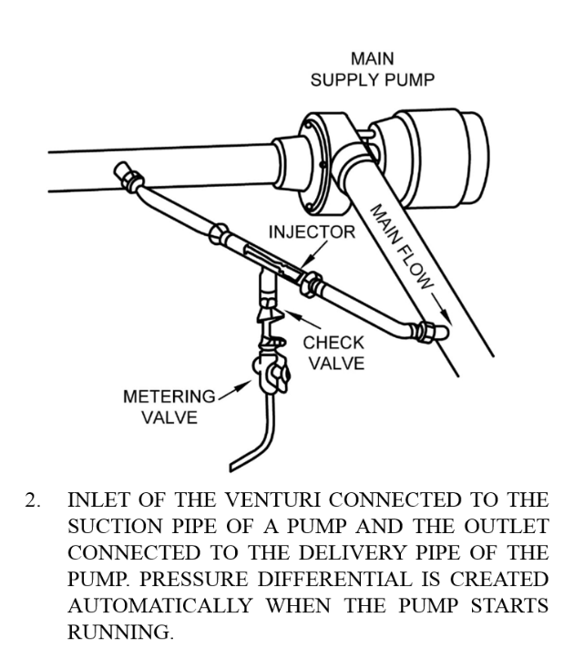
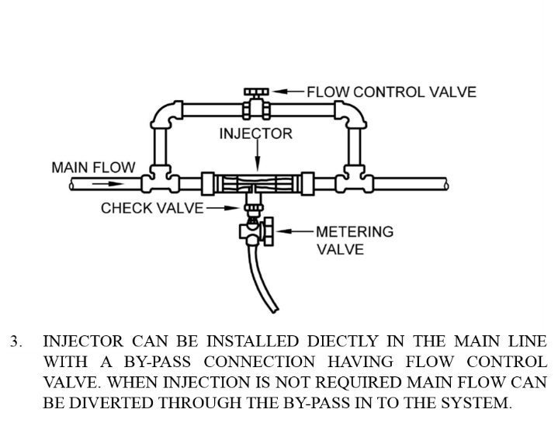
IS 14483 (Part 1) : 2024 FERTILIZER AND CHEMICAL INJECTION SYSTEM : PART 1 VENTURI INJECTOR (first revision)
INSTALLATION OF THE VENTURI INJECTOR IN THE IRRIGATION SYSTEMS FOR PERFORMANCE TESTING

Slide 16
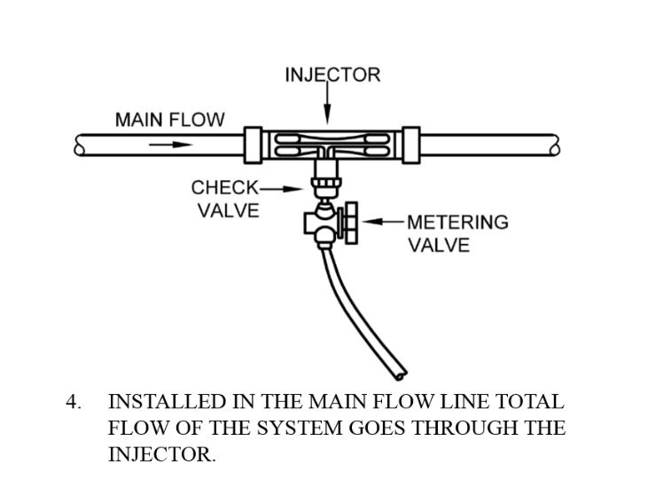
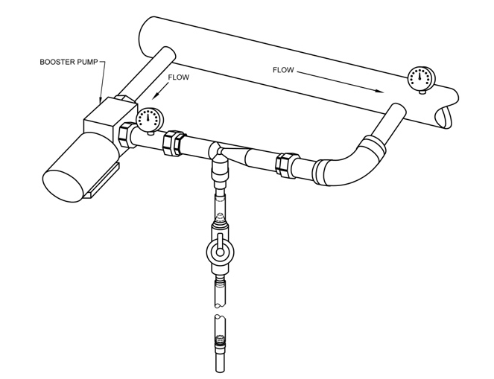
IS 14483 (Part 1) : 2024 FERTILIZER AND CHEMICAL INJECTION SYSTEM : PART 1 VENTURI INJECTOR (first revision)
INSTALLATION OF THE VENTURI INJECTOR IN THE IRRIGATION SYSTEMS FOR PERFORMANCE TESTING
5. VENTURI INJECTOR WITH BOOSTER PUMP

Slide 17
IS 14483 (Part 2) : 2025 FERTILIZER AND CHEMICAL INJECTION SYSTEM
PART 2 WATER-DRIVEN CHEMICAL INJECTOR PUMP (first revision)
According to Installation Type Title
In-1ine injector pump
On-line injector pump
According to Mixing Ratio
Proportional injector pump
Non-proportional injector pump
According to Working Principle
Rotodynamic
Positive displacement
IS 14483 (Part 2) This standard specifies the construction and operational requirements and methods for water driven chemical injector pumps. These injector pumps are intended to operate at water temperatures of up to 50°C and with the types and concentrations of chemicals routinely applied in irrigation.
CLASSIFICATION

Slide 18
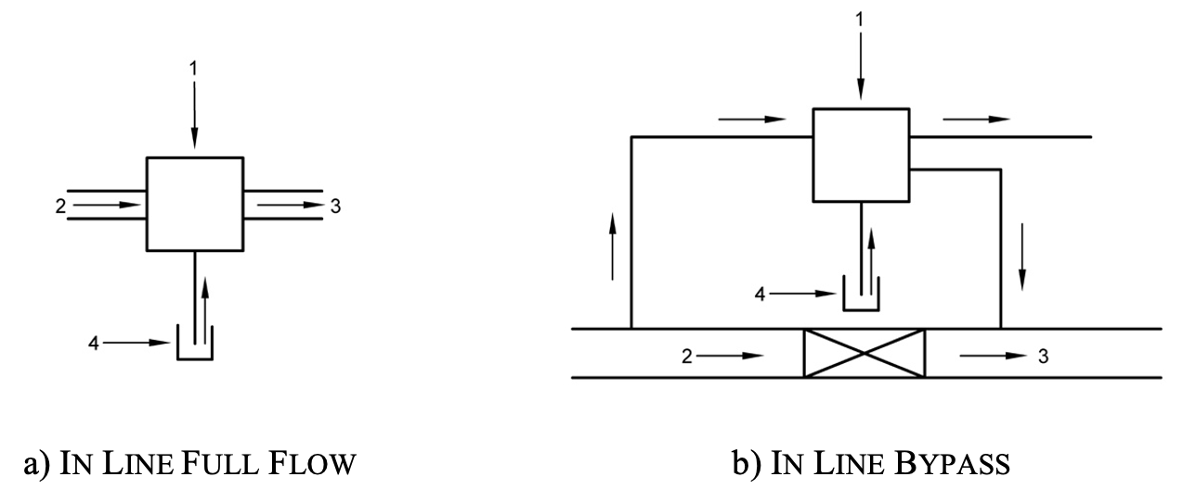
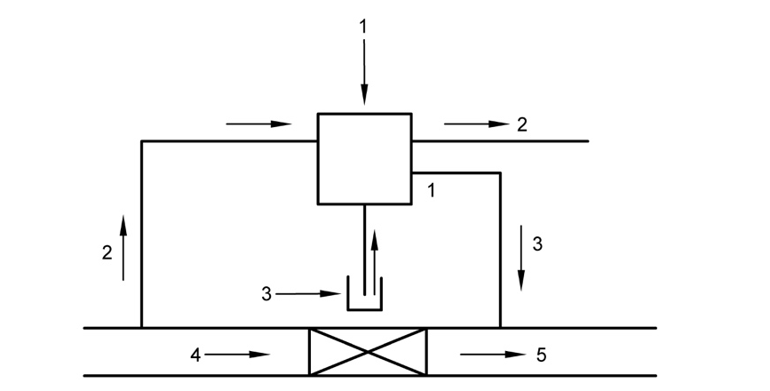
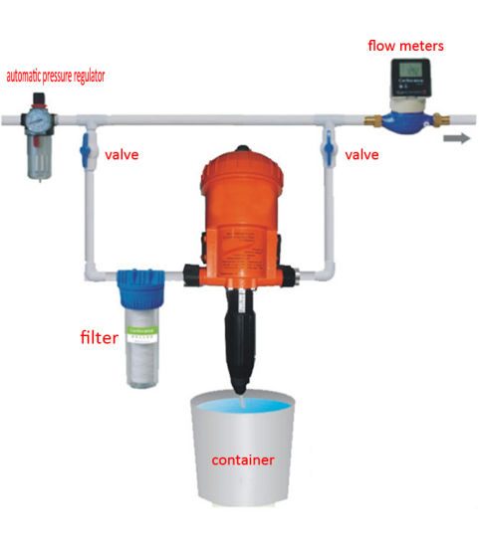
IS 14483 (Part 2) : 2025 FERTILIZER AND CHEMICAL INJECTION SYSTEM PART 2 WATER-DRIVEN CHEMICAL INJECTOR PUMP (first revision)
INSTALLATION OF INJECTOR PUMP IN THE IRRIGATION SYSTEMS FOR PERFORMANCE TESTING
ON-LINE
where
1 Injector pump
2 Drive water
3 Chemicals
4 Irrigation flow
5 Irrigation water with injected chemicals
where
1 Injector pump
2 Irrigation flow
3 Irrigation water with injected chemicals
4 Chemicals

Slide 19
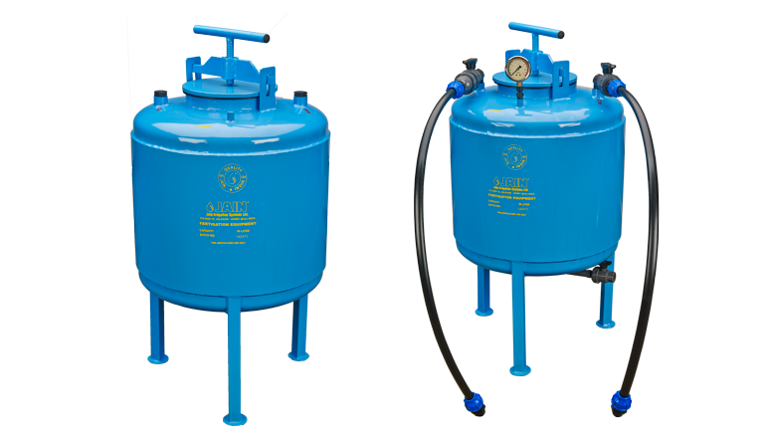
IS 14483 (Part 3) : 2018 FERTILIZER AND CHEMICAL INJECTION SYSTEM
PART 3 FERTILIZER TANL — SPECIFICATION
Fertilizer Tank is a component of fertigation systems used to mix and inject liquid or soluble fertilizers into irrigation water.
IS 14483 (Part 3) sspecifies the mechanical and functional requirements for fertilizer tanks used in irrigation systems, test methods and the data to be supplied by the manufacturer to permit correct installation and operation in the field.
This standard applies to fertilizer tanks working on the principle of differential pressure used in irrigation. systems. This standard also applies to the fittings used for connecting fertilizer tanks with the irrigation systems.

Slide 20
IS 14483 (Part 3) : 2018 FERTILIZER AND CHEMICAL INJECTION SYSTEM
PART 3 FERTILIZER TANL — SPECIFICATION
Classification
Proportionate model with rubber/plastic
bladder
Quantitative model
REQUIREMENTS
Resistance of Fertilizer Tanks to Hydrostatic Pressure at Ambient Temperature
Resistance to Hydrostatic Pressure at Elevated Temperature
Injection Rate Calibration

Slide 21
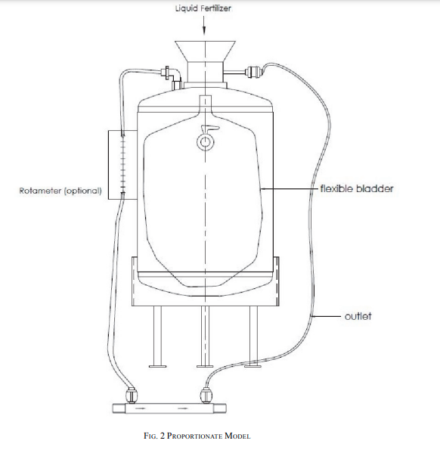
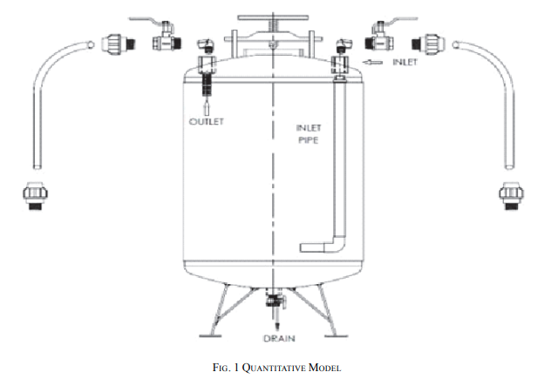
IS 14483 (Part 3) : 2018 FERTILIZER AND CHEMICAL INJECTION SYSTEM
PART 3 FERTILIZER TANL — SPECIFICATION

Slide 22
IS 14791 : 2024 PREVENTION AND TREATMENT OF BLOCKAGE PROBLEM IN DRIP IRRIGATION SYSTEM — CODE OF PRACTICE (first revision)
This standard specifies the guidelines for prevention and treatment of blockage problems in drip irrigation system.
Quality of Water to be supplied.
Chemical Injection System Installed with DIS.
Different Blockage Problems associated with DIS.
Method of Assessment of blockage problems.
Prevention and treatment of blockage problem.
Safety Requirements

Slide 23
IS 14791 : 2024 PREVENTION AND TREATMENT OF BLOCKAGE PROBLEM IN DRIP IRRIGATION SYSTEM — CODE OF PRACTICE (first revision)
Quality of Water | Sample of water supplied to DIS is tested for different parameters such as Suspended Solids, pH, EC, Ca, Mg, Fe, Presence of oil etc. Table 1 of IS 14791 provided the safe limits for presence of above-mentioned parameters in water.
Chemical Injection System Installed with DIS. | Chemical Inject Systems (venturi injector, injector pumps, differential pressure tanks) are used in conjunction with DIS for supplying fertilizers into the field. These equipment's should be well test before installing.
Different Blockage Problems associated with DIS. | Solid Contaminants Dissolved Contaminants - Biological or Chemical Clogging Problem Emitter Suck-back Physical Blockage of Dripline/Lateral Failure of Main Filtration System Poor Maintenance of the System Quality of Water

Slide 24
IS 14791 : 2024 PREVENTION AND TREATMENT OF BLOCKAGE PROBLEM IN DRIP IRRIGATION SYSTEM — CODE OF PRACTICE (first revision)
Method of Assessment of blockage problems | Driplines on Ground Surface : When driplines are laid on the surface, the degree of blockage can be checked by means of visual inspection and measuring the amount and uniformity of discharge through the emitters or orifices and comparing it with the specified discharge. Dripline Buried Under Ground ;
Prevention and treatment of blockage problem. | Physical Treatment : Use of silting reservoir use of Filters such as Hydrocyclone, screen filters, media filters, disc filters Flushing of irrigation pipelines Chemical Treatment : Bacterial precipitation of Iron, Sulphur, Aeration and settling, pH Control Chlorination of water, Acid Treatment Algae Control Emitter Clogging by Roots : trifluorine/ pendimethalin / copper can be used for prevention
Safety Requirements | The resistance of drip irrigation components to the chemical used should be taken into consideration. All chemicals-should be handled cautiously and should be stored in a secured place for the reasons of safety and hazardous nature of the products. Irrigation water should not be used for consumption by human beings and animals. Do not inhale acid fumes or chlorine gas.

Slide 25
IS 14792 : 2000 IRRIGATION EQUIPMENT — DESIGN, INSTALLATION AND OPERATION OF SPRINKLER IRRIGATION SYSTEMS — CODE OF PRACTICE
HYDROLOGICAL DESIGN
Depth of Water Application
Effective Crop Root Depths
Net Depth of Application
Leaching Requirement
Gross Depth of Application
Estimation of Soil Moisture Loss by Evaporation and Transpiration
Table 4 Potential Evapotranspiration (PET)
(Clause 3.5)
Sl. No. | Climate | mm of Water Used per Day
(1) | (2) | (3)
i) | Cool humid | 2.5-3.8
ii) | Cool dry | 3.8-5.1
iii) | Warm humid | 3.8-5.1
iv) | Warm dry | 5.1-6.3
v) | Hot humid | 5.1-7.6

Slide 26
IS 14792 : 2000 IRRIGATION EQUIPMENT — DESIGN, INSTALLATION AND OPERATION OF SPRINKLER IRRIGATION SYSTEMS — CODE OF PRACTICE
Table 6 Estimated Maximum Water Application Rates for Design (Clause 5.2)
APPLICATION RATE
0.8º slope — level to undulating.
9º-12.5° slope — undulating to low hill.
over 12.5° slope — low to steep hills.
Sl. No. | Soil Groups Based on Texture and Profile | Slopes¹⁾ 0-8º | Slopes²⁾ 9º to 12.5º | Slopes³⁾ over 12.5º
i) | Sands and light sandy loams uniform in texture to 1.82 m pumice | 31.8 | 25.4 | 20.3
ii) | Sandy loams to 0.61 m overlaying a heavier subsoil | 20.3 | 16.5 | 12.7
iii) | Medium loams to sandy clays over a heavier subsoil | 16.5 | 12.7 | 10.2
iv) | Clay loams over a clay subsoil | 12.7 | 10.2 | 7.6
v) | Silt loams and silt clay | 10.2 | 7.6 | 5.1
vi) | Clays | 6.4 | 5.1 | 3.8
vii) | Peat | 16.5 | - | -
1
2
3
see IS 14792 for more details

Slide 27
IS 14792 : 2000 IRRIGATION EQUIPMENT — DESIGN, INSTALLATION AND OPERATION OF SPRINKLER IRRIGATION SYSTEMS — CODE OF PRACTICE
Lateral spacing (6.2.4.1)
UNIFORMITY OF WATER APPLICATION
Pressure variation in sprayline
Spacing of sprinklers
Water application rate
Sprayline spacing
Sl. No. | Wind Velocity (km/h) | Lateral Spacing (% of wetting diameter)
(1) | (2) | (3)
i) | No wind | 65
ii) | < 8 | 60
iii) | 8 to 16 | 50
iv) | > 16 | 30
Sprinkler spacing (6.2.4.2)
Sl. No. | Pattern | Wind Velocity (km/h | Sprinkler Spacing (% of wetting diameter)
(1) | (2) | (3) | (4)
i) | Square or Rectangular | No wind | 65
ii) |  | < 7 | 60
iii) |  | 7 to 13 | 50
iv) |  | > 13 | 30

Slide 28
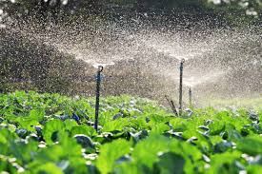
IS 14792 : 2000 IRRIGATION EQUIPMENT — DESIGN, INSTALLATION AND OPERATION OF SPRINKLER IRRIGATION SYSTEMS — CODE OF PRACTICE
INSTALLATION
i. Buried Mains - Particular attention is drawn to the necessity for concrete anchor blocks of sufficent size being provided at any significant change in direction or grade, change in diameter, major branch connection or terminal, and adjacent to any values or fittings that may give rise to hydraulic loading along the line.
ii. Pumps and Prime Mover - Internal combustion engines shall be provided with protective devices. Devices shall be supplied that stop the engine if
a) engine temperature exceeds the safety point for the prime move and
b) oil pressure falls below the minimum specified; or pressure because of loss of suction or reduction in delivery pressure.

Slide 29
IS 14792 : 2000 IRRIGATION EQUIPMENT — DESIGN, INSTALLATION AND OPERATION OF SPRINKLER IRRIGATION SYSTEMS — CODE OF PRACTICE
INSTALLATION
i. Buried Mains - Particular attention is drawn to the necessity for concrete anchor blocks of sufficent size being provided at any significant change in direction or grade, change in diameter, major branch connection or terminal, and adjacent to any values or fittings that may give rise to hydraulic loading along the line.
ii. Pumps and Prime Mover - Internal combustion engines shall be provided with protective devices. Devices shall be supplied that stop the engine if
a) engine temperature exceeds the safety point for the prime move and
b) oil pressure falls below the minimum specified; or pressure because of loss of suction or reduction in delivery pressure.
OPERATION
The purchaser shall be supplied with written operational data, performance, and layout details of the system and its components including:
a) sprinkler make, model, performance, and nozzle diameter;
b) design layout of sprayline;
c) design pump duty; and
d) correct range of operating pressures for the system.
The supplier or his agent shall demonstrate the important aspects regarding the operation, care, and maintenance of the unit including methods of shifting and setting up the portable components of the system.
Wiring and starting equipment for electrically operated planta shall comply with Electrical Code 1985. Electric motors shall be provided with overload, low-voltage, and inter phase variation protection.
Pumps, power units and transmission shall be effectively guarded.

Slide 30
IS 14792 : 2000 IRRIGATION EQUIPMENT — DESIGN, INSTALLATION AND OPERATION OF SPRINKLER IRRIGATION SYSTEMS — CODE OF PRACTICE
RESPONSIBILITIES OF MANUFACTURER/DEALER
Investigation
Design and information to purchaser before sale
Installation
RESPONSIBILITIES OF PURCHASER
ii. Purchase for Equipment
i. Request for Service

Slide 31
Thank You…

