Slide 1
Non-sewered Sanitation Systems

Slide 2
What is Sanitation?
Sanitation refers to the systems, practices, and infrastructure used to manage human excreta, wastewater, and solid waste in a safe and hygienic manner. Its primary goal is to protect human health, prevent environmental contamination, and ensure dignity. Sanitation is more than infrastructure; it is about dignity, health, and a commitment to building a safer, cleaner world for all.

Slide 3
Introduction to Non-Sewered Sanitation Systems
Owing to the limited access of a high share of urban and rural population to sewerage systems in India, strengthening the ecosystem for non-networked sanitation becomes imperative.
Non-sewered sanitation systems (NSS) are on-site sanitation solutions that operate without the need for a connection to a centralized sewer system. They are designed to safely manage human waste and provide hygienic services in areas lacking conventional sewer infrastructure and operate independently of piped sewer networks. They Include containment, emptying, transport, treatment, and disposal/reuse of waste and are adaptable to various environmental and socio-economic contexts. Additionally, they can also be used in integration with centralized sewer systems leading to reducing load on sewage treatment plants (STPs).
Non-sewered sanitation systems are critical to addressing global sanitation challenges, particularly in under-served communities, while contributing to health, dignity, and environmental preservation. They are most appropriate for urban slums and remote or rural regions with limited infrastructure. Bio toilets have also been installed in Indian railway coaches to manage onboard human waste.

Slide 4
Need for standardization
To facilitate the achievement of the desired public health and environmental outcomes through non-networked sanitation, it is crucial to safeguard the quality of existing on-site sanitation systems. Furthermore, the varying characteristics of settlements, hydrogeology, and environmental sensitivity necessitate innovations in product design to respond to the needs of these diverse contexts.

Slide 5
Packaged Sewage Treatment Systems
Packaged sewage treatment systems are compact, self-contained units designed to treat wastewater from small-scale applications such as homes, businesses, or remote locations. These systems use a combination of physical, biological, and chemical processes to remove contaminants, producing treated water suitable for discharge or reuse. Typically pre-engineered and modular, they are easy to install, require minimal space, and offer efficient wastewater treatment solutions. They are especially useful in areas without access to centralized sewage networks, providing a sustainable and cost-effective alternative for wastewater management.

Slide 6
Biodigesters for human waste decomposition
Biodigesters are systems that break down organic waste, such as human excreta, through anaerobic digestion (a process carried out by microorganisms in the absence of oxygen). This process and transforms organic waste into simpler organic molecule, effluent water and biogas.

Slide 7
Rotomoulded PolyEthylene Septic Tanks
A septic tank is an underground system designed to treat wastewater from homes or businesses, especially in areas without municipal sewage systems. Polyethylene is highly resistant to cracking, corrosion, and impact, making these tanks long-lasting and reliable in harsh environmental conditions. Polyethylene tanks are generally more affordable than tanks made from materials like concrete or fiberglass, offering a cost-effective solution for homeowners and businesses.

Slide 8
Packaged Sewage Treatment Plant
Role of Indian Standard IS 18797

Slide 9
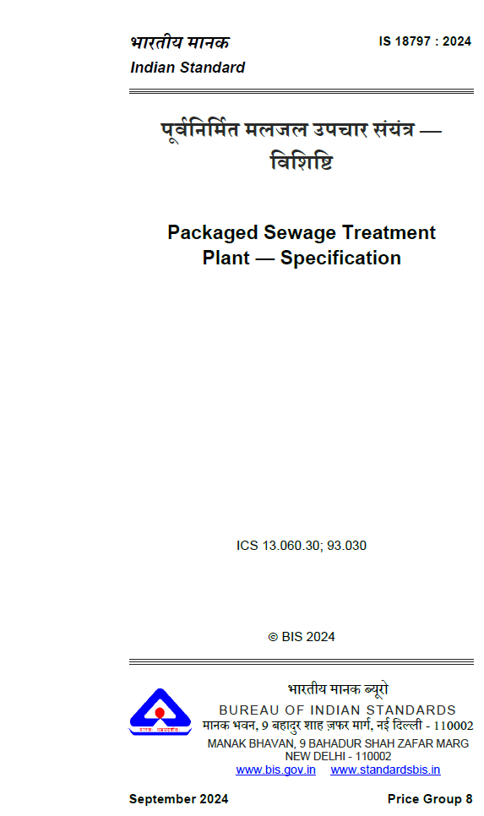
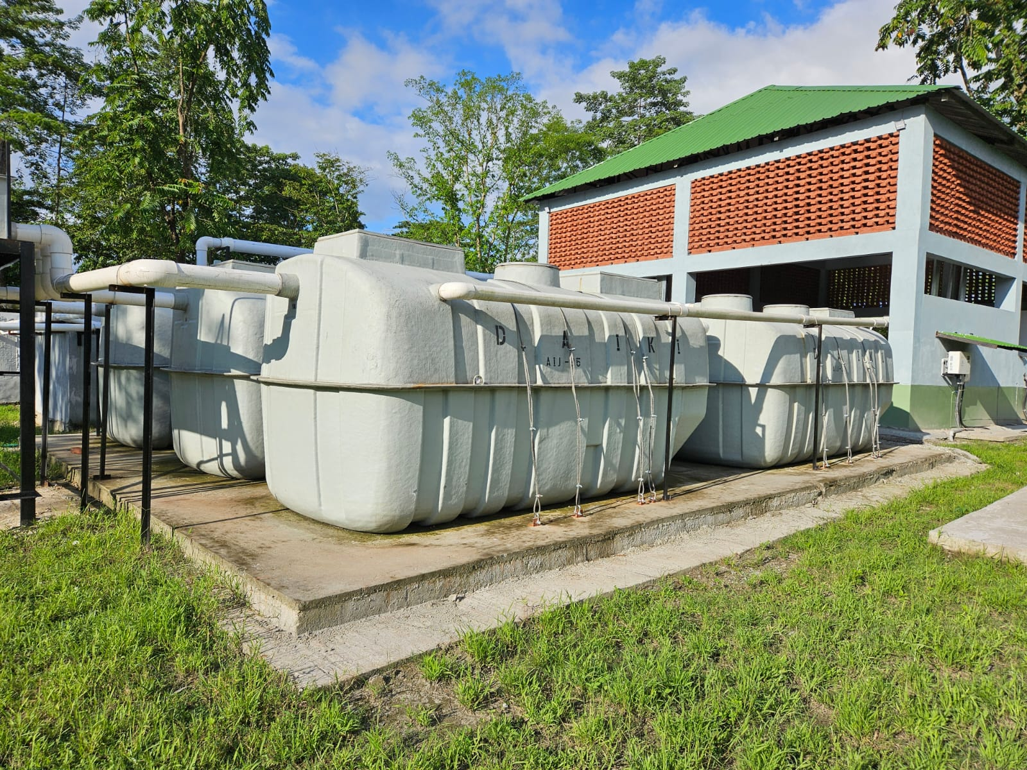
Indian Standard IS 18797 Packaged Sewage Treatment Plant
Packaged sewage treatment systems (PSTP) can provide a turnkey solution to the need of advanced on-site sewage treatment and are suitable for installation at the level of individual households or as a decentralized community-level solution.

Slide 10
Indian Standard IS 18797 Packaged Sewage Treatment Plant
Packaged Sewage Treatment System (PSTP) — A packaged system for the treatment of incoming sewage/domestic wastewater (grey and black water) installed on-site to serve individual premises or small populations such that the effluent meets the norms set by the relevant authority.
This standard outlines the requirements for materials, design, structural strength, performance, and testing of packaged sewage treatment plants (PSTP) made from GFRP, PE, PP, or DCPD. PSTPs are designed for areas where centralized sewer systems are unavailable and serve a minimum of 5 people. They treat raw sewage using natural biological processes without additives like enzymes or microorganisms. The standard applies to off-site assembled PSTPs, tested as complete units, and does not cover on-site assembled systems.

Slide 11
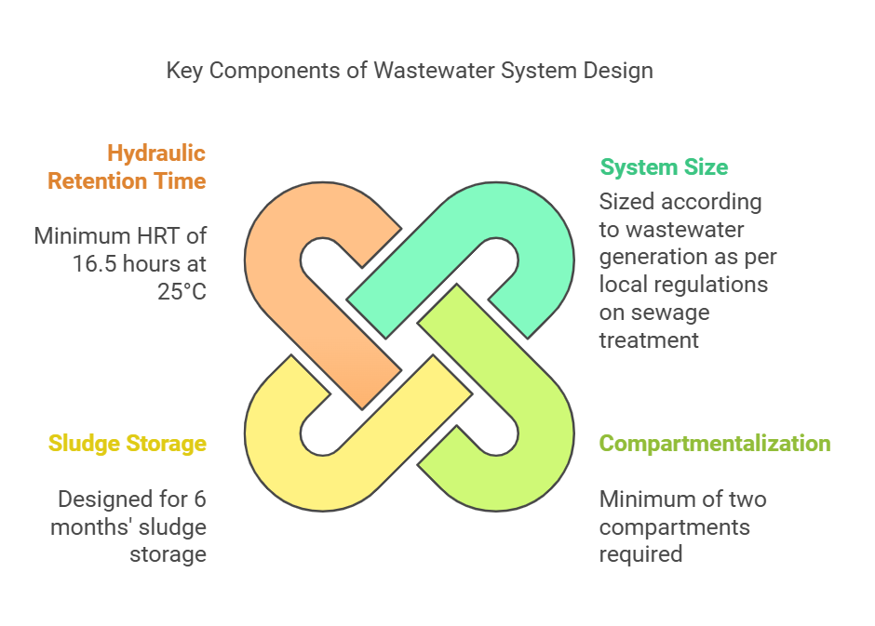
Indian Standard IS 18797 Packaged Sewage Treatment Plant

Slide 12
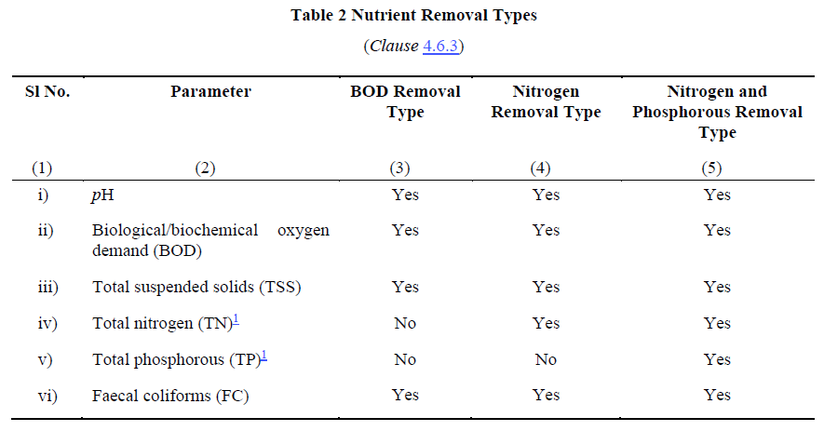
Indian Standard IS 18797 Packaged Sewage Treatment Plant

Slide 13
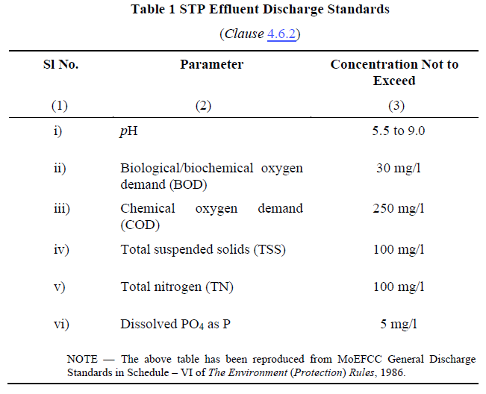
Indian Standard IS 18797 Packaged Sewage Treatment Plant
Treatment Efficiency

Slide 14
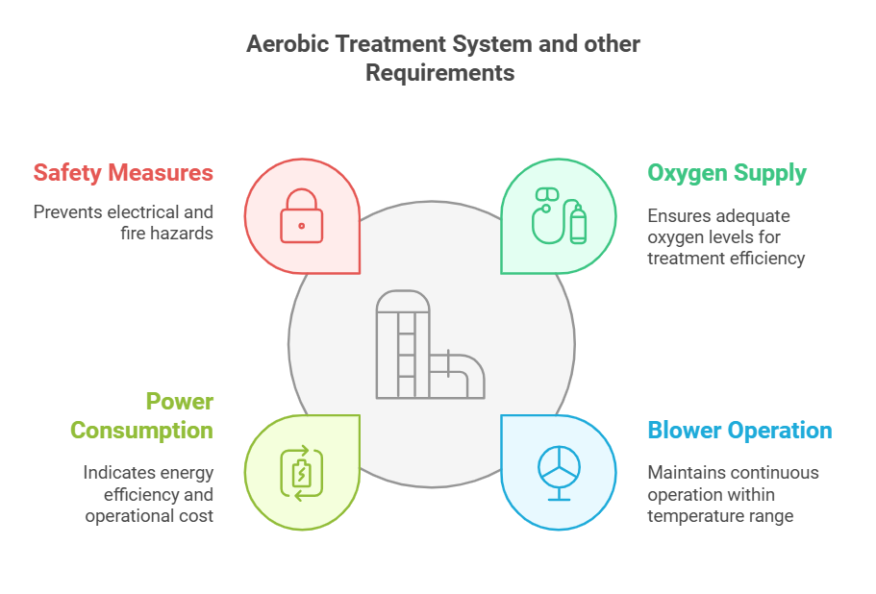
Indian Standard IS 18797 Packaged Sewage Treatment Plant

Slide 15
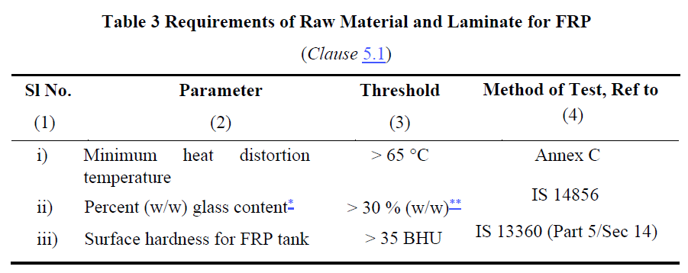
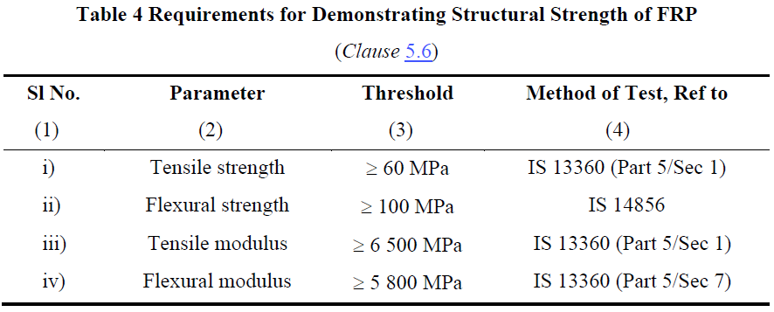
Indian Standard IS 18797 Packaged Sewage Treatment Plant
Raw material and structural strength requirements for FRP

Slide 16
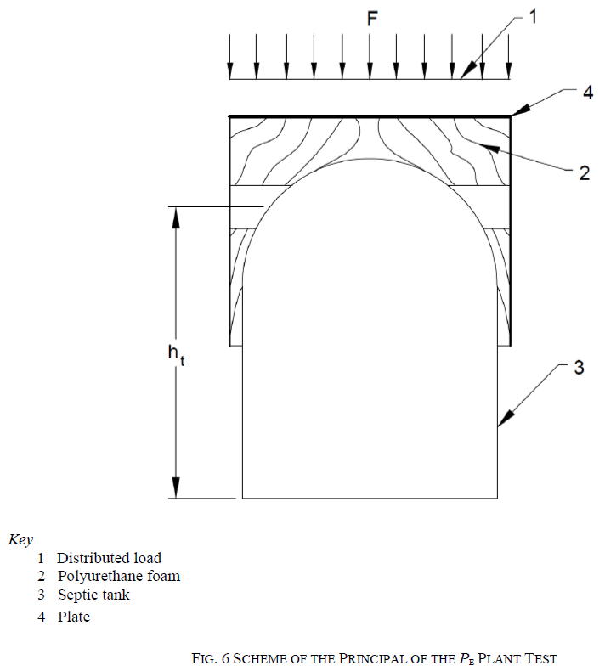
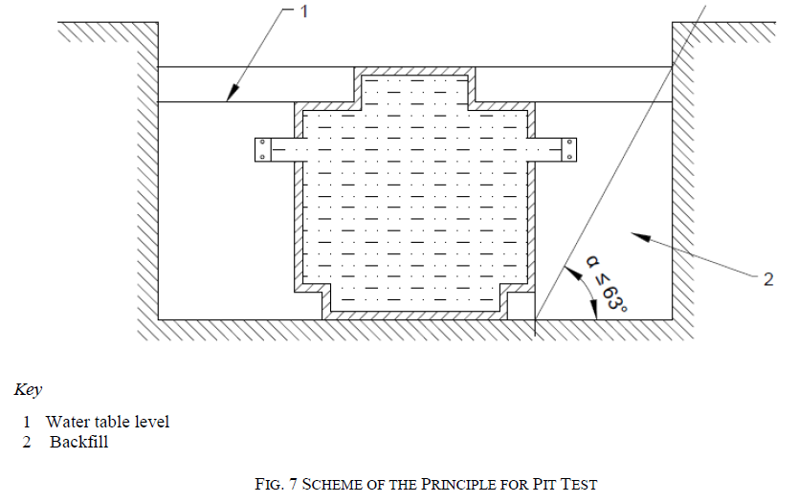
Indian Standard IS 18797 Packaged Sewage Treatment Plant
Load test for bearing capacity tank shall be done as per IS 18666.

Slide 17
Indian Standard IS 18797 Packaged Sewage Treatment Plant
Type Test
Type tests are intended to prove the suitability and performance of a PSTP of a new composition, a new technique, a new design, a new size or shape, or modified wall thickness. These shall also be done whenever a change is made in the raw material, raw material supplier or method of manufacturing.
Acceptance Test
Acceptance tests are carried out on samples taken from the lot for the purpose of acceptance of the lot.

Slide 18
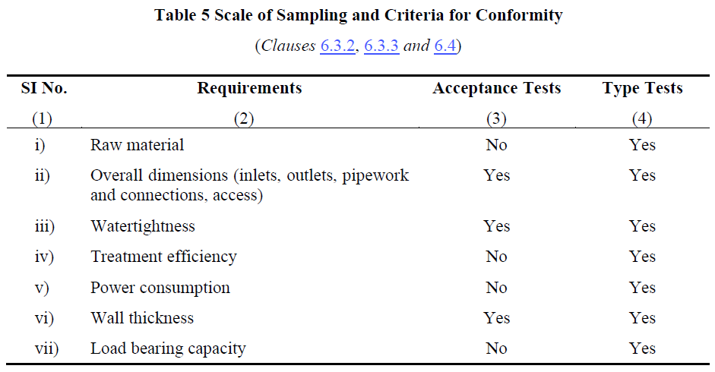
Indian Standard IS 18797 Packaged Sewage Treatment Plant

Slide 19
Indian Standard IS 18797 Packaged Sewage Treatment Plant
The following information shall printed on the system such that it is clearly visible.
a) Manufacturer’s name and recognized trademark, if any;
b) Model name or number of the system;
c) Lot or batch number and year of manufacture; and
d) Nominal size in litres and population equivalent.

Slide 20
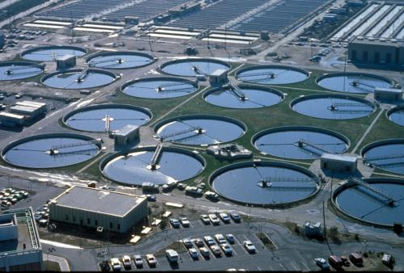
Basic concept_ Onsite Treatment
‘ Treat at site, reuse at site ’
Centralized STP
Ｊ
Ｊ
Ｊ
Ｊ
Install Remote area
Ｊ
Ｊ
Ｊ
Ｊ
Ｊ
Ｊ
Ｊ
Ｊ
Ｊ
Ｊ
Ｊ
Ｊ
Ｊ
Install Residencial area
Install High-Density area
Piping installation & maintenance
Remote Area
No need Piping & collect wastewater to Centralized STP
Complementary to
Centralized STP
High-density Area
Reduce pressure to Centralized STP

Slide 21
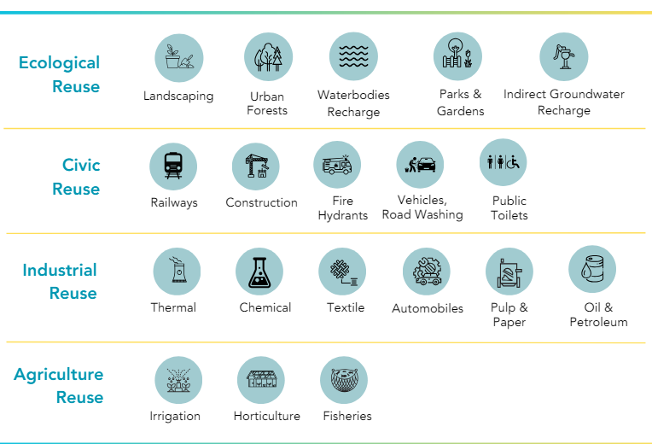
Potential Reuse

Slide 22
Key Benefits of Decentralized Approach
1. Implementation Time
2. Increasing Reuse Potential
3. Increasing Performance reliability
4. Enhance Flexibility and Scale
5. Low cost of ownership
Decentralised wastewater treatment has high potential, needs to be organised and developed in a holistic manner

Slide 23
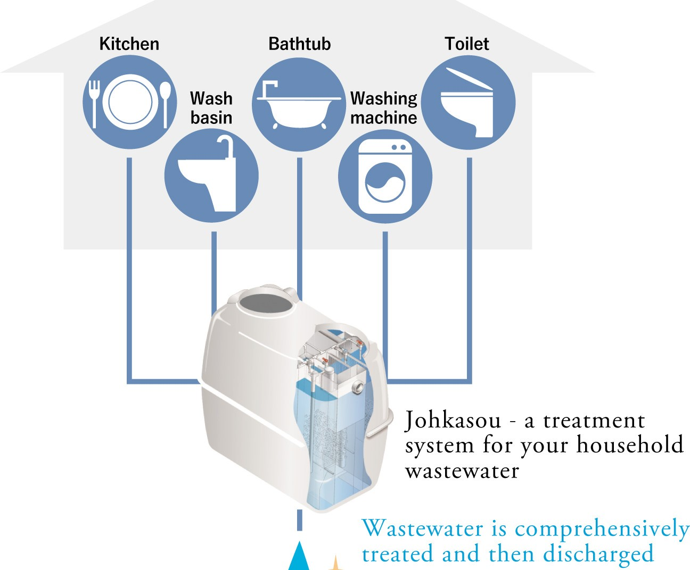


Explanation of Internal Treatment Process
B
Aeration Blower
Re-Circulation
Disinfection
Separation
Anaerobic Contact Media Chamber
Aeration Chamber
(MBBR)
1st
Sedimentation
2nd
Sedimentation
Process highlights:
Gravity flow
Internal capacity to mange peak and low flow
Avoids need for Full time operators and daily sludge handling at site

Slide 24
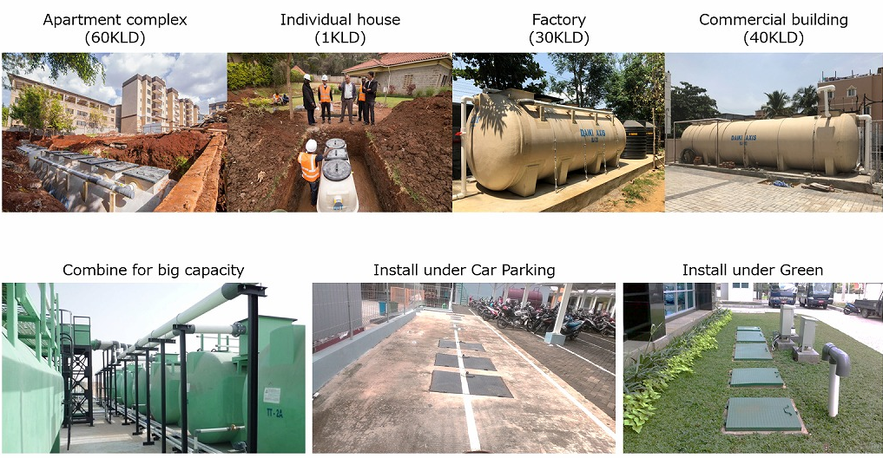
Provides Flexibility of Installation and Optimum use of the space

Slide 25
Biodigesters for human waste decomposition
Role of Indian Standard IS 18150

Slide 26
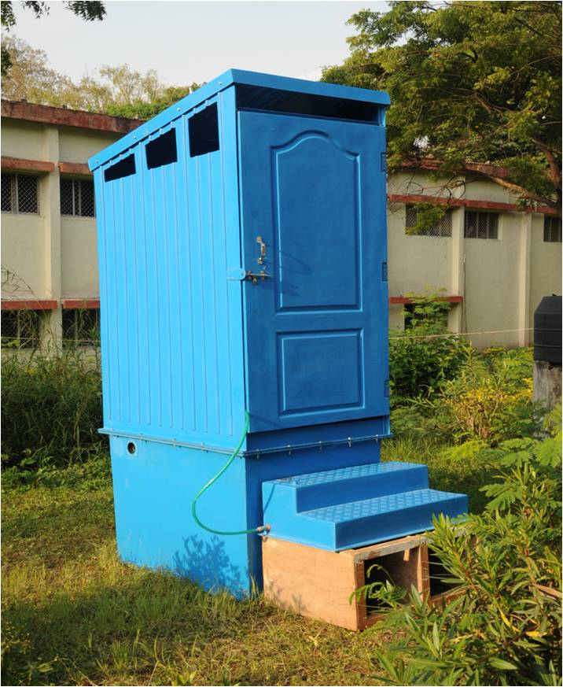
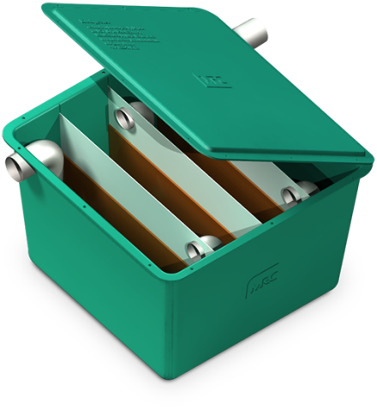
Bio digester
A pertinent solution for non-sewered sanitation
Bio digester as a non-sewered sanitation solution

Slide 27
Introduction
Biodigesters play a crucial role in managing waste sustainably in diverse sectors across India.
Biodigesters are used for sewage management in rural and urban areas for treatment of domestic wastewater.
Bio toilets have been installed in Indian railway coaches to manage onboard human waste.
Integration with centralized sewer systems lead to reduce load on sewage treatment plants (STPs).

Slide 28
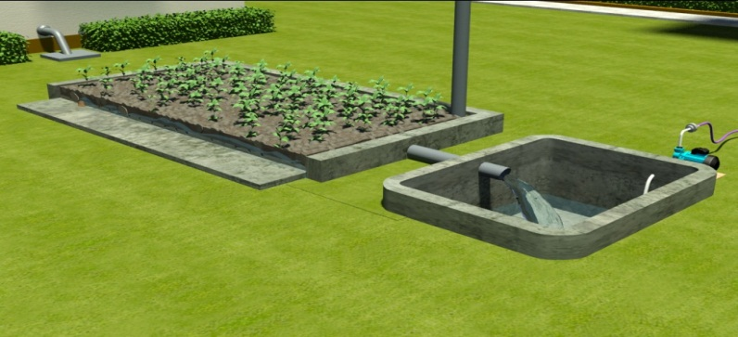
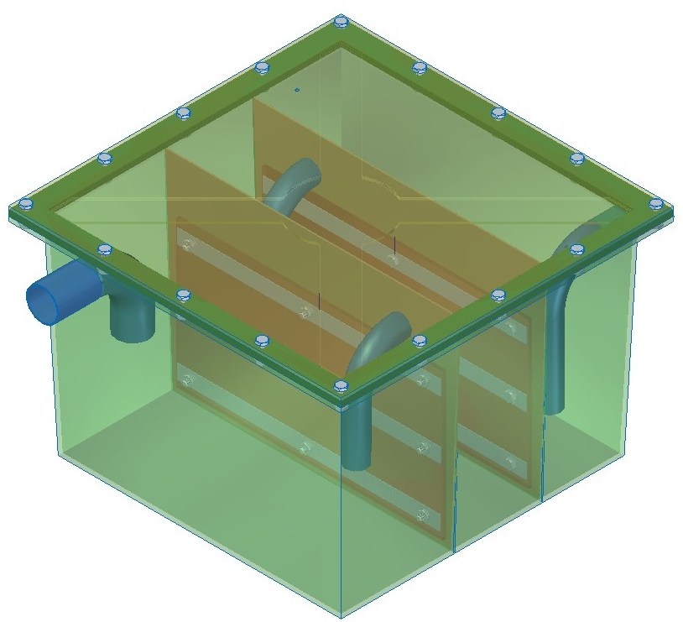
Bio digester: Basics
Device used for accelerated anaerobic microbial degradation of human waste mediated by AMI
Significant reduction in organic matter and sludge volume and Pathogen transmission is minimized.
Effluent is safe for environmental release or specific reuse.
Reduces organic load on Sewage Treatment Plants (STPs) and Enhances STP efficiency.

Slide 29
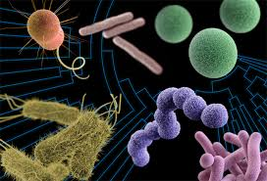
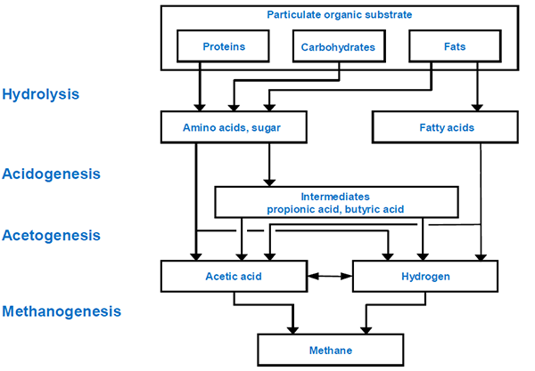
Bio digester: Core Principle
ANAEROBIC BIO-DEGRADTION PROCESS
Anaerobic Microbial Inoculums
(Microbial Consortium)

Slide 30
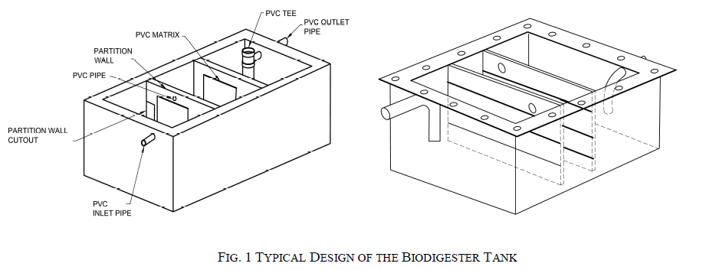
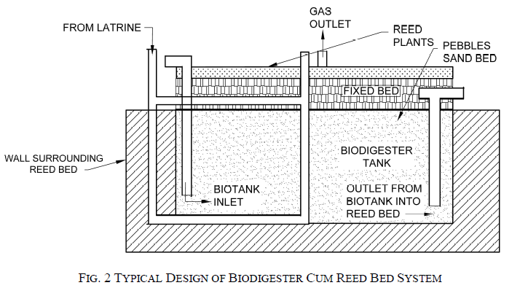
Bio digester: Core Principle

Slide 31


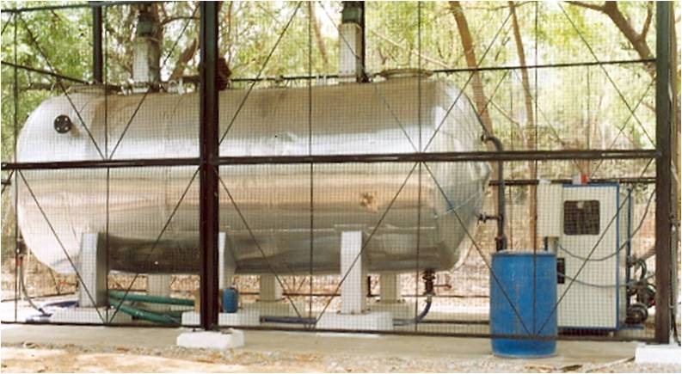
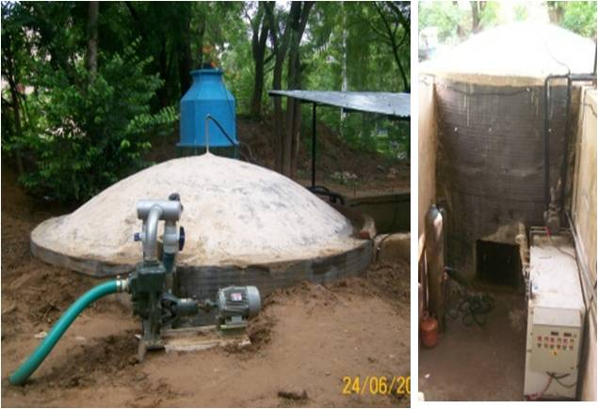
Bio digester: Microbial Consortium
BACTERIA (INOCULUM)
Anaerobic microbial consortium developed by acclimatization/ enrichment of microbes at low temperature and bio-augmentation with critical group of bacteria
Notes:
Components of biodigester: 1. Bacteria, 2. Biodigester/ Fermentation tank

Slide 32
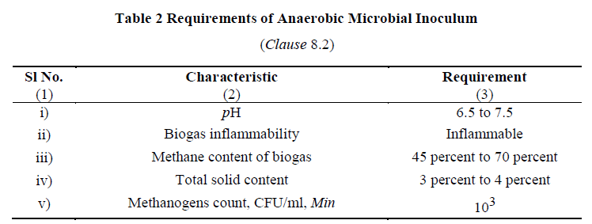
Bio digester: Microbial Consortium
Notes:
Components of biodigester: 1. Bacteria, 2. Biodigester/ Fermentation tank

Slide 33
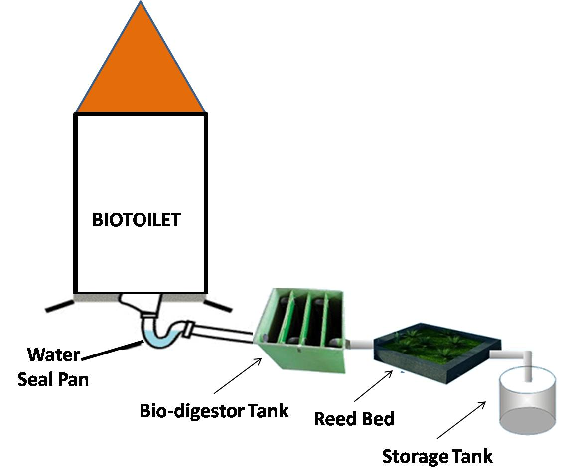
Bio digester: Typical Layout

Slide 34
Chamber Configuration:
Minimum two partition (baffle) walls creating three chambers.
Chamber volume ratio: 4 : 3 : 3.
volume of chamber containing inlet pipe should be approximately 40 percent of total volume.
PVC immobilization matrix should be provided on both sides of partition walls of the chambers
Bio digester: Design

Slide 35
Bio digester: Material for Biodigester Tank
FRP Biodigester Tank
Material Composition: Resin (isophthalic), fibre reinforcement, and additives processed uniformly.
Resin Properties: (tested as per IS 6746)
Colour: Cream or white, opaque liquid of uniform consistency.
Viscosity: 800-1,200 cps at 25°C
Acid Value: Max 15 mg KOH/g
Volatile Content: 33% ± 3%
Gel Time: 20 ± 5 minutes at 25°C
Relative Density: 1.15-1.25 at 27°C
Styrene Content: Max 27% of total mass

Slide 36
Bio digester: Material for Biodigester Tank
Cured cast resin Biodigester Tank
FRP Physical and Mechanical Properties
Physical State: Hard and tough.
Barcol Hardness: 42 to 45 (IS 6746 Annex J).
Water Absorption: Max 0.5% (IS 6746 Annex K).
Tensile Strength: Min 400 kg/cm² (IS 1998).
Cross-Breaking Strength: Min 350 kg/cm² (IS 1998).
Impact Resistance: Min 120 J/m (IS 1998).
Fiberglass Density: Min 450 g/m² with polyester resin system (three layers) (IS 11551).
Stiffeners: Can be sandwiched during hand laying or reinforced with FRP extra ribs to enhance strength.

Slide 37
Bio digester: Material for Biodigester Tank
Stainless Steel Biodigester Tank – shall conform to grade 304S1 as per IS 6911

Slide 38

Bio digester: Advantages
Aerobic biodegradation | Anaerobic biodegradation
Forced aeration is essential which is energy intensive | No aeration is required
Incomplete / partial aerobic conditions lead to foul smell | Complete anaerobic conditions
Not effective in pathogen inactivation | Effective Pathogen inactivation
Can not tolerate detergents/ phenyl | Anaerobes can degrade detergents/ phenyl
Generates large amount of sludge | Sludge generation is very less
Maintenance & recurring cost is high | Minimal maintenance & no recurring cost
OSS Option | Kinds of latrines
 | IHHL | Shared Latrine | Community Toilets | Public Toilets
Twin pit latrines/ Leach Pits | √
Septic Tank System with soak pit | √ | √ | √ | √
Bio-digester toilets (DRDO) | √ | √ | √ | √
Aerobic Bio Tank | √ | √ | √ | √
IHHL – Individual Household Latrine

Slide 39
Bio digester: Typical Performance
Benefits: Passive system for eco-friendly degradation of organic matter.
Customizable sizes and pre-fabricated options available commercially.
Promotes water recovery and recycling.
Zero running cost and zero maintenance cost for primary treatment and negligible maintenance cost for periodic evaluation of secondary treatment.
Does not require periodic replenishment of bacterial cultures and rigorous monitoring of performance.
Does not have intermittent de-sludging requirement
Does not restrict use of toilet cleaners
Can be deployed even in extreme climatic conditions and areas with high water table or risk of flooding.
Risk & Limitations of Biodigester:
Higher one time capital investment as compared to Leach Pits.
Removal of nitrogen and phosphorous requires reed bed. Space constraints in urban areas could limit implementation of reed bed.

Slide 40
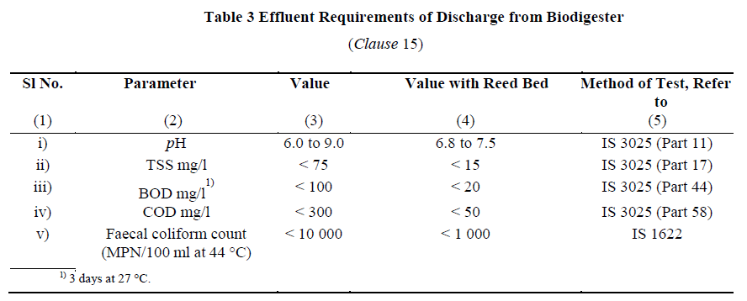
Bio digester: Effluent Requirements

Slide 41

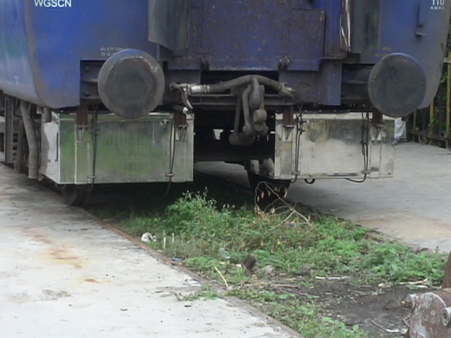
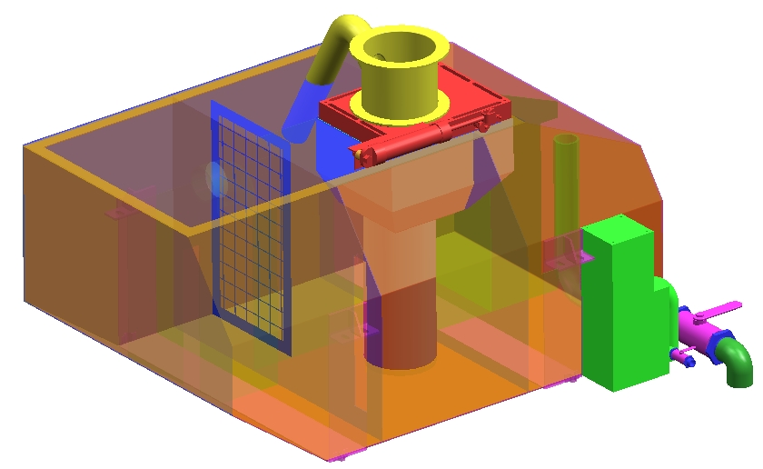
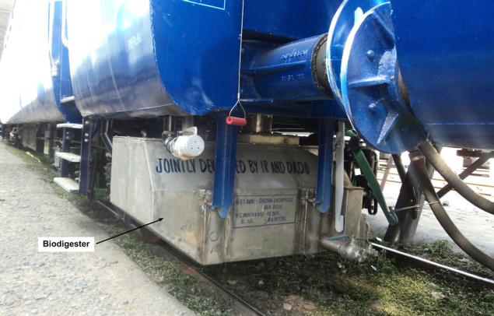
Success Story: Bio digester for Indian Railways
More than 2,15,000 bio-toilets fitted in passenger coaches

Slide 42
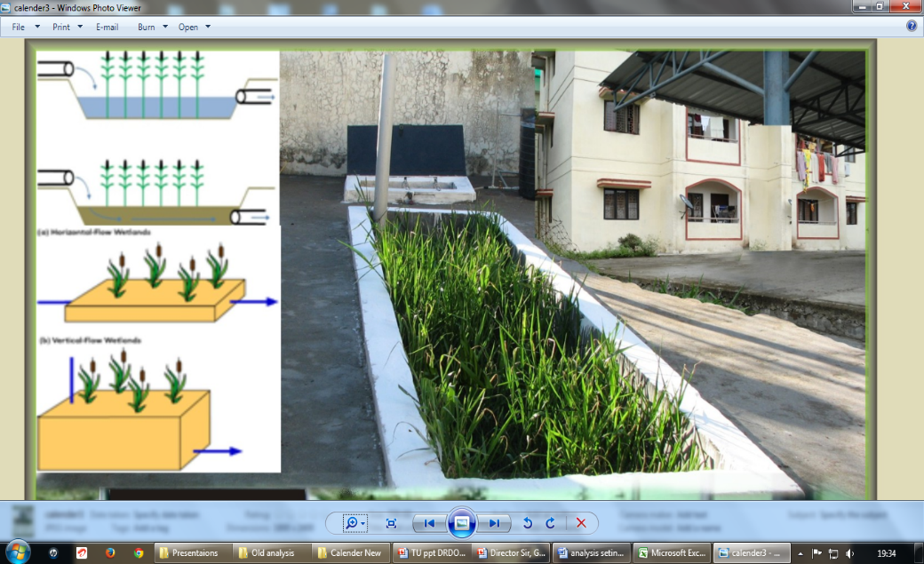
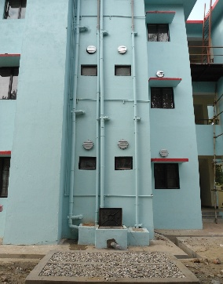
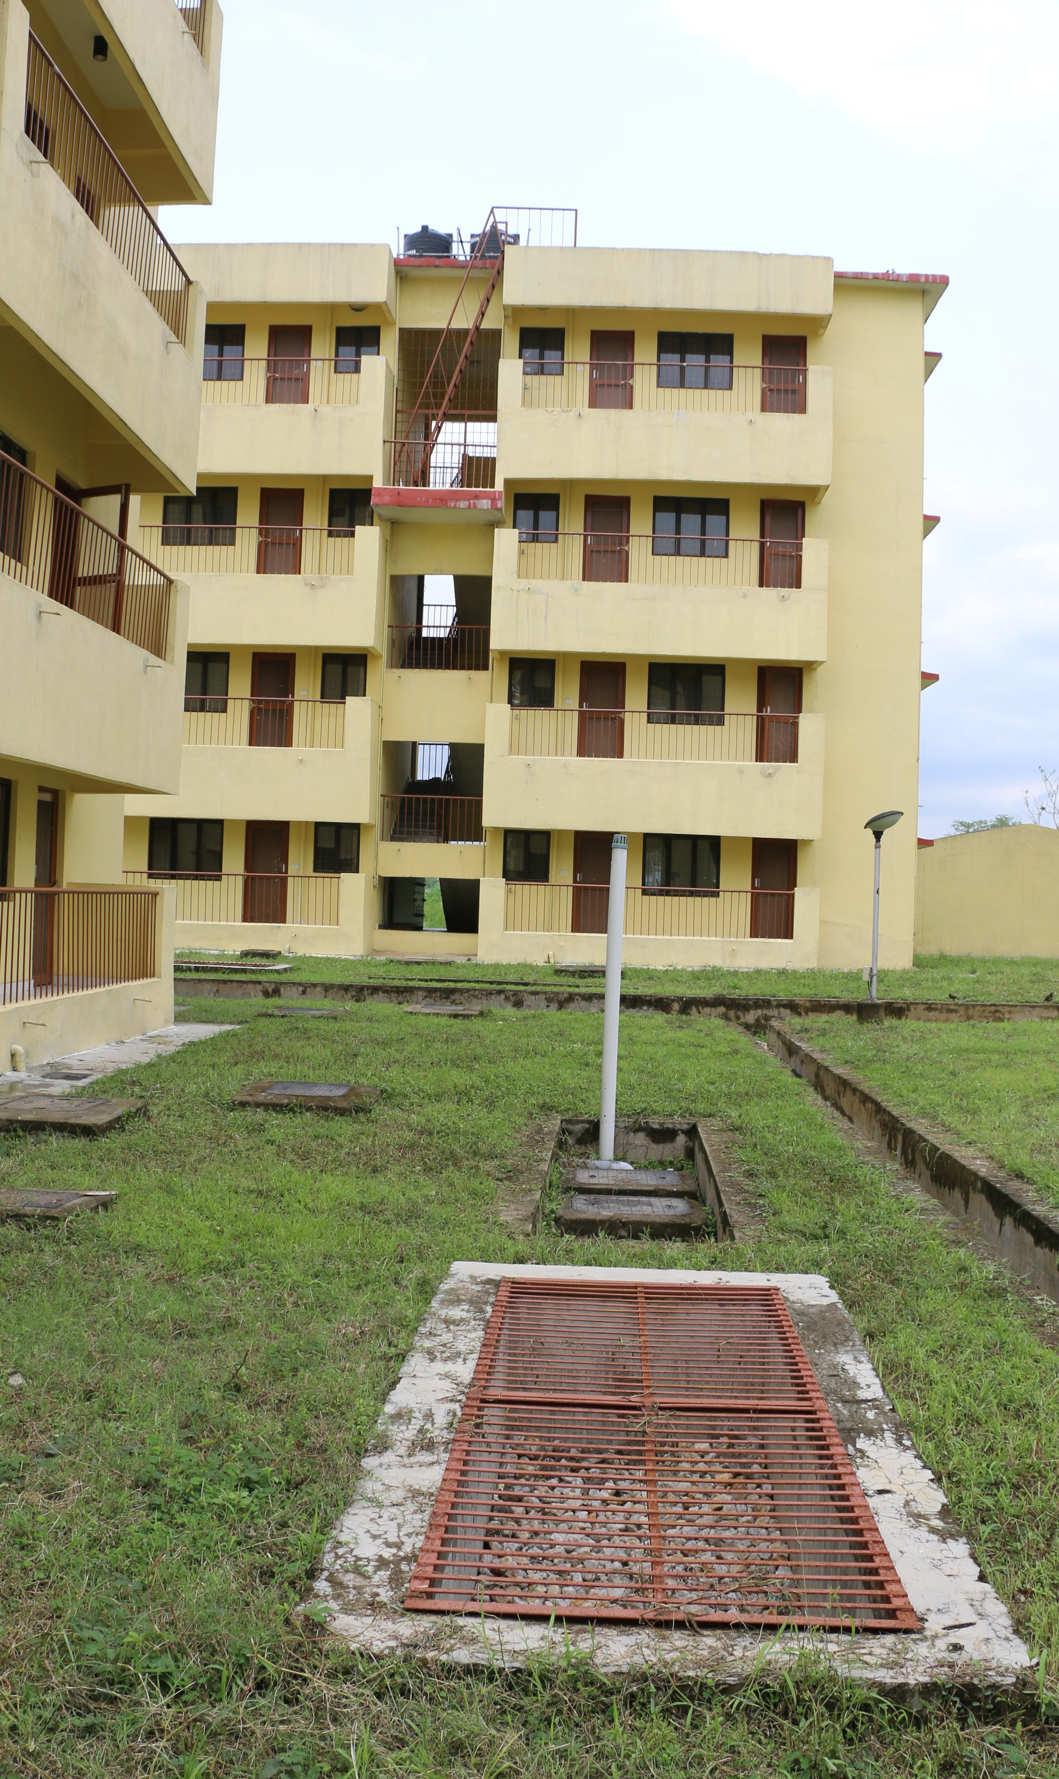

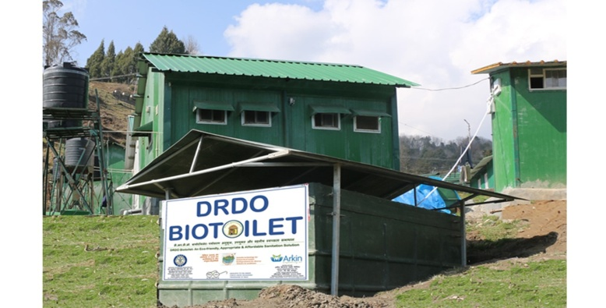
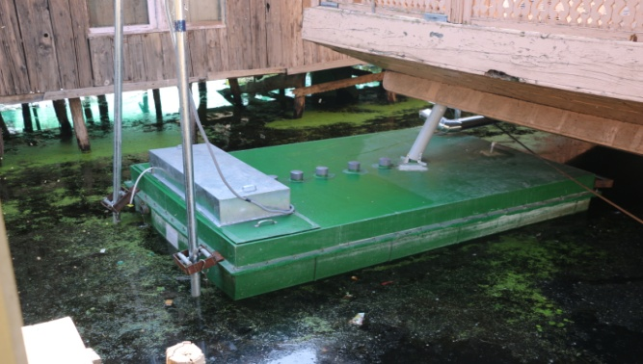
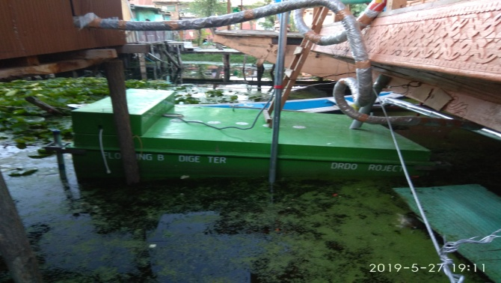
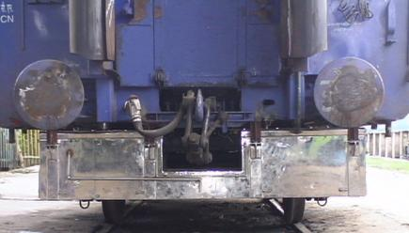
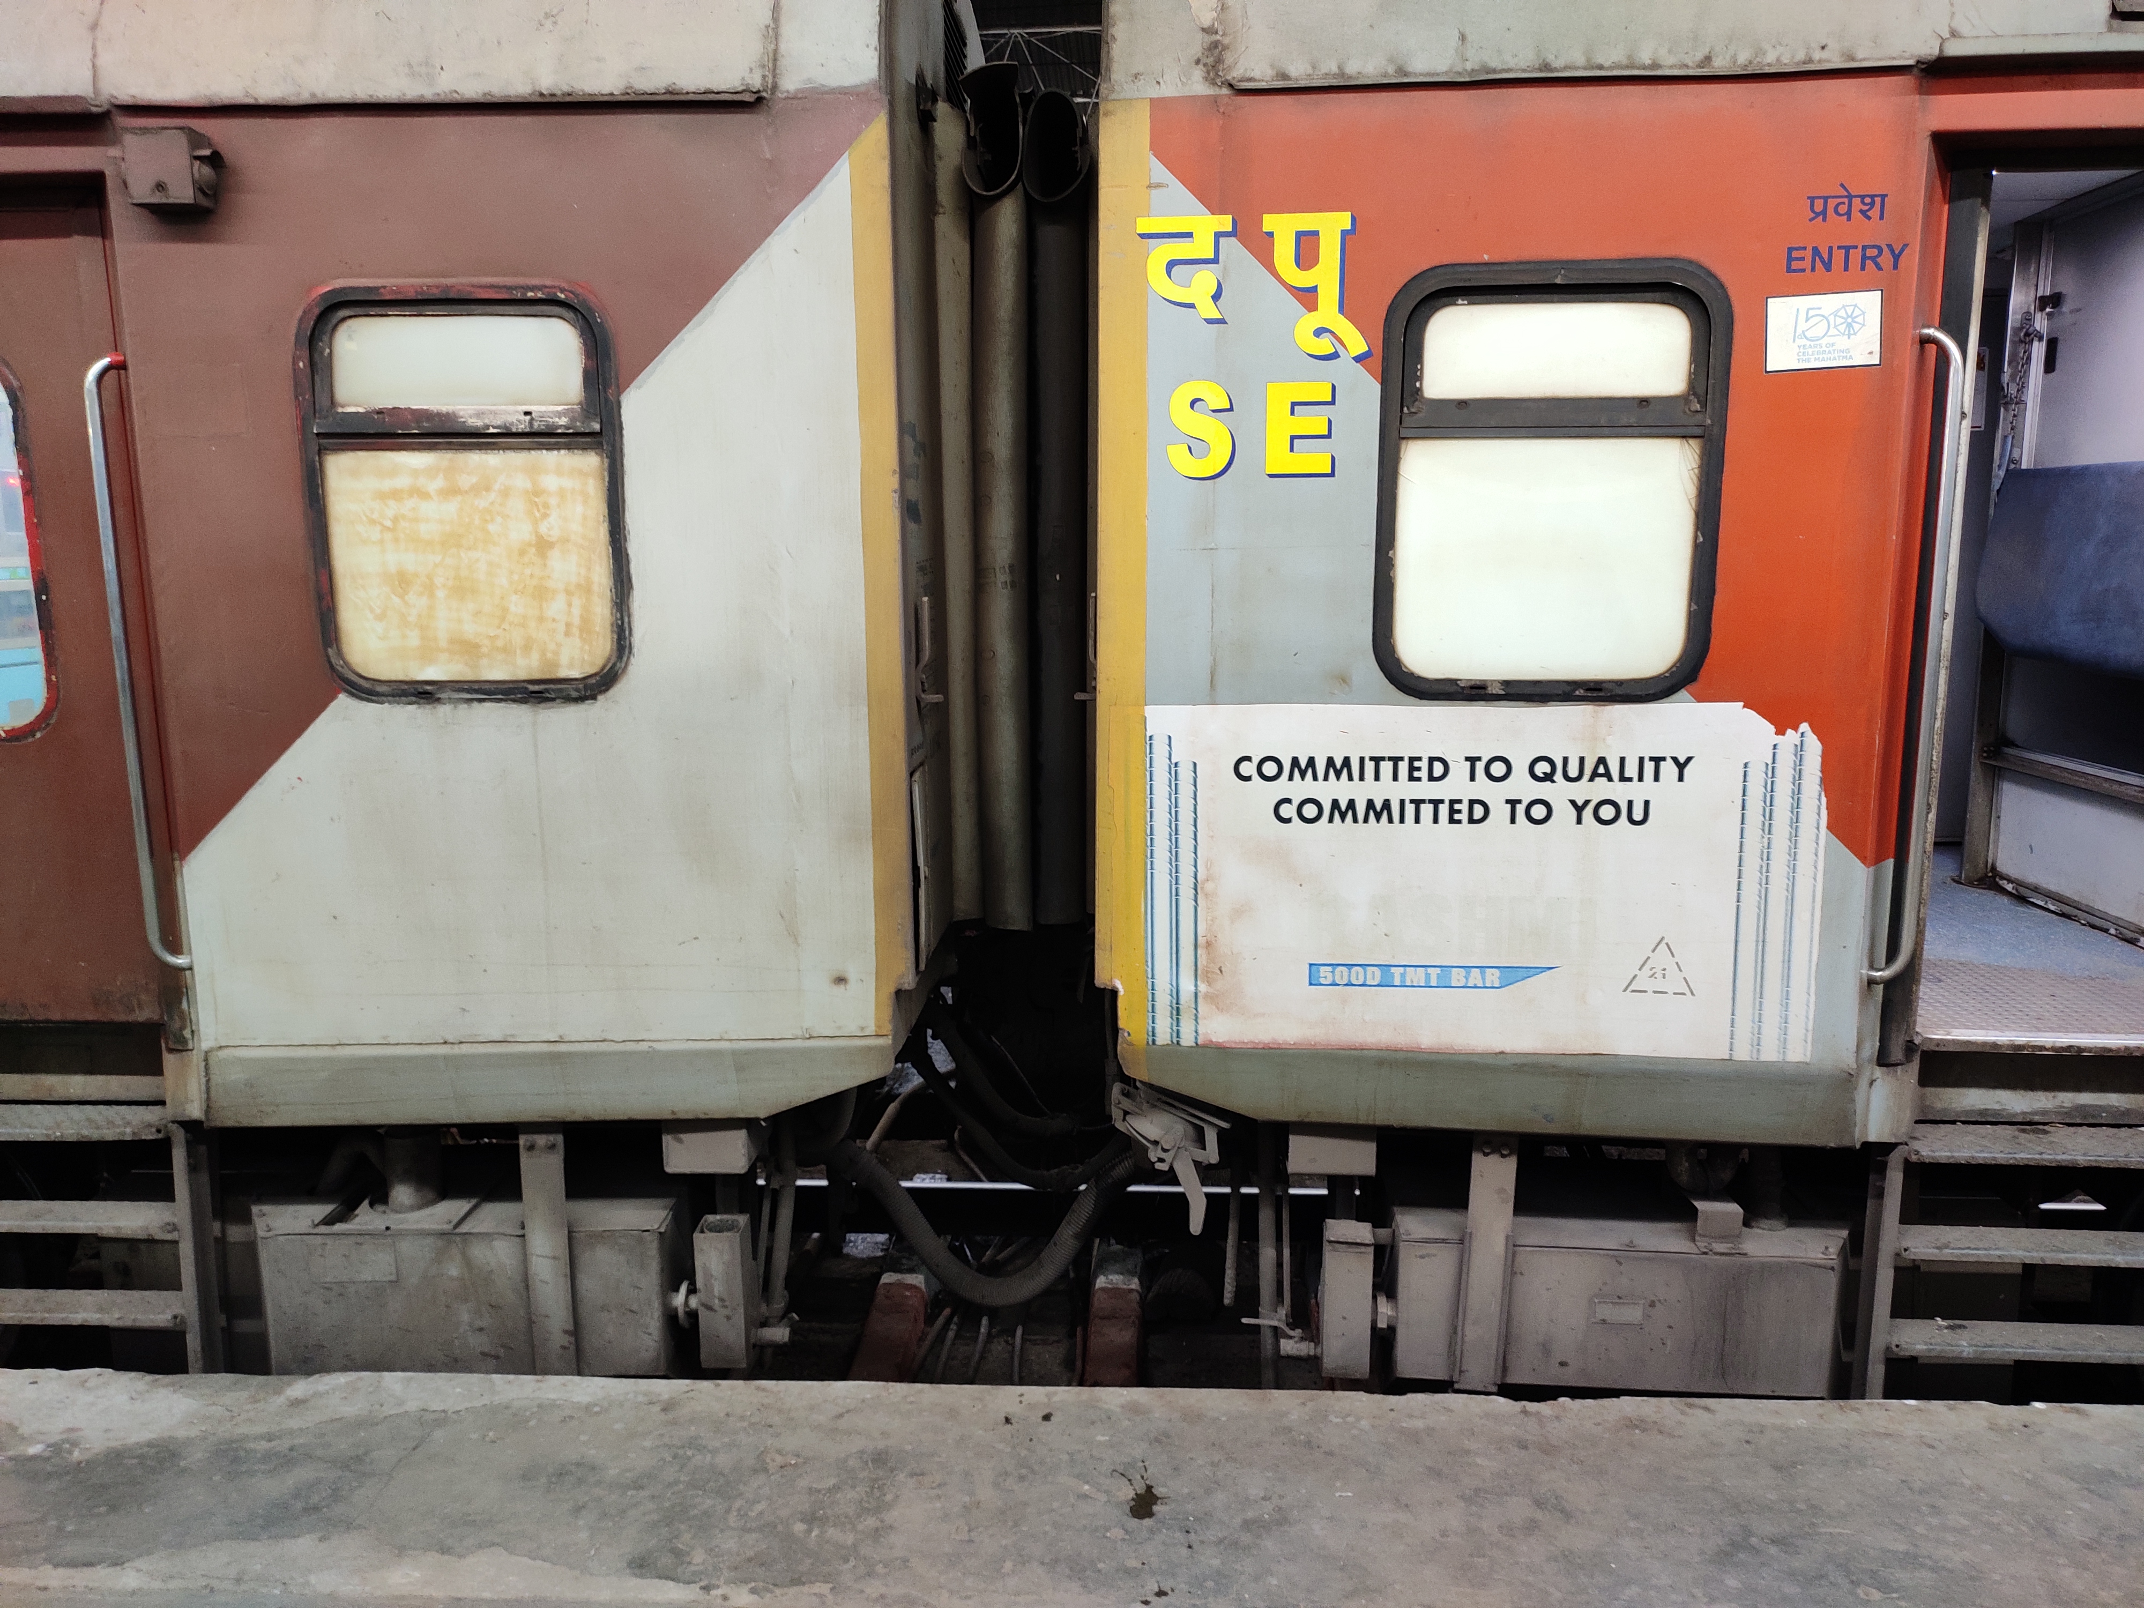
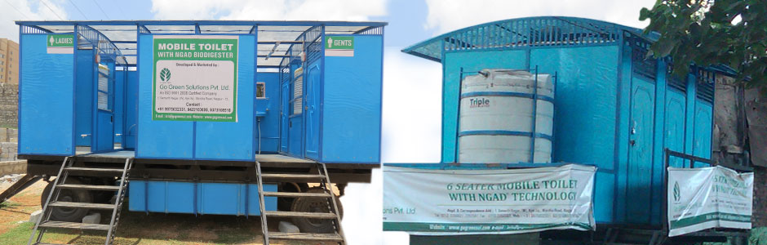
Stationary / Plains
Biodigester for different climates and conditions
Stationary / High altitude
Floating / Low Temp
Mobile platform
Rail coaches
Rail coaches
Mobile- trailers

Slide 43
Comparison with other non sewered sanitation technologies

Slide 44
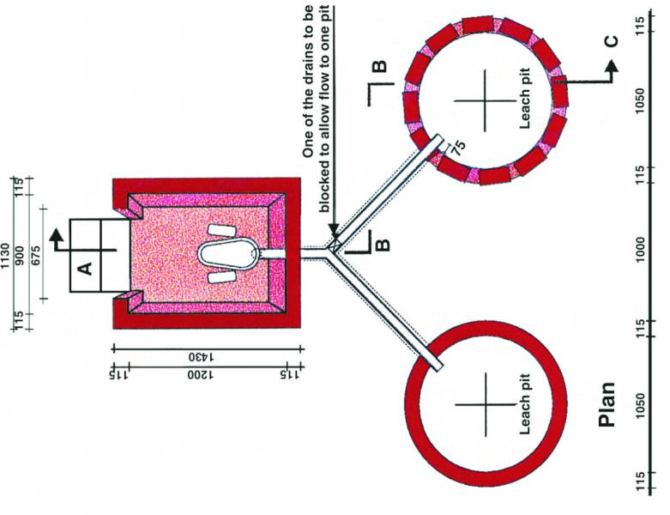
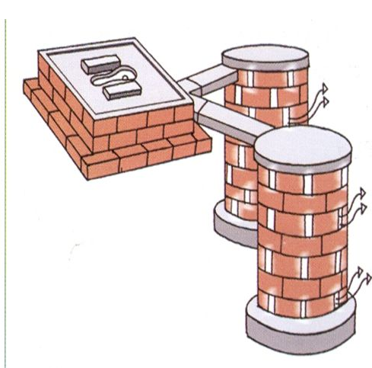
Twin Pit Toilets
Flagship technology for SBM (G) Ph I
Cheapest option
Based on Sulabh twin pit design
Variations are made locally

Slide 45
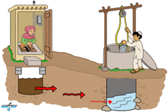

Twin Pit – issues and long term effects
Not suitable for high water table/ coastal/ hilly areas
Not suitable for rocky areas
Leads to water table contamination
Pathogen can survive and get reactivated in dry waste

Slide 46
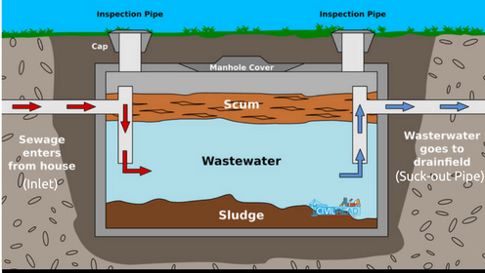
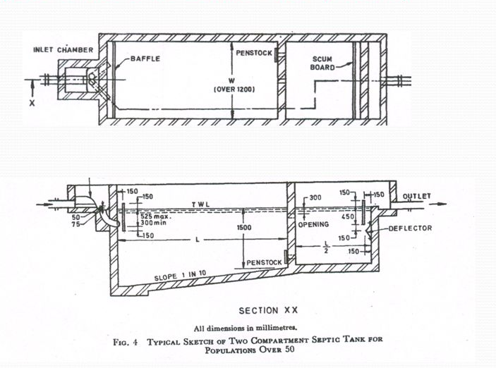
Septic Tank
Suitable for high water table areas also
Septage evacuation and disposal
Lower treatment efficiency
H₂S formation, harmful and corrosive

Slide 47
The Country needs practical and cost effective non sewered sanitation systems

Slide 48
Rotomoulded Polyethylene Septic Tanks
Role of Indian Standard IS 18666

Slide 49
Scope of IS 18666
Covers requirements for design, materials, size, performance, and testing of rotationally molded polyethylene (PE) septic tanks for underground installation.
Tanks are suitable for standard temperature and pressure conditions.
Excludes mechanisms for effluent disposal, which require further treatment as per IS 2470 (Part 2).

Slide 50
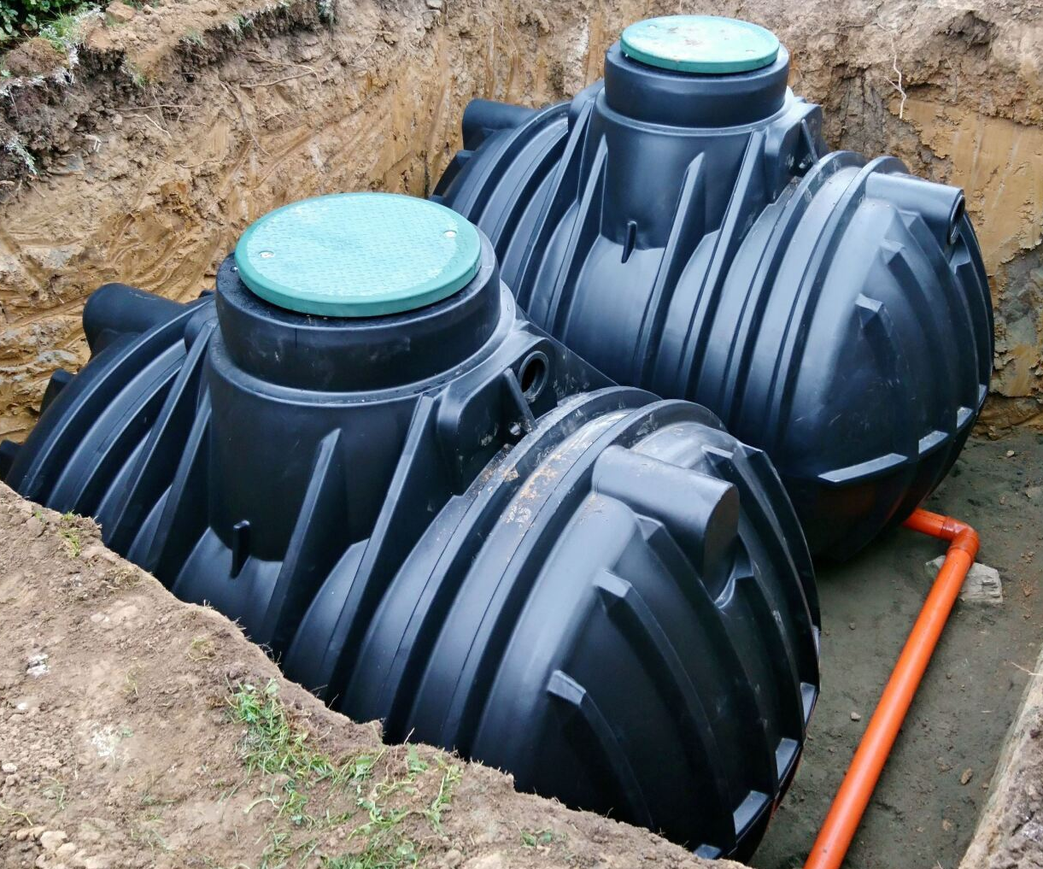
Application
On-site sanitation systems, like septic tank systems, are alternatives to centralized sewerage systems in areas where the latter is unfeasible or unavailable in both urban and rural areas. The septic tank effluent should be given secondary treatment either in a biological filter, up-flow anaerobic filter, on the land or in a sub-surface disposal system.

Slide 51
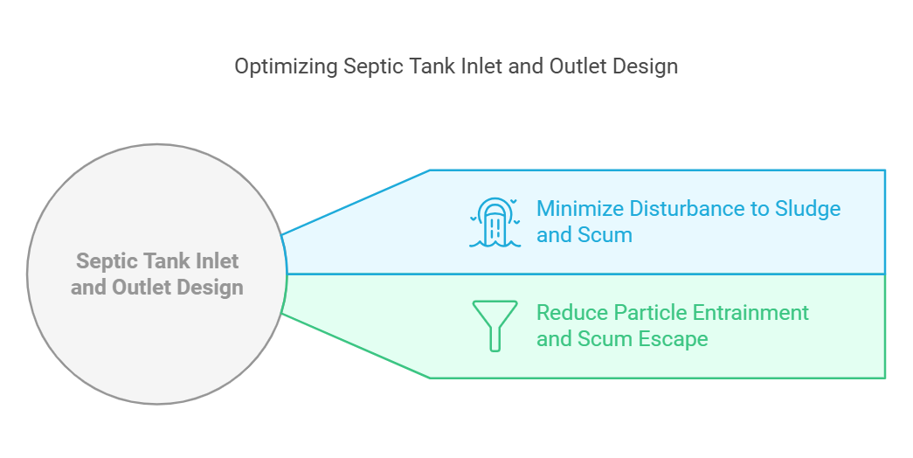
Key Design Specifications

Slide 52
Key Design Specifications
Effective Volume and Nominal Size
Minimum hydraulic retention time: 24 hours.
Minimum sludge storage period: 2 years
Minimum effective volume: 1,000 liters.
Recommended dimensions ensure durability.

Slide 53
Key Design Specifications
Compartmentation and Flow
Septic tanks over 2,000 liters must have 2 or more chambers with durable partitions.
The first chamber’s capacity must be at least twice that of subsequent chambers, with tops 100 mm above the water level for horizontal tanks.
Partitions must maintain tank integrity and withstand mechanized desludging.
Openings (100-150 mm wide) must be provided for inter-compartmental flow, with an optional up-flow transfer for improved efficiency.

Slide 54
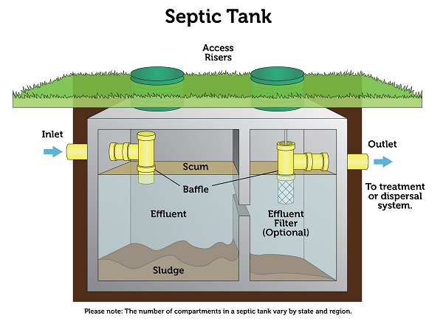
Typical Septic Tank

Slide 55
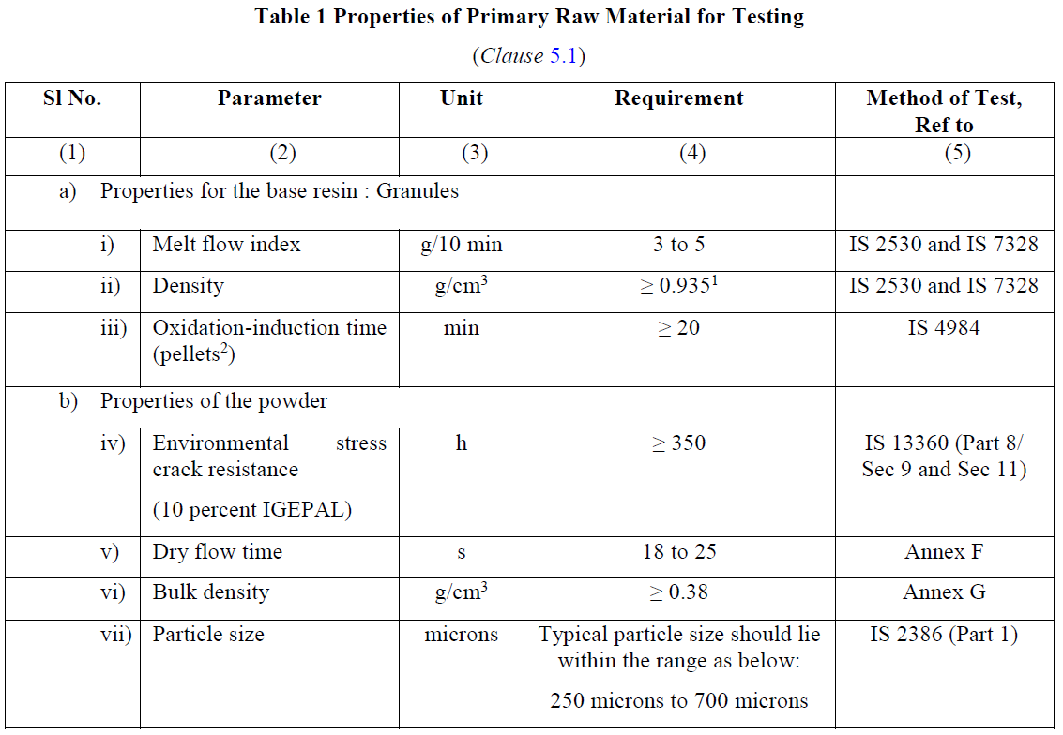
Raw Material

Slide 56
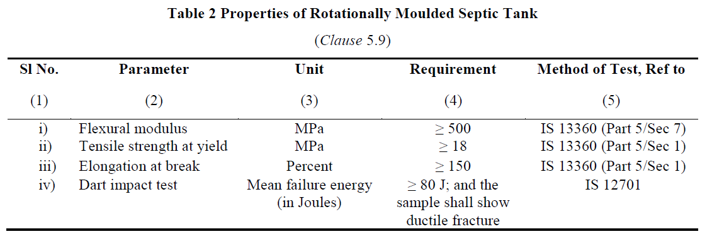
Structural Strength

Slide 57
Structural Strength and Integrity
The tank is designed to withstand soil loads, hydrostatic pressures, and thermal variations.
The Septic tank is tested for Durability, load bearing and structural strength.
No structural failures under load-bearing tests.
Finish
Free from visual defects ensuring durability.

Slide 58
Indian Standard IS 18797 Packaged Sewage Treatment Plant
Load test for bearing capacity tank shall be done as per Annex H.

Slide 59
Tests
Type Test
Type tests are intended to prove the suitability and performance of a Septic Tank of a new composition, a new technique, a new design, a new size or shape, or modified wall thickness. These shall also be done whenever a change is made in the raw material, raw material supplier or method of manufacture, or when a new design, size or shape of the septic tank is introduced.
Acceptance Test
Acceptance tests are carried out on samples taken from the lot for the purpose of acceptance of the lot.

Slide 60

Sampling & Testing Procedures

Slide 61

Sampling & Testing Procedures

Slide 62
Test Requirements
Key Parameters:
Hydraulic efficiency: ≥99%.
Water tightness: No leaks under specified conditions.
Structural strength: Verified through load and impact tests.

Slide 63
Installation & Maintenance
Installation:
Follow manufacturer's guidelines for placement, pipe connections, and backfill material.
Ensure ventilation and proper alignment.
Maintenance:
Periodic desludging based on usage and capacity.
Inspect and maintain structural integrity regularly.

Slide 64


