Slide 1
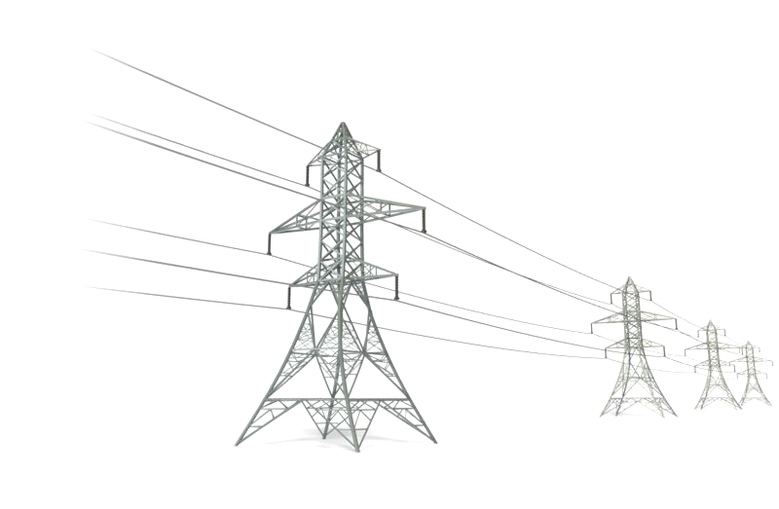
STANDARDIZATION OF OVERHEAD LINE CONDUCTORS AND AERIAL BUNCHED CABLES FOR ELECTRICAL POWER TRANSMISSION AND DISTRIBUTION

Slide 2

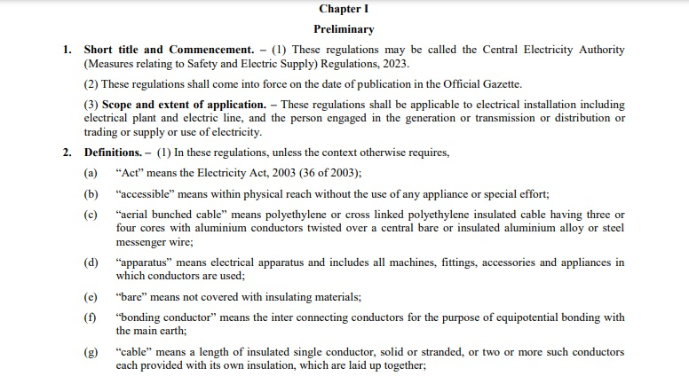
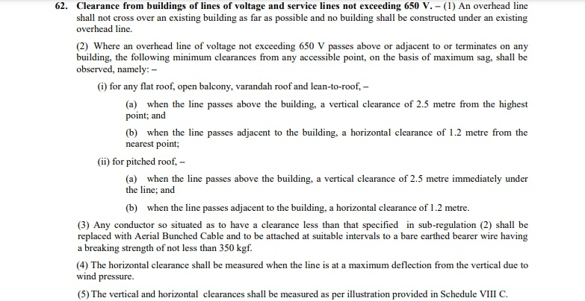
Current Regulatory Framework IS 14255: 1995
The CEA (Measures relating to Safety and Electric Supply) Regulations, 2023, notified by the Central Electricity Authority, specify the requirements for aerial bunched cables.

Slide 3
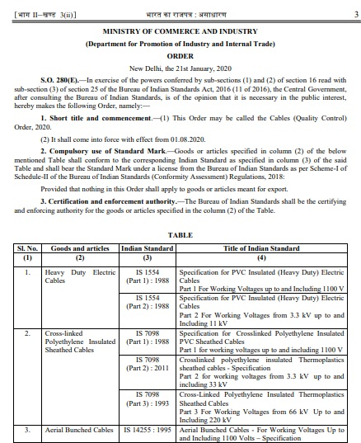
Current Regulatory Framework IS 14255: 1995
The Central Government after consultation with the Bureau of Indian Standards passed a Quality Control Order (QCO) which is called Cables Quality Control Order, 2020.
QCO became a regulatory mechanism to ensure that products meet prescribed standards of safety, reliability, and performance and protect consumers, promote industry standards, and encourage sustainable and ethical manufacturing practices.
The manufacture, storage, sale, and distribution of any electrical cables that do not conform to the specified standards and do not bear the Standard Mark of the Bureau upon obtaining a certification marks license from BIS have been prohibited by this QCO.

Slide 4
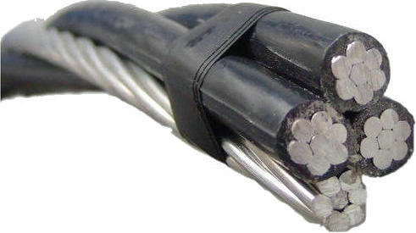
Overview of Aerial Bunched Cables (ABCs) for working voltages up to and including 1100 Volts IS 14255: 1995
This standard covers the requirements for polyethylene/crosslinked polyethylene insulated cables with aluminum conductors twisted over a central bare/insulated aluminum alloy messenger wire for use as overhead distribution feeders.
The cables covered in this standard are suitable for use where the combination of ambient temperature and temperature rise due to load, including temperature on exposure to direct sunlight results in a conductor temperature not exceeding the following:
Type of Insulation | Normal continuous operation | Short-circuit operation
Polyethylene(PE) | 70°C | 160°C
Crosslinked polyethylene (XLPE) | 90°C | 250°C

Slide 5
Conductor
Size and Requirements of Messenger Conductor
Sl. No. | Nominal Cross Section Area Of Phase Conductor | Messenger Conductor
 |  | Cross Section Area | Calculated Maximum DC Resistance at 20⁰C | Calculated Minimum Breaking Load | Min no. of wires
 | mm² | mm² | Ohm/km | kN | Nos
1 | 16 | 25 | 1.38 | 7 | 7
2 | 25 | 25 | 1.38 | 7 | 7
3 | 35 | 25 | 1.38 | 7 | 7
4 | 50 | 35 | 0.986 | 9.8 | 7
5 | 70 | 50 | 0.689 | 14.0 | 7
6 | 95 | 70 | 0.492 | 19.7 | 7
7 | 120 | 95 | 0.339 | 29.26 | 7
8 | 150 | 120 | 0.2735 | 36.64 | 19
9 | 185 | 150 | 0.2290 | 43.50 | 19

Slide 6
Insulation
The conductor shall be provided with crosslinked polyethylene (XLPE) or polyethylene (PE) insulation applied by extrusion.
Tests for XLPE Insulation Properties | Tests for PE Insulation Properties
Tensile Strength | Tensile Strength
Elongation at break | Elongation at break
Ageing in air oven | Melt Flow index
Hot set test | Vicat Softening Point
Shrinkage | Environmental Stress Cracking
Water Absorption (Gravimetric) | Volume Resistivity
Volume Resistivity

Slide 7
Testing of ABCs
 | Applicable Tests | Type Test | Acceptance Test | Routine Test
Tests on Phase/ Street Light Conductor | Tensile test | ✓ | ✓ | -
 | Wrapping test | ✓ | ✓ | -
 | Resistance test | ✓ | ✓ | ✓
Tests on Messenger Conductor | Breaking load | ✓ | ✓ | -
 | Elongation test | ✓ | ✓ | -
 | Resistance test | ✓ | ✓ | ✓
Physical tests for XLPE Insulation | Tensile strength & Elongation at break | ✓ | - | -
 | Ageing in air oven | ✓ | - | -
 | Hot set test | ✓ | ✓ | -
 | Shrinkage test | ✓ | - | -
 | Water Absorption (Gravimetric) | ✓ | - | -
Physical tests for PE Insulation | Tensile strength & Elongation at break | ✓ | ✓ | -
 | Melt Flow index | ✓ | - | -
 | Vicat Softening Point | ✓ | - | -
 | Environmental Stress Cracking | ✓ | - | -
Test for thickness of insulation |  | ✓ | ✓ | -
Insulation resistance (Volume resistivity) test |  | ✓ | ✓ | -
High voltage test |  | ✓ | ✓ | ✓
Bending test on a complete conductor |  | Optional test

Slide 8
Brief Description Of Tests
Thermal Ageing In Air (IS 10810 Part 11):
Thermoplastic and elastomeric insulation and sheath exposed to heat are subjected to many types of physical and chemical changes. The severity of exposures, in both time and temperature, determines the extent and type of change that takes place. This test makes an assessment of change in tensile strength and elongation of materials on subjecting them to accelerated ageing in air.
Hot Set Test (IS 10810 Part 30):
Many important properties of cable vary depending upon the degree to which the material is cross-linked. This test method serves as a means for determining whether or not the depending properties are fully realised after cross-linking.
Shrinkage Test (IS 10810 Part 12):
Shrinkage test covers determination of shrinkage characteristics of thermoplastic insulation and sheath of electric cables after exposure to specified elevated temperature. The extruded polymeric materials may have residual strain which is relieved on heating causing shrinkage. Shrinkage is defined as decrease in original length of test specimen after heat treatment, expressed as percentage of original length of test specimen. The purpose of this test is to determine such shrinkages so that this may not cause any problem in terminations when cable gets heated due to energization.

Slide 9
Brief Description Of Tests
Water Absorption Test (Gravimetric) (IS 10810 Part 33):
This test is done to ascertain the quantity of water absorbed when the insulation or sheath of cable laid underground comes into contact with water or moisture.
Melt Flow Index Test (IS 10810 Part 23):
This test describes a method for finding melt-flow index of polyethylene insulation and sheath of electrical cables by measuring the rate of extrusion of polyethylene through an orifice of a specified length and diameter, under prescribed conditions of temperature and pressure. This method is particularly useful for quality control tests on polyethylene having relatively low melt viscosities.
Vicat Softening Point (IS 10810 Part 22):
This test covers the procedure for measuring vicat softening point of polyethylene insulation and sheath of electrical cables. Data obtained by this method may be used to compare heat softening qualities of polyethylene.

Slide 10
Brief Description Of Tests
High Voltage Test (IS 10810 Part 45):
The insulation material in a cable is used to isolate the conductors from one another and from ground, as well as provide the necessary mechanical strength. The fundamental, requirement of the insulation in an electric cable is that it withstands the voltage imposed on it in service. It is necessary that an evaluation of the condition of the insulation be made by imposing a higher voltage stress for a short duration.
Bending Test on complete conductor (IS 14255):
This test is done to ensure that the conductor can withstand repeated bending and manipulation during installation without cracking, breaking, or losing functionality and can handle the mechanical stresses it will face during installation and operation while maintaining its safety, reliability, and long-term performance.

Slide 11
Important Indian Standards on Overhead Transmission Line Conductors
SI. No | IS No | Title
1 | IS 398 (Part 1) | Aluminium conductors for overhead transmission purposes - Specification: Part 1 aluminium stranded conductors
2 | IS 398 (Part 2) | Aluminium conductors for overhead transmission purposes - Specification: Part 2 aluminium conductors, galvanized steel - Reinforced
3 | IS 398 (Part 4) | Aluminium conductors for overhead transmission purposes: Part 4 aluminium alloy stranded conductors (Aluminium - Magnesium - Silicon Type) - Specification
4 | IS 398 (Part 6) | Aluminium Conductors for Overhead Transmission Purposes Part 6 High Conductivity Aluminium Alloy Stranded Conductors — Specification

Slide 12
Overview of IS 398 Part 1
Scope: This standard covers the requirements and tests for aluminium stranded conductors used for overhead power transmission purposes.
Physical constant for Hard drawn Aluminium:
Resistivity - 0.028264 ohm.mm²/m at 20 °C
Density - 2.70 g/cm³ at 20 °C
Constant Mass Temperature Co-efficient of Resistance - 0.00403/°C at 20 °C
Co-efficient of Linear Expansion - 23 X 10 ⁻⁶ per degree Celsius
Overview of IS 398 Part 2
Scope: This standard covers the requirements and tests for aluminium conductors, galvanized steel-reinforced (ACSR).
Construction
Core made of Galvanized Steel
Outer layers made of Hard- Drawn Aluminium
Physical constant for Hard drawn aluminium
Resistivity - 0.028264 ohm.mm²/m at 20 °C
Density - 2.703 g/cm³ at 20 °C
Constant Mass Temperature Co- efficient of Resistance - 0.00403/°C at 20 °C
Co-efficient of Linear Expansion - 23 X 10 ⁻⁶ per degree Celsius
Physical constant for Galvanized Steel Wires
Density - 7.80 g/cm³ at 20°C
Co-efficient of Linear Expansion - 11.5x10⁻⁶ /ºC

Slide 13
Overview of IS 398 Part 4
Scope: This standard covers the requirements and tests for aluminium alloy stranded conductors of aluminium-magnesium-silicon type for overhead power transmission purposes.
Physical constants for Hard drawn Aluminium Alloy:
Resistivity - 0.0325 ohm.mm²/m at 20 °C
Density - 2.70 g/cm³ at 20 °C
Constant - Mass Temperature Co - efficient of Resistance - 0.00360/°C at 20 °C
Co-efficient of Linear Expansion - 23 X 10 ⁻⁶ per degree Celsius

Slide 14
Factors for Conductor Selection / Designing
The selection of conductor for the transmission line is dependent upon many factors, such as :
The Quantum of power to be transmitted,
The amount of current to be handled,
Length of the transmission line,
The climatic conditions of the terrain through which the line is expected to pass,
The rural, urban, industrial, & oceanic areas need definite attention while selecting the conductor.
Basic Principles for Selection of Conductor
The conductor should have a cross section which allows a passage of particular amount of current.
Lower electrical resistance
The continuous current rating.
Short time current rating.
Lower thermal elongation (per degree C).
Higher annealing temperatures.
Sag of conductor.

Slide 15
Important Tests covered in the Standards
 | APPLICABLE TESTS | Acceptance and Routine Test | Type Test
Conductor | Visual examination | ✓ | ✓
 | Lay ratio and direction of lay | ✓ | ✓
 | DC Resistance Test on Stranded Conductor | - | ✓*
 | Ultimate tensile strength test on Stranded Conductor | - | ✓*
 | Surface Condition Test on stranded conductor | - | ✓*
 | Corona test (for conductors intended for use at 400kV and above voltage level, both a.c. and d.c.) | - | ✓
Aluminum / Aluminum Alloy wires | Measurement of diameter | ✓ | ✓
 | Breaking load test | ✓ | ✓
 | Wrapping test | ✓ | ✓
 | DC Resistance test | ✓ | ✓
 | Procedure qualification test on welded joint of Aluminium strands | ✓ | ✓
Galvanized Steel wires | Measurement of diameter | ✓ | ✓
 | Breaking load test | ✓ | ✓
 | Ductility test | ✓ | ✓
 | Wrapping test | ✓ | ✓
 | Galvanizing test | ✓ | ✓
* - This test is applicable to conductors of nominal aluminium area 10 mm² and above

Slide 16
Present Scenario of Overhead Transmission Line Conductors
Expansion of Overhead Transmission Infrastructure
Rapid growth to meet increasing electricity demand in India.
Adoption of Advanced Conductors
Integration of HTLS (High-Temperature Low-Sag) conductors for better performance in high-temperature environments.
Focus on High-Voltage Transmission
Emphasis on high-voltage systems for efficient power transmission and renewable energy integration.
Challenges
Right-of-way issues, weather-related vulnerabilities, and transmission losses.

Slide 17
Relevant regulations and compliance requirements
CEA Guidelines for Rationalized Use of High-Performance Conductors:
The Central Electricity Authority (CEA) guidelines provide comprehensive insights into various aspects of overhead transmission line conductors. These guidelines cover the following:
Ampacity comparision of various High Performance Conductors
Application areas for High Performance Conductors
Issues to be considered before installation of High Performance Conductors
Cost-benefit analysis
For more details, refer to the guidelines at the following link:
https://cea.nic.in/wp-content/uploads/2020/04/guidelines_conductors.pdf

Slide 18

THANK YOU

