Slide 1


भारतीय मानक ब्यूरो
Bureau of Indian Standards
Ensuring Safe Water :
The Role of Standards in Drinking Water Quality, Sampling, and Testing
Presenter
Ms. Nitasha Doger, Scientist-E, FAD
Ms. Shubhanjali Umrao, Scientist-C, CHD

Slide 2
Table of Contents
Importance of drinking water quality and the role of standards.
Drinking Water Sampling Techniques
3. Water Quality Testing Methods
4. Portable Field-Testing Kit for Onsite Testing of Drinking Water Specification
Notes:
m

Slide 3
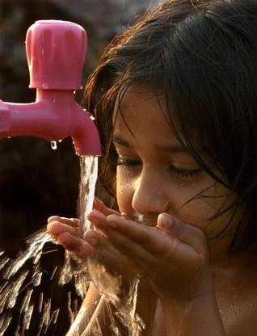
Significance of Drinking Water Quality
Water is vital for human survival, economic development, environmental sustainability, and social well-being
Human body composition: 55-60% of the human body is water
Cellular functions: Water is necessary for cellular processes, such as metabolism and temperature regulation
Hydration: Water helps maintain fluid balance and supports bodily functions.
Health: Access to clean water reduces disease risk and improves public health.

Slide 4
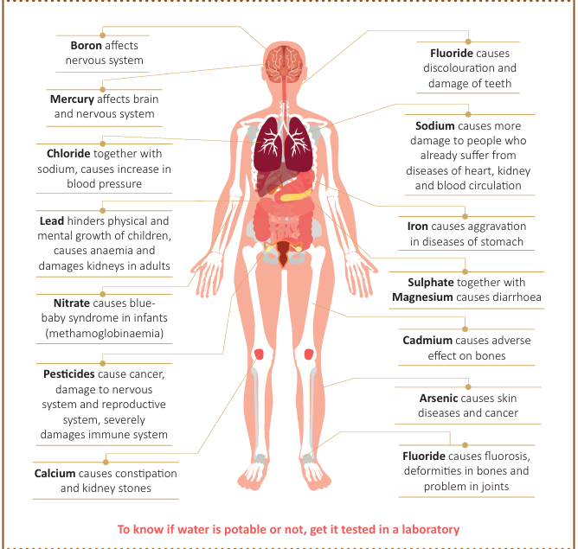
Significance of Various Chemical Parameters in Drinking Water

Slide 5
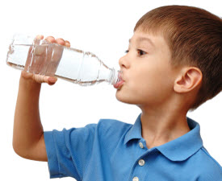
Concerns related to Water Quality
Many episodes of diarrhea, dysentery and other water borne diseases due to microbes in water
Presence of dangerous chemicals like Fluoride, Arsenic and Selenium in water
Consumption of water supplied through open wells, borewells, tubewells, hand pumps, tankers, etc. still prevalent
Safe treated Piped water supply yet to reach all households

Slide 6
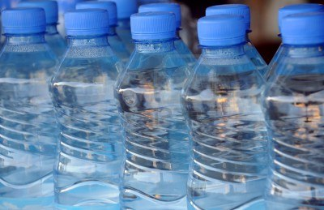
How standards address the concern?
Prescribe requirements for assessing the quality of water and to check the effectiveness of water treatment and supply by the concerned authorities
Sets criteria for conformity assessment and provides tool for regulatory compliance.
Prescribes good hygienic practices to improve processes and make them more efficient
Guide in consistent functioning and quality
Ensure health and safety from water borne diseases

Slide 7
Important Indian Standards on Drinking Water Quality
Indian Standard | Title
IS 10500 : 2012 | Drinking Water — Specification
IS 14543 : 2024 | Packaged Drinking Water (Other than Packaged Natural Mineral Water) — Specification
IS 13428 : 2024 | Packaged Natural Mineral Water — Specification
IS 17482 : 2020 | Drinking Water Supply Management System- Requirements for Piped Drinking Water Supply
IS 3025 (Series of standards) | Methods of Sampling and testing (Physical and Chemical for Water and Wastewater
.

Slide 8

IS 10500: 2012, Drinking Water — Specification
The standard prescribes the requirements and the methods of sampling and test for drinking water
Note: Drinking water is water intended for human consumption for drinking and cooking purposes from any source. It includes water (treated or untreated) supplied by any means for human consumption

Slide 9
Formulation & Implementation
IS 10500 was originally published in 1983 when the VI Five-Year Plan of India (1980-85) had made a special provision for availability of safe drinking water for the masses and United Nations declared an International Drinking Water Supply and Sanitation decade (beginning in 1981)
The standard was formulated with the objective of assessing the quality of water resources, and to check the effectiveness of water treatment and supply by the concerned authorities
The standard states that routine surveillance of drinking water supplies should be carried out by the relevant authorities to understand the risk of specific pathogens and to define proper control procedures

Slide 10
Acceptability Criteria
This standard specifies the acceptable limits and the permissible limits in the absence of alternate source
Acceptable limits are the values in excess of which the water is not suitable for drinking purposes. Such a value may, however, be tolerated in the absence of an alternative source
However, if the value exceeds the limits indicated under ‘permissible limit in the absence of alternate source’, the sources will have to be rejected

Slide 11
REQUIREMENTS COVERED
Organoleptic & Physical (6 Parameters)
Chemical requirements affecting acceptability (24 Parameters)
Toxic Substances (15 Parameters)
Pesticides Residues (20 Residues)
Biological Requirements [Bacteria , Virus , Protozoa ]
REQUIREMENTS

Slide 12
Organoleptic & Physical Requirements
S. No. | Requirements | IS 10500 : 2012 Drinking Water – Specification
 |  | Acceptable | Permissible
 | Colour, Hazen units, Max | 5 | 15
2. | Odour & Taste | Agreeable | Agreeable
3. | pH | 6.5-8.5 | No relaxation
4. | Turbidity, NTU, Max | 1 | 5
5. | Total dissolved solids, mg/l | 500 Max | 2000 Max

Slide 13
Organoleptic & Physical Requirements
Colour, cloudiness, particulate matter and visible organisms effect acceptability.
These parameters in drinking-water may be indicative of potentially harmful substances.
Taste and odour can originate from natural inorganic and organic chemical contaminants and biological sources or processes.
The cause should be investigated and the appropriate remedial action to be taken.
Notes:
Should there be min. requirement for TDS

Slide 14
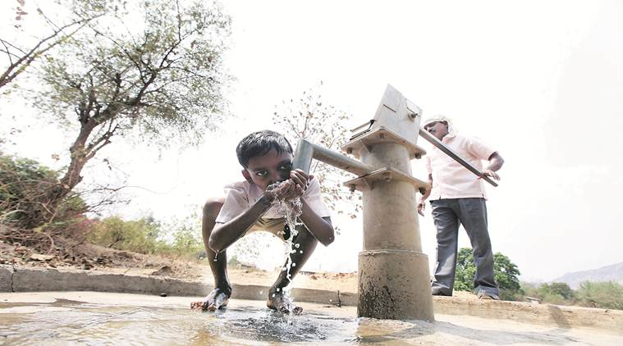
Chemical Contaminants in Drinking Water
High levels of arsenic, fluoride, iron, and uranium exist naturally in some geological formations, contaminating groundwater.
Excessive use of fertilizers, pesticides, and herbicides leach harmful chemicals into the water table.
Untreated industrial effluents often find their way into groundwater sources, introducing heavy metals and other toxins.
Leaky sewage systems and improper waste disposal in urban areas contribute to groundwater pollution
Water may also be contaminated by trace metals such as lead, mercury, cadmium, copper, chromium, and nickel, which possess carcinogenic properties.

Slide 15
Substances Undesirable in Excessive Amount
S. No. | Requirements | Acceptable | Permissible
1. | Aluminium (as Al), mg/l, Max | 0.03 | 0.2
2. | Ammonia (as total ammonia-N), mg/l, Max | 0.5 | No relaxation
3. | Anionic detergents (as MBAS) mg/l, Max | 0.2 | 1.0
4. | Barium (as Ba), mg/l, Max | 0.7 | No relaxation
5. | Boron (as B), mg/l, Max | 0.5 | 2.4
6. | Calcium (as Ca), mg/l, Max | 75 | 200
7. | Chloramines (as Cl2), mg/l, Max | 4 | No relaxation
8. | Chloride (as Cl), mg/l, Max | 250 | 1000
9. | Copper (as Cu), mg/l, Max | 0.05 | 1.5
10. | Fluoride (as F) mg/l, Max | 1.0 | 1.5
11. | Iron (as Fe), mg/l, Max | 1.0 | No relaxation
12. | Magnesium (as Mg), mg/l, Max | 30 | 100

Slide 16
Substances Undesirable in Excessive Amount
S. No. | Requirements | Acceptable | Permissible
13. | Manganese (as Mn), mg/l, Max | 0.1 | 0.3
14. | Mineral oil, mg/l, Max | 1.0 | No relaxation
15. | Nitrate (as NO3) mg/l, Max | 45 | No relaxation
16. | Phenolic compounds (as C₆H₅OH), mg/l, Max | 0.001 | 0.002
17. | Residual free chlorine, mg/l, Min | 0.2 | 1
18. | Selenium (as Se), mg/l, Max | 0.01 | No relaxation
19. | Silver (as Ag), mg/l, Max | 0.1 | No relaxation
20. | Sulphate (as SO₄), mg/l , Max | 200 | 400
21. | Sulphide (as H₂S), mg/l , Max | 0.05 | No relaxation
22. | Total alkalinity (as CaCO₃), mg/l , Max | 200 | 600
23. | Total hardness (as CaCO₃), mg/l , Max | 200 | 600
24 | Zinc (as Zn), mg/l , Max | 5 | 15

Slide 17
Toxins in Drinking Water
Drinking water with higher amounts of arsenic, iron, lead, cadmium, chromium and uranium has a direct effect on an individual’s health.
While excess arsenic increases the risk of skin diseases and cancer, higher amounts of iron can lead to diseases related to the nervous system such as Alzheimer’s and Parkinson’s.
Lead consumed more than the prescribed amount can affect one’s nervous system, while high levels of cadmium can increase the risk of kidney disorders.
Consuming excess amount of uranium in drinking water, poses higher risk of kidney diseases and cancer.
High amounts of chromium can result in diffuse hyperplasia in the small intestine, leading to tumours.

Slide 18
Toxic Substances
S. No. | Requirements | Acceptable | Permissible
1. | Cadmium (as Cd), mg/l, Max | 0.003 | No relaxation
2. | Chromium (as Cr), mg/l, Max | 0.05 | No relaxation
3. | Cyanide (as CN), mg/l, Max | 0.05 | No relaxation
4. | Lead (as Pb), mg/l, Max | 0.01 | No relaxation
5. | Mercury (as Hg), mg/l, Max | 0.001 | No relaxation
6. | Molybdenum (as Mo), mg/l, Max | 0.07 | No relaxation
7. | Nickel (as Ni), mg/l, Max | 0.02 | No relaxation
8. | Polychlorinated biphenyls, mg/l, Max | 0.0005 | No relaxation
9. | Polynuclear aromatic hydrocarbons (as PAH), mg/l, Max | 0.0001 | No relaxation
10. | Total Arsenic (as As), mg/l, Max | 0.01 | No relaxation
11. | Uranium, mg/l, Max | 0.03 | No relaxation

Slide 19
Pesticides
Pesticide residues limits in IS 10500 are based on consumption pattern, persistence and available manufacturing data.
Some of the specified limits are as under (IS 10500, Table 5)
Pesticide | Acceptable (µg/l) | Permissible
Alachlor | 20 | No relaxation
Aldrin/ Dieldrin | 0.03 | No relaxation
Alpha HCH | 0.01 | No relaxation
Beta HCH | 0.04 | No relaxation
Delta HCH | 0.04 | No relaxation
DDT (o, p and p, p – Isomers of DDT, DDE and DDD) | 1 | No relaxation
Ethion | 3 | No relaxation
Gamma — HCH (Lindane) | 2 | No relaxation

Slide 20
Radiological Safety in Drinking Water
Water sources can contain radionuclides of natural and artificial origin
Radiation protection is based on the assumption that any exposure to radiation involves some level of risk.
The process of identifying individual radionuclides in drinking-water and determining their concentration is time-consuming and expensive. A more practical approach is to use a screening procedure, where the total radioactivity present in the form of alpha and beta radiation is first determined, without regard to the identity of specific radionuclides.
Radioactive Substances IS 10500, Table 4
Alpha emitters Bq/l, Max | 0.1 | No relaxation
Beta emitters Bq/l, Max | 1.0 | No relaxation
In case of non-conformity of radioactive residues, the source of water shall be abandoned and water shall be recalled immediately.

Slide 21
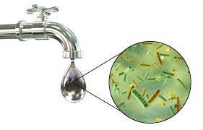
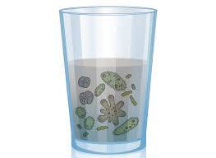
Microbial Safety in Drinking Water
Infectious diseases caused by pathogenic bacteria, viruses, protozoa and helminths are the most common and widespread health risk associated with drinking‑water
It is not practical to set performance targets for all potentially waterborne pathogens. A more practical approach is to identify reference pathogens that represent groups of pathogens.
The human health effects caused by waterborne transmission vary in severity from mild gastroenteritis to severe and sometimes fatal diarrhoea, dysentery, hepatitis and typhoid fever.
Waterborne out breaks have been associated with inadequate treatment of water supplies and unsatisfactory management of drinking water distribution.
Analysis for faecal indicator organisms provides a sensitive, indication of pollution of drinking-water supplies.

Slide 22
Microbiological Requirements
Organisms | Requirements
E. coli or thermotolerant coliform bacteria (IS 10500,Table 6) | shall not be detectable in any 100 ml sample
Coliforms (IS 10500, Table 6) | shall not be detectable in any 100 ml sample
MS2 phage (indicator of viral contamination) (IS 10500, Clause 4.2.7) | shall be absent in 1 liter water
Cryptosporidium (IS 10500, Clause 4.3.8) | shall be absent in 10 liter of water
Giardia (IS 10500, Clause 4.3.9) | shall be absent in 10 liter of water
The microbiological requirements for Packaged drinking water(IS 14543) are more elaborate than those in IS 10500 in terms of the variety of microbiological parameters tested which includes microbiological requirements w.r.t. Faecal Streptococci and Staphylococcus aureus, Sulphite Reducing Anaerobes, Pseudomonas Aeruginosa, Aerobic Microbial Count, Yeast and mould, Salmonella and Shigella, Vibrio cholera and V. parahaemolyticus
Notes:
With regard to failure in the requirement for E. Coli, the Indian standard further provides following guidelines:
Immediate investigative action shall be taken if either E.coli or total coliform bacteria are detected. The minimum action in the case of total coliform bacteria is repeat sampling; if these bacteria are detected in the repeat sample, the cause shall be determined by immediate further investigation.
Although, E. coli is the more precise indicator of faecal pollution, the count of thermos-tolerant coliform bacteria is an acceptable alternative. If necessary, proper confirmatory tests shall be carried out. Total coliform bacteria are not acceptable indicators of the sanitary quality of rural water supplies, particularly in tropical areas where many bacteria of no sanitary significance occur in almost all untreated supplies.
It is recognized that, in the great majority of rural water supplies in developing countries, faecal contamination is widespread. Under these conditions, the national surveillance agency should set medium-term targets for progressive improvement of water supplies.
The Indian standard further provides that Chlorination, at the dosages normally employed in waterworks, is ineffective against certain parasites, including amoebic cysts; they can be excluded only by effective filtration or by higher chlorine doses than can be tolerated without subsequent dechlorination. Amoebiasis can be conveyed by water completely free from enteric bacteria; microscopic examination after concentration is, therefore, the only safe method of identification.

Slide 23

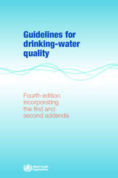
WHO Guidelines for Drinking Water Quality
WHO Guidelines are international standards for drinking water quality which are used by various countries and regions across the world including CODEX, EU Directives, etc. The primary purpose of the Guidelines for drinking-water quality is the protection of public health.
Technical specifications for drinking water quality in IS 10500 is at par with WHO Guidelines. (https://www.who.int/publications/i/item/9789240045064 )

Slide 24
Indian Standards on Packaged Waters
IS 14543 : 2016 Packaged Drinking Water (Other than Packaged Natural Mineral Water) which may be subjected to various treatments such as decantation, filtration, combination of filtration, cartridge filter, activated carbon filtration, demineralization, remineralization, reverse osmosis and packed after disinfecting the water and is offered or sold in packaged form.
IS 13428 : 2005 covers various mineral waters in packaged form such as Naturally Carbonated Natural Mineral Water, Non-carbonated Natural Mineral Water, decarbonated Natural Mineral Water, Natural Mineral Water Fortified with Carbon Dioxide from the Source, Carbonated Natural Mineral Water

Slide 25
Drinking Water and Packaged Drinking Water Specifications - Key Differences
IS 10500 & IS 14543 have been formulated for drinking water based on the end use of the product and the treatments generally done
The standards primarily differ in the microbiological requirements which are more elaborate (11 more) and stricter (for E. coli & coliforms) in case of IS 14543 because the product needs to be kept safe for its entire shelf life in packaged form.
Some requirements like those of viruses & protozoan cysts have been specified only in case of IS 10500 because of the simpler treatments done and contamination during distribution through pipes/ tankers, etc.
IS 10500 also has additional parameters like chloramines, ammonia and tri-halomethanes, which are process by-products of disinfection methods employed
IS 10500 also specify permissible limits (in addition to acceptable limits) which are more relaxed and have been kept for tolerability of water where there are no alternate sources
01
02
03
04
05

Slide 26

Hygienic Practices for PDW Processing Units
1
Collection of Drinking Water
2
Protective Measures
3
Transport of Drinking Water
4
Design & Facilities
5
Establishment

Slide 27
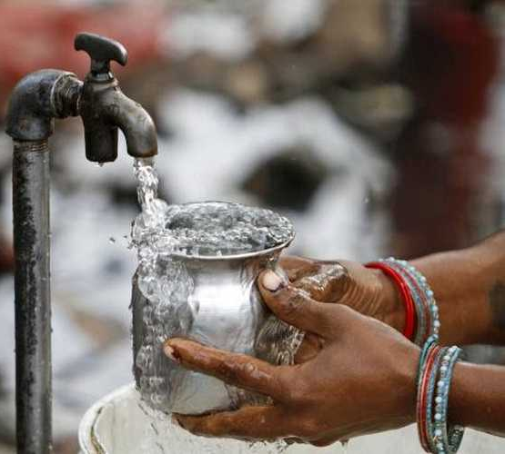
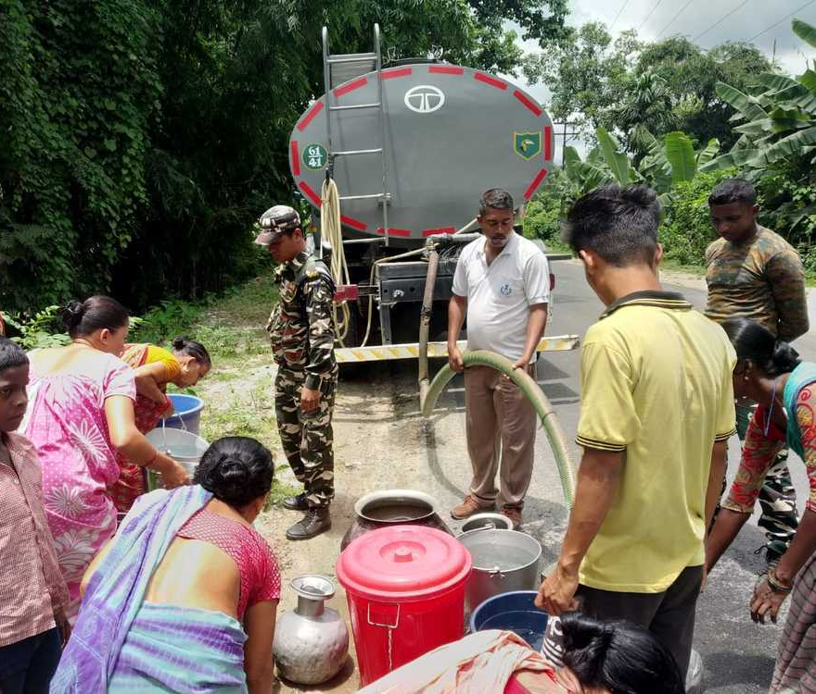
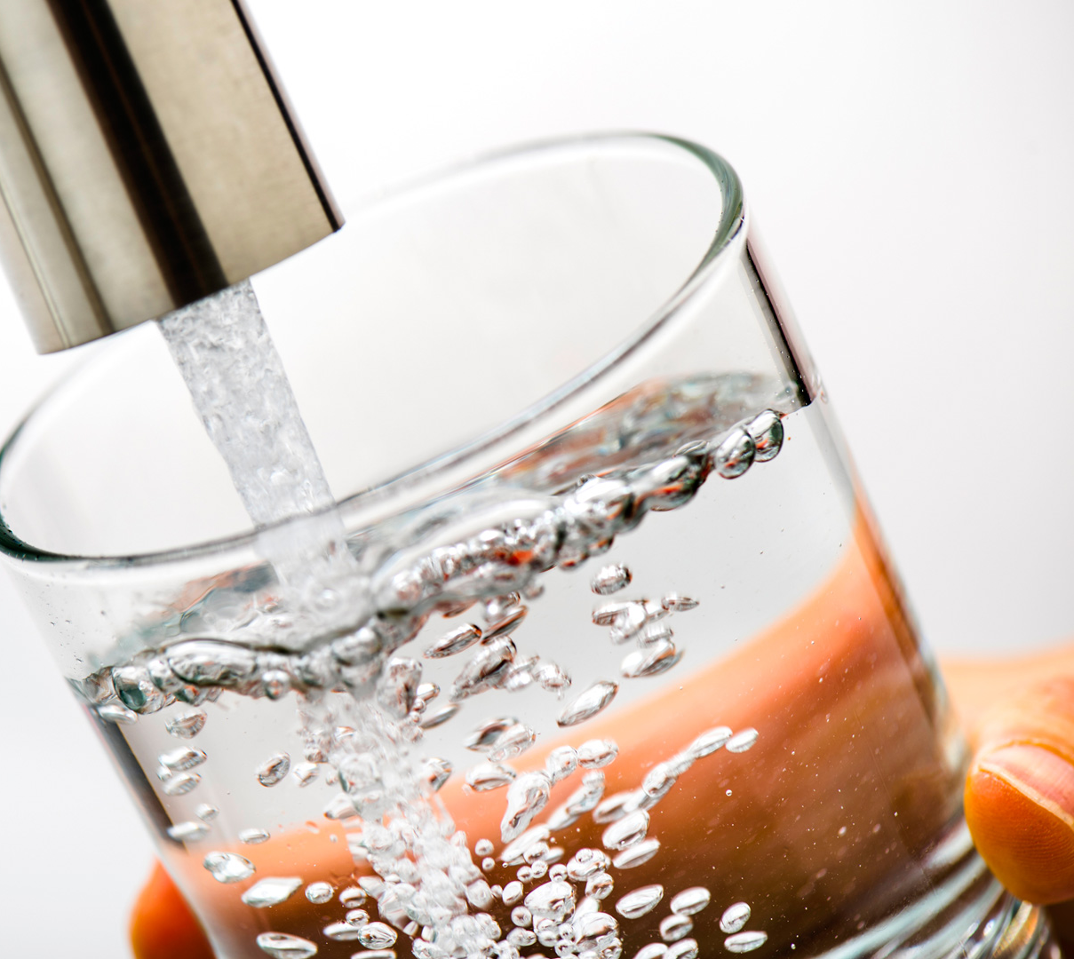
Drinking Water Sampling Techniques
This Photo by Unknown author is licensed under CC BY.

Slide 28
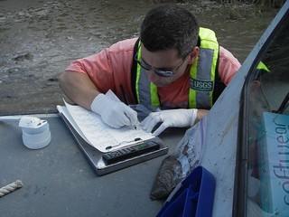
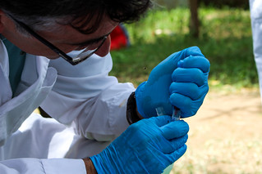
Need for Sampling Programmes
Quality control measurements
Quality characterization measurements
Identification and control of sources of contamination.
Sampling of Drinking Water
Sampling of Drinking Water Distributed by Tankers or Means Other than Distribution Pipes IS 17614 (Part 21)
Sampling of Drinking Water from Treatment Works and Piped Distribution Systems IS 17614 (Part 5)

Slide 29
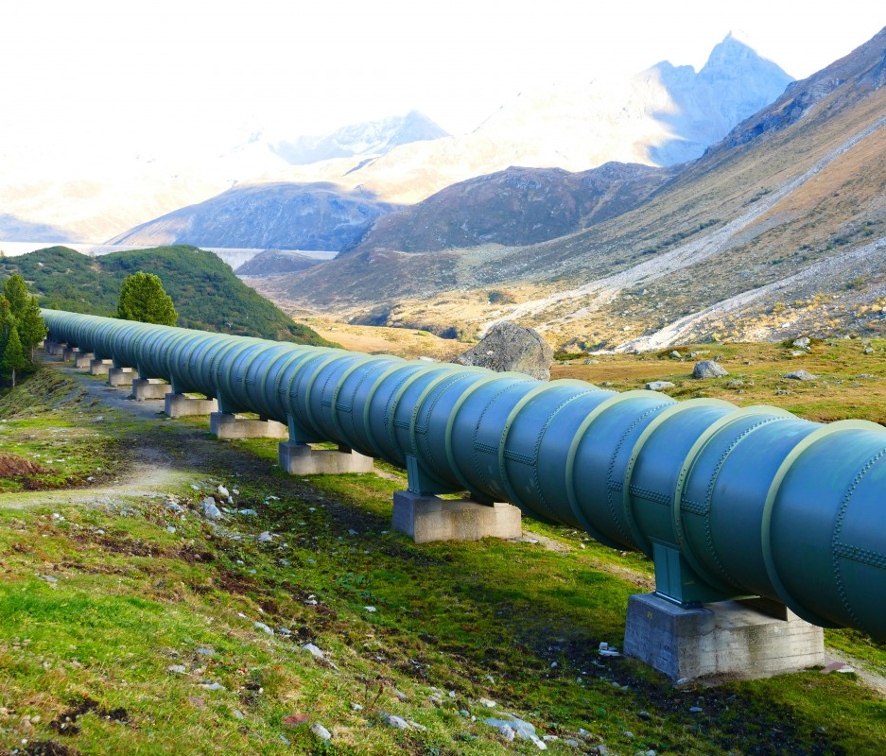
17614 (Part 5) Water Quality- Sampling Part 5 Guidance on Sampling of Drinking Water from Treatment Works and Piped Distribution Systems
SCOPE
This standard is confined to those circumstances where water is drawn from municipal or similar distribution systems (including individual systems).
This standard does not provide guidance on:
The sampling of source water, e.g. groundwater and impoundments.
This standard establishes principles to be applied to the techniques of sampling water provided for drinking and for use in the manufacture of food and beverage products.
The sampling of potable water supplies derived from non-contiguous supplies covered by ISO 5667-21.
The sampling of beverage products (including bottled waters) or food containing potable water used in its preparation.

Slide 30
Drinking Water from Treatment Works and Piped Distribution Systems - Sampling Location
In systems with more than one water source, sample collection locations should reflect the output of each source, the demand on each source and the relative population using each source.
Sample collection locations should be widely distributed throughout a piped distribution system, the number being proportional to the number of links or branches in the system.
Where waters from different sources mix within a complex piping system, sample collection locations should permit identification of relative proportions from each source through the system.
Where a distribution system connects to large buildings such as hotels or office blocks, there should be sample collection locations at the intake and throughout each building.
Samples should be collected from the inlet and outlet pipes as close as possible to the service reservoir. The outlet sample location should be upstream of the first customer.
If a service reservoir has more than one compartment but the compartments are hydraulically connected, the compartments may be regarded as a single reservoir.
Sample collection locations should include locations representative of the most un-favourable sources and locations considered vulnerable to contamination such as loops, low-pressure zones and ends of systems.
Samples from the distribution system are typically collected from domestic faucets, installed sampling faucets, or fire hydrants.

Slide 31
Order of Sampling
First draw samples
1
Flush (if total organic carbon sample required)
2
Take total organic carbon samples
3
Turn off the faucet
4
Clean the faucet
5
Take all other samples for physico-chemical parameters (including field determinations) in an order designed to minimize cross contamination of samples by reagents;
6
Turn off the faucet;
7
Disinfect the faucet for collecting sample for microbiological analysis
8
Flush the faucet
Flush

Slide 32

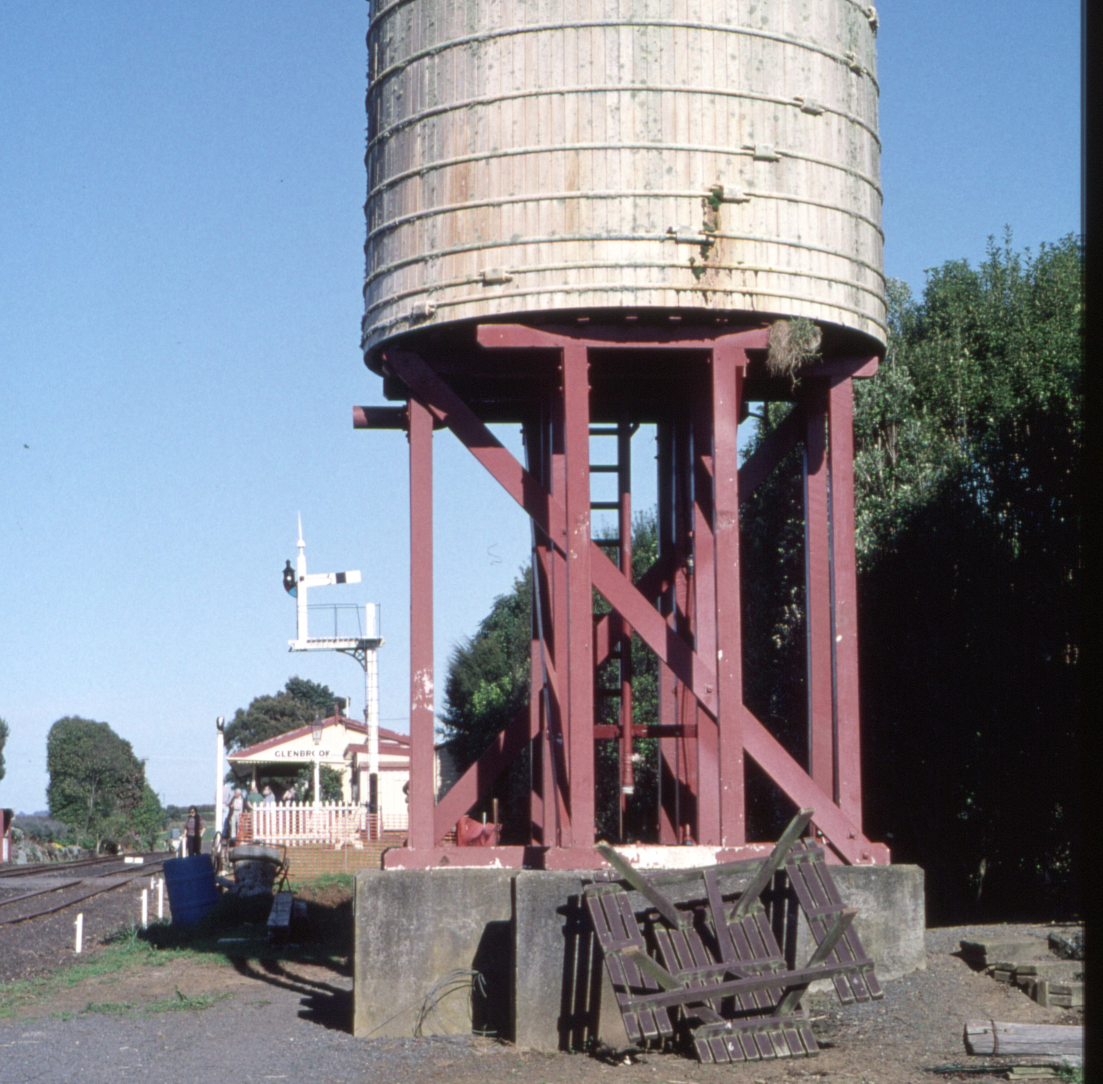
IS 17614 (Part 21) Water Quality — Sampling Part 21 Guidance on Sampling of Drinking Water Distributed by Tankers or Means Other than Distribution Pipes
SCOPE
This standard is applicable to water that is supplied by tanker or other non-contiguous bulk means, but not contiguously as part of a piped distribution system, during any stage of use up to and including the point of consumption or transfer to a piped distribution system.
This standard does not provide guidance on:
The sampling of source water, e.g. groundwater and impoundments.
This standard establishes principles to be applied to the techniques of sampling water provided for drinking and for use in the manufacture of food and beverage products.
The sampling of potable water supplies derived from contiguous piped supplies covered by ISO 5667-5.
The sampling of beverage products (including bottled waters) or food containing potable water used in its preparation.
The sampling of drink vending machines.

Slide 33
Frequency and Timing of Sampling
The purpose for which sampling is being performed
The number of consumers served
The volume of water distributed
The quality of the source water
The variability of the raw-water quality
The water treatment required
The health hazard involved
The complexity and characteristics of the specific distribution system being sampled
Specific parameters

Slide 34
Sample Collection and handling
If filtration required, it should be done at time of collection to minimize the changes that occur in sample.
Each sample bottle to be labelled, registered, carefully packed and delivered to testing facility within the time frame. Before transportation appropriate transportation technique is to be applied.
In analysis laboratory it should be kept in dark cool room away from reagent.
Volume of sample to be collected depends on number and type of analysis to be performed.
For sample collection from tanks 2 min of free flow should be allowed to flush out any stagnant water within the sampling line.
On-site analysis is particularly recommended for such parameters as odour, taste, pH, chlorine, ozone, ambient air temperature as well as for the visual inspection of the sample.

Slide 35
Drinking Water Distributed by Tankers or Means Other than Distribution Pipes - Sampling Locations
Sampling points should be located at the inlet and outlet of bulk storage containers to represent the water within the container and not from external sources or secondary distribution systems.
In systems with multiple inlets or outlets, sample locations should reflect potential differences in water quality based on the purpose of the sampling.
When water from different sources mixes within a bulk storage container, sample locations should represent the quality of water from each source.
In distribution systems with many similar inlets or outlets, it is advisable to sample at both the most remote and the closest points to the water source. Care must be taken to ensure that the sampling process does not introduce contaminants into the system to avoid the risk of contamination during sampling.
For non-contagious, non-piped sources such as mobile tanker, static tanks samples should be collected from outlet taps. Standpipes and hoses should be disinfected and flushed before use and check no cross connection with non-portable water supplies.
For bottled water supplied in an emergency should be taken at random, at point of filling and at point of distribution and taken to the laboratory analysis.

Slide 36
Content of Sampling Manual
The types of bottles or containers, their closures and the specific purposes for which they are to be used
Where relevant, the cleaning procedure and shelf life for bottles, containers and closures used for each parameter, including the amount and type of preservative to be added
The sampling procedure for each parameter, including the type of sample to be collected (e.g. first draw, flushed, stagnation) and the procedure for collecting samples for different parameters
The frequency and order of sampling
The conditions of storage and transport of samples and the maximum time that can elapse before analysis should commence for each parameter
Description of preservation reagents (including usual colour), plus appropriate safety measures in case of spill, or contact with skin or eyes.

Slide 37

Training of samplers
All samplers should be fully trained before being allowed to work unsupervised. Training should include Principles and practices of water supply distribution
Principles and practices of water supply hygiene
Introductory knowledge of water chemistry and of microbiology
Knowledge of water supply vulnerabilities to contamination including case studies of genuine contamination events
Experience in all aspects of sampling
Supervised experience with laboratory techniques if the sampler is expected to take analytical measurements or to operate on-line monitoring equipment
The full content of the sampling manual with special emphasis on identifying, and safely coping with or avoiding potential hazards

Slide 38
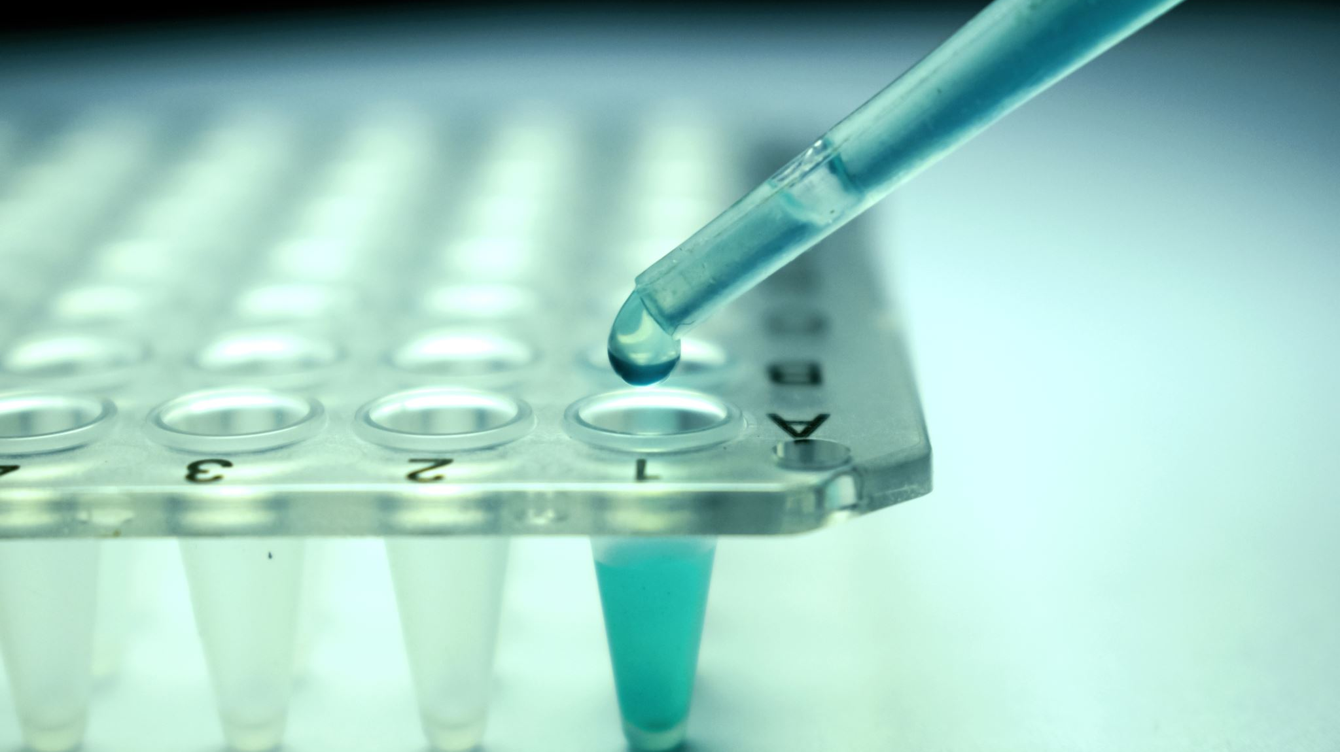
Water Quality Testing Methods

Slide 39
Exploring Standards for Drinking Water Test Methods
Physical and Chemical Parameters
IS 3025 Series
Standards Related to Method of Test for Parameters related to Drinking water
IS 14194 (Part 1) and IS 14194 (Part 2)
Radiological Parameters
IS 1622
Microbiological Parameters
Pesticides Residue
USEPA Methods

Slide 40
Speed (they are quick)
Sample required in less quantity and waste generation is less
Accuracy (they reliably identify elements and compounds)
Sensitivity (they can detect very small amounts of a substance in a small amount of sample)
For drinking water there are ICP-OES and ICP –MS instruments which can provide results for more than 50 parameters in one go .
Advantages Cutting-Edge Instrumental Methods for Drinking Water Testing

Slide 41
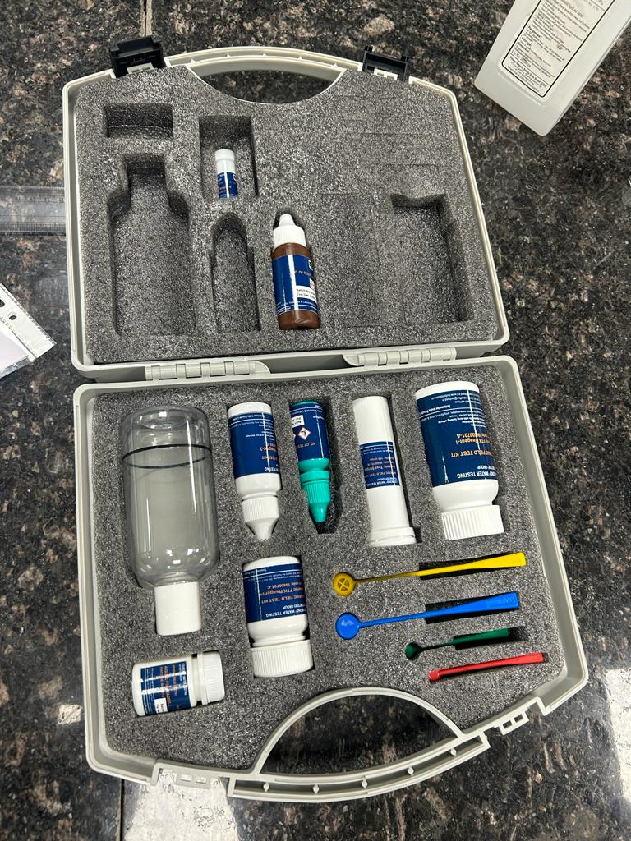
Portable Field-Testing Kit for Onsite Testing of Drinking Water Specification
The Field-Testing Kit (FTKs) is a simple device which can be used for rapid testing of some critical water quality parameters in the field. For compliance and/or detailed potability of drinking water refer to IS 10500. By onsite testing, the general quality of water can be easily assessed and this can give first-hand information on the quality of water.
Key stakeholders benefitted from this product
Jal Boards &PHEDs
Testing laboratories
FTKs manufacturers
Regulatory Bodies
Consumer Groups

Slide 42

Overview of IS 18283:2023
Brief history of the standard
The proposal to formulate standard on Field Test Kits (FTKs) to check the quality of water used for drinking purposes as per IS 10500 ‘Drinking Water - Specifications’, was received from the Ministry of Jal Shakti dated 17.03.2022. The standard shall incorporate the 14 parameter along with testing procedure, their test standards, minimum shelf life reagents along with any other salient features as felt necessary for maintain the quality make/ production in commercial production.
These FTKs are basically to be used as rapid test for contaminants exceeding the permissible limit of IS 10500.
Stakeholders involved in development of this standard
Regulators
Department of Drinking Water& Sanitation
Testing Laboratories
Manufacturers of FTKs
Consumer Groups

Slide 43
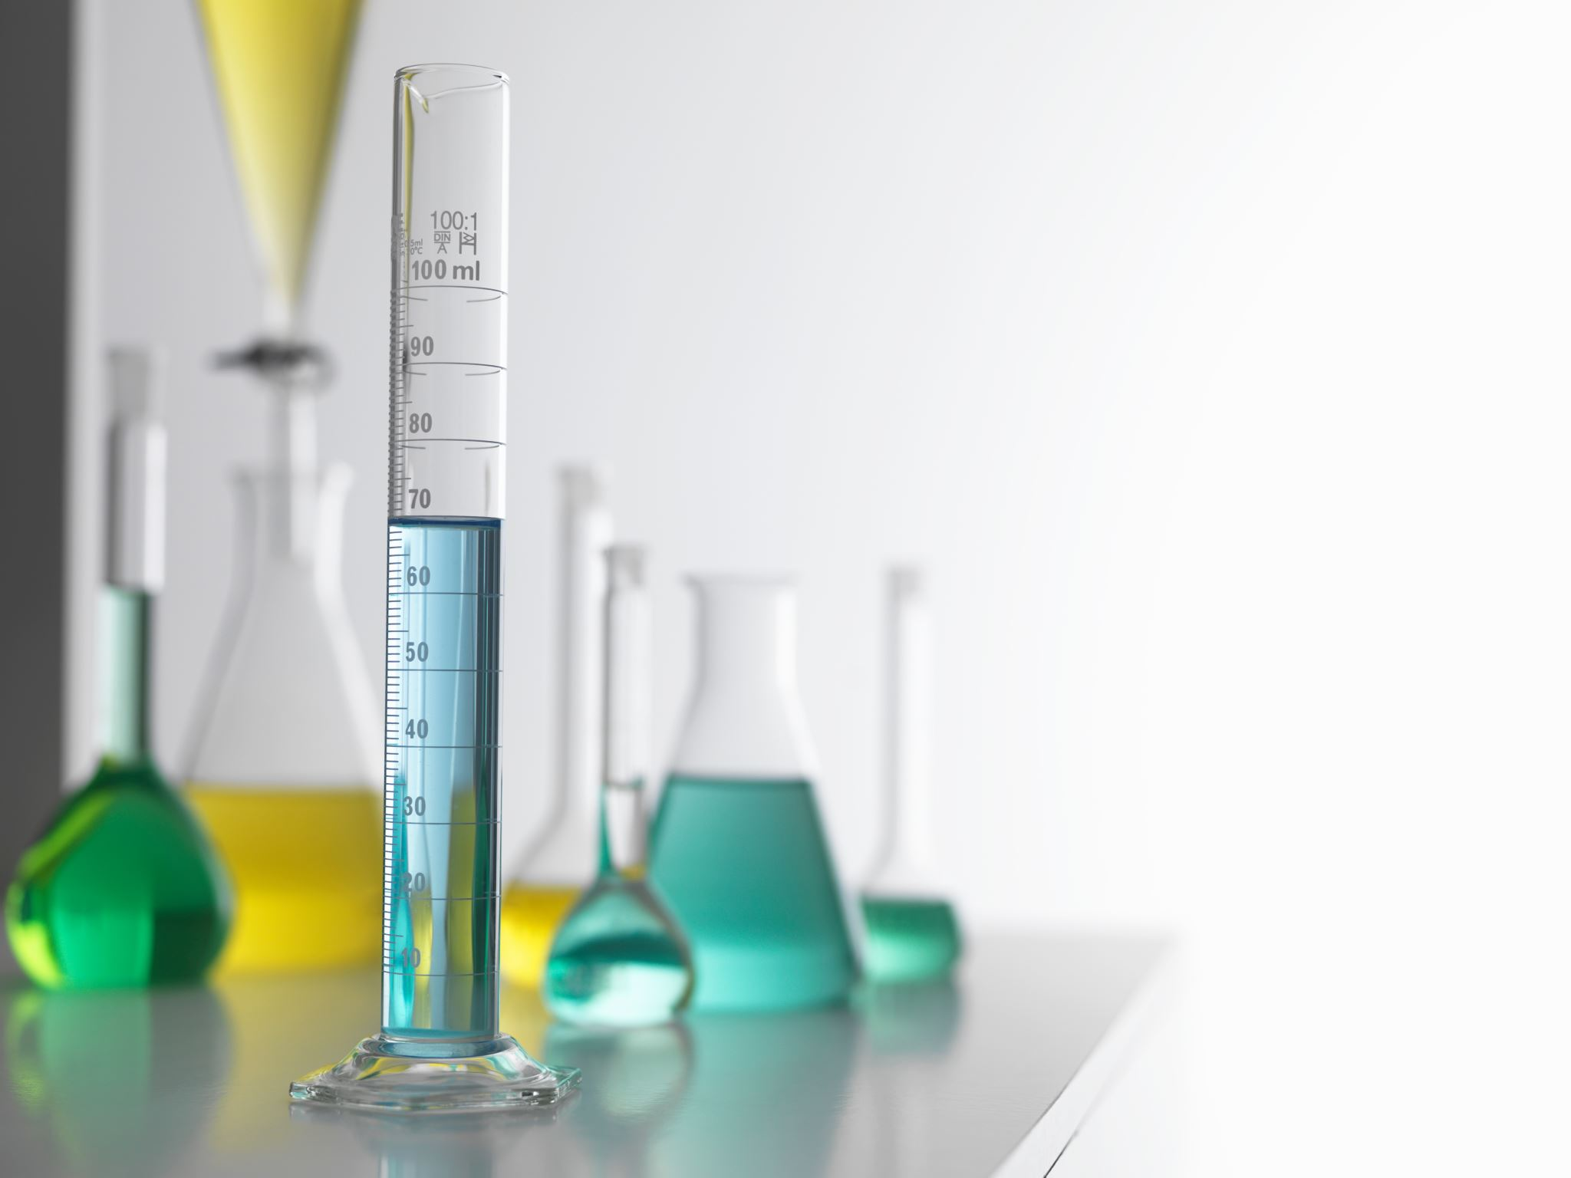
Key Components of the Standard IS 18283: 2023
Scope of IS 18283
This standard prescribes the requirements and method of test of Field Test Kits (FTKs) for onsite testing of drinking water for measurement of specified parameters in drinking water.
Parameters covered by IS 18283:2023
Physiochemical Parameters- pH, chloride, iron, turbidity, sulphates, nitrates, residual free chlorine, Total alkalinity, total hardness, fluoride, arsenic, TDS
Microbiological Parameters - total coliform bacteria, and E. Coli or thermo-tolerant coliform bacteria

Slide 44
THANK YOU

