Slide 1
Non-Sewered Sanitation System –
Biodigesters for human waste decomposition
Role of Indian Standard IS 18150
Shri Devakanta Pahad Singh
Scientist ‘G’, Centre Head DIBER (DRDO)
Shri Dheeraj Damachya
Scientist ‘B’, Assistant Director
CED, BIS

Slide 2
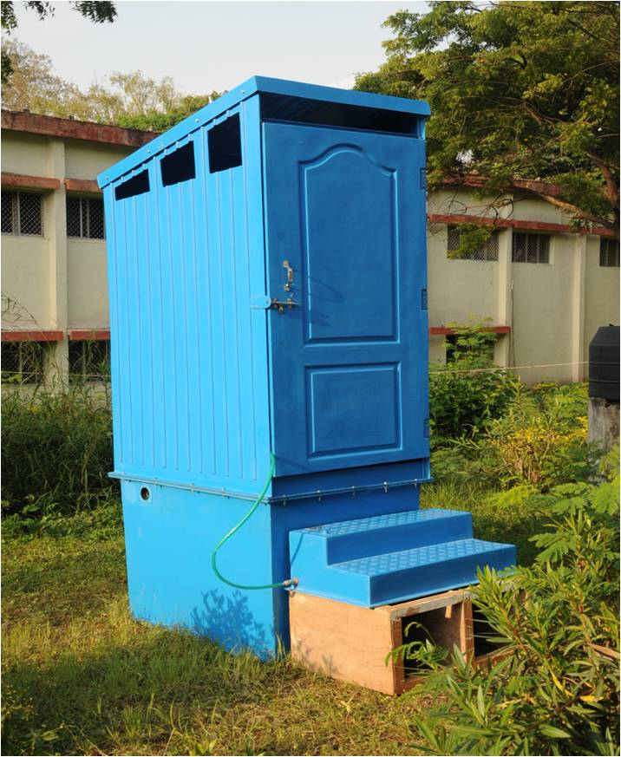
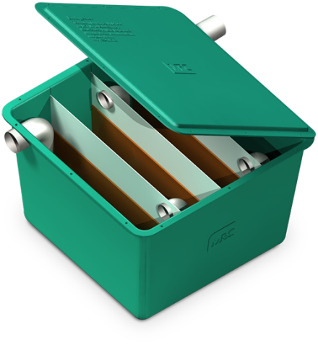
Bio digester
A pertinent solution for non-sewered sanitation
Bio digester as a non-sewered sanitation solution

Slide 3
Introduction
Biodigesters play a crucial role in managing waste sustainably in diverse sectors across India.
Biodigesters are used for sewage management in rural and urban areas for treatment of domestic wastewater.
Bio toilets have been installed in Indian railway coaches to manage onboard human waste.
Integration with centralized sewer systems lead to reduce load on sewage treatment plants (STPs).

Slide 4
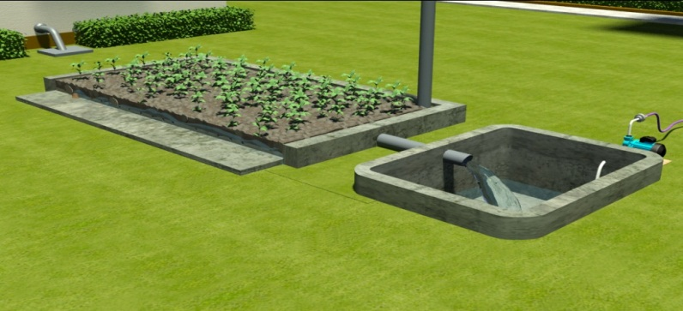
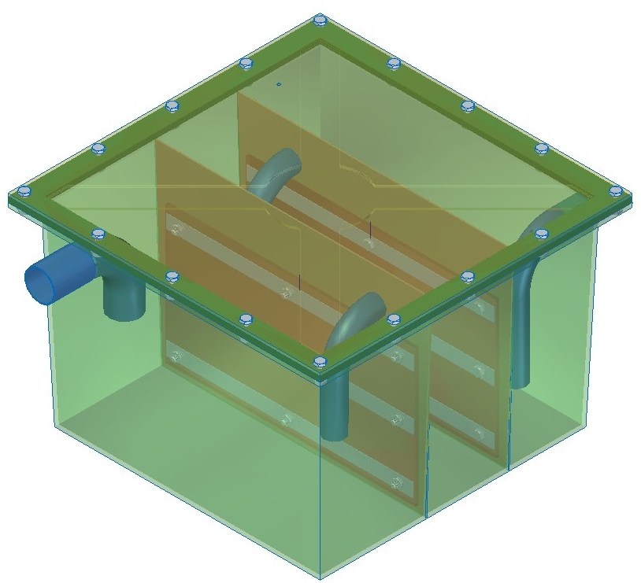
Bio digester: Basics
  Device used for accelerated anaerobic microbial degradation of human waste mediated by AMI
  Significant reduction in organic matter and sludge volume and Pathogen transmission is minimized.
  Effluent is safe for environmental release or specific reuse.
  Reduces organic load on Sewage Treatment Plants (STPs) and Enhances STP efficiency.

Slide 5
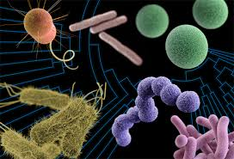
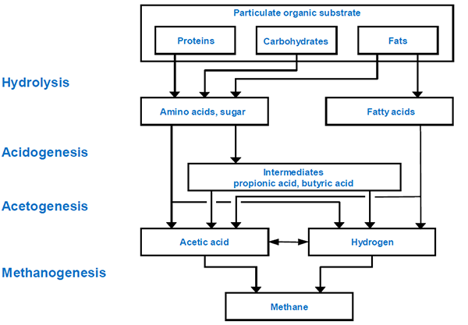
Bio digester: Core Principle
ANAEROBIC BIO-DEGRADTION PROCESS
Anaerobic Microbial Inoculums
(Microbial Consortium)

Slide 6
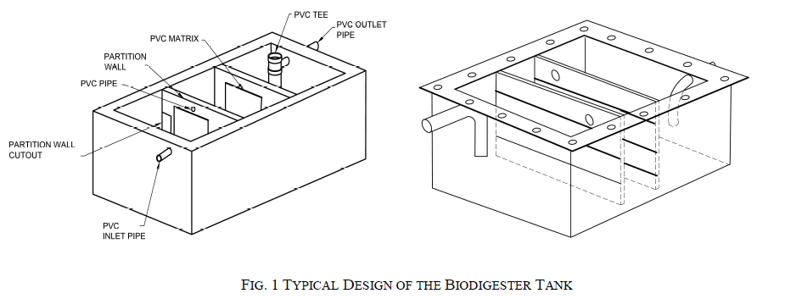
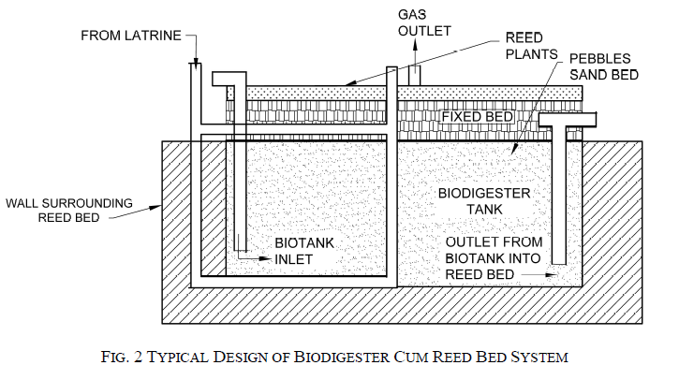
Bio digester: Core Principle

Slide 7

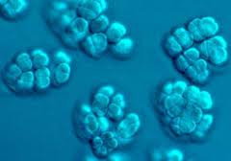
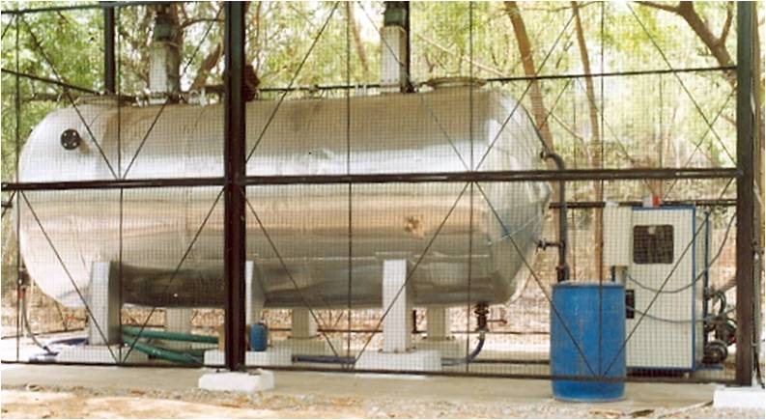
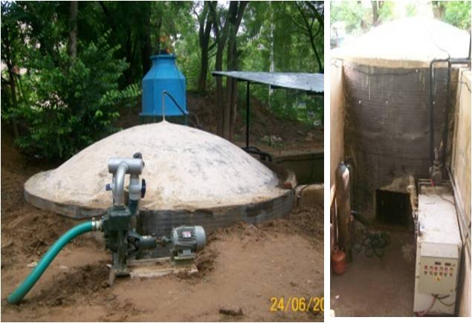
Bio digester: Microbial Consortium
BACTERIA (INOCULUM)
Anaerobic microbial consortium developed by acclimatization/ enrichment of microbes at low temperature and bio-augmentation with critical group of bacteria
Notes:
Components of biodigester: 1. Bacteria, 2. Biodigester/ Fermentation tank

Slide 8
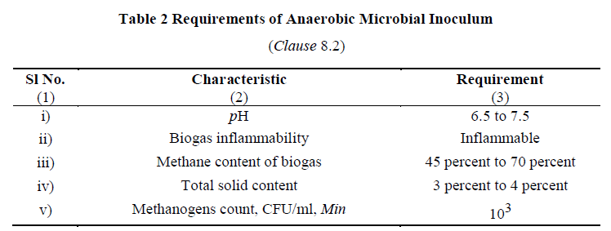
Bio digester: Microbial Consortium
Notes:
Components of biodigester: 1. Bacteria, 2. Biodigester/ Fermentation tank

Slide 9
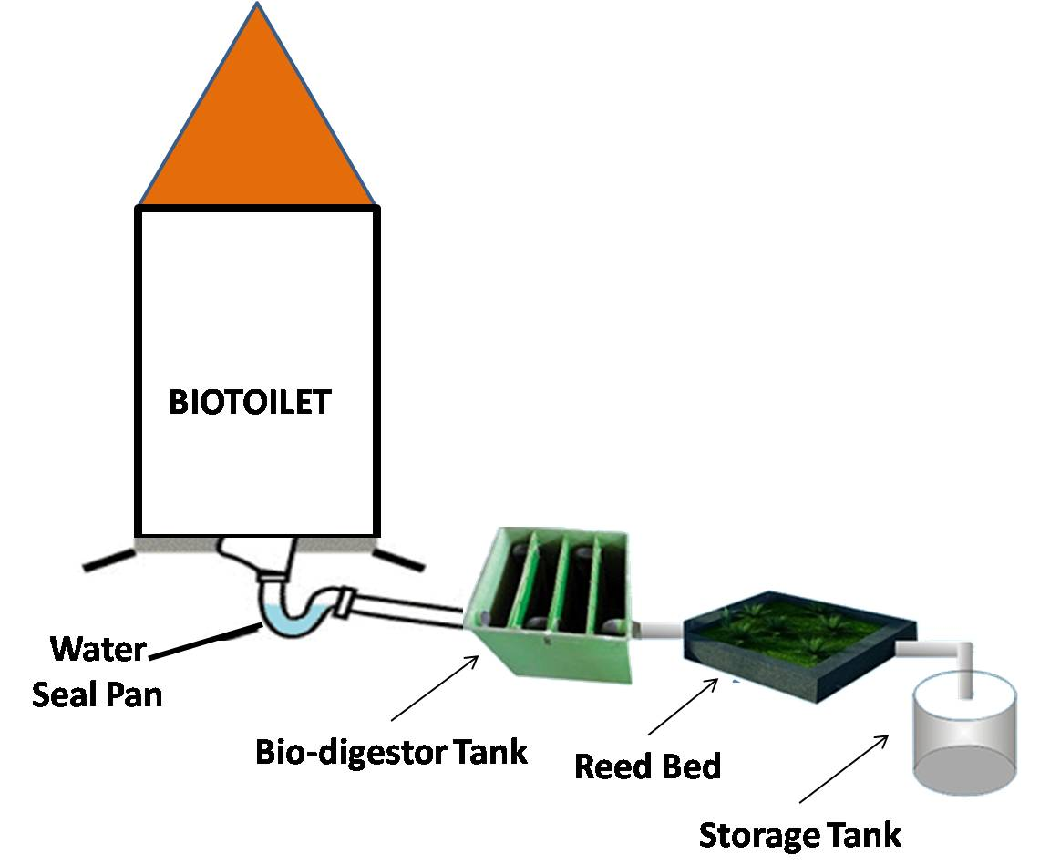
Bio digester: Typical Layout

Slide 10
Chamber Configuration:
Minimum two partition (baffle) walls creating three chambers.
Chamber volume ratio: 4 : 3 : 3.
volume of chamber containing inlet pipe should be approximately 40 percent of total volume.
PVC immobilization matrix should be provided on both sides of partition walls of the chambers
Bio digester: Design

Slide 11
Bio digester: Material for Biodigester Tank
FRP Biodigester Tank
Material Composition: Resin (isophthalic), fibre reinforcement, and additives processed uniformly.
Resin Properties: (tested as per IS 6746)
Colour: Cream or white, opaque liquid of uniform consistency.
Viscosity: 800-1,200 cps at 25°C
Acid Value: Max 15 mg KOH/g
Volatile Content: 33% ± 3%
Gel Time: 20 ± 5 minutes at 25°C
Relative Density: 1.15-1.25 at 27°C
Styrene Content: Max 27% of total mass

Slide 12
Bio digester: Material for Biodigester Tank
Cured cast resin Biodigester Tank
FRP Physical and Mechanical Properties
Physical State: Hard and tough.
Barcol Hardness: 42 to 45 (IS 6746 Annex J).
Water Absorption: Max 0.5% (IS 6746 Annex K).
Tensile Strength: Min 400 kg/cm² (IS 1998).
Cross-Breaking Strength: Min 350 kg/cm² (IS 1998).
Impact Resistance: Min 120 J/m (IS 1998).
Fiberglass Density: Min 450 g/m² with polyester resin system (three layers) (IS 11551).
Stiffeners: Can be sandwiched during hand laying or reinforced with FRP extra ribs to enhance strength.

Slide 13
Bio digester: Material for Biodigester Tank
Stainless Steel Biodigester Tank – shall conform to grade 304S1 as per IS 6911

Slide 14

Bio digester: Advantages
Aerobic biodegradation | Anaerobic biodegradation
Forced aeration is essential which is energy intensive | No aeration is required
Incomplete / partial aerobic conditions lead to foul smell | Complete anaerobic conditions
Not effective in pathogen inactivation | Effective Pathogen inactivation
Can not tolerate detergents/ phenyl | Anaerobes can degrade detergents/ phenyl
Generates large amount of sludge | Sludge generation is very less
Maintenance & recurring cost is high | Minimal maintenance & no recurring cost
OSS Option | Kinds of latrines
 | IHHL | Shared Latrine | Community Toilets | Public Toilets
Twin pit latrines/ Leach Pits | √
Septic Tank System with soak pit | √ | √ | √ | √
Bio-digester toilets (DRDO) | √ | √ | √ | √
Aerobic Bio Tank | √ | √ | √ | √
IHHL – Individual Household Latrine

Slide 15
Bio digester: Typical Performance
Benefits: Passive system for eco-friendly degradation of organic matter.
Customizable sizes and pre-fabricated options available commercially.
Promotes water recovery and recycling.
Zero running cost and zero maintenance cost for primary treatment and negligible maintenance cost for periodic evaluation of secondary treatment.
Does not require periodic replenishment of bacterial cultures and rigorous monitoring of performance.
Does not have intermittent de-sludging requirement
Does not restrict use of toilet cleaners
Can be deployed even in extreme climatic conditions and areas with high water table or risk of flooding.
Risk & Limitations of Biodigester:
Higher one time capital investment as compared to Leach Pits.
Removal of nitrogen and phosphorous requires reed bed. Space constraints in urban areas could limit implementation of reed bed.

Slide 16
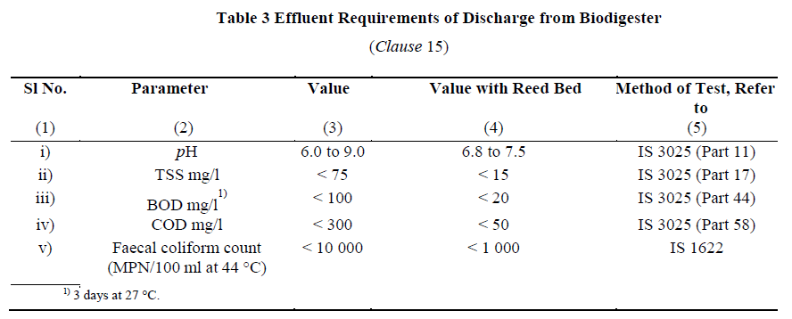
Bio digester: Effluent Requirements

Slide 17

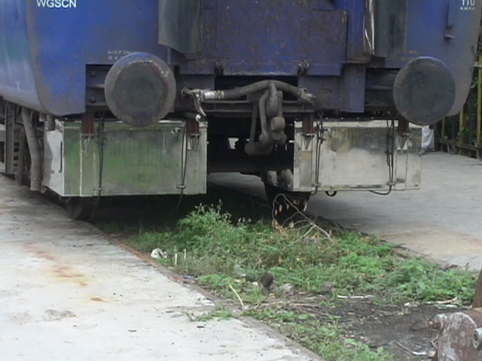
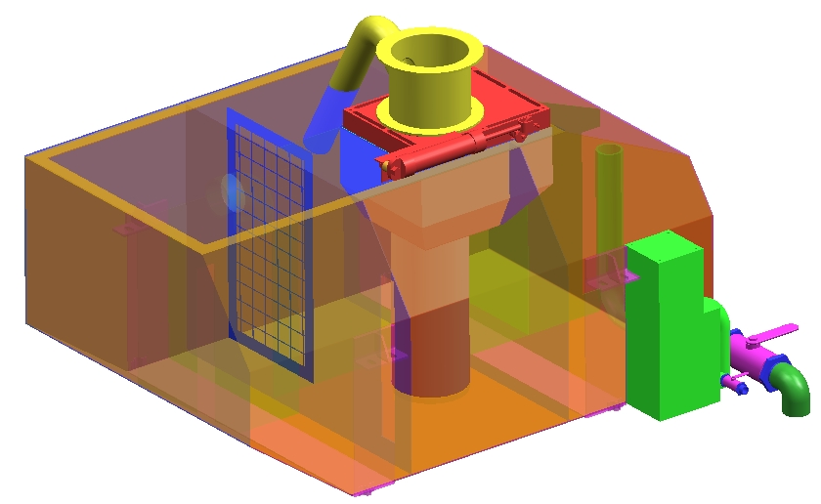
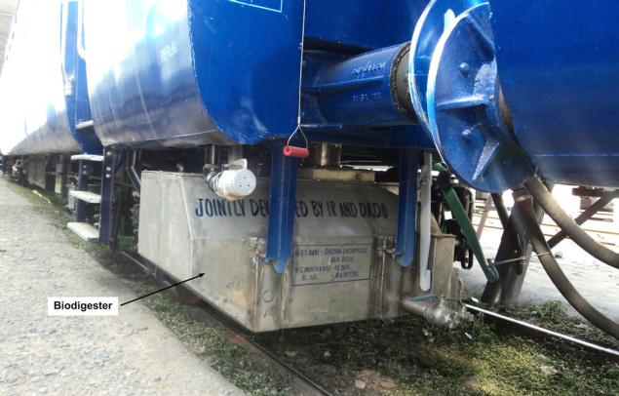
Success Story: Bio digester for Indian Railways
More than 2,15,000 bio-toilets fitted in passenger coaches

Slide 18
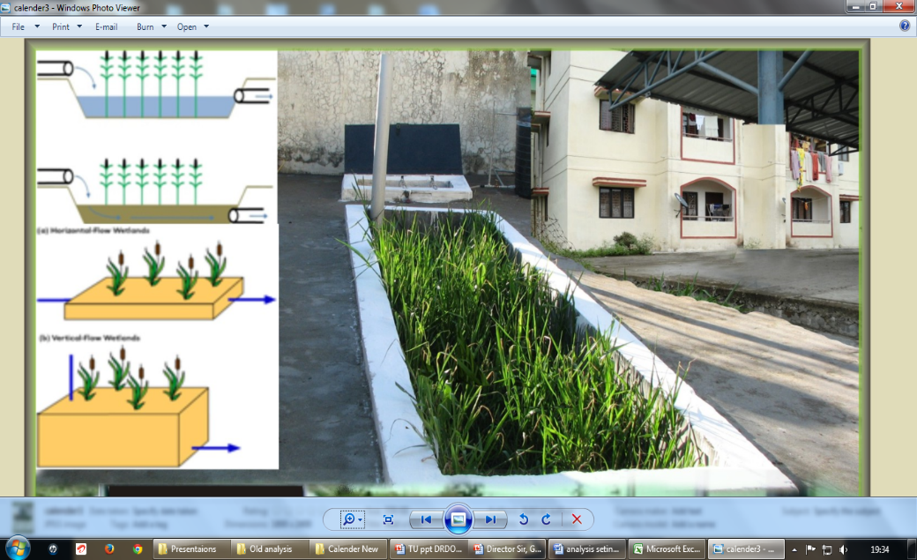
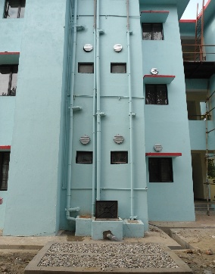
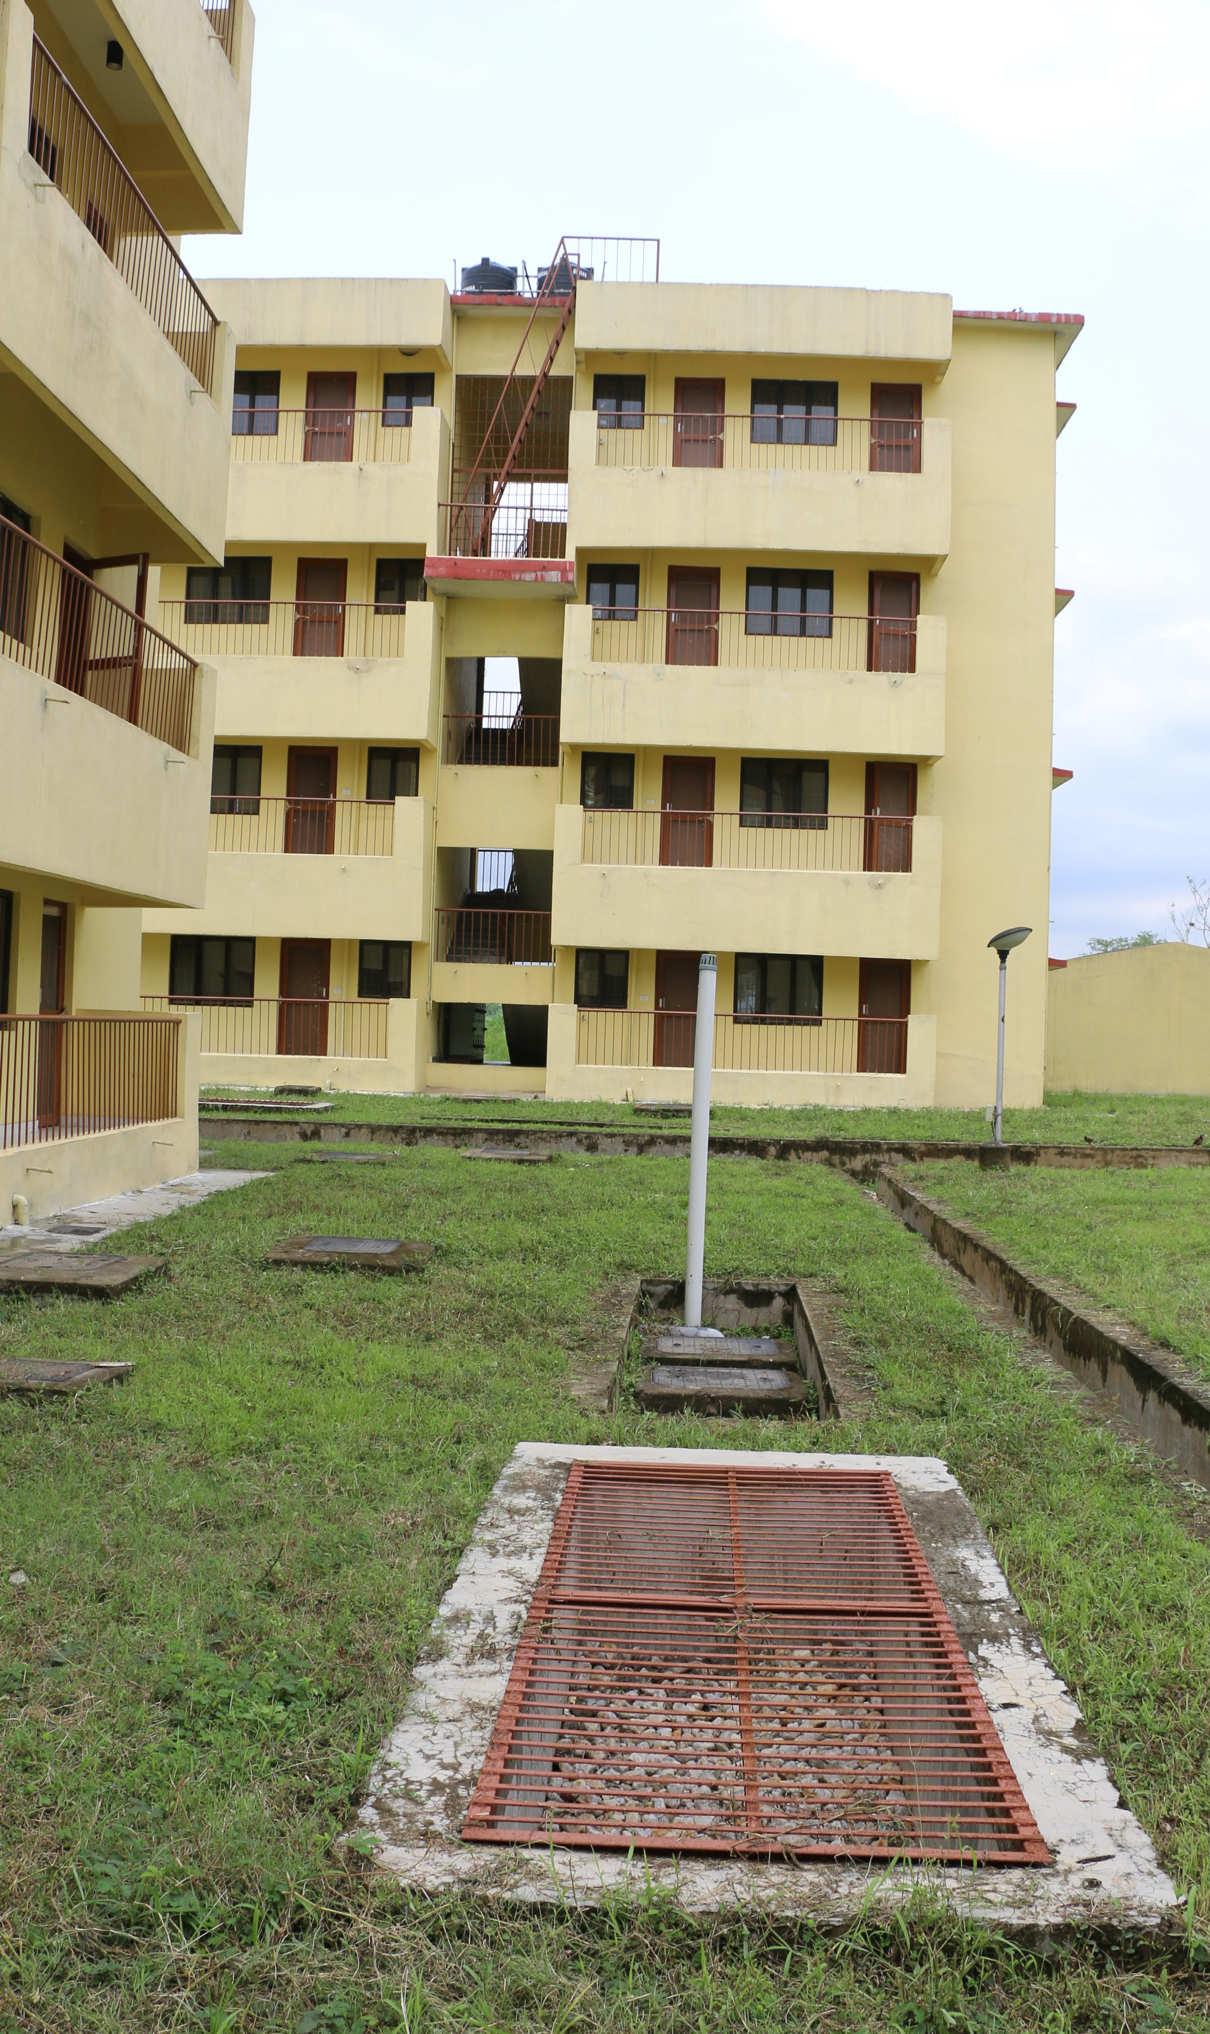
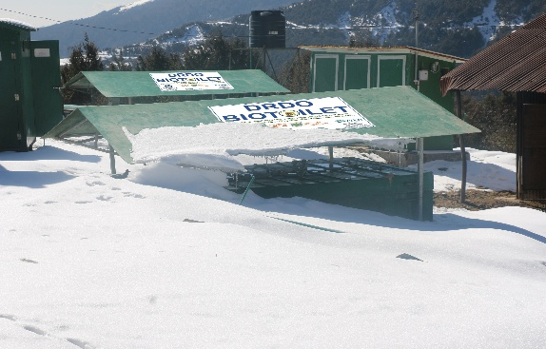
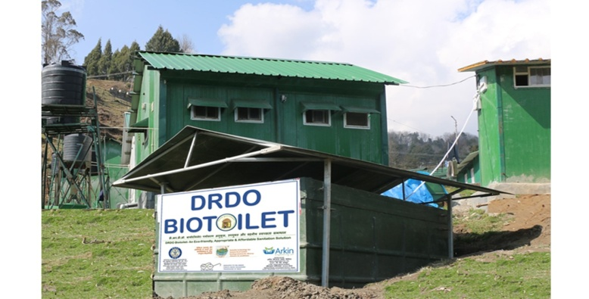
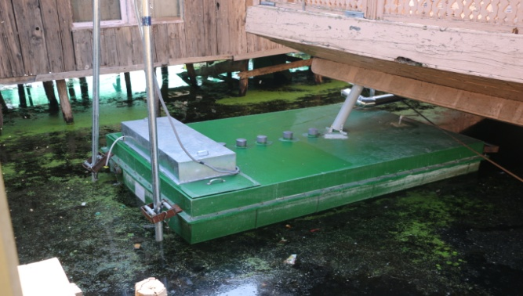
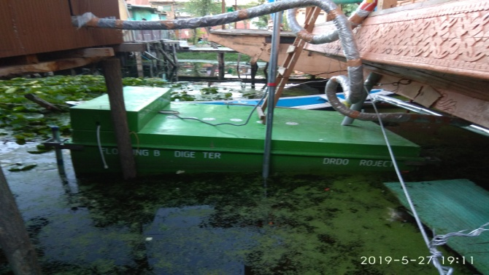
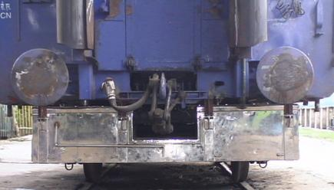
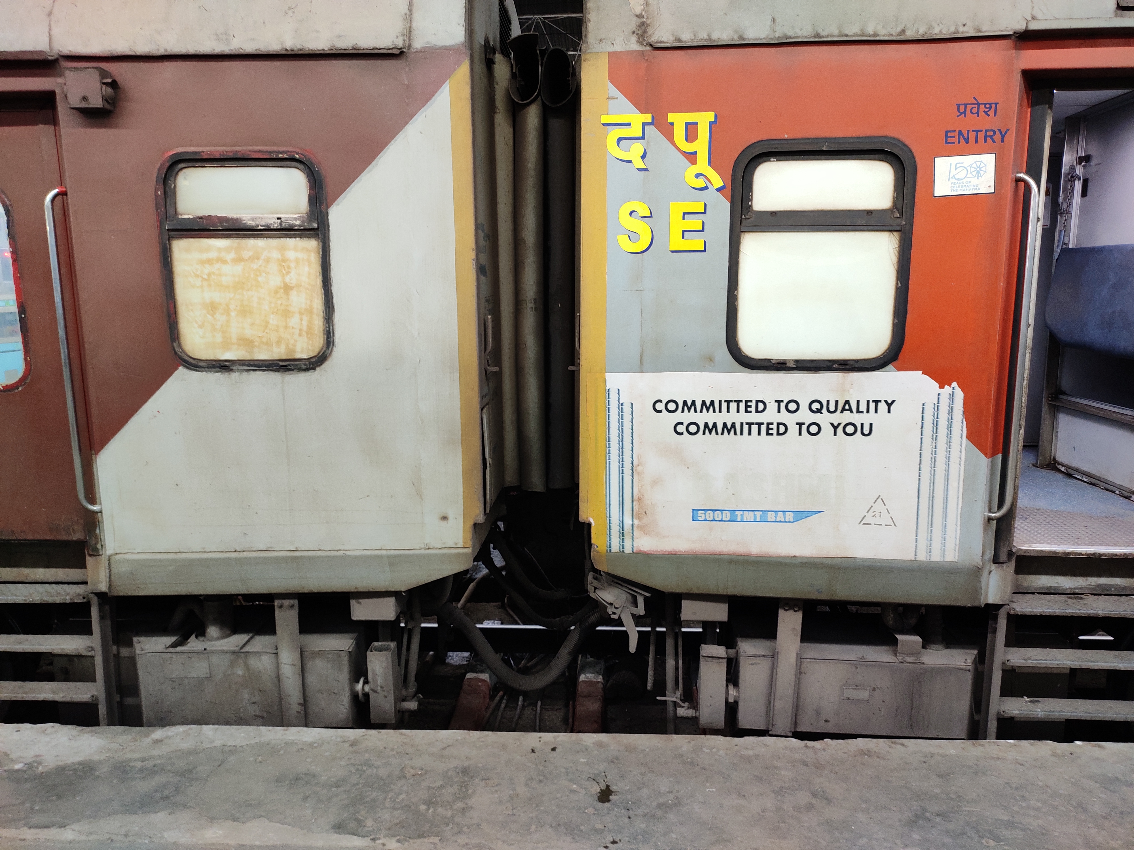
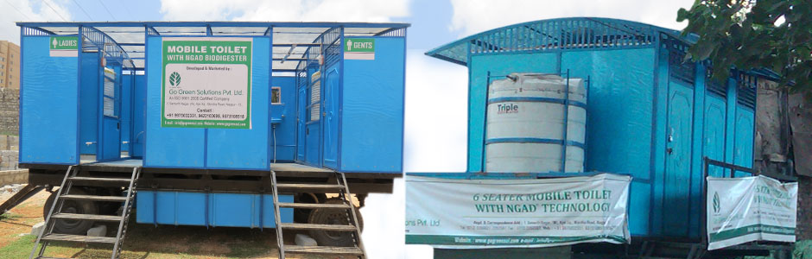
Stationary / Plains
Biodigester for different climates and conditions
Stationary / High altitude
Floating / Low Temp
Mobile platform
Rail coaches
Rail coaches
Mobile- trailers

Slide 19
Comparison with other non sewered sanitation technologies

Slide 20
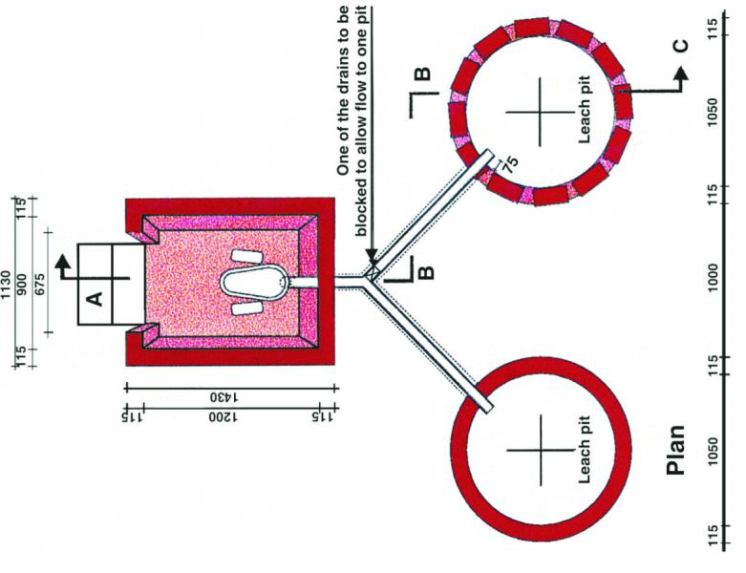
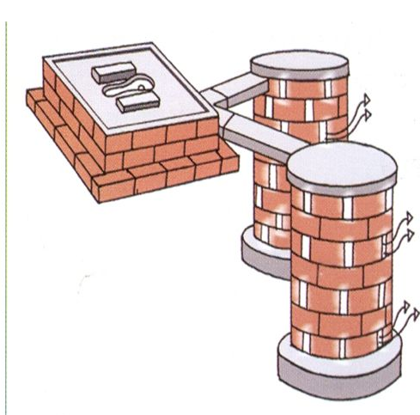
Twin Pit Toilets
Flagship technology for SBM (G) Ph I
Cheapest option
Based on Sulabh twin pit design
Variations are made locally

Slide 21
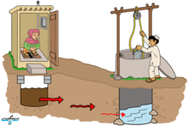
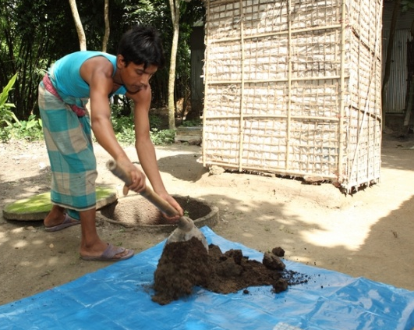
Twin Pit – issues and long term effects
Not suitable for high water table/ coastal/ hilly areas
Not suitable for rocky areas
Leads to water table contamination
Pathogen can survive and get reactivated in dry waste

Slide 22
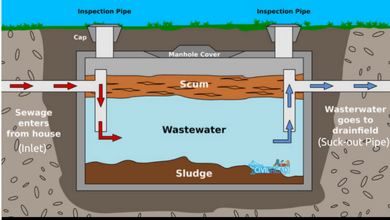
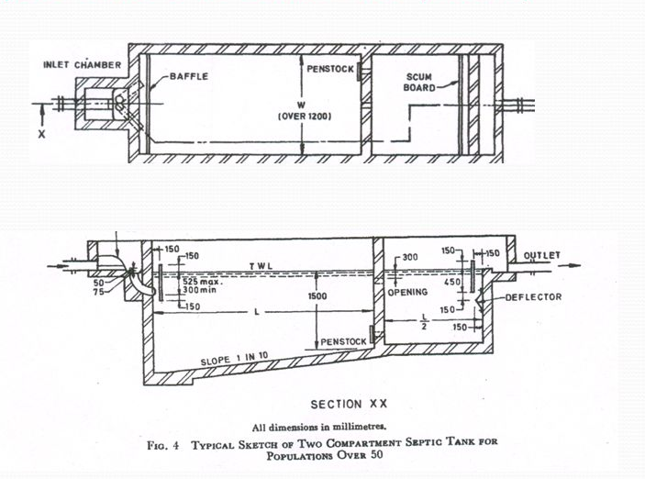
Septic Tank
Suitable for high water table areas also
Septage evacuation and disposal
Lower treatment efficiency
H₂S formation, harmful and corrosive

Slide 23
The Country needs practical and cost effective non sewered sanitation systems

Slide 24


