Slide 1
Non-Sewered Sanitation System – Rotationally Moulded Polyethylene Septic Tanks
Role of Indian Standard IS 18666
Shri Dheeraj Damachya
Scientist ‘B’, Assistant Director
CED, BIS

Slide 2
Scope of IS 18666
Covers requirements for design, materials, size, performance, and testing of rotationally molded polyethylene (PE) septic tanks for underground installation.
Tanks are suitable for standard temperature and pressure conditions.
Excludes mechanisms for effluent disposal, which require further treatment as per IS 2470 (Part 2).

Slide 3
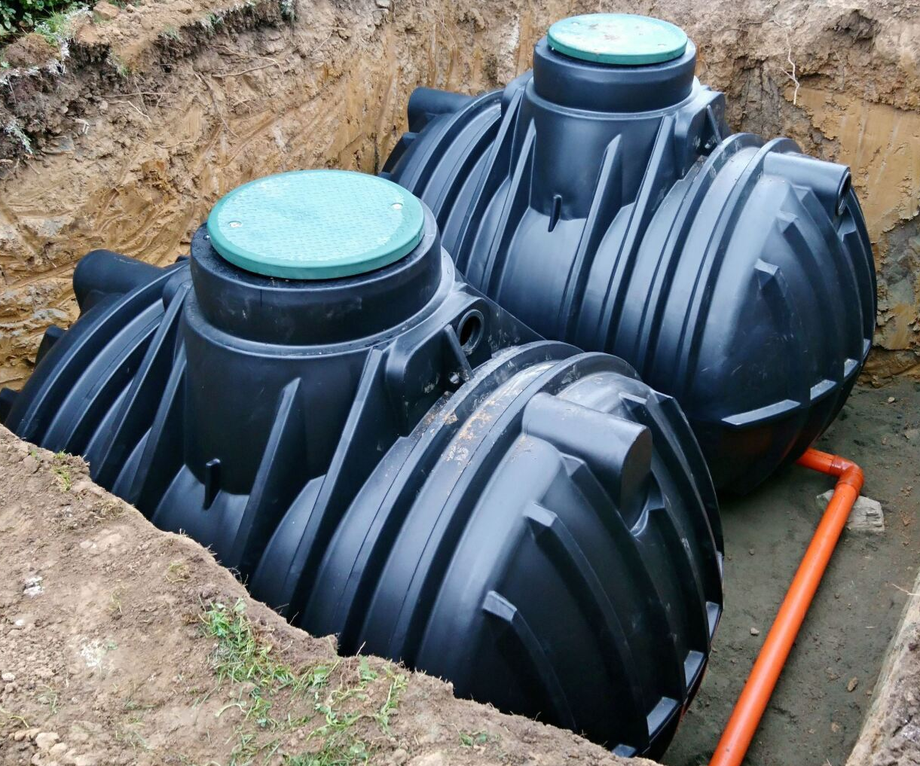
Application
On-site sanitation systems, like septic tank systems, are alternatives to centralized sewerage systems in areas where the latter is unfeasible or unavailable in both urban and rural areas. The septic tank effluent should be given secondary treatment either in a biological filter, up-flow anaerobic filter, on the land or in a sub-surface disposal system.

Slide 4
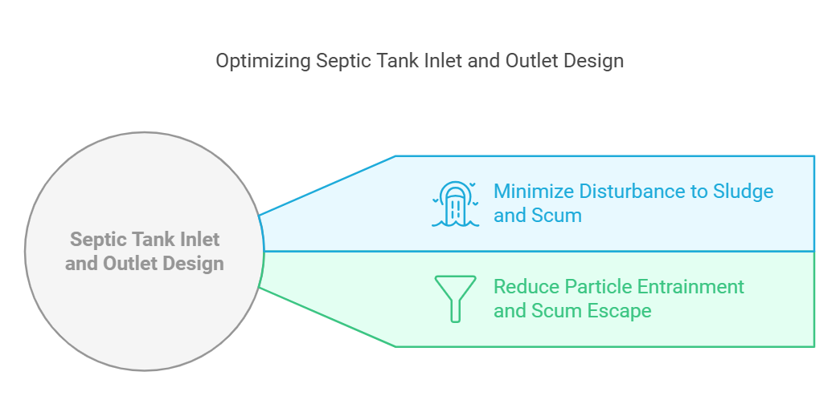
Key Design Specifications

Slide 5
Key Design Specifications
Effective Volume and Nominal Size
Minimum hydraulic retention time: 24 hours.
Minimum sludge storage period: 2 years
Minimum effective volume: 1,000 liters.
Recommended dimensions ensure durability.

Slide 6
Key Design Specifications
Compartmentation and Flow
Septic tanks over 2,000 liters must have 2 or more chambers with durable partitions.
The first chamber’s capacity must be at least twice that of subsequent chambers, with tops 100 mm above the water level for horizontal tanks.
Partitions must maintain tank integrity and withstand mechanized desludging.
Openings (100-150 mm wide) must be provided for inter-compartmental flow, with an optional up-flow transfer for improved efficiency.

Slide 7
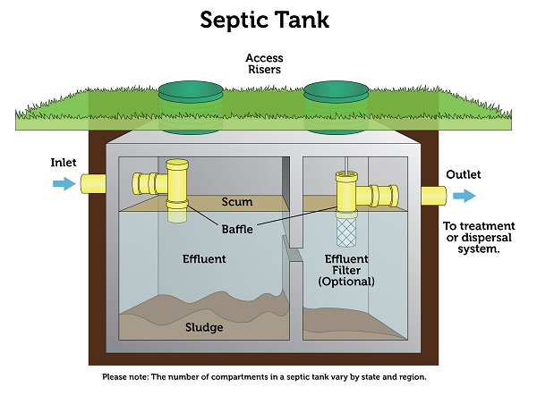
Typical Septic Tank

Slide 8
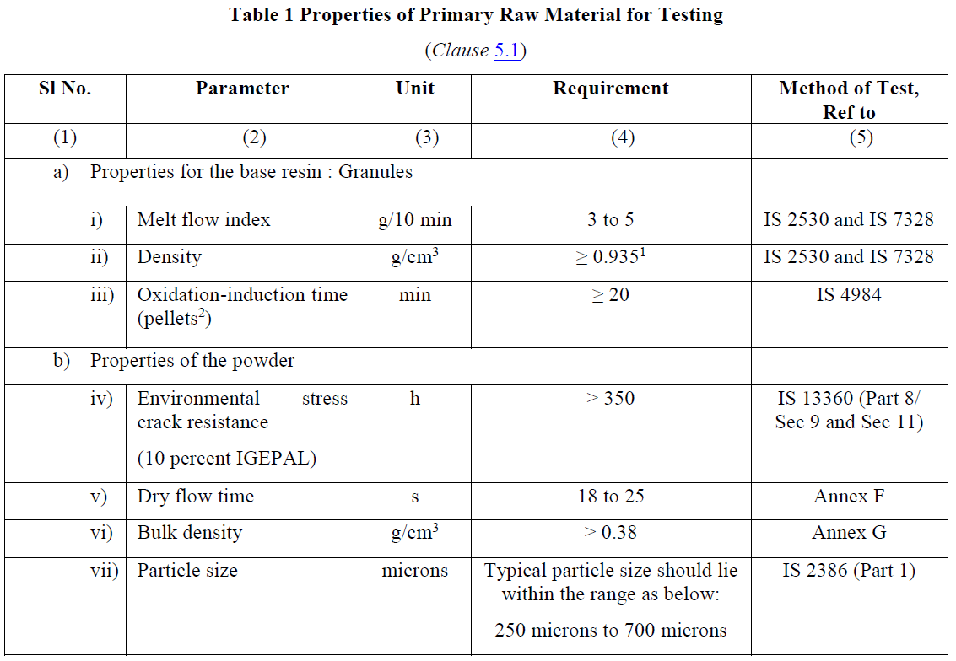
Raw Material

Slide 9
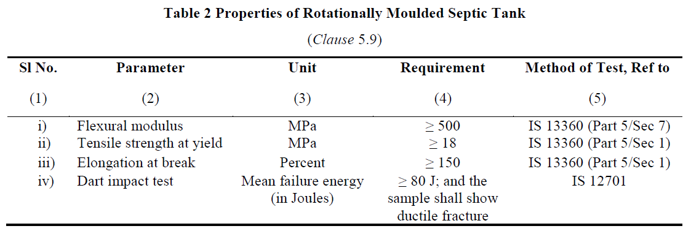
Structural Strength

Slide 10
Structural Strength and Integrity
The tank is designed to withstand soil loads, hydrostatic pressures, and thermal variations.
The Septic tank is tested for Durability, load bearing and structural strength.
No structural failures under load-bearing tests.
Finish
Free from visual defects ensuring durability.

Slide 11
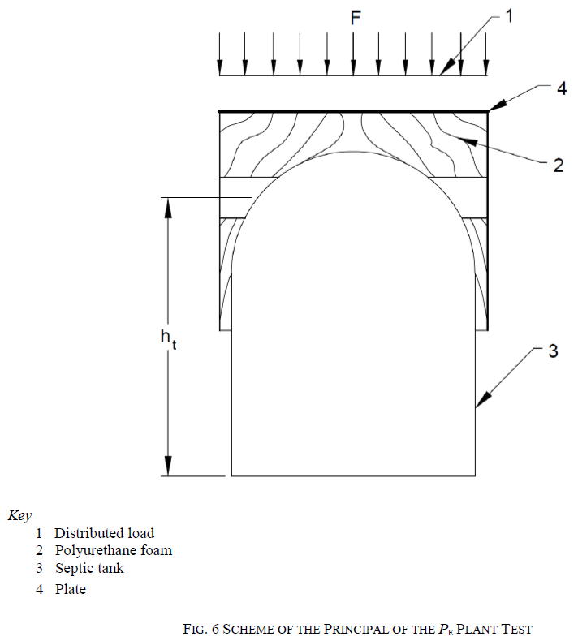
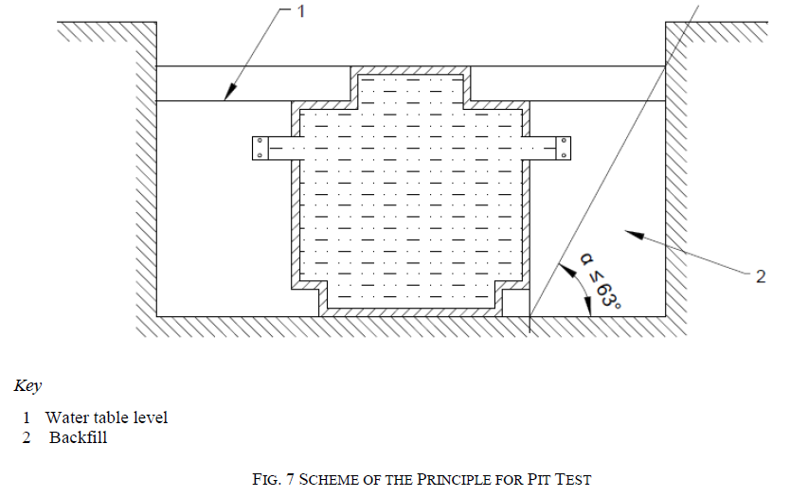
Indian Standard IS 18797 Packaged Sewage Treatment Plant
Load test for bearing capacity tank shall be done as per Annex H.

Slide 12
Tests
Type Test
Type tests are intended to prove the suitability and performance of a Septic Tank of a new composition, a new technique, a new design, a new size or shape, or modified wall thickness. These shall also be done whenever a change is made in the raw material, raw material supplier or method of manufacture, or when a new design, size or shape of the septic tank is introduced.
Acceptance Test
Acceptance tests are carried out on samples taken from the lot for the purpose of acceptance of the lot.

Slide 13
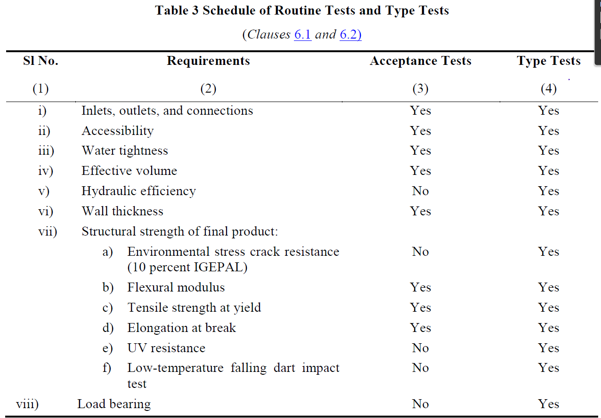
Sampling & Testing Procedures

Slide 14
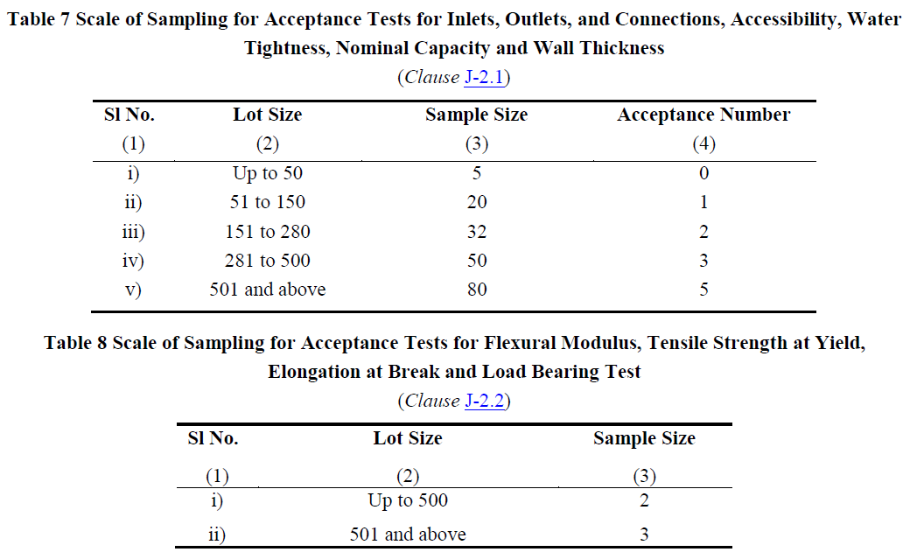
Sampling & Testing Procedures

Slide 15
Test Requirements
Key Parameters:
Hydraulic efficiency: ≥99%.
Water tightness: No leaks under specified conditions.
Structural strength: Verified through load and impact tests.

Slide 16
Installation & Maintenance
Installation:
Follow manufacturer's guidelines for placement, pipe connections, and backfill material.
Ensure ventilation and proper alignment.
Maintenance:
Periodic desludging based on usage and capacity.
Inspect and maintain structural integrity regularly.

Slide 17


Thank you

