Slide 1
Leading Steps towards Standardization in the field of Sewer Rehabilitation
Vikram Singh
Former Chief Engineer (DJB)
Member CED-24

Slide 2
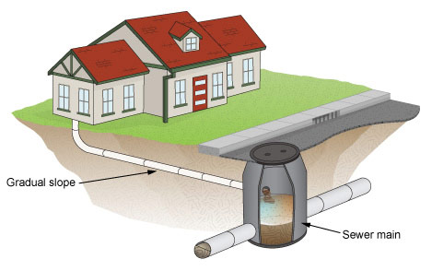
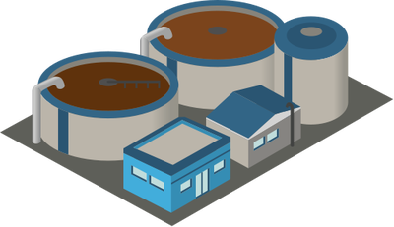
Typical Sewer System
Internal Sewer
Sewer Manhole
Peripheral Sewer
WWTP
Trunk Sewer

Slide 3
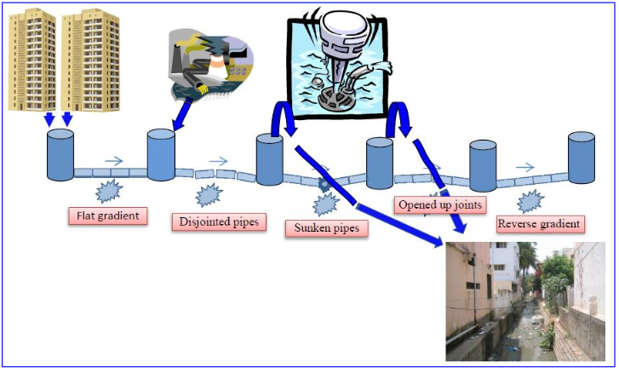
Problems in the Sewer Network

Slide 4
Prime Objective of Rehabilitation
Restore or increase the structural capacity of the sewer.
Seal all opened up and leaking joints.
Remove all reverse gradients and make good the gradient of the sewer.
Protect the internal surface of the sewer from chemical and biological attack from a sewage environment in a tropical climate.
Provide adequate abrasion resistance to the internal surface of the sewer to prevent structural degradation due to migration of silt, sand and debris and movement of cleansing equipment.
Improve hydraulic performance of the sewer by using materials that offer least flow resistance.
Provide complete water tightness to the sewer.
Enhance economic life span of sewers to 50 years.

Slide 5
Sewer Rehabilitation Technologies
  Cure In Place Pipe (CIPP) Technology
  Glass Reinforced Plastic (GRP) Technology
  Machine Wound Spiral Lining (MWSL) Technology
  Spin cast Geopolymer Spray Lining Technology

Slide 6
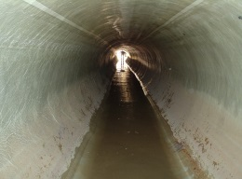
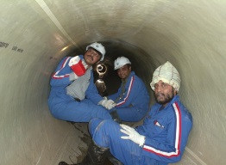
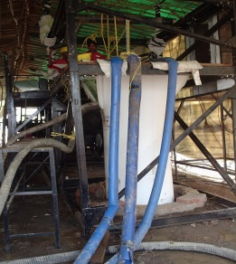
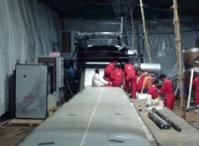
Rehabilitation Technologies
About Cured in Place Pipe (CIPP) Technology
The CIPP process involves inserting a resin impregnated fabric (felt or fiber) liner tube by an inversion process into the sections nominated for structural strengthening.
Heating the water filled liner, the liner is cured to become a self supporting pipe within the host pipe.
The CIPP liner is joint less close fit liner which fits in the host pipe. Thus prevents infiltration and ex-filtration of water.
Sewer rehabilitation by CIPP in Delhi

Slide 7
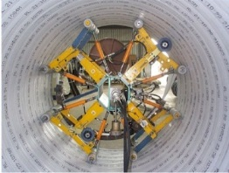
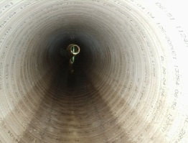
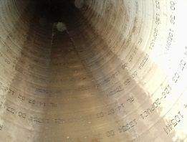
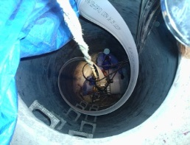
Rehabilitation Technologies
About Spiral Wound Liner Technology
The system consists of a single manageable PVC or HDPE strip which is spirally wound into the host pipe by a winding machine positioned in the base of a manhole.
In the case of man entry size sewers the liners can be spirally wound inside the host pipe by a travelling winding machine.
The edges of the strips are interlocked as it is spirally wound to form a continuous watertight liner pipe within the host sewer pipe.
The PVC or HDPE strip can be also reinforced depending on the structural and design requirements of the sewer pipe.
Spiral Wound Liner installed in Delhi Sewer

Slide 8
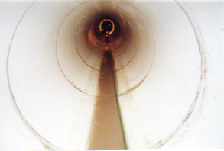
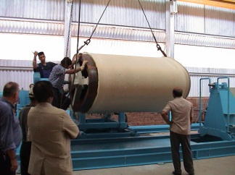
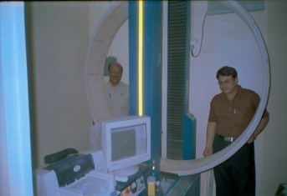
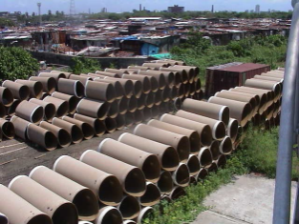
Rehabilitation Technologies
About GRP Liner Technology
Structural strengthening of deteriorated sewer using GRP liner pipes have been widely used worldwide for rehabilitation deteriorated man entry size sewer. The GRP, as a material, is in existence for more than 50 years
The lining is comprised pipes made of various combinations of fiberglass mats, glass fibers, and resins and sometimes, silica sand.
The pipes are manufactured off site in a factory controlled quality environment. A 2-3 mm thick resin layer is incorporated to form a corrosion resistance barrier to the inner surface of the liner pipe.
GRP Liner installed in circular and ovoid sewers

Slide 9
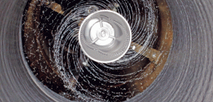
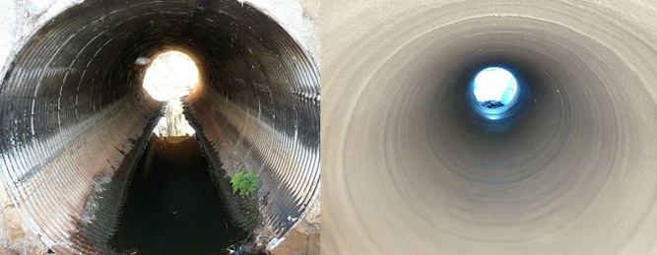
Rehabilitation Technologies
About Spin-Cast Geopolymer Pipe (SCGP)
Spin-Cast Geopolymer Pipe (SCGP) is provided for the rehabilitation of existing sanitary sewer pipelines, channels and manholes, either structural or protective coating, using an structural geopolymer lining system.
The liner may be spin cast or hand sprayed to various pipe surfaces including: brick, concrete, corrugated metal, clay tile, and various other compatible materials.
The lining system is used to rehabilitate the interior of all designated sewer pipelines or manholes.
The manhole lining system consists of a Geopolymer coat applied to the cleaned and prepared surfaces.

Slide 10
Present Status of Standards for Rehabilitation Technologies
No Indian Standards available till now.
All Rehabilitation Works in India are being undertaken mainly based on
  ASTM Standards
  WRC Manual
In recent past, comprehensive ISO Standards have been published for Sewer Pipes Rehabilitation.
Some Australian Standards (AS), British Standards (BS)/European Standards(EN) are also available for Rehabilitation Technologies.

Slide 11
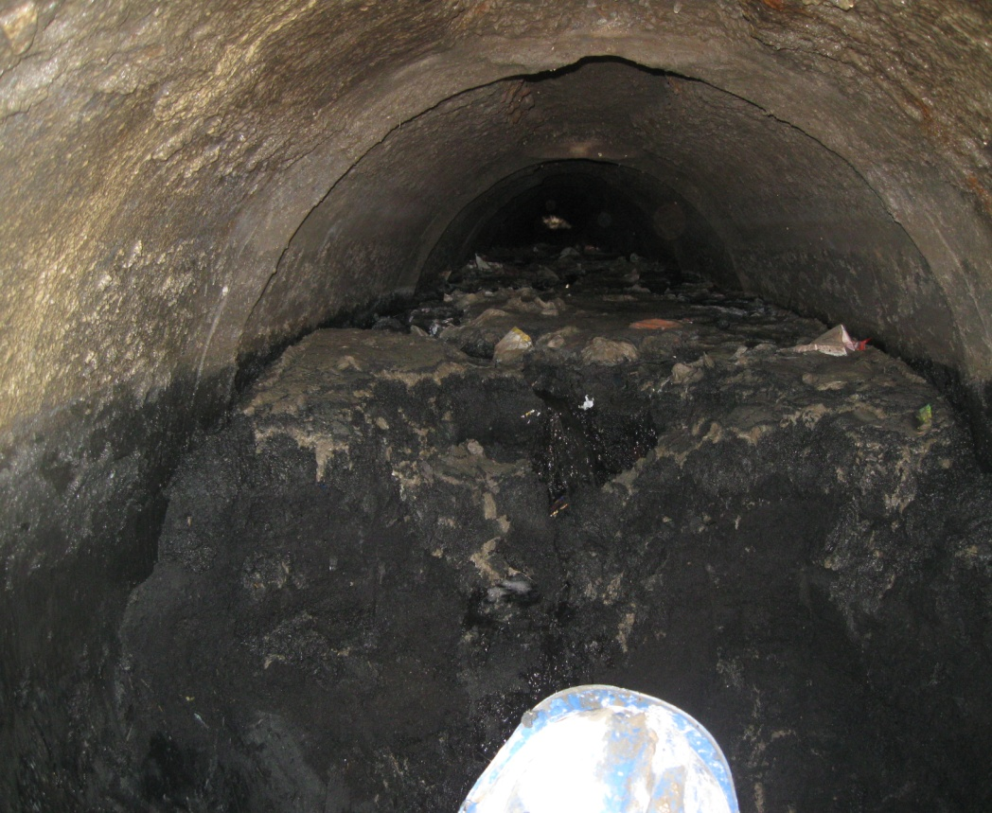
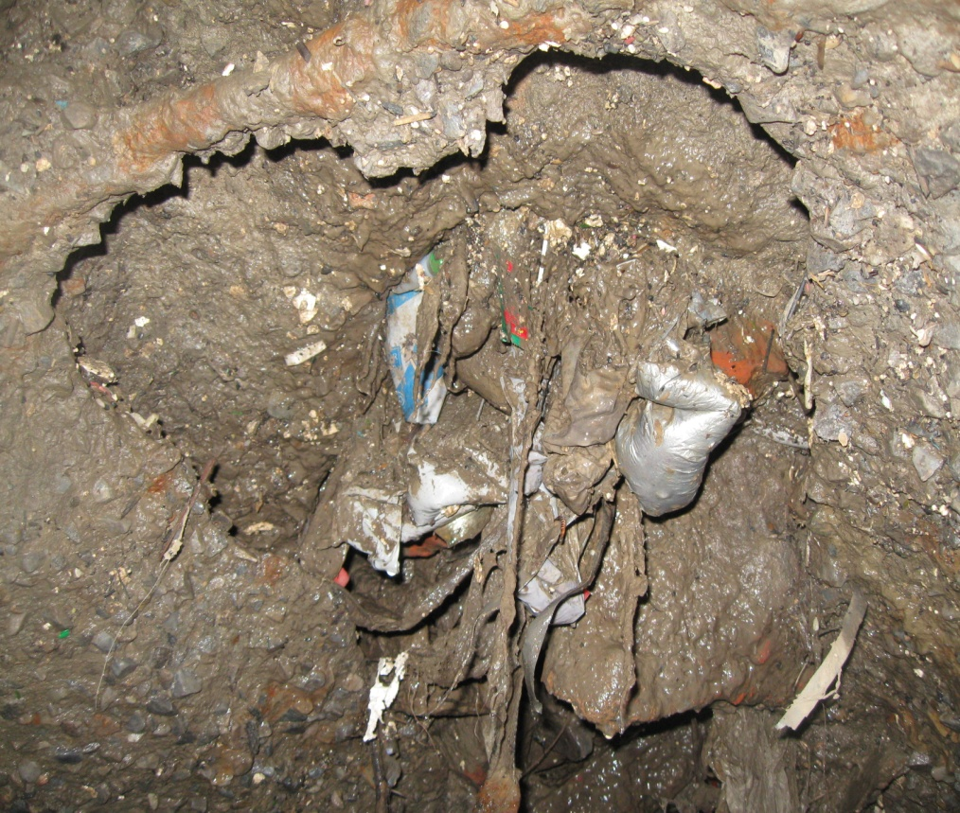
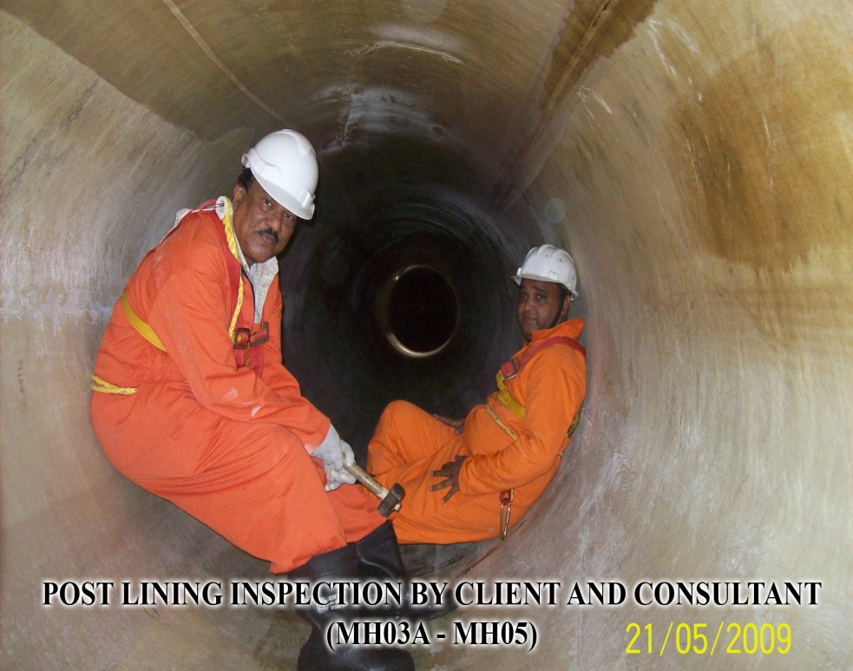
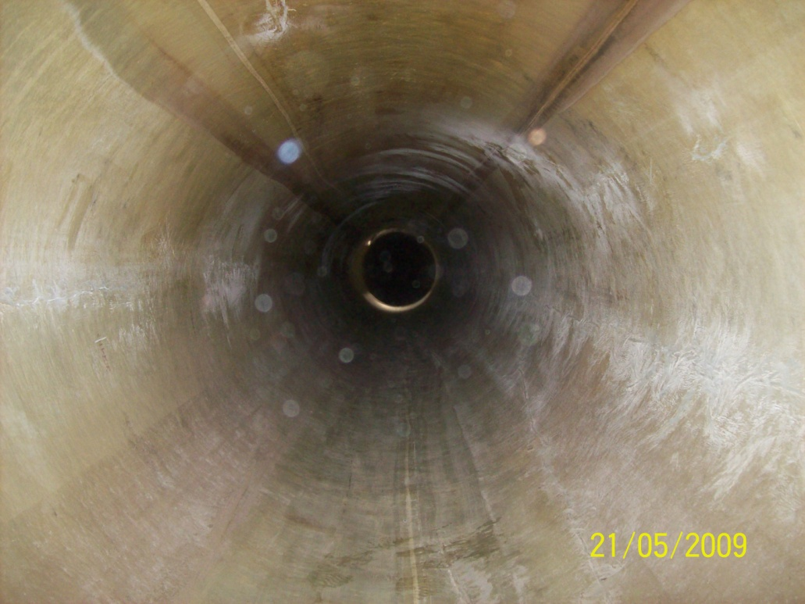
Rehabilitation of Old Sewer Lines
Sewer Before Lining
Sewer After Lining

Slide 12
Relevant American Standards (ASTM)
Standard | Subject
ASTM F1216 | Standard Practice for Rehabilitation of Existing Pipelines and Conduits by the Inversion and curing of a Resin- Impregnated Tube.
ASTM F1743 | Standard Practice for Rehabilitation of Existing Pipelines and Conduits by Pulled-in-Place Installation of Cured-in-Place Thermosetting Resin Pipe ( CIPP)
ASTM F2019 | Standard Practice for Rehabilitation of Existing Pipelines and Conduits by Pulled-in-Place Installation of Glass Reinforced Plastic (GRP) Cured-in-Place Thermosetting Resin Pipe (CIPP)
ASTM D5813 | Standard specification for Cured-in-Place Thermosetting Resin Sewer Piping System
ASTM D683 | Standard Test Method for Tensile Properties of Plastics
ASTM D790 | Standard Test Method for Flexural Properties of Unreinforced and Reinforced plastics and Electrical Insulating Materials
ASTM D2412 | Test for Apparent Tensile Strength of Reinforced Thermosetting Plastic Pipes and Tubes.

Slide 13
Relevant British / European Standards
Standard | Subject
BS EN 13566-1 | Plastics piping systems for renovation of underground non-pressure drainage and sewerage networks Part 1: General
BS EN 13566-2 | Part 2: Lining with continuous pipes;
BS EN 13566-3 | Part 3: Lining with close-fit pipes;
BS EN 13566-4 | Part 4: Lining with cured-in-place pipes;
BS EN 13566-7 | Part 7: Lining with spirally-wound pipes;

Slide 14
Relevant ISO Standards
Standard | Subject
ISO 11296-1 | Plastics piping systems for renovation of underground non-pressure drainage and sewerage networks — Part 1: General
ISO 11296-2 | Part 2: Lining with continuous pipes;
ISO 11296-3 | Part 3: Lining with close-fit pipes;
ISO 11296-4 | Part 4: Lining with cured-in-place pipes;
ISO 11296-5 | Part 5: Lining with discrete pipes
ISO 11296-7 | Part 7: Lining with spirally-wound pipes;
ISO 11296-8 | Part 8: Lining with pipe segments;
ISO 11296-9 | Part 9: Lining with a rigidly anchored plastics inner layer
ISO 11296-10 | Part 10: Lining with sprayed polymeric materials
ISO/TS 23818-1 | Assessment of conformity of plastics piping systems for the rehabilitation of existing pipelines — Part 1: Polyethylene (PE) material
ISO/TS 23818-2 | Part 2: Resin-fibre composite (RFC) material
ISO/TS 23818-3 | Part 3: Unplasticised poly(vinyl chloride) (PVC-U) material

Slide 15
Way forward……….
A Working Group was constituted for finalization of Draft Standard for CIPP Lining System.
CIPP Lining System is one of the many such Technologies available For Rehabilitation of sewer Pipes.
It is considered that publication of Standard in isolation only for one Technology will not serve the requirement of the Indian Industry, where almost all available Technologies are being used.
Therefore, it is planned to carryout compressive study and assessment of all available Standards such as ASTM, BS/EN, ISO and to develop group of Indian Standards for all such Rehabilitation Technologies considering Indian environment conditions.
The feedback and inputs from various Departments using Rehabilitation Technologies will also be considered.
A time Frame of about six months is anticipated for preparing draft set of Standards.

Slide 16
THANK YOU FOR YOUR TIME

