Slide 1

PEST HEALTH MANAGEMENT — INDIAN STANDARDS ON PESTICIDES
Kuldeep Mittal
Scientist-B/Assistant Director
Food & Agriculture Department.
Bureau of Indian Standards, New Delhi

Slide 2
FAD1 – At a Glance
Dr. J.P Singh
Plant Protection Adviser to GoI, Directorate of Plant Protection Quarantine and Storage, Faridabad
Chairman
Total Members
31
Organization and Members in Individual Capacity
17 Organization and 2 in Individual Capacity
Standards Published
314
Licenses in Operation

Slide 3
Distribution of Indian Standards IN FAD1
Total Standards Under FAD 1
Product | 305
Code of Practices | 1
Methods of Test | 3
Terminology | 1
Others | 4
Total | 314

Slide 4
Important Standards under FAD1
IS 6940 - Methods of test for pesticides and their formulations
IS 8190 (part 1) - Requirements for packing of pesticides: Part 1 solid pesticides IS 8190 (part 2) - Requirements for packing of pesticides: Part 2 liquid pesticides IS 8190 (part 3) - Requirements for packing of pesticides: Part 3 household pesticides IS 8190 (part 4) - Requirements for packing of pesticides: Part 4 fumigants
IS 8963 : 2006 Chlorpyrifos, technical – Specification IS 8944 : 2005 Chlorpyrifos EC - Specification IS 1832 :1978 Specification for malathion, technical IS 1832 :1978 Specification for malathion, technical IS 2568 : 1978 Specification for malathion dusting powders IS 2569 : 1978 Specification for malathion water dispersible powder concentrates IS 16145 : 2013 Fipronil suspension concentrate (SC) - Specification IS 16331 : 2015 Fipronil granules –Specification IS 12003 : 1987 Specification for fenvalerate, technical
Test Method Standard
Packaging Standards
Products Standards

Slide 5
PRODUCT STANDARDS CONTD…..
IS 15341 : 2003 Fenvalerate DP – Specification
IS 8072 : 2023 Quinalphos Technical Specification
IS 8029 : 2023 Quinalphos Dusting Powders Specification
IS 8028 : 2023 Quinalphos Emulsifiable Concentrate Specification
IS 14410 : 2023 Quinalphos Af Specification
IS 15238 : 2002 Profenofos, technical – Specification
IS 15240 : 2002 Profenofos emulsifiable concentrate – Specification
IS 8025 : 1990 Monocrotophos, technical specification
IS 8074 : 1990 Monocrotophos SL – Specification
IS 14159 : 1994 Carttap hydrochloride, technical – Specification
IS 14183 : 1994 Pesticide - Cartap hydrochloride SP – Specification
IS 12915 : 1990 Acephate, technical – Specification
IS 12916 : 1990 Acephate SP- Specification
IS 15334 : 2003 Imidacloprid WS – Specification
IS 15334 : 2003 Imidacloprid WS – Specification
IS 16131 : 2015 Imidacloprid suspension concentrate (SC) – Specification
IS 14299 : 1995 Neem extract concentrate containing azadirachtin – Specification
IS 14300 : 1995 Neem based EC containing azadirachtin - Specification

Slide 6
IS 6940 - Methods of test for pesticides and their formulations
This standard specifies general methods of test for technical grade pesticides and their different formulations.
Melting Point
Relative Density of Liquid Pesticides
Moisture Content
TESTS FOR TECHNICAL GRADE PESTICIDES
Setting Point
Softening Point
Material Insoluble in Ethanol

Slide 7
Suspensibility Test after Accelerated storage/without Pre-treatment
Sieving Test after accelerated storage/without Pre-treatmeat
3) Acidity or Alkalinity Test
4) Wettability Test
Tests for WDP
Tests for Granules
Pesticidal Formulations
Sieving Requiremeat for Particle Size
Test for Bulk Density After Compacting
Tests for DP
E
Encapsulation
Attrition Test
Water Run-Off Test
Wet Test for Encapsulation
Tests for EC
Cold Test
Test for Emulsion Stability
Test for Heat Stability
Acidity or Alkalinity

Slide 8
IS 6940 is under review now and it would be sent into wide circulation.
The following new test methods have been incorporated w.r.t
different formulation:
Water Content
Bulk (Pour & Tap) Density/Relative Density
Wettability
Persistent Foam
Wet Sieve
Dry Sieve
Nominal Size Range
Dustiness
Attrition Resistance
Dispersibility
Degree of dissolution and solution stability

Slide 9
12. Tablet Integrity
13. Disintegration of Tablets
14. Miscibility with hydrocarbon oil
15. Flash point
16. Release Rate
17. Emulsion Stability
18. Spontaneity of dispersion
19. Suspensibility
20. Acidity/Alkalinity/pH
21. Melting Point Range
22. Acetone/ Other organic solvent/ Water Insoluble

Slide 10
Chlorpyrifos
It is used as insecticide.
Following Indian Standards are pertaining to chlorpyrifos:
IS 8963 : 2006 Chlorpyrifos, technical – Specification
IS 8944 : 2005 Chlorpyrifos EC – Specification

Slide 11
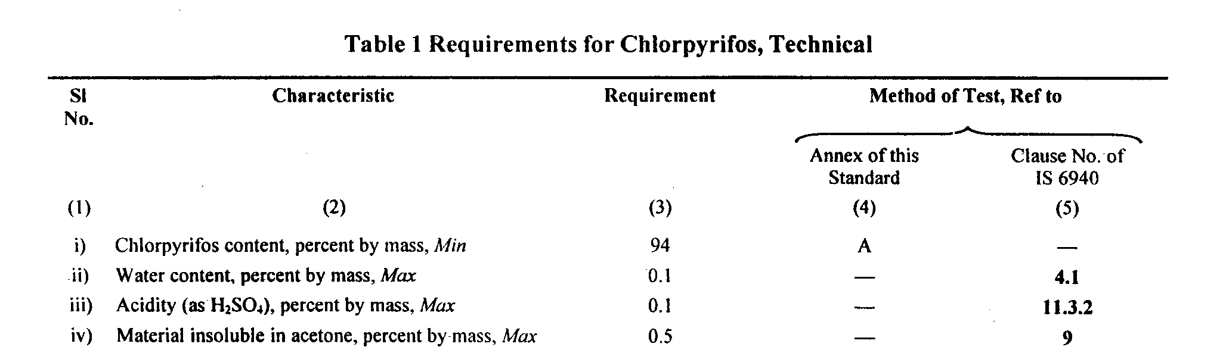
IS 8963 : 2006 Chlorpyrifos, technical - Specification
This standard prescribes the requirements and the methods of sampling and test for chlorpyrifos, technical.

Slide 12
IS 8944 : 2005 Chlorpyrifos, EC - Specification
Chlorpyrifos, EC is used for the control of insect pest and is generally manufactured to contain 20 percent m/m and 50 percent m/m of chlorpyrifos.
Requirements of Chlorpyrifos, EC
Cold Test - No turbidity or separation of-solid or oily matter or both shall occur when the material is subjected to the cold test at 10°C as prescribed in 13.1 of IS 6940 or any other lower temperature as agreed to between the purchaser and the supplier.
Flash Point (Abel) - When determined by the method prescribed in IS 1448 [ P : 20 ], the flash point of the material shall be minimum 24.5°C.
Emulsion Stability - Any separation including creaming at the top and sedimentation at the bottom of 100 ml of emulsion prepared in standard hard water with 2.0 ml of EC shall not exceed 2.0 ml when tested by the method prescribed in 13.3 of IS 6940.
Acidity (H₂SO₄) - When tested by the method prescribed in IS 6940, acidity (as H₂SO₄) shall be 0.05 percent by mass, Max.

Slide 13
malathion
Malathion is a man-made organophosphate insecticide that is commonly used to control mosquitoes and a variety of insects that attack fruits, vegetables, landscaping plants, and shrubs
Following Indian Standards are pertaining to malathion:
IS 1832 :1978
Specification for malathion, technical
IS 2567 : 1978
Specification for malathion emulsifiable concentrates
IS 2568 : 1978
Specification for malathion dusting powders
IS 2569 : 1978
Specification for malathion water dispersible powder concentrates

Slide 14
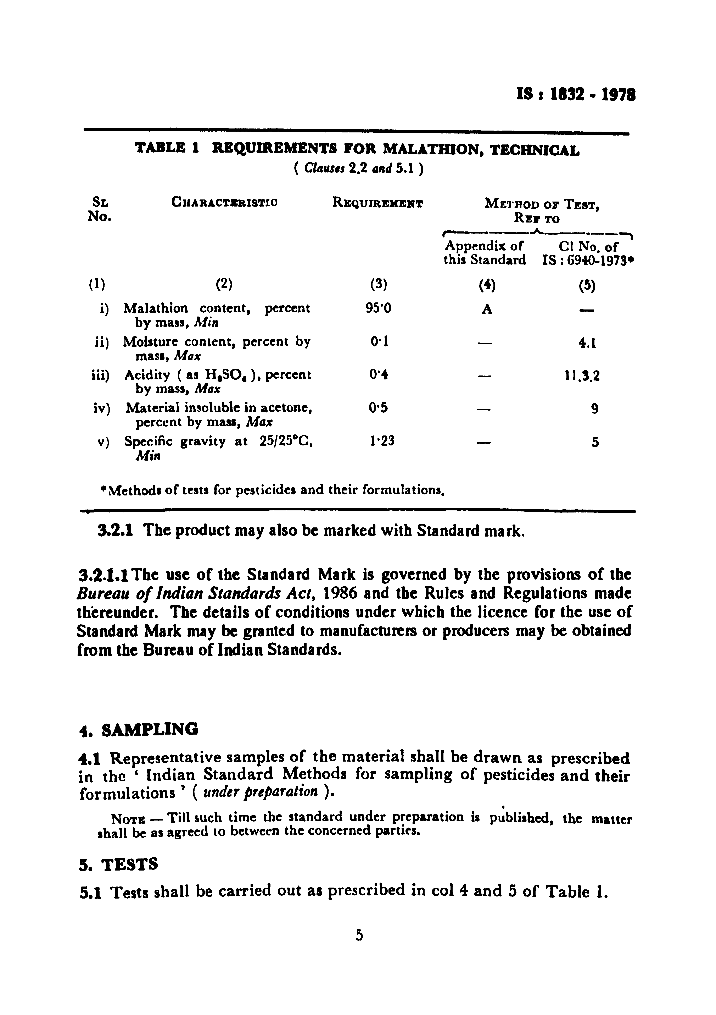
IS 1832 :1978 Specification for malathion, technical
This standard prescribes the requirements and the methods of sampling and test for malathion, technical, employed in the preparation of insecticidal formulations.

Slide 15
IS 2567 : 1978 Specification for malathion emulsifiable concentrates
This standard prescribes the requirements and the methods of sampling and test for malathion emulsifiable concentrates.
Requirements of Malathion, EC
Cold Test - No turbidity or separation of solid and/or oily matter shall occur when the material is subjected to the cold test at 10°C prescribed in IS 6940 or any other lower temperature as agreed between the purchaser and the vendor.
Flash Point - When determined by the method prescribed IS 1448 [P : 20] the flash point of the material shall be above 24.5°C.
Emulsion Stability – Any separation, including creaming at the top and sedimentation at the bottom of 100 ml of emulsion prepared in standard hard water with 5 ml for public health use and 2 ml for agricultural use, shall not exceed 1 ml when tested by one of the methods prescribed in IS 6940.
Acidity- When tested by the method prescribed in IS 6940, the acidity (as H₂SO₄), shall be not more than 0·5 percent by mass.

Slide 16
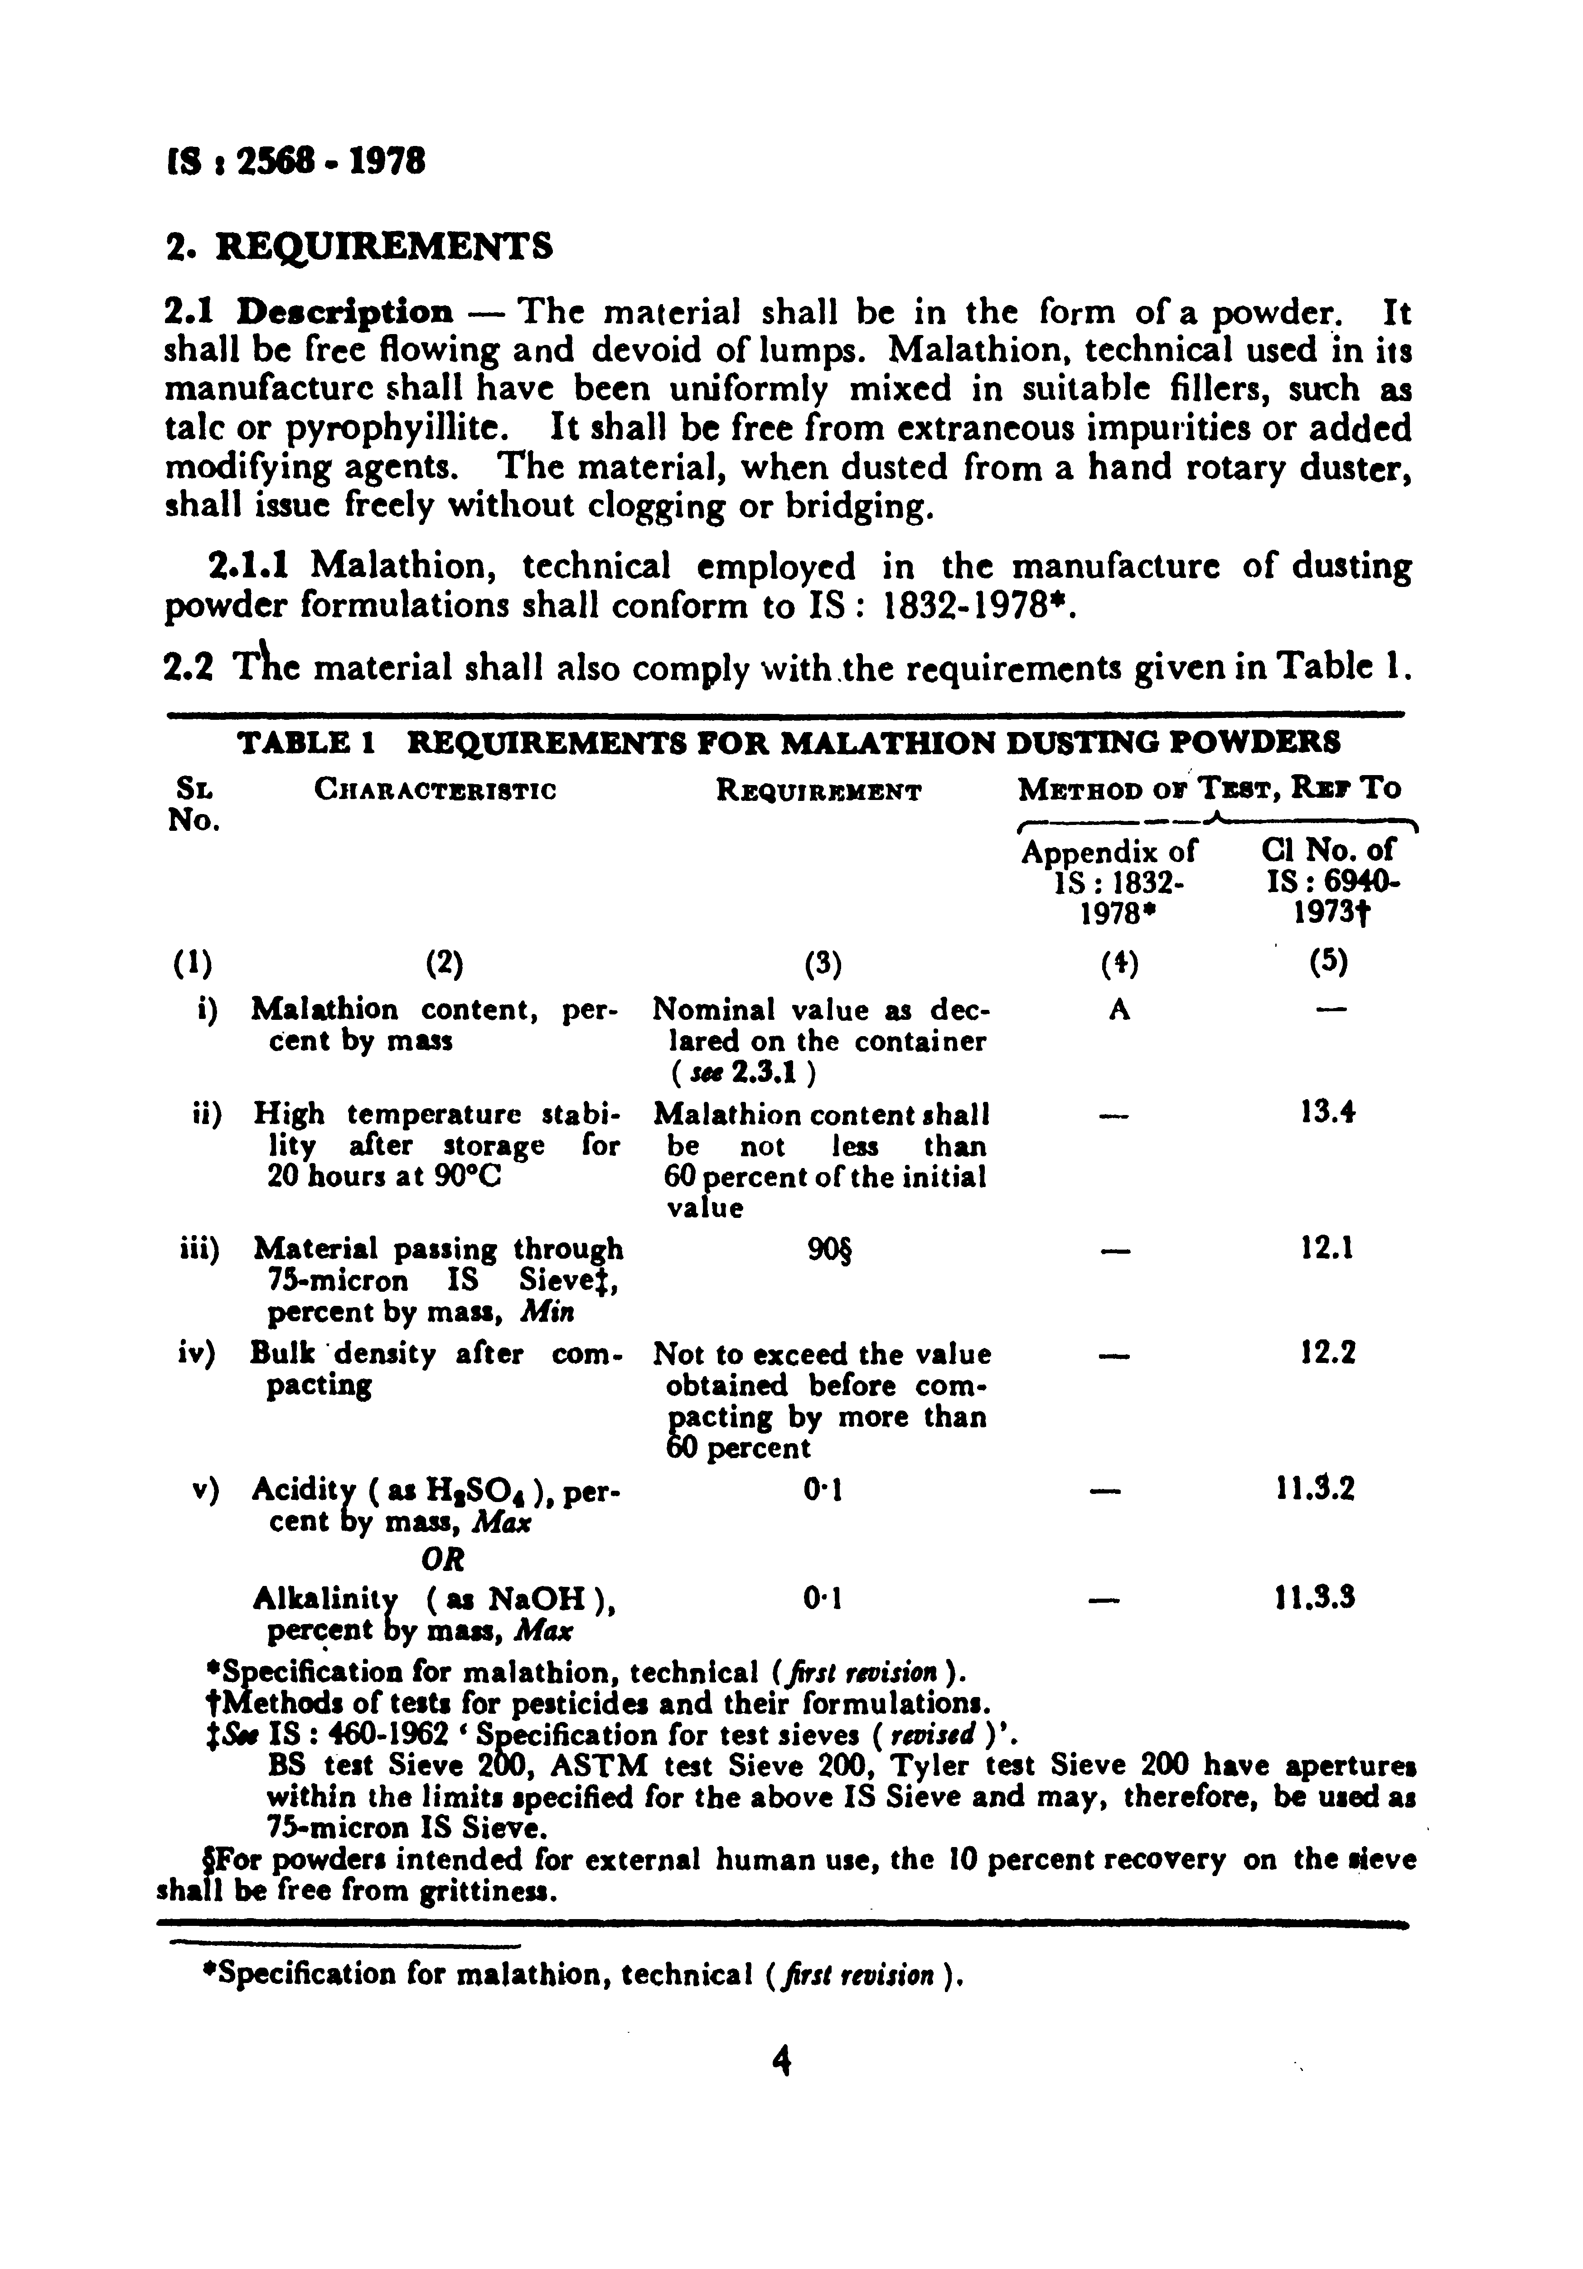
IS 2568 : 1978 Specification for malathion dusting powders
This standard prescribes the requirements and the methods of sampling and test for malathion dusting powders.

Slide 17
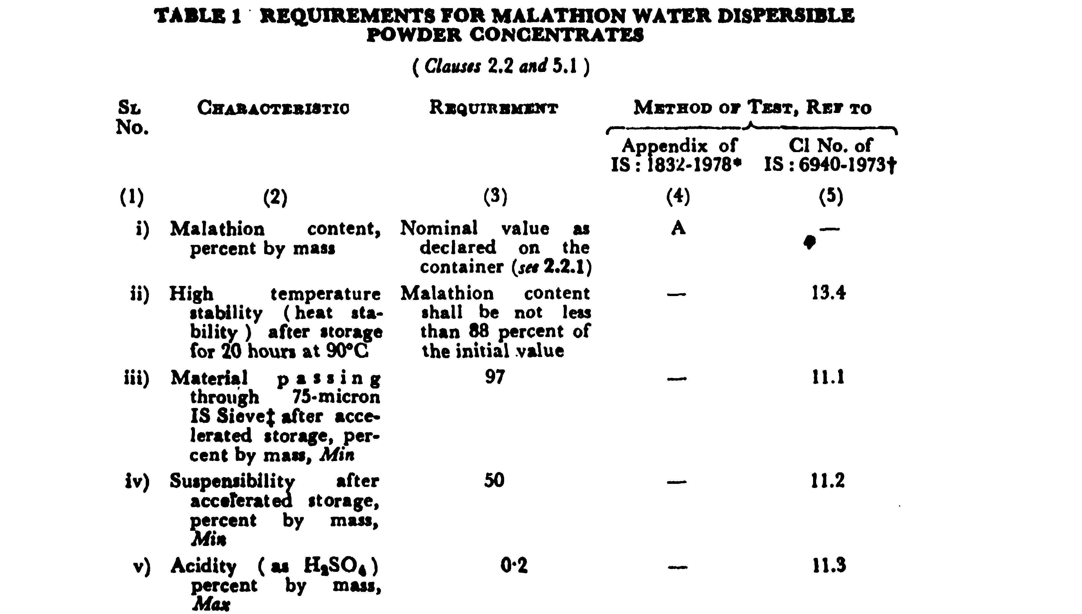
IS 2569 : 1978 Specification for malathion water dispersible powder concentrates
This standard prescribes the requirements and the method of sampling and test for malathion water dispersible powder concentrates.

Slide 18
Fipronil
Following Indian Standards are pertaining to Fipronil mentioned underneath –
IS 16145 : 2013
Fipronil suspension concentrate (SC) - Specification
IS 16331 : 2015
Fipronil granules - Specification

Slide 19
IS 16145 : 2013 Fipronil suspension concentrate (SC) - Specification
This standard prescribes the requirements and the methods of sampling and test for Fipronil SC.
Requirements of Fipronil, SC
Pourability - When determined by the method prescribed in Annex A, the residue shall not be more than 5 percent (m/m) and rinsed residue shall not be more than 0.50 percent (m/m).
Spontaneity of Dispersion - When determined by the method prescribed in Annex B, the spontaneity of dispersion of the material shall not be less than 60 percent (m/m).
Suspensibility - When determined by the method prescribed in Annex C, the suspensibility of the material shall not be less than 60 percent (m/m).
Wet Sieve Test - Not less than 98 percent by mass of the material shall pass through a 45 micron IS sieve when determined by method described in IS 6940.
Persistent Foam - When determined by the method prescribed in Annex D, the persistent foam shall not be more than 60 ml in 1 min.
pH of Suspension - When determined by the method prescribed in Annex E, the pH of 1 percent solution in standard hard water (342 ppm) shall be between 4.0–8.5.
Acidity/Alkalinity - When tested by the method prescribed in IS 6940, the acidity (as H₂SO₄) or alkalinity (as NaOH) of the material shall not be more than 0.5 percent by mass, respectively.

Slide 20
IS 16331 : 2015 Fipronil granules -Specification
This standard prescribes the requirements and the methods of sampling and test for Fipronil granules.
Requirements of Fipronil Granules
Dust - When determined by the method prescribed in IS 6940, not more than 1.0 percent by mass of the product shall pass through 75 micron IS Sieve [see IS 460 (Part 1)].
The portion passing through this sieve shall contain fipronil 0.270 - 0.360 percent by mass when determined by method described in Annex A.
Moisture Content - When determined by the method described in IS 6940, the moisture content shall not exceed 1.0 percent by mass.
Acidity/Alkalinity When tested by the method prescribed in IS 6940, the acidity (as H₂SO₄) shall not be more than 0.1 percent by mass or alkalinity (as NaOH) of the material shall not be more than 0.15 percent by mass.

Slide 21
Fenvalerate
Fenvalerate is a highly active contact insecticide that is effective against a wide range of pests, including strains resistant to organochlorine, organophosphorus and carbamate insecticides.
It is used mainly in agriculture, with about 90% used on cotton.
Following Indian Standards are pertaining to Fenvalerate mentioned underneath –
IS 12003 : 1987
Specification for fenvalerate, technical
IS 15341 : 2003
Fenvalerate DP - Specification

Slide 22
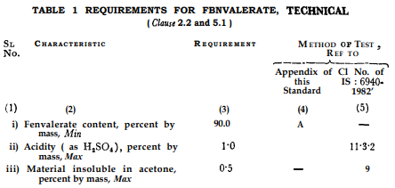
IS 12003 : 1987 Specification for fenvalerate, technical
This standard prescribes the requirements and the methods of sampling and test for fenvalerate, technical.

Slide 23
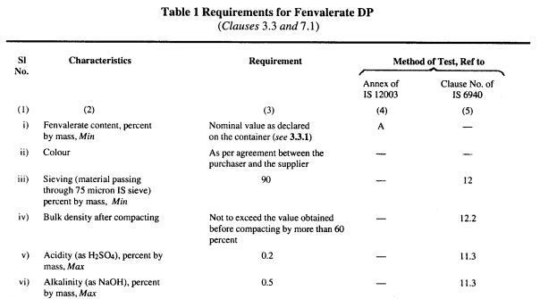
IS 15341 : 2003 Fenvalerate DP - Specification
This standard prescribes the requirements and the methods of sampling and test for fenvalerate dusting powder.

Slide 24
QUINALPHOS
Quinalphos is an organothiophosphate chemical chiefly used as a pesticide. It is widely used in wheat, rice, coffee, sugarcane, and cotton.
Following Indian Standards are pertaining to quinalphos:
IS 8072 : 2023
QUINALPHOS TECHNICAL SPECIFICATION
IS 8072 : 2023
QUINALPHOS TECHNICAL SPECIFICATION
IS 8028 : 2023
QUINALPHOS EMULSIFIABLE CONCENTRATE SPECIFICATION
IS 14410 : 2023
QUINALPHOS AF SPECIFICATION

Slide 25
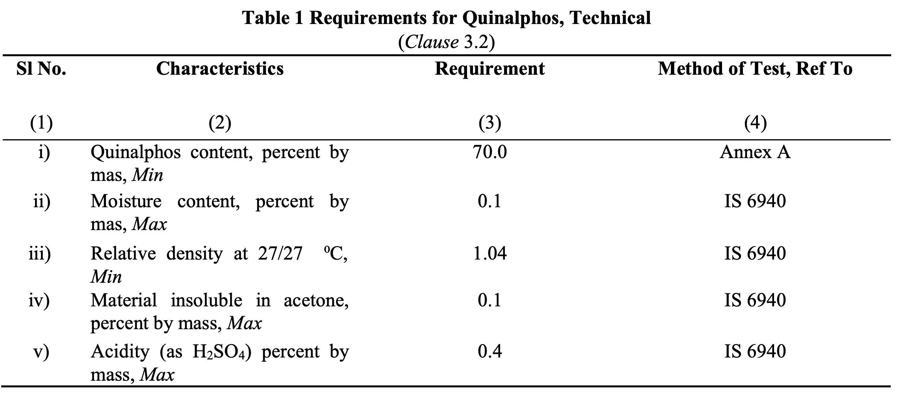
IS 8072 : 2023 QUINALPHOS TECHNICAL SPECIFICATION
This Indian Standard prescribes the requirements and the methods of sampling and test for quinalphos, technical.

Slide 26
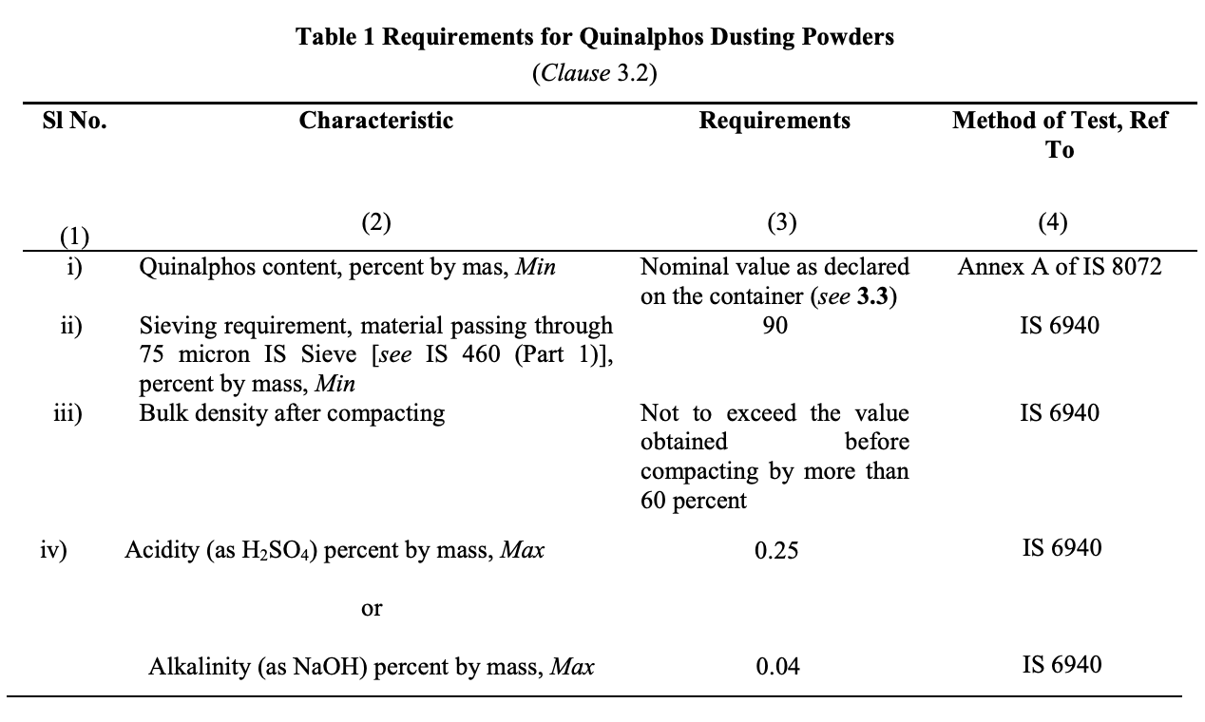
IS 8029 : 2023 QUINALPHOS DUSTING POWDERS SPECIFICATION
This Indian Standard prescribes the requirements and the methods of sampling and test for quinalphos dusting powder.

Slide 27
IS 8028 : 2023 QUINALPHOS EMULSIFIABLE CONCENTRATE SPECIFICATION
This Indian Standard prescribes the requirements and the methods of sampling and test for quinalphos emulsifiable concentrate.
Requirements of Quinalphos, EC
Cold Test - No turbidity or separation of solid and/or oily matter shall occur when the material is subjected to the cold test at 10°C prescribed in IS 6940 or any other lower temperature as agreed between the purchaser and the vendor.
Flash Point - When determined by the method prescribed IS 1448 [P : 20] the flash point of the material shall be above 24.5°C.
Emulsion Stability – Any separation, including creaming at the top and sedimentation at the bottom of 100 ml of emulsion prepared in standard hard water with 5 ml for public health use and 2 ml for agricultural use, shall not exceed 2 ml when tested by one of the methods prescribed in IS 6940.
Acidity- When tested by the method prescribed in IS 6940, the acidity (as H₂SO₄), shall be not more than 0·5 percent by mass.

Slide 28
IS 14410 : 2023 QUINALPHOS AF SPECIFICATION
This Indian Standard prescribes the requirements and the methods of sampling and test for quinalphos, AF.
Requirements of Quinalphos, AF
Cold Test - No turbidity or separation of solid and/or oily matter shall occur when the material is subjected to the cold test at 10°C prescribed in IS 6940 or any other lower temperature as agreed between the purchaser and the vendor.
Flash Point [Cleveland (Open) Cup] - When determined by the method prescribed IS 1448 [P : 69] the flash point of the material shall be above 100°C.
Emulsion Stability – Any separation, including creaming at the top and sedimentation at the bottom of 100 ml of emulsion prepared in standard hard water with 5 ml for public health use and 2 ml for agricultural use, shall not exceed 2 ml when tested by one of the methods prescribed in IS 6940.
Acidity- When tested by the method prescribed in IS 6940, the acidity (as H₂SO₄), shall be not more than 0·5 percent by mass.

Slide 29
Profenofos
Profenofos is an insecticide used on a wide variety of crops to control many pests but mainly Lepidoptera and mites.
Following Indian Standards are pertaining to profenophos:
IS 15238 : 2002
Profenofos, technical - Specification
IS 15240 : 2002
Profenofos emulsifiable concentrate - Specification

Slide 30
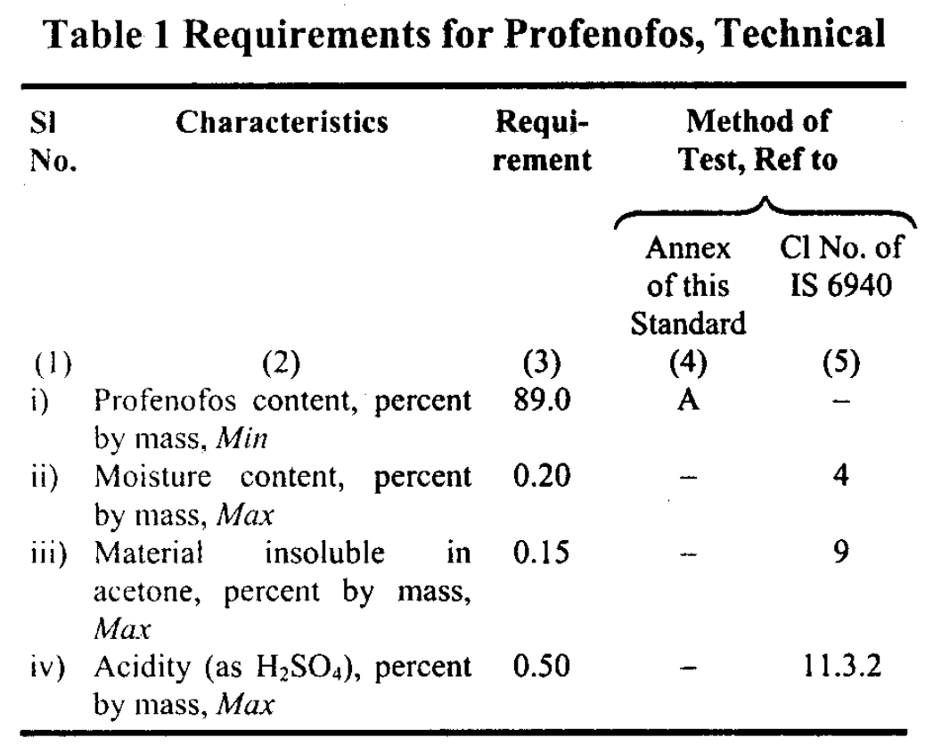
IS 15238 : 2002 Profenofos, technical - Specification
This Indian Standard prescribes the requirements and the methods of sampling and test for Profenofos, technical.

Slide 31
IS 15240 : 2002 Profenofos emulsifiable concentrate - Specification
This Indian Standard prescribes the requirements and the methods of sampling and test for Profenofos emulsifiable concentrate.
Requirements of Profenfos, EC
Cold Test - No turbidity or separation of solid and/or oily matter shall occur when the material is subjected to the cold test at 10°C prescribed in IS 6940 or any other lower temperature as agreed between the purchaser and the vendor.
Flash Point - When determined by the method prescribed IS 1448 [P : 20] the flash point of the material shall be above 24.5°C.
Emulsion Stability – Any separation, including creaming at the top and sedimentation at the bottom of 100 ml of emulsion prepared in standard hard water with 5 ml for public health use and 2 ml for agricultural use, shall not exceed 2 ml when tested by one of the methods prescribed in IS 6940.
Acidity- When tested by the method prescribed in IS 6940, the acidity (as H₂SO₄), shall be not more than 1.0 percent by mass.

Slide 32
Monocrotophos
Monocrotophos is principally used in agriculture, as a relatively cheap pesticide.
Following Indian Standards are pertaining to monocrotophos mentioned underneath –
IS 8025 : 1990
Monocrotophos, technical specification
IS 8074 : 1990
Monocrotophos SL - Specification (Second Revision)

Slide 33
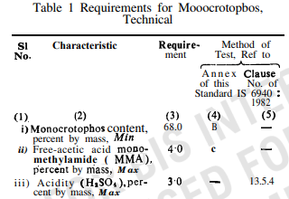
IS 8025 : 1990 Monocrotophos, technical specification
This Indian Standard prescribes the requirements and the methods of sampling and test for monocrotophos, technical.

Slide 34
IS 8074 : 1990 Monocrotophos SL - Specification
This standard prescribes the requirements - and the methods of sampling and test for monocrotophos SL.
Requirements of Monocrotophos, SL
Cold Test - No turbidity or separation of solid matter shall occur when the material is subjected to cold test at 10°C as prescribed in IS 6940 or any other lower temperature as agreed to between the purchaser and the vendor.
Flash Point ( Abel ) - When determined by the method prescribed in IS 1448 (Part 20), the flash point of the material shall be above 24.5°C.
Chemical - The material shall comply with the following chemical requirements.
Acidity - When tested by the method prescribed in lS 6940, the acidity (as H₂SO₄)of the material shall not be more than 2.5 percent by mass

Slide 35
Cartap hydrochloride
It is used for the control of chewing and sucking pests and results in insect paralysis. It has been categorized as a high-effectiveness, low-toxicity, and low-residue pesticide used in rice and sugarcane fields.
Following Indian Standards are pertaining to cartap hydrochloride:
IS 14159 : 1994
Carttap hydrochloride, technical - Specification
IS 14183 : 1994
Pesticide - Cartap hydrochloride SP - Specification

Slide 36
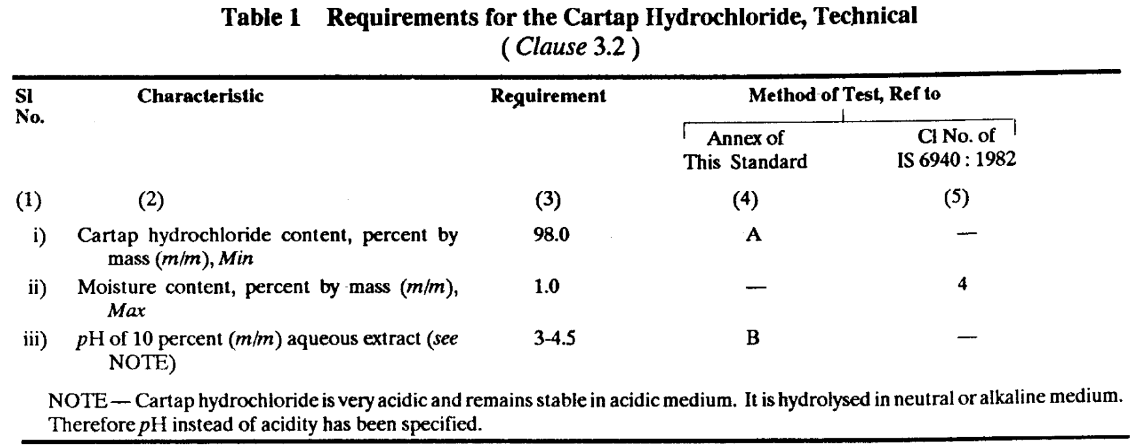
IS 14159 : 1994 Carttap hydrochloride, technical - Specification
This Indian Standard prescribes the requirements and the methods of sampling and test for cartap hydrochloride, technical.

Slide 37
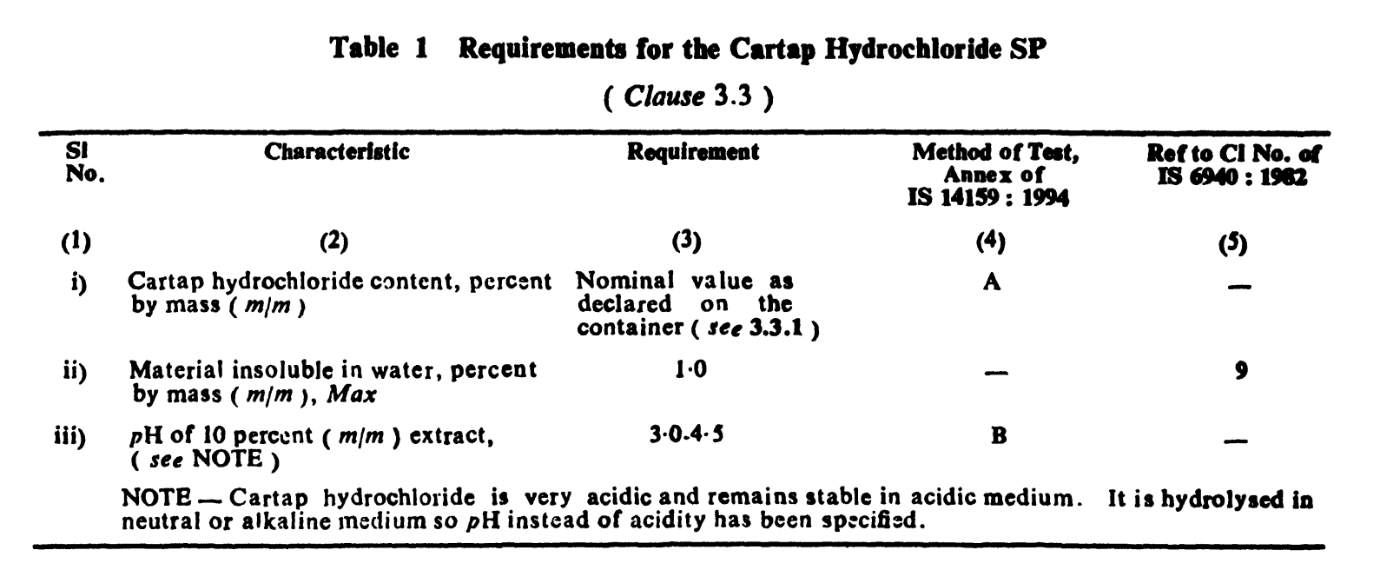
IS 14183 : 1994 Pesticide - Cartap hydrochloride SP - Specification
This Indian Standard prescribes the requirements and the methods of sampling and test for cartap hydrochloride, SP.

Slide 38
Acephate
Acephate is an organophosphate foliar and soil insecticide. It is used primarily for control of aphids, including resistant species, in vegetables (e.g. potatoes, carrots, greenhouse tomatoes, and lettuce) and in horticulture (e.g. on roses and greenhouse ornamentals).
Following Indian Standards are pertaining to Acephate:
IS 12915 : 1990
Acephate, technical - Specification
IS 12916 : 1990
Acephate SP- Specification

Slide 39
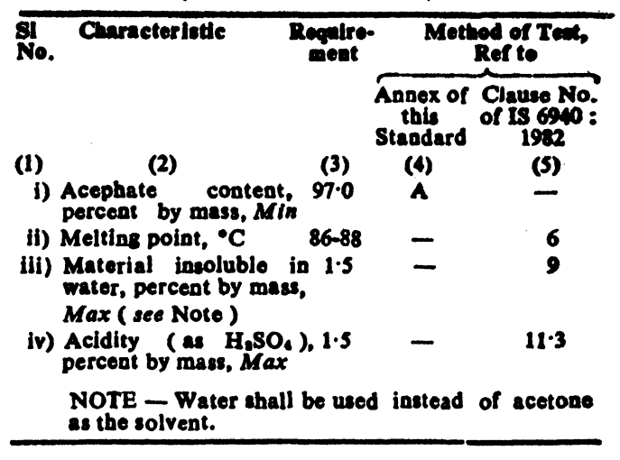
IS 12915 : 1990 Acephate, technical - Specification
This Indian Standard prescribes the requirements and the methods of sampling and test for acephate, technical.

Slide 40
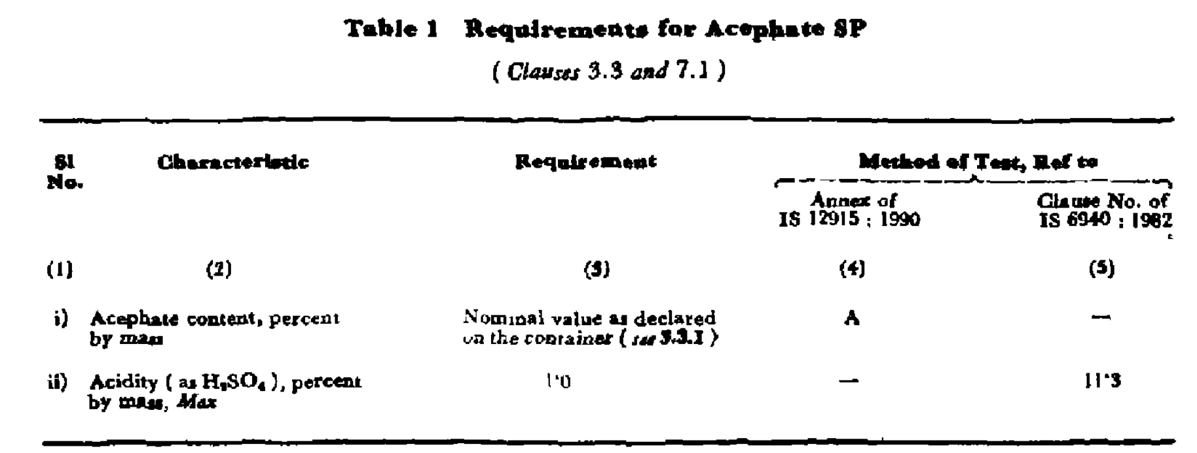
IS 12916 : 1990 Acephate SP- Specification
This Indian Standard prescribes the requirements and the methods of sampling and test for acephate, SP.

Slide 41
Imidacloprid
Imidacloprid is used to control sucking insects, some chewing insects including termites, soil insects, and fleas on pets. In addition to its topical use on pets, imidacloprid may be applied to structures, crops, soil, and as a seed treatment.
Following Indian Standards are pertaining to imidacloprid:
IS 15443 : 2004
Imidacloprid technical - Specification
IS 15334 : 2003
Imidacloprid WS - Specification
IS 15335 : 2003
Imidacloprid SL - Specification
IS 16131 : 2015
Imidacloprid suspension concentrate (SC) - Specification

Slide 42
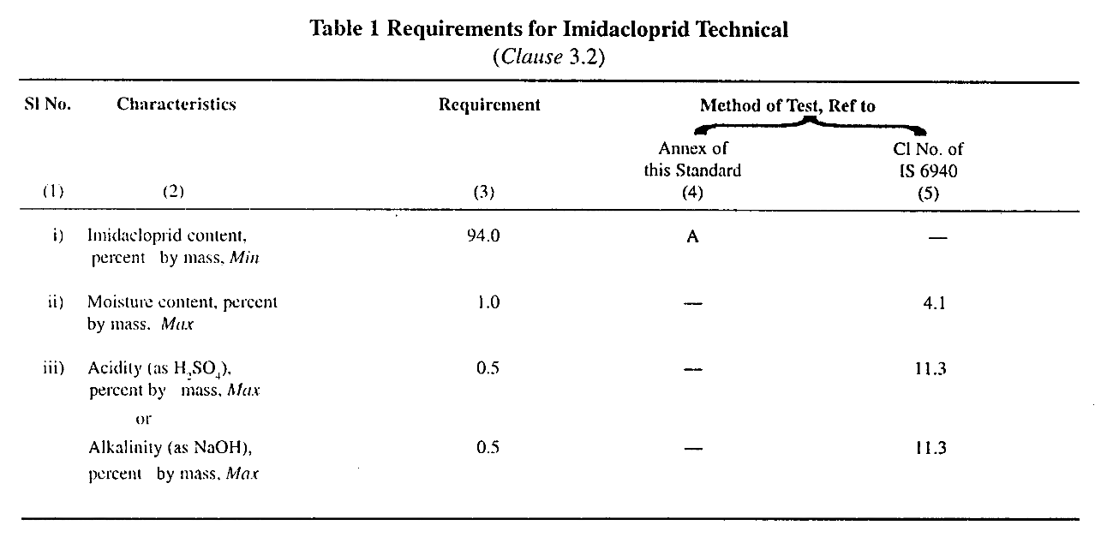
IS 15443 : 2004 Imidacloprid technical - Specification
This Indian Standard prescribes the requirements and the methods of sampling and test for imidacloprid technical.

Slide 43
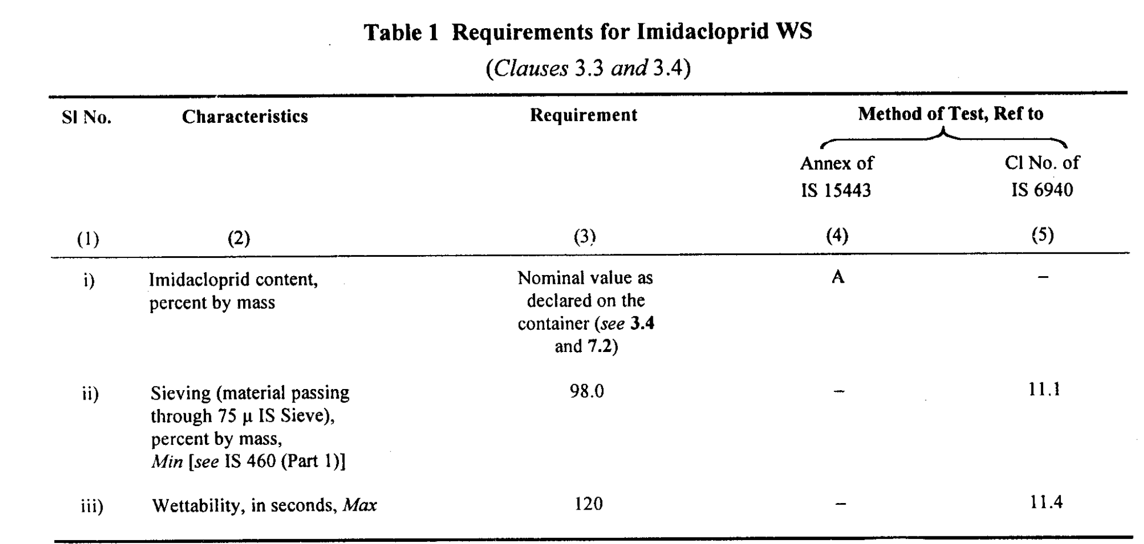
IS 15334 : 2003 Imidacloprid WS - Specification
This Indian Standard prescribes the requirements and the methods of sampling and test for imidacloprid WS.

Slide 44
IS 15335 : 2003 Imidacloprid SL - Specification
This Indian Standard prescribes the requirements and the methods of sampling and test for imidacloprid SL.
Requirements of Imidacloprid, SL
Cold Test - No turbidity or separation of solid and/or oily matter shall occur when the material is subjected to the cold test at 10°C prescribed in IS 6940 or any other lower temperature as agreed between the purchaser and the vendor.
Flash Point - When determined by the method prescribed IS 1448 [P : 20] the flash point of the material shall be above 24.5°C.
Acidity- When tested by the method prescribed in IS 6940, the acidity (as H₂SO₄), shall be not more than 1.0 percent by mass.

Slide 45
IS 16131 : 2015 Imidacloprid suspension concentrate (SC) - Specification
This Indian Standard prescribes the requirements and the methods of sampling and test for imidacloprid, SC.
Requirements of Imidacloprid, SC
Pourability (Rinsed Residue) - When determined by the method prescribed in Annex A, the rinsed residue shall not be more than 0.8 percent (m/m).
Spontaneity of Dispersion - When determined by the method prescribed in Annex B, the spontaneity of dispersion of the material shall not be less than 70 percent (m/m).
Suspensibility - When determined by the method prescribed in Annex C, the suspensibility of the material shall not be less than 90 percent (m/m).
Wet Sieve Test - Not less than 95 percent by mass of the material shall pass through a 45 micron IS sieve when determined by method described in 11.1 of IS 6940.
Persistent Foam - When determined by the prescribed in Annex D, the persistent foam shall not be more than 30 ml after 2 min.

Slide 46
NEEM BASED PESTICIDES
Neem botanically known as Azadirachta indica A. Juss belongs to family meliaceae bas a great economic importance from ancient time, Neem seed/kernel contains triterpenes which are normally-called Neem bitters. The Neem bitters are known to contain a number of active derivatives including Azadirachtin which have the insect-pest control properties.
Neem extracts containing Azadirachtin may be used for making formulation or applied directly in the field crops with appropriate dilution for the control of pests of agricultural crops.
Neem Based Pesticides are as follows :-
IS 14299 : 1995 Neem extract concentrate containing azadirachtin - Specification
IS 14300 : 1995 Neem based EC containing azadirachtin - Specification

Slide 47
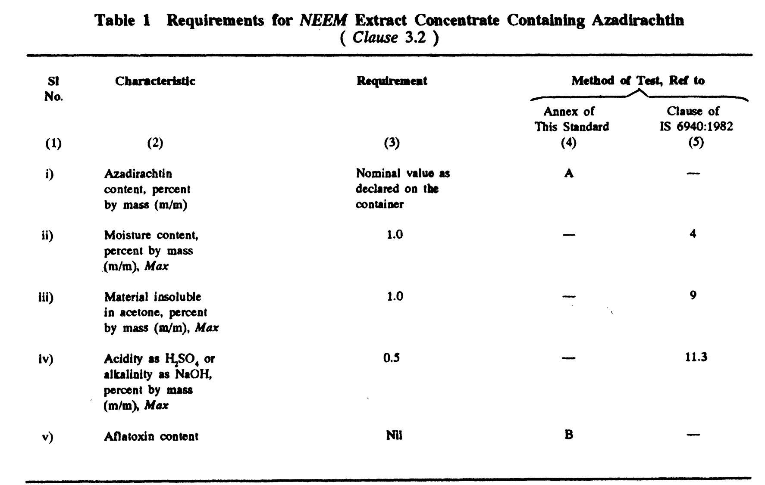
IS 14299 : 1995 Neem extract concentrate containing azadirachtin - Specification
This Indian Standard prescribes the requirements and the methods of sampling and test for Neem extract concentrate containing azadirachtin.

Slide 48
IS 14300 : 1995 Neem based EC containing azadirachtin - Specification
This Indian Standard prescribes the requirements and the methods of sampling and test for Neem based EC containing azadirachtin.
Cold Test - When tested by the method prescribed in IS 6940, no turbidity or separation of solid or oily matter shall occur.
Flash Point - When determined by the method prescribed IS 1448 [P : 20] the flash point of the material shall be above 24.5°C.
Emulsion Stability – Any separation, including creaming at the top and sedimentation at the bottom of 100 ml of emulsion prepared in standard hard water with 5 ml for public health use and 2 ml for agricultural use, shall not exceed 2 ml when tested by one of the methods prescribed in IS 6940.
Acidity/ Alkalinity - When tested by the method prescribed in IS 6940, the acidity or alkalinity of the material shall not be more than 0.5 percent by mass as H₂SO₄ or NaOH respectively

Slide 49
RECENTLY PUBLISHED INDIAN STANDARDS
Sl No. | IS No. | Title
1. | IS 18122 : 2023 | Gibberellic Acid technical- Specification
2. | IS 18389 : 2023 | Fipronil, technical - Specification
3. | IS 18390 : 2023 | Fipronil + Acetamiprid suspension concentrate (SC) - Specification
4. | IS 18391 : 2023 | Fipronil + Thiamethoxam suspension concentrate (SC) - Specification
5. | IS 18440 : 2023 | Isoprothiolane + Fipronil emulsifiable concentrate - Specification
6. | IS 18441 : 2023 | Lambdacyhalothrin + Thiamethoxam, ZC - Specification
7. | IS 18579 : 2024 | Ametoctradin + Dimethomorph suspension concentrate - Specification
8. | IS 18588 : 2024 | Metrafenone suspension concentrate - Specification
9. | IS 18600 : 2024 | Pyraclostrobin capsule suspension (CS) - Specification
10. | IS 18604 : 2024 | Thiophanate methyl + Pyraclostrobin flowable suspension concentrate - Specification

Slide 50
STANDARDS UNDER DEVELOPMENT
The draft revisions of following Indian Standards are under wide circulation:
Sl No. | Doc. No. | Title
1. | FAD 01(20166)WC | Afidopyropen dispersible concentrate - Specification
2. | FAD 01(20125)WC | Fluxapyroxad + Pyraclostrobin suspension concentrate - Specification
3. | FAD 01(25459)WC | Copper oxychloride dusting powder - Specification (third revision of IS 1506)
4. | FAD 01(25460)WC | Copper oxychloride technical - Specification (third revision of IS 1486)
5. | FAD 01(25461)WC | Copper oxychloride water dispersible powder concentrate - Specification (third revision of IS 1507)

Slide 51
Sl No. | Doc No. | Title
6. | FAD 01(25455)WC | Alpha naphthyl acetic acid, technical (first revision of IS 13070)
7. | FAD 01(25457)WC | Alpha naphthyl acetic acid soluble concentrate (SL) - Specification (first revision of IS 13138)
8. | FAD 01(25474)WC | Butachlor, technical – Specification (first revision of IS 9355)
9. | FAD 01(25475)WC | Butachlor emulsifiable concentrate (EC) – Specification (first revision of IS 9356)
10. | FAD 01(25476)WC | Monocrotophos, technical – Specification (third revision of IS 8025)
11. | FAD 01(25477)WC | Monocrotophos soluble concentrate (SL) – Specification (third revision of IS 8074)
12. | FAD 01(25488)WC | Aluminium phosphide formulations - Specification (second revision of IS 6438)

Slide 52
STANDARDS ON BIO-PESTICIDES UNDER DEVELOPMENT
The following Indian Standards related to bio-pesticides are under development:
Sl No. | Title
1. | Draft Indian Standard on ‘Beauveria bassiana, Metarhizium anisopliae Verticillium lecanii and Ampilomyces quisqualis – Specification’
2. | Draft Indian Standard on ‘Bacillus thuringiensis var. israelensis – Specification’
3. | Draft Indian Standard on ‘Bacillus subtilis – Specification’
4. | Draft Indian Standard on ‘Bacillus thuringiensis var. galleriae – Specification’
5. | Draft Indian Standard on ‘Bacillus sphaericus –Specification’
6. | Draft Indian Standard on ‘Bacillus thuringiensis var kurstaki – Specification’
7. | Draft Indian Standard on ‘Pseudomonas fluorescence – Specification’
8. | Draft Indian Standard on ‘Trichoderma viride and Trichoderma harzianum – Specification’

Slide 53
THANK YOU….

