Slide 1

Pumps and Indian standards
BUREAU OF INDIAN standards

Slide 2
What is a Pump?
A pump is a device that moves fluids (liquids or gases) by mechanical action. Pumps operate by creating a pressure difference across the fluid, which causes the fluid to flow from regions of higher pressure to lower pressure.

Slide 3
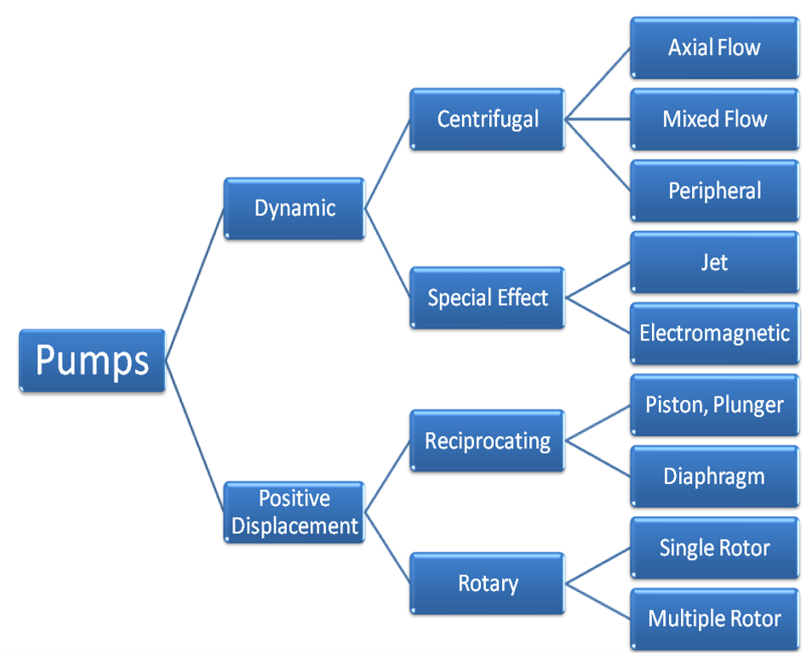
Classification of Pumps

Slide 4
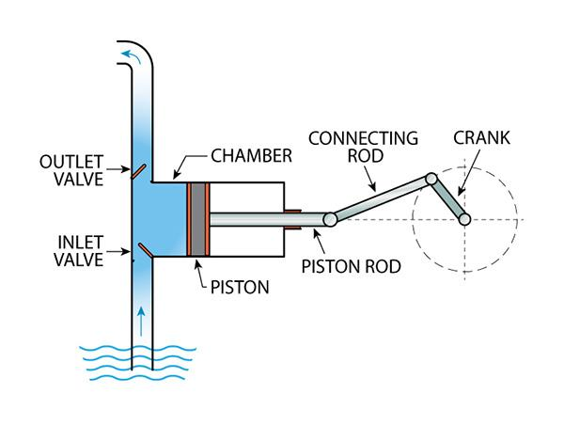
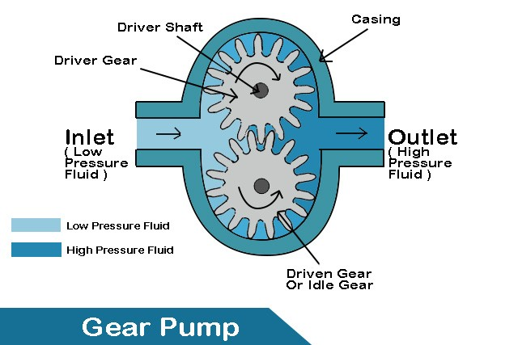
Positive Displacement Pumps
Working Principle: Traps a fixed amount of fluid and displaces it to create flow.
Types:
Reciprocating Pumps: Use a piston or diaphragm (e.g., Piston pumps, plunger pumps, diaphragm pumps)
APPLICATIONS: HIGH-PRESSURE APPLICATIONS, HYDRAULIC SYSTEMS.
Rotary Pumps: Use gears, screws, or vanes (e.g., Gear pumps, screw pumps, vane pumps)
APPLICATIONS: LUBRICATION SYSTEMS, FUEL TRANSFER, CHEMICAL PROCESSING.

Slide 5
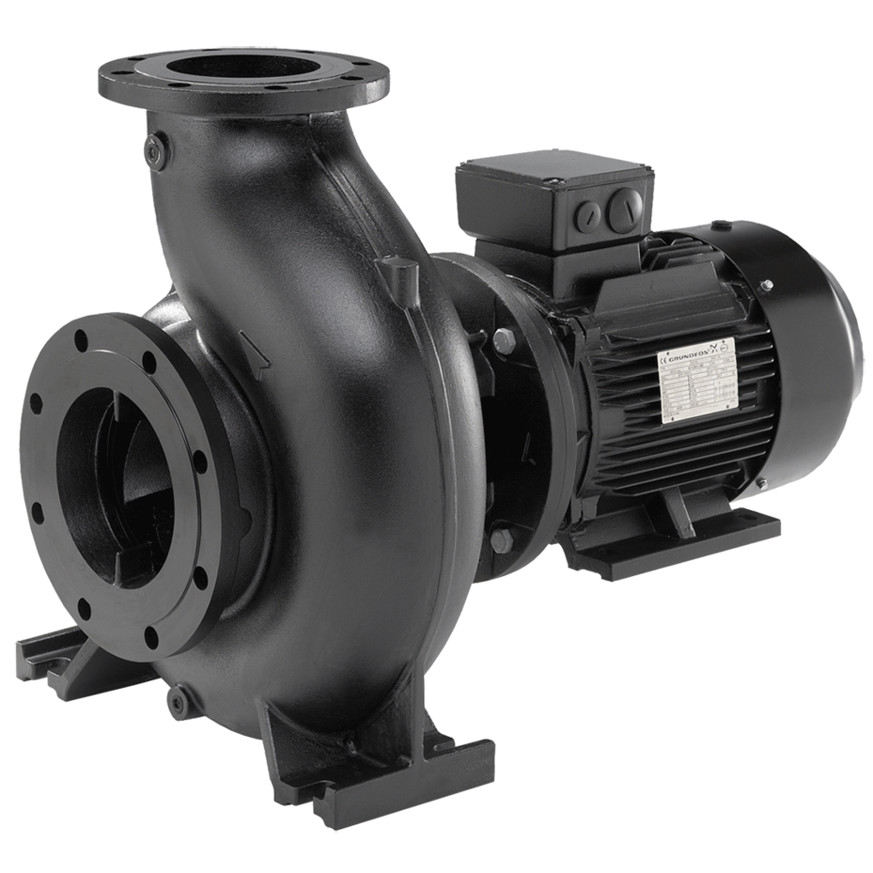
Dynamic Pumps
Working Principle: Adds energy to the fluid primarily through the dynamic action of the rotating impeller.
Centrifugal Pumps
Working Principle: Converts rotational kinetic energy to hydrodynamic energy, uses a rotating impeller to increase the velocity of a fluid.
APPLICATIONS: WATER SUPPLY, SEWAGE TREATMENT, CHEMICAL
INDUSTRIES.
Axial Flow Pumps
Working Principle: Fluid flows parallel to the pump shaft.
APPLICATIONS: HIGH FLOW, LOW HEAD APPLICATIONS, IRRIGATION, FLOOD CONTROL.

Slide 6
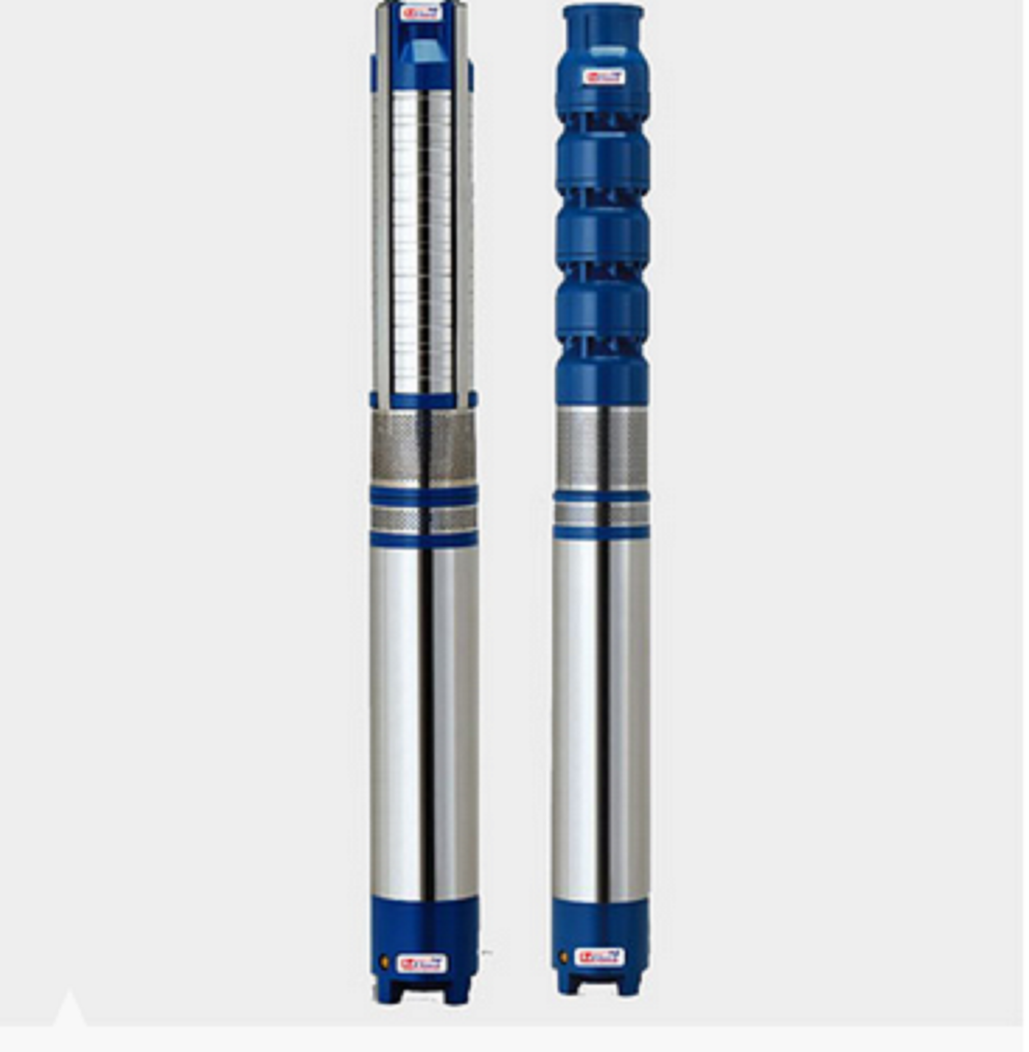
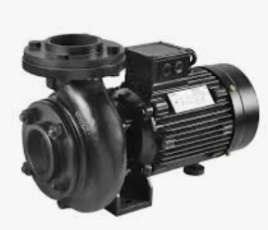
Centrifugal Pumps
Monoblock Pumps
(IS 9079)
Submersible Pumps
(IS 8034)

Slide 7
Terminology (3 of IS 5120)
Total suction head: This is equal to the static suction head minus the friction and entrance losses in suction pipe line
Total delivery head: This is the sum total of the static delivery head and the friction and exit losses in the delivery pipe line
Total head: This is the measure of the energy increase per unit mass of liquid imparted to it by the pump and is, therefore, the algebraic difference of the total delivery head and the total suction head
Net positive suction head (NPSH): This is the total suction head of liquid in metres, absolute, determined at the pump suction nozzle and corrected to pump datum less the vapour pressure head of the liquid at pumping temperature, at the suction nozzle in metres absolute
Specific Speed: it is a term used for classifying pumps on the basis of their performance and dimensional proportions regardless of their actual size or t h e speed at which they operate

Slide 8
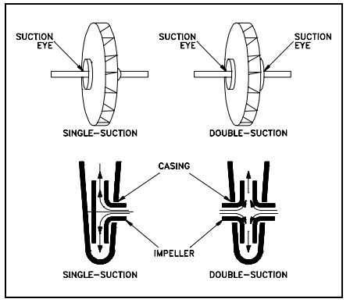
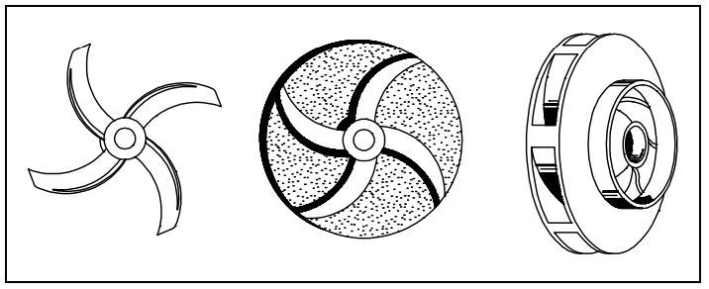
Impeller Classification
A rotating element producing head (table 1 of IS 5120)
Impellers can be either single suction or double-suction
Impellers can be open, semi-open, or enclosed
Single Suction & Double Suction Impellers
Open, Semi-Open and Closed Impellers

Slide 9
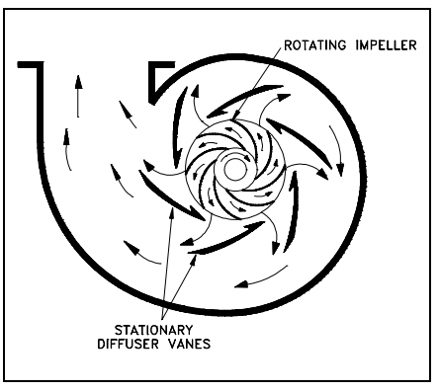
Diffuser
Some centrifugal pumps contain diffusers to increase the efficiency of the centrifugal pump by allowing a more gradual expansion and less turbulent area for the liquid to reduce in velocity. (table 1 of IS 5120)
The diffuser vanes are designed in a manner that the liquid exiting the impeller will encounter an ever increasing flow area as it passes through the diffuser.
This increase in flow area causes a reduction in flow velocity, converting kinetic energy into flow pressure
Diffuser

Slide 10
Why standards?
STRUCTURED TECHNICAL INFORMATION
raw material specification
BENCHMARKING PARAMETERS
safety requirements
REPEATABLE AND RE-PRODUCABLE TEST METHODS
technical data
ENABLES conformity assessment
information for consumers

Slide 11
Important Indian Standards on Pumps USED FOR AGRICULTURAL PURPOSE
Sl No. | IS No. | IS Title
1. | IS 8034 : 2018 | Submersible Pump Sets - Specification (Third Revision)
2. | IS 6595 (Part 1) : 2018 | Horizontal Centrifugal Pumps for Clear, Cold Water - Specification: Part 1 Agricultural and Rural Water Supply Purposes (Fourth Revision)
3. | IS 9079 : 2018 | Mono-set Pumps for Clear, Cold Water for Agricultural and Water Supply Purposes - Specification (Third Revision)
4. | IS 14220 : 2018 | Openwell Submersible Pumpsets - Specification (First Revision)
5. | IS 17018 (Part 1) : 2022 | Solar Photovoltaic Water Pumping Systems Part 1 Centrifugal Pumps Specification

Slide 12
Do you know? What is covered in product standard?

Slide 13
Contents of a product standard
SCOPE OF STANDARD
REFERENCES
TERMINOLOGY
CLASSIFICATION
DESIGN FEATURES
GENERAL REQUIREMENTS
SAFETY REQUIREMENTS
TOLERANCES ON SPECIFIED VALUES
TEST METHODS
INFORMATION FOR CONSUMERS

Slide 14
Components of Centrifugal Pump (table 1 of IS 5120)
Impeller : Rotating part that imparts kinetic energy to the fluid
Casing : Encloses the impeller and directs fluid flow
Pump shaft : Transmit power from the motor to the impeller
Suction nozzle : Inlet pipe that brings fluid into the pump
Discharge nozzle : Outlet pipe that discharges fluid from the pump
WHAT MATERIALS SHOULD BE USED FOR MANUFACTURING THEM?
STANDARD PROVIDES THE SOLUTION

Slide 15
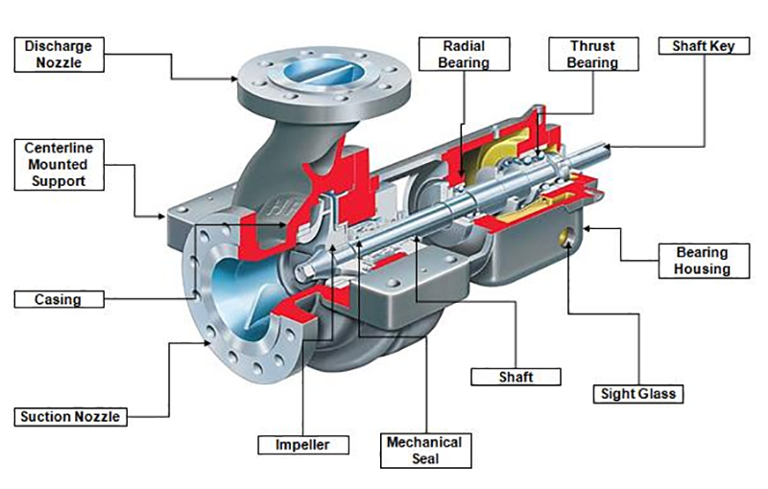
Components of Centrifugal Pump (table 1 of IS 5120)

Slide 16
Components of Centrifugal Pump (6.2 of IS 8034)
Sl No. | Component | Material of Construction (Parts Made of Casted/Moulded/ Sheet Metal Fabricated Process)
1. | Shaft Sleeve | Bronze grade LTB 2, 3, 4 or 5 of IS 318 or 12 percent chromium steel grade X 04 Cr 12, X 12 Cr 12 and X 20 Cr 13, X04Cr19Ni-9/10 conforming to IS 6911 or IS 6603
2. | Casing Wear Ring (if provided) | Bronze grade LTB 2, 3, 4 or 5 of IS 318 or nitrile rubber or NBR or plastic/technopolymer or X04Cr19Ni-9/10 of IS 6911
3. | Bush | Bronze grade LTB 2, 3 or 4 of IS 318 or nitrile/cutless rubber or NBR
4. | Discharge Casing/ Non Return Valve Housing | Cast iron grade FG 200 of IS 210 or plastic/technopolymer or X04Cr19Ni-9/10 of IS 6911
5. | Impeller | Bronze grade LTB 2 of IS 318 or stainless steel grade X 12 Cr 12 or X04Cr19Ni-9/10 of IS 6911 or IS 6603 or plastic/technopolymer
6. | Pump Bowl/Diffuser | Cast iron grade FG 200 of IS 210 or plastic/technopolymer or X04Cr19Ni-9/10 of IS 6911
7. | Pump Shaft | Stainless steel grade X 04 Cr 12, X 12 Cr 12 or X 20 Cr 13 or X15Cr16Ni2 of IS 6603
8. | Suction Casing | Cast iron grade FG 200/FG 260 of IS 210 or X04Cr19Ni-9/10

Slide 17
Do you know? What are parameters used for benchmarking of submersible pumps (IS 8034)?

Slide 18
Requirements of Pumps
General Requirements:
Material of construction (6.2 of IS 8034)
Design features & sizes ( 7 of IS 8034)
Balancing (8.5 of IS 8034)
Direction of rotation (8.7 of IS 8034)
Locked rotor test (9.9 of IS 8034)
Marking (14 of is 8034)
Performance requirements:
Pump efficiency (11.4 of IS 8034)
Overall efficiency (11.5 of IS 8034)

Slide 19
Electrical Performance & safety requirements
Insulation Resistance Test (9.2 of IS 8034)
High Voltage Test (9.3 of IS 8034)
Leakage Current Test (9.4 of IS 8034)
Temperature Rise Test (9.5 & 9.6 of IS 8034)
Breakaway (Starting) Torque Test (9.7 of IS 8034)
Speed (9.8 of IS 8034)
No load running of motor (9.9 of IS 8034)

Slide 20
Factors Affecting Performance
Impeller Design : Shape, size, and number of blades
Pump Speed : Rotational speed of the impeller
Fluid Properties : Viscosity, density, and temperature
System Configuration: Pipe length, diameter, and fittings

Slide 21
Do you know? What are the test methods?

Slide 22
√ Minimize human error √ Standard Testing Environment √ Standard Test Equipment √ Repeatable √ Reproducible √ Reliable Test Results
BENEFITS OF
STANTARD TEST METHODS

Slide 23
Test methods for Pumps
IS NO. | IS TITLE
IS 11346: 2002 | TESTS FOR AGRICULTURAL AND WATER SUPPLY PUMPS - CODE OF ACCEPTANCE (FIRST REVISION)
IS 17429: 2020 | SOLAR PHOTOVOLTAIC WATER PUMPING SYSTEMS - TESTING PROCEDURE - GUIDELINES
IS 9137: 2019 | CODE FOR HYDRAULIC PERFORMANCE ACCEPTANCE TESTS FOR CENTRIFUGAL, MIXED AND AXIAL FLOW PUMPS - CLASS C (FIRST REVISION)
IS 10981: 1983 | CODE OF ACCEPTANCE TEST FOR CENTRIFUGAL, MIXED FLOW AND AXIAL PUMPS - CLASS B
IS NO. | IS TITLE
IS 14536: 2018 | SELECTION, INSTALLATION, OPERATION AND MAINTENANCE OF SUBMERSIBLE PUMPSET - CODE OF PRACTICE (FIRST REVISION)

Slide 24
Test for Hydraulic Performance of Pump
Flow Measurement: (see 3.1.1 of IS 11346)
Volumetric Tank Method
Vee-Notch Method
Orifice Plate Method
Flow Meters
Measurement of Total Head (see 3.1.2 of IS 11346)
Delivery Head Measurement by Mercury Manometer or Pressure Gauge
Suction Head Measurement by Vacuum Gauge or Mercury Manometer
Head measurement by pressure transducers
Power Measurement (see 3.1.3 of IS 11346)
Speed (see 3.2.4 of IS 11346)

Slide 25
Routine and type tests
Routine tests are to be carried out on every unit of pump sets manufactured (repeatable tests)
Type tests required not to be carried out on every unit of pump sets (sampling basis). Testing carried out only when there is change in design

Slide 26
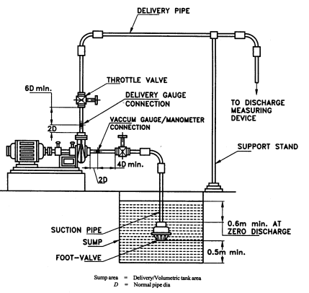
TYPICAL TEST SETUP FOR
NON-SELF-PRIMING PUMPS

Slide 27
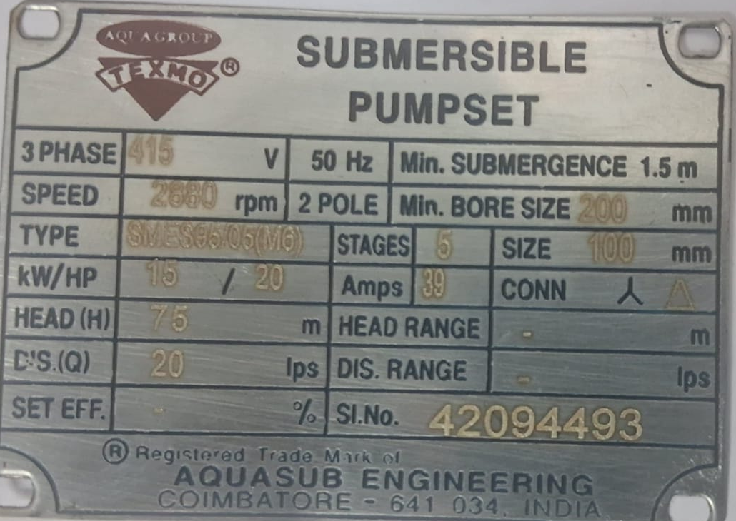
Markings on Pump (14 of is 8034)
A name plate of corrosion-resistant material is affixed on the pumpset with the following details:
a) Manufacturer’s name or trade-mark, if any;
b) Model;
c) Serial No.;
d) Number of stages;
e) Bore size, Min;
f) Head, at nominal duty point;
g) Discharge, at nominal duty point;
h) Overall efficiency;
j) Motor rating (kW);
k) Rated speed (rpm);

Slide 28
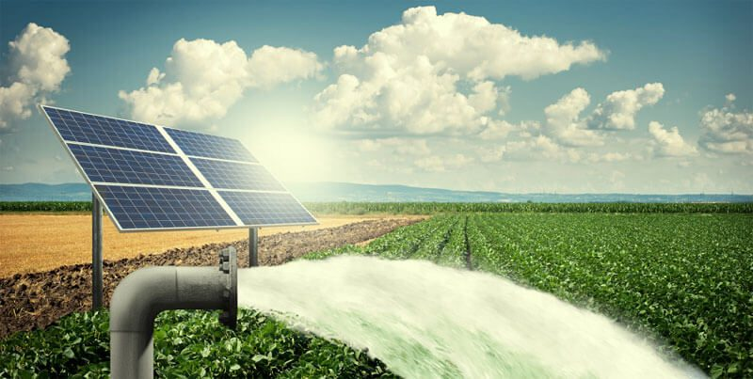
Solar Photovoltaic (SPV) Water Pumping System
Constructional Features [4 of is 17018 (part 1)]
Motor Pumpset
SPV Pump Controller
Module Mounting Structures (MMS) and Tracking System
Testing of SPV Pumps using PV array simulator (IS 17429)
Hot and Cold day solar irradiance profiles

Slide 29
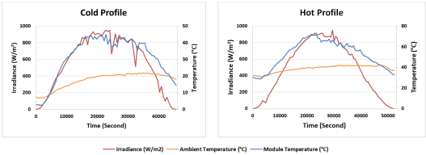
Typical Solar Radiation Hot and Cold Profile (5.2 of is 17429)

Slide 30

Conformity assessment
Standards enables third party certification (bis product certification)
The submersible pump sets may also be marked with BIS Standard Mark, if obtained from the Bureau of Indian Standards.

Slide 31
CONCLUSION
Solutions by standards:
consumer : information required for purchasing a pump
Manufacturer : quality assurance and competitive advantage
Govt. Depts. : no need to have separate technical specifications
entrepreneur : no reinventing of wheel, use existing standards as building blocks
professionals : availability of standard testing procedures
Environment : improved power efficiency and safety
Society : quality culture

Slide 32

Thank You !

