Slide 1

ROLE OF GEOSPATIAL TECHNOLOGIES IN INFRASTRUCTURE PLANNING
Delivered by:
Electronics and IT Department
BUREAU OF INDIAN STANDARDS

Slide 2
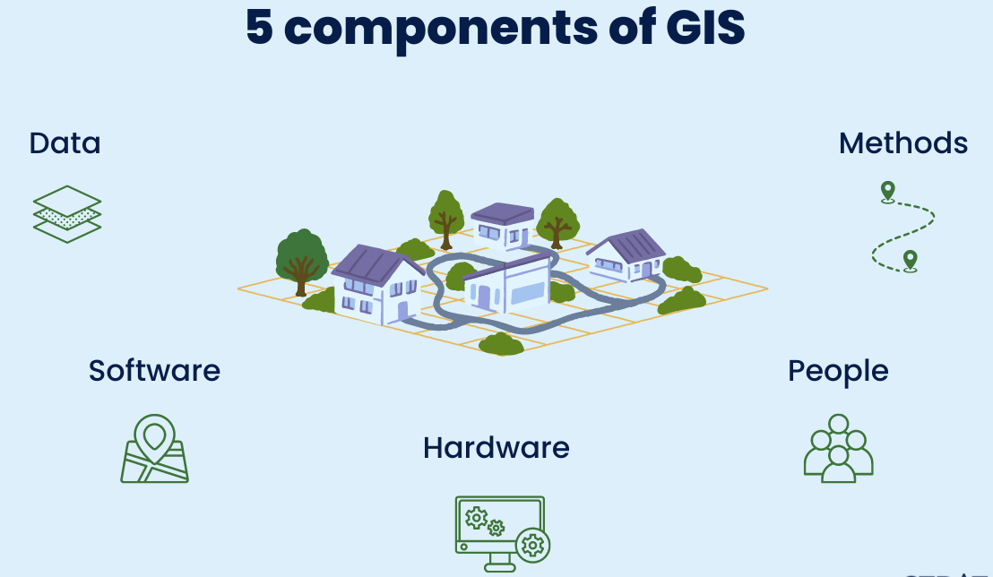
INTRODUCTION TO GEOSPATIAL TECHNOLOGIES AND TOOLS
Overview of Geographic Information Systems (GIS) for mapping and analysis
A geographic information system (GIS) is a system that creates, manages, analyzes, and maps all types of data. GIS connects data to a map, integrating location data (where things are) with all types of descriptive information (what things are like there).
Notes:
Hardware:
Hardware includes the physical tools and devices used to run GIS software and process spatial data. This includes computers, servers, GPS devices, scanners, and plotters. Advanced hardware, such as drones and LiDAR systems, is also used for data collection and mapping.
Software:
GIS software provides the tools to store, analyze, and visualize spatial data. Popular GIS software includes ArcGIS, QGIS, and Google Earth. These platforms enable tasks such as data manipulation, spatial analysis, and map creation, offering a wide range of functionalities for various applications.
Data:
Data is the most critical component of GIS. It consists of spatial data (location-based information like coordinates and boundaries) and attribute data (descriptive information such as population, land use, or elevation). Accurate and updated data is essential for meaningful analysis and decision-making.
People:
People are the users who operate GIS tools, analyze data, and apply insights to solve real-world problems. They include GIS specialists, surveyors, urban planners, and decision-makers. Proper training and expertise are crucial for effective GIS use.
Methods:
Methods refer to the processes, models, and workflows used to collect, analyze, and interpret GIS data. This includes best practices for data acquisition, analysis techniques, and standardized protocols to ensure accuracy and consistency in GIS projects.

Slide 3
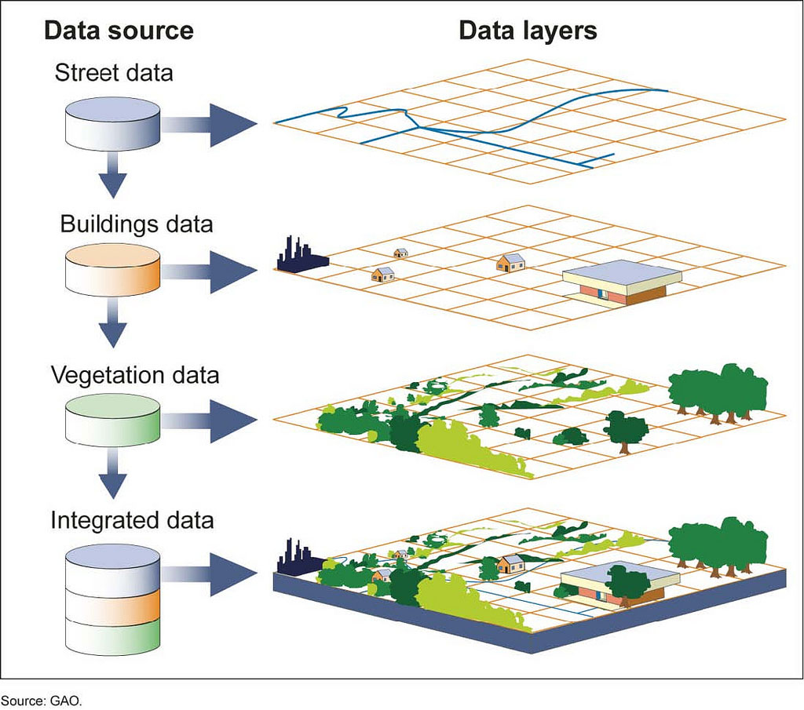
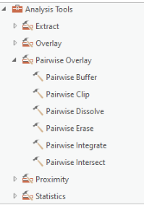






Geographic Information Systems (GIS)
Geospatial Analysis Tools encompass a wide range of software applications, libraries, and platforms used for processing, analyzing, and visualizing geographic data. Some commonly used tools are ArcGIS, QGIS, Python Geospatial Libraries, R Spatial Packages, Google Earth Engine, Network Analysis Tools.

Slide 4
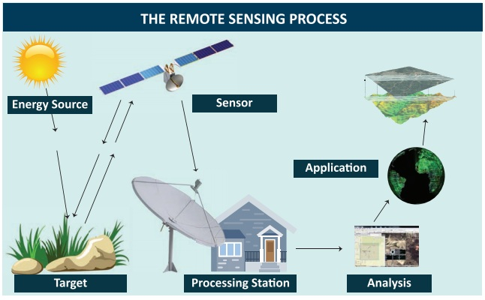
Role of Remote Sensing in monitoring and planning
Remote sensing is the process of detecting and monitoring the physical characteristics of an area by measuring its reflected and emitted radiation at a distance (typically from satellite or aircraft).
Notes:
Energy Source (Illumination):
The process begins with a source of electromagnetic energy (e.g., the Sun or artificial sources) that illuminates the Earth's surface.
Interaction with the Surface:
The energy interacts with objects on the Earth's surface, being absorbed, reflected, or transmitted depending on the material properties.
Data Acquisition (Sensor):
Sensors on satellites, drones, or aircraft capture the reflected or emitted energy. These sensors record data in various wavelengths, such as visible light, infrared, or microwave.
Data Transmission and Processing:
The collected data is transmitted to ground stations, where it undergoes processing to remove noise, correct distortions, and convert raw signals into usable images or datasets.
Data Analysis and Interpretation:
The processed data is analyzed to extract information. This may involve classifying land cover, monitoring environmental changes, or detecting patterns for specific applications like agriculture, urban planning, or disaster management.

Slide 5
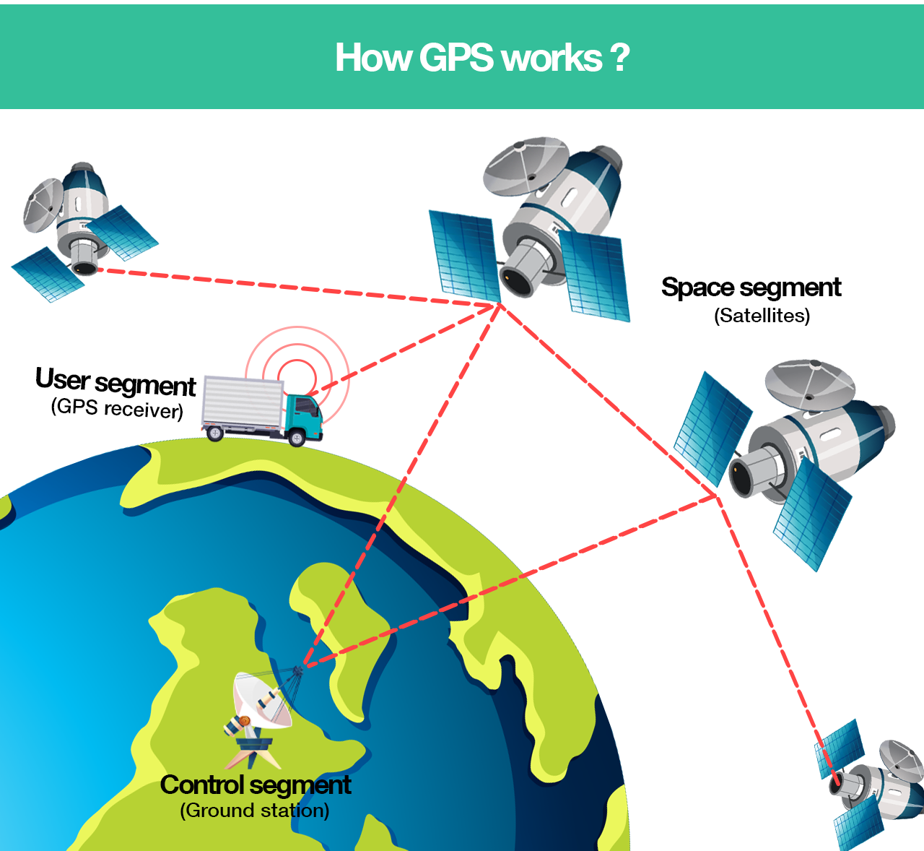
Basics of Global Positioning Systems (GPS)
There are five main uses of GPS:
Location — Determining a position.
Navigation — Getting from one location to another.
Tracking — Monitoring object or personal movement.
Mapping — Creating maps of the world.
Timing — Making it possible to take precise time measurements.
Notes:
GPS (Global Positioning System) is a satellite-based navigation system that provides precise location, velocity, and time information anywhere on Earth, as long as there is an unobstructed line of sight to four or more GPS satellites.

Slide 6


APPLICATION OF GEOSPATIAL PLANNING IN RESOURCE MANAGEMENT
Case Study: PM GatiShakti Mission
The PM GatiShakti Mission is a prime example of application of Geospatial technologies in Infrastructure planning.
Started by the Indian government with the goal of integrating and optimizing infrastructure development across many sectors in order to minimize delays, cut expenses, and foster economic growth.
Notes:
It operates on a comprehensive digital platform powered by GIS-based systems that integrate geospatial data from various sectors. This facilitates precise planning by identifying optimal routes, assessing terrain, and analyzing connectivity between key industrial, logistic, and economic hubs. The mission emphasizes coordination among multiple stakeholders, including central and state government departments, private contractors, and local authorities.

Slide 7
APPLICATION OF GEOSPATIAL PLANNING IN RESOURCE MANAGEMENT
Case Study: Designing an Industrial Corridor from Delhi to Alwar Using PM GatiShakti Mission
The development of industrial corridors, such as the proposed Delhi to Alwar corridor, presents numerous challenges in terms of planning, execution, and sustainability. Key among these challenges is the lack of integrated spatial data to assess land suitability, environmental impacts, and connectivity to existing infrastructure such as roads, railways, and ports. Traditional planning methods often rely on fragmented datasets and manual processes, leading to inefficiencies, increased costs, and delays in project execution.
This case study highlights the role of geospatial technologies in planning, designing, and implementing an industrial corridor.
Parameters for Designing the Corridor
Agencies
Environmental Impact Assessment
Risk and Hazard Mapping
Land Use and Land Cover Analysis (LULC)
Surveyors
Demographic and Socioeconomic Analysis
Connectivity Mapping
Terrain Analysis
Industrial Corridor from Delhi to Alwar
Notes:
Land Use and Land Cover Analysis (LULC): To identify suitable areas for industrial zones, avoiding ecologically sensitive zones or agricultural lands.
Connectivity Mapping: To map existing transportation networks (roads, railways, and airways) ensures seamless integration and improved multi-modal connectivity.
Environmental Impact Assessment (EIA): It identifies eco-sensitive areas, such as wetlands and forests, to minimize environmental disruption.
Demographic and Socioeconomic Analysis: Analyzes population density, workforce availability, and proximity to markets, ensuring the corridor supports economic development.
Risk and Hazard Mapping: Geospatial tools identify natural hazard-prone areas, such as flood zones, to design resilient infrastructure.
Terrain Analysis: Using digital elevation models (DEMs) and contour mapping to optimize the alignment of the corridor, avoiding steep terrains and reducing construction costs.

Slide 8
APPLICATION OF GEOSPATIAL PLANNING IN RESOURCE MANAGEMENT
Case Study 2: Geospatial Framework for Affordable Housing Projects
Traditional site selection processes often rely on manual surveys and incomplete data, leading to suboptimal decisions that overlook critical factors such as land suitability, accessibility, infrastructure availability, and environmental impact.
Planning and Execution
land availability, proximity to public amenities, environmental constraints demographics, land use, and infrastructure.
Stakeholder Collaboration
Urban development authorities partnered with local governments, housing developers, and financial institutions.
Risk Management
Challenges like data inaccuracies and conflicting land claims can be mitigated through ground surveys
Quality and Safety
Compliance with building codes and environmental regulations can be ensured through GIS-based impact assessments.
Sustainability
minimize urban sprawl & integrating green spaces into housing projects, ensuring long-term liveability

Slide 9
STANDARDS OF GEOSPATIAL INFORMATION
Geospatial Standards
Importance of Data Standards
Focussed Expert Groups with technical support
Academia – Industry to be involved
Coordination & Monitoring
Fundamental Data Standards are necessary for Interoperability
ISO/OGC standards need to be studied and Indian profiles be made in conjunction with BIS
These be adopted as national standards by BIS
Focussed expert groups for various themes need to be created
Technical support embedded with the committees i.e. Data Modellers / Standards Experts/ Documenters
Lead dept to operationalize such committees
Academia and Industry along with domain experts to be further utilized to support formation of standards by the committees
New standards for latest geospatial aspects such as LiDAR, NavIC Receivers, Cadastral Data are in process
Lead depts of TWGs should create Standardization Cell to develop profiles in respective domain.
TWGs should submit the draft to BIS to be developed as Indian Standard

Slide 10
National Fundamental Geospatial Data Themes
Sl. | Thematic Working Groups (TWGs) | Nodal Ministry/Dept | Convener | Draft Standard (UC)
1. | Geodetic Reference Frame | SOI | Dr U N Mishra | Geodetic Reference Frame - Specs
2. | Orthoimagery | SOI | Shri Sandeep Shrivastava | Orthoimage - Specifications
3. | Functional Areas (Administrative Boundaries) | SOI | Sh S V Singh | Administrative Boundaries (P Draft)
4. | Geographical Names (Toponymy) | SOI | Sh Mahesh Ravindranathan
5. | Elevation and Depth | SOI | Ms Bindu Manghat (Elevation) | Elevation - Specifications
6. | Water | DoWR
7. | Transport Networks | MorTH, MoR, MoCA
8. | Buildings and Settlements | MoHUA, MoPR
9. | Land Cover and Land Use | NRSC, FSI
10. | Physical Infrastructure | MoHUA and MoPR
11. | Land Parcels | DOLR | Sh Kunal Satyarthi (DoLR) | LADM (IS 18594)
12. | Addresses | Dept of Posts | Sh Dushyant Mudgal (Posts) | DIGIPIN
13. | Geology and Soils | GSI and NBSSLUP |  | DCS – Soils, Geology and Forestry
14. | Population Distribution | ORGI
Notes:
The National Geospatial Policy, 2022 (the Policy) is a citizen-centric policy that seeks to strengthen the Geospatial sector to support national development, economic prosperity and a thriving information economy. The Policy builds on conducive environment generated by the “Guidelines for acquiring and producing Geospatial Data and Geospatial Data Services including Maps” dated 15.02.2021 (the Guidelines), issued by Department of Science and Technology (DST), Government of India (GoI).

Slide 11
Key standards of Geospatial Information
SI. No. | IS No. | Title
1. | IS 13393 : 2017; ISO 6709 | Standard representation of geographic point location by coordinates (First Revision)
2. | IS 16439 : 2016 | Metadata standard for geospatial information
3. | IS 16554 : 2017 | Data exchange standard for geospatial information
4. | IS 16626 : 2017; ISO 19136 : 2007 | Geographic information - Geography markup language (GML)
5. | IS 16626 (Part 2) : 2018; ISO 19136-2 : 2015 | Geographic information - Geography markup language (GML): Part 2 extended schemas and encoding rules
6. | IS 16699 : 2018; ISO 19128 : 2005 | Geographic information - Web map server interface
7. | IS 16701 : 2021; ISO 19142: 2010 | Geographic information — Web Feature Service
8. | IS 16966 : 2018; ISO 19132 : 2007 | Geographic Information — Location-Based Services — Reference Model
9. | IS 16967 : 2018; ISO 19133 : 2005 | Geographic information - Location - Based services - Tracking and navigation
10. | IS 16968 : 2018; ISO 19134 : 2007 | Geographic information - Location - Based services - Multimodal routing and navigation
11. | IS 16970 : 2018; ISO 19109 : 2015 | Geographic information - Rules for applications schema
12. | IS 17007 : 2018; ISO 19103 : 2015 | Geographic information - Conceptual schema language
13. | IS 18565 (Part 1) : 2024; ISO 19157-1 :2023 | Data quality Part 1 General requirements
14. | IS 18565 (Part 2) : 2024; ISO/TS 19157-2 | Geographic Information Data Quality Part 2: XML Schema Implementation
15. | IS 18594 : 2024; ISO 19152:2012 | Land Administration Domain Model (LADM)
16. | IS 18620 (Part 1) : 2024; ISO 19168-1:2020 | Geospatial API for features Part 1: Core

Slide 12
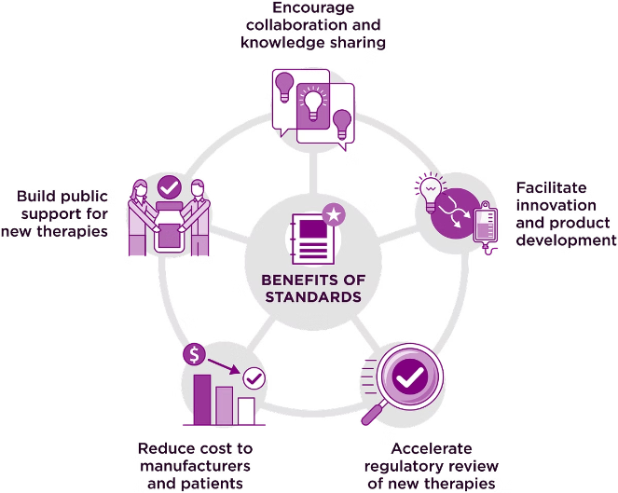
Importance of data accuracy, interoperability, and metadata in geospatial systems
Data accuracy ensures the information used for planning and analysis reflects real-world conditions, minimizing errors. Projects like road construction or utility network planning require precise spatial data to avoid costly errors and delays.
Interoperability ensures that diverse geospatial systems, datasets, and software can work together seamlessly, which is essential in complex projects involving multiple stakeholders.
Metadata is the descriptive information about geospatial data that ensures its usability, reliability, and transparency.

Slide 13
Key challenges in geospatial planning implementation
Case study: Mapping Sewer Lines for Sustainable Urban Sanitation
Problem: India faces a critical challenge in managing its sewer systems due to rapid urbanization and outdated infrastructure. Many urban areas lack proper maps of existing sewer lines, resulting in inefficient planning, frequent blockages, and environmental contamination.
Solution: By integrating spatial data with existing sewer infrastructure, GIS can create accurate and interactive sewer line maps. Integrating Artificial Intelligence (AI) into GIS-based solutions can amplify efficiency and accuracy in addressing India’s sewer line challenges.
Surveying Existing Infrastructure
pipe dimensions, connections, and flow directions
predict future demand for sewer infrastructure
most efficient routes for new sewer lines, factoring in cost, environmental impact, and construction feasibility.
Planning New Sewer Lines
Optimizing Routes and Resources
Real-Time Monitoring and Maintenance

Slide 14

Thank You…

