Slide 1

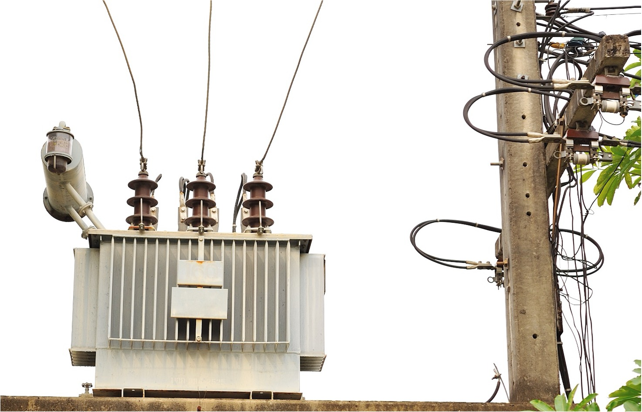
Repair of Distribution transformers-Code of practice
Electrotechnical Department
Bureau of Indian Standards, New Delhi
Notes:
NOTE:
To change the image on this slide, select the picture and delete it. Then click the Pictures icon in the placeholder to insert your own image.

Slide 2
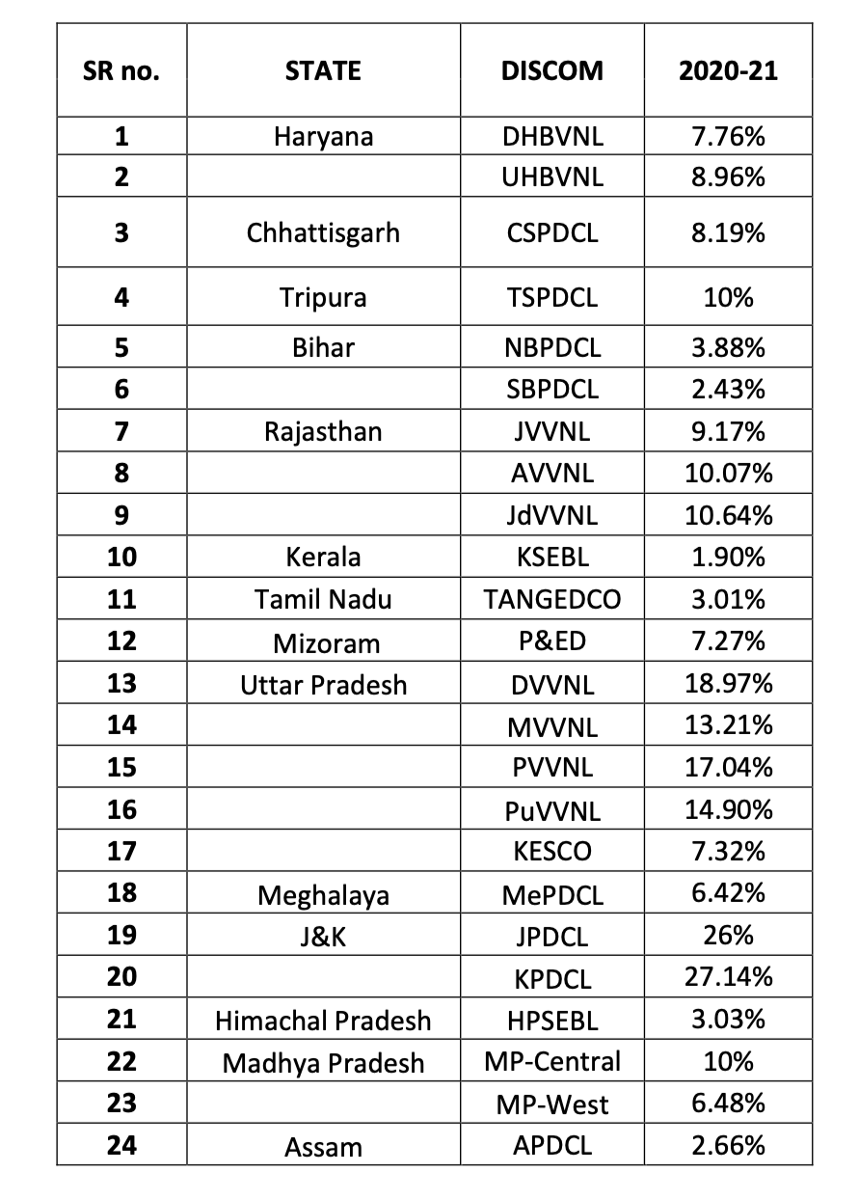
Failure Rates of Discoms in the country during 20-21 as per Operational & Maintenance of Distribution Transformers Guidelines published by CEA in 2023

Slide 3
Importance of Quality Repair of Distribution Transformers
Ensures Reliable Power Supply
Reduces Economic Losses
Enhances Operational Efficiency
Promotes Safety
Prevents Repeated Failures
Prolongs Transformer Lifespan
Ensures Performance Optimization
Supports Environmental Sustainability

Slide 4

Major Causes of Failure of Distribution Transformers During Service
Factors Related to Manufacturing | Factors Related to Installation and Service | External & Internal Faults | Ageing & Material Related Factors
Design Defects, Improper Clearances etc. Selection and Use of Substandard Raw Materials, Components etc. Poor Workmanship Inadequate in-process and quality controls. Improper Testing and Inadequate Checks before Dispatch. | Lack of Information of Load Profile of the Site. Improper/Loosened Connectors, Unsupported Cables. Improper Earthing Inadequate rating of drop out fuse. Low Oil Level due to unattended oil leakages. Aged Silica Gel Breather or Loss of Breather. Lack of Condition Monitoring Mechanism. | Transient Overvoltage Surges and Lightning. External Short-Circuits. Internal Faults. High Inrush Current due to Pump/Motor Loads in Agricultural Area. Overheating and Hotspots due to Overloads. Effects of Non-Linear Loads. | Ageing and DC Magnetization effect on Core. Loosening of Core due to continuous vibrations. Creep Behaviour of Winding Conductors & Loosening thereof. Insulation Material Ageing and Deterioration. Change in Oil Characteristics due to Moisture & Ageing. Loosening of Gaskets and Washers during Service. Damaged bushings or Worn Metal Parts

Slide 5
Consequences/Impacts due to Improper Repair of Distribution transformers
Reduced Reliability and Performance
Safety Hazards
Shortened Transformer Lifespan
Increased Operational Costs
Environmental Risks
Economic Losses
Regulatory Penalties
Reputation Damage

Slide 6
Need for Formulation of IS 18284:2023
DTs are backbone of electrical distribution network.
Internal and external factors for failure of DTs which results into interruption of power supply to consumers.
Disruption affects economy of nation in the form of loss of revenue, materials, repairing charges etc.
Approx INR 10,900 Crores incurred per annum towards Repair and Replacement (Repair- INR 4,300 Crores and Replacement-INR 6,600 Crores).
Standardize the Repairing of Failed Distribution Transformers for the reduction of failures.
Supports SDG 12-Responsible Consumption and Production.

Slide 7
Challenges Encountered during Repairing of Transformers

Slide 8
Challenges Encountered during Repairing of Transformers
Core and Assembly Issues
Insulation degradation, mechanical damage, or alignment problems in the core and coil assembly.
Damage to the Accessories
Damage to accessories such as bushings, Gaskets, Radiators, and Tap changers.
Loss Evaluation and Energy Efficiency
Increased losses post-repair leading to efficiency drops.
Assembly and Testing Procedures
Improper reassembly causing mechanical misalignments or electrical faults.
Oil Contamination and Breakdown Voltage
Contaminated or degraded dielectric oil leading to lower breakdown voltage (BDV).
Transport and Packaging
Damage during transportation due to improper handling

Slide 9

Repair of Distribution Transformers-Code of Practice (IS 18284:2023)
IS 18284:2023 provides guidelines along with the tests including failure analysis and record keeping for the repair of
Liquid immersed
Dry-type
Outdoor/indoor type
Stacked core/wound core with CRGO or amorphous core material
Double wound DTs with nominal system voltages upto and including 33KV.
Liquid-immersed: Oil/Natural Ester/Synthetic-Organic Ester:
3-phse ratings upto and including 2500KVA(Sealed and non-sealed).
1-phase ratings upto and including 100 KVA(Sealed type).
Dry-type:
3-phase ratings upto and including 3150KVA
1-phase ratings upto and including 100KVA
IS 18284:2023 supports SDG 12- Responsible Consumption and Production

Slide 10
Salient Features of IS 18284:2023
General Requirements
Record Keeping
Testing and Quality Control
Pre and Post Repair Testing
Calibration of equipment
Environmental and Safety Standards
Oil Handling
Painting and Coating
Personnel Safety

Slide 11
Salient Features of IS 18284:2023
Labelling and Traceability
Transport and Packaging
Material and Component Standards
Testing Facilities and Equipment
Retro-Filling with Ester Fluids

Slide 12
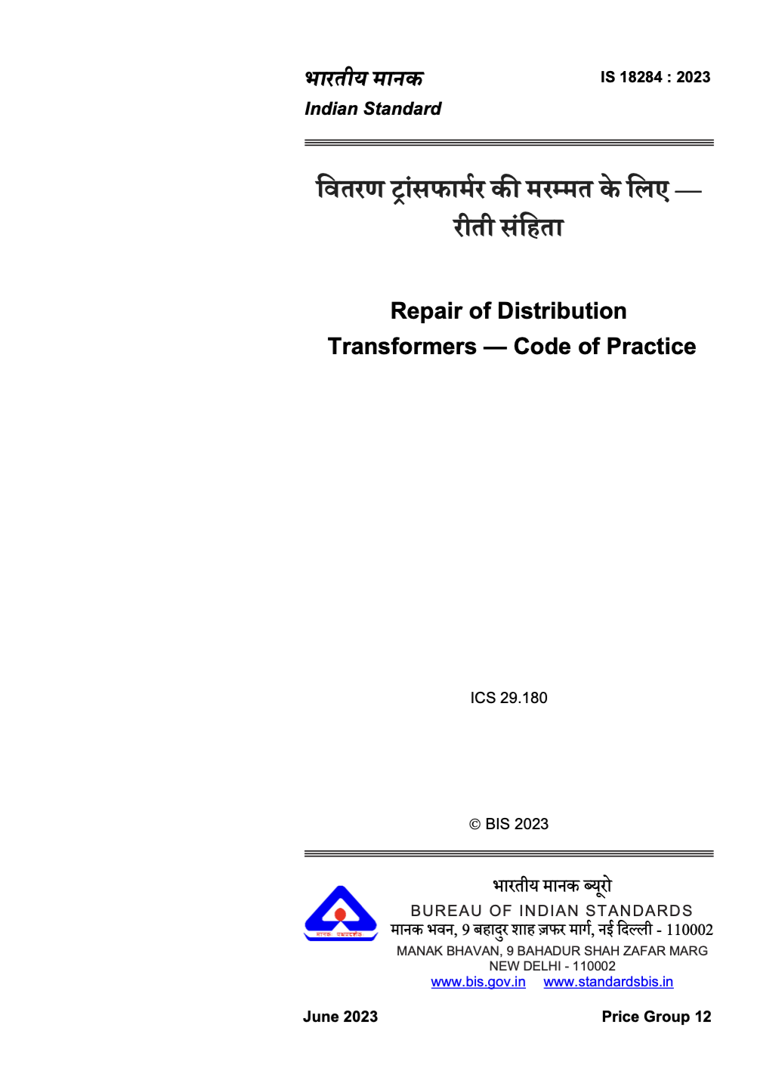
Overview of IS 18284:2023

Slide 13

Classification of Repair Activities
Extent of repair
Repair Activities
Minor repair work
Major repair work
Defines general guidelines for all kinds of repair
works.

Slide 14



General
Identification: 4 important Aspects
Regarding failure site of the transformer as stated by customer including accidents if any.
Which is crucial and to be kept by the service center for records;
That is to be attached to the transformer part being repaired; and
That can be assessed and retained by the customer post repair work.
Record Keeping
Nameplate
Service Centre Labels
Safety Considerations
Assessment/Investigation for failure of transformer
Cleaning

Slide 15
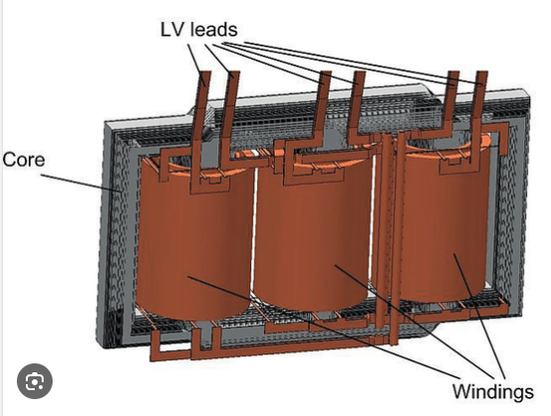
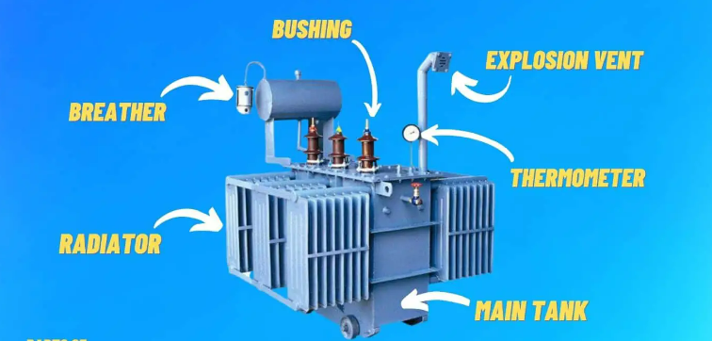
General
Terminals
Leads
Connectors
Enclosures
Accessories
Tanks, Radiators and Enclosures

Slide 16
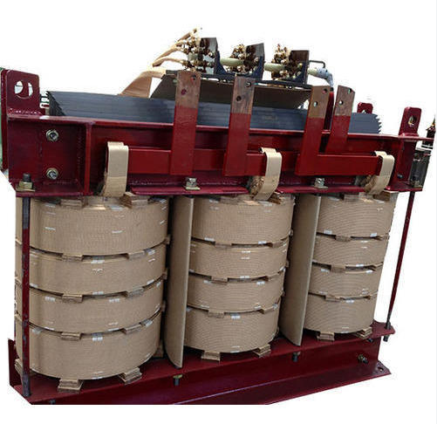
Repair of Core Coil Assembly
The most common rewind is that which is based on the original design. The winding process has essentially three components:
the investigation of the original failure
gathering physical data for the existing core and coils; and
the actual winding of the new coils.
The capacity and energy performance of the transformer can be enhanced, depending on the condition and data of the existing core and tank, by core and/or winding augmentation. For details, (see Annex B).

Slide 17
Repair of Core Coil Assembly
Investigation:
Failure
Record keeping
Features
Fault
Detailed information
Transformer received for repair
Check no-load losses
< 15 % of the original no-load losses
> 15 % of the original no-load losses
Transformer shall be repaired
Core shall be scrapped

Slide 18
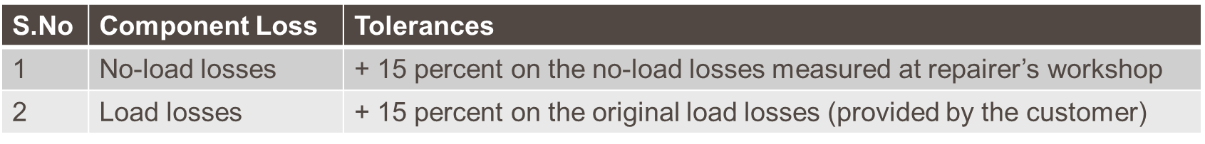
Repair of Core Coil Assembly
The total losses (pre-repair) shall then be calculated as below:
Total Losses (pre-repair) = No-load losses measured at repairer’s workshop + original load losses (provided by the customer)
After repair, the total losses shall be measured and the same shall not exceed the total losses (pre-repair) by more than 10 percent that is
Total Losses (post-repair) ≤ 110 percent (that is 1.10) × Total Losses (pre-repair)
The tolerances on component losses (that is no-load losses and load losses) measured post-repair shall be as below
NOTE — The tolerance values specified in above clauses are not applicable for repair of distribution transformers during the warranty period.

Slide 19
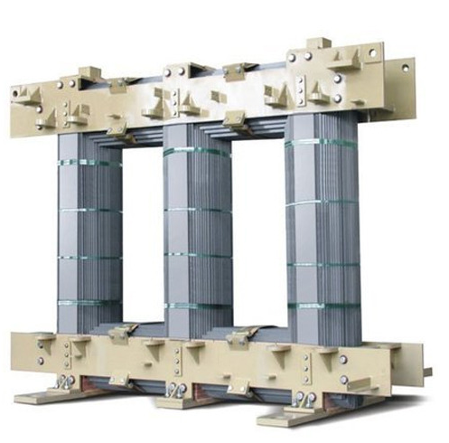
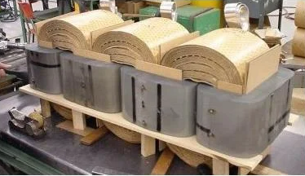
Repair of Core Coil Assembly
Data Collection
Coil Winding
Core Laminations
Cores are generally stacked cores or wound cores.
Disassembly of Stacked Cores (CRGO)
Assembly of Stacked Cores and Coil
Disassembly of Wound Cores (CRGO)
Assembly of Wound Cores and Coils
Disassembly of Amorphous Wound Cores
Assembly of Amorphous Wound Cores
Connections and Joints
Connections in the Winding
External Connections
Insulating Connections

Slide 20
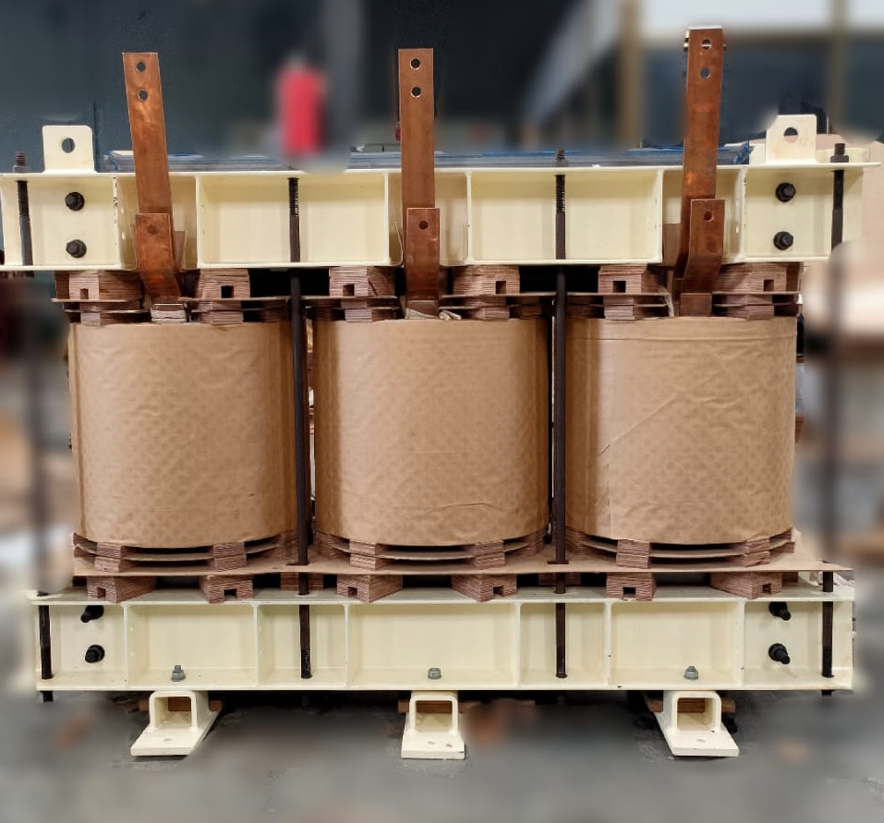
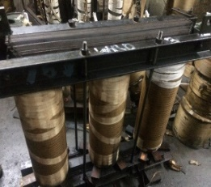
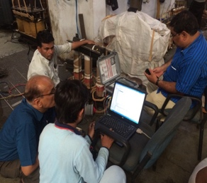
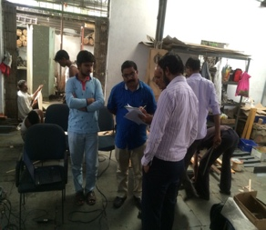
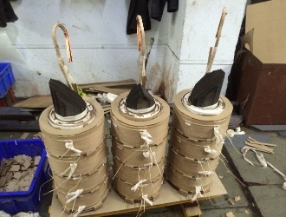
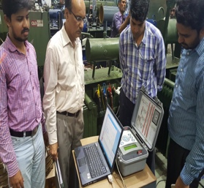
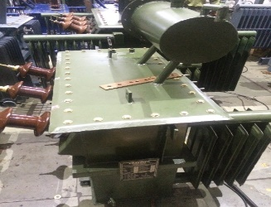
Repair of Core Coil Assembly
Leads and Winding Connections as per Vector Group
Final Assembly of the Transformer (After Repair)
DT Selection
Pre-repair Testing
Design solutioning
Active Repair Execution
Post Repair Testing
Reporting

Slide 21
Repairing of Liquid-Filled Transformer
The operations to repair a liquid-filled transformer are similar to those described for dry-type transformers except final assembly and impregnation process.
Much of the additional work required relates to the dielectric fluid and the tank. Retro-filling, as indicated in Annex C, helps to increase the life of the transformer, it is overloading capability, and makes it eco-friendly and safer from fire safety point of view.
Checking for Service Suitability
Tests
Equipment Checks
Summary of Results
Preparation for Shipment

Slide 22
Repairing of Liquid-Filled Transformer
Overhauling
Preliminary Inspection and Tests
Removal of Core and Coils
Major Inspection and Tests
Cleaning and Repairs
Reassembly
Final Tests
Packaging and Shipment
Rewind
Inspection and Test
Dismantle (for Three-Phase Unit if Necessary)
Winding New Coils
Reassembly
Final Tests
Shipment

Slide 23
Repairing of Dry-type Transformer
Three basic levels of repair: verifying service suitability, overhaul and rewind or another major component replacement.
Checking for Service Suitability
All name-plate data should be recorded on the service order form
Tests
Equipment Checks
Summary of Results
Preparation for Shipment
Overhauling
Rewind
Inspection and Test
Dismantle Core and Coil Assembly (for Three Phase Transformers)
Winding of New Coils
Reassembly
Final Tests
Shipment

Slide 24

Painting
The transformer should be painted.
Specify the colour
Know its characteristics, and be aware of safety and health hazards the product presents
Be aware of any environmental regulations covering the usage of product
Under controlled conditions according to the paint manufacturer’s instructions.
Heated, well-ventilated area isolated from other personnel.
A paint booth or spray recovery system
Safety equipment
Clean and free from oil and grease
It is important to protect items such as bushings or gauges during the painting process.
The coverings on the bushings and any other items should be removed when the paint has cured.

Slide 25
Packing and Transportation
Labelled
Packaged to prevent damage during transportation to the customer
The type of packaging and method of transport should be provided to the transport company and the customer.
It should be confirmed that no PCB contamination is present in the liquid filled transformers.
The distribution transformer should be transported generally in liquid-filled condition. In either case, the transport agency should be equipped with an emergency response kit.
Additional protection should be provided for fragile items such as bushings, gauges, etc.
Extra care should be taken to secure and support enclosures for dry-type transformers to avoid damage by crushing during shipment.
For larger units, the enclosure may be disassembled, or special supports can be fabricated to prevent damage.
For smaller units, this can be achieved by bolting the enclosure (and core and coil assembly) to a pallet.
In all cases, it should be ensured that the transformer has been securely tied to the transport vehicle and is properly protected against the weather.
Unless otherwise instructed by the customer, the tap switch or tap connections should always be set at the rated voltage position.

Slide 26
Enhancing Reliability and Energy Performance in Repaired Distribution Transformer
Active Repair of Distribution Transformers
The loading capacity, energy efficiency and overall reliability of the repaired distribution transformers can be enhanced by way of augmentation or replacement of the active materials – core and winding, depending on the condition and design of the existing core and tank. This type of repair is commonly known as ‘active repair of distribution transformers.
Types of Active Repairs
Core Augmentation
Core augmentation can help in reducing the no-load losses. However, generally, the core is left unchanged. A repairer may consider replacement of core or a part of it or damaged laminations by maintaining the matching geometry, if necessary.
NOTE — The laminations shall comply with the existing regulations if any.

Slide 27
Enhancing Reliability and Energy Performance in Repaired Distribution Transformer
Winding Augmentation
Winding augmentation is an approach to increase a transformer’s useful life by improving its no load and load loss characteristics.
Augmenting refers to replacing high resistivity winding material with low resistivity material, using material with lower thermal coefficient of linear expansion etc. in one or both the windings.
Distribution transformers can be modified to take increased load potential by maximizing the efficiency at which excess heat is dissipated from the main core and windings.
Target for Loss Reduction during Repair of Distribution Transformer
During active repair efforts should be put to attain as close as possible to energy efficiency level 1 of total losses (No Load + Full Load) at least at 100 percent loading as per IS 1180 series.

Slide 28
Enhancing Reliability and Energy Performance in Repaired Distribution Transformer
Aspects to be considered before changing the material of conductor
Electrical Properties
Physical Properties
Thermal Properties
Mechanical Properties

Slide 29
List of Major Equipment required for Repair and Testing of Distribution Transformers
Major Equipment required for Repair | Major Equipment required for Testing
LV & HV Coil Winding Machine (For Layer/Crossover/Disc type Coil) Insulation Cutting/Shearing Machine Manual Press Machine-For Dovetailed Spacer/Block Cutting Air Drying Oven Weighing Machine EOT Crane Oil Filter and Oil Storage Machine Drill Machine Welding Machine Gas Welding/Brazing Set Compressor Spray Painting Gun Other Zigs, Tools and Accessories | Turns Ratio Mater Winding Resistance Meter Megger HV Tester HV Testing Transformer Single/Three Phase Variac Motor-Generator Set (DVDF test setup) Intermediate Testing Transformer Current Transformer Potential Transformer Power Analyzer Oil Test Kit (BDV) Digital Clamp Meter Paint Thickness Gauge Pressure Gauge

Slide 30

Thank You

