Slide 1
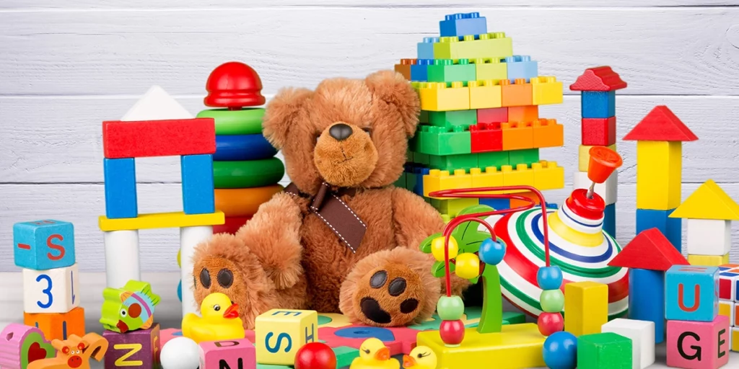
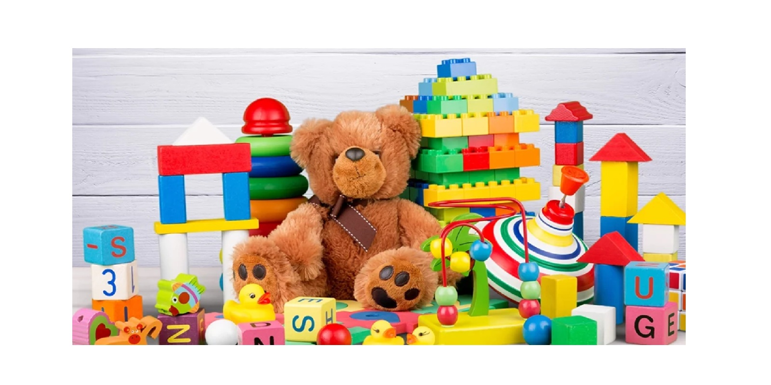
SAFETY OF TOYS
PETROLEUM, COAL AND RELATED PRODUCTS DEPARTMENT

Slide 2

While buying toys for children, few of the major concerns arises among parents all over the world such as:
TOXICITY
CHOKING HAZARD
SHARP EDGES / POINTS
NOISE LEVEL
Any sharp parts that could injure their child
Loud sounds or music that could damage a child’s hearing
Worrying about small parts or pieces that could be swallowed or pose a choking risk
Harmful chemicals or materials that can pose a risk to children’s health

Slide 3
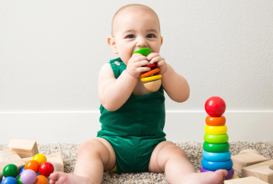
TOXICITY
Phthalates are used as plasticizers (softening agents) in the manufacture of polyvinyl chloride, which in turn is used in toys and childcare articles.
Migration of elements such as antimony, arsenic, barium, cadmium, mercury, lead, chromium, etc.
Phthalates have the potential to cause adverse effects on reproduction system and development of child
Effects of these metals on child health may be Neurological damage, Immune system suppression, Endocrine disruption, etc.

Slide 4
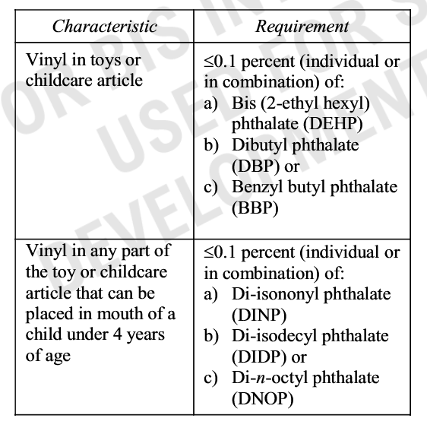
HOW INDIAN STANDARDS ENSURES SAFETY OF CHILD FROM THESE HARMFUL CHEMICALS?
BIS has published IS 9873 (Part 9) which prescribes the maximum acceptable limit of Phthalates. Presence of these chemicals within the mentioned limit will not pose risk to child health.
BIS has published IS 9873 (Part 6) which specifies the method for the determination of Phthalates content.

Slide 5
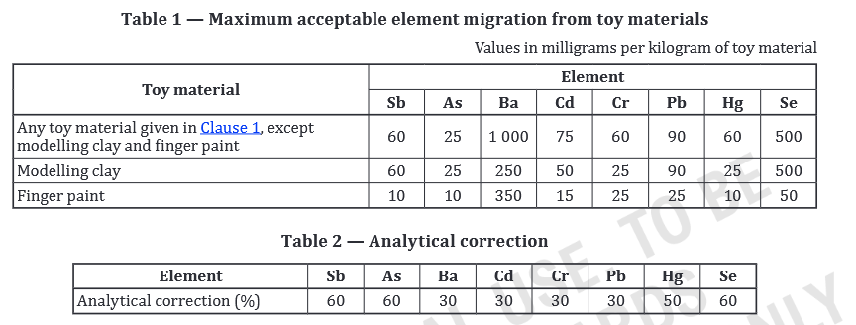
Continued…
Also, IS 9873 (Part 3) prescribes the determination of these elements content through the method of test given in the standards.

Slide 6
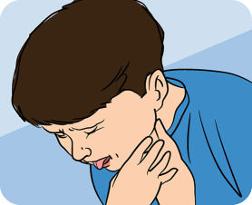
CHOKING HAZARD
Choking and Airway Blockage
Internal Injury in digestive tract
Emotional and Psychological Impact
Aspiration of Lungs
Digestive problems
SOLUTION ?
BIS has published IS 9873 (Part 1) which specifies the requirement of small part test to ensure elimination of choking hazard.

Slide 7
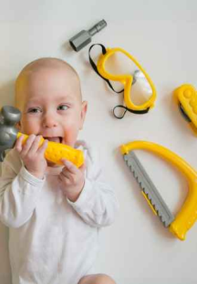
Sharp Edges / Points
Eye Injuries
Psychological Impact
Cuts and Lacerations
ANY SOLUTION ?
Mouth and Oral Injuries
Yes, BIS has published IS 9873 (Part 1) which specifies the requirement of sharp edges/points.

Slide 8

Hearing Loss
Sleep Disturbances
Cognitive and Developmental Delays
Neurological Effects
NOISE LEVEL
ANY SOLUTION ?
BIS has published IS 9873 which provides for Acoustic requirements within permissible limits of noise levels.

Slide 9
There are total 11 Indian Standards exists for Safety of Toys as listed :

Slide 10
Indian Standards on Safety OF Toys
1. IS 9873 (Part 1):2019/ ISO 8124-1 : 2018 Safety of toys: Part 1 Safety aspects related to mechanical and physical properties
2. IS 9873 (Part 2) : 2017/ ISO 8124-2 : 2014 Safety of toys: Part 2 Flammability
3. IS 9873 (Part 3) : 2020/ ISO 8124-3 : 2020 Safety of toys: Part 3 Migration of certain elements

Slide 11
Indian Standards on Safety Requirement for Toys (Cont.)
4. IS 9873 (Part 4) : 2017/ ISO 8124-4 : 2014 Safety of Toys :Part 4 Swings, Slides and Similar Activity Toys for Indoor and Outdoor Family Domestic Use
5. IS 9873 (Part 5) : 2017/ ISO 8124-5 : 2015 Safety of Toys :Part 5 Determination of Total Concentration of Certain Elements in Toys
6. IS 9873 (Part 6) : 2021/ ISO 8124-6 : 2018 Safety of Toys Part 6 Determination of Certain Phthalate Esters in Toys and Children Products

Slide 12
Indian Standards on Safety Requirement for Toys (Contd.)
7. IS 9873 (Part 7) : 2017/ ISO 8124-7 : 2015 Safety of Toys Part 7 Requirements and Test Methods for Finger Paints
8. IS 9873(Part 8): 2019/ ISO/TR 8124-8:2016 Safety of Toys: Part 8 age determination guidelines
9. IS 9873 (Part 9) : 2017 Safety of Toys: Part 9 Certain Phthalates Esters in Toys and Children Products

Slide 13
Indian Standards on Safety Requirement for Toys (Contd.)
10. IS 9873 (Part 10):2024/ ISO 8124-10:2023 Safety of toys Part 10: Experimental sets for chemistry and Related Activities
11. IS 9873(Part 11): 2024/ ISO 8124-11:2024 Safety of Toys: Part 11 Chemical Toys Sets Other than Experimental Sets

Slide 14
ISO/ TC 181 Safety of Toys
At International level, ISO/TC 181 “Safety of toys” is responsible for the standardization of toys with respect to safety relating to their mechanical, physical, chemical and flammable properties.
Excluded: All electrical aspects which are dealt with by IEC.
So far, ISO/ TC 181 has published 16 standards.

Slide 15

ANY REGULATIONS TO ENFORCE ?

Slide 16
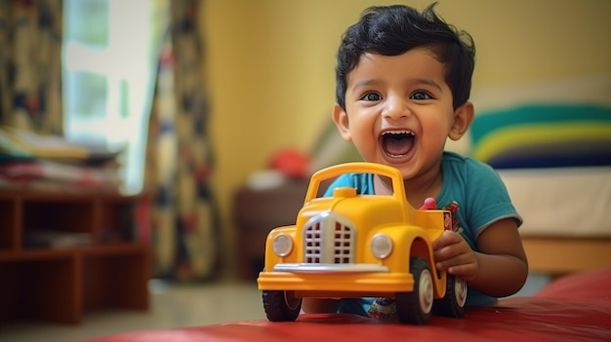

Safety of Toys
Out of these 11 Indian standards which ensures safety of toys for the children under the age of 14 years, 06 Indian standards are under Mandatory certification brought by Toys (Quality Control) Order, 2020 issued by Department for Promotion of Industry and Internal Trade.
Which toys are covered under above order?
As per Toys (Quality Control)Order 2020, Product or material designed or clearly intended, whether or not exclusively, for use in play by children under 14 years of age or any other product as notified by the Central government from Time to time.

Slide 17


