Slide 1
Basic Safety of Medical Equipment

Slide 2
Why is safety testing required?
To test and confirm the medical equipment is electrically safe to be used in a healthcare environment.
Medical procedures usually expose the patient to more hazards than the typical home or workplace, because :
In medical environments the skin and mucous membranes are frequently penetrated or altered.
There are many sources of potentially hazardous substances and energy forms that could injure either the patient or the medical staff.

Slide 3
Why is safety testing required?
Most injuries are attributable to improper use of a device because of inadequate training and lack of experience
Medical personnel rarely read User Manuals until a problem occurred
Each year, numerous device-related patient injuries are reported in India

Slide 4
What is Electrical Safety?
Electric Safety is the best possible limitation of hazardous electrical Macro — and/or Microshocks, sustained by patients, as well as explosion, fire or damage to equipments and buildings.
Electric safety in hospital is a shared responsibility between several parties, in addition to the physician, including:
  The nurses
  All engineers (electrical, biomedical, facility, etc)
  Manufacturers
  The hospital

Slide 5
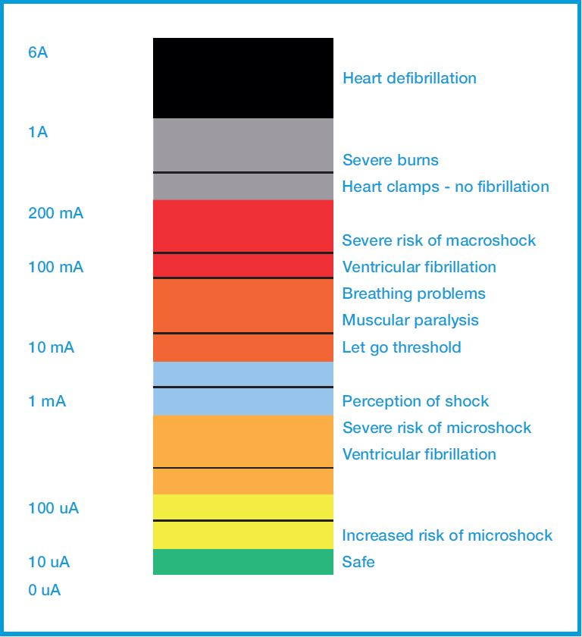
Safety of Medical Equipment
The purpose of safety testing medical electronic equipment is to ensure that a device is safe from electrical hazards to patients, maintenance personnel's and users.
Electric shock are caused by electricity flowing through the body after touching a damaged electrical device and results muscle spasms, burns, cardiac and respiratory arrest and Ventricular Fibrillation

Slide 6
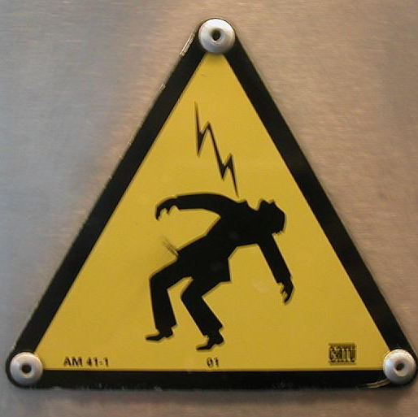
Electrical Shock
Electric Shock : Unwanted or unnecessary physiological response to current.
Three phenomena
  Electrical stimulation of excitable tissue (nerve & muscle)
  Resistive heating of tissue, and
  Electrochemical burns and tissue damage

Slide 7
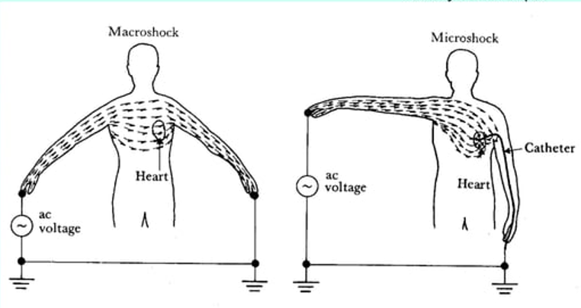
Macroshock and Microshock Hazards
Macro-shock is the most common type of shock received and occurs when the human body becomes a conductor of electric current passing by means other than directly through the heart.
Micro-shock is the electrically conducting devices unintentionally make direct contact with heart muscles, ventricular fibrillation may be induced by minute current (e.g., 200uA) well below the threshold of feeling.

Slide 8
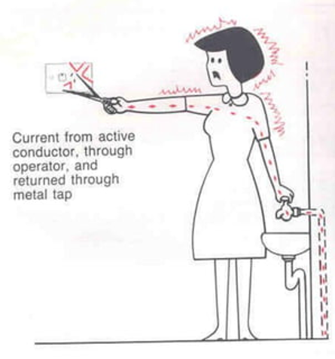
Physiological effects of electricity
For a physiological effect to occur, the body must become part of an electric circuit. Current must enter the body at one point and leave at some other point
The magnitude of the current is equal to the applied voltage divided by the sum of the series impedances of the body tissues and the two interfaces at the entry points

Slide 9
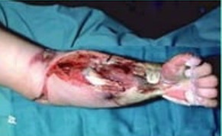
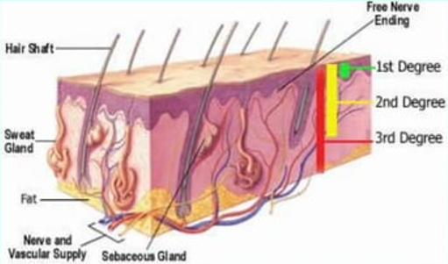
Physiological effects of electricity: Burns
When an electric current passes through any substance having electrical resistance, heat is produced. The amount of heat depends on the power-dissipated. Whether or not the heat produces a burn depends on the current density.

Slide 10
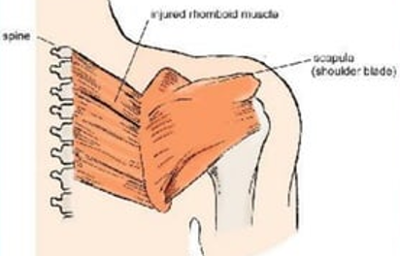
Physiological effects of electricity: Muscle Cramps
When an electrical stimulus is applied to a motor nerve or muscle, the muscle does exactly what it is designed to do in the presence of such a stimulus i.e., it contracts. The prolonged involuntary contraction of muscles (tetanus) caused by external electrical stimulus is responsible for the phenomenon where a person who is holding an electrically live object can be unable to let go.

Slide 11
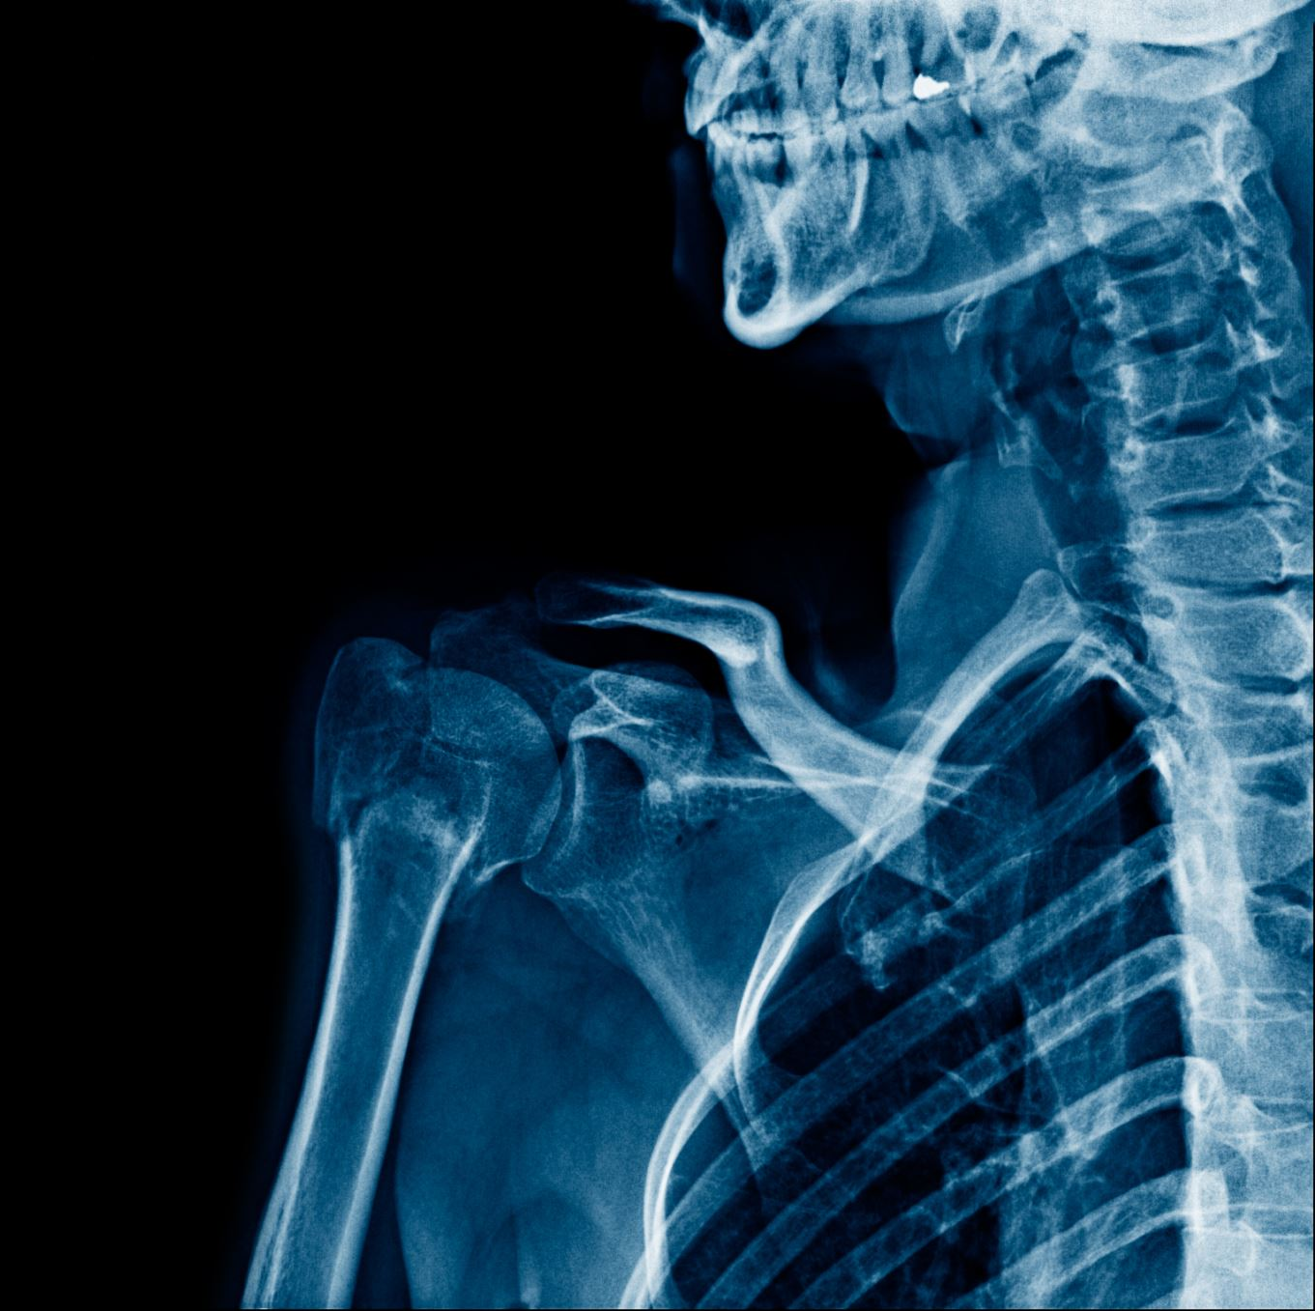
Respiratory Arrest
The muscles between the ribs (intercostal muscles) need to repeatedly contract and relax in order to facilitate breathing. Prolonged tetanus of these muscles can therefore prevent breathing.

Slide 12
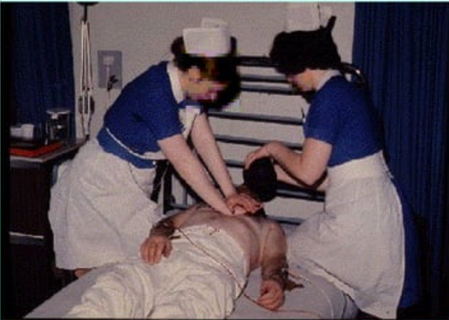
Cardiac Arrest
The heart is a muscular organ which needs to able to contract and relax repetitively in order to perform its function as a pump for the blood. Tetanus of the heart musculature will prevent the pumping process.

Slide 13
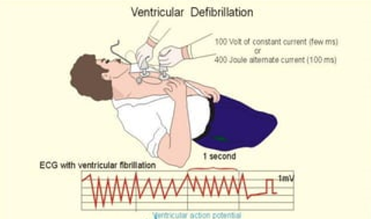
Ventricular Fibrillation
The ventricles of the heart are the chambers responsible for pumping blood out of the heart. When the heart is in ventricular fibrillation, the musculature of the ventricles undergoes irregular, uncoordinated twitching resulting in no net blood flow. The condition proves fatal if not corrected in a very short space of time.

Slide 14
Leakage Current
It is current flowing from the enclosure that is accessible to the operator or patient.
Must be tested with a Safety Analyzer from a conductive surface to the ground

Slide 15
Leakage Current
Unavoidable and as a result of capacitive and resistive dielectrics
Flowing from high to low potential ( to ground or across the body arm – to arm)
Non-hazardous if controlled through standards design criteria
Potentially hazardous if outside the stated standard limits
It is prone to be overlooked and subject to incorrect testing

Slide 16

Electrical Safety - Critical Points
The electrical installation is a critical part of the safety requirements.
Plugs and cords must be checked and rejected if defective
Only devices tested for safety should be used.
Electrical compatibility of the entire electrical system must be tested regularly.
Patients leads must be attached and connected properly.
Radio-frequency devices (including mobile telephones) must be excluded.

Slide 17
Electricity - Class and Types of Equipment
Classes of Equipment
All electrical equipment is categorized into classes according to the method of protection against electric shock that is used.
Types of Equipment
The degree of protection for medical electrical equipment is defined by the type designation.

Slide 18
IS 13450 (Part 1) : 2024
Applies to the basic safety and essential performance of medical electrical equipment and medical electrical systems
Cover:
  MEDICAL ELECTRICAL EQUIPMENT
  MEDICAL ELECTRICAL SYSTEMS: Assembled by several medical electrical equipment components that is used in above equipment

Slide 19
Aspects covered by IS 13450 Part 1
General requirements for ME EQUIPMENT
Classification of ME EQUIPMENT and ME SYSTEMS
ME EQUIPMENT identification, marking and documents
Protection against electrical HAZARDS from ME EQUIPMENT
Protection against MECHANICAL HAZARDS of ME EQUIPMENT and ME SYSTEMS
Protection against unwanted and excessive radiation HAZARDS
Protection against excessive temperatures and other HAZARDS
Accuracy of controls and instruments and protection against hazardous outputs
HAZARDOUS SITUATIONS and fault conditions for ME EQUIPMENT
Construction of ME EQUIPMENT
Electromagnetic compatibility of ME EQUIPMENT and ME SYSTEMS

Slide 20
IS 13450 (Part 1/Sec 2) : 2024
Applies to the basic safety and essential performance of medical electrical equipment and medical electrical systems
Applies to the basic safety and essential performance of ME equipment and me systems in the presence of electromagnetic disturbances and to electromagnetic disturbances emitted by me equipment and me systems.
Basic safety about electromagnetic disturbances is applicable to all ME equipment and ME systems.

Slide 21
Aspects covered by IS 13450 Part 1/Sec 2
RISK MANAGEMENT PROCESS for ME EQUIPMENT and ME SYSTEMS
General test conditions
List of tests
Documentation of the tests
ELECTROMAGNETIC EMISSIONS requirements
Protection of radio services and other equipment
Electromagnetic IMMUNITY requirements

