Slide 1

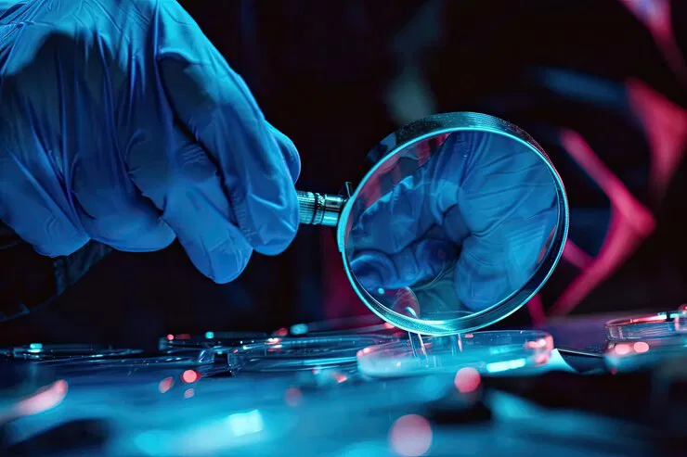
Forensic Sciences
Satyam Rathore,
Scientist B/ Assistant Director,
Medical Equipment and Hospital Planning Department,
Bureau of Indian Standards,
Ministry of Consumer affairs, Food and Public Distribution

Slide 2

Agenda
Introduction
Indian Standards on:
Instruments used in Forensic Sciences
Forensic Sciences – SOPs
Upcoming areas in the field

Slide 3
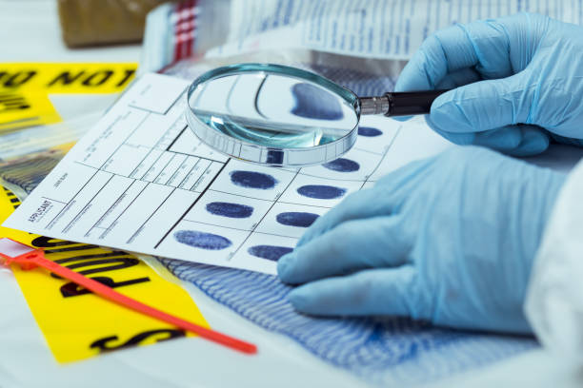
Introduction of Forensic Sciences
Forensic science is the use of scientific methods to analyze evidence and solve crimes. It's also known as criminalistics.
Forensic science helps support legal decision-making in criminal and civil cases. Forensic scientists work with police departments to solve crimes.

Slide 4
Indian Standards on Instruments / Devices used in Forensic Sciences
Paraffin Dispenser
Embalming Machine
Grossing Station Automated Specification
Tissue Embedding station
Dissection Table
Isolated Organ Bath
Polygraph
Physiograph

Slide 5
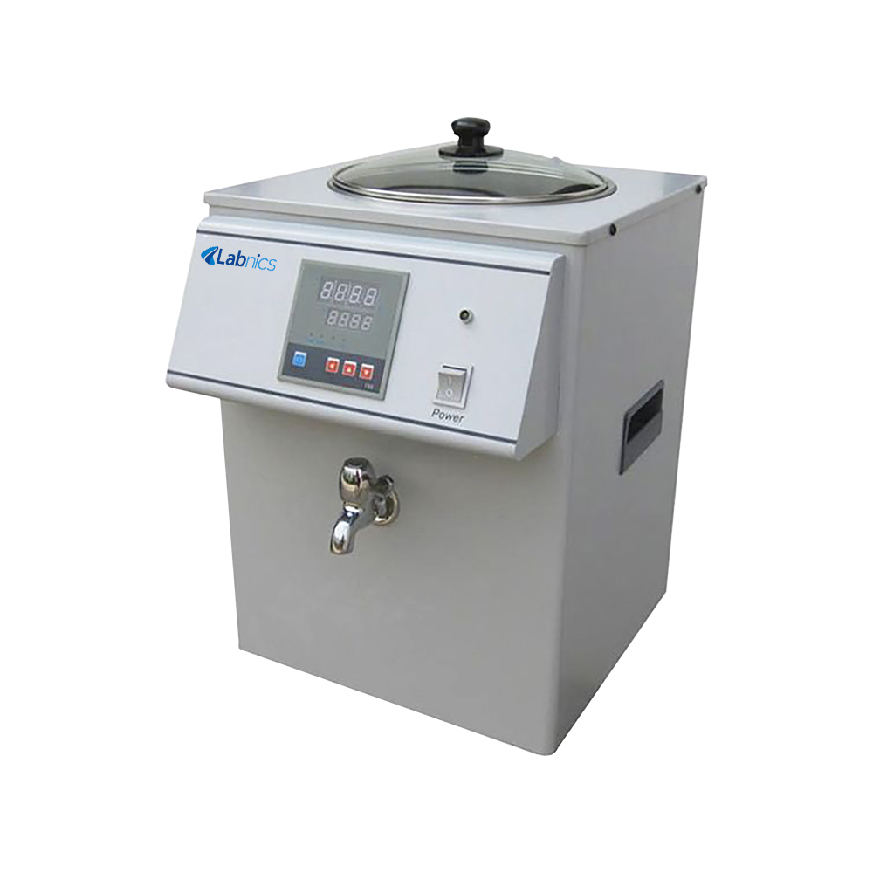
Paraffin Wax Dispenser
IS no. IS 17533 : 2021
This Indian Standard specifies basic requirements for Paraffin dispenser used in Histopathology, Forensic Medicine and Anatomy Lab, where wax embedded moulds or blocks are prepared.
These dispensers are specially designed for use where large volume of paraffin is required, to facilitate disposing of wax for embedding purpose.

Slide 6
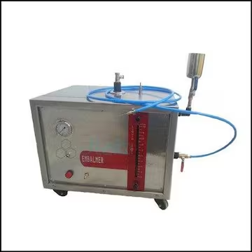
Embalming Machine
IS no. IS 17534 : 2021
This Indian Standard specifies the essential requirements for an embalming machine, also known as cadaverous injector.
Forensic scientists use embalming machines to preserve bodies for examination and analysis, and to preserve evidence.
Embalming machines have a fluid reservoir, a pump system, tubing, and control mechanisms. The pump system circulates the embalming fluid through the body by creating pressure

Slide 7
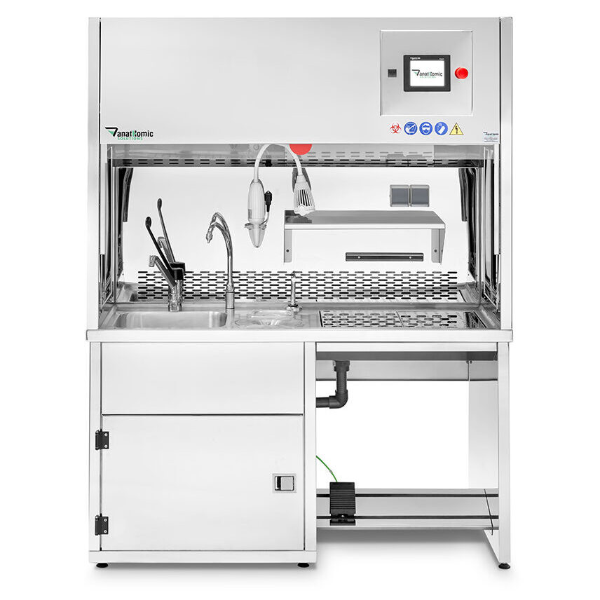
Grossing Station Automated
IS no. IS 17535 : 2021
This Indian Standard specifies the essential requirements of automated grossing station meant to inspect pathological specimens with the bare eye to obtain diagnostic information, while being processed for further microscopic examination.
Improved accuracy: Grossing stations can help to improve the accuracy of tissue examination.
Standardized sample preparation: Grossing stations can help to ensure that samples are prepared in a standardized way..

Slide 8
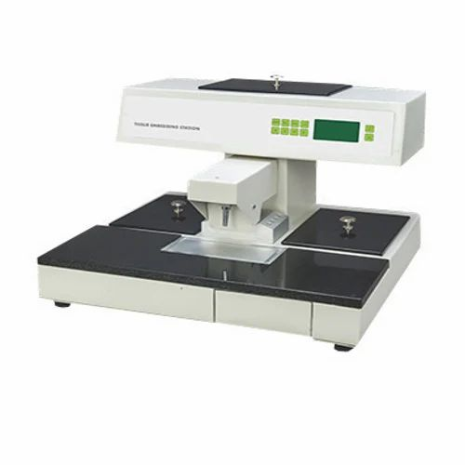
Tissue Embedding Station
IS no. IS 17543 : 2021
This Indian Standard specifies basic requirements for tissue embedding system which is a bench-top unit incorporated with Paraffin dispensing system and automated microprocessor based control system meant for embedding tissues in laboratories and pathological centres.
Preserves tissue integrity: The embedding process preserves the tissue's structural integrity.
Provides accurate data: The embedding process ensures that researchers can get accurate and representative data..

Slide 9
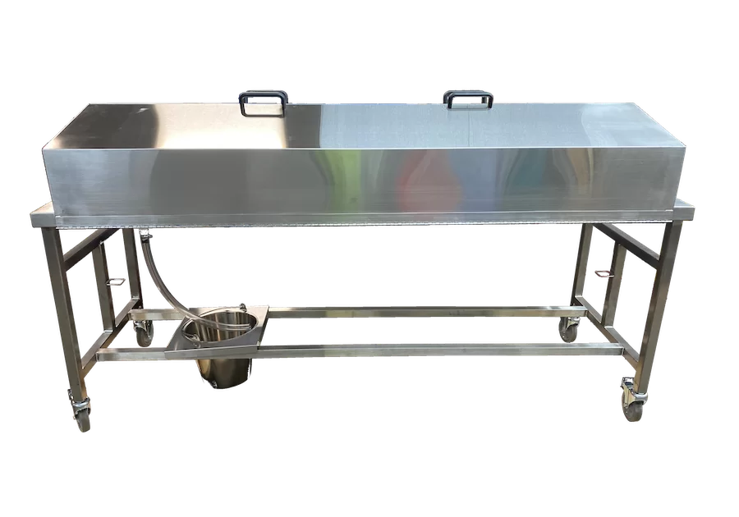
Dissection Table
IS no. IS 17584 : 2021
This Indian standard covers minimum requirements and dimensional details for dissection table. This standard covers specifications for both the small and the standard dissection tables.
Physical dissection tables, also known as autopsy tables, are used in forensic science to perform postmortem examinations. They are also used in medical schools and mortuaries.

Slide 10
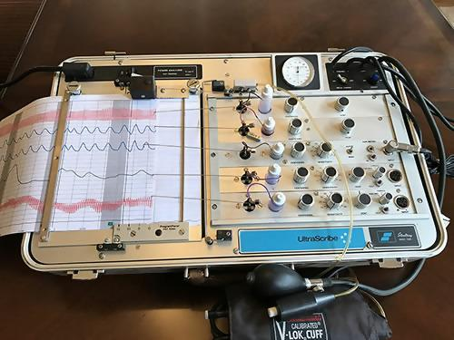
Polygraph
IS no. IS 18308 : 2023
This Indian Standard specifies requirements for polygraph intended for research and teaching use. This standard covers the general description of standard materials, technical parameters, test settings, and procedures.
Polygraph tests, also known as lie detector tests, are used in forensic sciences to detect deception and help solve crimes. They are used in a variety of settings, including law enforcement, national security, and business

Slide 11
Indian Standards on Forensic Sciences – SOPs
Minimizing the risk of human DNA contamination in products used to collect store and analyze biological material
Recognition Recording Collecting Transport and Storage of Items
Protocol for Medico-Legal Examination of Accused of Sexual Assault (Standard Operating Procedure)
Protocol for Medico-Legal Examination of Survivor of Sexual Assault (Standard Operating Procedure)

Slide 12
Minimizing the risk of human DNA contamination in products used to collect store and analyze biological material
IS no. IS 17741 : 2021
This Indian Standard specifies requirements for the production of products used in the collection, storage, and analysis of biological material for forensic DNA purposes, but not those consumables and reagents used in post-amplification analysis..
This Indian Standard specifies a requirement for manufacturers to minimize the risk of occurrence of detectable human nuclear DNA contamination in products used by the global forensic community.

Slide 13
Forensic sciences Part 2: Recognition Recording Collecting Transport and Storage of Items
IS no. IS 17742 (Part 2) : 2021
This Indian Standard specifies requirements for the forensic process focusing on recognition, recording, collection, transport and storage of items of potential forensic value. It includes requirements for the assessment and examination of scenes but is also applicable to activities that occur within the facility. This document also includes quality requirements
The requirements for Quality, Requests for service, Impartiality and confidentiality, Health and safety, Equipment and consumables, Detection, screening and enhancement techniques, Facilities etc. are given in the document.

Slide 14
Protocol for Medico-Legal Examination of Accused of Sexual Assault (Standard Operating Procedure)
IS no. IS 18737 : 2024
This standard specifies the standard operating procedure (SOP) — Protocol for medico-legal examination of accused of sexual assault, required to be followed by the medical doctors for collecting evidentiary materials without missing any step during medico-legal examination.
This Indian Standard covers Instructions for the Doctors, Medico-legal Examination Report Format of Accused of Sexual Assault, Body Diagrams, Medical Opinion Format, Checklist of Steps of Medico-legal Examination, Medico-legal Evidence Collection Kit in Sexual Assault Cases (Accused).

Slide 15
Protocol for Medico-Legal Examination of Survivor of Sexual Assault (Standard Operating Procedure)
IS no. IS 18757 : 2024
This standard specifies the standard operating procedure (SOP) — Protocol for medico-legal examination of the survivor of sexual assault, required to be followed by the medical doctors for conducting medico legal examination and collecting evidentiary materials without missing any step during medico-legal examination.
This Indian Standard covers Instructions for the Doctors, Medico-legal Examination Report Format of Survivor of Sexual Assault, Body Diagrams, Medical Opinion Format, Checklist of Steps of Medico-legal Examination, Medico-legal Evidence Collection Kit in Sexual Assault Cases (Survivor).

Slide 16
Upcoming Areas in the Field
Body storage tank and Cold storage chambers
Autopsy Saw and Autopsy Table
Dissection Hall Layout Specifications
Body Bags
Grossing Station with Imaging and Documentation

Slide 17

Brainstorming Session

Slide 18

Medical Equipment and Hospital Planning Department,
Bureau of Indian Standards,
Ministry of Consumer affairs, Food and Public Distribution
mhd@bis.gov.in

