Slide 1


MEDICAL TEXTILES FOR HEALTH DEPARTMENT
BUREAU OF INDIAN STANDARDS
NEW DELHI

Slide 2
Contents
Infection Control Management
Wound Management
02
04
01
03
05
Overview of Medical Textiles
Support for Pain and Injury Management
Conclusion

Slide 3

MEDTECH SECTOR: AN OVERVIEW
Out of total Indian textile industry, only 13% contributes to technical textiles, and out of this 13%, the share of Meditech, in technical textiles market is in the range of 6-8%.
Global Medical Textiles Market Size is expected to reach around USD 26 billion by 2028 and expected to grow at a CAGR of approx. 4.5 % from 2022-2028 according to a market report.
The main volume growth driver in Meditech is the Non-implantable segment which includes nonwoven, surgicals & healthcare/hygiene products.
Rising awareness for healthcare practices among the consumers/professional/users
Demand for face masks, PPEs, Surgical gowns, has been increased during pandemic.
India as a popular destination for medical tourism among patients from countries in south and western Asia, Middle East, Africa
Government initiatives for infrastructure and technological advancements, R & D, skill development through Atmanirbhar Bharat, Production Linked Incentive (PLI) scheme and National Technical Textiles Mission, National Health Mission, Ayushman Bharat Yojana etc.
Source : Market Research Report/Baseline Survey 2020 on TT

Slide 4
CLASSIFICATION OF MEDICAL TEXTILES
1.HEALTHCARE AND HYGIENE PRODUCTS
Healthcare and hygiene textiles materials are mainly used for protection from infections in hospital environment or personnel hygiene. They are used either in the operation theatre or in the hospital wards for hygiene care safety for the staff, doctor and patients or personnel hygiene.
e.g. PPE Coverall, Surgical caps, masks, gowns, drapes and shoe covers, Bed sheets and pillow cover, Baby Diapers/Adult Diaper, Sanitary napkins, Under pads, Wipes etc.
2.NON-IMPLANTABLE MEDICAL TEXTILE:
This is used for external application on the body with or without skin contact. This is used for protection against infection, absorption, and exudation of blood & excess fluids, healing applications etc
e.g. wound dressing, plaster, bandage, gauge, swabs, compression stocking etc.
3. IMPLANTABLE MEDICAL TEXTILE:
Implantable medical textiles are partly or totally inserted into the human body. These materials are used in effecting repair to the body whether it is wound closure or replacement surgery or soft tissue implants.
e.g. Suture, Vascular grafts , Hernia Mesh, Artificial Heart Valve, Artificial ligament/tendon, Artificial joint/skin/bone etc.
4. EXTRA CORPOREAL
Extracorporeal mainly deals with artificial organ which are made from specialized textile implants that can function as a part of human body for blood purification apheresis, hemodialysis, hemofilteration, plasma pheresisn etc. e.g. Artificial kidney, Artificial lever, Artificial valves and Artificial Lungs etc.

Slide 5

STANDARDIZATION OF MEDTECH
Standardization in the field of Medical Textiles has been undertaken by TECHNICAL TEXTILES FOR MEDTECH APPLICATION SECTIONAL COMMITTEE, TXD 36 under Textiles Division Council with mandate to formulate Indian Standards for terminology, testing and specifications for technical textiles for medtech applications such as healthcare and hygiene textile products, implantable and non-implantable and extra corporeal textile products.
Number of standards formulated: 76 (Product -63, Method of test -12), code of practice-1
Number of standards under development: 05

Slide 6
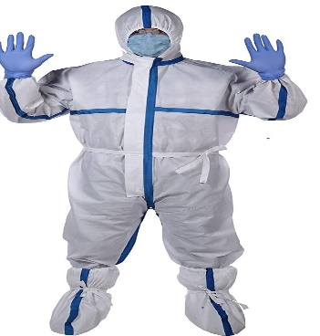
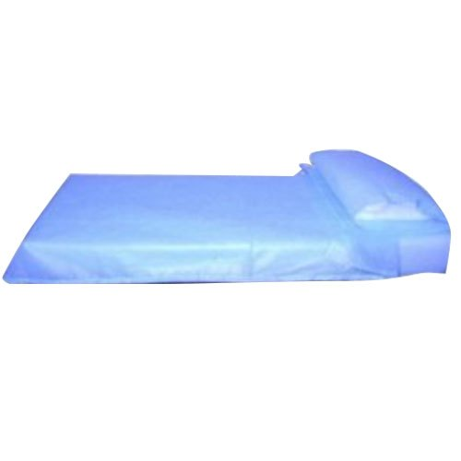
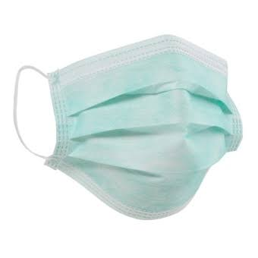
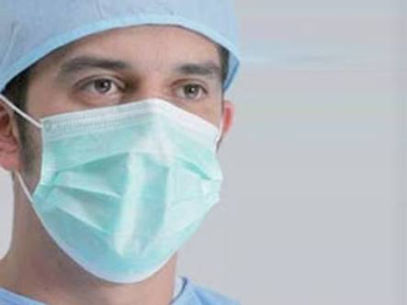
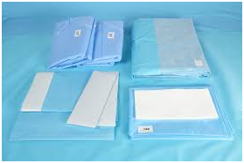
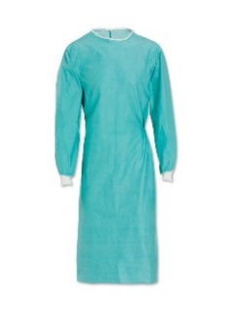
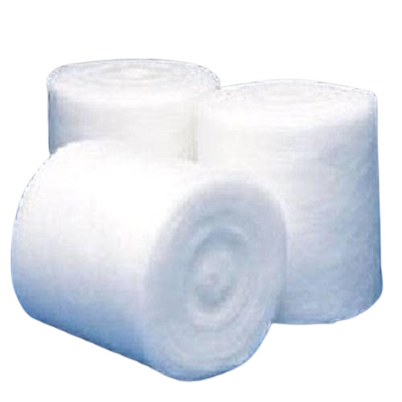
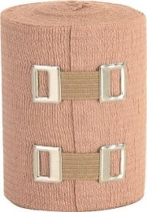
IMPORTANT PRODUCT OF MEDICAL TEXTILES
SURGICAL FACE MASK COVERALL BEDSHEET/ PILLOW COVER
SURGICAL GOWN/DRAPE CREPE BANDAGE ABSORBENT COTTON

Slide 7

IMPORTANT STANDARDS PUBLISHED ON MEDICAL TEXTILES
IS 5405 : 2019, Sanitary napkins
IS 17514 : 2021, Reusable Sanitary Napkin
IS 17509 : 2021, Disposable Baby Diaper
IS 17349 :2020 Shoe Cover
IS 17354 : 2020 Dental Bib/Napkin
IS 17630 : 2020 Bedsheet and Pillow Cover
IS 17787 : 2021, Nonwoven Wipes
IS 18552 : 2024, Guidelines for Processing of Multiple-Use Healthcare Textiles
https://www.services.bis.gov.in/php/BIS_2.0/bisconnect/pow_details (for more details)
IS 17423 : 2021, Bio-Protective Coveralls
IS 16289 : 2014 Surgical Face Mask
IS 17334 : 2019 Surgical Gowns/Surgical Drapes
IS 17508 : 2020, Adult Incontinence Diaper
IS 17629 : 2021, Caps
IS 16111 : 2013, Elastic bandage
IS 4605 : 2020, Crepe Bandage
IS 19022: 2023, Barrier Face Covering
IS 18266 : 2023, Medical Respirator
IS 758 : 2023, Absorbent Cotton Gauze
IS 863 : 2023 Cotton Bandage Cloth

Slide 8

IMPORTANCE OF INFECTION CONTROL MANAGEMENT
Infection control management is essential for preventing the spread of infections in healthcare settings, safeguarding both patients and healthcare professional by reducing the risk of harmful infections that can cause complications, prolonged hospital stays, or even death.
Benefits
Protects Patients and Healthcare Professional - Patients and healthcare professionals are at high risk of exposure to infectious agents. Effective infection control reduces their risk and ensures patient and healthcare professionals’ safety.
Preventing outbreaks: - By implementing effective infection control measures, healthcare facilities can minimize the risk of outbreaks of contagious diseases and hospital-acquired infections (HAIs).
Reduces Healthcare Costs - Preventing infections decreases hospital admissions, antibiotic use, and the need for expensive treatments, thereby reducing overall healthcare costs.
Quality of care: - Effective infection control is considered a key component of high-quality healthcare delivery.
Ensures Compliance with Regulations - Governments and health organizations mandate strict infection control policies, and non-compliance can result in penalties and legal consequences.

Slide 9

Key Parameters and Selection Criteria for PPE (Coverall, Surgical Gown, Mask etc)
Parameter | Description | Considerations
Barrier Protection | Protection against blood, bodily fluids, and infectious agents | Ensure high fluid resistance and coverage for all exposed areas
Material Quality | Durability, comfort, and breathability | Choose materials that are durable, comfortable for extended wear, and breathable
Fit and Comfort | Proper fit and ease of movement | Ensure PPE fits well and allows for ease of movement without causing discomfort
Sterility | Sterile or sterilizable PPE | Use sterile PPE for surgical procedures; ensure PPE can be sterilized if reusable
Ease of Use | Simple to put on and take off | PPE should be easy to don and doff quickly and efficiently
Compatibility | Compatibility with other PPE and surgical equipment | Ensure PPE does not interfere with the use of surgical instruments and other PPE
Regulatory Compliance | Compliance with relevant standards and regulations | Follow BIS standards for medical PPE (Coverall, Surgical Gown, Mask)
Cost-Effectiveness | Balance between cost and quality | Consider the cost of PPE while ensuring it meets safety and performance standards
Environmental Impact | Disposal considerations | Wherever possible reduce waste; ensure proper disposal methods

Slide 10
IMPORTANT STANDARDS FOR INFECTION CONTROL MANAGEMENT
IS 16289 : 2014 Surgical Face Mask
Surgical face masks are essential in healthcare settings, serving as a protective barrier that prevents the inhalation of large particles, droplets, and bodily fluids.
The transmission of infective agents during surgical procedures in operating theatres and other healthcare settings can occur in several ways. Sources are, for example noses and mouths of the surgical team
Surgical mask play a crucial role in infection control by safeguarding both healthcare workers and patients from potential contaminants during procedures.
The surgical masks have been categorized into three classes i.e., Class 1, Class 2 and Class 3. The key performance requirements specified in IS 16289 Surgical Facemask include Bacterial filtration efficiency and Sub-micron particulate filtration efficiency at 0.1 micron for safety, Differential pressure for comfort, splash resistance to protect from blood and body fluids during surgery.

Slide 11
IMPORTANT STANDARDS FOR INFECTION CONTROL MANAGEMENT
IS 17423 : 2021 Bio-protective Coverall
Coverall is a type of personal protective equipment (PPE) intended to be worn by healthcare personnel for the purpose of isolating all parts of the body from a potential hazard. The bio-protective coveralls provide protection against various biological agents due to their material sealing arrangement.
This standard specifies the requirements for single use and reusable bio-protective coveralls which can be supplied in sterile as well as unsterile condition.
To ensure the safety, comfort and quality of Bio-protective coverall for healthcare professional, BIS has published IS 17423 (single use and reusable) which specifies the important performance requirement such as resistance to synthetic blood penetration, resistance to viral penetration, breathability, tensile strength, seam strength, cleanliness – microbial, resistance to dry microbial penetration and biocompatibility etc.
Based on anticipated risk and barrier protection, the bio-protective coverall has been classified in 4 categories: - Level 1 (low risk), level 2 (medium risk), level 3 (high risk) and level 4 (very high risk).

Slide 12
IMPORTANT STANDARDS FOR INFECTION CONTROL MANAGEMENT
IS 17334 :2019 Surgical Gown and Drape
Surgical gowns and drapes are vital components in maintaining a sterile environment during medical procedures, particularly surgeries. They serve as protective barriers that prevent the transmission of microorganisms and contaminants between healthcare personnel and patients, significantly reducing the risk of hospital-acquired infections.
To ensure the safety, comfort, durability and quality of surgical gown and drape for healthcare professional, BIS has published IS 17334 (single use and reusable) which specifies the important performance requirement such as resistance to synthetic blood penetration, resistance to viral penetration, breathability, tensile strength, seam strength, cleanliness – microbial, resistance to dry/wet microbial penetration and biocompatibility etc.
Based on anticipated risk and barrier protection, the surgical gown and drape has been classified in 4 categories: - Level 0 (low risk), level 1 (medium risk), level 2 (high risk) and level 3 (very high risk).

Slide 13
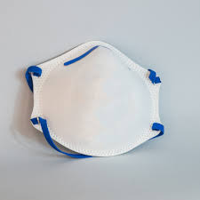
IMPORTANT STANDARDS FOR INFECTION CONTROL MANAGEMENT
IS 18266 : 2023 Medical Respirator
A medical respirator is a respiratory protective device designed to achieve a very close facial fit and covers at least the nose, mouth and may cover the chin. Medical respirators are used to protect both the surgical patient and the operating room personnel/staff from transfer of microorganisms, body fluids and particulate material.
Medical respirators have been categorized into two classes based on performance IN95 and IN99 based on degree of protection offered by them.
IS 18266 outlines essential requirements for medical respirators, including breathing resistance, splash resistance, filter penetration, inward leakage, CO2 content, microbial cleanliness, and flammability. Additionally, it mandates a biocompatibility evaluation to assess cytotoxicity, irritation, and skin sensitization. These criteria ensure that medical respirators provide effective protection for both healthcare personnel and patients, maintaining safety and hygiene in surgical and healthcare environments.

Slide 14
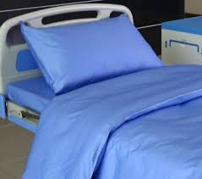
IMPORTANT STANDARDS FOR INFECTION CONTROL MANAGEMENT
IS 17630 : 2021 Bedsheet And Pillow Cover
Bedsheets and pillow covers used in hospitals are critical components of patient care and hospital hygiene. These products serve not only as a foundation for patient comfort but also play a vital role in infection control. In a healthcare setting, where patients may be vulnerable to infections, the quality and cleanliness of bedsheets and pillow covers are paramount.
To ensure the quality, durability, comfort, safety for user, BIS has published IS 17630 : 2021, on Bedsheet and Pillow Cover which covers important parameters
like Physical test like colorfastness test, pilling resistance, tensile strength, bursting strength, Seam strength , Chemical test like scouring loss, pH, Water soluble substance, Bioburden test like Cleanliness–microbial, Biocompatibility Evaluation – Cytotoxicity, Irritation and skin sensitization, Moisture vapour transmission rate for breathability

Slide 15
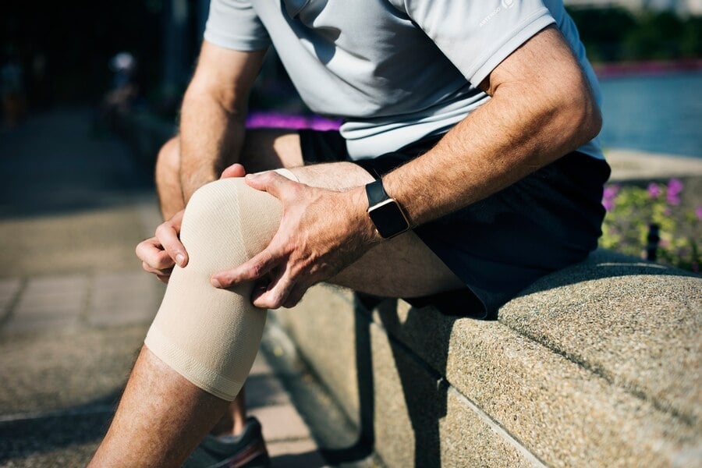
IMPORTANCE OF SUPPORT FOR PAIN AND INJURY MANAGEMENT
Managing pain and injury is essential for maintaining overall health, preventing complications, and improving quality of life. Effective pain and injury management helps individuals recover faster, stay functional, and avoid long-term damage.
Benefits
Prevents Further Injury - Supportive devices restrict excessive movement, protecting injured areas from additional strain. They help maintain proper posture and alignment, reducing the risk of worsening the injury.
Reduces Pain and Discomfort - By providing compression and stability, supports minimize stress on muscles and joints. Reduced movement in the affected area helps decrease inflammation and irritation.
Speeds Up Healing - Supports enhance blood circulation, ensuring oxygen and nutrients reach the injured tissues. Controlled movement prevents overuse while allowing gradual recovery.
Improves Mobility and Function - With the right support, individuals can continue daily activities with less pain. It prevents compensatory movements that could lead to secondary injuries.
Enhances Confidence and Psychological Well-being - Knowing that the injured area is supported boosts confidence in movement. Reduced pain leads to improved mental well-being and quality of life.

Slide 16
IMPORTANT STANDARDS FOR INJURY SUPPORT AND PAIN MANAGEMENT
IS 4605 : 2020 Crepe Bandage
Crepe bandage consists of characteristic fabric of plain weave or needle loom weave, in which the warp threads are crepe-twisted for ensuring maximum elasticity. Crepe bandage is used for dressing of varicose veins, weak ankles, legs, knees and wrists in case of sprains and other conditions in which light support is required.
They work by applying gentle, even pressure to the affected area, which helps in reducing swelling and inflammation, alleviating pain, and stabilizing joints. This compression encourages blood flow, which is crucial for faster recovery, and reduces the chance of further injury by limiting unnecessary movement.
IS 4605 on crepe bandages outline specific requirements for the material, construction, and performance to ensure their effectiveness and durability. This standard cover parameters such as breaking load (the maximum force the bandage can withstand before breaking), elasticity (to provide adequate stretch and fit), as well as permissible levels of water-soluble and ether-soluble substances, ensuring the bandage remains safe and comfortable for prolonged use.

Slide 17
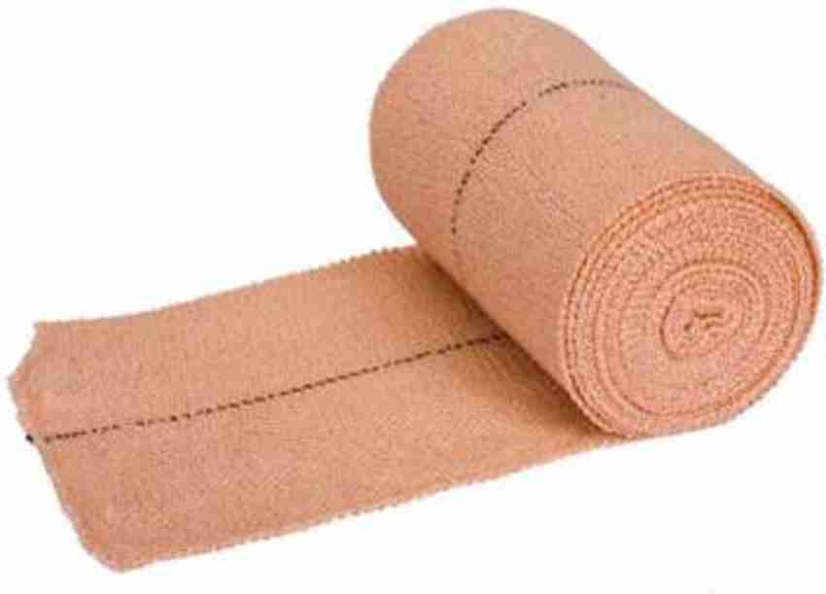
IMPORTANT STANDARDS FOR INJURY SUPPORT AND PAIN MANAGEMENT
IS 16111 :2013 Elastic Bandage
An elastic bandage is a continuous strip without joints, of woven/knitted material to provide support and immobilize dressings covering the wounds besides the function of compression and support for orthopaedic purposes. Their flexibility ensures comfort and proper fit, while preventing further injury during the healing process.
IS 16111 specify six types of elastic bandages :
a) Type A – Woven cellulosic yarn bandage b) Type B – Knitted cellulosic yarn bandage
c) Type C – Woven non-cellulosic yarn bandage d) Type D – Knitted non-cellulosic yarn bandage
e) Type E – Combination of both cellulosic yarn/noncellulosic yarns woven knitted
f) Type F – Combination of both cellulosic yarn/noncellulosic yarns woven knitted.
The standard prescribes requirements relating to dimensions and tolerances, weight, stretch length and extensibility, and regain that an elastic bandage must conform in order to ensure a quality product which would provide the desired function of compression and support for the wound dressings.

Slide 18
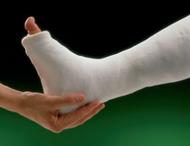
IMPORTANT STANDARDS FOR INJURY SUPPORT AND PAIN MANAGEMENT
IS 4738 : 2020, Bandage, Plaster of Paris
Plaster of Paris bandages are used primarily in the medical field for immobilizing fractures and providing support during the healing process. When mixed with water, the bandage becomes moldable and can be applied directly to the injured area, where it hardens into a rigid cast, stabilizing broken bones and preventing movement. The significance of Plaster of Paris bandages lies in their ability to ensure proper bone alignment, reduce the risk of further injury, and promote faster healing by providing strong, durable support to the affected area until recovery is complete.
Important performance parameters
Setting Time : The plaster mass which remains workable for not less than 1 minute after removal of the bandage from water, shall set within 8 min. The time of setting in plaster of Paris bandages is crucial for ensuring ease of application, patient comfort, and the stability of the cast.
Cast Breaking Strength - The cast breaking strength of plaster of Paris bandage shall not be less than 175 N (17.5 kgf approx) – Cast breaking strength is a critical parameter for plaster of Paris bandages because it determines the durability and effectiveness of the cast in immobilizing the injured area.
Calcium Sulphate Content - Calcium sulphate content of plaster of Paris bandage shall not be less than 88 percent, Plays a vital role in the setting and hardening process.

Slide 19
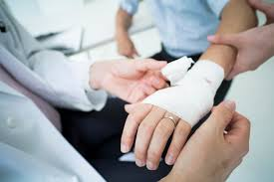
IMPORTANCE OF WOUND MANAGEMENT
Managing wounds properly is crucial for several reasons :-
Prevention of Infection: An untreated wound can become a breeding ground for bacteria, which can lead to infections. Managing a wound by cleaning and dressing it properly reduces the risk of bacterial contamination.
Promotes Faster Healing: Proper wound care helps to maintain a moist environment, which promotes quicker and more effective healing. This also helps minimize scarring and other long-term complications.
Pain Relief and Reduces Inflammation : By managing wounds with appropriate treatments, you can alleviate pain and discomfort. For example, keeping the wound clean and covered can reduce exposure to irritants and minimize pain. Managing wounds helps control inflammation, which can further damage tissues and slow down the healing process.
Prevents Complications: Poor wound care can lead to complications like chronic wounds, delayed healing, or systemic infections that could be life-threatening, such as sepsis.
Minimizes Scarring: Proper wound management helps the tissue heal in a more organized and functional way, reducing the formation of excessive scar tissue.
Improves Quality of Life: Effective wound management can reduce the impact on daily activities by preventing discomfort, infection, or long-term complications, allowing the individual to return to regular activities sooner

Slide 20
IMPORTANT STANDARDS FOR WOUND MANAGEMENT
IS 16468 : 2016 Absorbent Cotton (Sterile and Non - Sterile)
Absorbent cotton is widely used in wound management due to its high absorbency, softness, and sterility. It serves various purposes, including as a primary or secondary dressing to absorb exudate and promote healing, cleansing wounds with cotton swabs or pads, and absorbing blood or fluids to maintain a dry environment.
IS 16468 outlines the requirements for both sterile and non-sterile absorbent cotton, ensuring they meet specific standards for medical use.
The standard covers key performance criteria such as the presence of foreign fibers, neps, fluorescence loss on drying, absorbency, pH of aqueous extract, extractable coloring matter, water-soluble substances, and surface-active substances. For sterile cotton, sterility is also specified. Additionally, the standard includes clauses on marking, sampling, conformity criteria, and packing requirements to ensure consistent quality and safety in medical settings.

Slide 21
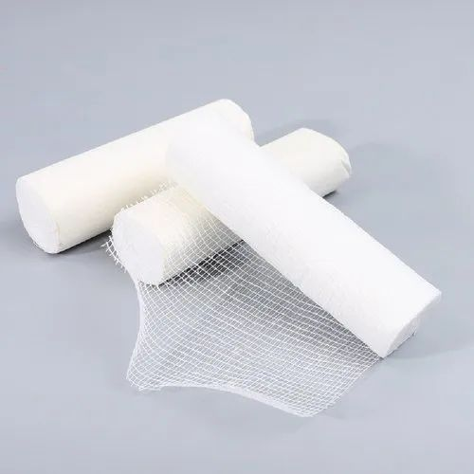
IMPORTANT STANDARDS FOR WOUND MANAGEMENT
IS 758 : 2023 Cotton Absorbent Gauze
Dressing and gauze are essential components of wound care, providing protection and support to facilitate healing. Dressings are used to heal wounds, preventing infection and absorbing exudate while maintaining a moist environment conducive to recovery.
Gauze, typically made from woven cotton, is often employed in conjunction with dressings for its high absorbency and breathability, making it ideal for dressing wounds, cleaning, and applying medications.
IS 758 on absorbent cotton gauze provide specific requirements for the material, construction, and performance parameters such as pH (to prevent skin irritation), absorbency (to soak up fluids effectively), cleanliness–microbial/bioburden test (free from harmful levels of contamination), scouring loss and freedom from optical whitener (to ensure cleanliness and the absence of optical whiteners).

Slide 22
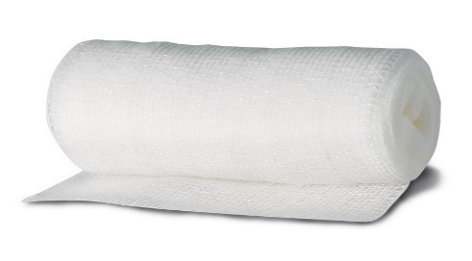
IMPORTANT STANDARDS FOR WOUND MANAGEMENT
IS 863: 2023 COTTON BANDAGE CLOTH
Cotton bandage cloth is a versatile and commonly used material in medical applications, particularly for wound care and injury support. It is soft, breathable, and gentle on the skin, making it ideal for wrapping injured areas without causing irritation. Cotton bandage cloth is highly absorbent, allowing it to effectively manage moisture from wounds or exudates, and is often used for securing dressings, providing support for sprains or strains, and immobilizing body parts after injuries.
The Indian Standard IS 863:2023 specifies the requirements for Cotton Bandage Cloth used for medical and surgical applications. The parameters of fibre content, construction, dimension, pH, scouring loss, freedom from defects, optical whitener, colorfastness, and sterility are crucial for ensuring the quality and safety of cotton bandage cloth.
Correct fibre content ensures softness and absorbency, while proper construction and dimensions provide strength, durability, and suitable sizing. pH balance prevents skin irritation, and low scouring loss ensures fabric stability. Freedom from defects maintains functional integrity, while avoiding optical whiteners ensures skin safety. Colorfastness guarantees long-lasting appearance and hygiene, and sterility is vital for infection control in medical use.

Slide 23
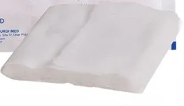
IMPORTANT STANDARDS FOR WOUND MANAGEMENT
IS 17351 : 2020, Dressing Shell Compressed
Dressing Shell Compressed is an essential medical product used for wound protection and care. It is compact for easy storage and handling but expands to cover wounds when applied, providing cushioning, absorption of exudates, and a sterile barrier.
Its primary uses include protecting surgical sites, managing wound fluids, and offering comfort to patients by preventing contamination and infection. The significance lies in its ability to promote faster healing by maintaining a clean and dry environment, while also being cost-effective, versatile, and suitable for a wide range of wounds.
IS 17351 standard specifies the requirements for dressing, shell compressed intended to be used mainly as emergency life saver to stop blood flow in case of open injuries
The standard specifies performance requirements for water-soluble substances, ether-soluble substances, sulphated ash, sinking time, absorbency, and biocompatibility which are crucial for compressed dressing shells to ensure their safety, effectiveness, and compatibility with the human body in medical applications

Slide 24
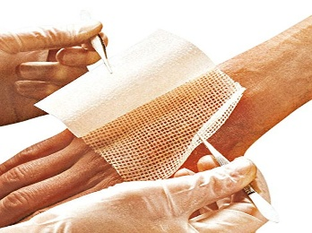
IMPORTANT STANDARDS FOR WOUND MANAGEMENT
IS 17528 : 2021, Chlorhexidine Gauze Dressing
Chlorhexidine gauze dressings are essential in treating burn wounds and major injuries with skin damage. They provide effective infection prevention due to chlorhexidine's broad-spectrum antimicrobial properties, reduce pain with its mild numbing effect, and promote faster healing by maintaining a clean environment. These dressings act as a protective barrier against contaminants, support prolonged healing, and reduce the frequency of dressing changes, making them an important tool in managing severe wounds and promoting recovery.
It consists of fabric of leno weave with two picks in each shed in which the warp and weft threads consists of cotton or viscose or combined cotton and viscose yarn. The fabric has been evenly impregnated with a suitable ointment containing a dispersion of chlorhexidine acetate. The dressing is supplied sterile in single pieces.
IS 17528 performance requirements such as fibre identification, threads per dm, weight per square meter, content of chlorhexidine acetate, sterility, and ether soluble substances are important for Chlorhexidine Gauze Dressings to ensure their safety, effectiveness, and quality in medical applications.

Slide 25









Why it is required to have regulations and standards?
Patient Safety
Quality Assurance
Efficacy
Risk Management
Compliance
Encouraging Innovation
Accountability
Market Access
Consumer Confidence

Slide 26
STANDARDS UNDER FOR QCO
Section 16 of BIS Act - Authorizes the Central Govt to issue Quality Control Orders to make BIS certification mandatory for protection of human health, animal or plant health, safety of environment, prevention of unfair trade practices, national security etc.
Initially a list of 54 product standards published on Medical Textiles was considered by Ministry of Textiles for Quality Control Orders, out of these 48 medical textiles products are covered under ambit of Central Drugs Standard Control Organization (CDSCO).
Ministry of Textiles, Govt. of India issued Quality Control Orders on the following 6 standards on 27 September, 2023 for mandatory BIS Certification
Sl No. | IS No. | Product Title
1 | IS 5405:2019 | Sanitary napkins – Specification (second revision)
2 | IS 17349:2020 | Medical textiles – Shoe covers – Specification
3 | IS 17354:2020 | Medical textiles – Dental bib/Napkins – Specification
4 | IS 17509:2021 | Disposable Baby Diaper Specification
5 | IS 17514:2021 | Reusable Sanitary Pad / Sanitary Napkin / Period Panties — Specification
6 | IS 17630:2021 | Medical Textiles Bedsheet and Pillow Cover Specification

Slide 27
Conclusion
01
Key Takeaways
Indian Standards on Medical textiles products like surgical mask, coverall, gown, bandage and dressing ensure quality products for infection control management, support for pain and recovery, wound management
02
Challenges and Solutions
Challenges such as high initial costs, eco-friendly products and lack of awareness can be addressed through education, awareness, subsidies, and demonstration projects to showcase their benefits.
03
Future Directions
Future efforts should focus on developing cost-effective, biodegradable medical textiles and expanding their use in diverse filed of infection control management, support for pain and recovery, wound management to maximize their potential.

Slide 28
Summary of Key Points
The future of medical textiles is promising, with advancements in smart technologies and biodegradable materials paving the way for more efficient and eco-friendly infection control and wound management practices.
Future Outlook
Importance of Medical Textiles
The importance of medical textiles lies in their ability to address key challenges, from accessibility, affordability, awareness and environmental sustainability.
Recap of Benefits
Medical textiles provide essential support in healthcare by aiding wound healing, pain management, infection control, and safety and comfort of patient/healthcare professional.
3
2
1

Slide 29
THANK YOU

