Slide 1

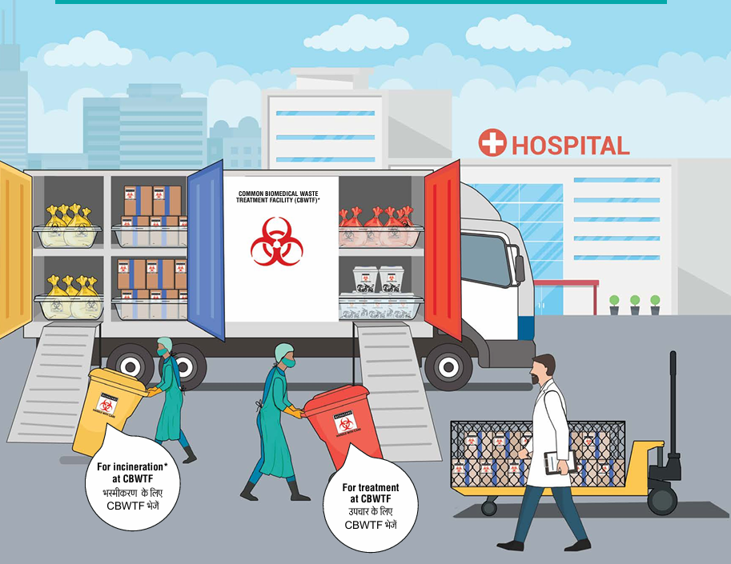
Hospital Biomedical Waste Management
Nagavarshini M.,
Scientist C/ Deputy Director,
Medical Equipment and Hospital Planning Department,
Bureau of Indian Standards,
Ministry of Consumer affairs, Food and Public Distribution

Slide 2

Agenda
Introduction
Hospital Biomedical Waste Management
Life cycle of Biomedical Waste
Indian Standards under development for Products and Process
Indian Standards for Sharp injury Protection system
Brainstorming

Slide 3
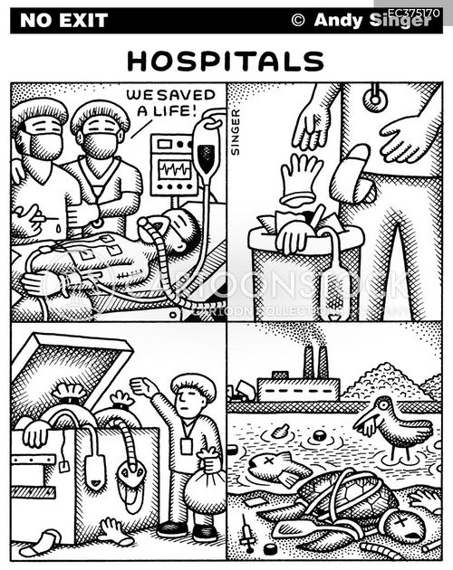
Introduction
Biomedical Waste Management in Hospital - an integral part of delivering safe and effective health services

Slide 4

Health Care Facility (HCF)
Place where diagnosis, treatment or immunization of human beings is provided irrespective of type and size of health treatment system, and research activity pertaining thereto
Health Care Facilities (HCF) includes
District Hospitals
Sub Divisional Hospitals
Community Health Centers
Primary Health Centers and Sub Centers

Slide 5
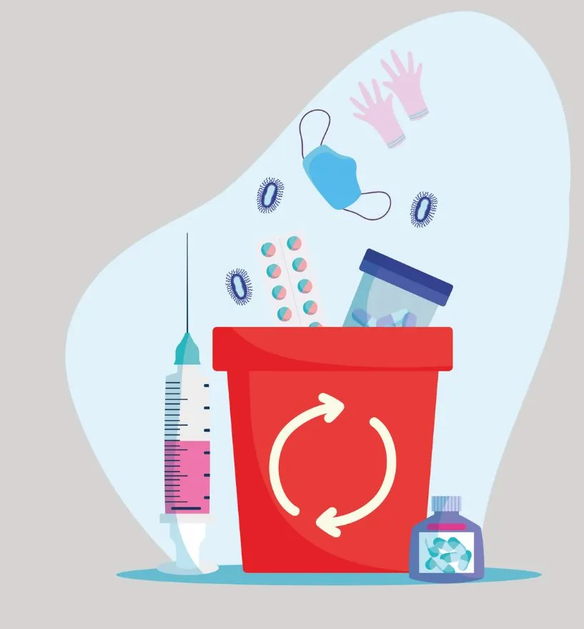
Hospital Waste - Types
Biomedical Waste - Biomedical Waste Management Rules 2016 (BMWM Rules)
General Waste - Solid Waste Management Rules 2016
Other Waste

Slide 6
Biomedical Waste - Types
Infectious waste: Waste that is contaminated with blood and other bodily fluids e.g. discarded diagnostic samples, cultures and stocks of infectious agents from laboratory work (waste from autopsies and infected animals from laboratories), waste from patients with infections e.g. swabs, bandages and disposable medical devices.
Pathological waste: Wastes like human tissues, organs or fluids, body parts and contaminated animal carcasses.
Sharps: Syringes, needles, disposable scalpels and blades, etc.
Chemical waste: Solvents and reagents used for laboratory preparations, disinfectants, sterilant and heavy metals contained in medical devices like mercury in broken thermometers and batteries.
Pharmaceutical waste: Expired, unused and contaminated drugs and vaccines.
Cytotoxic waste: Waste containing substances with genotoxic properties (i.e. highly hazardous substances that are, mutagenic, teratogenic or carcinogenic), such as cytotoxic drugs used in cancer treatment and their metabolites.
Radioactive waste: Wastes such as products contaminated by radionuclides including radioactive diagnostic material or radiotherapeutic materials.
General waste: Waste that does not pose any particular biological, chemical, radioactive or physical hazards

Slide 7
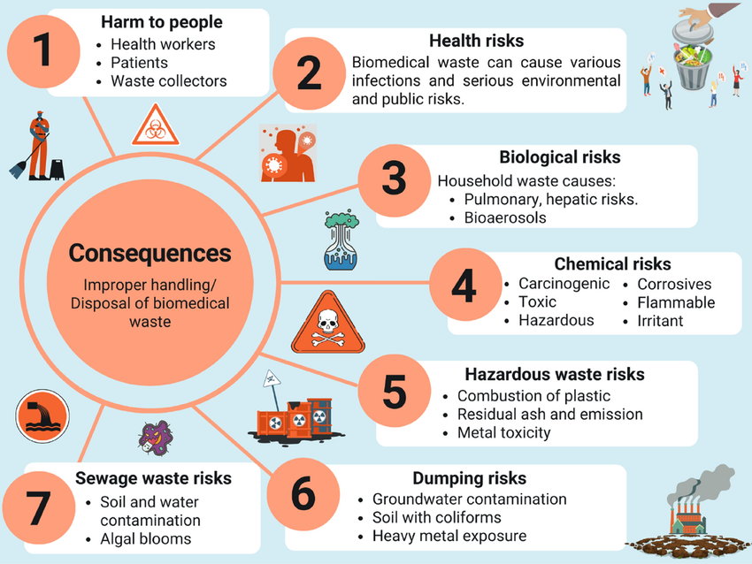
Consequences of Noncompliance to Safe Disposal of Biomedical Waste

Slide 8
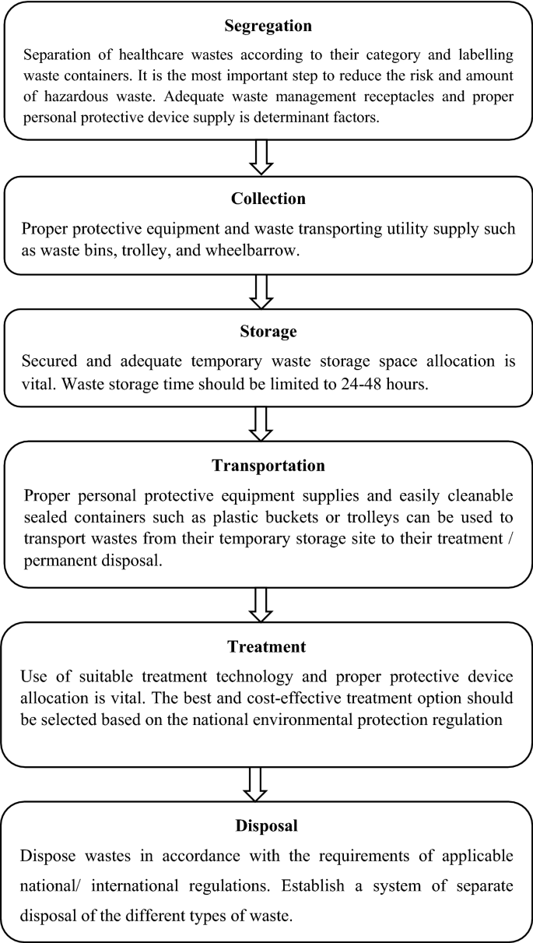
Biomedical Waste Management Process Flow
Segregation
Collection
Storage
Transportation
Treatment
Disposal

Slide 9
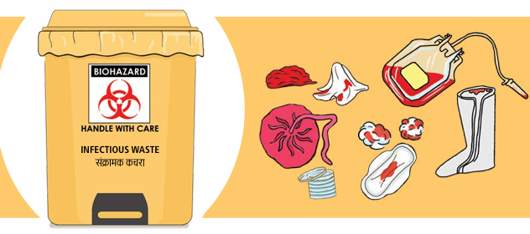
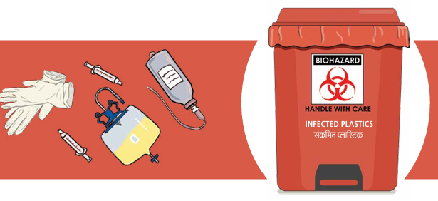
Segregation & Collection at the Point of generation
Yellow | Red (Contaminated Waste)
Anatomical waste, Chemical waste, Soiled waste, Chemotherapy waste, Discarded linen and Medicines Laboratory waste | Contaminated waste Disposable items such as tubing, plastic bottles, intravenous tubes and catheters, cannulas, syringes without needles

Slide 10
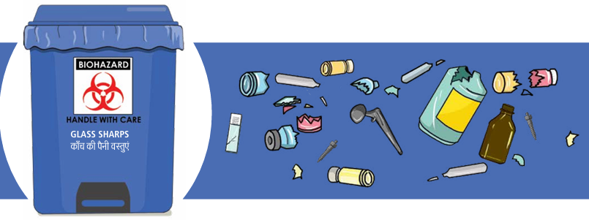
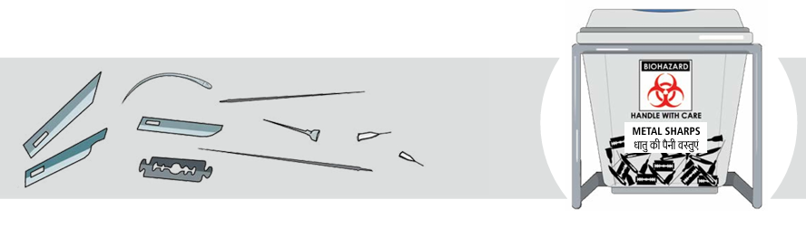
Segregation & Collection at the Point of generation
White | Blue
Metal Sharps like needle, syringe, blade etc. | Glassware waste such as broken and discarded vials, bottles, slides, glass petri dishes etc. Metallic implants

Slide 11
Indian Standards for Products used in Biomedical waste management

Slide 12
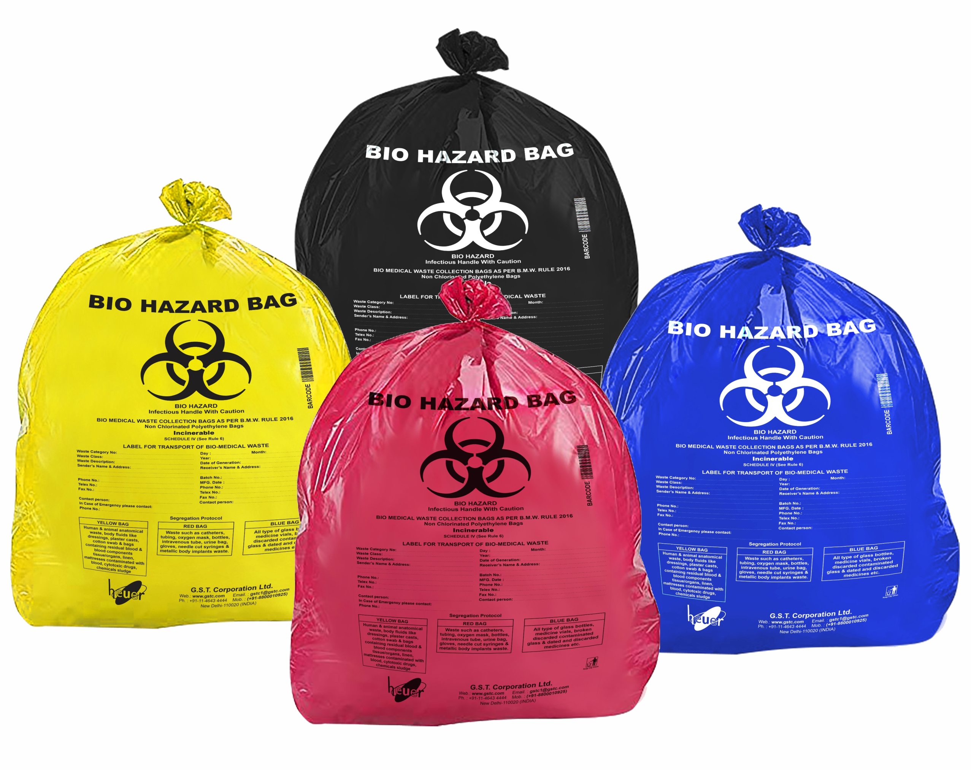
Biomedical Waste Bags (Non-chlorinated) – Document No MHD 21 (26445)
Key aspects covered
Material requirements
Thickness and Dimension requirements
Tensile and Elongation test requirements
Drop test
Tear Strength test
Autoclavability test
Marking and Labelling requirements

Slide 13
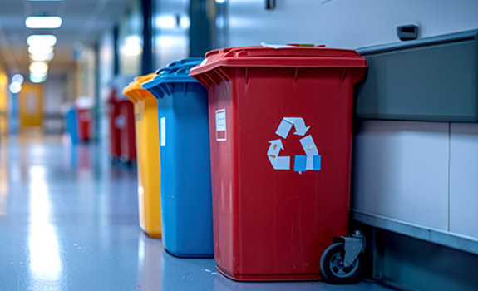
Medical Waste Container - IS 6904
Key aspects covered
Material requirements
Adhesion test
Marking and Packaging requirements
Shape and Dimension requirements
Manufacture and Workmanship

Slide 14
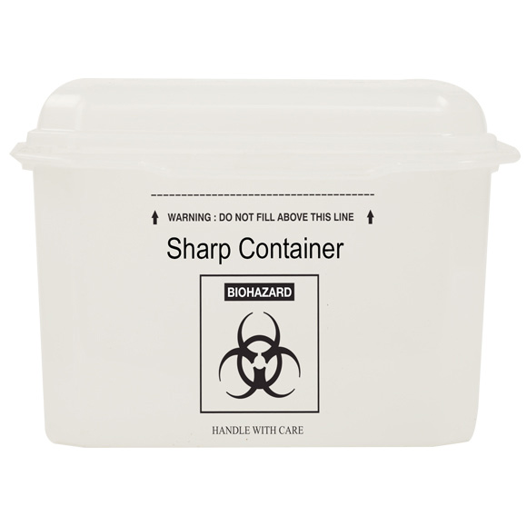
Sharp Containers - IS 18200 (Part 1)
Key aspects covered
Marking and Labelling requirements
Toppling Spillage Test
Container stability test
Handling Strength test
Penetration resistance test
Drop test on damage and leakage

Slide 15
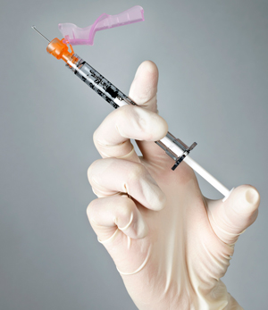
Sharp Injury Protection system - IS 18481
Key aspects covered
Risk based Design approach
Testing Activation of sharp feature
Test for security in safe mode
Testing in simulated clinical conditions
Marking and Labelling requirements

Slide 16
Biomedical waste management – Process Systems Standard
Under Development
Aiming to effectively manage biomedical waste (BMW) by defining standards to ensure public health and environmental safety

Slide 17

Brainstorming Session

Slide 18
Summary
Proper execution of Biomedical waste management process and product standard requirements ensures:
Safety for healthcare workers, patients, and the community
Protection of the environment from hazardous contaminants

Slide 19

Medical Equipment and Hospital Planning Department,
Bureau of Indian Standards,
Ministry of Consumer affairs, Food and Public Distribution
mhd@bis.gov.in

